Slide 1
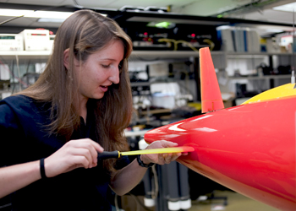
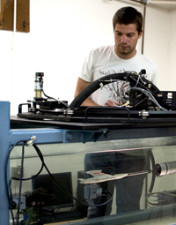
MBARI Summer 2013 Internship Program
The Monterey Bay Aquarium Research Institute's summer internship program provides an opportunity for talented college students (undergraduate and graduate) and educators to come to MBARI for a period of 10 weeks (June 10–August 16) to work on a specific project under MBARI staff supervision.
Summer interns are responsible for developing a project (in conjunction with their sponsor) which can be completed in the 10-week period of the internship, and for carrying the project to completion. The primary purpose of the intern's project is for the specific educational benefit of the intern, and to make a contribution to the general good of the oceanographic community. If publications results from this collaboration, the authorship should be a joint authorship (including both the intern and the sponsor).
Controls, Robotics and other Engineering students may be particularly interested in the following Intern project:
Profiling float for coastal oceanography applications
MBARI is developing a profiling float for coastal oceanography applications. This float is being designed to acquire scientific data autonomously in the coastal regions of the world's oceans for durations in excess of 3 years. Intern activities may include participation in the control algorithm and mission execution software development for the at-sea prototype, design development and refinement of mechanical and electrical elements of the profiler, and test/data analysis for all of the above. The ideal candidate would have some background in control systems as well as one of the following areas; Mechanical Engineering, Electrical Engineering or Robotics. Experience with any of the following tools will also be valuable; embedded software development in C/C++, Matlab, Labview, Solidworks, and Solidworks Simulation.
For more information: Gene Massion magene@mbari.org
http://www.mbari.org/education/internship/default.htm

