Slide 1

Developing parameter estimation techniques for controller optimization of a Coastal Profiling Float
Aug 14, 2013
1445 -1500
Nicholas Sohn
~
Gene Massion

Slide 2

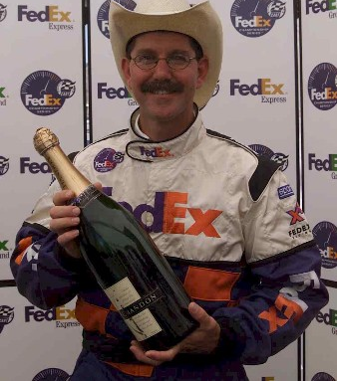
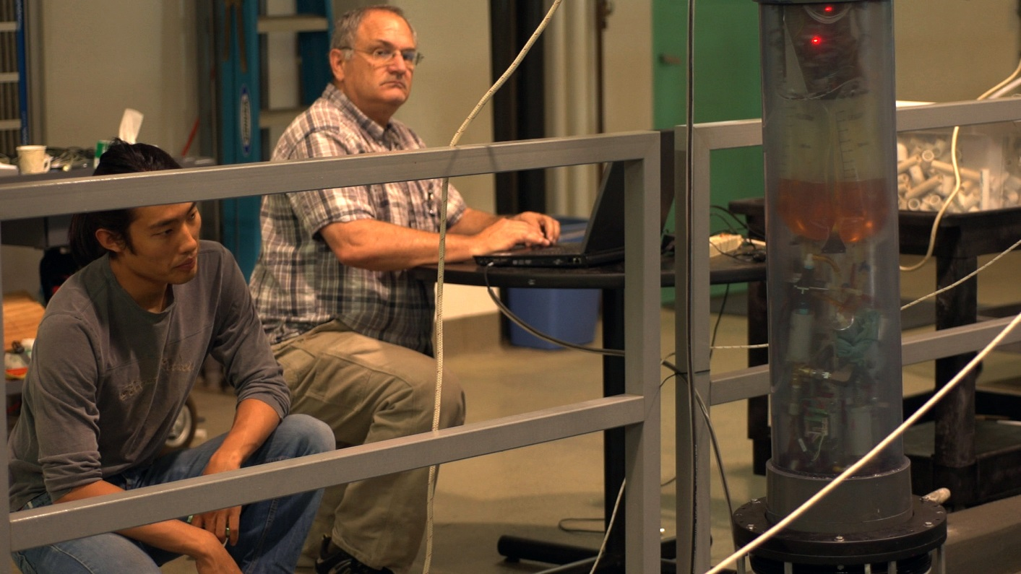
Acknowledgments
Photo: Todd Walsh, MBARI 2013

Slide 3
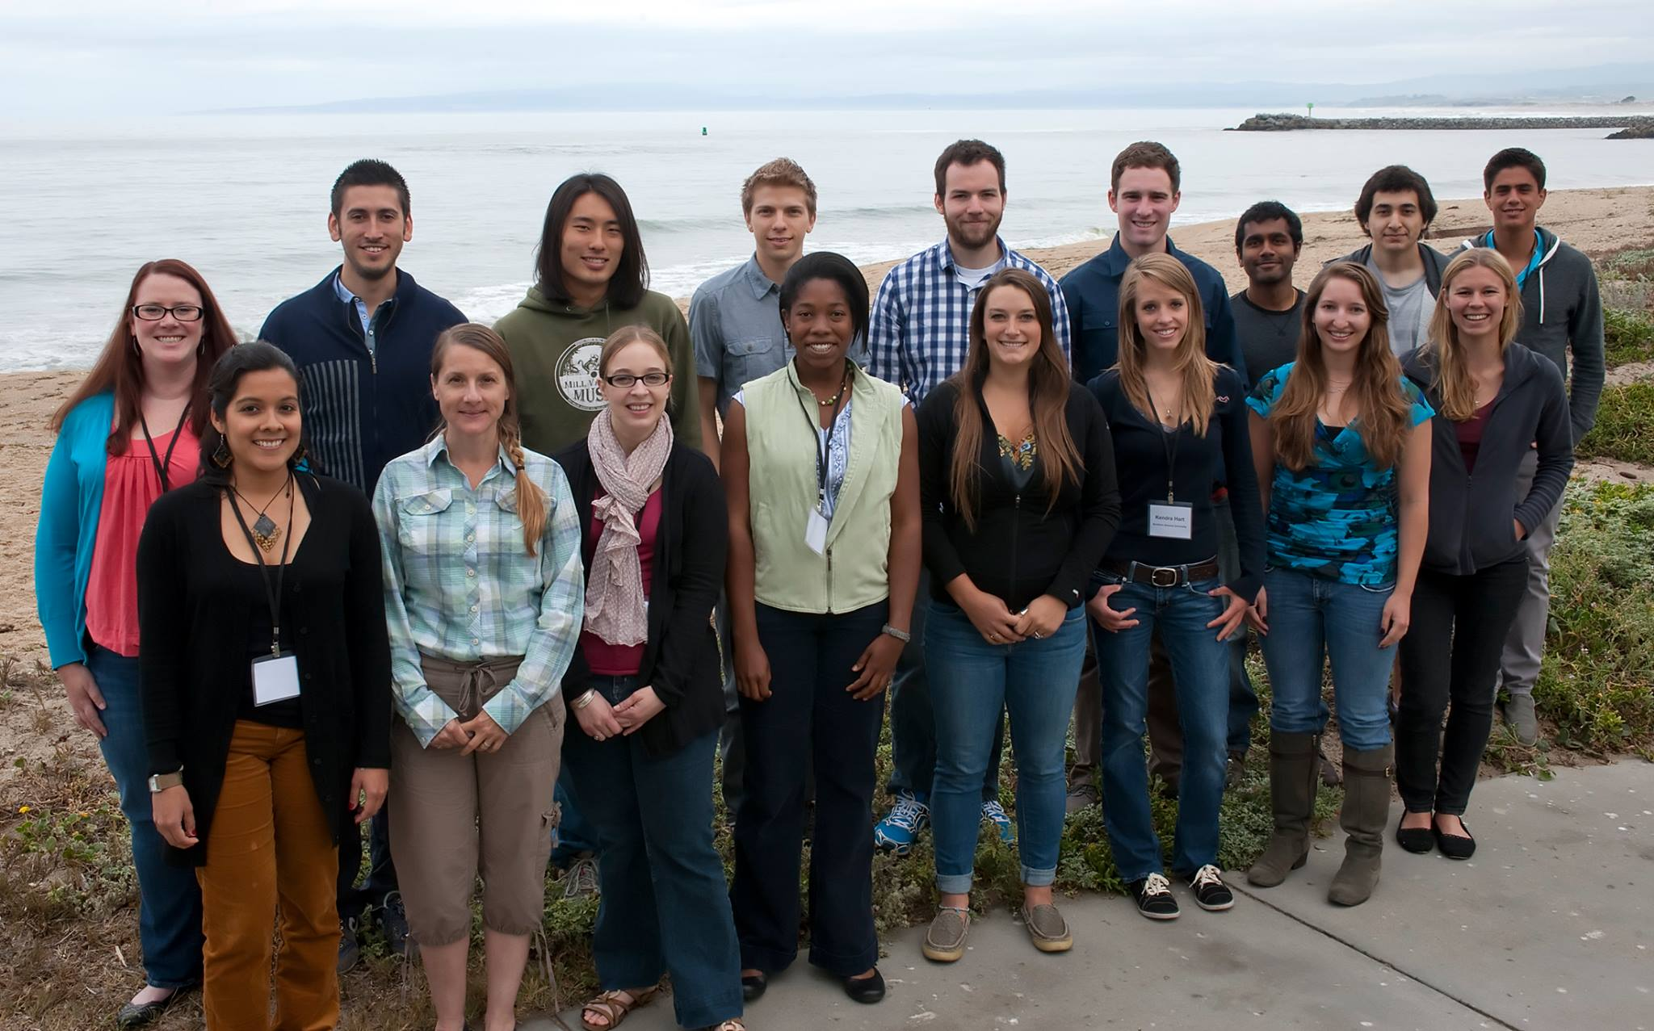
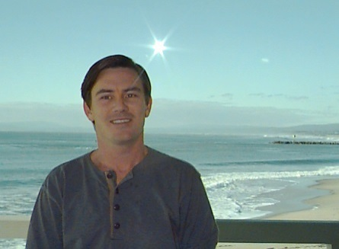
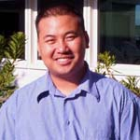
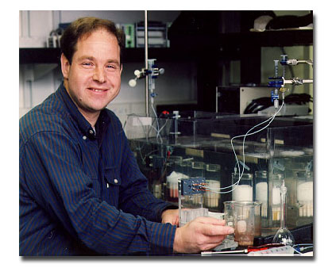
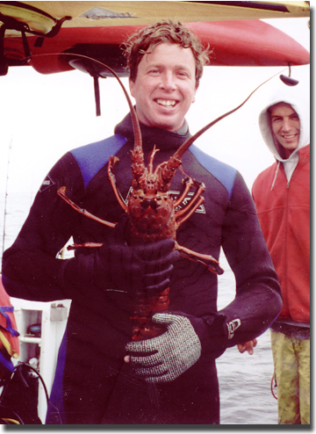
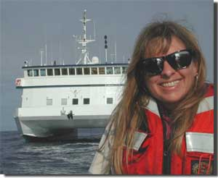

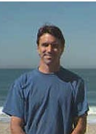
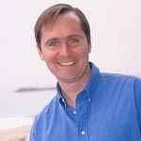

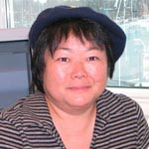
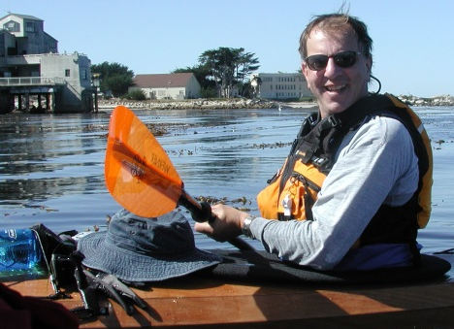
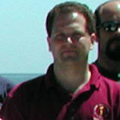
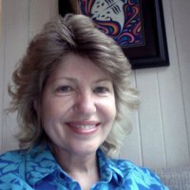
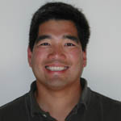
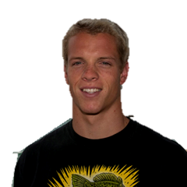

Acknowledgments
Interns

Slide 4
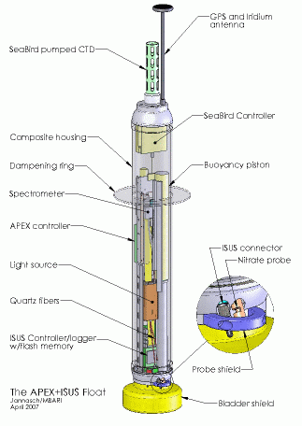
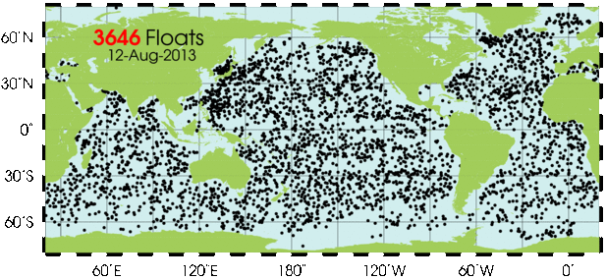
Why Profiling Floats?
High Spatial and Temporal Resolution
Low Cost
www.argo.ucsd.edu
www.mbari.org/chemsensor
Project Background ∙ Project Goals ∙ System Overview ∙ Results ∙ Conclusions

Slide 5
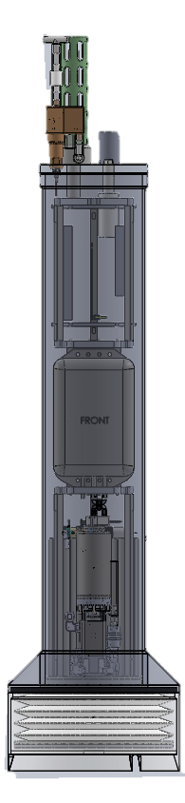
Profiling Floats?
Coastal
Why
Coastal environments are highly variable
Critical for understanding
  Hypoxia
  Acidification
  Anthropogenic Waste
Chem Sensor CPF Project’s Mission:
  “Is net primary production changing on the
  West Coast of the US?”
Background ∙ Project Goals ∙ System Overview ∙ Pressure Simulator ∙ Test Tank Prototype ∙ Conclusions

Slide 6
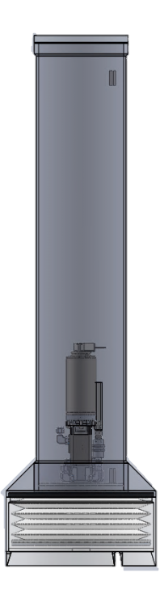
Project Goals
Upgrade Pressure Simulator
  Design pressure housing
  Assemble System
  Characterize pump efficiency v. pressure
Estimate Test Tank Prototype Physical Constants
  Drag Coefficient
  Added Mass
Background ∙ Project Goals ∙ System Overview ∙ Pressure Simulator ∙ Test Tank Prototype ∙ Conclusions

Slide 7
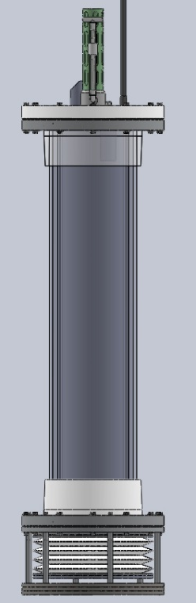

System Overview
STP
Pump
x1
x2
Reservoir
Spring Loaded
Piston
Bellows
Bellows
Bellows Housing
P
Background ∙ Project Goals ∙ System Overview ∙ Pressure Simulator ∙ Test Tank Prototype ∙ Conclusions

Slide 8
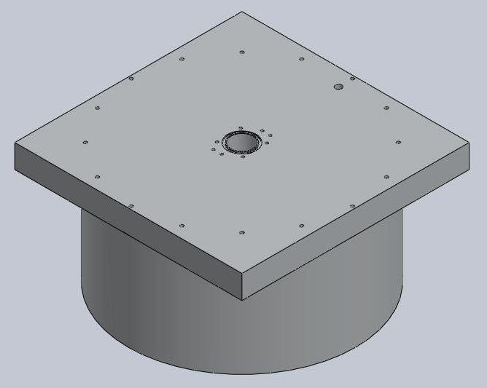
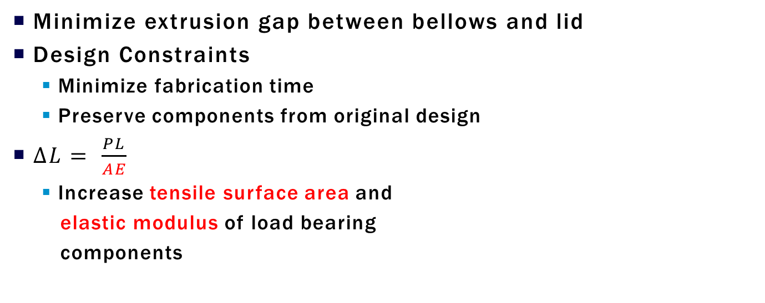
Pressure Housing Design
Minimize extrusion gap between bellows and lid
Design Constraints
  Minimize fabrication time
  Preserve components from original design
$∆L= \frac{PL}{AE}$
  Increase tensile surface area and
  elastic modulus of load bearing
  components
Background ∙ Project Goals ∙ System Overview ∙ Pressure Simulator ∙ Test Tank Prototype ∙ Conclusions

Slide 9
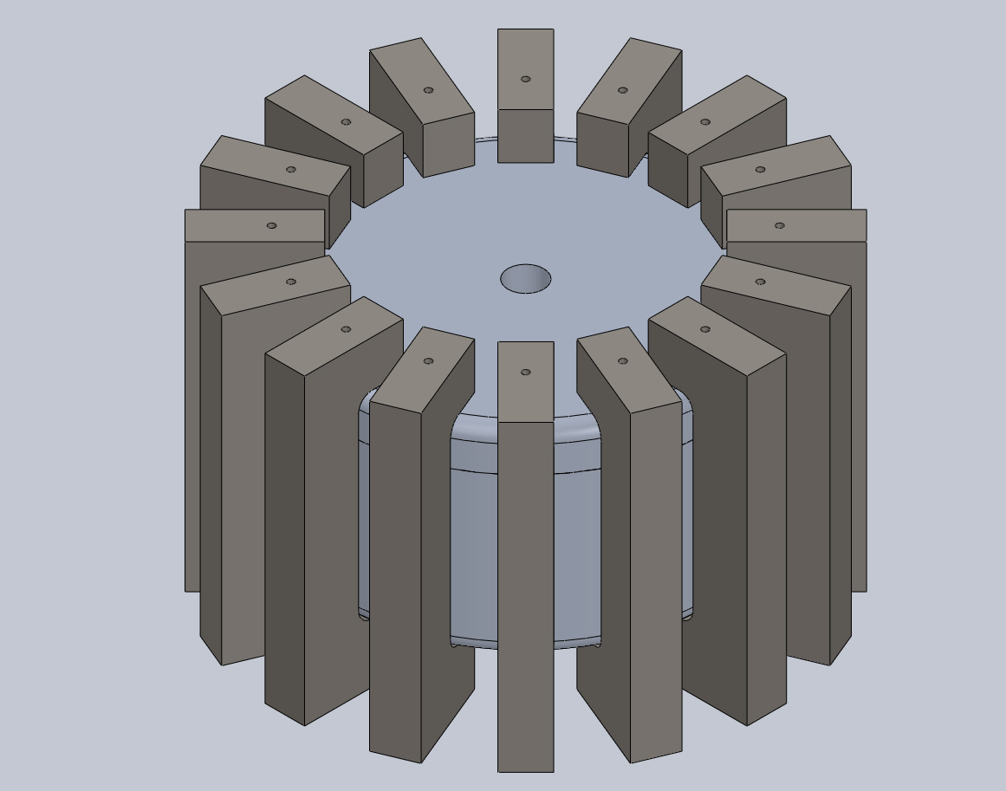
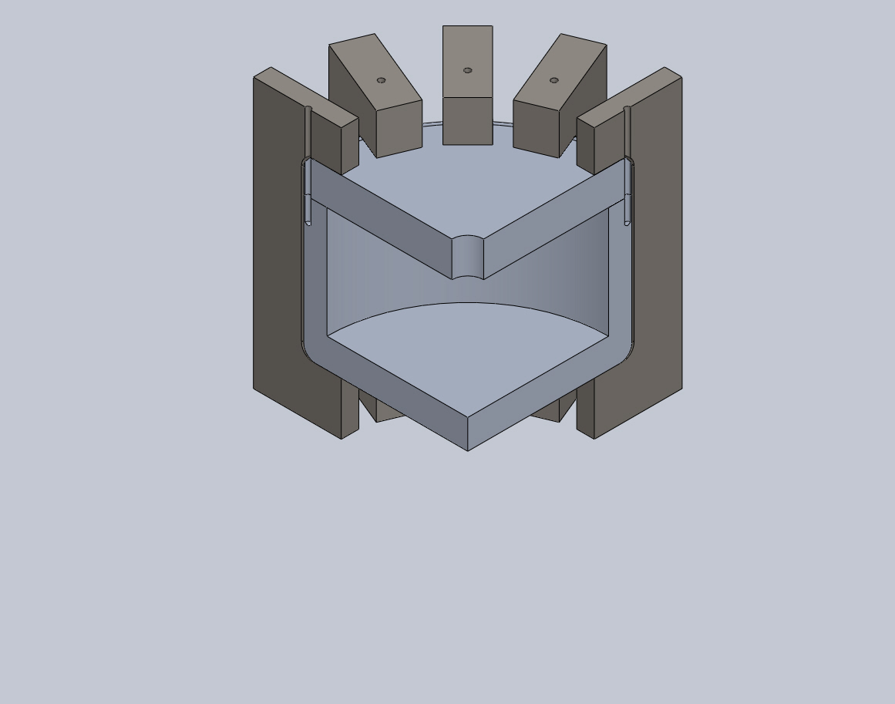
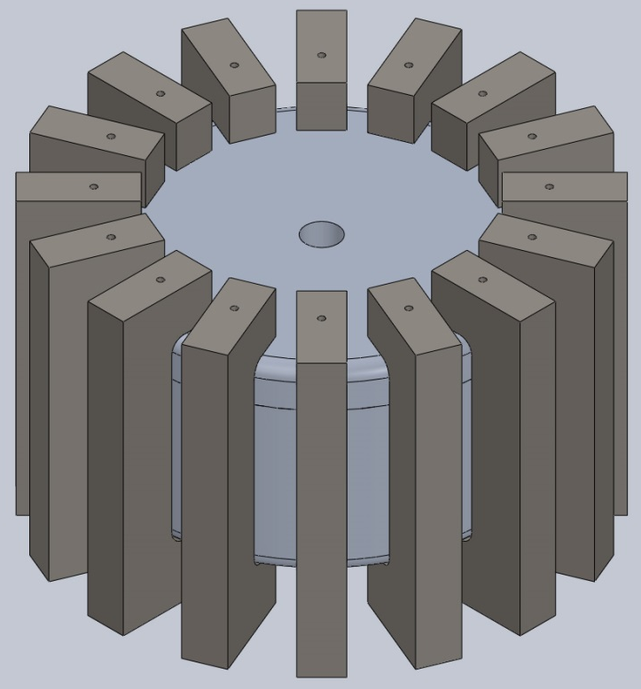
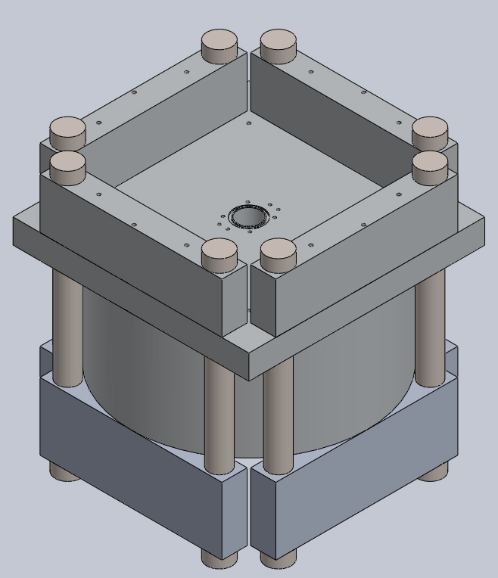
Pressure Housing Design
Background ∙ Project Goals ∙ System Overview ∙ Pressure Simulator ∙ Test Tank Prototype ∙ Conclusions

Slide 10
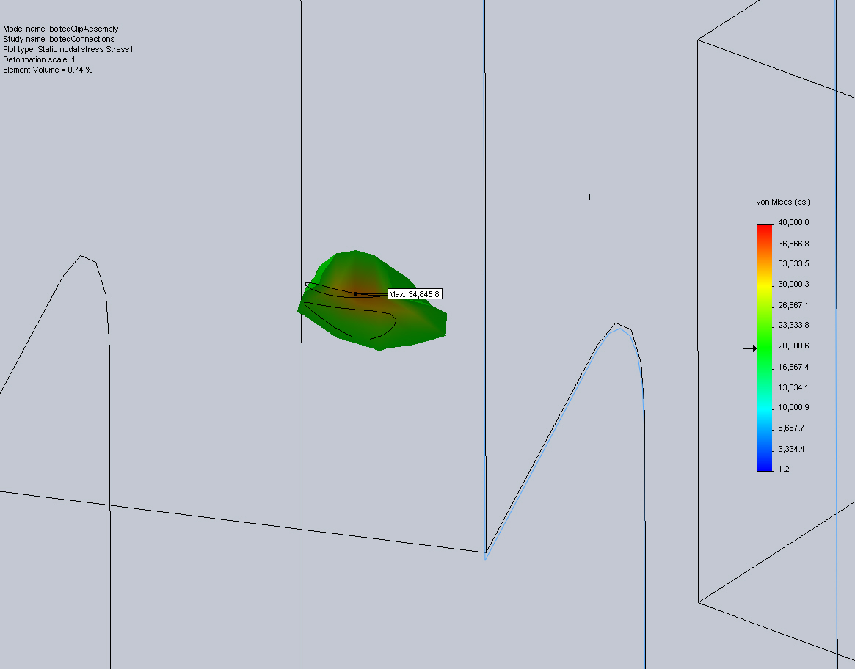
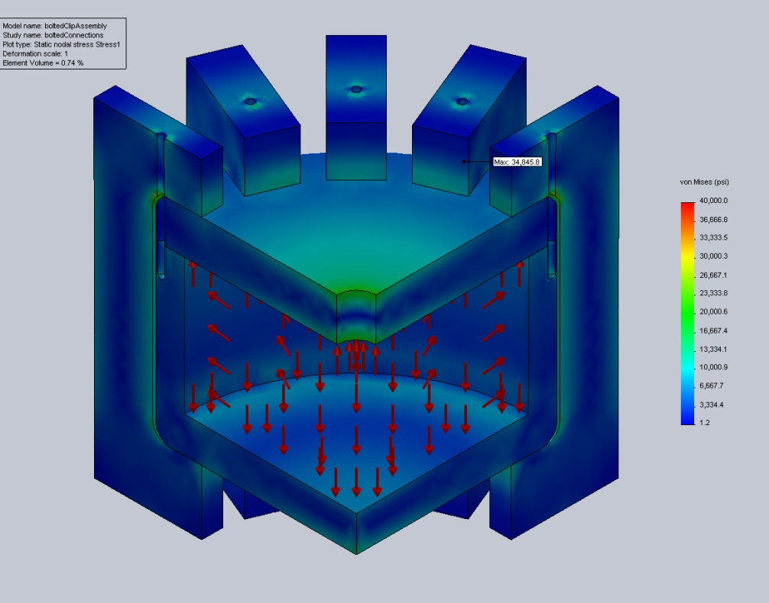
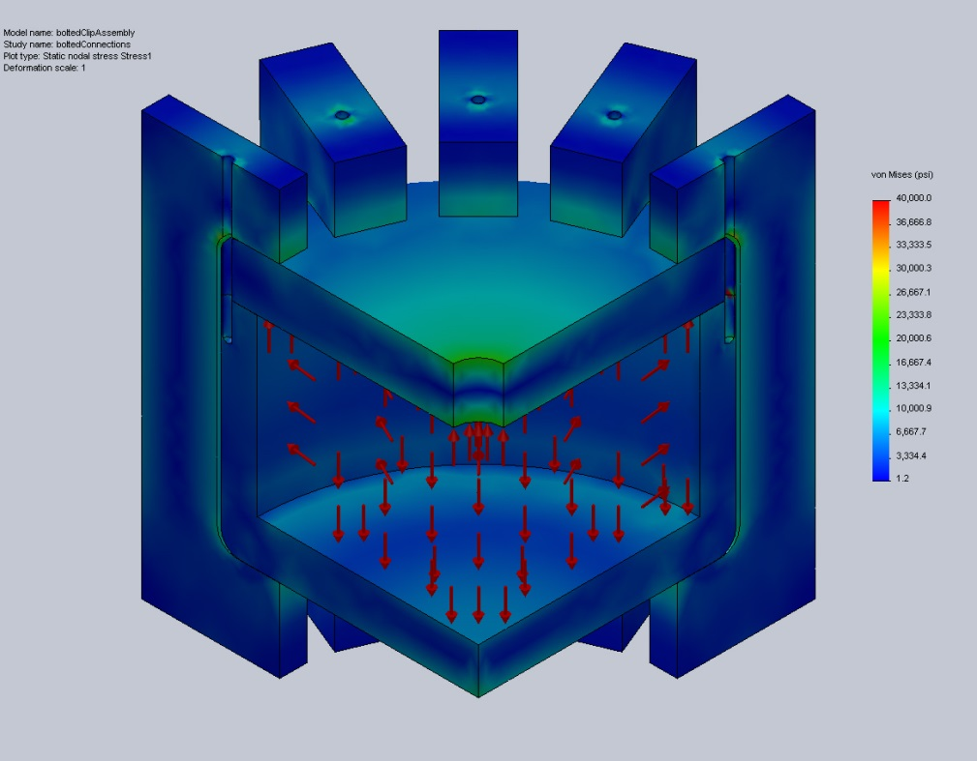
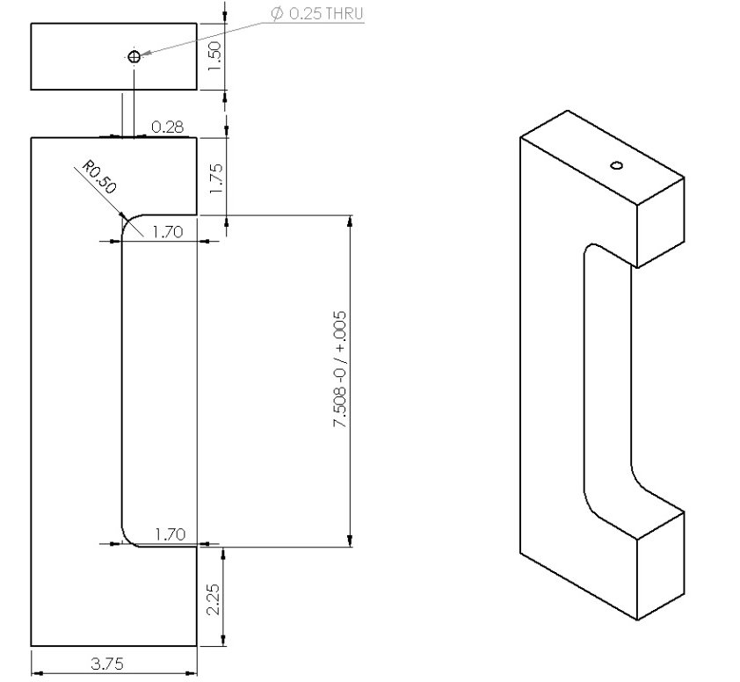
Pressure Housing Design
Background ∙ Project Goals ∙ System Overview ∙ Pressure Simulator ∙ Test Tank Prototype ∙ Conclusions

Slide 11
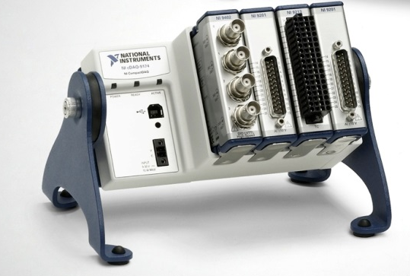
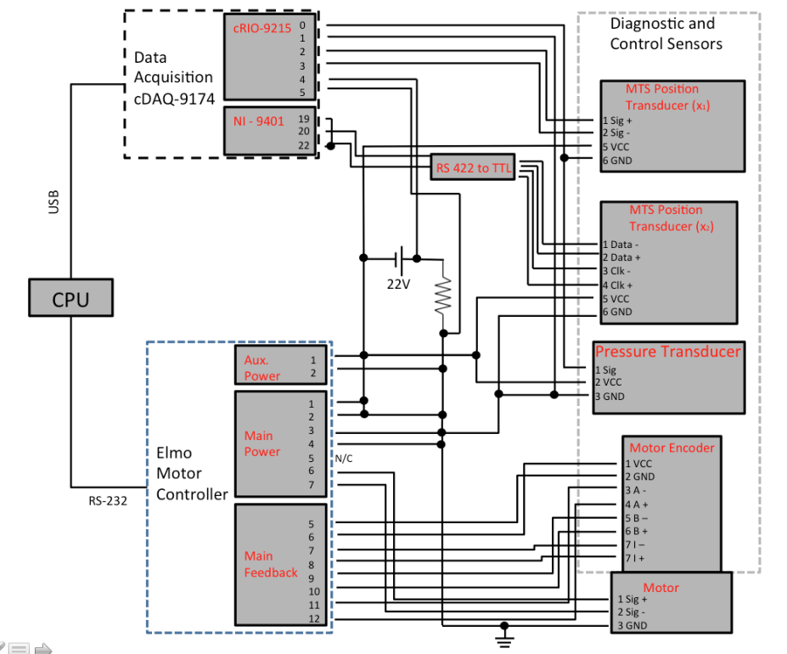
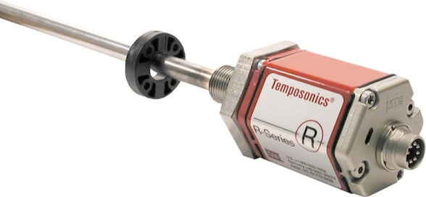
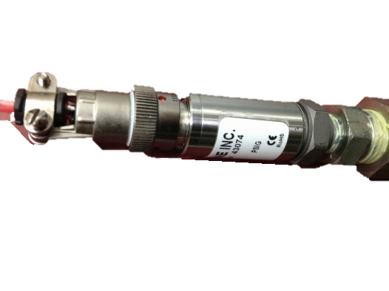
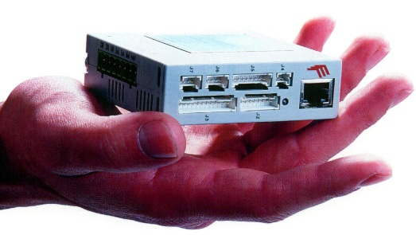
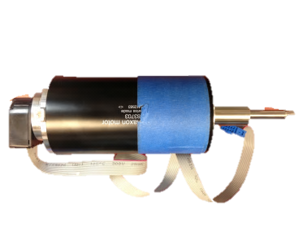
Device assembly
www.electromate.com
www.engineers.nl
news.thomasnet.com
Background ∙ Project Goals ∙ System Overview ∙ Pressure Simulator ∙ Test Tank Prototype ∙ Conclusions

Slide 12
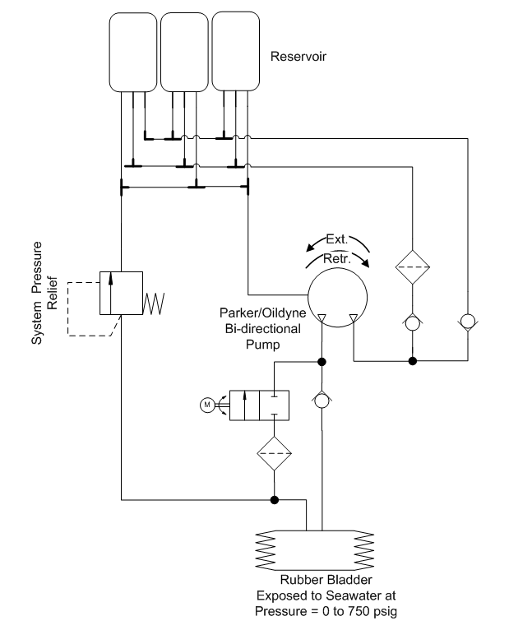
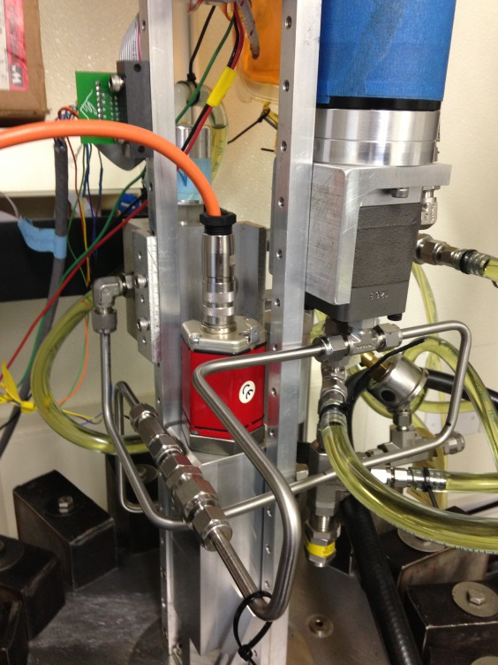
Device assembly
Background ∙ Project Goals ∙ System Overview ∙ Pressure Simulator ∙ Test Tank Prototype ∙ Conclusions

Slide 13
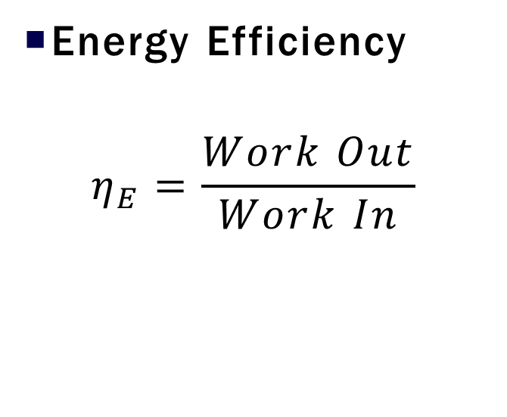
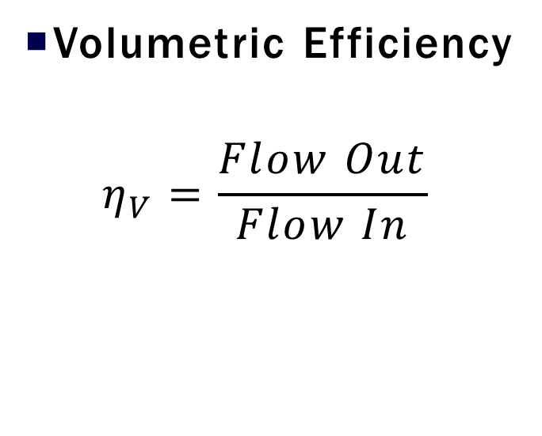
Efficiency Metrics
Volumetric Efficiency
$$η_{V}=\frac{Flow Out}{Flow In}$$
Energy Efficiency
$$η_{E}=\frac{Work Out}{Work In}$$
Background ∙ Project Goals ∙ System Overview ∙ Pressure Simulator ∙ Test Tank Prototype ∙ Conclusions

Slide 14
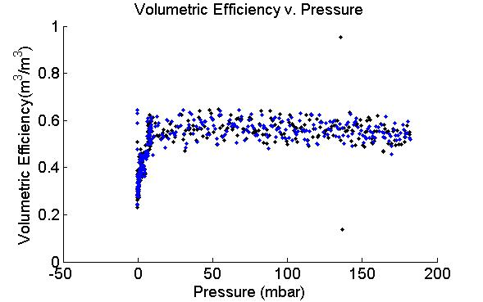
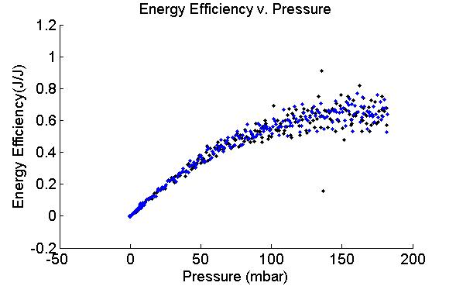
Efficiency Metrics
Volumetric Efficiency
Energy Efficiency
Background ∙ Project Goals ∙ System Overview ∙ Pressure Simulator ∙ Test Tank Prototype ∙ Conclusions

Slide 15
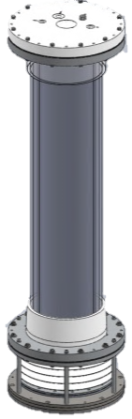



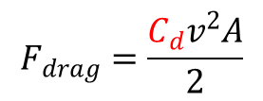

Characterization of Test Tank Prototype
$$F_{d}$$
$$F_{B}$$
Physical Parameters govern float dynamics
$ΣF=F_{weight}− F_{drag}−F_{Buoyant}=m′∙acceleration$
$$F_{drag}=\frac{C_{d}v^{2}A}{2}$$
$$m^{′}=m_{system}+m_{added}$$
$$m_{system}∙g$$
Background ∙ Project Goals ∙ System Overview ∙ Pressure Simulator ∙ Test Tank Prototype ∙ Conclusions

Slide 16
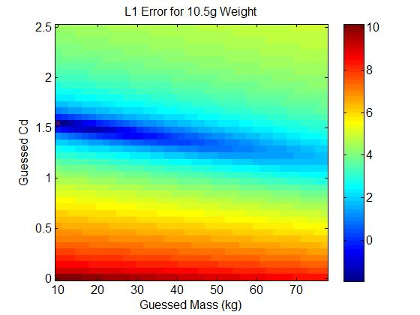
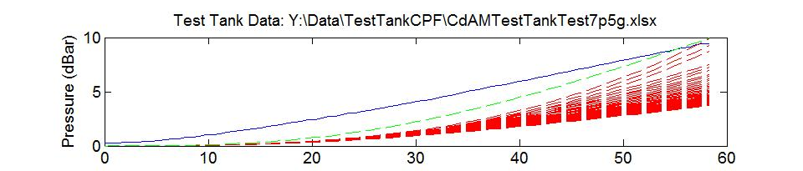
Characterization of Test Tank Prototype
Estimation of Drag Coefficient and Added Mass
  Measure position over time of a
  negatively buoyant profiling float
  Compare measured float trajectory to
  predicted trajectory using guessed
  drag coefficients and added mass
Background ∙ Project Goals ∙ System Overview ∙ Pressure Simulator ∙ Test Tank Prototype ∙ Conclusions

Slide 17
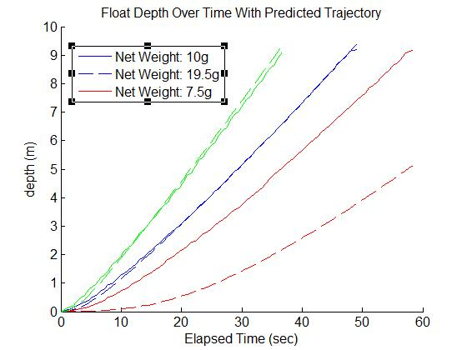
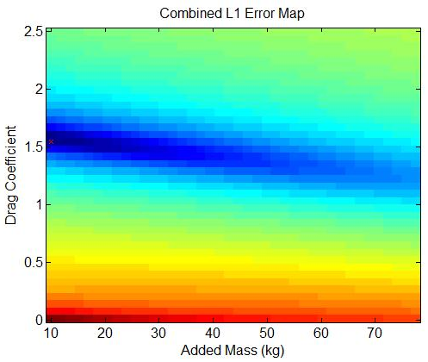
Characterization of Test Tank Prototype
Background ∙ Project Goals ∙ System Overview ∙ Pressure Simulator ∙ Test Tank Prototype ∙ Conclusions

Slide 18
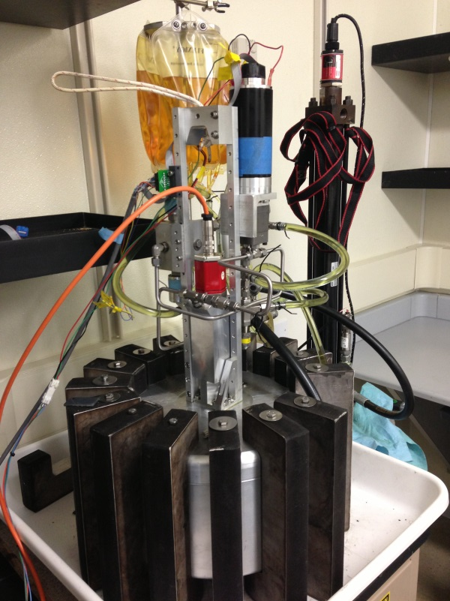
Project Summary
Complete reimplementation of laboratory
simulator for MBARI CPF buoyancy engine
  Developed and evaluated design concepts
  Reviewed and selected design options with
  project engineer
  Performed fabrication, subsystem integration
  and performance testing
Developed procedure for estimating
physical parameters required in CPF
velocity and depth control algorithm
Background ∙ Project Goals ∙ System Overview ∙ Pressure Simulator ∙ Test Tank Prototype ∙ Conclusions

Slide 19
Developing parameter estimation techniques for controller optimization of a Coastal Profiling Float
Aug 14, 2013
1445 -1500
Nicholas Sohn
~
Gene Massion

