Slide 1
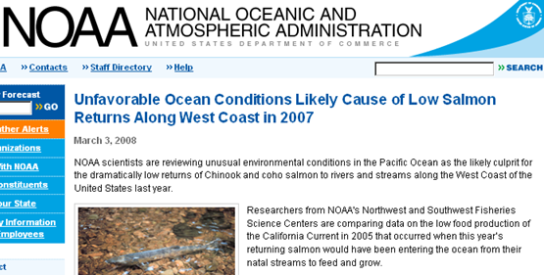
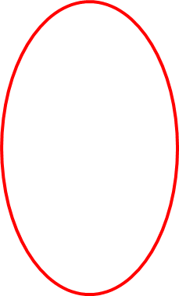
Fishery yield depends on “food production” (Net Community Production), but there are no tools that allow widespread observations of ocean NCP. This is what the CPF program aims to provide.

Slide 2
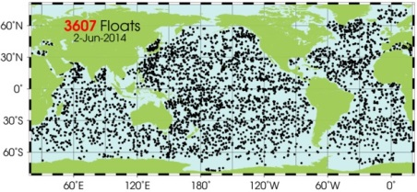
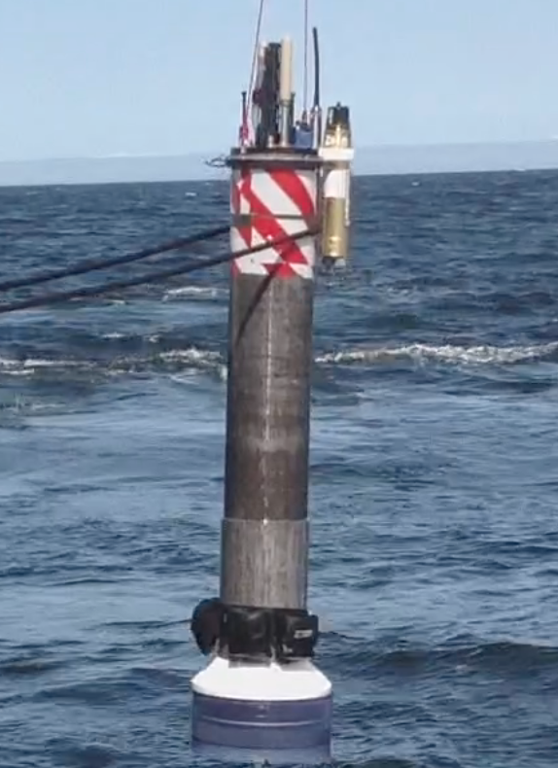
MBARI Coastal Profiling Float
The Argo array is one (maybe the only) example of an economically sustainable program capable of making large scale measurements
Argo does not target the coast because there is little heat stored in shallow water.
An opportunity exists to design and build a float optimized for the coast with biogeochemical sensors – oxygen, pH, nitrate, chlorophyll that enable ecosystem management.

Slide 3
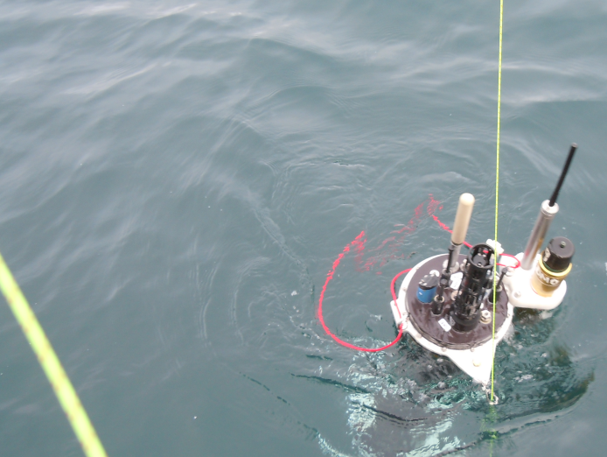
Requirements:
  Scalable to support multi-decade experiment in the CA Current Large Marine Ecosystem at a cost consistent with economic impact
  Endurance, depth, buoyancy, sensors optimized for coastal operations
Status
  The profiler has been tested extensively in the test tank
  At sea testing is in progress with primary goal of making long term, high quality biogeochemical measurements
Notes:
CCLME – California Current Large Marine Ecosystem

