Slide 1
Development of a Coastal Profiling Float
Gene Massion, Ken Johnson, Wayne Radochonski
Driving Science Mission
  Is net production changing on the West Coast of the US ?
Overarching Technology Requirement
  Need to saturate the measurement volume with large numbers of economical, sustainable, capable instrument suites
The Chem Sensor lab has been developing new instruments for the global Argo array for >10 years
  This project builds on our past technology investment and leverages our existing academic and commercial collaborations to adapt existing technology (Argo floats) to a significant set of new research questions
Bench and Test Tank Prototypes complete; first article is being built up now with testing late this year

Slide 2
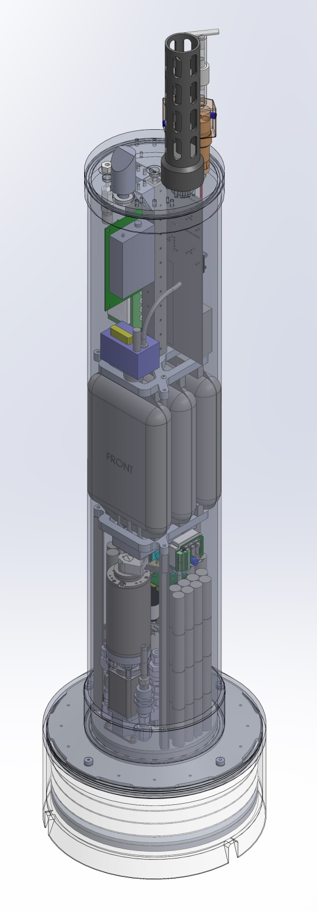
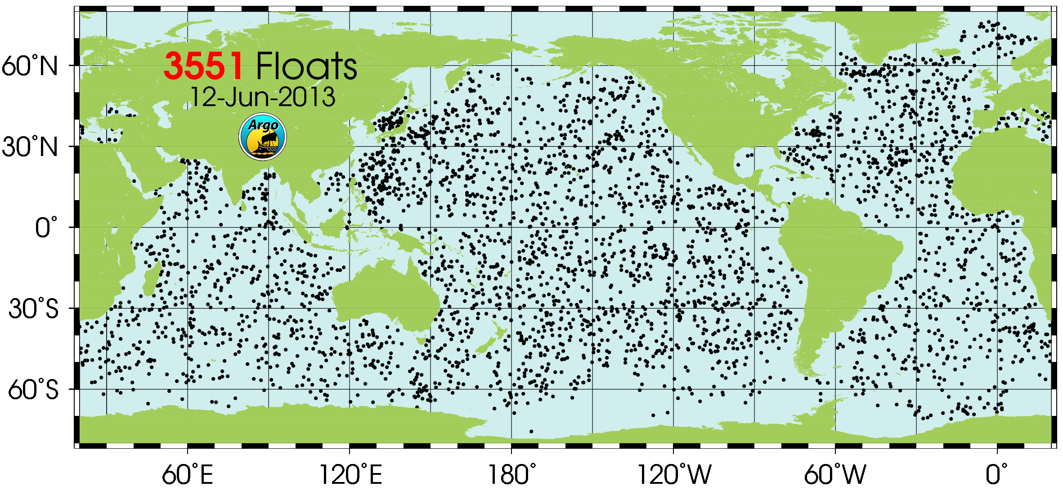
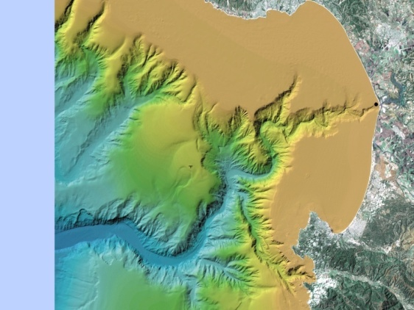
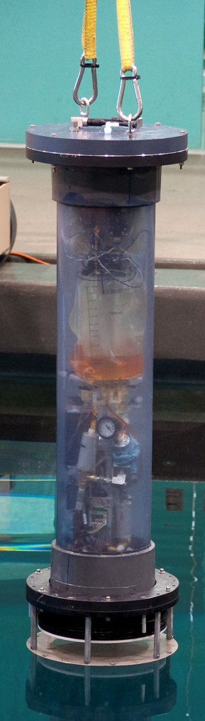
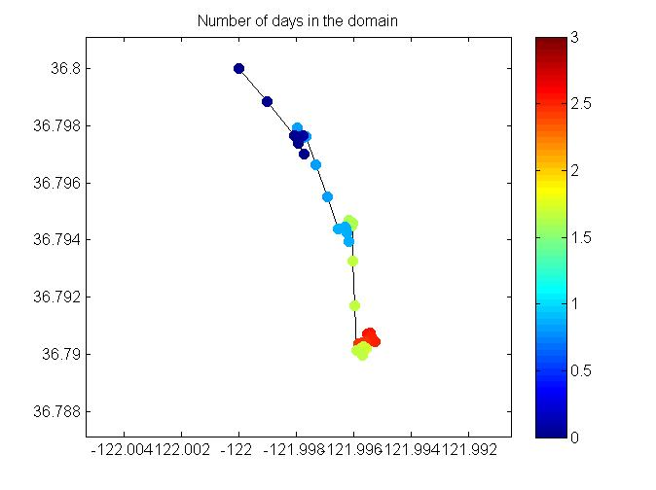
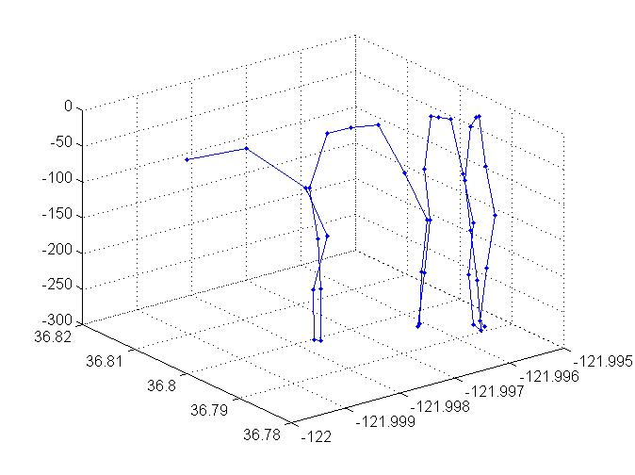
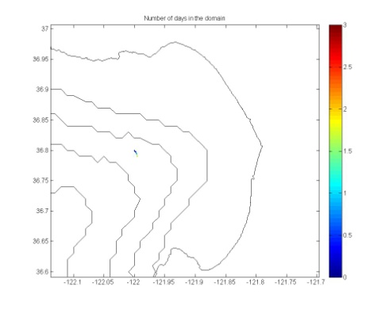
The Big Picture
Depth Control < .2m
Test Tank Results
408m
1025m
Modeling Results

