Slide 1

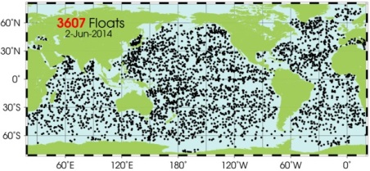
MBARI Coastal Profiling Float
Science Driver: Is net production changing on the West Coast of the US?
  Need to sample this
  With enough platforms, carrying the right
  sensors, over decades in an economically
  sustainable program
MODIS Chlorophyll June 28, 2011
The Argo array is one (maybe the only) example of an economically sustainable program capable of making these kind of large scale measurements
  3500 + floats making globally integrated measurements of ocean heat content (temperature and salinity)
  $20M per year total O&M costs

Slide 2
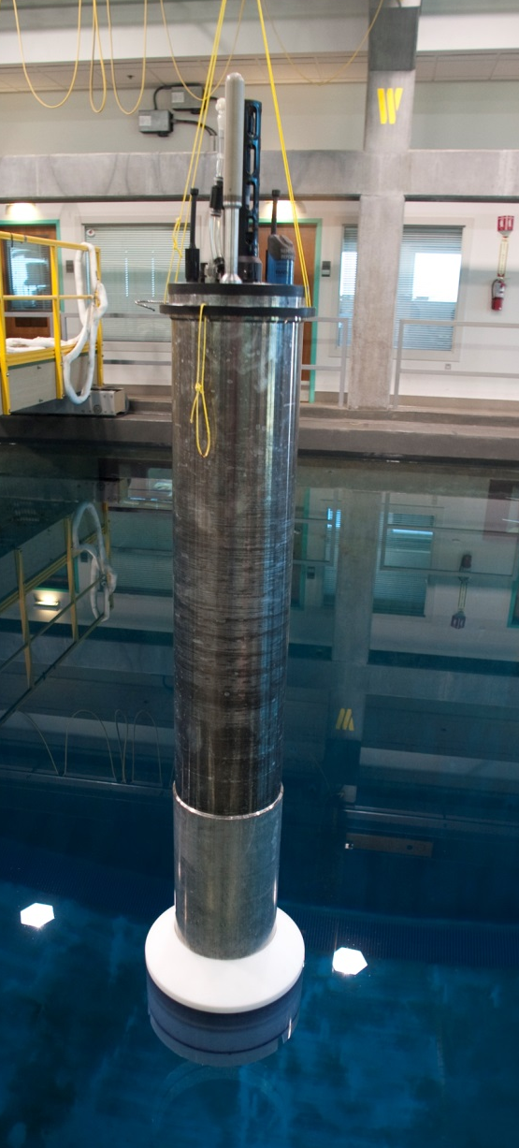
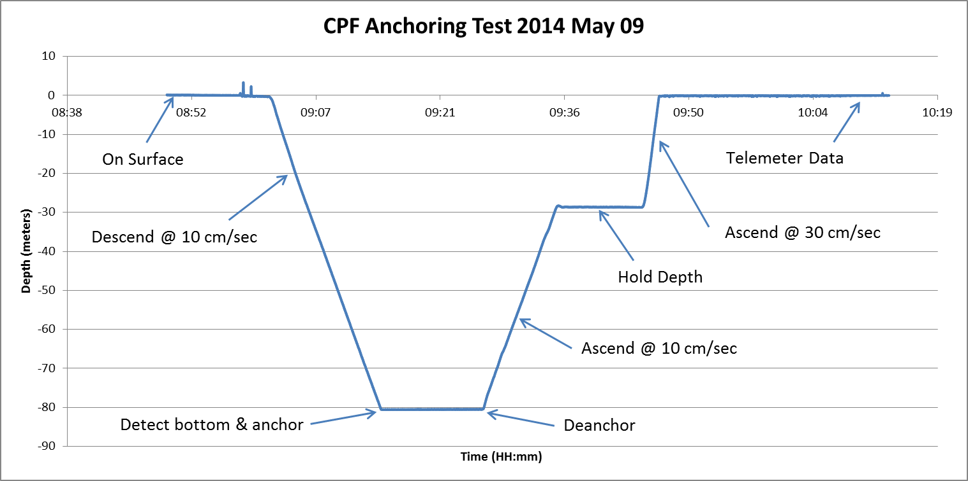
MBARI’s Coastal Profiling Float
Extend Argo technology to meet the needs of a coastal oceanography program
  Broader biogeochemical instrument suite (CTD, O₂, pH, NH₃, Radiometer, Fluorometer, Backscatter)
  Support anchoring/deanchoring to stay in the desired measurement volume
  Better depth control
  $60K price target (in quantity)
West Coast 10 year Experiment cost WAG
  200 Floats in the water at all times + 20 Floats per year = $25M. Maybe $50M overall cost

