Slide 1
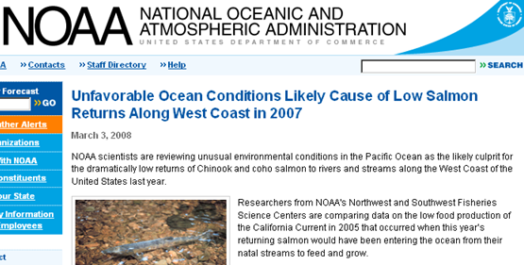
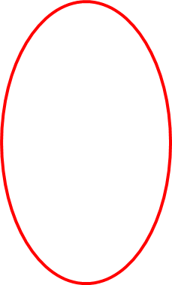
Fishery yield depends on “food production” (Net Community Production), but there are no tools that allow widespread observations of ocean NCP. This is what the CPF program aims to provide.

Slide 2
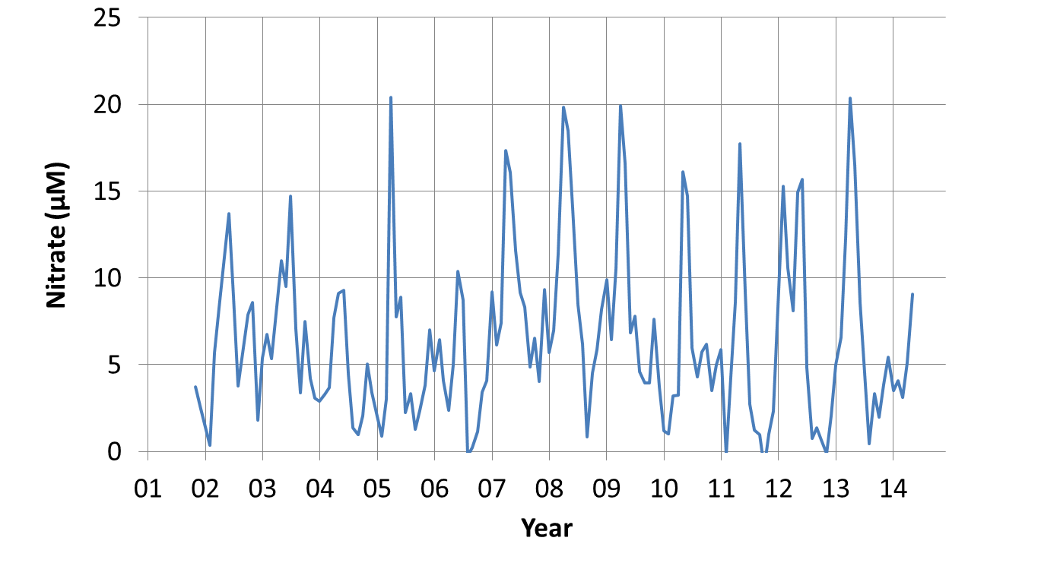
MBARI ISUS nitrate sensor on M1 mooring:
2004 – 2006 were low nutrient years
2014 off to slow start.
One can compute NCP from nitrate. How do you scale sensor systems to a whole coast to provide managers the information they need?

Slide 3
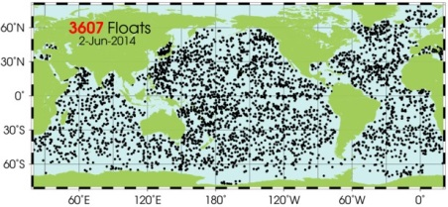
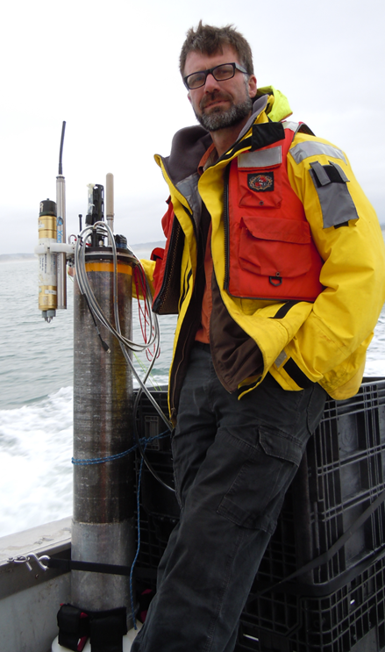
MBARI Coastal Profiling Float
The Argo array is one (maybe the only) example of an economically sustainable program capable of making large scale measurements
Argo does not target the coast because there is little heat stored in shallow water.
An opportunity exists to design and build a float optimized for the coast with biogoechemical sensors – oxygen, pH, nitrate, chlorophyll that enable ecosystem management.

Slide 4
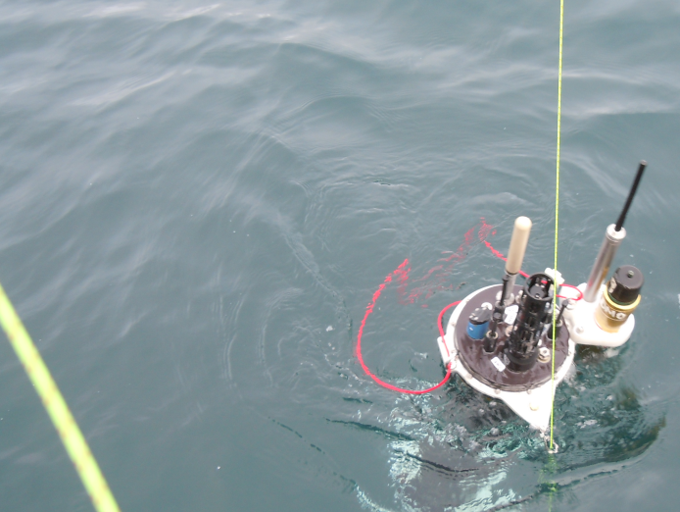
Requirements
Scalable to support multi-decade experiment in the CCLME at a cost consistent with economic impact.
Endurance, depth, buoyancy, sensors optimized for coastal operations.
Notes:
CCLME – California Current Large Marine Ecosystem

