Slide 1
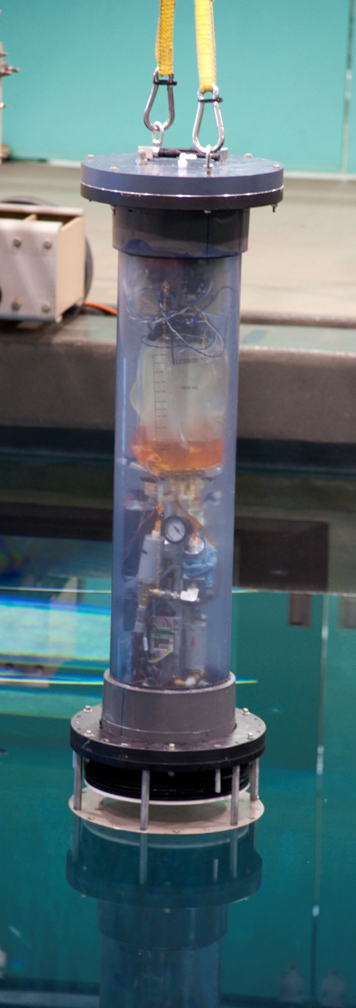
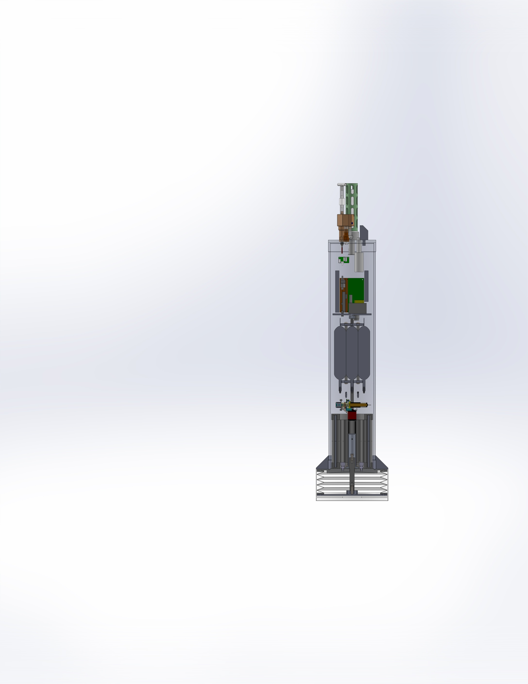
Development of a Profiling Float for Coastal Oceanography
With some comments on developing an effective engineering process in an academic environment
Gene Massion
Monterey Bay Aquarium Research Institute
Moss Landing, CA
2013 Oct 31

Slide 2
Table of Contents
What is the science mission?
Why are we building coastal profiling floats?
What is a coastal profiling float
Some interim results
With occasional comments on developing an effective engineering process

Slide 3
The Chemical Sensor Group at MBARI
Develop instruments to measure chemicals in the ocean mostly for deployment on buoys
  Iron, Nitrate, pH, Phosphate, Ammonia, …
Run field programs using these, and other, sensors
  Land/Ocean Biogeochemical Observatory (LOBO)
  Southern Ocean Iron Experiment (SOFeX)
  Iron Regulation of Coastal Ecosystems
  Southern Ocean Biogeochemistry and others
Ken Johnson is the Senior Scientist

Slide 4
What should we propose now?
Given MBARI’s and the Packard Foundation’s strategic plan and our group’s interests and expertise, what should our next project be?
Step 1: Pick a specific, relevant science mission without explicit regard to technology
  Is net production changing on the West Coast of the US
    What is changing, where, at what rate?
Step 2: Define the overarching technology requirements again without worrying about what technology
  Need to flood the measurement volume with a large number of economical, sustainable, capable instruments suites. Both initial capital costs and on-going O&M costs are important
Now think about the technology (with an open mind)
  Profiling floats make sense

Slide 5
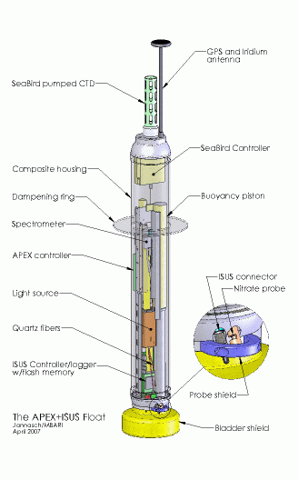
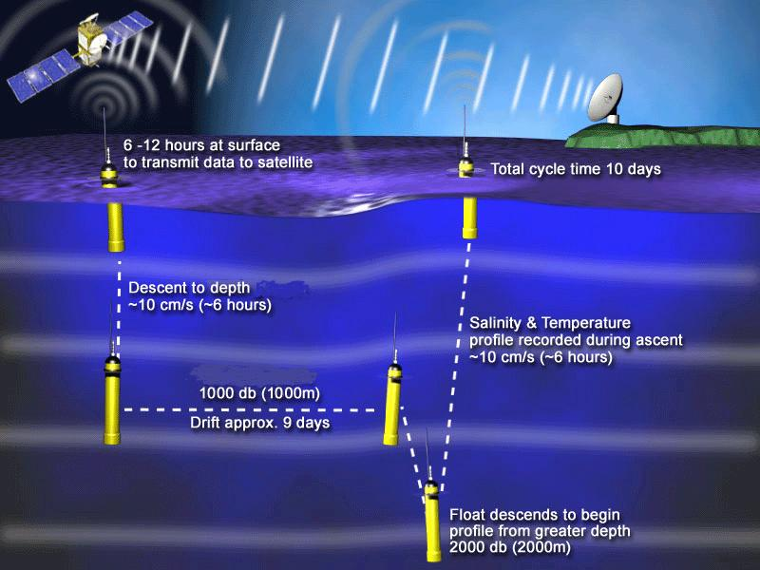
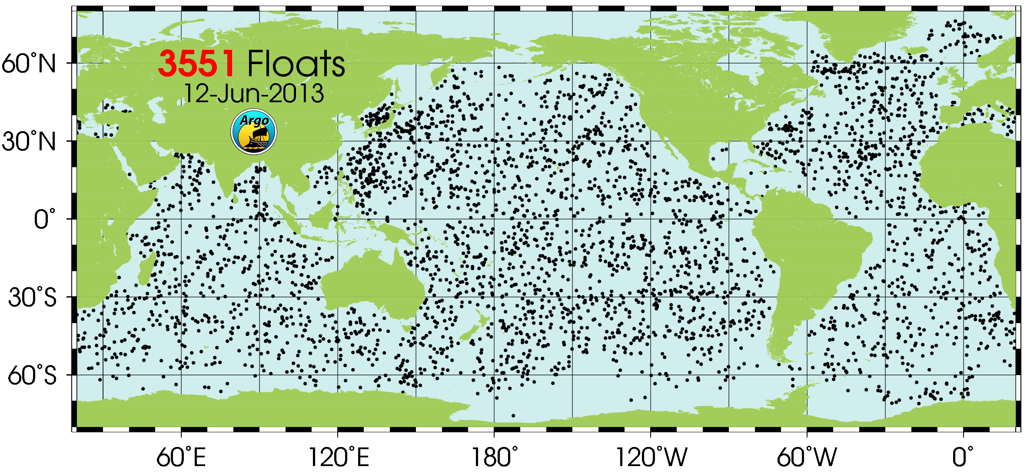
What is a Profiling Float?
http://www.argo.ucsd.edu/
http://wo.jcommops.org/cgi-bin/WebObjects/Argo

Slide 6

The Big Picture
What can you get for a 5 year $10M experiment?
Profiling float costs
  CSOBOM float = $60K capital costs + $0/year
  Minimal small boat deployment costs
Glider costs (from actual users)
  $250K capital costs + $50K/year maintenance
  Somewhat greater small boat costs due to ~3 month refurb.
166 floats, 20% loss = 133 in the array for 5 years
20 gliders w/4 on shore for refurbishment = 16 in the array at any 1 time
MODIS Chlorophyll June 28, 2011
htttp://podaac-tools.jpl.nasa.gov/soto/

Slide 7
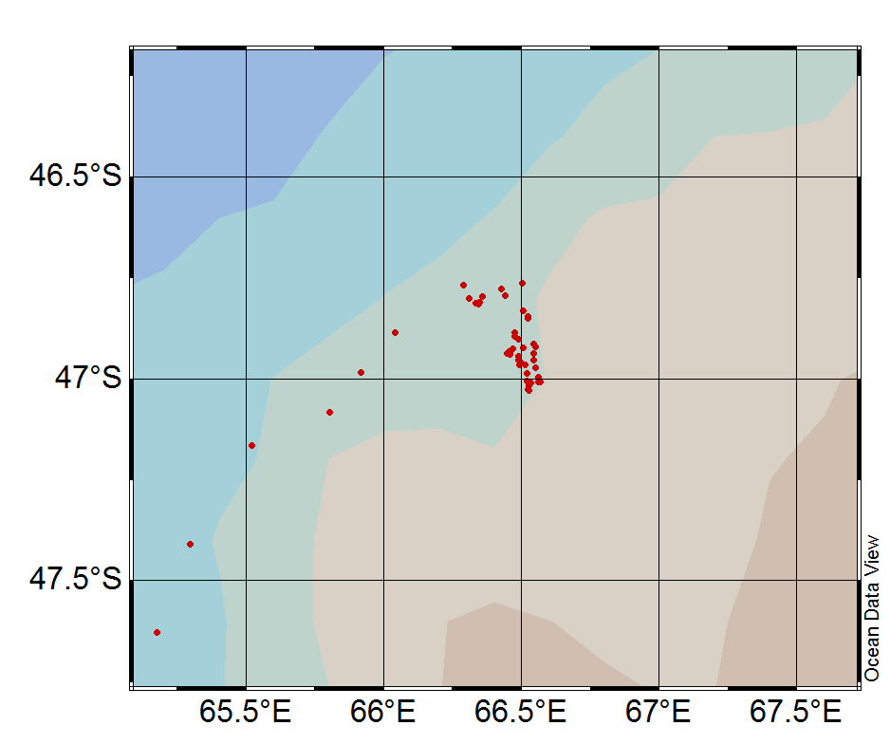
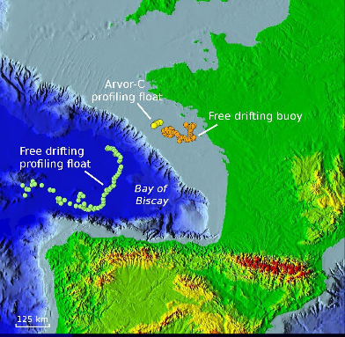
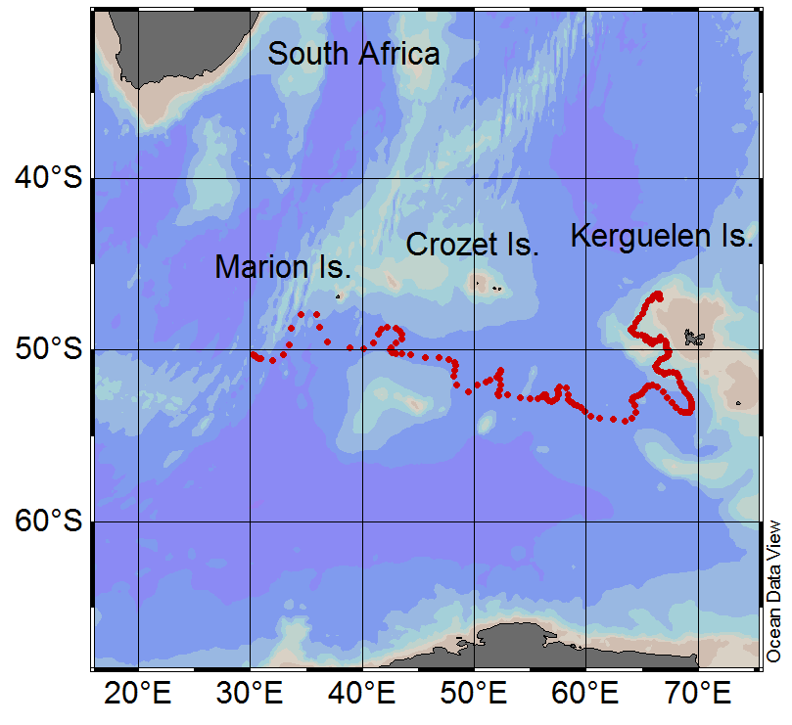
Argo 7647: 9 months parked at ~1000m
Some evidence this may work
0.25⁰=28km
ARVOR-C 200m/day
Buoy @ 50m = 4000m/day
Drifting profiler = 4300m/day

Slide 8
Significant Risks
Can we keep an array of profiling floats in a “coastal” measurement volume for the desired mission duration (3-5 years)
  This is the overriding risk factor and we need to have a plan for addressing it
Biofouling in the 500 meter range
  This isn’t a bio-fouling mitigation project and this remains a significant risk
Initial calculations suggest we need significantly more ΔV/V (volume change divided by total platform volume) than most existing floats
  We can definitely do something about this

Slide 9
Typical Mission Scenario
Define a grid of initial float deployment positions
Deploy the floats
Descend, anchor, deAnchor, profile to surface, telemeter results (Iridium satellite telemetry), repeat
Track all the floats in real time
Re-program individual float to “park” on descent at a user specified depth to take advantage of serendipitous currents when possible
If necessary, recover/redeploy as necessary
  Paragon, Moss Landing orange RHIB size boat

Slide 10

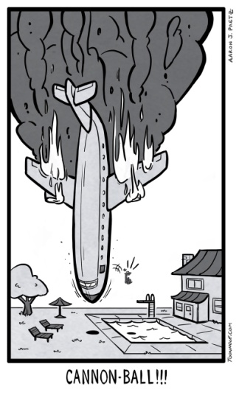
Effective Engineering 1
There is a Scientific Method, shouldn’t there be an Engineering Method?
Military, aerospace and software projects all have mature and evolving “System Engineering” processes to increase a system’s Probability of Success
  If these processes weren’t effective, these for-profit companies wouldn’t be using them
Every effort at applying standard “System Engineering” techniques in an academic environment that I’ve attempted or witnessed has been abysmal failures (see Figure 1)
Figure 1
The previous 4 slides are the result of a covert approach to the textbook System Engineering tasks of
  Defining traceable level 1 functional requirements
  Developing a defensible overall system lifecycle cost mode
  Assessing risk and developing a risk mitigation plan”

Slide 11
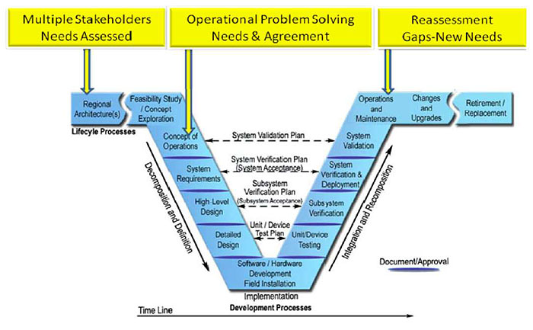
The Standard System Engineering Process
Everything on this chart has value, the key is finding an efficient way to accomplish these tasks in our academic culture
  Hint: It’s best not to let anyone know you might be doing any of this
Google the “Vee Model”
If you’re interested

Slide 12
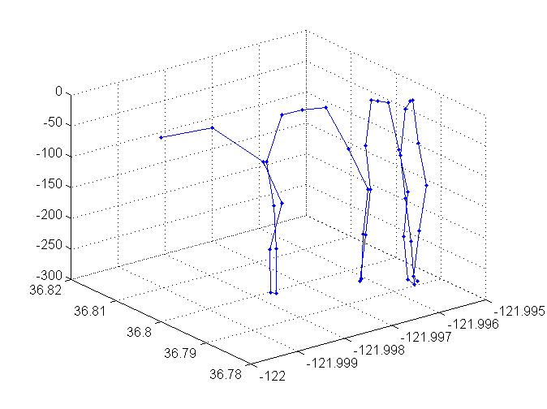
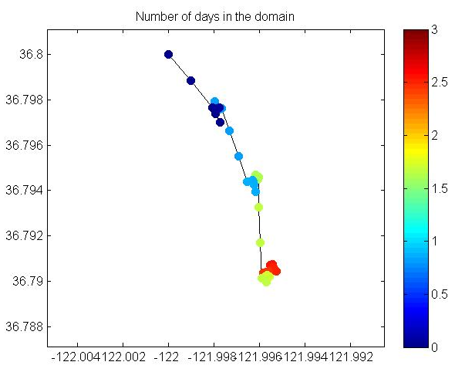
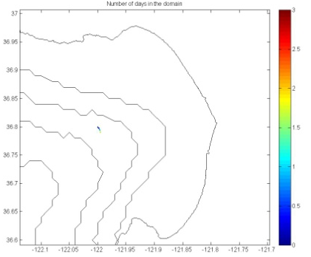
ROMS Model Initial Results
Keeping floats in the desired coastal measurement volume is the biggest risk
IOOS runs the JPL.UCLS ROMS predicting ocean currents for the US West Coast on an operational basis
We might be able to use the model to find serendipitous currents we can using during the float’s park stage to nudge us back into the measurement volume
408m
1025m

Slide 13
Effective Engineering 2
Process Matters (at least to me)
My personal process is continually evolving with the goal of getting the right balance of analysis, shore side testing , at-sea testing and review/documentation
Current process:
  Analyze everything I can think of
  Prototype the risky elements and then a quick and dirty prototype of the whole system
  Build the first article go-to-sea prototype
Next version of the process
  Analyze everything you can think of but be quicker about it
  Prototype the risky elements and a quick and dirty prototype that can go to sea after tank testing

Slide 14
Mechanical Subsystem
CTD, O2, Nitrate, pH, PAR, FLBB
Except for the BE the CPF is a pretty typical mechanical design
ΔVolume/Total Volume matters
  Existing designs can’t always descend/surface through strong pycnoclines
  Parking may take significant force
  If ΔV/V matters then overall float weight & volume matter
Unfortunately, $$$ matter if we really want to flood the measurement volume with instruments
Electronics
Internal Oil Reservoir
Batteries and Hydraulics
2.5l External Oil Bladder

Slide 15
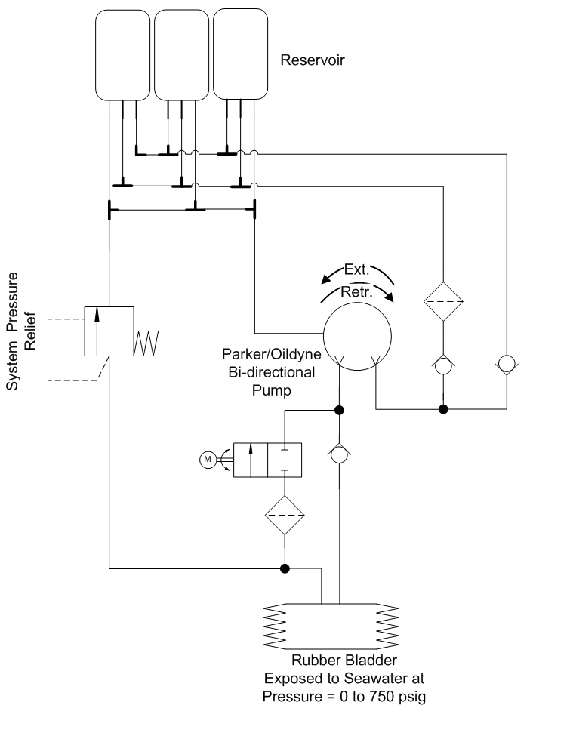
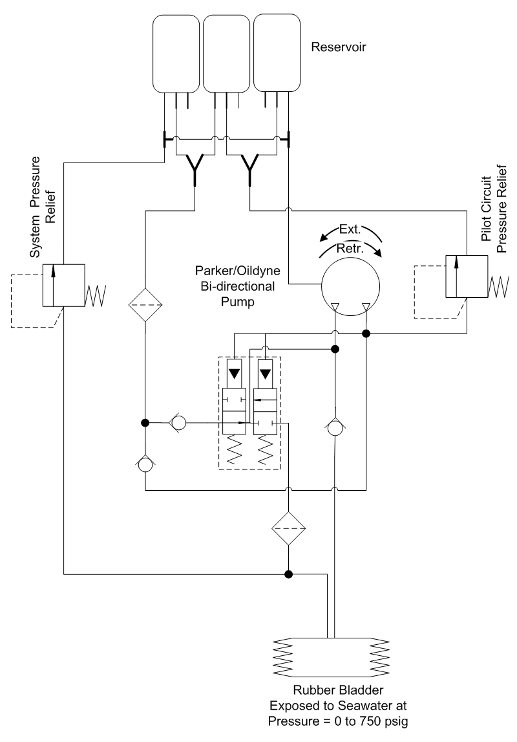
Buoyancy Engine
2 design options
  single stroke = driven hydraulic cylinder
  multi-stroke = hydraulic pump
Efficiency is the deciding factor
  Cylinder – high volumetric efficiency, high frictional and gear head losses, difficult form factor
  Pump – lower volumetric efficiency, lower frictional losses, no gear head, flexible form factor
2 multi-stroke design options
  Pilot operated valve: automatic but somewhat more complex
  Motor operated Swagelok valve: simpler but requires control to switch between extend and retract
Note: This is part of the concept design study where multiple design approaches are evaluated. Making the decision based on a quantitative assessment as a function of the requirements is effective, other approaches may not be as effective

Slide 16
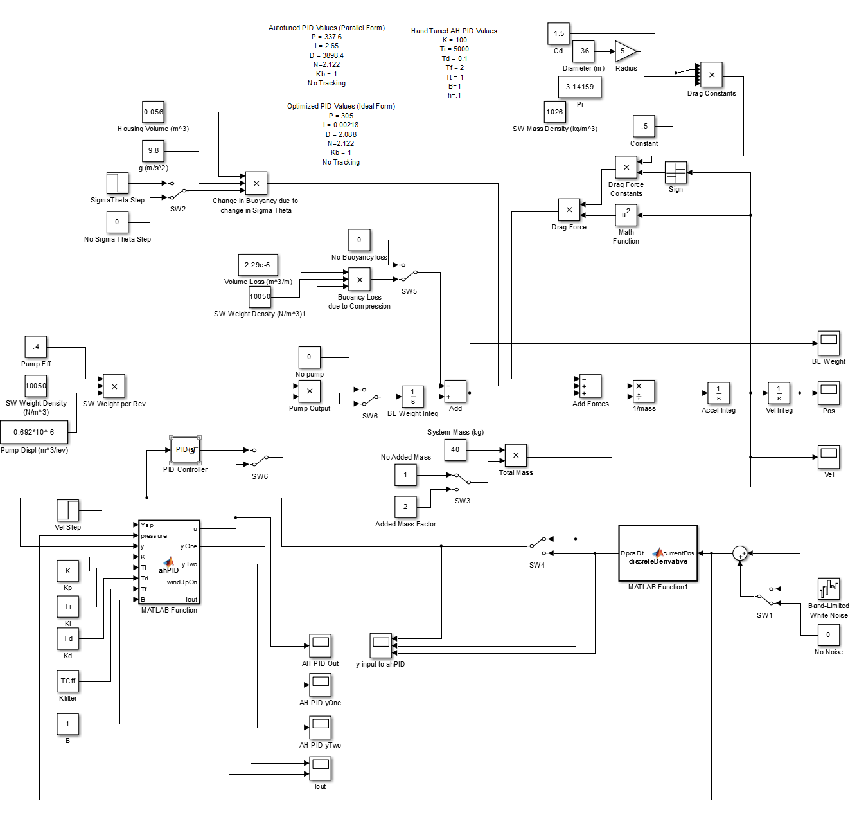
Simulink Buoyancy Control Model
Estimate PID constants
& understand control system trends
Drag
Water column density profile
∫∫a=F/m to get Position and Velocity
System
Compressibility
Hyd. Pump
Added mass
PID controller
w/filtering and anti-windup

Slide 17
Simulink vs. Reality
Inner Velocity Loop, Outer Position Loop

Slide 18
First Tank Tests
(after initial fumbles)

Slide 19
Electrical Subsystem

Slide 20
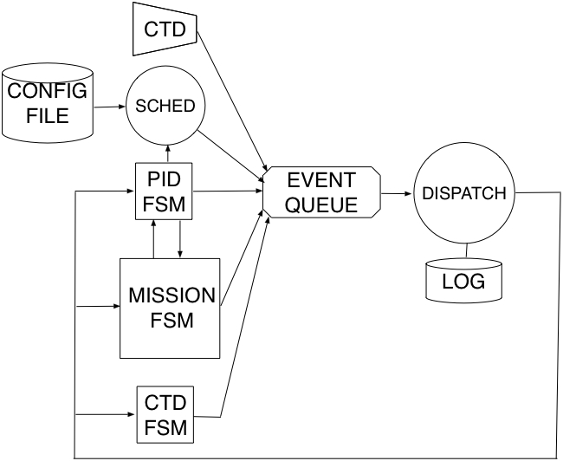
Software Subsystem is a
Hierarchical State Machine with Event Queuing

Slide 21
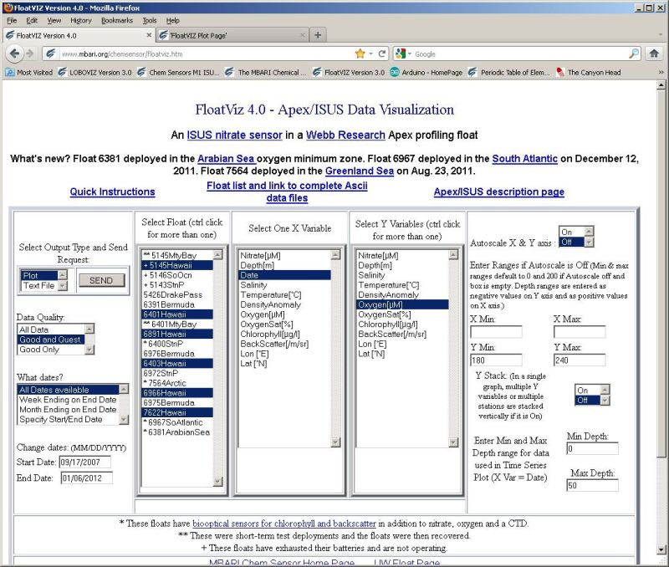
Data Subsystem – floatViz http://www.mbari.org/chemsensor/floatviz.htm

Slide 22
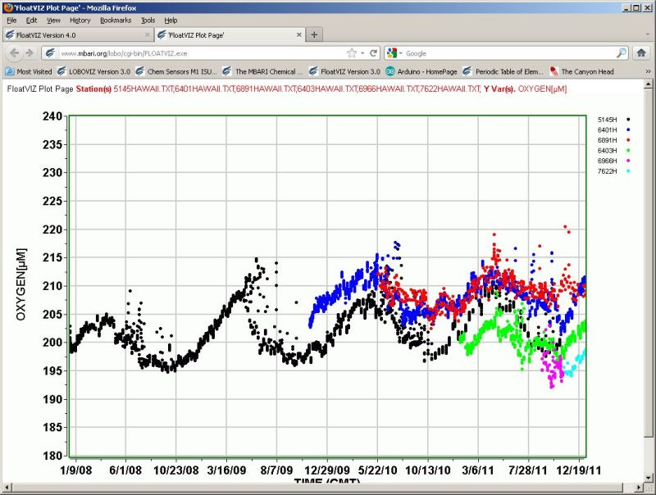
Typical floatViz Plot

Slide 23
Effective Engineering 3
Concentrate on the important stuff
More and better sensors, keeping floats in the MV, more capable buoyancy engine, better science user interface, easy & effective data access
Much of what our systems do is (with some over simplification) the same from system to system
  Mechanical: Protect the electronics from the environment, move stuff like seawater, hydraulic oil, reagents and control surfaces
  Electrical: distribute power, interface to sensors, provide compute resources
  Software: read sensors, do some arithmetic, drive actuators, store the data, telemeter the data, repeat
There’s got to be a framework that provides an 80% solution, i.e. 80% (or there-abouts) of what a custom design would provide so we can concentrate of the important (usually harder) stuff
Arduino and .Net Micro Framework/Gadgeteer are two examples that come close for the Electrical and Software subsystems

Slide 24
.Net Micro/Gadgeteer Ecosystem
The .Net Micro Framework is a subset of Microsoft’s “Dot Net” environment
  Developed by Microsoft Labs for embedded systems
  Completely open source, except for tools and certain drivers (WiFi). No license required for use.
  Totally integrated into MS Visual Studio IDE, arguably “best of breed” tools for embedded software development.
  Tools are freely downloadable from Microsoft.
  Provides a FAT32 file system, event handlers, TCP/IP networking, threads, timers, etc.
Gadgeteer vendors provide a wide variety of hardware
  ARM7, ARM9, Cortex M3, Cortex M4 CPUs with UARTs, SPI, Ethernet, I2C, …
  Digital, analog (not a lot) and industrial IO
  A surprisingly wide variety of sensors: GPS, accelerometers, compass, cameras, barometer, temperature, pulse oximeter and a bunch more
  Most importantly with the necessary software drivers (usually)

Slide 25
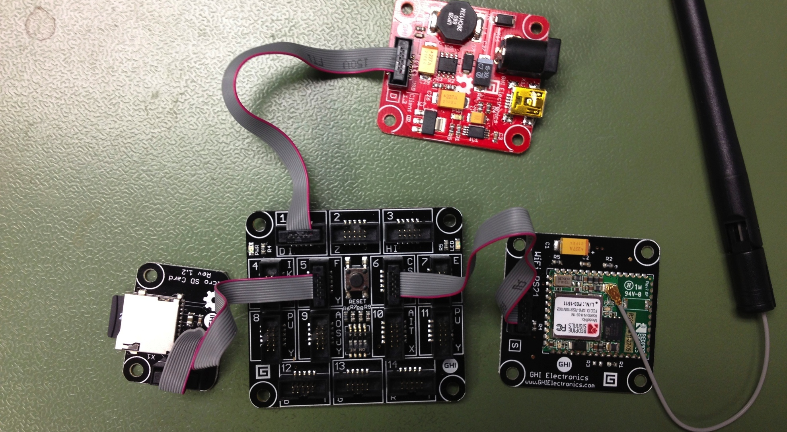
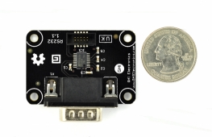
Gadgeteer Experiment Results
Our initial Experiment was an unequivocal success
  Near total ignorance of .NET/Gadgeteer to full BE control system tests underway in 2 weeks. Rapid iterations thereafter
  10 Hz PID loop, event driven serial IO, SPI, USB and Bluetooth interfaces and an 8 GB microSD file system
  We’re using it for the go-to-sea version
Arm 7 processor
WiFi
USB
8 GB uSD card
RS232 serial

Slide 26
Summary
Many of today’s important science questions will require systems that are economically feasible and sustainable for many decades in order to start developing answers
  The Argo global array of profiling floats is one of a very few examples
If we can keep our coastal floats in the measurement volume we’ll be able to do some good science
There is a scientific method, developing an engineering method that works for you might be worth the effort
  But don’t let anyone know
Thanks for listening!

Slide 27
Effective Engineering 3
Everyone wants to be a hero
How do we make sure we’re applying our limited resources to the important issues?
  Which are IMHO, floats that stay in the desired volume, more effective science user interface, better ability to access and analyze data, etc.
  Which are not IMHO snazzy custom processor boards with the latest CPU, re-jiggering Linux to do what you really need it to, etc.
Given the following
  We’ve got a bunch of really good mechanical, electrical and software engineers
  They all want to do a really good job; even better than they (or their peers) did last time
  High tech is sexier than low tech and Silicon Valley is right over the hill from MBARI

