Slide 1
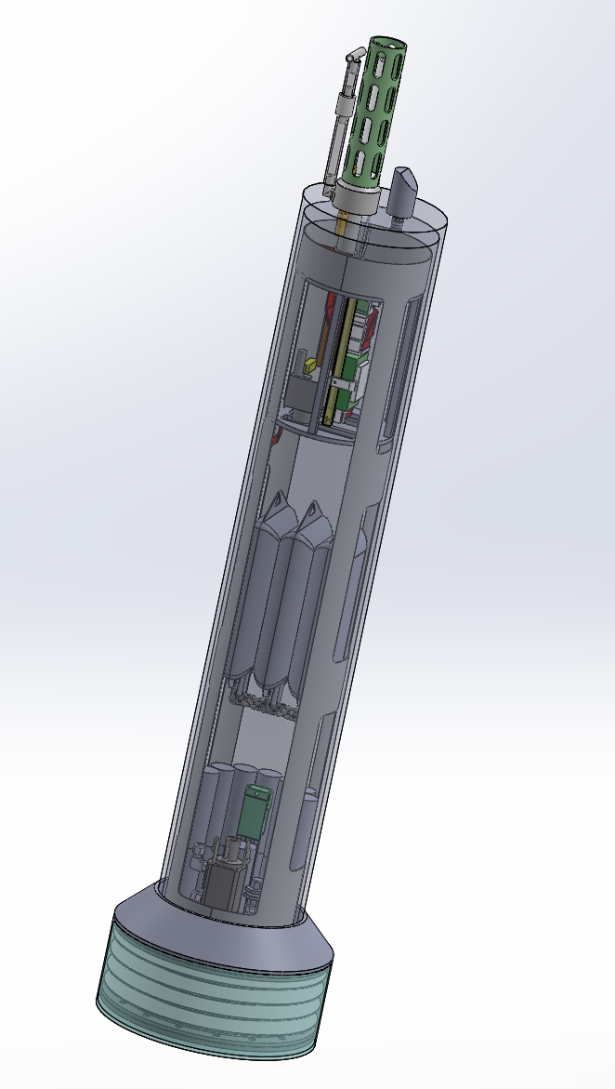
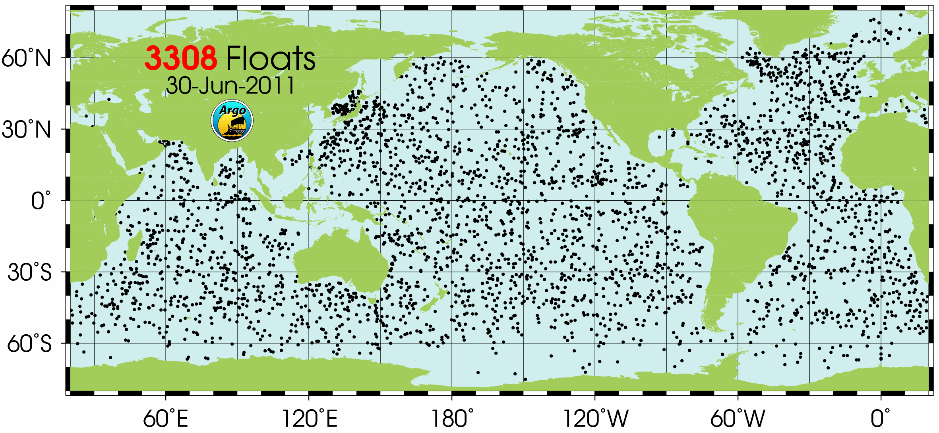
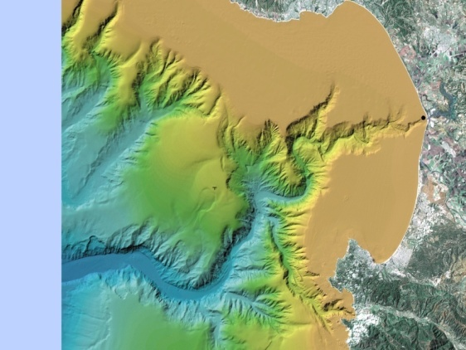
Development of a Coastal Profiling Float
Ken Johnson & Gene Massion

Slide 2
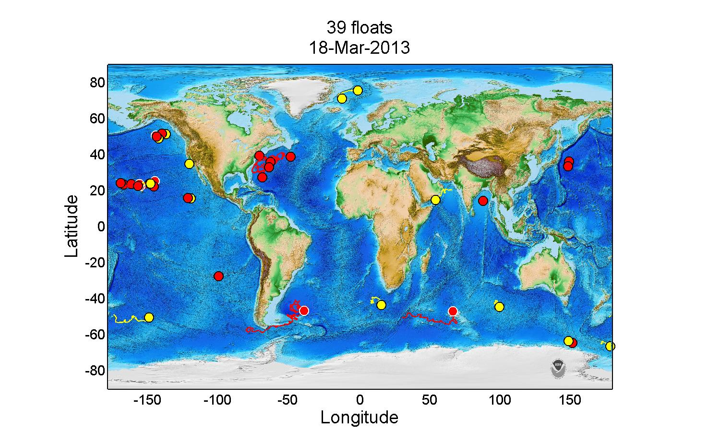
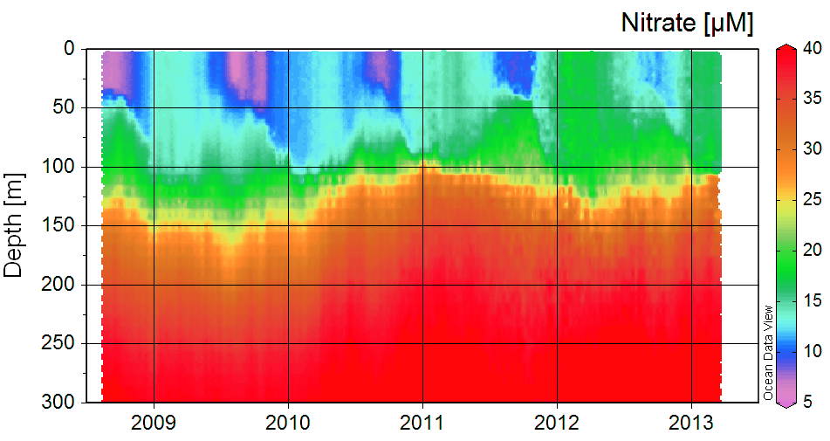
Profiling floats provide unparalled view of ocean chemistry and biology.

Slide 3
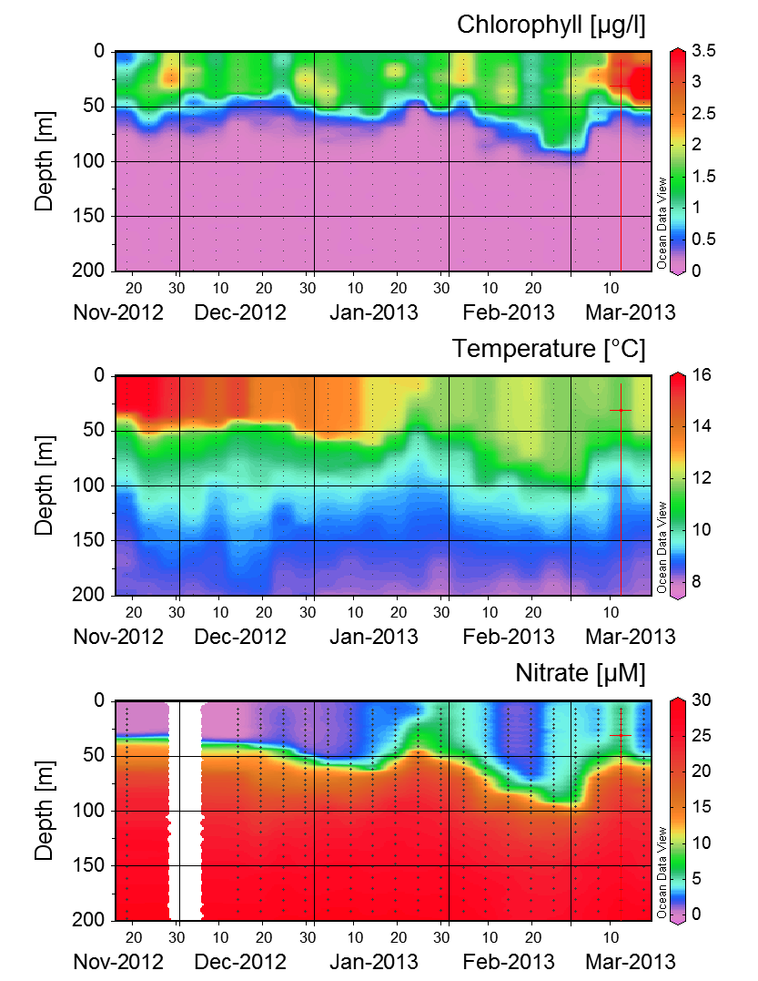
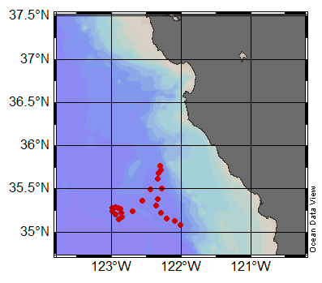
Global array moving closer to shore. Float 7647 off Central California. Additional floats this summer off So. Cal & Oregon.

Slide 4
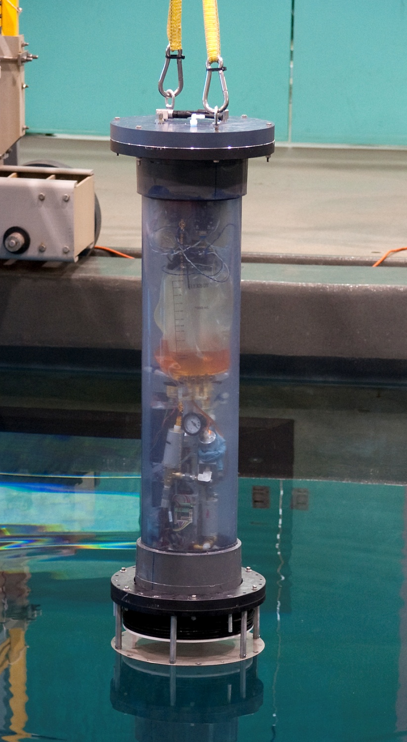
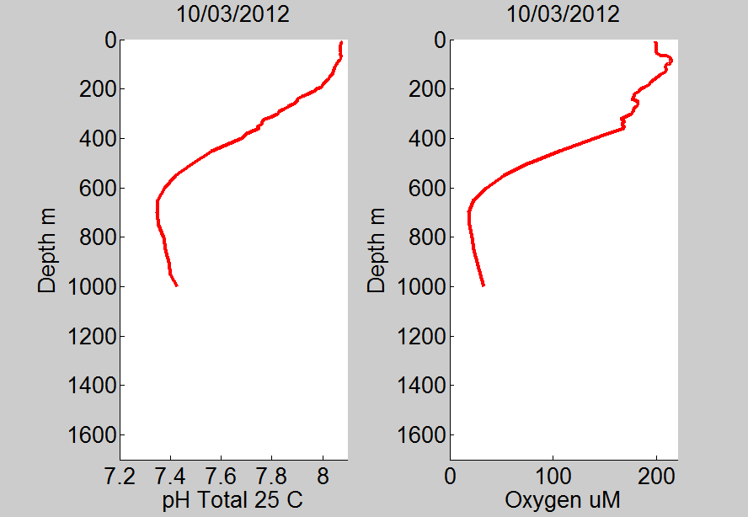
Coastal float engineering prototype
Developments:
A coastal float that can be deployed on the cont. shelf.
New sensors, including pH.
pH on Float 7672 near Hawaii.

