Slide 1
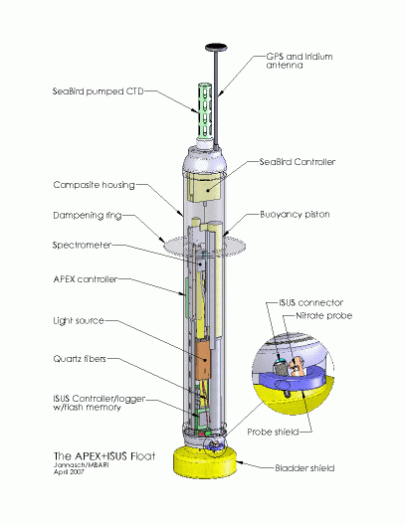
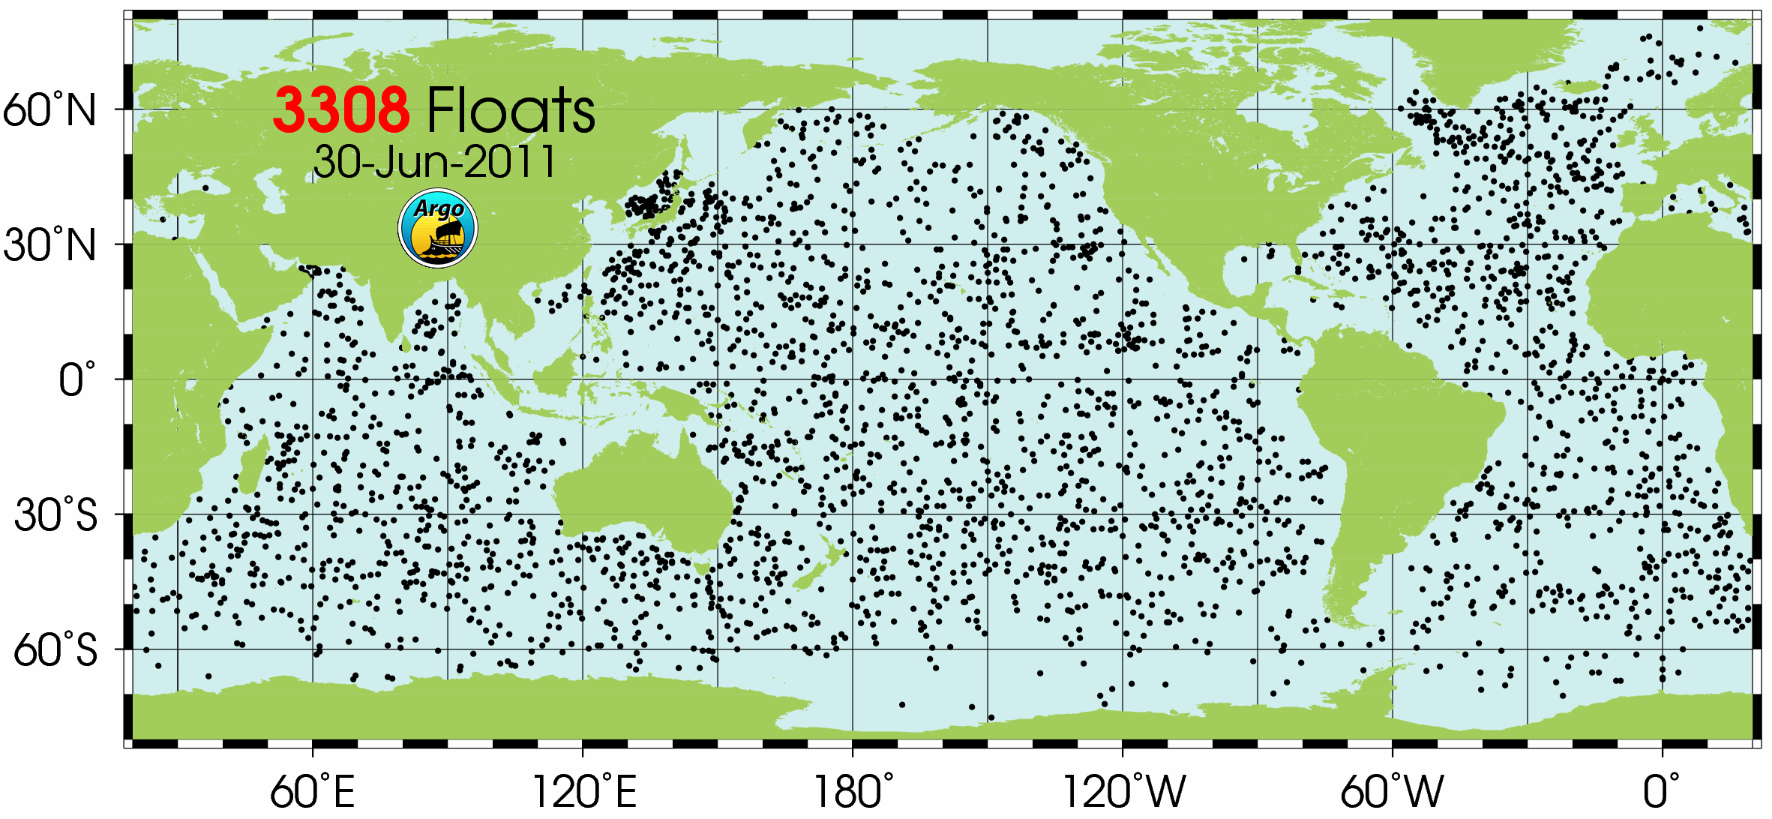
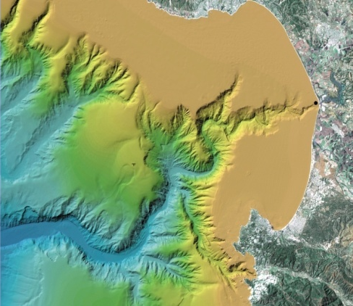
Development of a Coastal Profiling Float
Ken Johnson & Gene Massion
Replace existing buoyancy engine with more efficient, better form factor engine with enough buoyancy control to “park” on the bottom.
Re-organize components to allow more sophisticated instrument suites better suited for coastal measurements
Improve controller to support more sophisticated instrument suites
Redesign float base to function as a “parking brake”

Slide 2
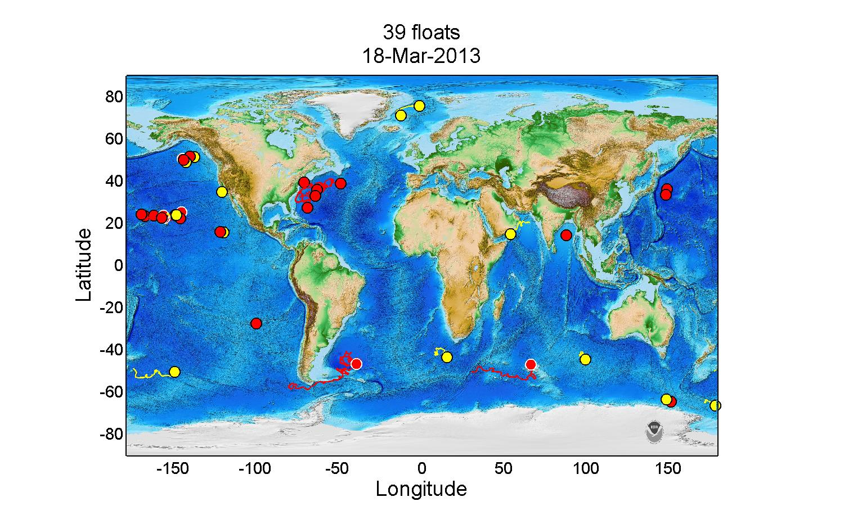
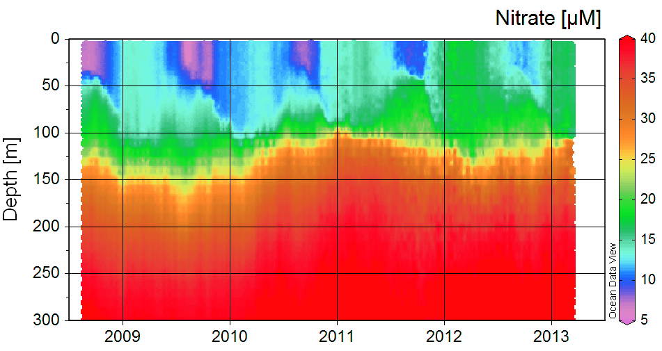
Profiling floats provide unparalled view of ocean chemistry and biology.

Slide 3
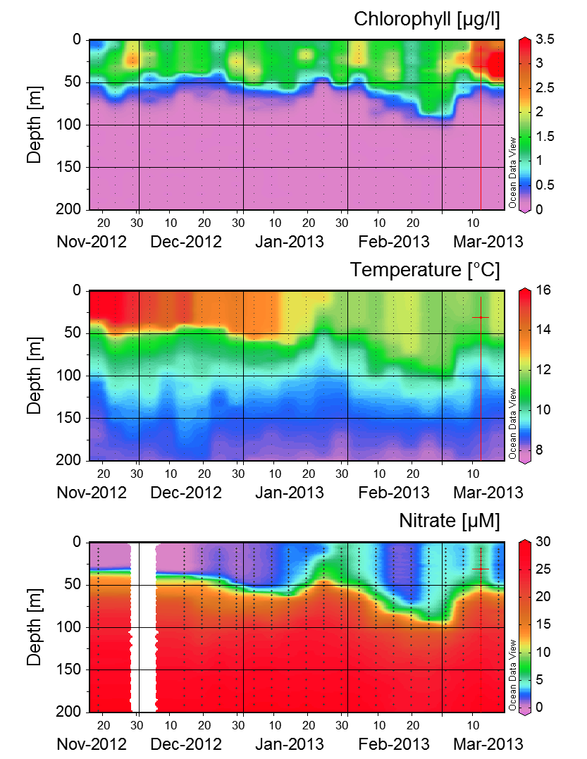
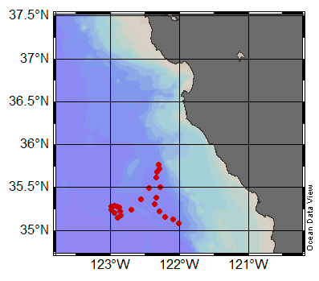
Global array moving closer to shore. Float 7647 off Central California. Additional floats this summer off So. Cal & Oregon.

Slide 4
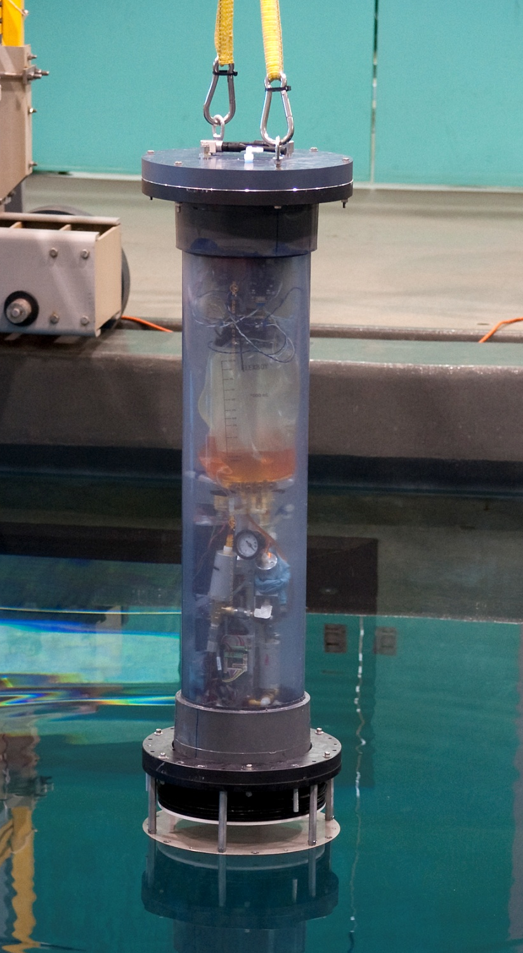
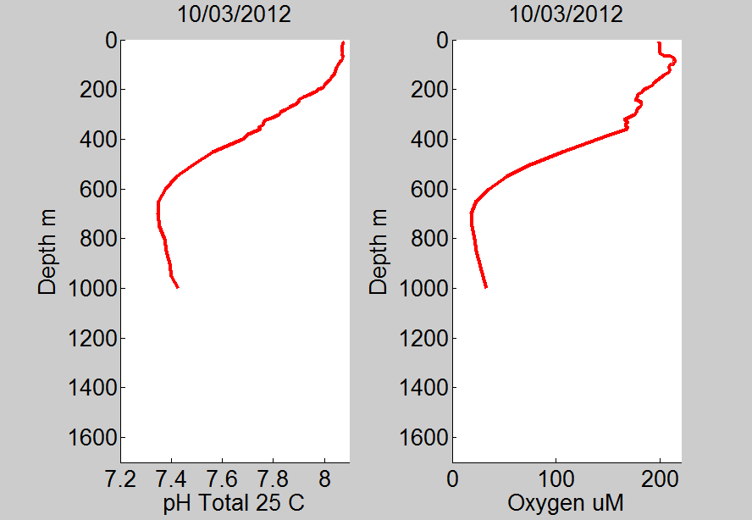
Developments:
A coastal float that can be deployed on the cont. shelf.
New sensors, including pH.
Float 7672 near Hawaii.

