Slide 1
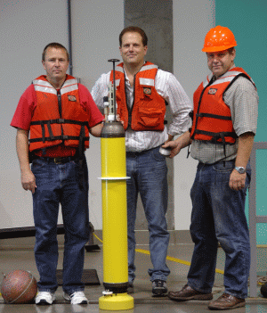
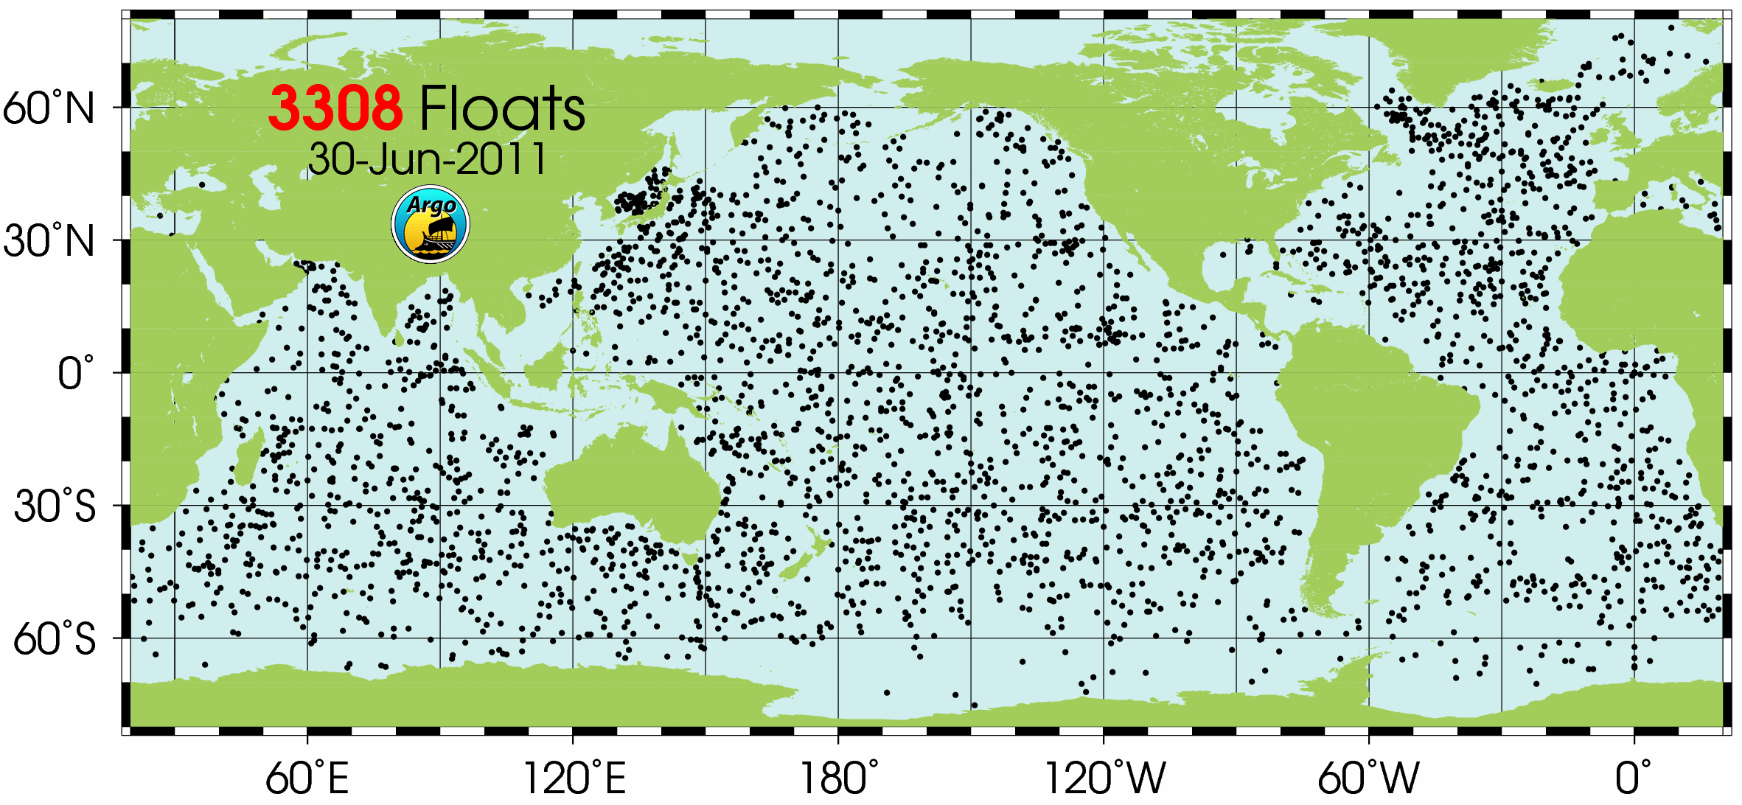
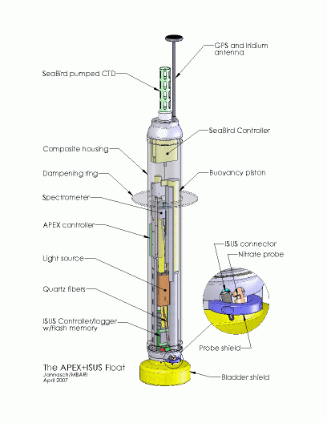
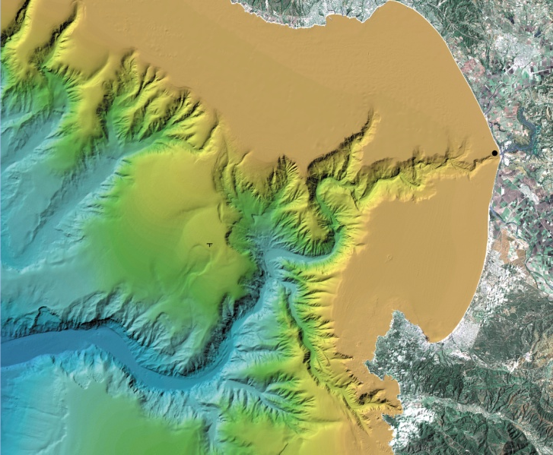
Development of a Coastal Profiling Float
Ken Johnson & Gene Massion

Slide 2
Motivation
Argo floats provide a globally distributed set of platforms optimized for statistically defensible measurements of the changing heat content of the global ocean
A similar platform optimized for coastal regions would be just as valuable and potentially just as successful
This effort is well linked to MBARI and Packard Foundation themes and (as far as we know) is not being pursued elsewhere

Slide 3
Project Goal
Optimize the existing ARGO APEX float for use in coastal applications
  Add a bottom “parking” mode to increase residence time in desired region
    A 2nd buoyancy engine optimized for this application is the preferred design, others are possible and will be looked at
  Improve sensor integration for coastal instrumentation
    pH, nitrate, oxygen and bio-optical sensors
Proposed “product”
  Coastal scale (e.g. Monterey Bay) affordable, continuous, synoptic maps of pH, nitrate, oxygen, CT

Slide 4
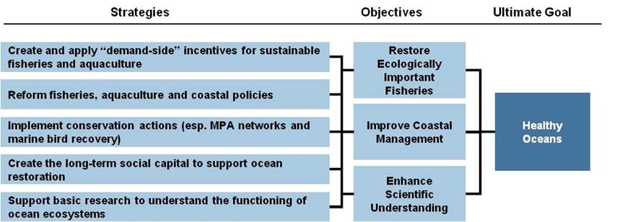
Links to MBARI Strategic Plan & Packard Foundation Oceans Grant Making Program
This work will provide technology capable of providing defensible, long term, regional scale, economical measurements of ocean parameters critical to science based coastal ecosystem management

Slide 5
Engineering Approach
Foundation
  Work with Riser Lab to understand APEX architecture
  Duplicate software development environment
Build up operational experience
  Deploy floats as is in Monterey Bay
Develop predictive capability (3D trajectory model)
Evaluate “parking mode” options
  Existing buoyancy engines are a good place to start
  analyze, design, prototype, lab test, field test

Slide 6
Feasibility Calculations
What are the forces
  Drag with profiler upright in a 20 cm/sec bottom current ~= 1 lbf
  Laying the profiler down (further into the boundary) layer significantly reduces drag force
How much energy is required?
  150 parking cycles, 250m depth, 5 lbf ~= 5 standard DD Li APEX batteries

