Slide 1
MBARI Coastal Profiling Float
Project Kick-off Meeting
January 10, 2012

Slide 2
Project Goals
Develop a coastal profiling float optimized for coastal waters and coastal science
Beg, borrow, steal as much appropriate ARGO (or other) technology as possible
  We have an informal collaboration with Steve Riser’s group at UW

Slide 3
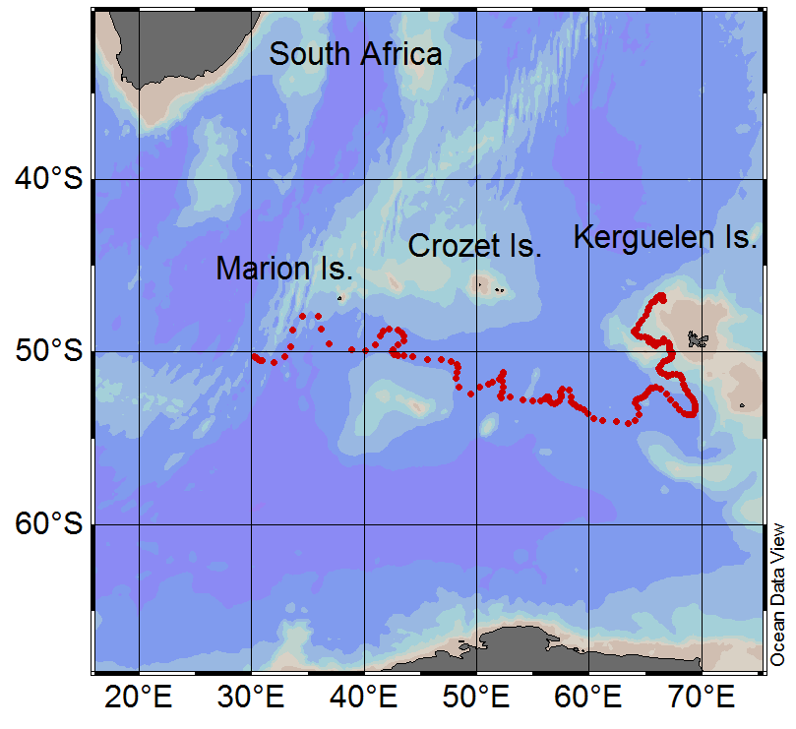
An inadvertent bottom parking experiment with Float 5146

Slide 4
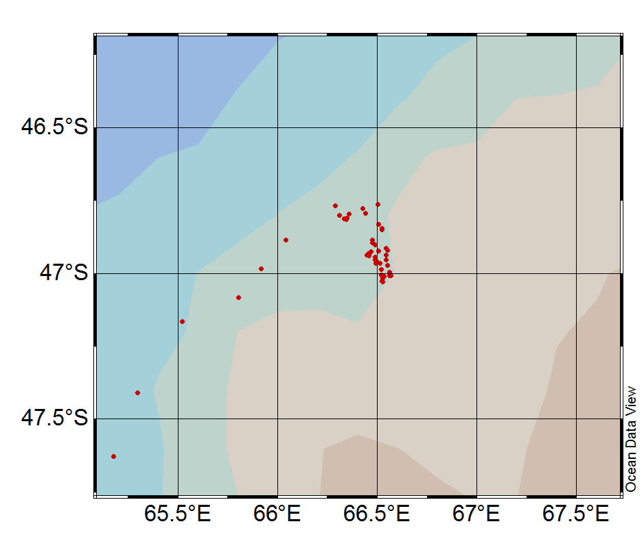
9 months with about +/- 15 miles
Parked at ~1000m

Slide 5
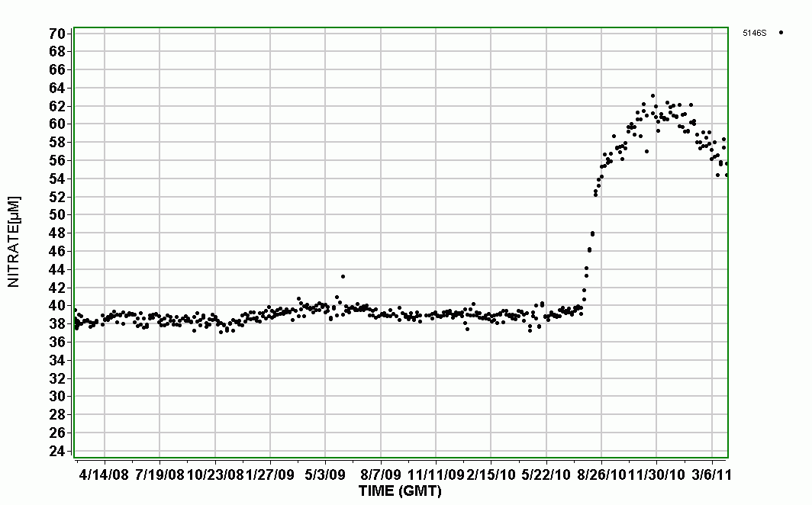
Nitrate sensor did foul when it hit, but that’s probably fixable

Slide 6
Preliminary Functional Requirements
Mission profile: goal is 1 profile every day for 3-5 years. Reality will be driven by physics and batteries
  Current Argo profile 1 profile every 10 days for 4 years ~= 150 profiles w/260 mL buoyancy engine
Typical sensor suite: C, T, D, pH, O₂, NO₃, Fluor./Backscatter, PAR
  Engr: GPS, temperature, humidity, leak(?), accelerometer(?)
Depth: goal is 500m, 250 m minimum
Provide a bottom “parking” mode
Bi-directional Iridium comms
Data integrated with existing MBARI FloatViz (SSDS?)

Slide 7
Preliminary Functional Requirements II
Use existing operational modeling capability to identify potentially advantageous currents, i.e. currents that will move the float back into the desired measurement volume
Provide for constant depth mode to take advantage of friendly currents
Shore-side float tracking program to identify floats aiming at “keep out” areas e.g., shore, Marine Protected Area
“Easy” integration of other, similar sensors
Economical at qty 10-100s

Slide 8
Functional Requirements III
Control Ascent rate
Look at seapoint FL/BB
Internal housing pressure sensor(?)
Integrate data with ARGO
Deploy/recover with 2 people and a whaler

Slide 9
Monterey Bay Vicinity
100-500 m Contours

Slide 10
Risky Elements
Sensor lifetime
  ARGO parks at 1000 meters, we will be 100-500m
Energy budget
  Argo = 260mL buoyancy engine, we’re looking at 5-10X
  ~2X Number of ARGO instruments
Getting the overall package neutral
Bottom parking may turn into something more permanent
Keeping the floats in the desired measurement volume

Slide 11
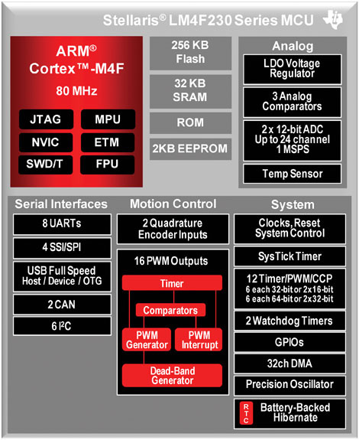
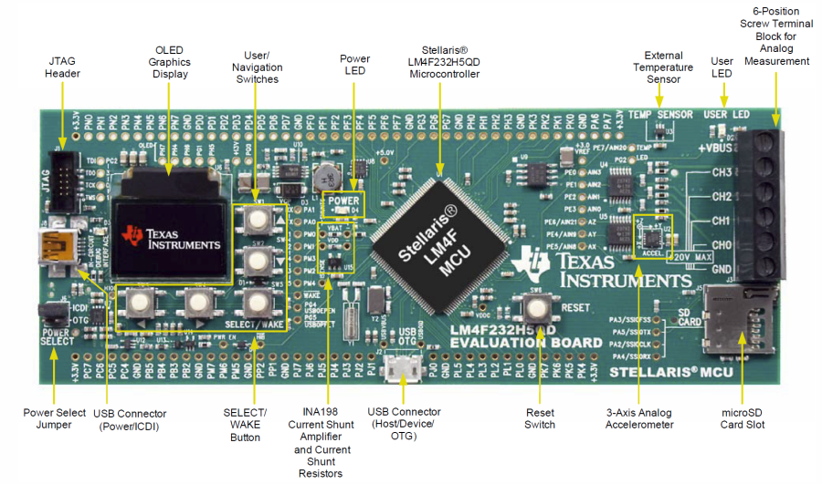
Current Design Leanings
Rotary pumped buoyancy engine
  Assuming the BE has to do the same work in the same time the difference between rotary and single stroke pumps is efficiency.
  Rotary pump has motor and pump inefficiencies
  Single stroke pump has motor, gearhead, leadscrew and piston inefficiencies
Iridium 9602 SBD Modem
Cortex M4-ish processor
  Everything on @ 80 MHz: 50 mA @ 3.3V
  Hibernate: <10 uA @ 3.3V
  Good driver library and IDE
2.25”
6.0”

Slide 12
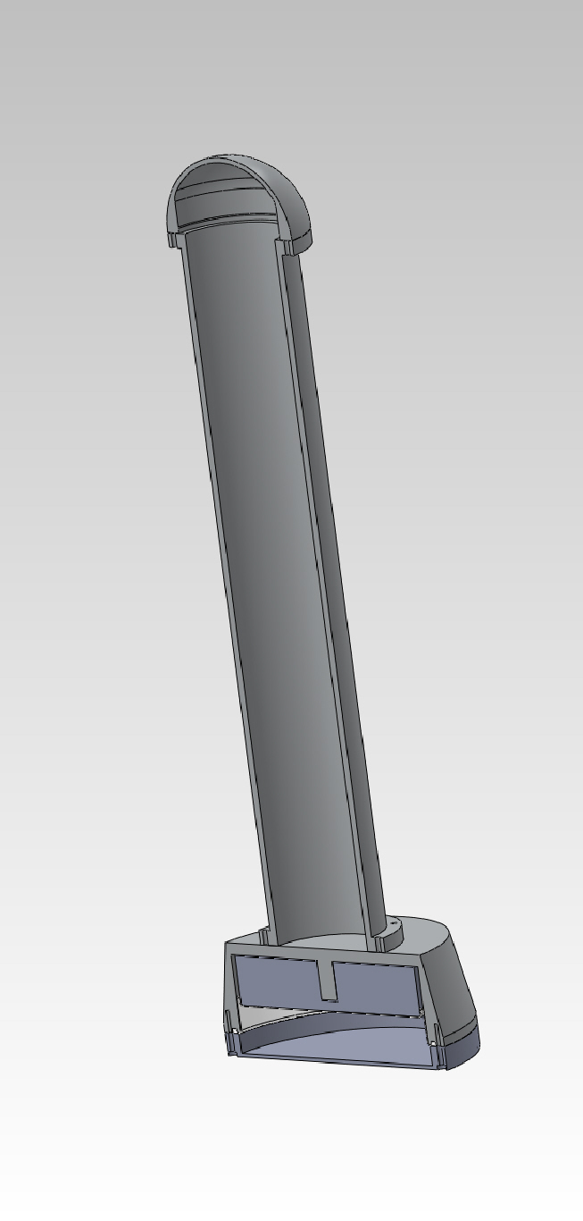
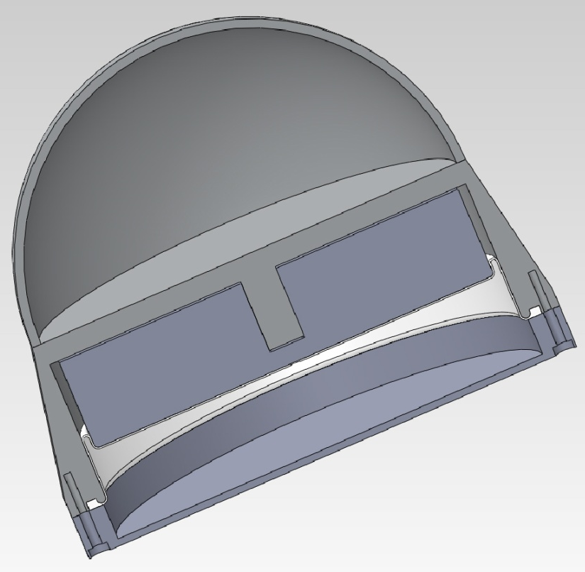
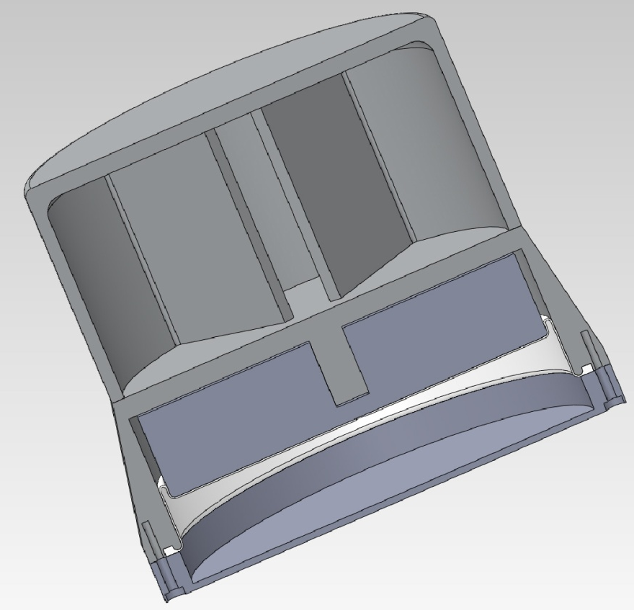
Package Concepts

Slide 13
2012 Development plan
Buy and deploy APEX float
  Develop operational experience with floats
  “Quantify” sensor lifetime issues in our coastal environment
  Compare actual float track with model track
  Baseline for coastal float performance comparison
  Build float tracking application
Develop operational model
Develop buoyancy engine prototype
  Test in the lab and the test tank
Develop core controller
  Buoyancy engine control, Iridium comms, RS-232 sensor “driver” for GPS and 1 or 2 sensors
  COTS development board
Develop complete profiler design, build first article

Slide 14
Design Calculations
Proposal
  Anchor weight vs. current
  F=mA buoyancy engine power budget
2012 To date
  Motor based buoyancy engine power budget
  Acceleration and Terminal Velocity vs. Buoyancy
  Neutral buoyancy package dimensions started
Planned
  Total power budget as a function of mission profile, instruments, telemetry, …
  Detailed weight and balance
  Buoy stability (metacentric height)
Operational Model
  Initial look mid-February

Slide 15
Milestones
Permitting Addressed: June 2012
  MBNS agreed this can be covered as part of normal, annual MBARI permit
PDR: Aug 2012
CDR: Nov 2012
1st Engr. Prototype Deployments: Q1 2013
Science Deployments: Q1 2014

