Slide 1

A LOW COST, UNDERWATER CO₂ SENSOR FOR EDUCATION AND RESEARCH
Miguel Uzcategui, University Of The District Of Columbia
Mentor: Ken Johnson
Notes:
Good Morning everybody, as George said, I am Miguel Uzcategui and I will be talking about a low cost, underwater CO2 sensor for education and research

Slide 2
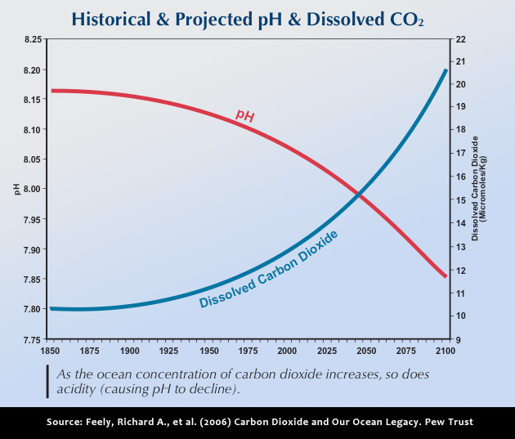
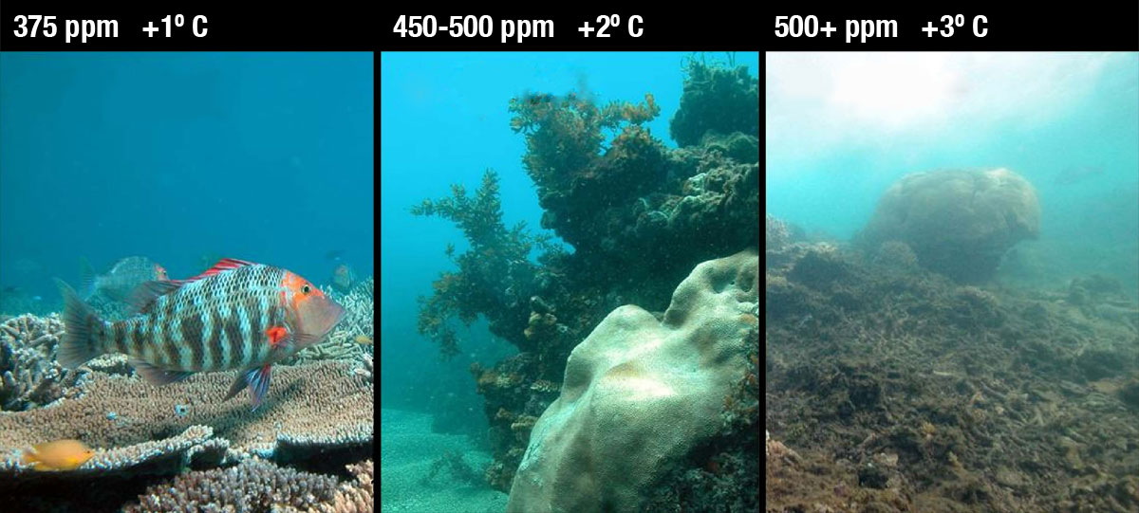
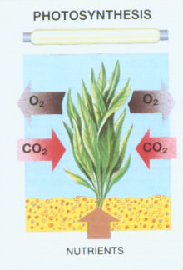
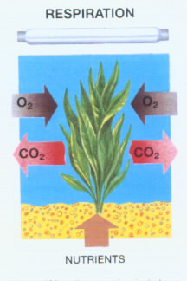
The importance of measuring CO₂
CO₂ affects the behavior of different underwater species
Study the metabolism of respiration and photosynthesis in different plants.
Ocean acidification
Notes:
Some of the reasons why there is the need to measure underwater CO2 are:
Ocean acidification: When carbon dioxide (CO₂) is absorbed by seawater, chemical reactions occur that reduce seawater pH, which means that the water gets more acidic. By studying carbon dioixide concentration in different parts of the ocean, the rate at which the ph is getting lower can be found.
Co2 affects the behavior of different underwater species: Different underwater react different to different carbon dioxide concentrations, which could lead to an erratic behavior that could endanger those species.
Study the metabolism of respiration and photosynthesis in different plants: By knowing the CO2 concentration, it could be predicted, how well the process of photosynthesis and respiration are working in an specific region, and it could be found how important are different plants in this porcess.

Slide 3
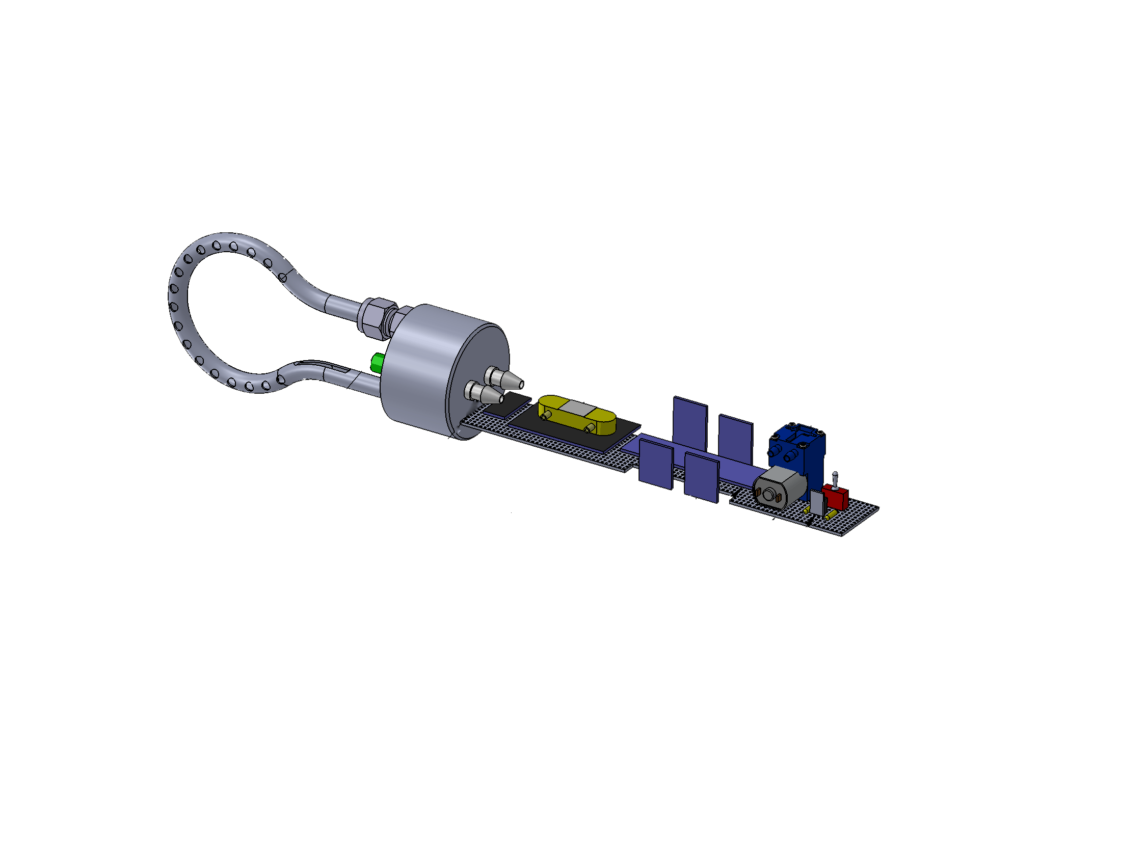
How the sensing module is built
Air pump
Switch
7805 Voltage regulator
Teflon AF tubing
Copper nickel tubing
End cap
Jeenode
RTC, relay, UART, and memory Plugs
CO₂ sensor (Telaire 6615)
Temperature and humidity sensor (SHT21)
Notes:
Jeenode: The Jeenode is a microcontroller based on the Arduino concept that is designed for low power consumption It counsumes 9mA while active, and about 16uA while sleeping if no plugs are connected
Plugs: I2C interface. There is an RTC plug to keep track of the time, relay plug to turn the pump and sensor on and off, Uart plug for communications with the sensor and memory plug.
CO2 sensor:
Temperature and humidity sensor: SHT21
Accessories: Air pump, 7805 voltage regulator, switch,
Cooper nickel tubing: To avoid bio fouling
End cap: Which is going to be the sealed link between the sensor, the tubing and the water
Teflon Af tubing: Inside the Cooper nickel tubing.

Slide 4
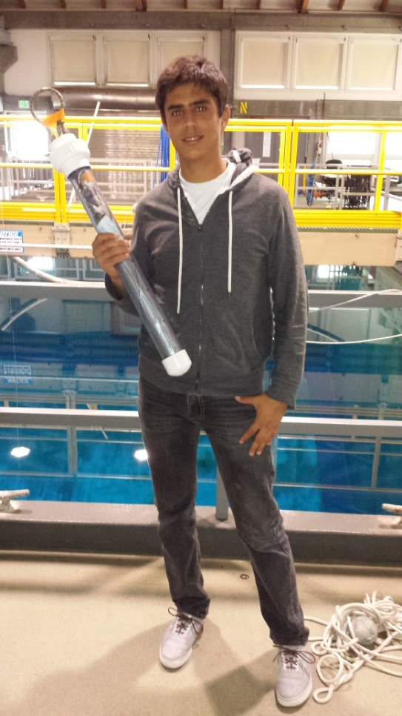
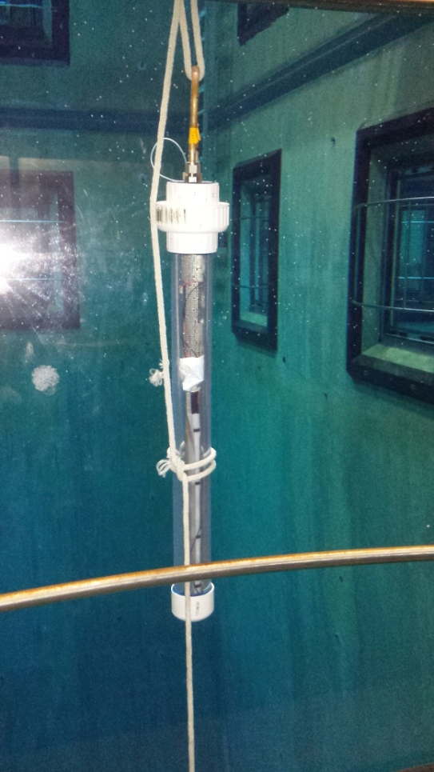
CO₂ sensing module

Slide 5
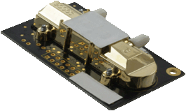
How Is it different from other CO₂ sensing modules
Teflon AF tubing
Equilibrates pCO2 through membranes
CO₂ sensor
It is a dual channel sensor
It communicates using UART protocol
Flow through to avoid any leak of air
pCO₂
Notes:
Teflon AF: The Teflon AF tubing is a type of tubing made out of Teflon AF-2400. This type of material is permeable to many materials, specially to CO2.It is made out of small membranes which allows the partial pressure of CO2 to equilibrate; therefore, it could act as an equilibrator in an aquatic medium.
CO2 module: It is a dual channel sensor, one of the channels measures the reference light that was shined and the second channel measures the amount of light that comes back, it communicates using serial communication and it is designed to be flow through meaning that air can just enter to the sensor using the tubing exits that it has.

Slide 6
Tubing Layout
Tygon tube
In
Out
Teflon AF
B
Air pump
A
Endcap
D
C
Tygon tube
Teflon AF
Nafion tube
CO2 Sensor
Notes:
How the tubing system is going to work is:
Starts first at the Teflon AF which is going to do the equilibration of CO2, the teflon will go into the endcap, at the end of the endcap Tygon tubing is going to be attached, it is going to the inlet of the pump, on the outlet of the pump Nafion tubing is going to be attached in order to protect the sensor, it will go to the sensor and the outlet of the sensor is going to go to the endcap using Tygon tubing

Slide 7
Experiments
The vacuum flask experiment
power consumption experiment
CO2 Sensor
Power meter
Batteries
CO₂ module
Out
Supply
In
Air pump
Flask
Figure 14( Equilibration in Water of Teflon AF, FIrst graph has an equilibration rate of 4.73 ppm/min, Second graph has an equilibration rate 3.73ppm/min, Third graph has an equilibration rate of 8.17 ppm/min)
Notes:
The vacum flask experiemtn consist on the teflon AF tubing going inside of a glass flask that can be completely sealed. The experiment objective is to see if the teflon AF can equilibrate, and if it cans at what rate?. So the pump will be turned on all the time, the supply will be turned on for ten minutes, then closed and the flask will be sealed, then the sensor will take samples every 20 seconds. The experiment was done in air and in water to see any differences that it might have.
The second experiment was the power consumption experiment to see how much power the module consumes, the module was connected to a power meter in the following fashion, and all of the current consumptions of the different modes of the sensing module were recorded.

Slide 8
The vacuum flask experiment
4.73 min
3.73 min
8.17 min

Slide 9
Power Consumption experiment
Pump Consumption: 3.08mAh
Sensor while awake (lights on): 6.04mAh
Microcontroller +SHT21+ 7805 Voltage regulator+ Sensor (sleep mode): 38.3mAh
Total= 47.42mAh
D cell battery life: 14.5 days

Slide 10
Algorithm flow chart
Start
Yes
No
Time to Pump
Yes
No
Time to read?
No
Turn on the pump
Go to Sleep
Yes
Do reading
10 minutes before reading?
Turn on Sensor

Slide 11
Results
Test tank
Harbor (8/9/13 to 8/10/13 )

Slide 12

Price of the module
Jeenode | $27
RTC plug | $15
Relay plug | $14
UART plug | $11
Memory plug | $9.50
Telaire 6615 | $115
SHT21 | $40
Air pump | $290
7805 voltage regulator | $2
Switch | $4
Teflon AF | $300
Nafion tubing | $90
PVC endcap | $1
PVC tubing | $1
PVC pipe locker | $3
Cooper nickel tube | $5
= $927

Slide 13

Future Improvements
Develop a Better Algorithm
Validate the results from the module
Use a higher precision CO₂ sensor
Pressure test the Teflon AF tubing
Find ways to make the module resist greater depths

Slide 14
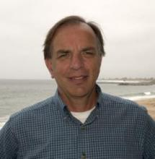

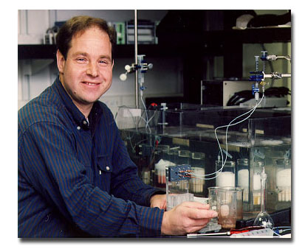

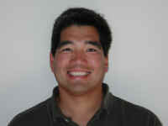

Acknowledgments
Ken Johnson
Oriol Pallares
Hans Jannasch
Patrick Gibson
George Matsumoto
Linda Kuhnz
David & Lucile Packard Foundation

