Slide 1

MEASURING OCEAN RESPIRATION:
VALIDATION OF A LOW COST CO₂ SENSOR
Wiley Wolfe, Oregon State University
Mentor: Ken Johnson
Notes:
Meeting
Sensor
Deploy
New

Slide 2
Why is Measuring CO₂ Important?

Slide 3
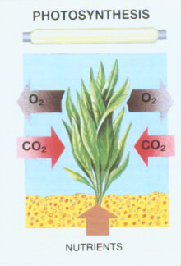
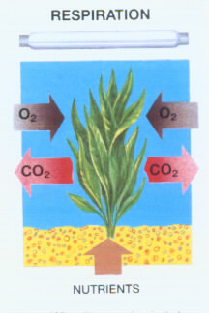
Why is Measuring CO₂ Important?
Notes:
Respiration Cycle

Slide 4
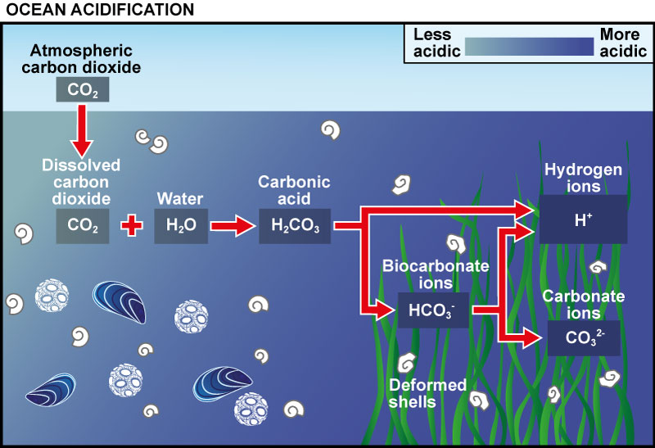
Why is Measuring CO₂ Important?
Notes:
Carbon system
CO2
pH
DIC Dissolved Inorganic Carbon
Alkalinity

Slide 5
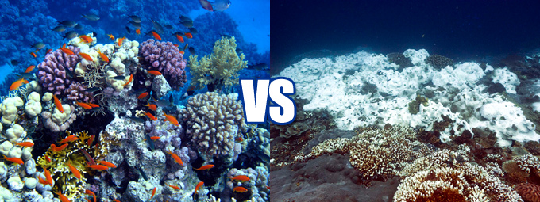
Why is Measuring CO₂ Important?
Notes:
Ocean Acidification
Biology

Slide 6
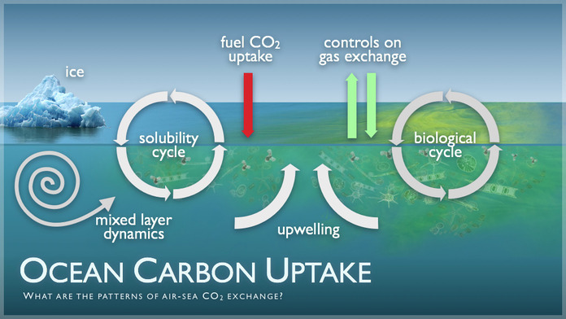
Why is Measuring CO₂ Important?
Notes:
CO2 atmosphere
Uptake

Slide 7
Why is Measuring CO₂ Important?
Notes:
Papers
Predictions often wrong
Important

Slide 8
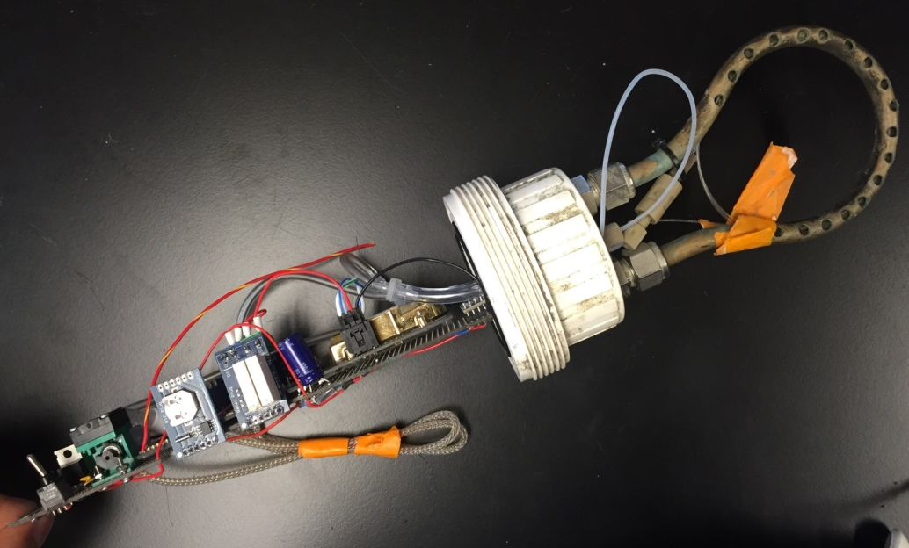
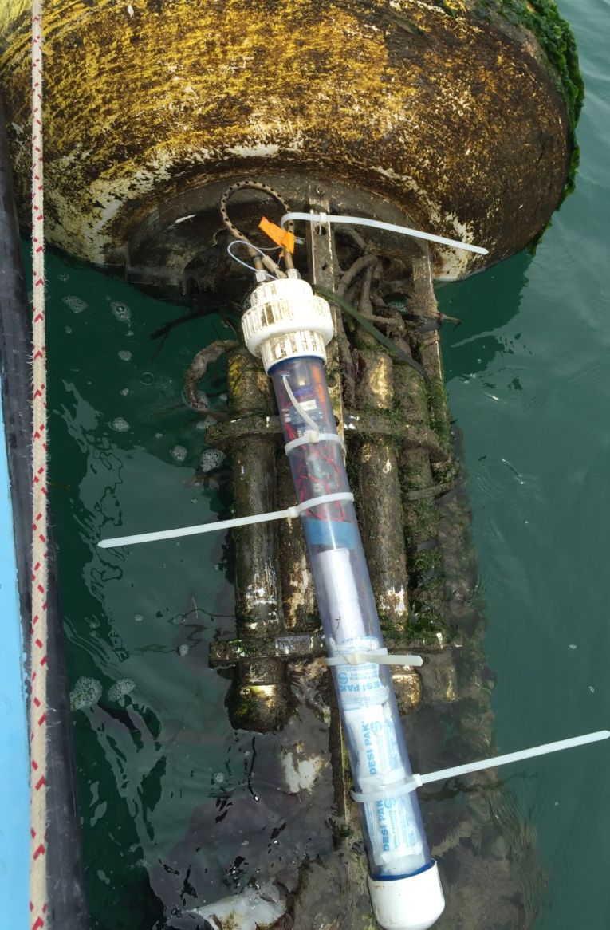
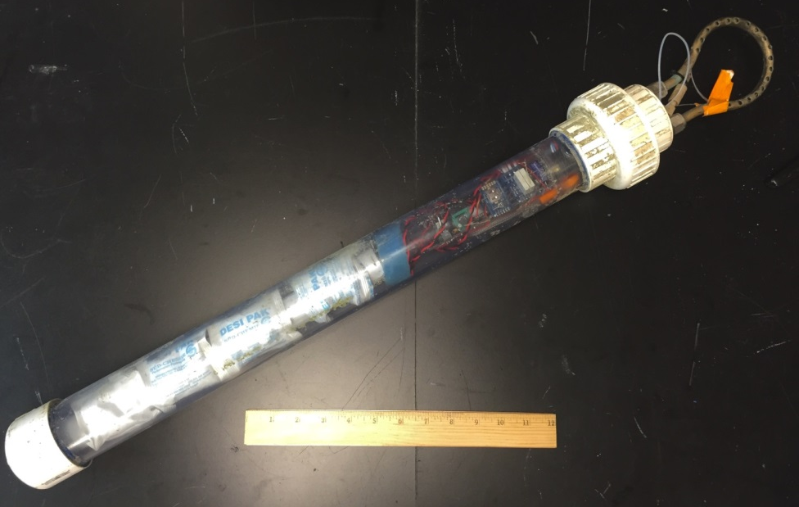
CO₂ Sensor 1.0
Notes:
Sensor

Slide 9
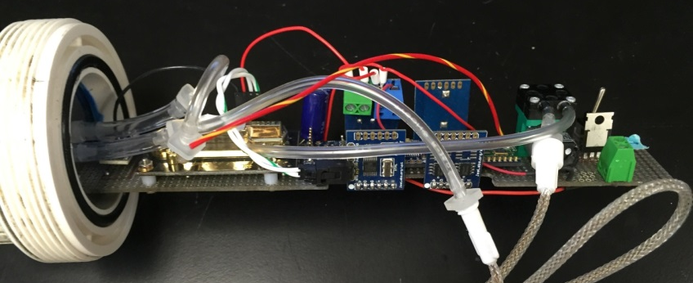
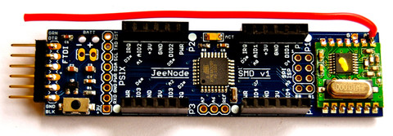
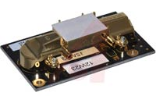
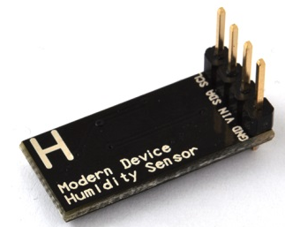
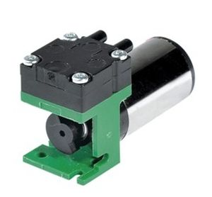
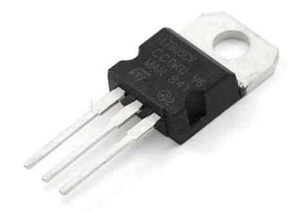
Circuit Components
JeeNode
Temp+Humidity Sensor
Air Pump
GE Telaire 6615
  Voltage Regulator
Notes:
JeeNode
Other
GE Wall co2 senor,
dual beam infrared
Light
Gas Phase

Slide 10
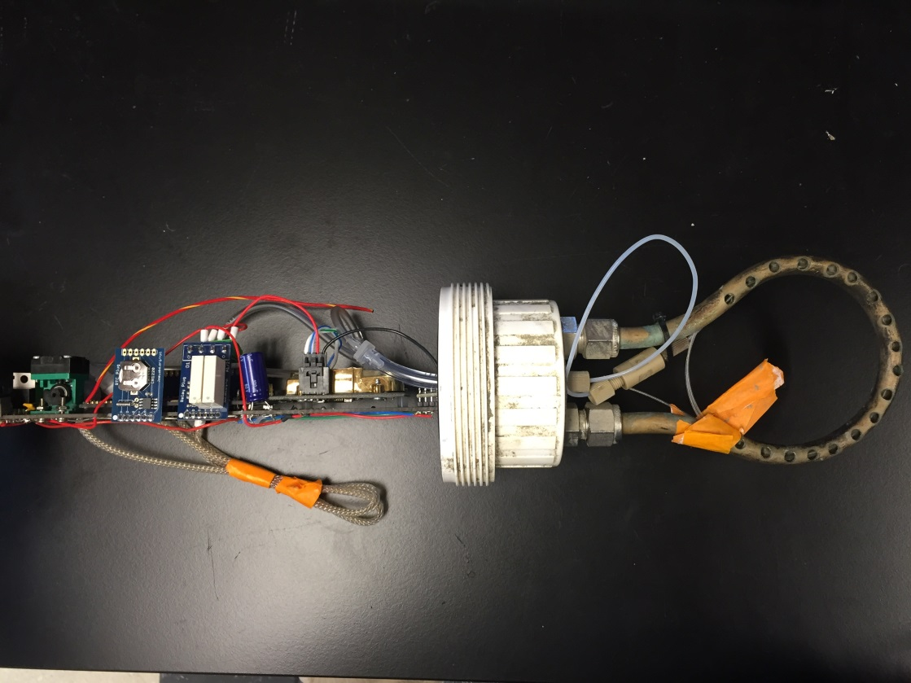
Gas Flow
Tygon Tube
In
Out
Teflon AF
B
Air pump
A
Endcap
D
Teflon AF
Tygon Tube
C
Nafion Tube
CO2 Sensor
Notes:
AF Membrane
Pump
Nafion
Sensor

Slide 11
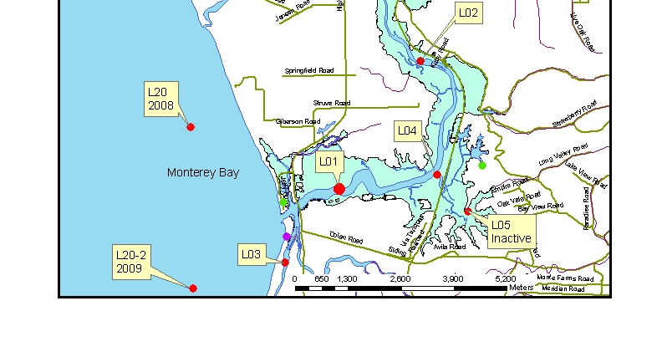
MBARI
Notes:
Land/Ocean biochemical observatory

Slide 12
Sensor
MBARI
Notes:
Land/Ocean biochemical observatory

Slide 13
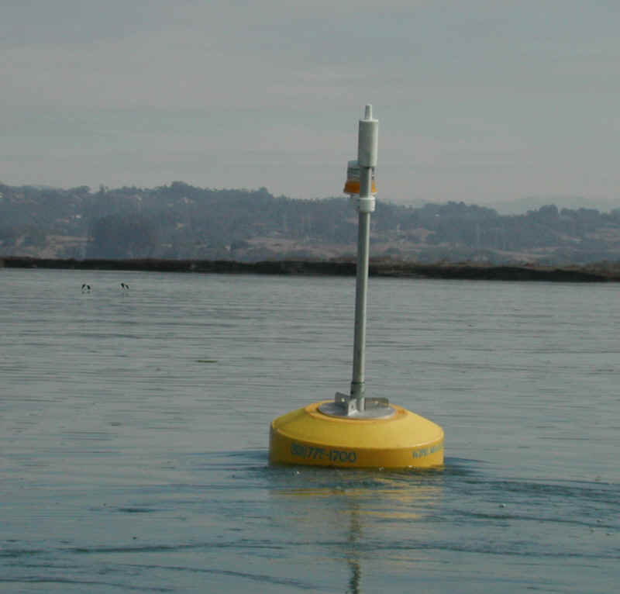
Notes:
Float

Slide 14

Notes:
Biofouling

Slide 15
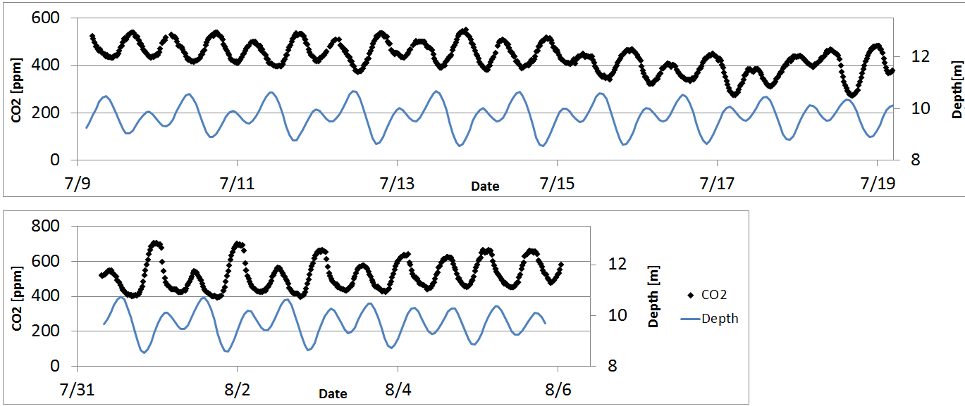
Deployments at LO1
Notes:
Dates
CO2
Tide
Looks Tidal

Slide 16
Deployments at LO1
Notes:
High Tide
Low CO2

Slide 17
Deployments at LO1
Notes:
Low tide
High CO2

Slide 18
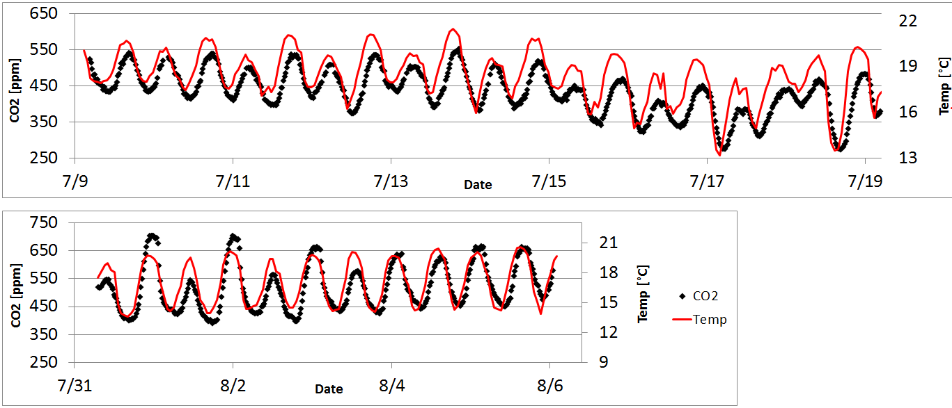
Deployments at LO1
Notes:
CO2
Temp
Close
Measures CO2
Sensor Affected

Slide 19
Deployments at LO1
Notes:
Trend

Slide 20
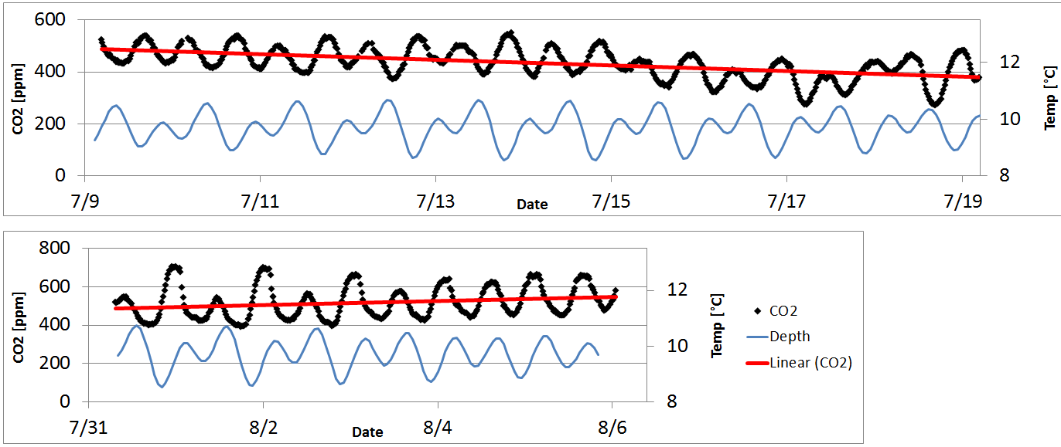
Deployments at LO1
Notes:
More clear
Drift
Forget 600
Post Cal Check

Slide 21
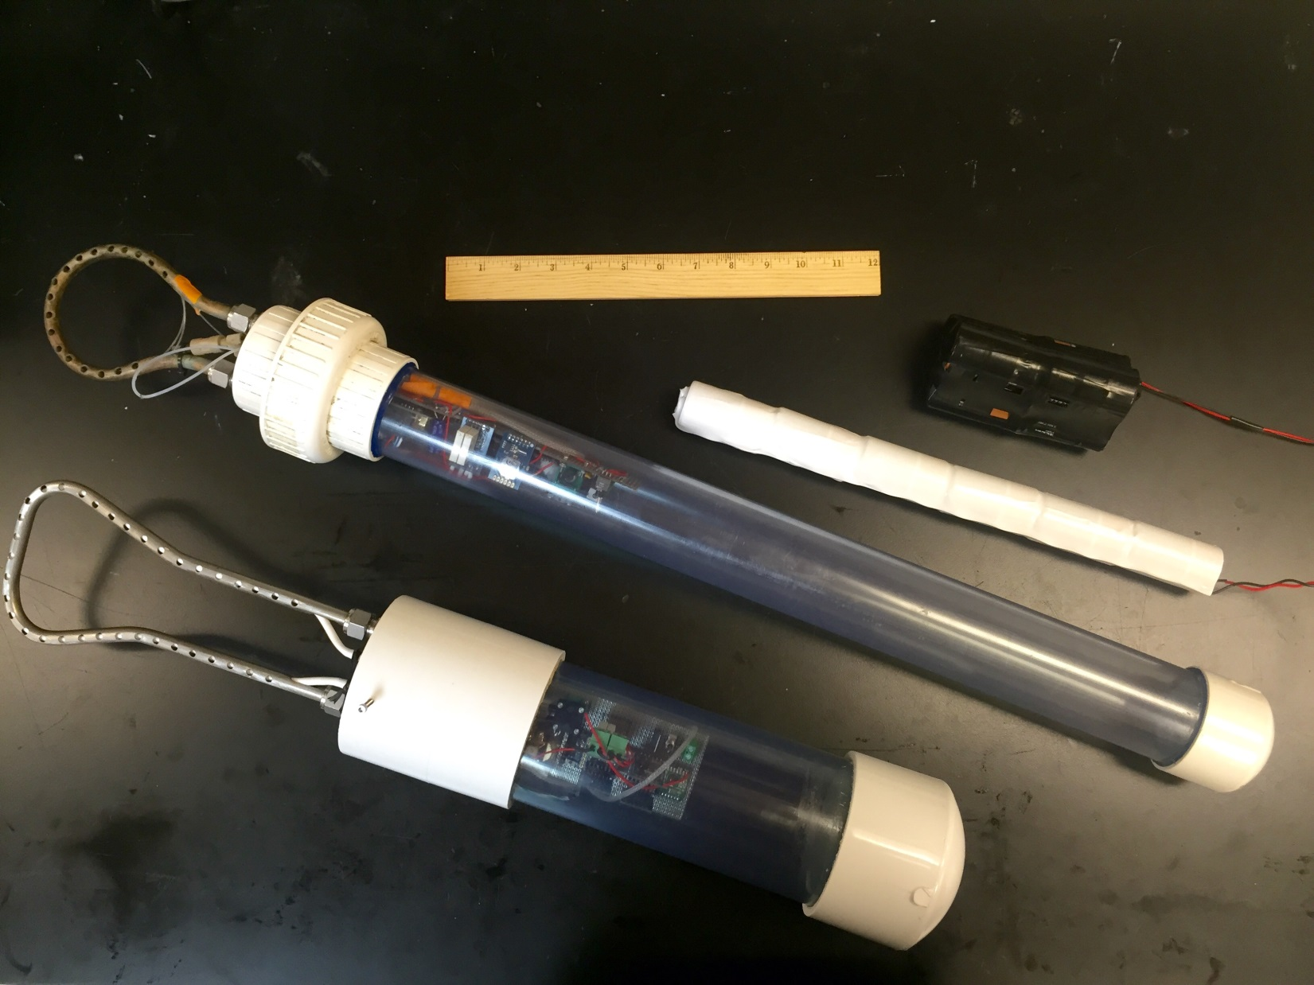
Sensor Comparison
Notes:
Improve
Short
Bat

Slide 22
Gas Flow 1.0
Tygon Tube
In
Out
Teflon AF
B
Air pump
A
Endcap
D
C
Tygon Tube
Teflon AF
Nafion Tube
CO2 Sensor
pCO₂
Notes:
New Gas

Slide 23
Gas Flow 2.0
Tygon Tube
In
Out
Teflon AF
D
B
Air pump
A
Endcap
D
C
Tygon Tube
D
Teflon AF
Nafion Tube
CO2 Sensor
Notes:
Not teflon AF

Slide 24

Gas Flow 2.0
ePTFE
Tygon Tube
In
Out
Teflon AF
D
B
Air pump
A
Endcap
D
C
Tygon Tube
D
Teflon AF
ePTFE
Nafion Tube
CO2 Sensor
Notes:
Lower cost

Slide 25
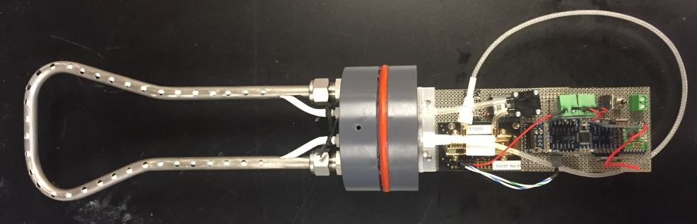
Gas Flow 2.0
ePTFE
In
Out
Teflon AF
Tygon Tube
D
Air pump
Endcap
A
CO2 Sensor
D
Teflon AF
Nafion Tube
ePTFE
Tygon Tube
Notes:
greater equilibration volume
Copper Prop
Smaller dead volume

Slide 26

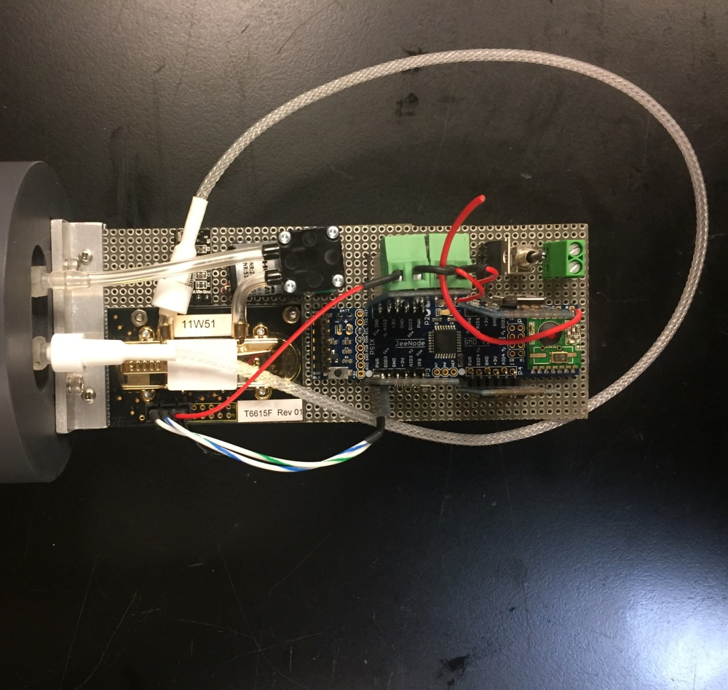
Sensor Comparison
Notes:
Less tubing
Whoo hoo

Slide 27
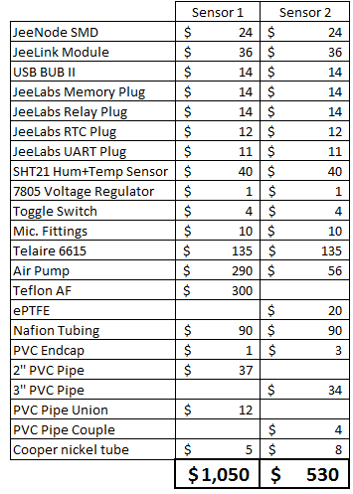
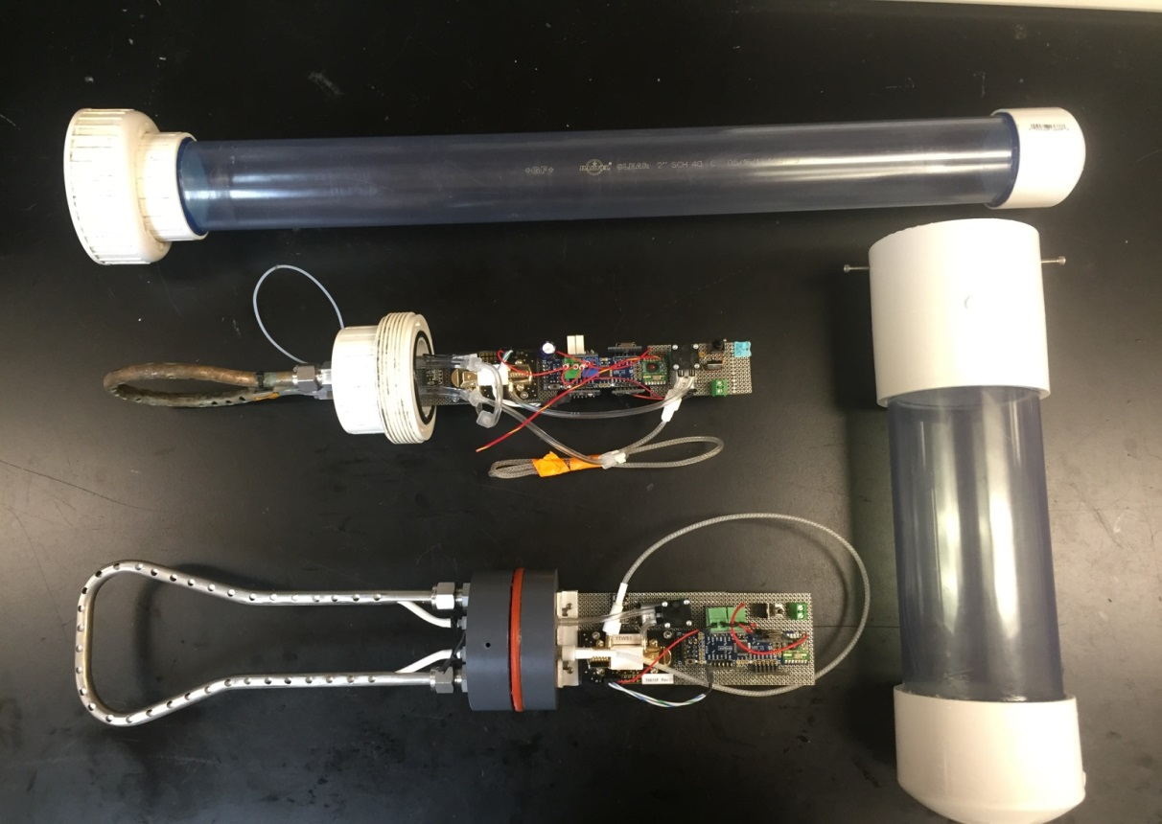
Cost Comparison
1.
2.
Notes:
College Students Important
Cost Compare
½ price

Slide 28
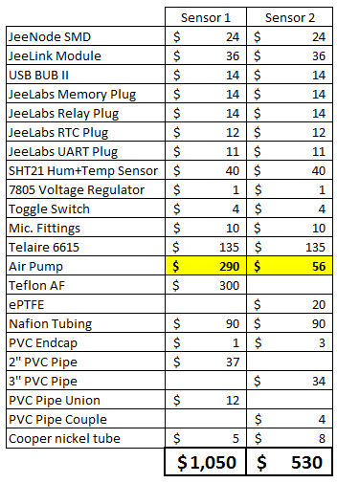
Cost Comparison
1.
2.
Notes:
Air pump

Slide 29
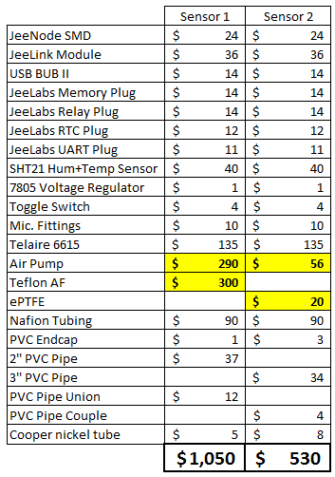
Cost Comparison
1.
2.
Notes:
Tube Type
$15,000
$50,000
Tesla vs 10 x 10 speed bikes

Slide 30
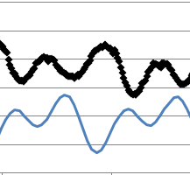

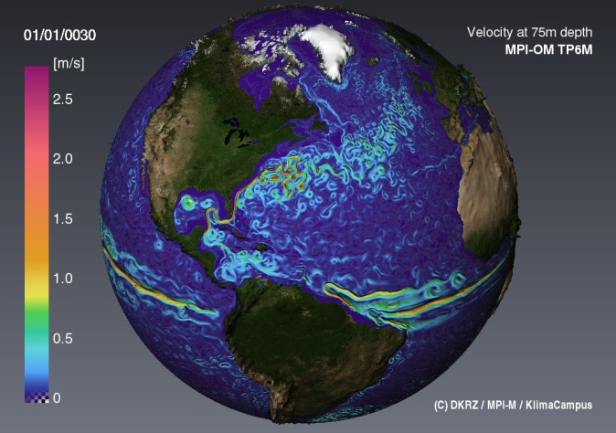
Conclusion
Able to Resolve Tidal/Diel Respiration Cycle
Possible Improve Further
Low Cost = Spatial Resolution
Notes:
Diel reparation cycle
Drift
Improve
High protive costal zones
Low cost
Spatial resolution on environmental variability

Slide 31


Future Work
Parallel Deployment
Optimize for Power
Open Source Sensor
Notes:
Debug second sensor cuircut
Parallel deplyoment
Optimize for lower power
Open sorce low cost sensor for education and rearch

Slide 32
Photo Sources
http://www.directindustry.com/prod/gardner-denver-thomas/product-
7127-447148.html
https://octopart.com/t6615-5k-general+electric-42877703
http://www.digitalsmarties.net/products/jeenode-smd
http://chapar.co/wp-content/uploads/2015/04/modern-style-coral-bleaching
-before-and-after-with-7336684680-a6f3d66c94-b.jpg
http://muftbooks.com/wp-content/uploads/2015/05/bleached-coral
-photo-0001.jpg
http://www.pmel.noaa.gov/co2/files/pmel-research.003_med.jpg
http://www.mbari.org/lobo/pictures/maps/network2.jpg
Notes:
Where all of the photos taken by people other than me can be found.
Line numbers visable 2
3
4
5
6
7
8
9
10
11
12
13
14
15
16
17
18
19
20

Slide 33


Thank You!
Ken Johnson
Hans Jannasch
Ginger Elrod
Josh Plant
Carole Sakamoto
Luke Coletti
Electronics Lab
George Matsumoto
Linda Kuhnz
Z
Miguel Uzcategui
Notes:
Multiple locations

Slide 34
Questions?

Slide 35
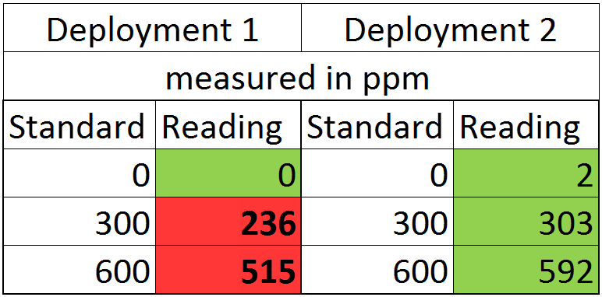
Sensor Drift
Notes:
Not so good.
Low

Slide 36
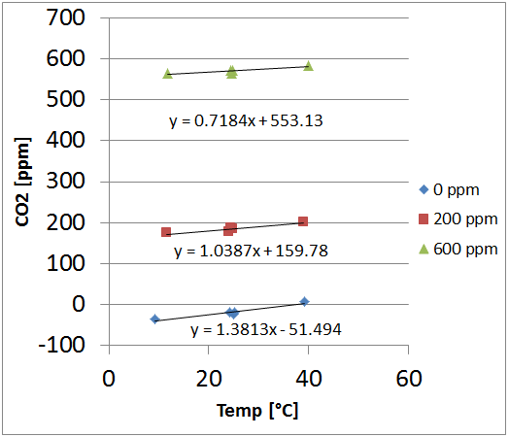
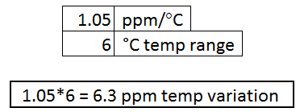
Temperature Correlation
Notes:
Experiment
We “Ken already done”
Per degree
6 ppm total

Slide 37
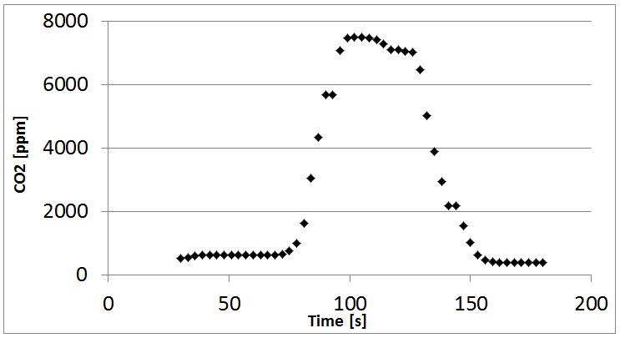
ePTFE
Notes:
CO2 Perm
Bottle
Blow
15s
35s

Slide 38
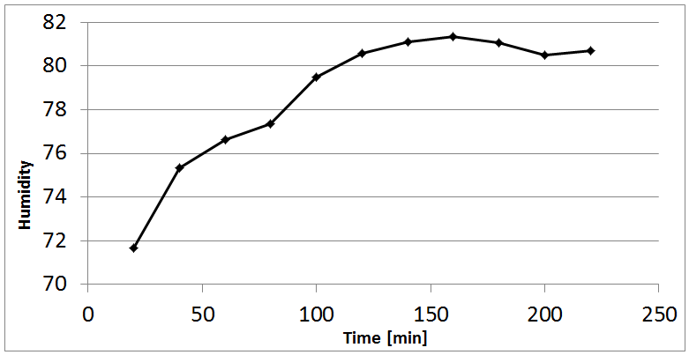
ePTFE
Notes:
Humidity increased but didn’t flood so we will say it works
Need to use desiccate and nafion

Slide 39
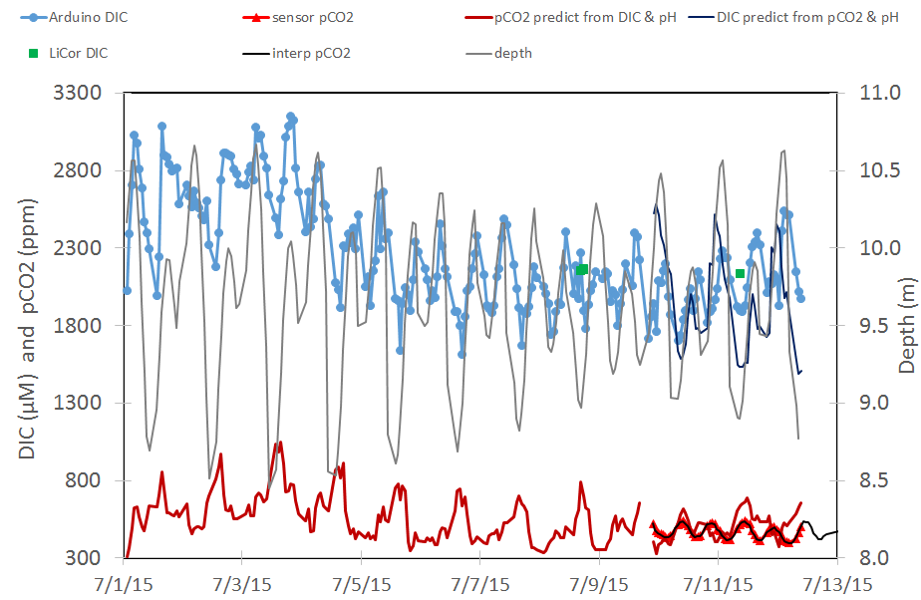
Notes:
Probably not. Too much Explaining

Slide 40
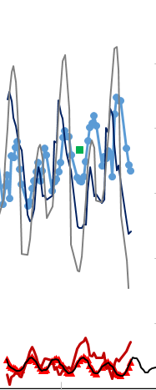


Slide 41
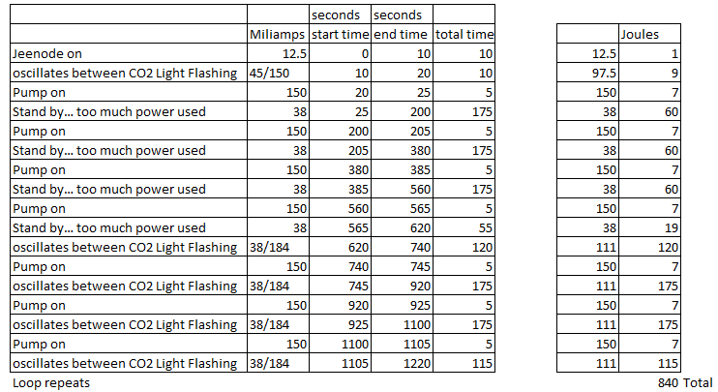
Power Budget

Slide 42
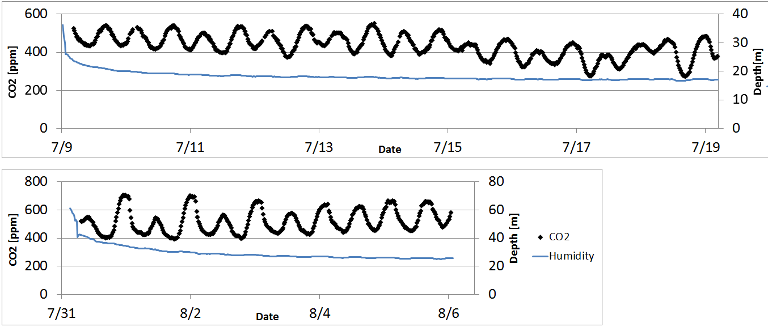
Humidity = Sensor Drift?

Slide 43
Notes for self
Notes:
Plot Humidty vs cos and in time for both depoyments
ePTFE water permi
Maybe look at OA2 pCO2 data
Mbari
Data and images
Morring data
Quick look plots
Pco2
OA2

Slide 44

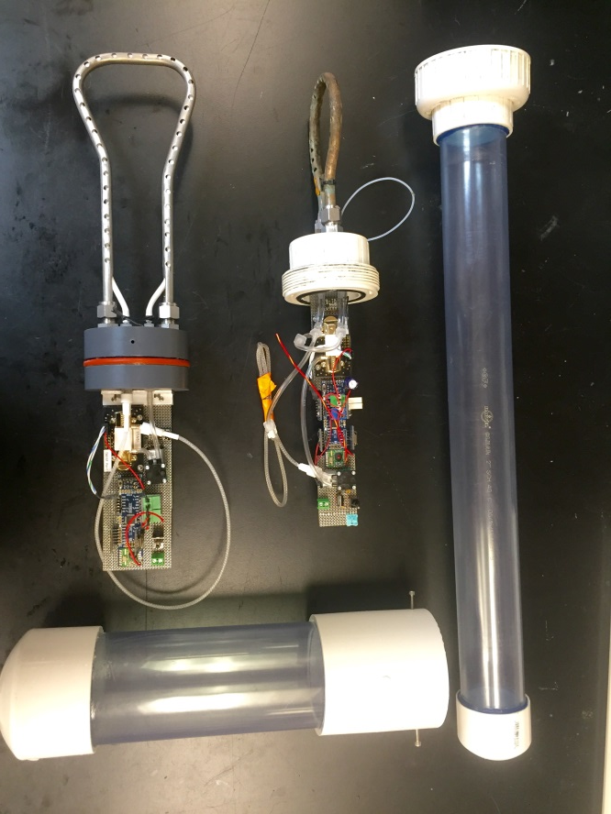
Deployments at LO1
Notes:
High Tide
Low CO2

