Slide 1
READI-Net Mechanical Update
07-19-2023

Slide 2
Agenda
Show / Discuss Subsystems
  Cylinder
  Cylinder Drive System
  Puck Actuator
  Fluidic System
  RFID
  Frame
Schedule

Slide 3
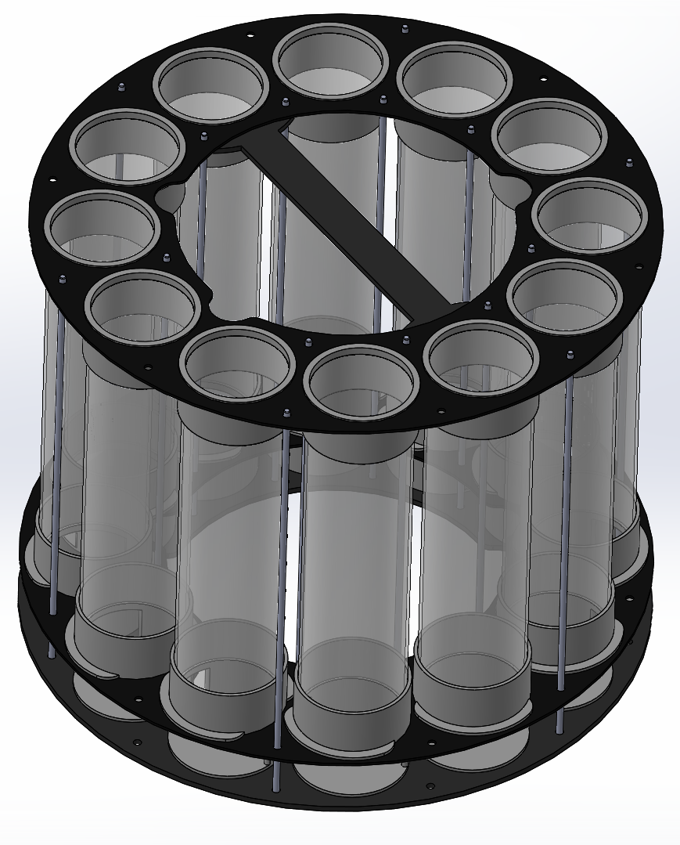
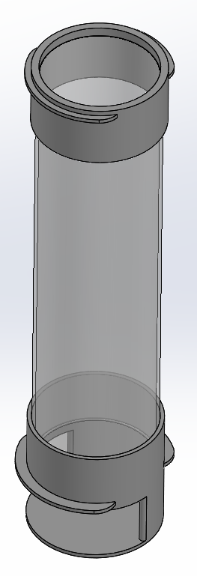
Cylinder
Requirement | Status
Hold ~150 Pucks | Satisfied – holds 144 pucks
Retain pucks during transport | Tabled – not a required for October
Primary Design Decisions:
Higher part count
  Smaller / simpler parts (better suited for printing)
  More flexible
  More complicated assembly
Threaded Rods
  Prototype assembly method
  Can glue and remove rods
Remaining Work:
Complete handle
Finalize fastening
Order parts
  MJF tube ends
  Plates
* I intend to send out all parts.
Part Count:
7 Unique Parts (excluding COTS items)

Slide 4
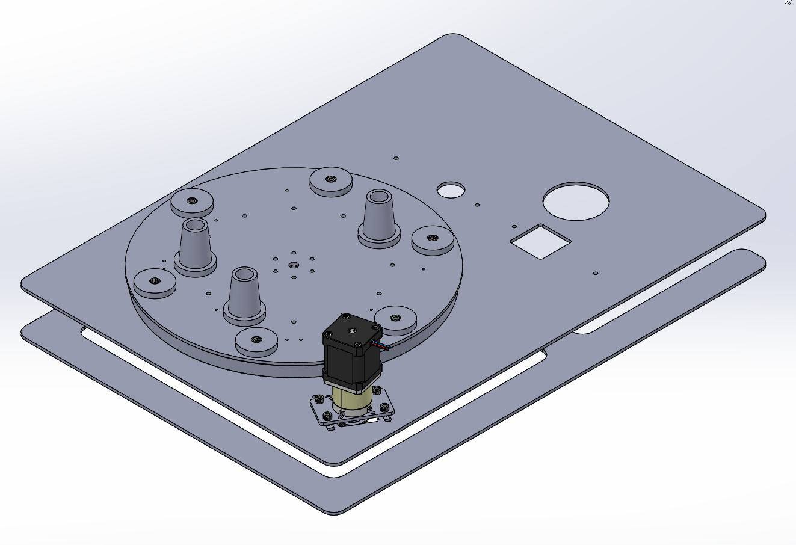
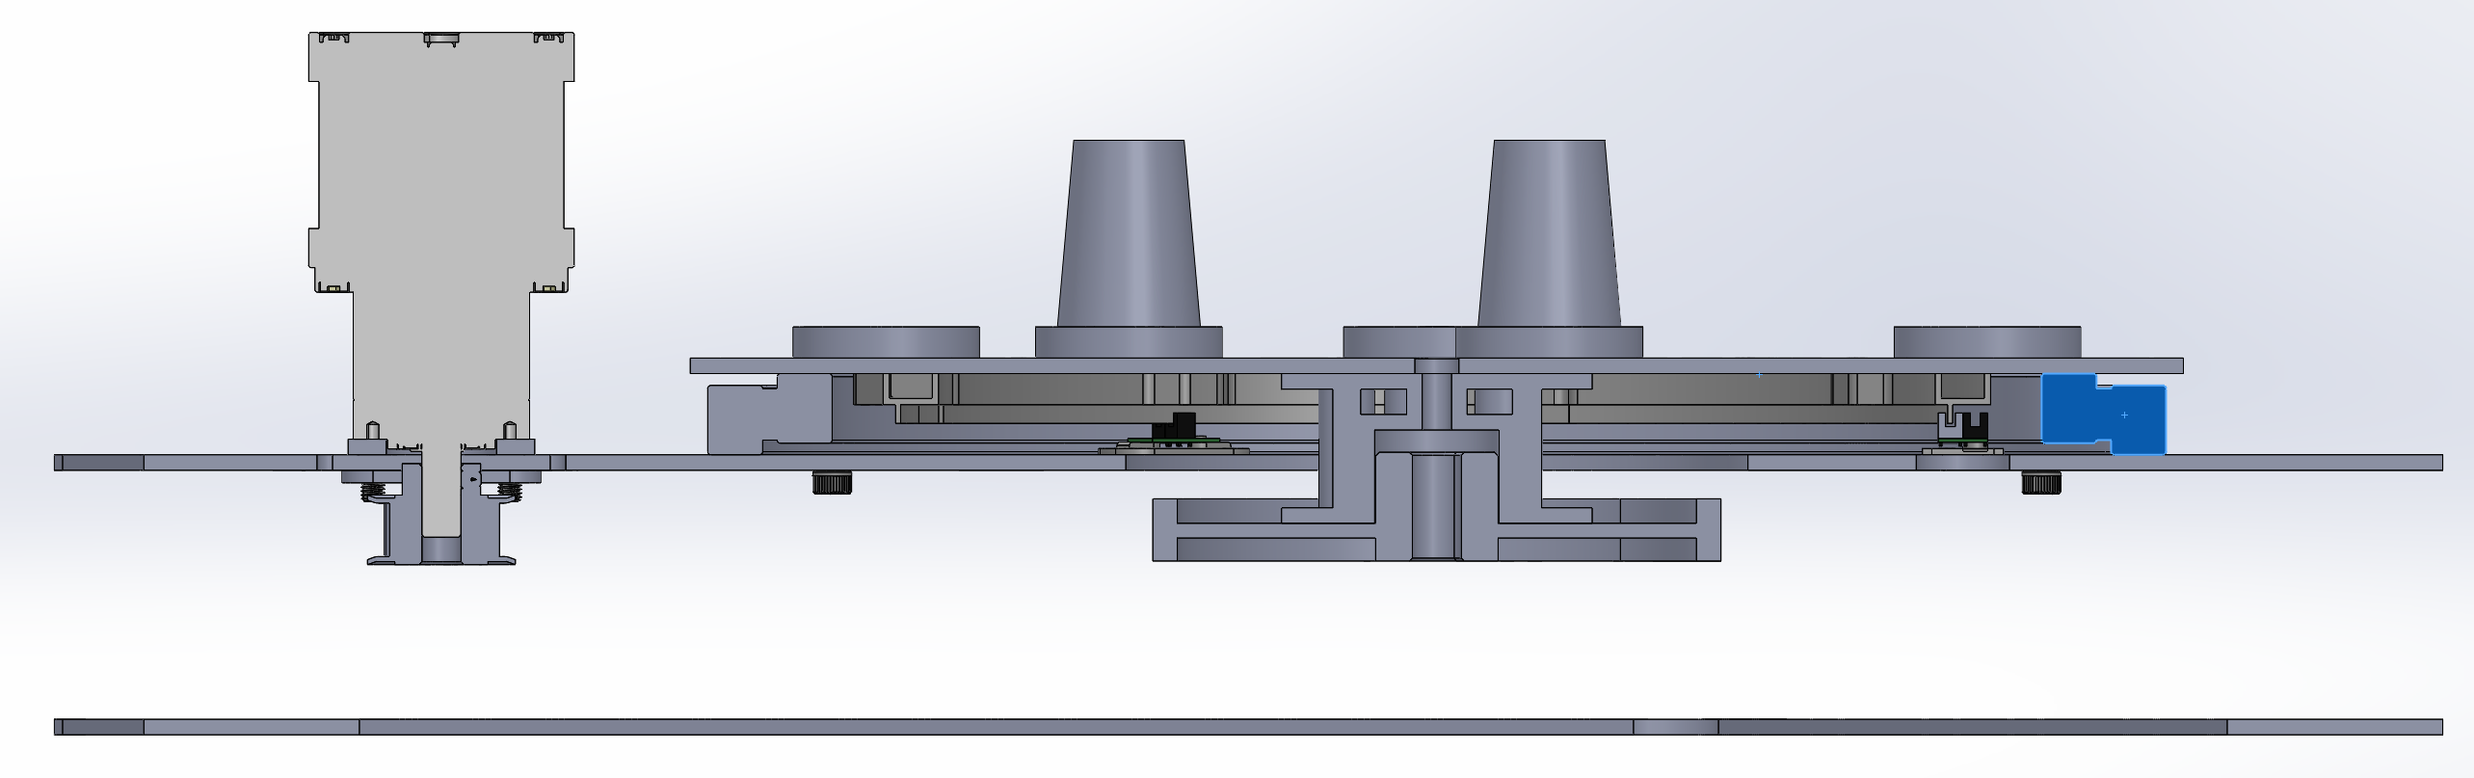
Cylinder Drive
Requirement | Status
Encoder resolves 12 positions | Satisfied
Cylinder engages in only one position | Satisfied
Primary Design Decisions:
Belt Drive
  Flexible motor positioning
Simple tensioning system
  Cantilevered pulleys
Combine with frame
  Less parts
  Less flexible
Remaining Work:
Finalize layout & fastening of top / bottom plates
Drawings (Plates, Pulley)
Order parts
  MJF encoder fins
  MJF encoder mounts
  Sprocket Spacer
  Plates (cut here)
  Cylinder Alignment Parts (print here)
Part Count:
12 Unique Parts (excluding COTS items)

Slide 5
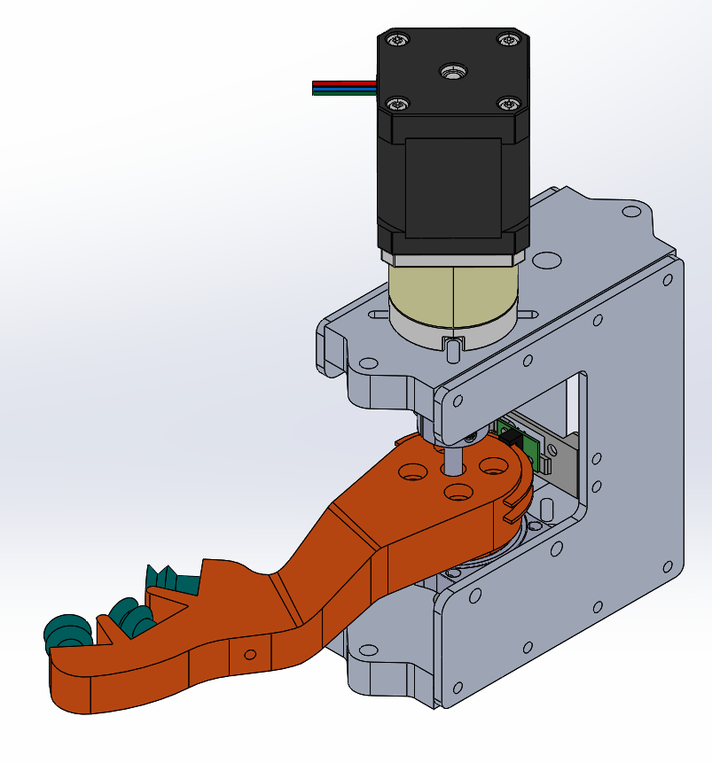
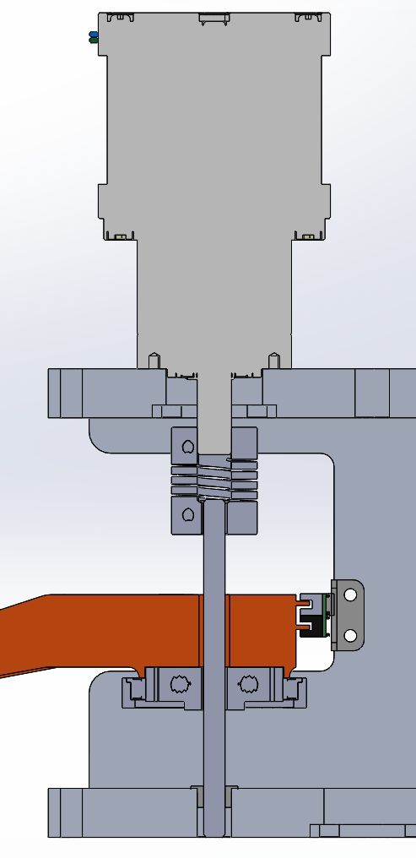
Puck Actuator
Requirement | Status
Removes Puck from storage | Satisfied *need to check at 10,000ft
Moves puck to fluidics | Satisfied
Deposit puck into collection | Satisfied
Primary Design Decisions:
Direct Drive
  Geared Motor
  Simplified drive arrangement
  Coupling needed
Cantilevered Arm
  Allows direct reuse of clamp frame
Single Encoder PCB
Remaining Work:
Finalize fastening
Finalize arm vacuum feature
Add mounting for additional components.
Drawings (Plates)
Order parts
  SLA Arm
  MJF encoder mounts
  Plates (cut / machine here)
Part Count:
5 Unique Parts (excluding COTS items)
*Shares frame with clamp

Slide 6
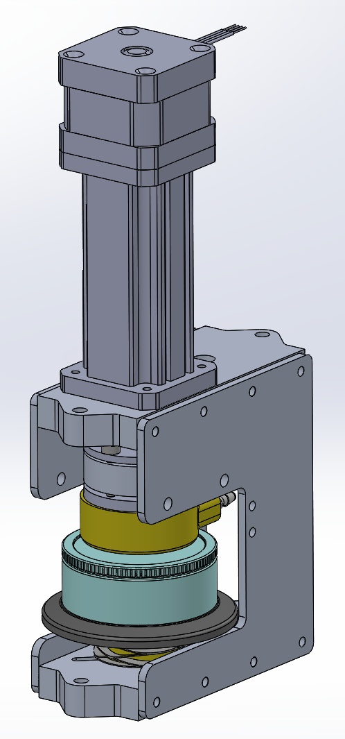
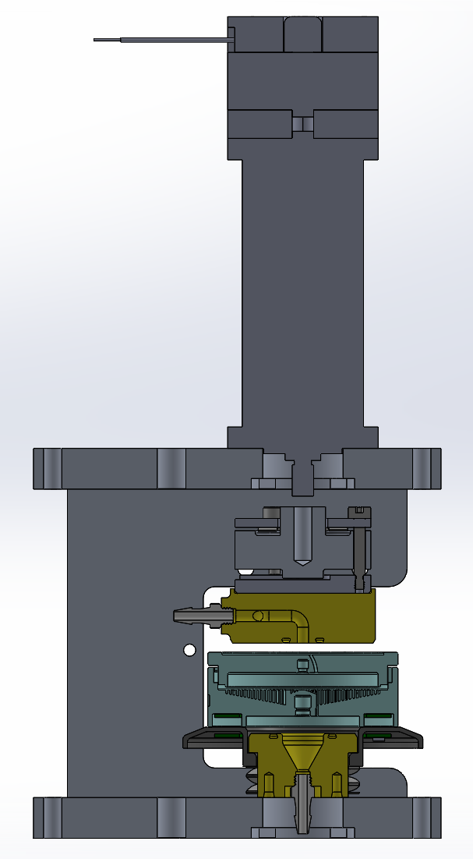
Fluidic System
Requirement | Status
Pump sample through pucks | Satisfied
Pump preservative through pucks | Satisfied
Flush / purge system | Satisfied
Primary Design Decisions:
Linear actuator w/ guidance and anti-rotation
  Taller package
  Simpler mechanical layout
Assembled frame
  More parts
  Far easier to fabricate
Remaining Work:
Finalize fastening
Finalize manifold path & seals
Finalize platen
Add mounting for additional components.
Drawings (Plates)
Order parts
  SLA fluidic parts
  Plates (cut / machine here)
Part Count:
9 Unique Parts (excluding COTS items)
*Shares frame with vacuum arm

Slide 7
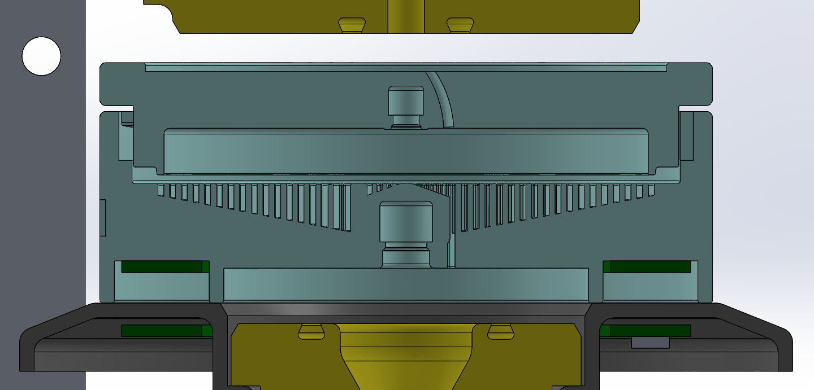
RFID
Status:
Modified puck to house PCB RFID antenna.
Printing test coupons to check performance antenna performance with surrounding material.
Potting compound Loctite EA E60NC
Antenna spacing ~.2”

Slide 8
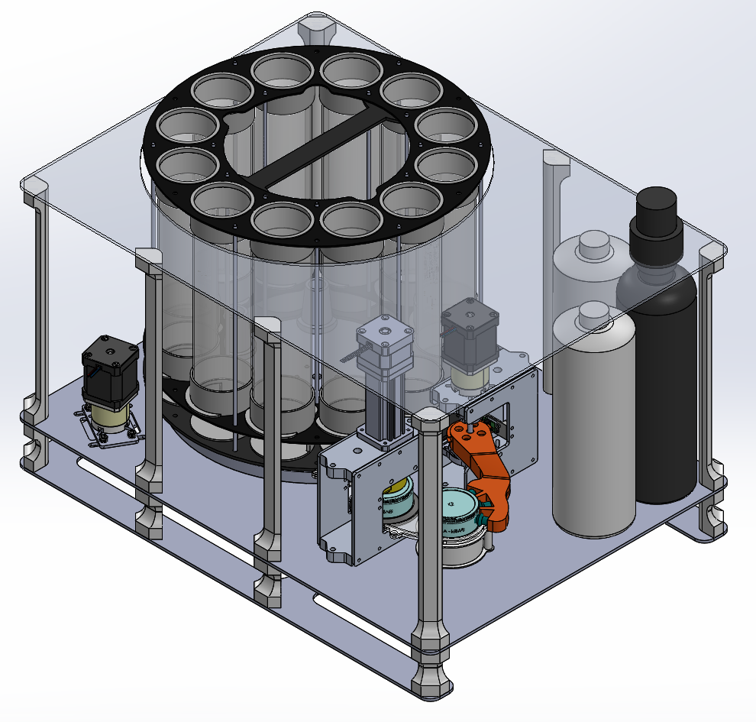
Frame
Status:
Spent smallest amount of time on frame / packaging.
Roughly this is what it might look like.
Not pictured:
  Feature to retain the cylinder from the top.
  Features to guide cylinder into instrument.
Instrument fits in: https://www.casecruzer.com/shipping-carrying-cases/kr2317-14/index.html
Spent pucks need more space

Slide 9
Schedule
Entering into detail design.
On track to submit drawings / complete ordering by 08-14.
Discussed machined parts with Roman & Mark. They do not see any issues with the timeline.
Targeting start of build / test 09-14

