Slide 1
FIDO: A new type of autonomous sampling instrument for ‘omics studies
Jim Birch
Monterey Bay Aquarium Research Institute (MBARI)
2025 AquaEcomics
Evian-les-Bains, France
Mar 17-20, 2025

Slide 2
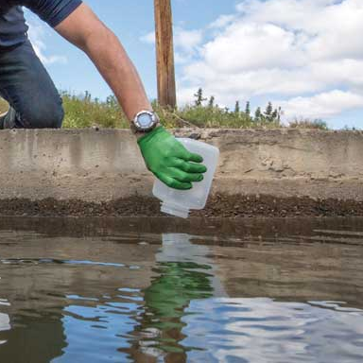
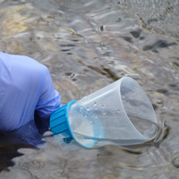
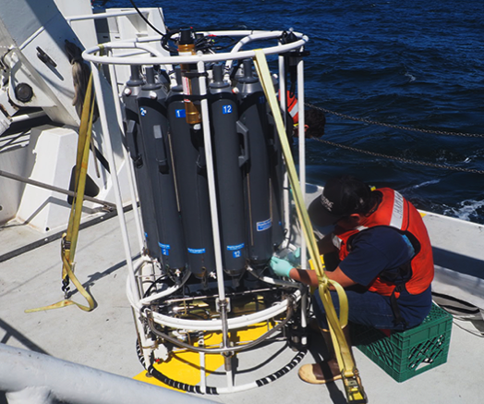
eDNA analyses start with sample collection
In the quest for answers, this is boring…

Slide 3
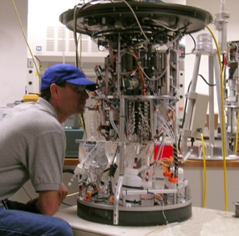
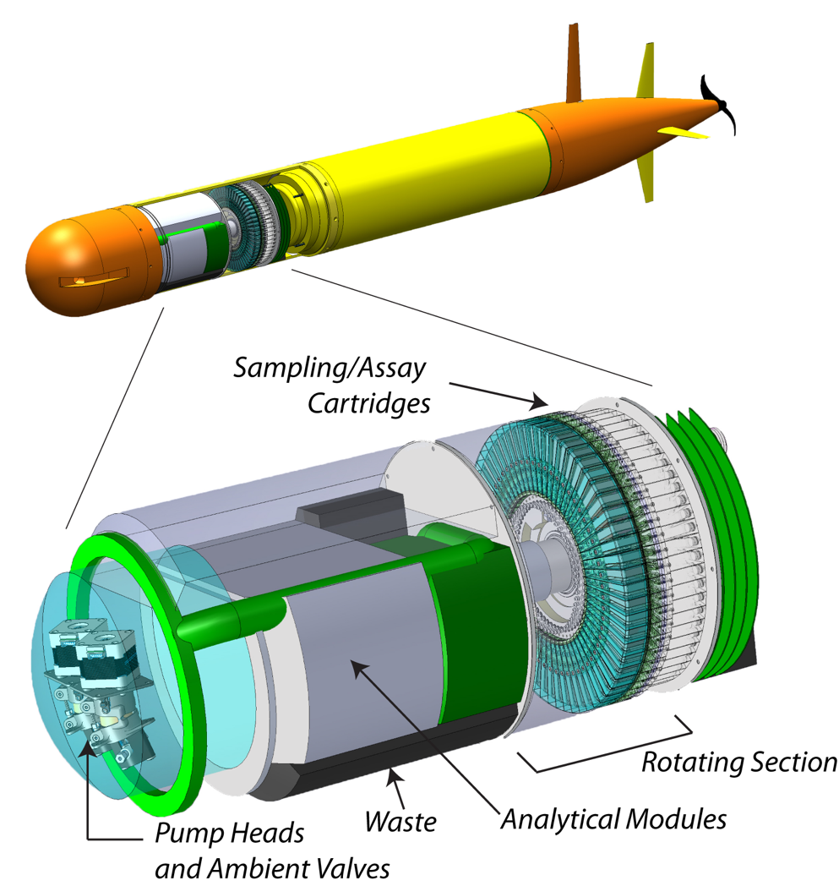
2G ESP (TRL 9)
Reaction Chamber = PUCK
Environmental Sample Processor
2nd Generation ESP
3rd Generation ESP
Specific design requirements:
Submerged or Autonomous Vehicle Deployments with in situ analysis
Notes:
For almost 3 decades our team has been developing the ESP or environmental sample processor. Starting with the 2G ESP on the left and 3G ESP on the right. I am happy to discuss these instruments with folks, but I really want to hone in on their design requirements
Both of these instruments were designed with the idea providing in situ analytical capabilities. Where we are no longer returning samples back to the lab but instead sending back data. Moreover, functional these instruments were designed for submerged deployments in the ocean either on stationary moorings, in the case of the 2G ESP or mobile deployments on 3G ESP using AUV.
These are very specific requirements that enable us to ask and solve different scientific research questions.

Slide 4








Sampling robots have enabled robust science
Ottesen, E.A., et al. Metatranscriptomic analysis of autonomously collected and preserved marine bacterioplankton. 2011. ISME Journal 5: 1881-1895
Saito, M.A., et al. Examination of microbial proteome preservation techniques applicable to autonomous environmental sample collection. 2011. Frontiers in Aquatic Microbiology. 2: 215.
Nowinski, B., et al. Microdiversity and temporal dynamics of marine bacterial dimethylsulfoniopropionate genes. 2019. Environmental Microbiology 21(5): 1687-1701.
Yamahara, K., et al. In situ autonomous acquisition and preservation of marine environmental DNA using an autonomous underwater vehicle. 2019. Frontiers in Marine Science. 6:373.
Den Uyl, P., et al. Lake Erie field trials to advance autonomous monitoring of cyanobacterial harmful algal blooms. 2022. Frontiers in Marine Science. 9:1021952.
Sepulveda, A.J., et al. Robotic environmental DNA bio-surveillance of freshwater health. 2020. Scientific Reports 10:14389.
Zhang, Y., et al. A system of coordinated autonomous robots for Lagrangian studies of microbes in the oceanic deep chlorophyll maximum. 2021. Science Robotics 6: eabb9138.
Truelove, N.K., et al. Expanding the temporal and spatial scales of environmental DNA research with autonomous sampling. 2022. Environmental DNA. 4: 972-984.
Preston, C., et al. Autonomous eDNA collection using an uncrewed surface vessel over a 4200-km transect of the eastern Pacific Ocean. 2023. Environmental DNA, 6, e468.
Zhang, Y., et al. Using a long-range autonomous underwater vehicle to find and sample harmful algal blooms in Lake Erie. 2024. Lim. & Ocean, Methods. Science. 9:1021952.

Slide 5
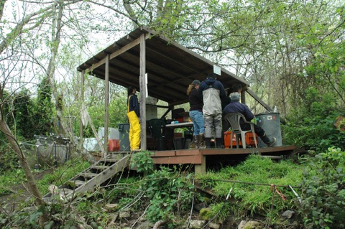
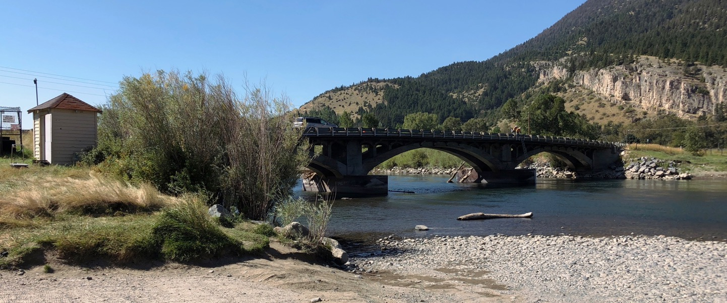
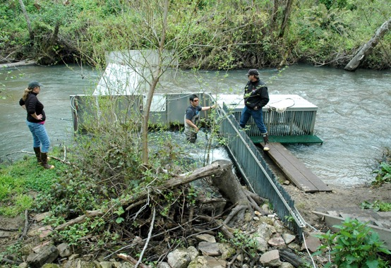
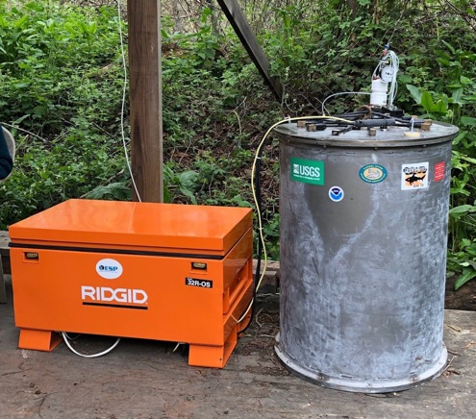
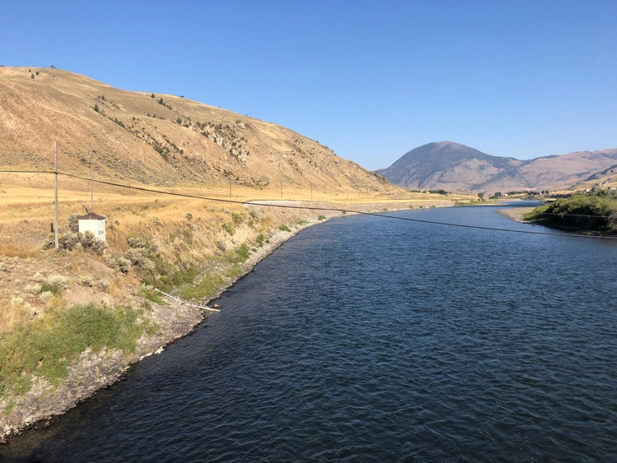
High Frequency or Long Term sampling
USGS -- repeated deployments in 2018, 2019, 2021, 2022
NOAA -- Scott Creek
Carter’s Bridge (Yellowstone R.)
Scott Creek (Santa Cruz)
Corwin Springs (Yellowstone R.)

Slide 6
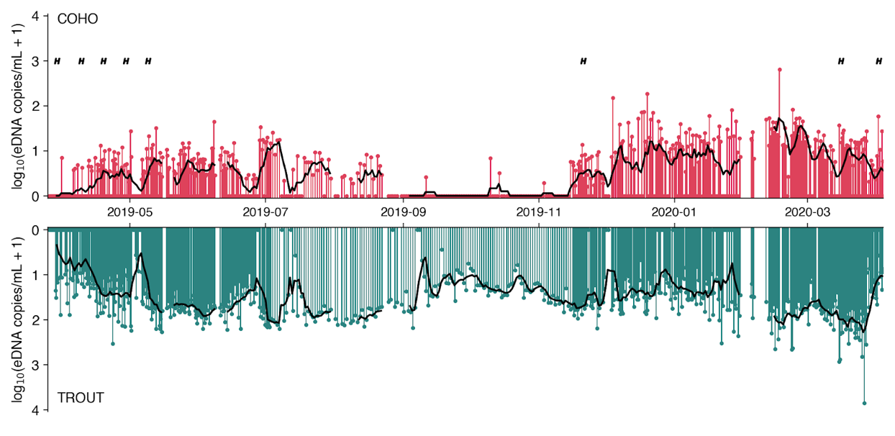
Scott Creek Salmonid eDNA concentrations
Mar 2019
May
July
Sep
Nov
Jan 2020
Mar
Searcy et al., Environmental DNA, 2022
(DOI: 10.1002/edn3.293)
Notes:
H are when they did hatchery releases…..
377 days of deployment
Took from 1-3 samples a day
Conclusions for Scott Creek:
High-resolution continuous sampling can yield long-term datasets that reflect temporal changes in ecosystems
eDNA sampling detected salmonids in Scott Creek significantly more often than fish traps
eDNA concentrations were patchy at high frequencies and aligned with the species' ecology on seasonal time scales.

Slide 7
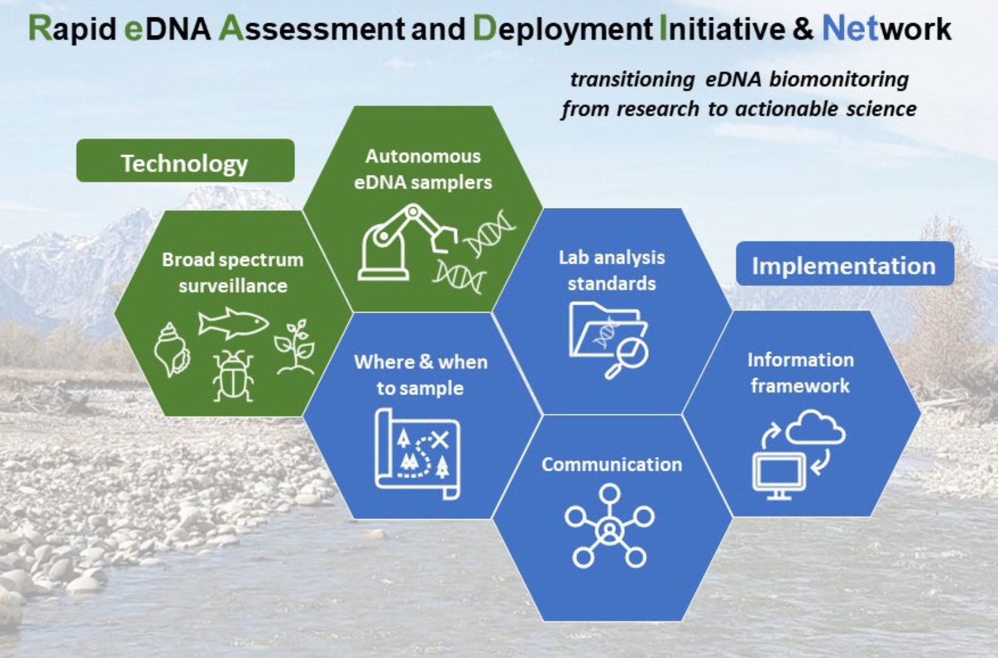
READI-Net
Courtesy of Adam Sepulveda - USGS

Slide 8
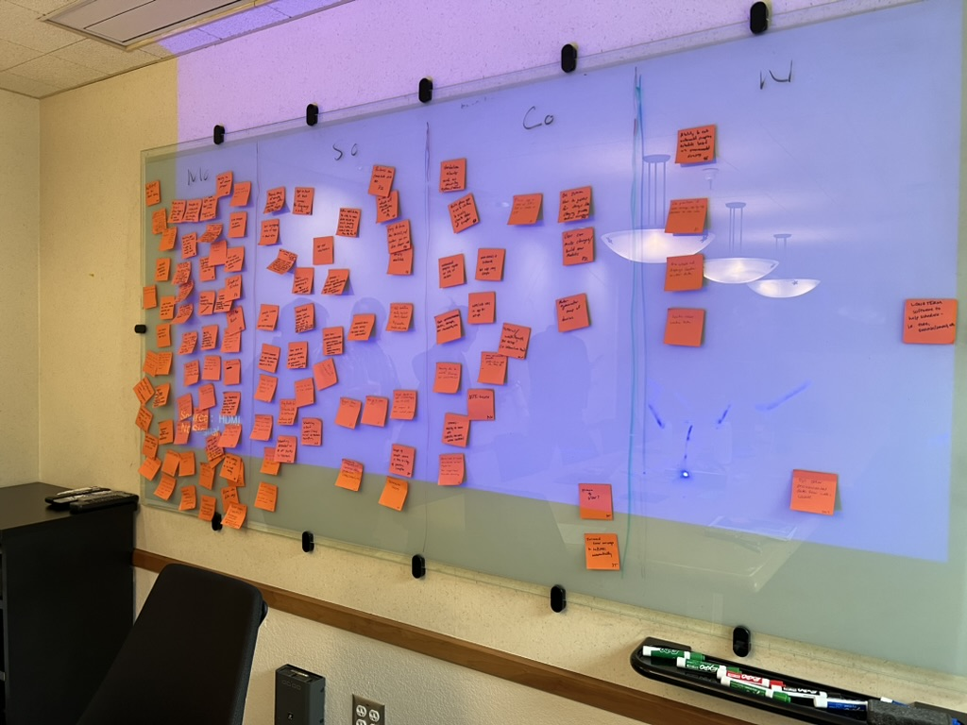
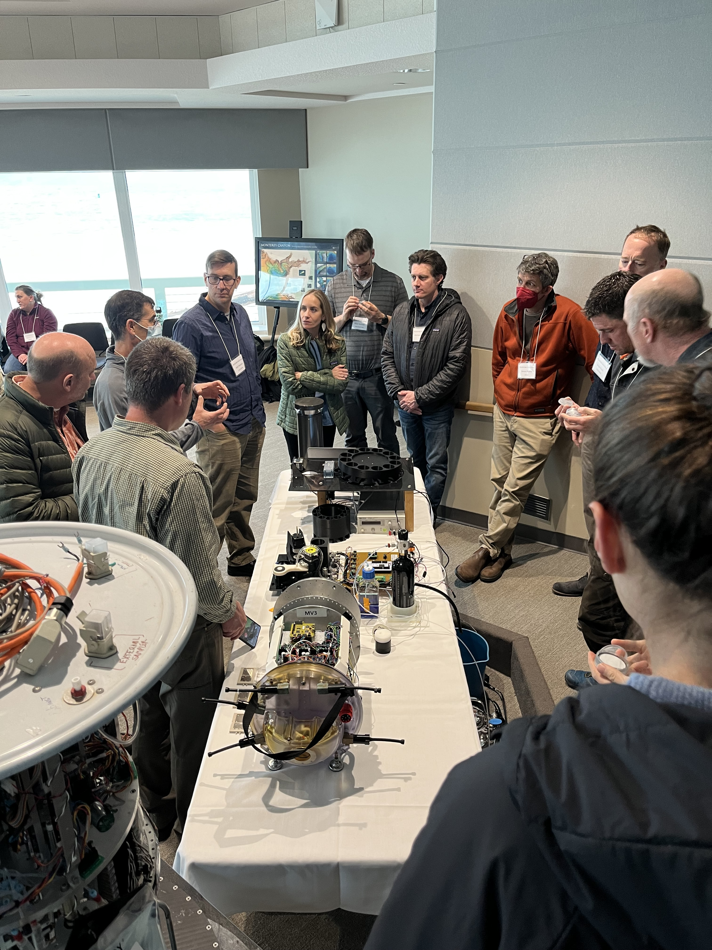
READI-Net
READI-Net Kickoff meeting – March 1-2, 2023
Must have, Should have, Could have or Won’t have Prioritization
Notes:
We utilized members of the READI-net program to co-design the instrument. We were invited members to prioritize instrument functions and capabilities through a MoSCoW priotization framework. Here we asked readi-net researchers to prioritize instrument functions that were Must Haves, Should Have, Could Haves or Wont Haves. We generated thousands of sticky notes that were distilled down into the functional requirement of the instrument design.

Slide 9
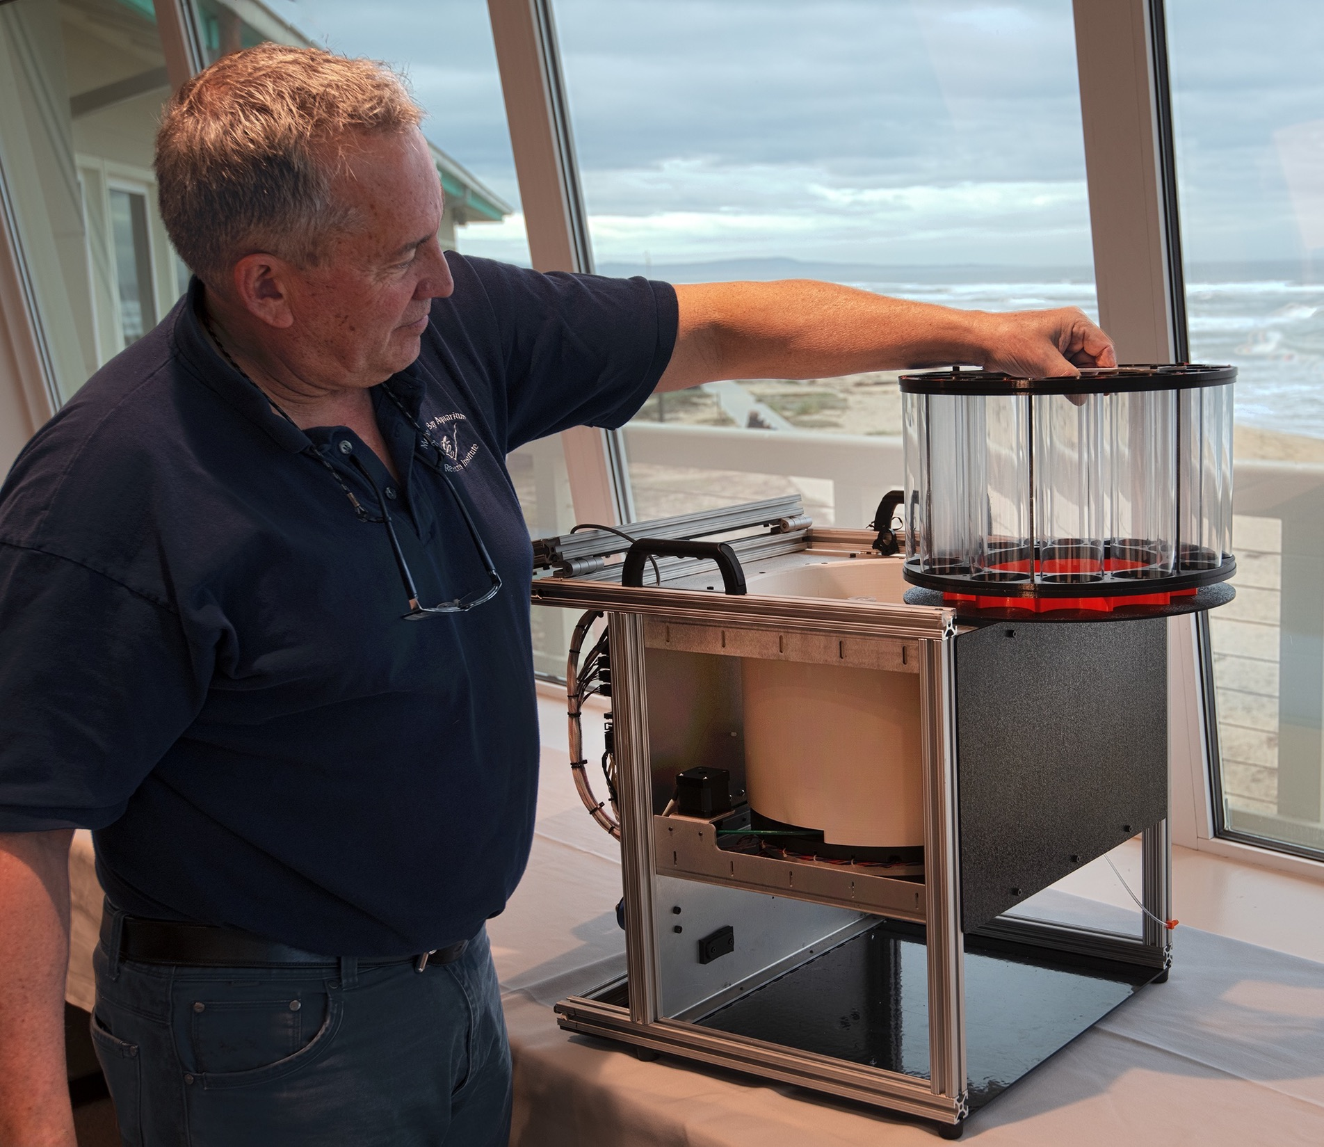
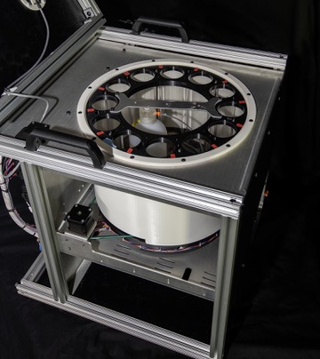
FIDO: Filtering Instrument for DNA Observations
144 samples – 47mm Membranes
Liquid preservation & decontamination
Remote Command & Control GUI
  Wifi, Cellular and Satellite
Sample metadata encoding
Simple servicing and replenishment
…simple, simplicity, simpleness, straightforward…

Slide 10




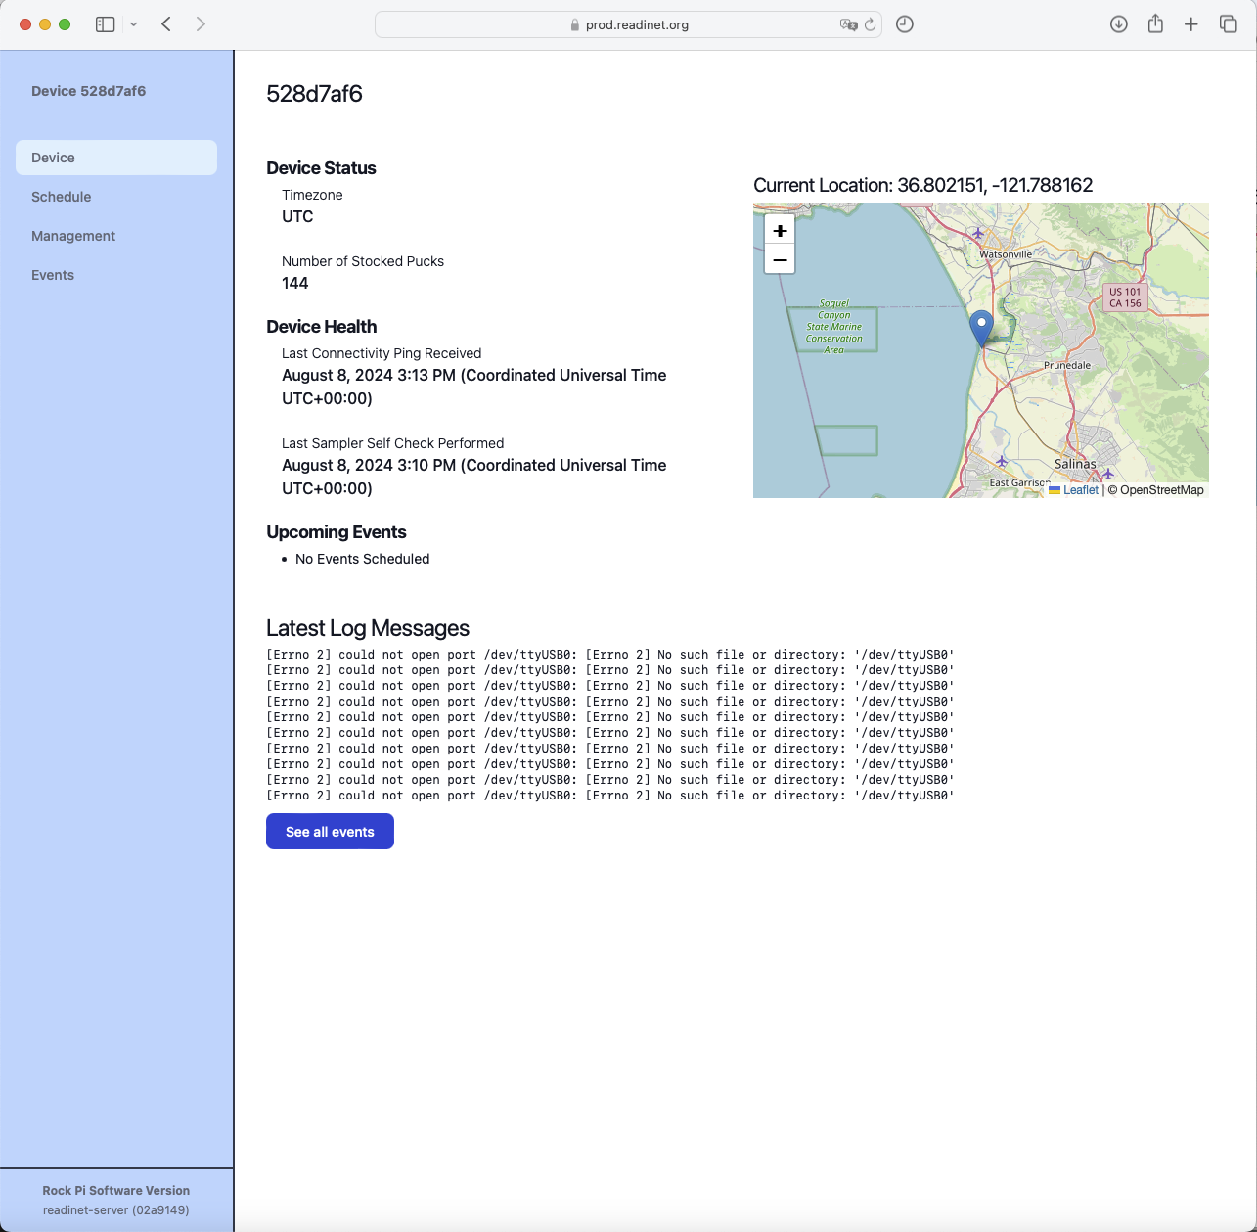

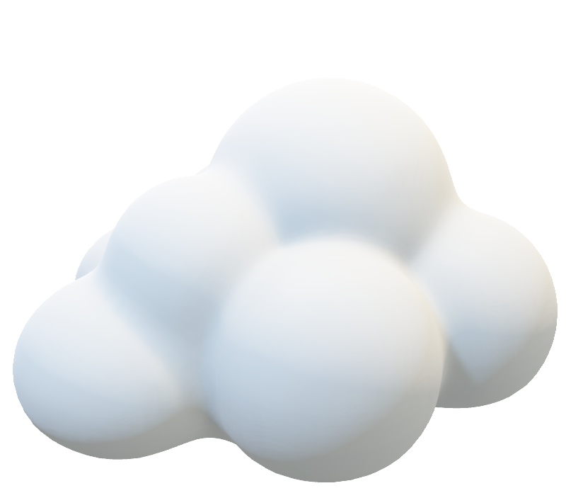
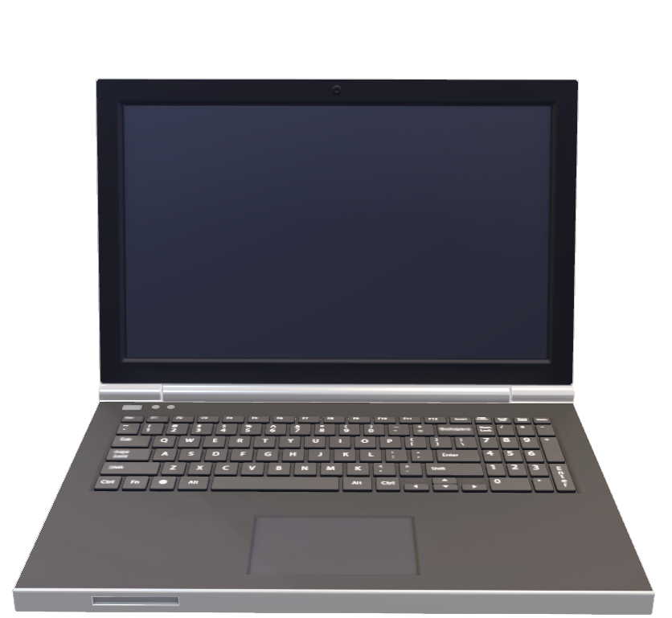
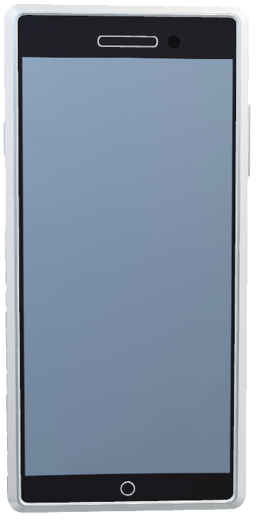

FIDO: internet control
or
Amazon Web Service (AWS)
Linux Host Computer
Bluetooth or hardwire
Notes:
We also utilized the MOSCOW framework to develop the communication and GUI requirements. And these are the end products based around web-based application interface using a cloud instance and satellite or cellular communications we can access and control these instruments anywhere in the world.
And on the left is summary page of the instrumentation provide a bit of instrument state, its location, and any important log information.

Slide 11
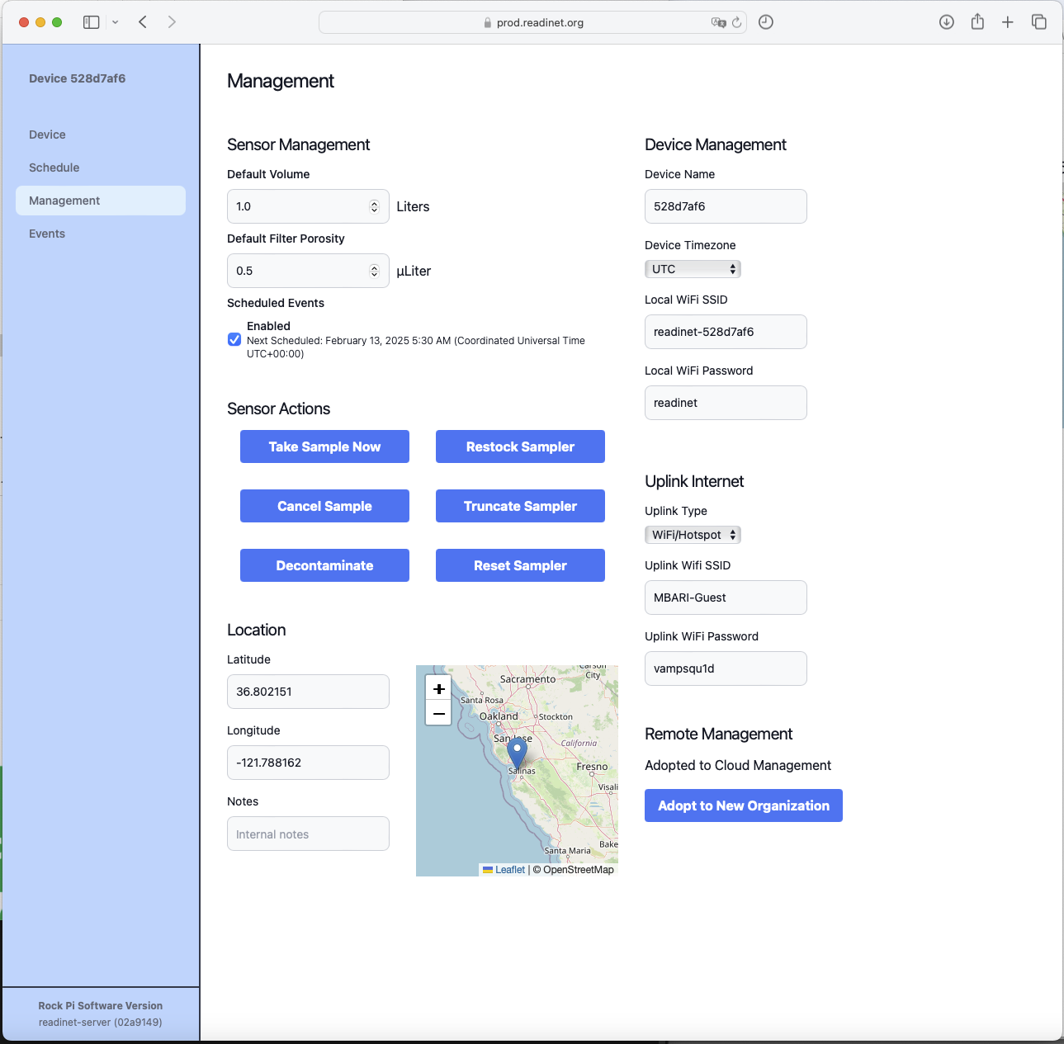
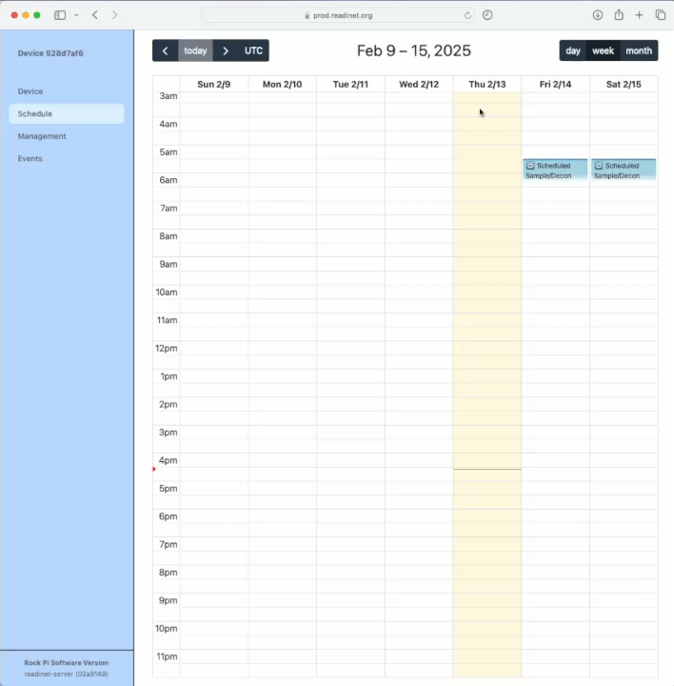
FIDO: GUI Control
Notes:
Here are two additional screenshots of the GUI, on the left is the management page and the left is the schedule page. The management page allows us to directly interact with the instrument and provides end-users the ability to take a sample, define sample volumes, resupply the sampler and decontaminate the samples. We spent a bunch of time on the GUI scheduler, using a google calendar approach for being able to simply schedule sampling for future events. And this video is showing those functions of scheduling recurring events.

Slide 12
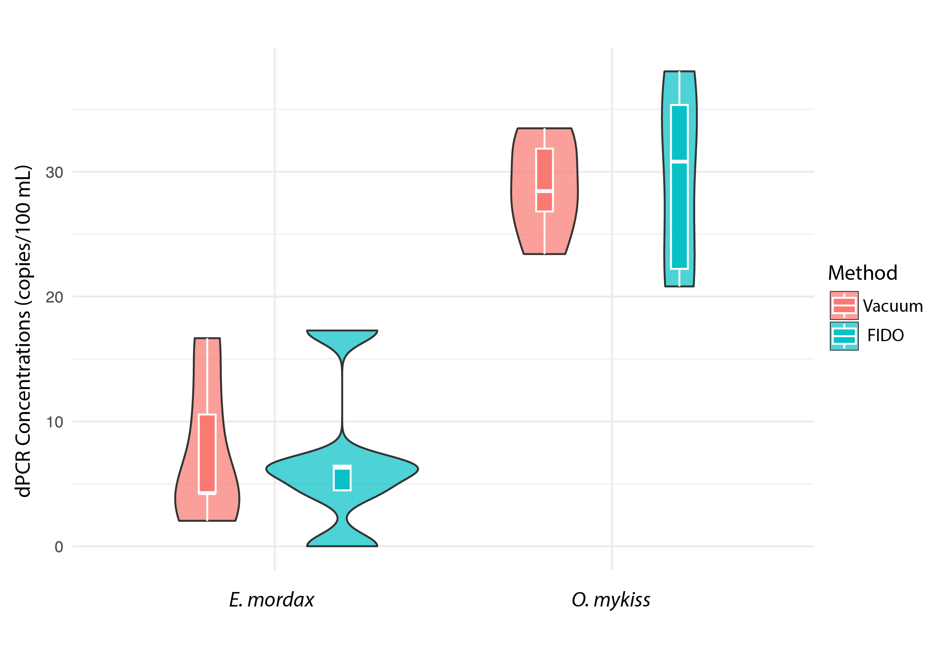
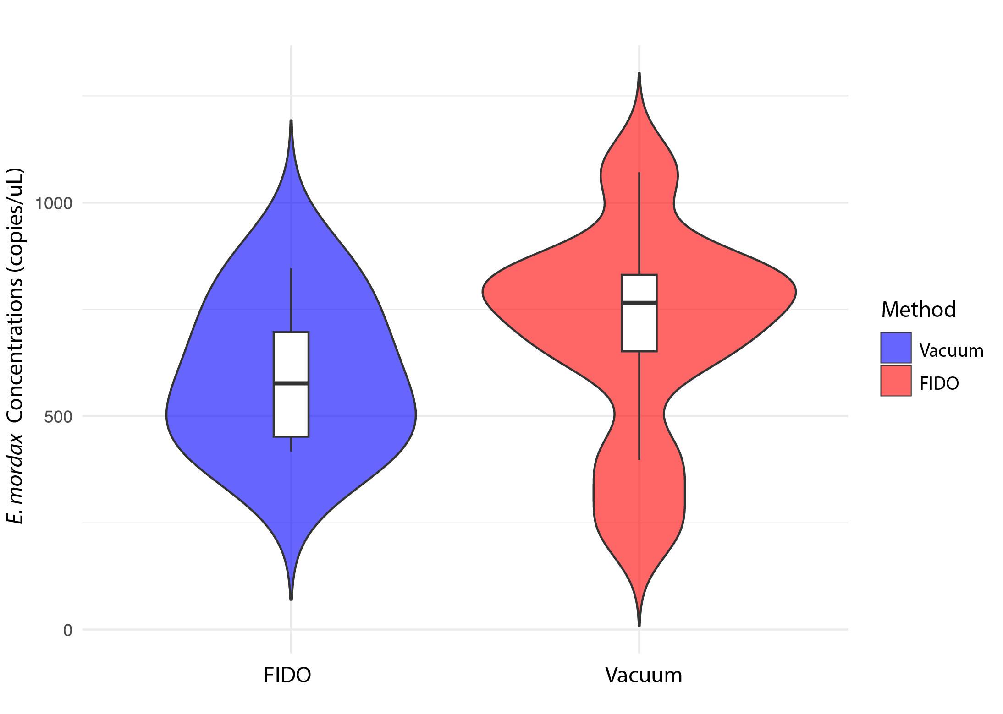
FIDO dPCR and qPCR Validations
dPCR Anchovy and Rainbow Trout
qPCR Anchovy
Notes:
So now onto the data.
Here I am showing some initial digital PCR data for validation filtration of anchovy and rainbow trout. The red violins are the matched vacuum filtration method and the green violin are the FIDO filtrations. dPCR concentration of the target eDNA on the y-axis. This experiment was performed after we had finalized the filtration housing or puck design.
More recently, as part of a larger instrumentation validation study in November. We performed a similar study using qPCR for anchovies, where the vacuum filtration, is now shown in blue and FIDO is show in red.
For all of these comparisons, there was no significant difference between vacuum filtration and FIDO filtrations.

Slide 13
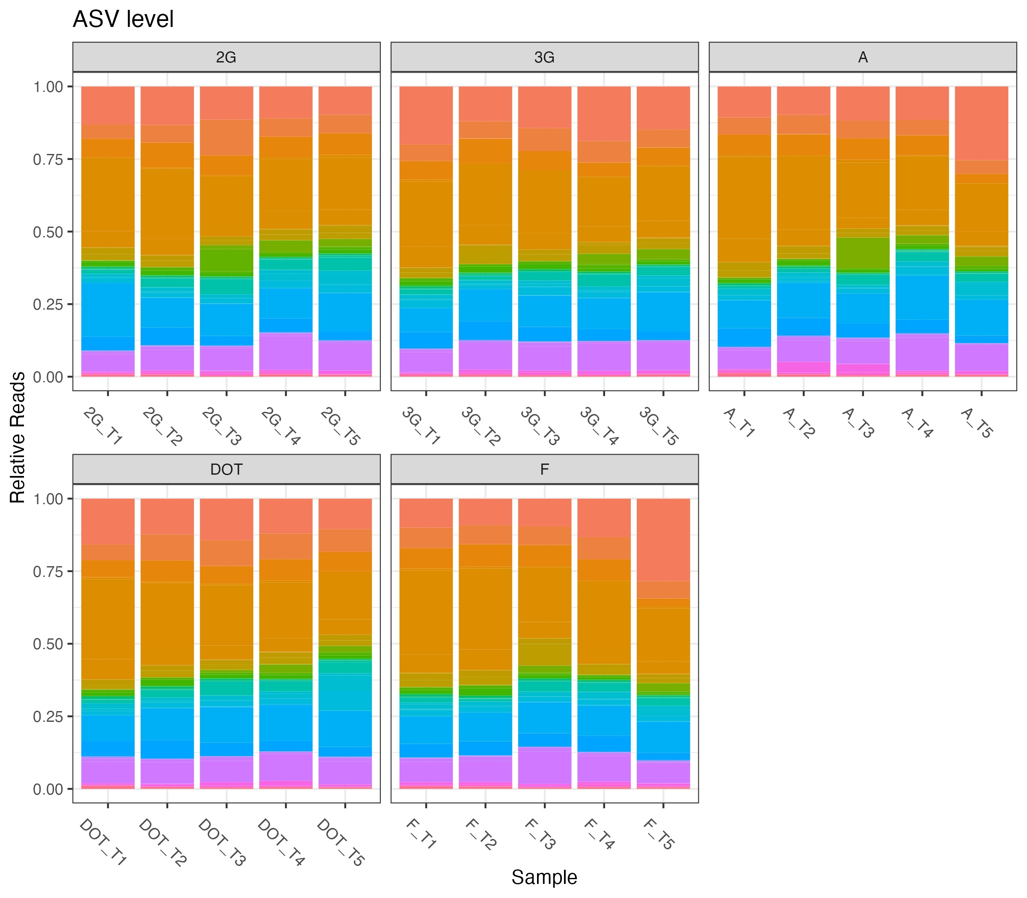
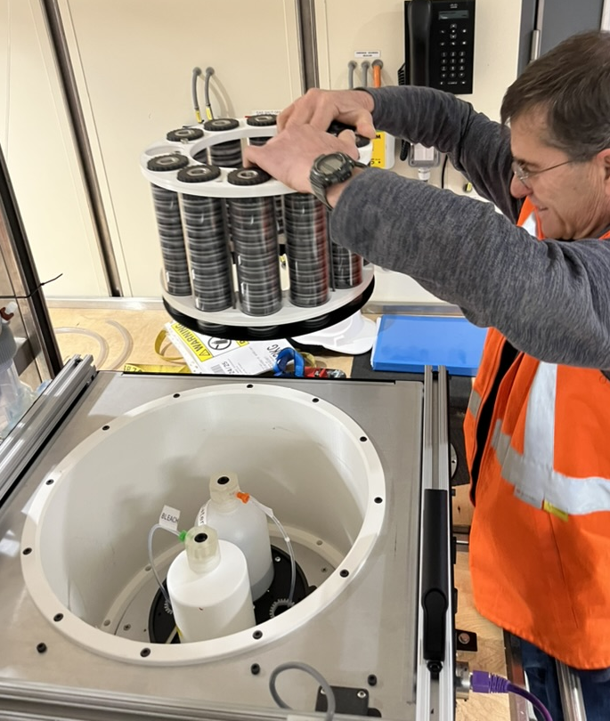
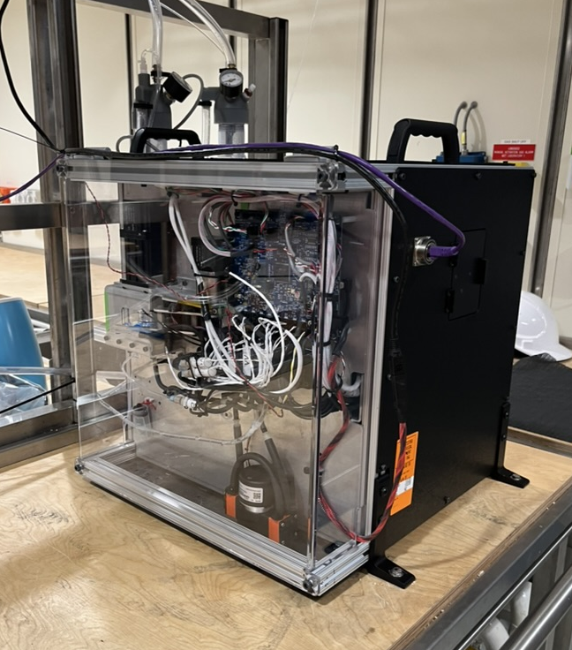
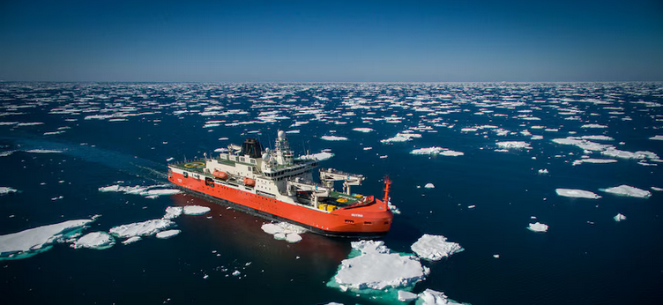
Next Steps
ASV Level – 12S MiFish
Validation is continuing
  qPCR and metabarcoding
READi-net Implementation in 2025
  10 production units are currently being built
  Looking to license to commercial vendor
Relative Reads
Courtesy of Eily Allan
Integration on-board research vessels
Notes:
So what are the next steps.
As part of a larger instrumentation validation study, we will continue validation of FIDO filtrations with 12S Mifish Metabarcoding and here is the metabarcoding data that we received last week and plotted yesterday by Elizabeth Allen at the eDNA Collaborative.
We are currently building 10 production instruments for the READI-net program that will be field test this year.
And we are currently investigating the installation of these instruments on research vessels to sample underway water during research cruises. In fact, a few members of our team are in Hobart outfitting the Nuryia for their upcoming anartica cruise.

Slide 14
Take-home message
Use-cases should drive the instrument design.
  There is no single BEST instrument for all use-cases.
  Applications should be matched to appropriate instrumentation
Validation is important!!
  Proper validation builds confidence in data and reduces operational risks
Large number of samples=good, but ‘kicks the can down the road’
  Ideally, in situ processing alleviates laboratory bottleneck.

Slide 15
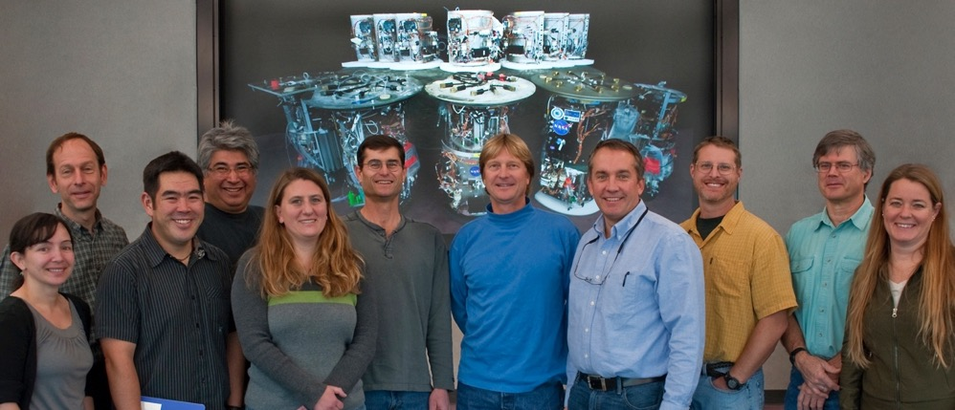
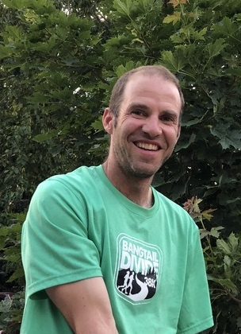


Acknowledgements
Adam Sepulveda

