Slide 1
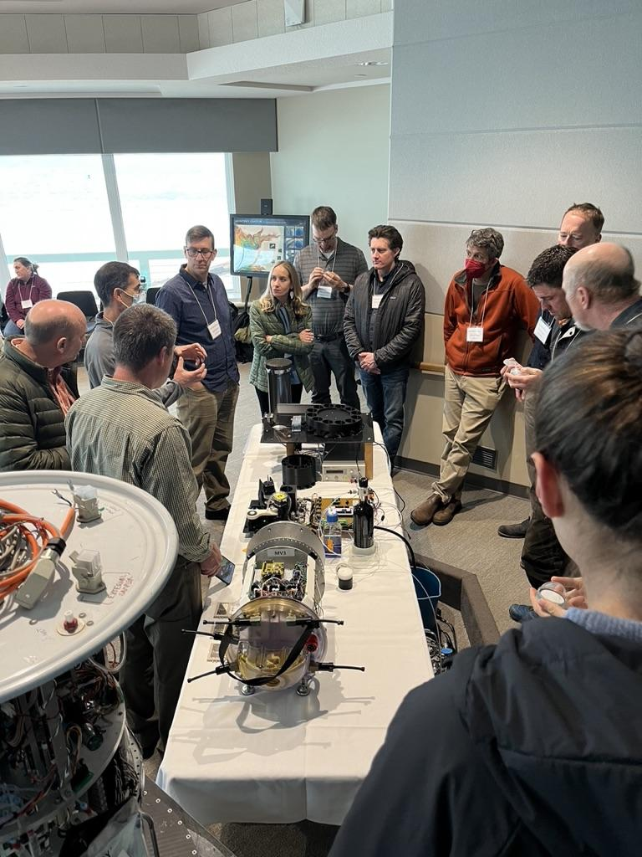
READI-Net Instrumentation Update
Jim Birch
Kevan Yamahara
December 9, 2024
Feb 28, 2023

Slide 2
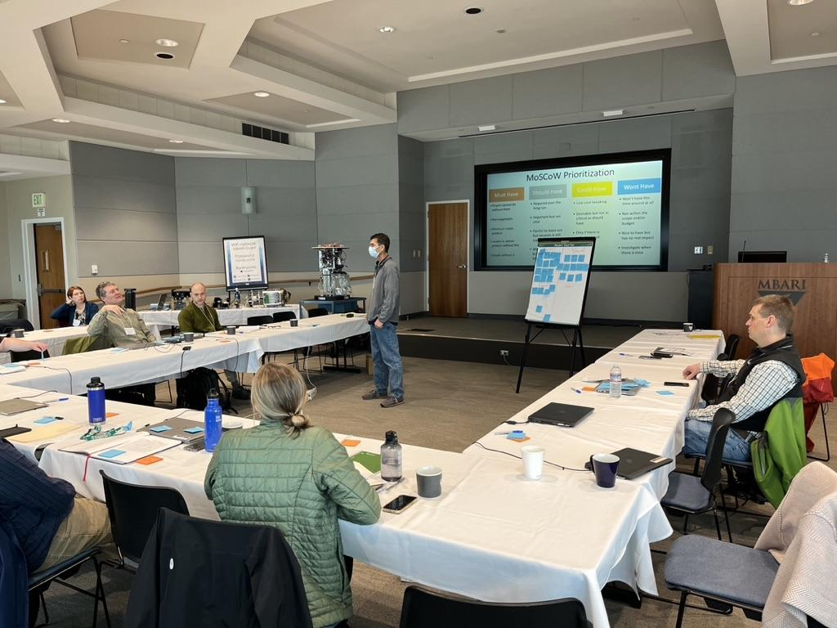
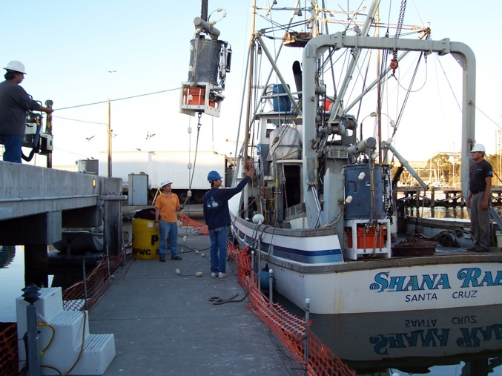
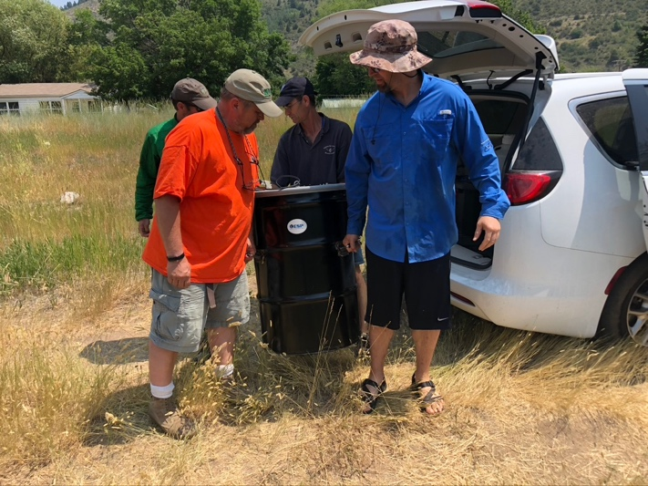
Lessons learned from various experiences
Every user/deployment has different requirements
  Design for the average
At February, 2023 MBARI meeting, you helped define MOSCOW groupings:
    MUST have’s
    Should have’s
    Could have’s
    Won’t have
Notes:
Lessons learned from field demonstrations
Good demonstration, but difficult to deploy….

Slide 3
MoSCoW
Must have
  Required for product to have expected outcome; minimum viable product
Hardware
Components of ESP associated with collecting, filtering and preserving water samples.
e.g., size, weight, sample capacity
Should have
  Requirements that will improve product, but product can work without them
Could have
Software
  Requirements that are desirable
Programs used to communicate between the user and the hardware
e.g., web-based vs app-based, calendar vs spreadsheet
Won’t have now
Removal order
  Requirements which will not be included this time, but will be considered for future iterations

Slide 4
Balancing the “Haves” (Must, Could, Should, Won’t)
Ensuring alignment with objectives, timelines, and resource availability
Prevent overcommitment by limiting "Could Haves" and "Should Haves”
  Prioritizing Input/Output Interfaces and Modularity – flexibility for future updates
Define "Won’t Haves" to safeguard core deliverables
  Adversely impact impact size, cost or significant development time

Slide 5
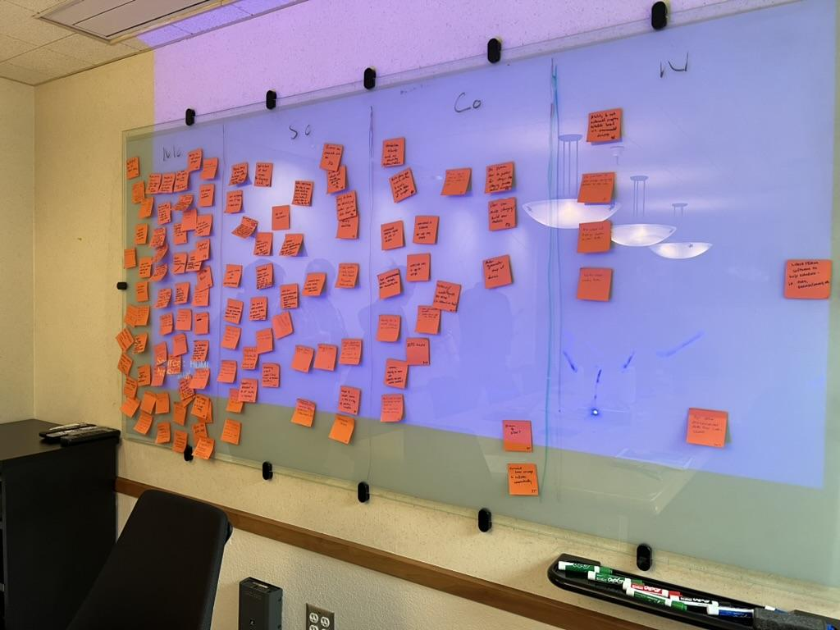
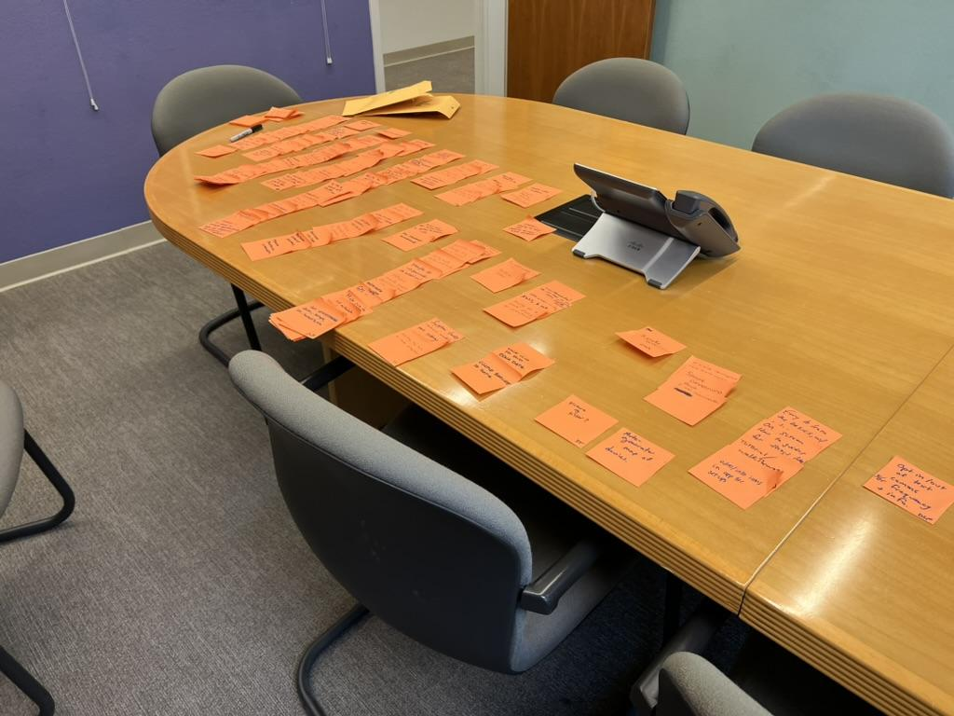
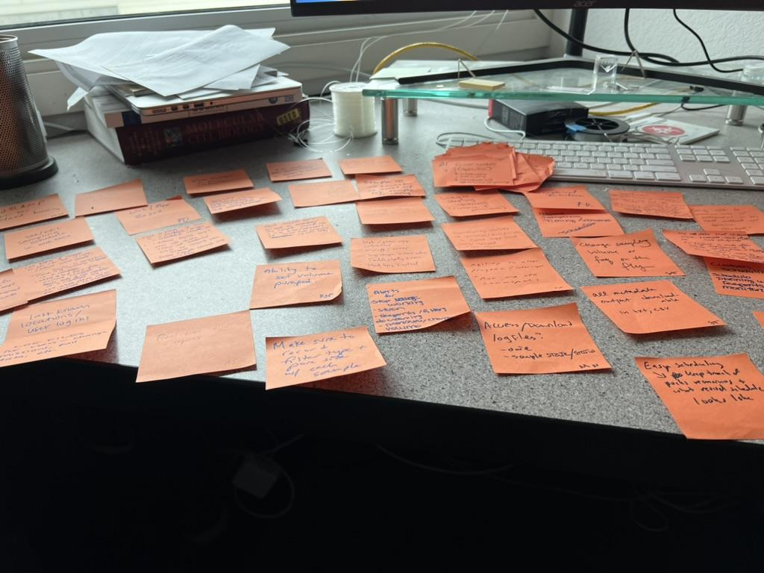
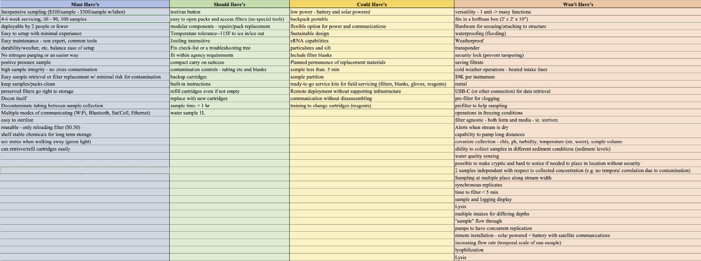
MoSCoW Exercise

Slide 6
Focus Design Requirements
  Hardware
    Inexpensive (< $30K)
    100 samples
    Deployable by 2 people (max)
    Simple setup and maintenance
    Decontamination of system
    Multiple communication options (e.g., WIFI, Bluetooth, Cellular, Satellite)
    Maximize sample volume (1L)
  Software/UI/UX
    Simple Web-based GUI
    Sample-specific data logging (volume, date-time stamp, flowrate)
    Two-way communication
    Manual and Schedule-Based Sampling
    Instrument State (Current State)

Slide 7
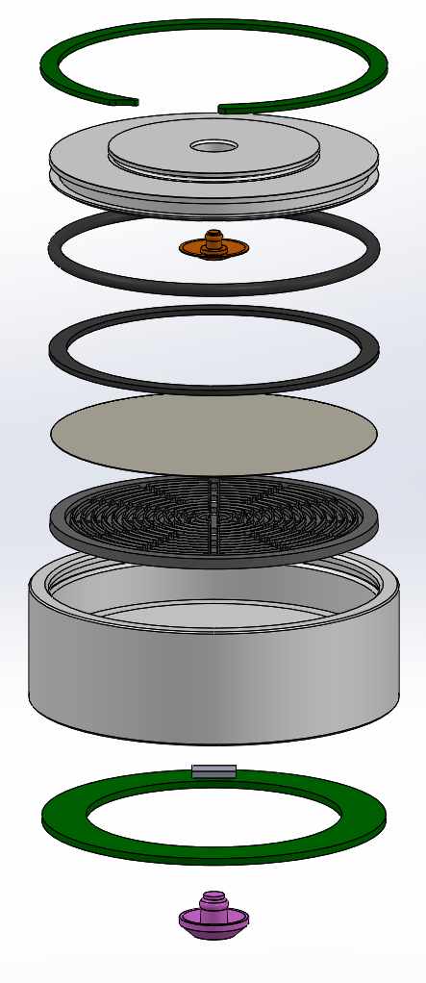
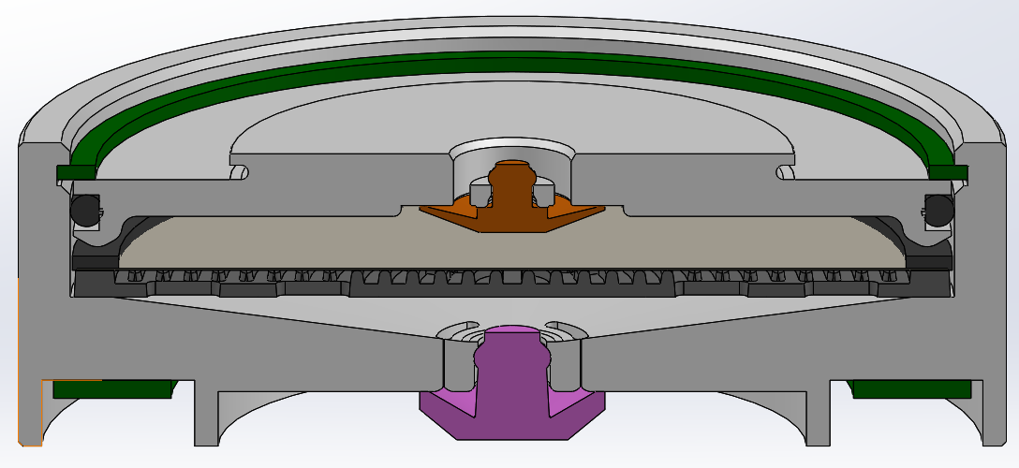
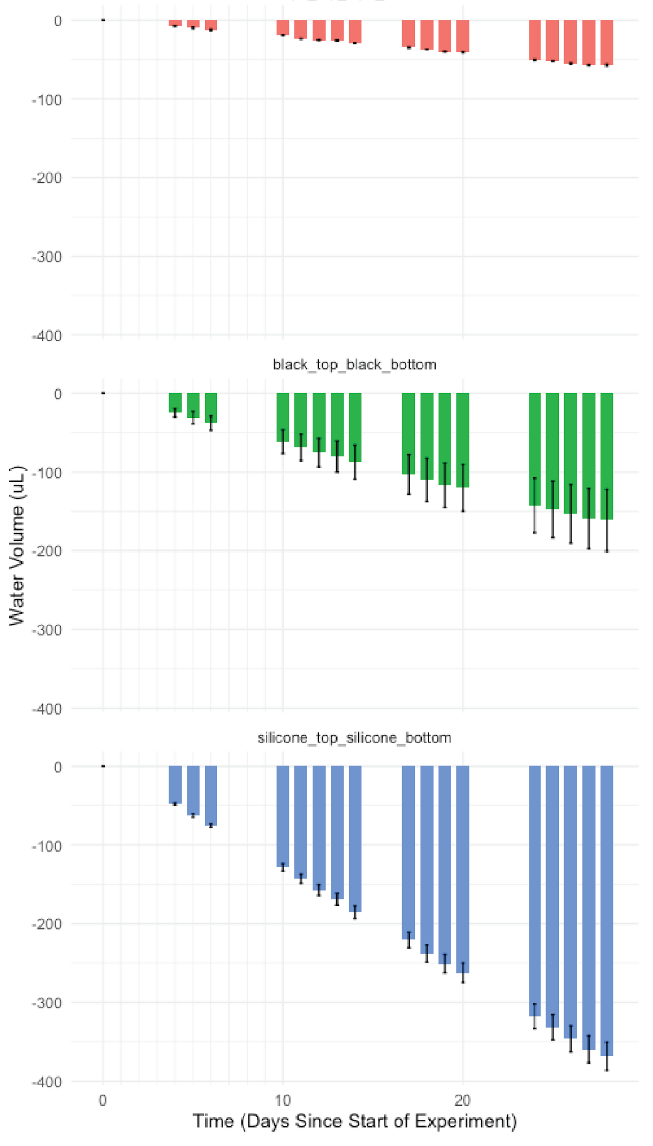
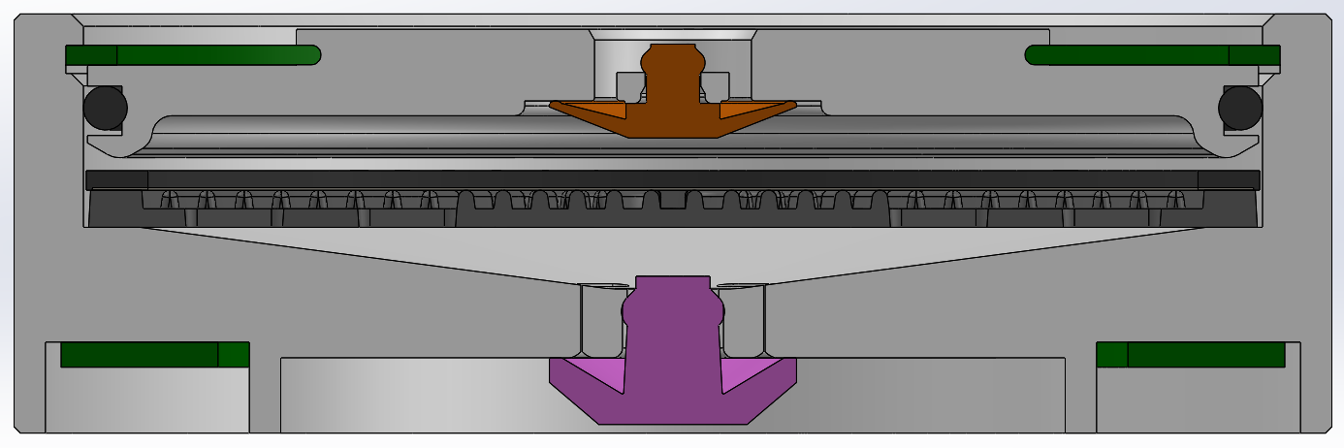
Testing
Puck design is locked-down.
Effects of different materials on evaporation within filter housings
0
100
Sealed
200
300
400
0
100
EPDM
Mini-valves
Vol lost (ul)
200
300
400
0
Silicone
100
200
300
400
0
10
20
Days since start

Slide 8
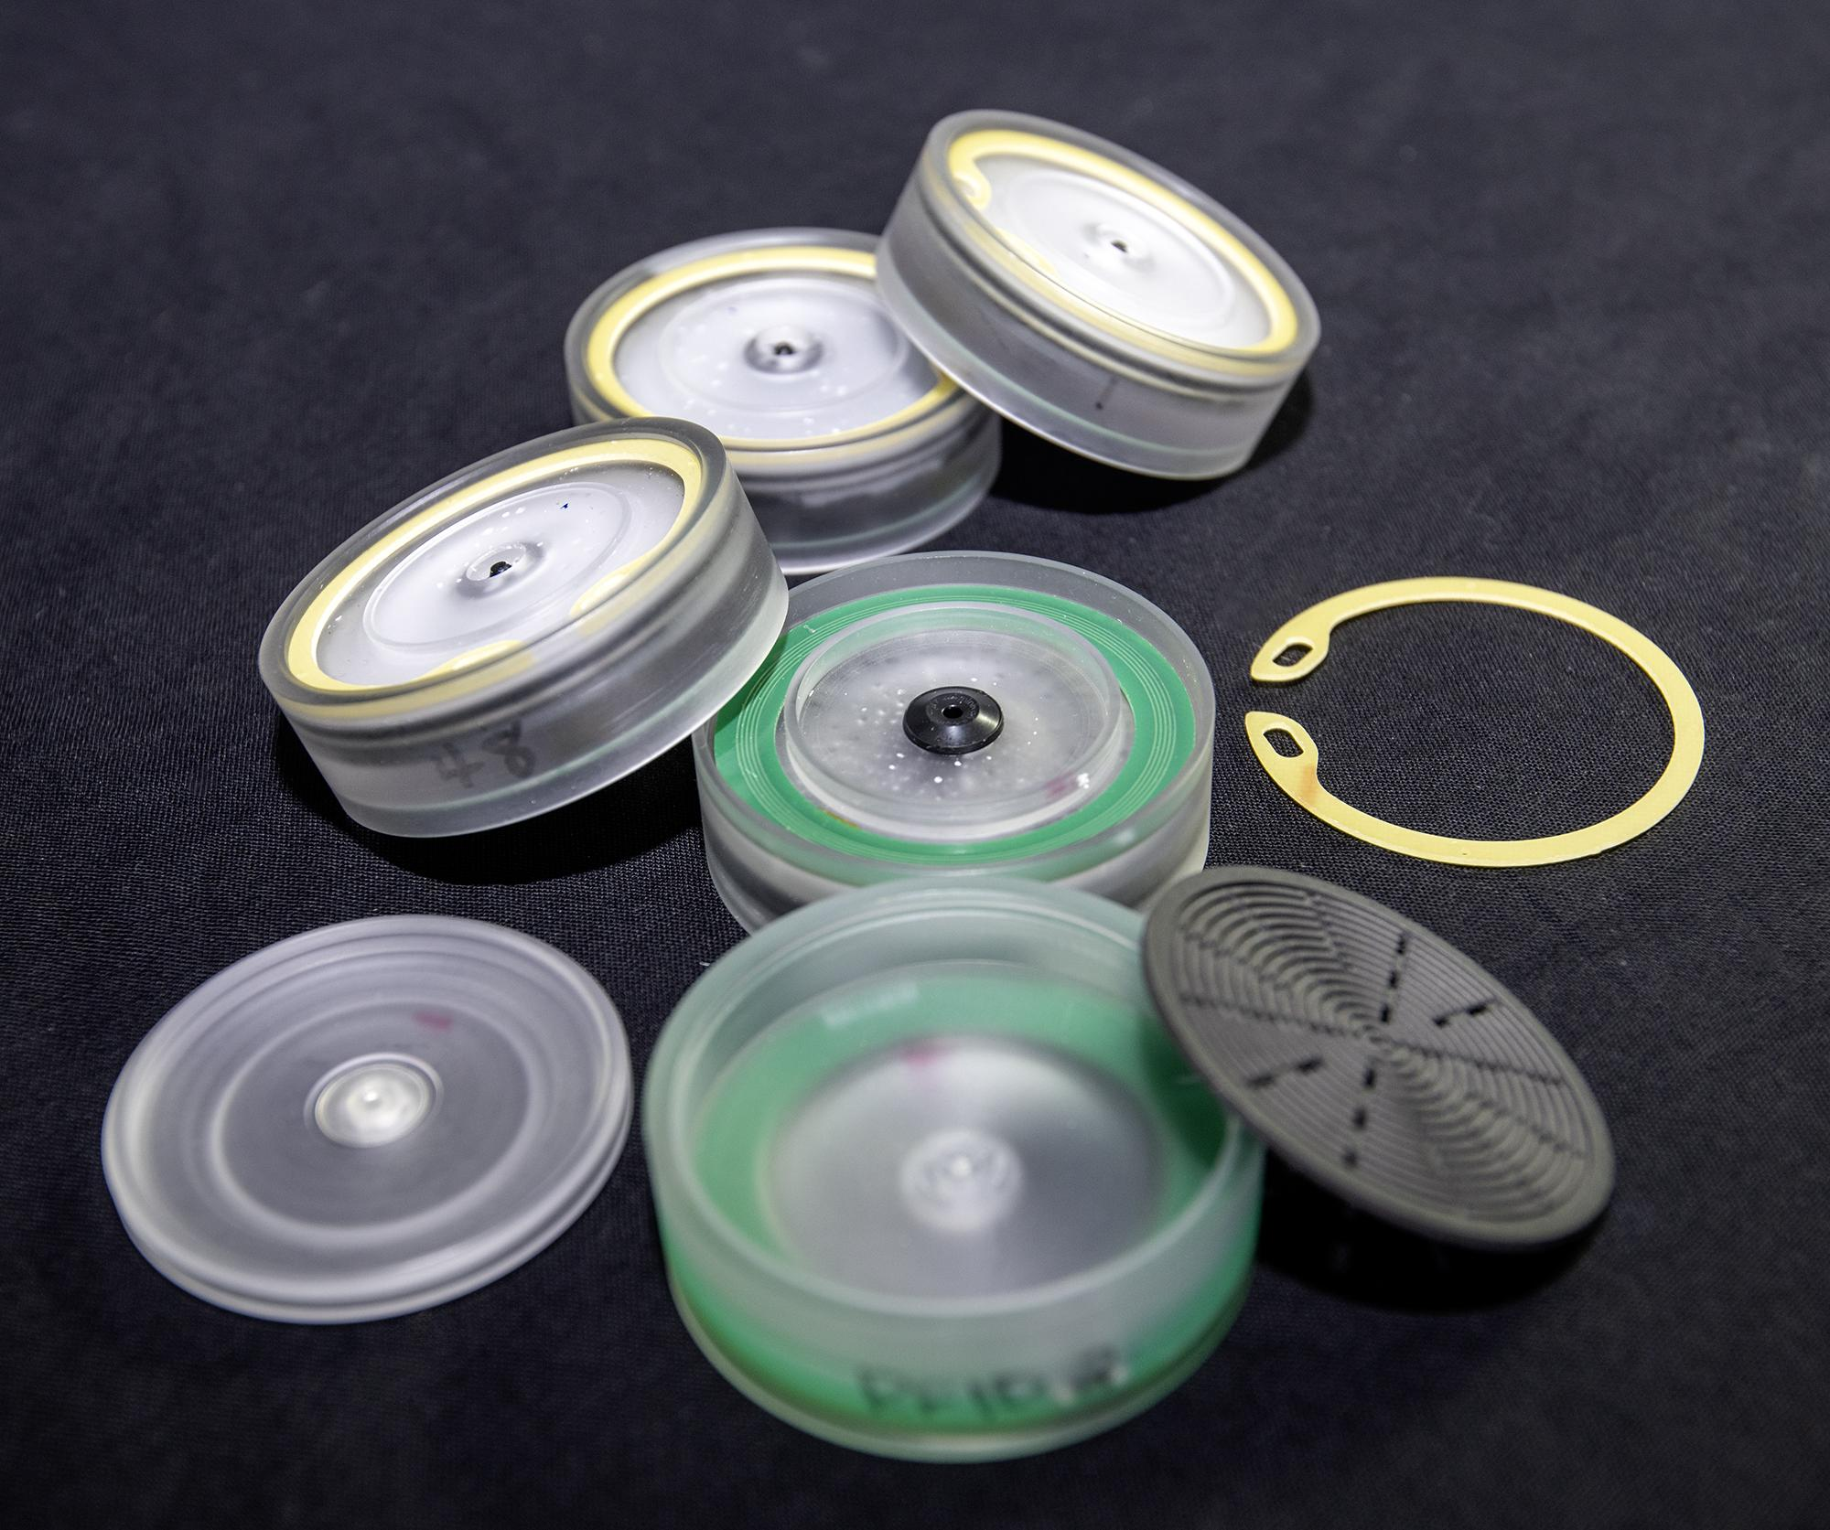
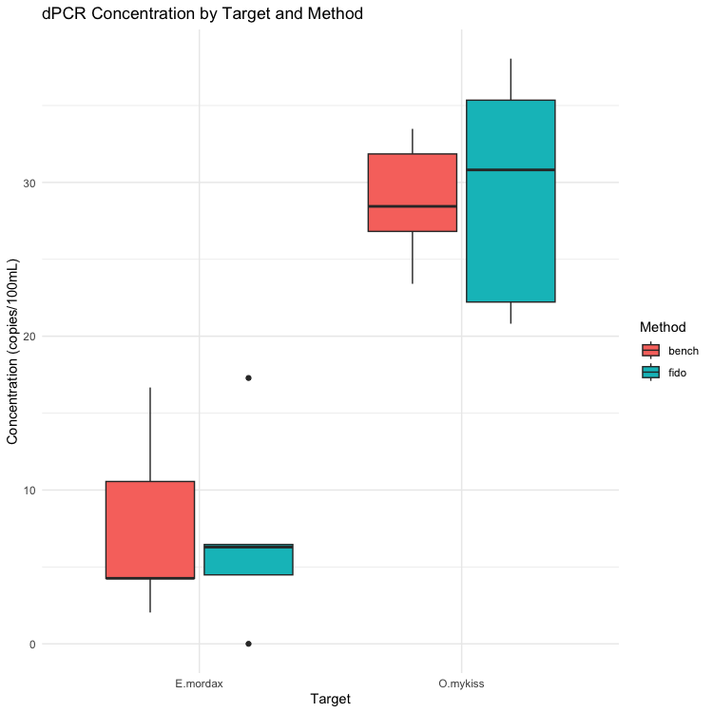
Larger Filter Validation
Validating Recovery of Target DNA for 47 mm filter housings
Anchovy
Rainbow Trout
Target

Slide 9
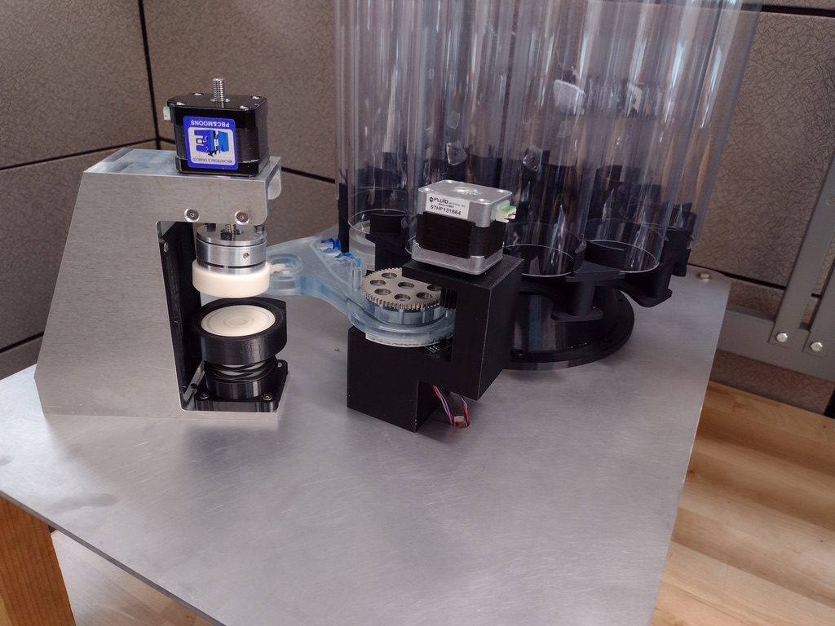
Iterations with larger filter size
June, 2023
How to store and move pucks?
How to clean?

Slide 10
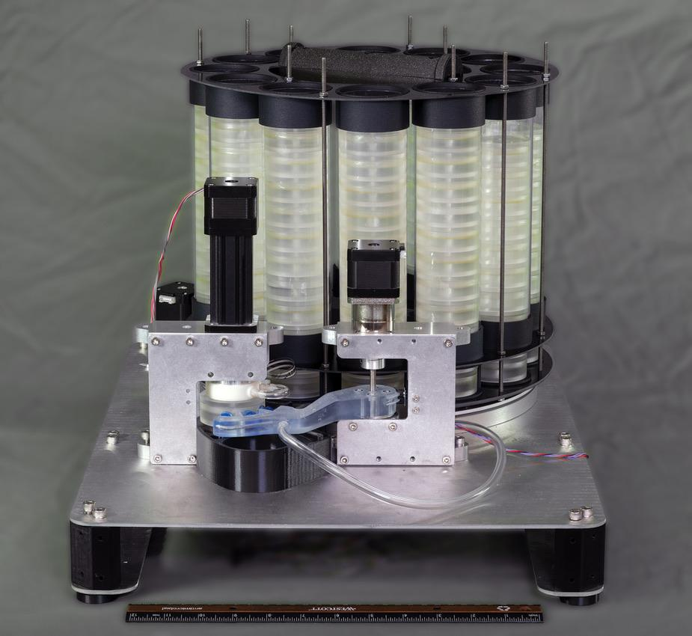
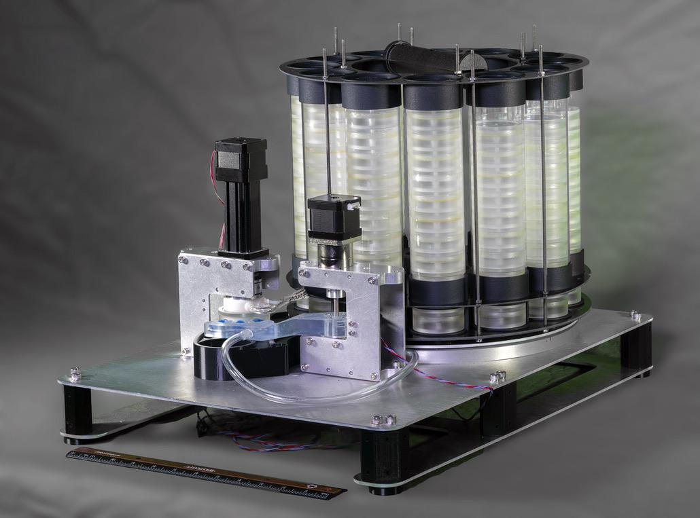
Refining concepts
Aug, 2023

Slide 11
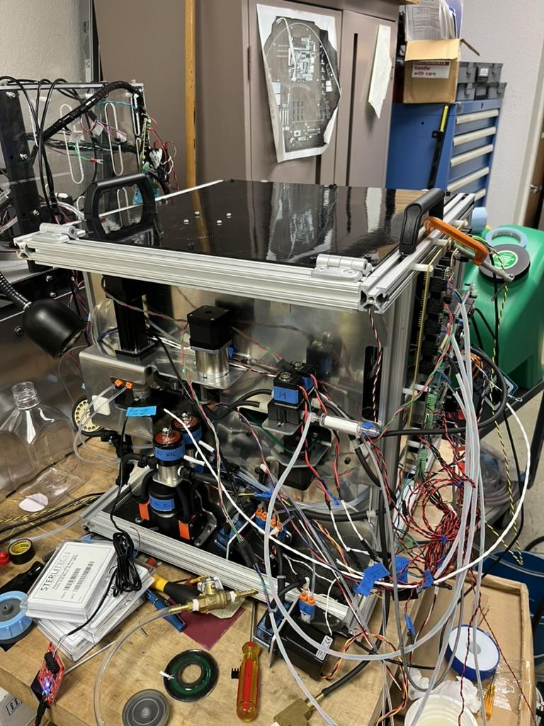
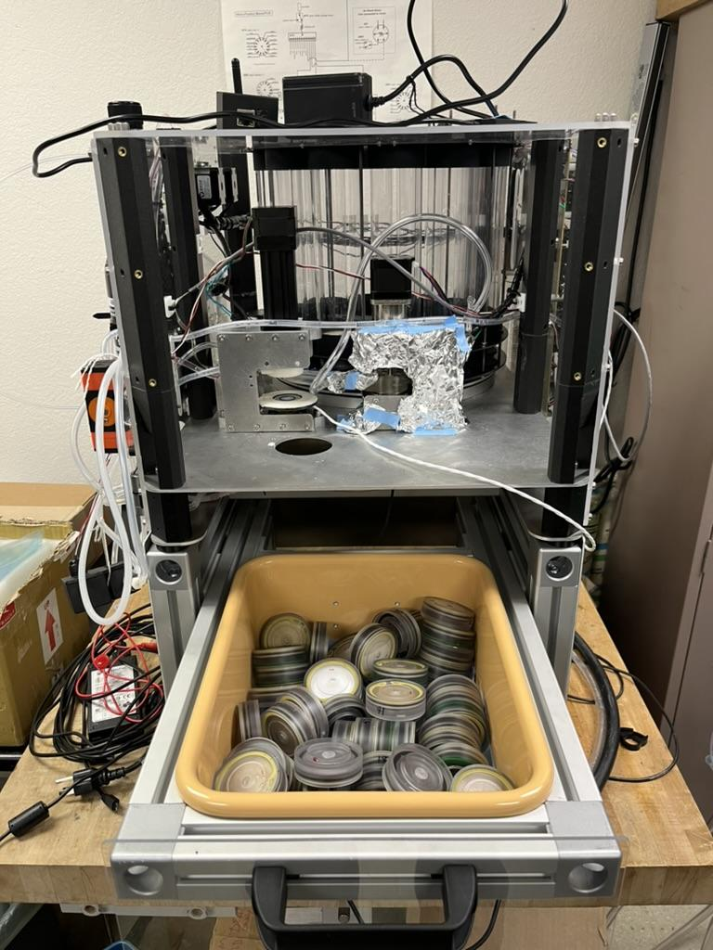
Further refinement
Fall, 2023

Slide 12
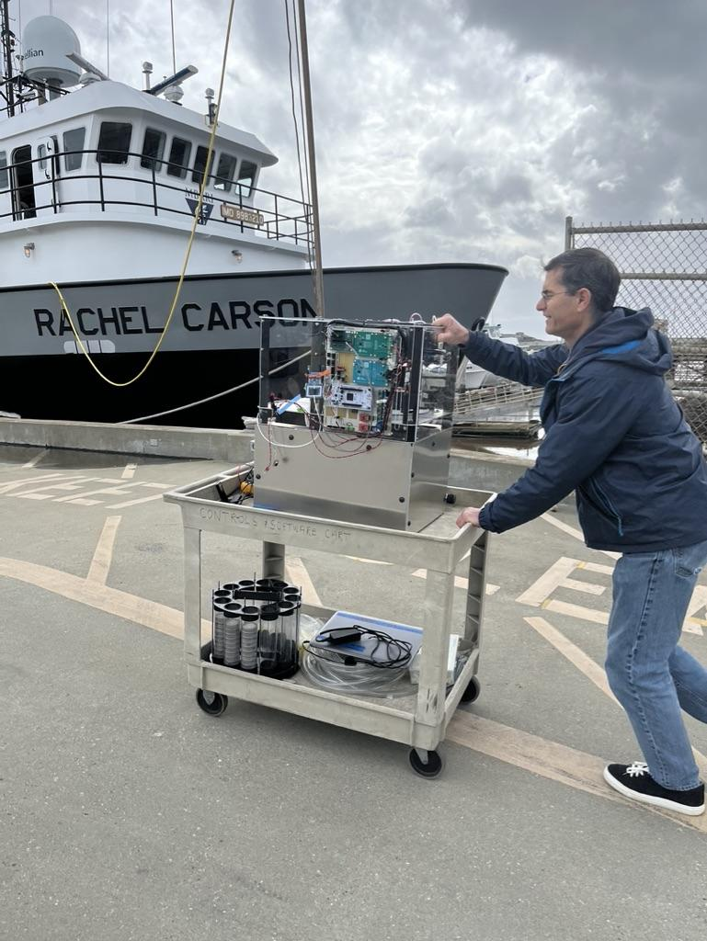
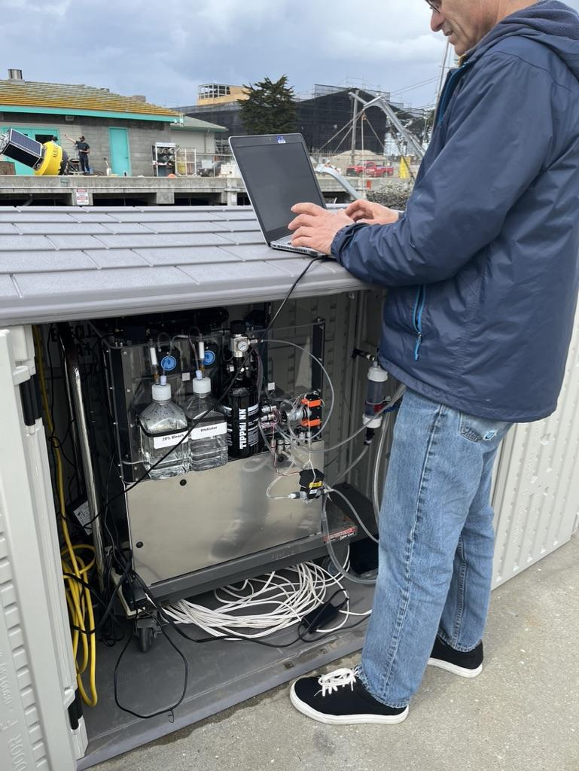
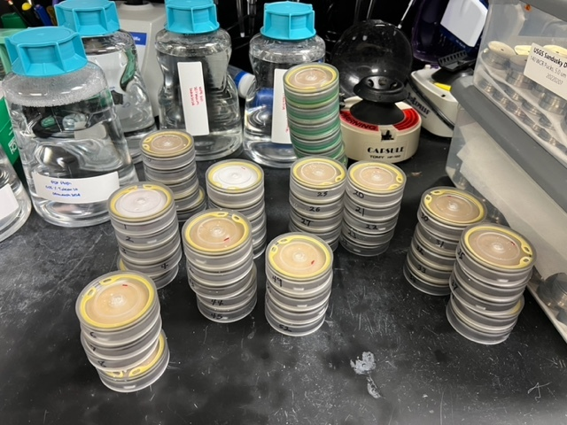
Dock deployment—First ‘Field’ test!
Feb, 2024
…so where are we now (Dec, 2024)?

Slide 13
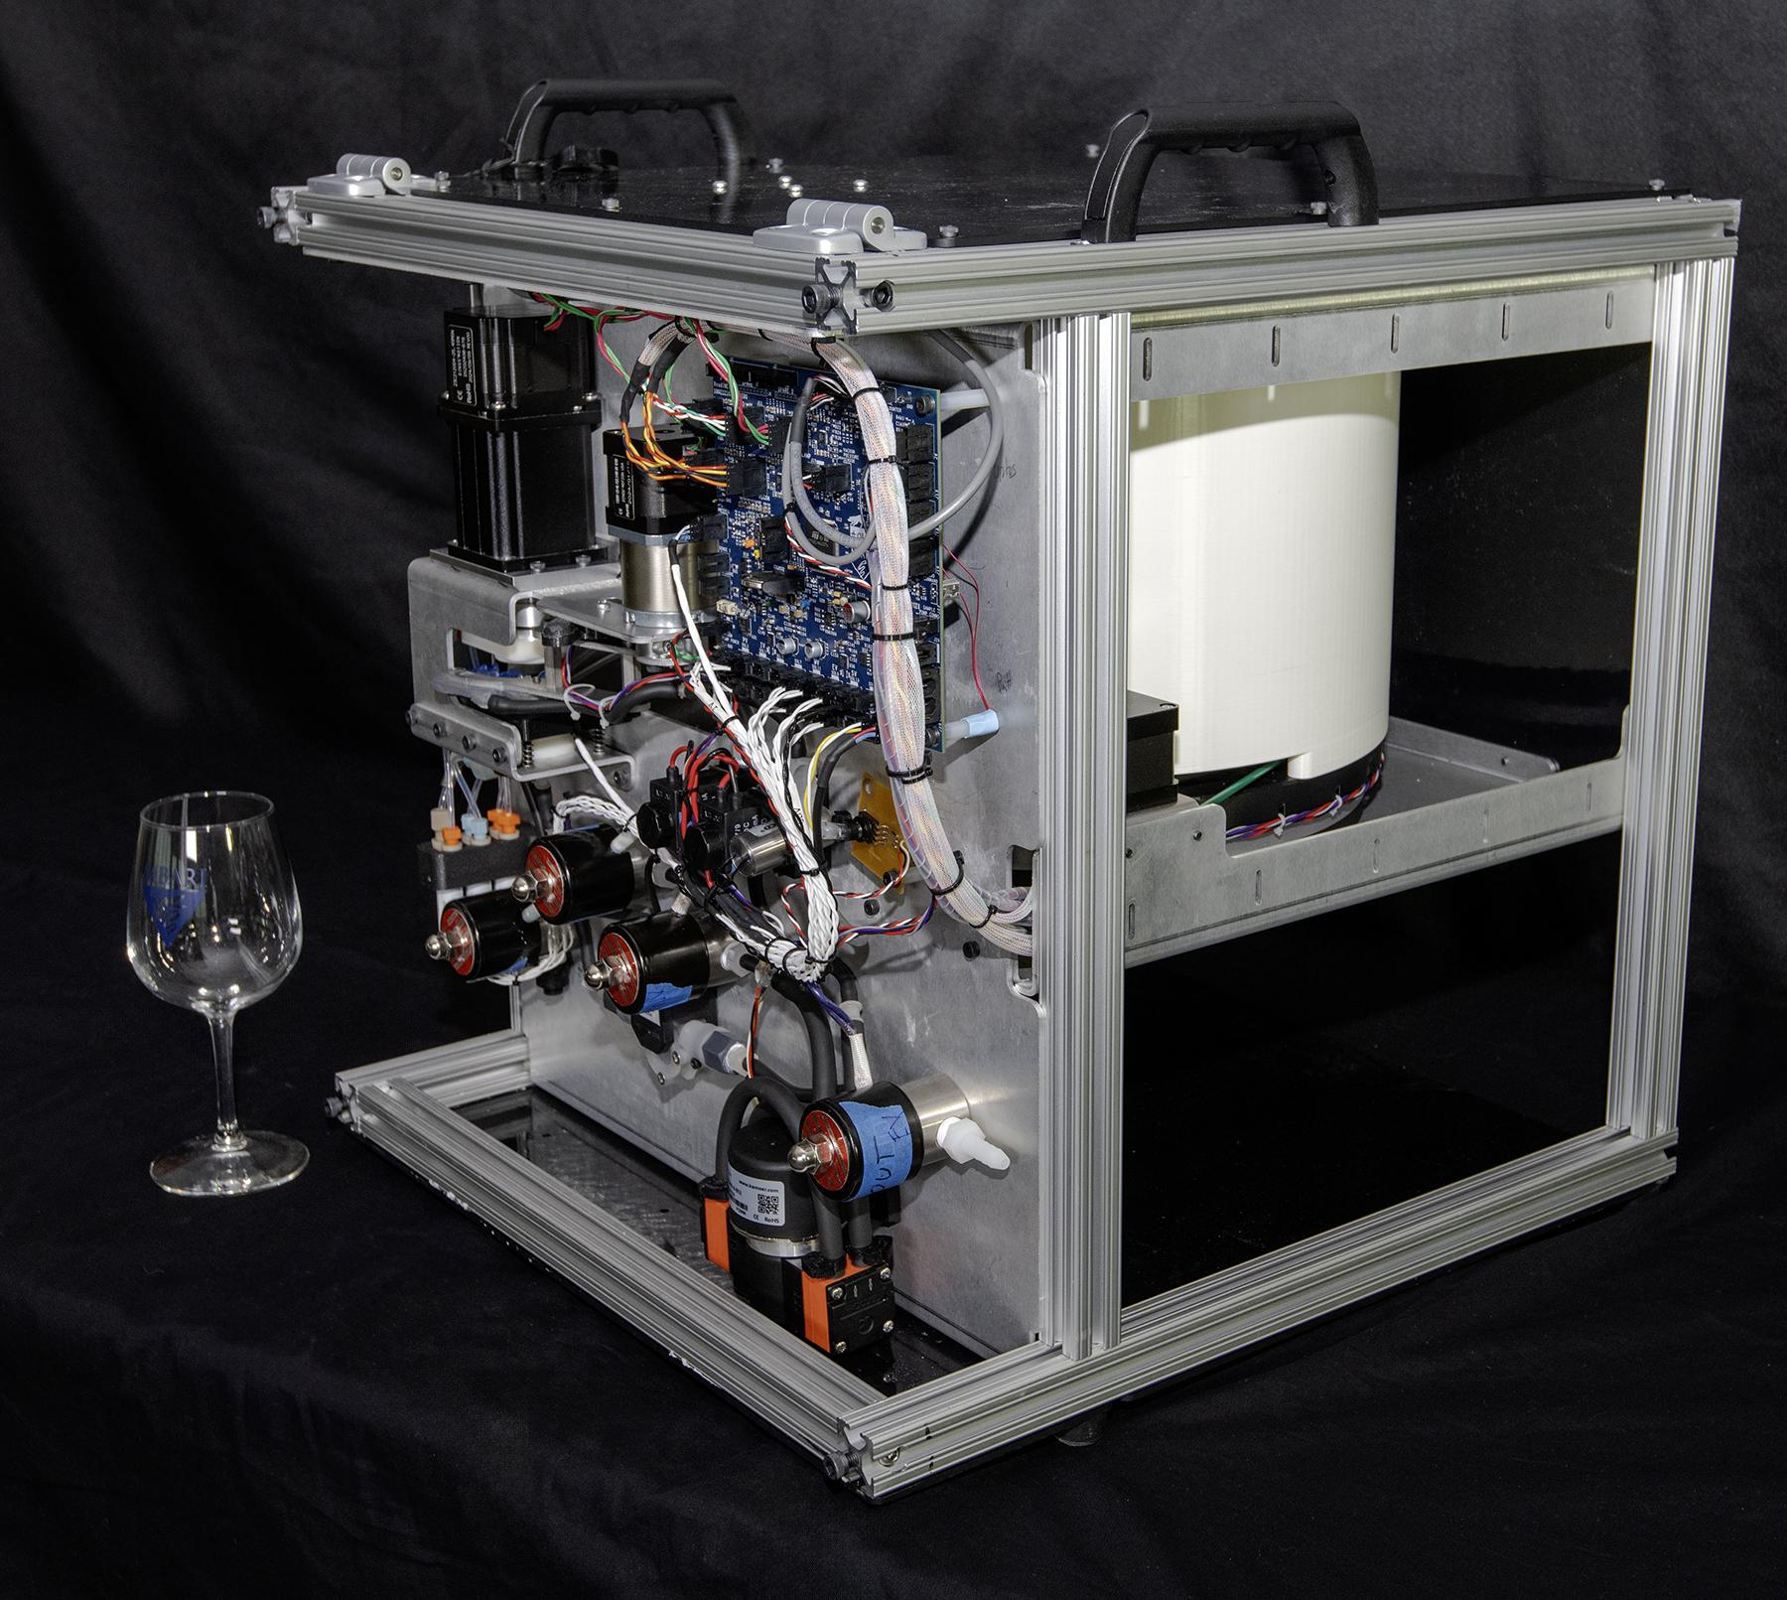
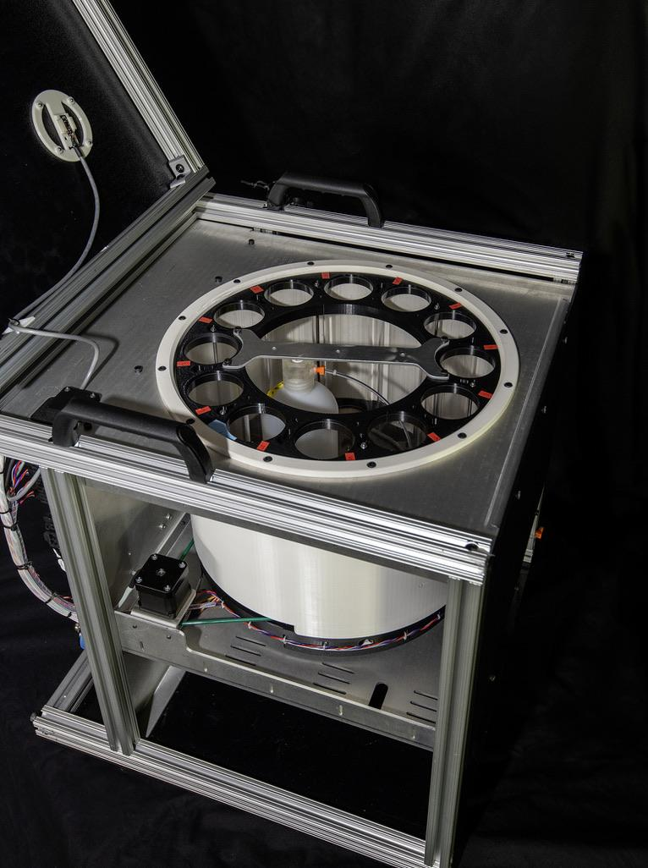
FIDO: Purpose Built / Simple Approach
April 9, 2024 🡪

Slide 14
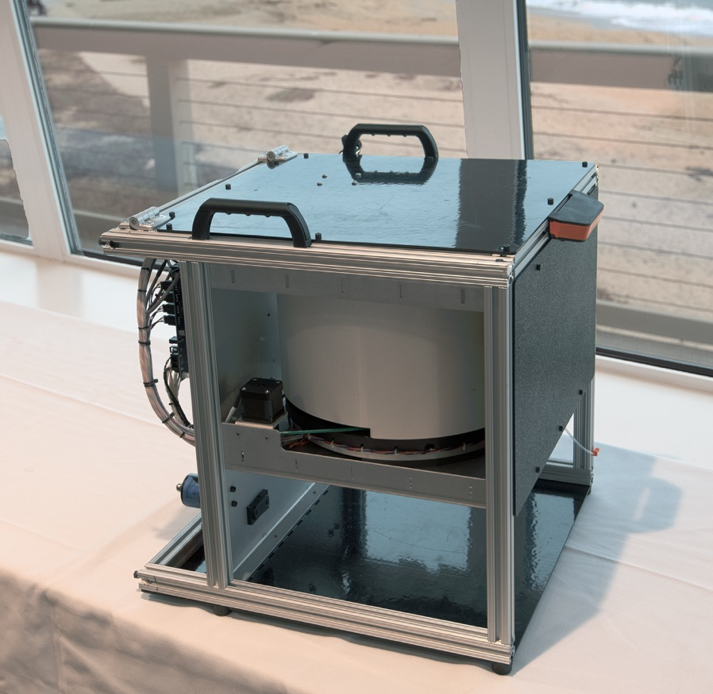
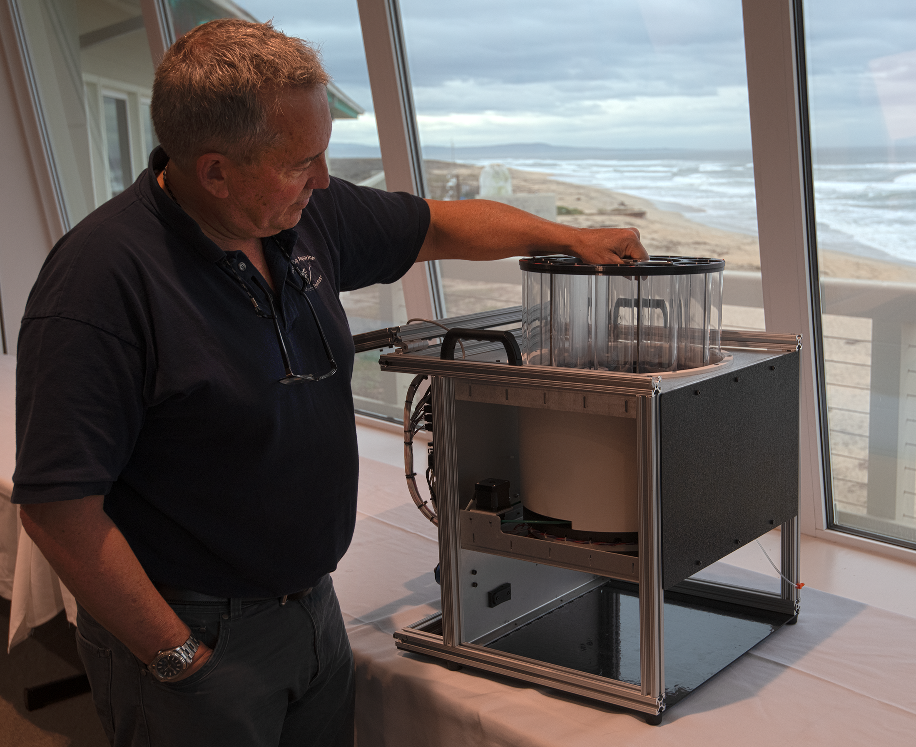
FIDO: Purpose Built / Simple Approach

Slide 15
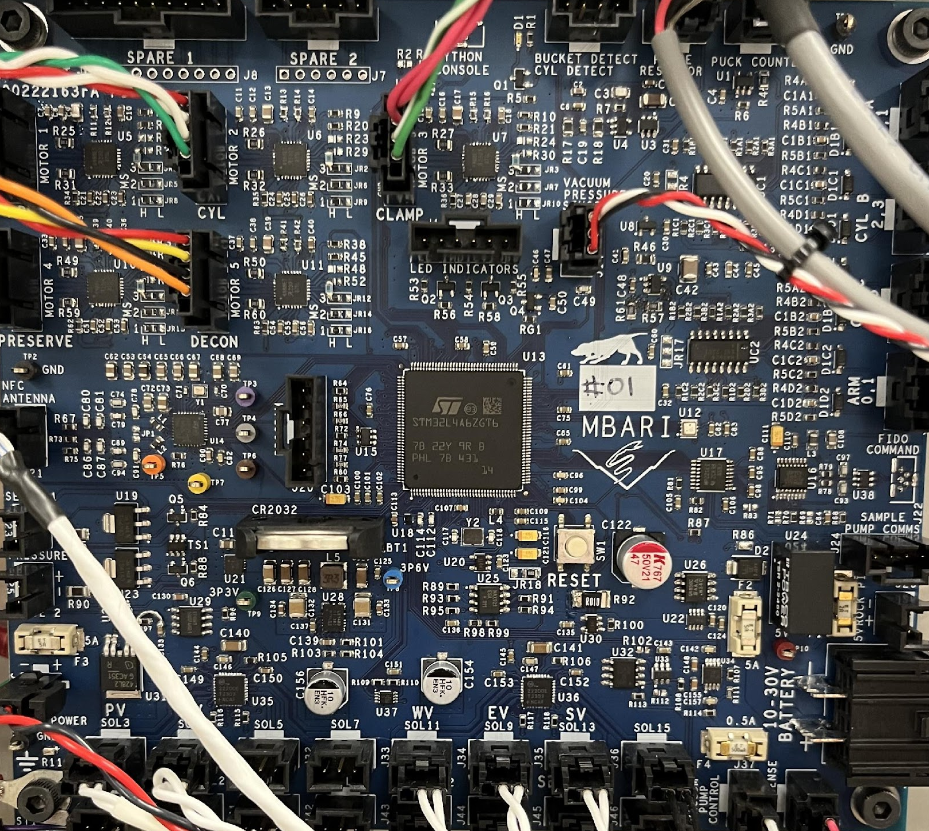
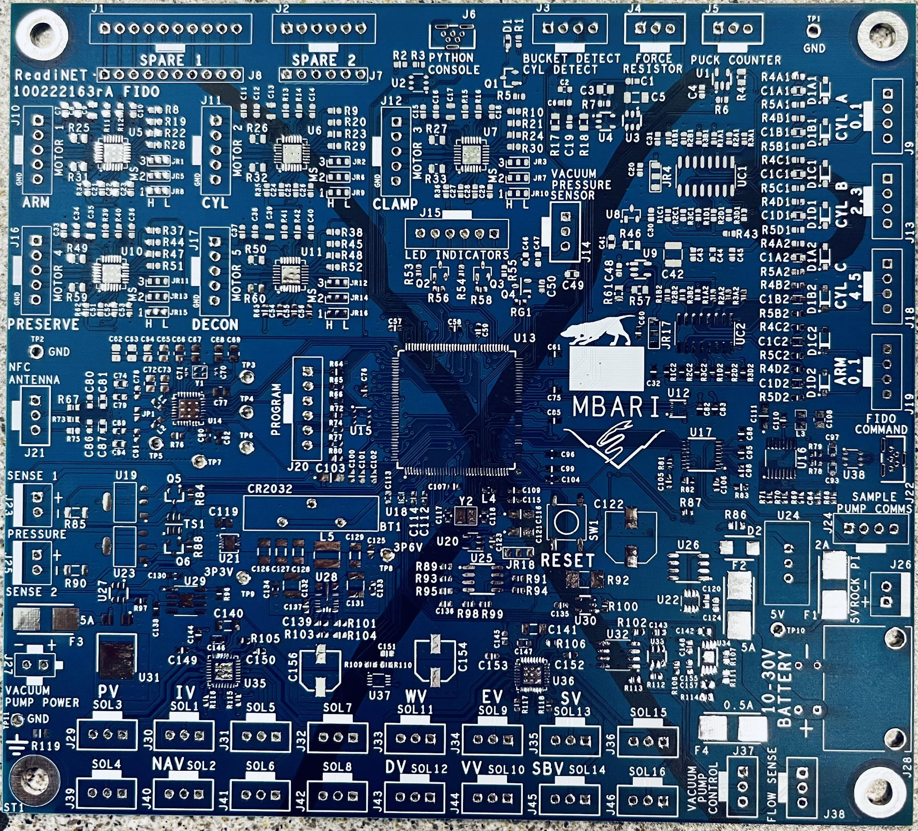
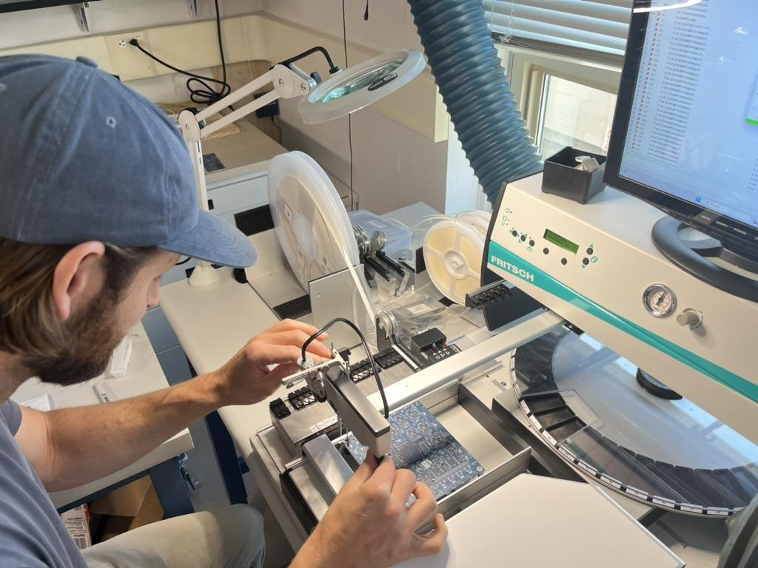
Control Board is finished

Slide 16
Designing User Interface
FIDO User Interface

Slide 17
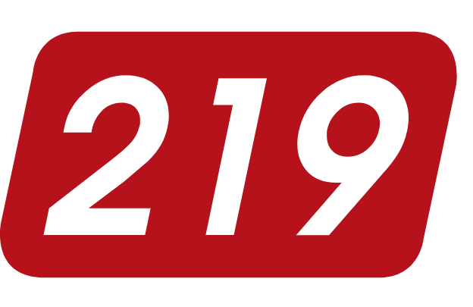
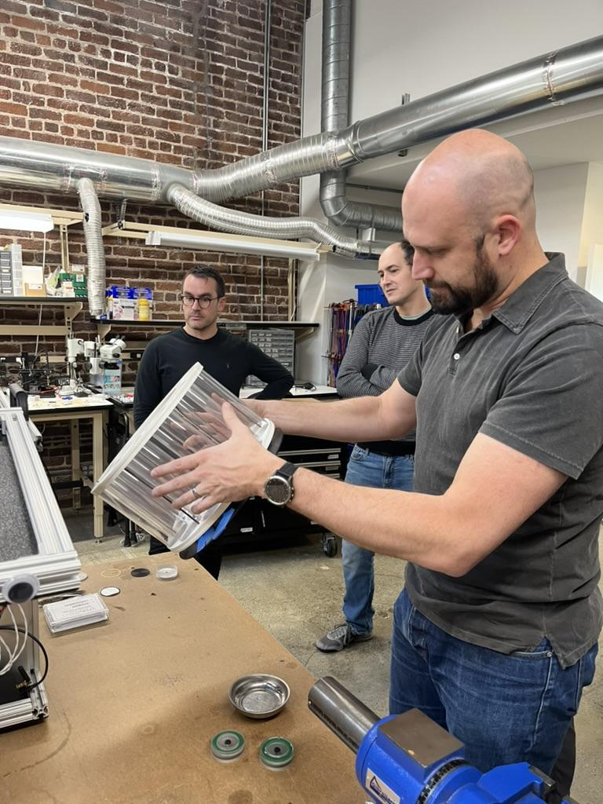
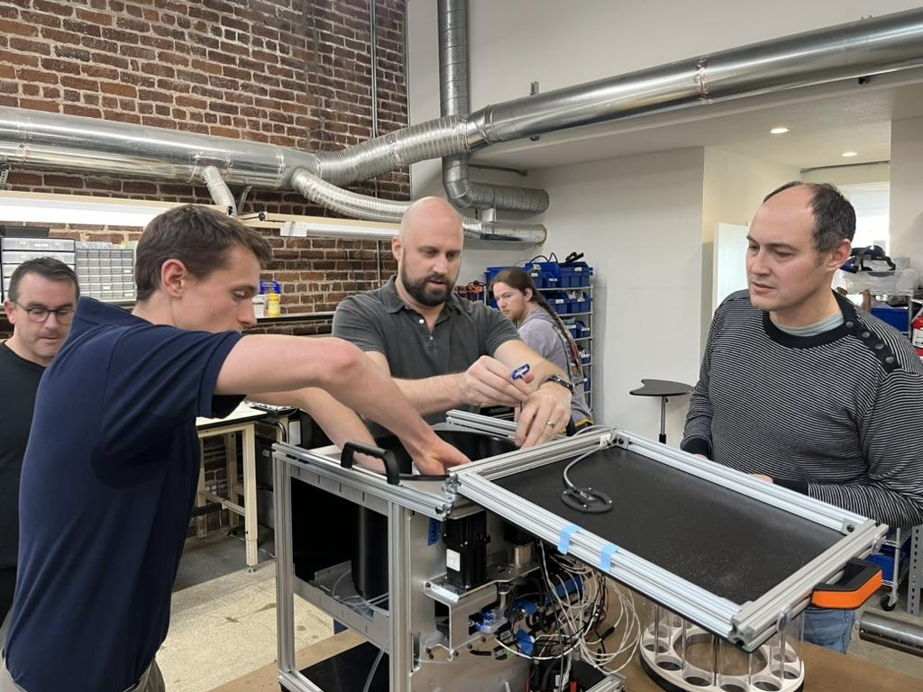
Manufacturing review is underway
DESIGN
509 6th St., San Francisco, CA
https://219design.com/

Slide 18
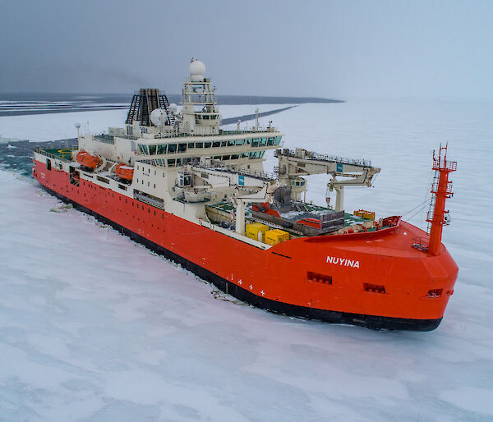
Looking forward…
2024
2025
2026?
  Complete Manufacturing Review
  Begin ordering parts for 10-build
  Build 10
  Testing & Refinement
  Field test prototypes
  Train end users
  Deploy and test
  Further refinement?
  License?
  Wider distribution?
Feb 20-May 2, 2024

Slide 19
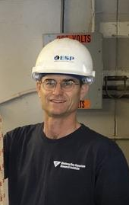
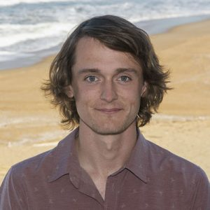



Acknowledgements
Enoch Nicholson- Mechanical Engineer
Scott Jensen-Lead Engineer

