Slide 1
Vacuum
sensor
Arm
suction
cups
Vacuum
Pump
Waste
Container
RNA Later
(preservative)
Bleach
(cleaner)
Nitrogen
(Compressed)
Filter
Puck
Upstream
Manifold
Downstream
Manifold
Intake
Flow
meter
Exhaust

Slide 2
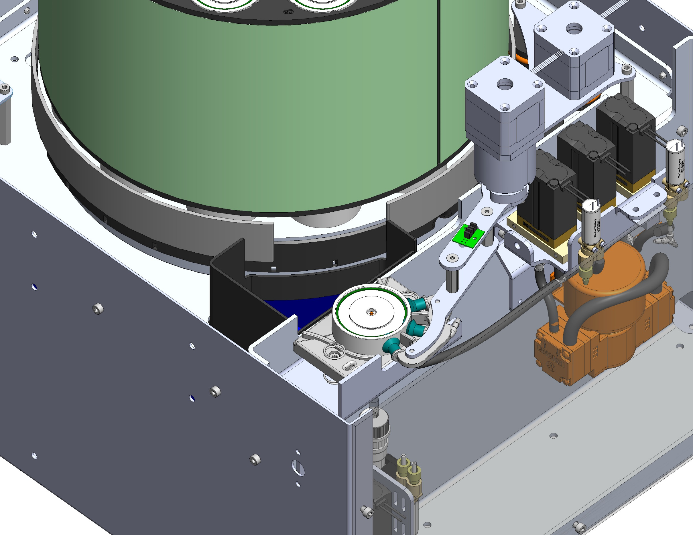

Slide 3
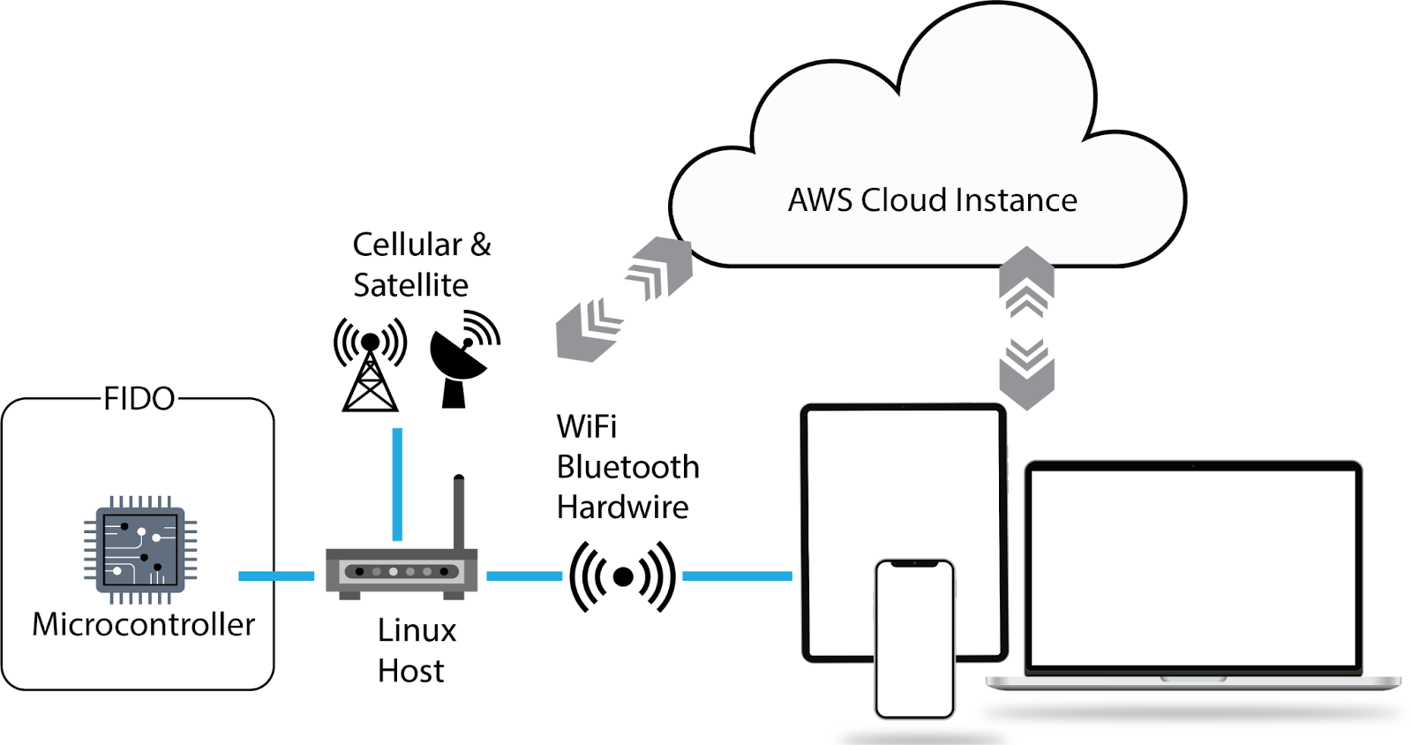

Slide 4
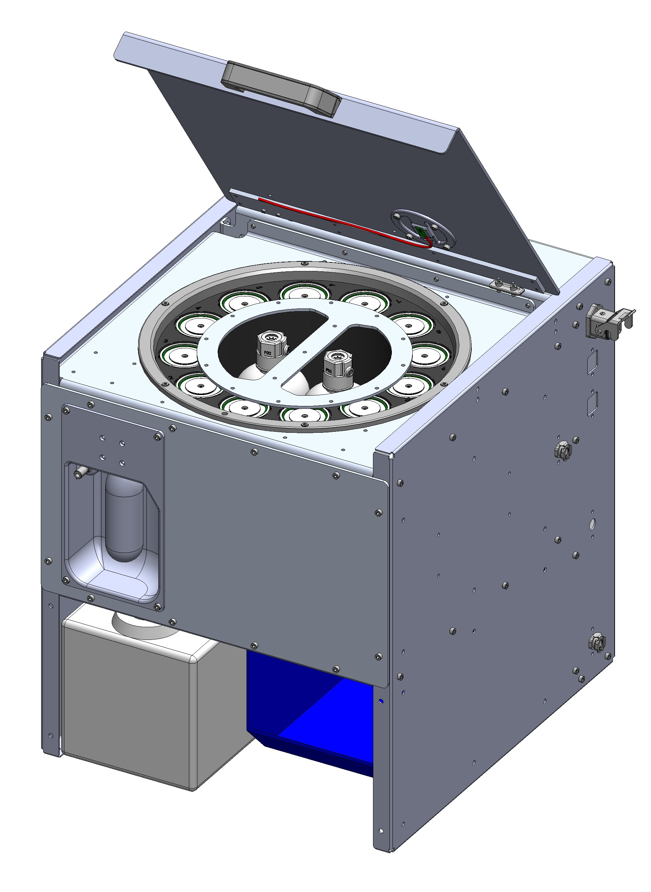
49 cm
47 cm
43 cm

