Slide 1
FIDO: An Innovative Autonomous Instrument for Environmental DNA Sampling
Kevan Yamahara, Scott Jensen, Adam Sepulveda, Enoch Nicholson, James Birch
2nd Australian & New Zealand Environmental DNA Conference
February 20th, 2025
Notes:
Good afternoon everyone! I want to start by thanking the organizing and steering committees for giving me the opportunity to present some of our recent developments in the Environmental Sample Processor group at the Monterey Bay Aquarium Research Institute. Today I will be talking about FIDO, or the Filtration Instrument for DNA Observations:

Slide 2
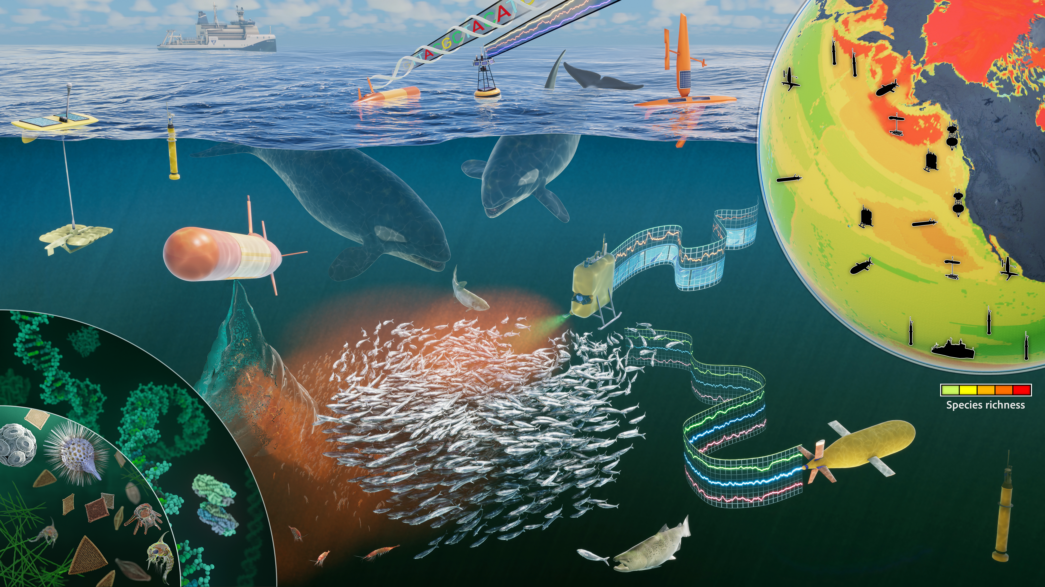
Conceptualizing is easy…….
Figure courtesy of E. Virginia Armbrust and the Center for Environmental Visualization at the University of Washington Seattle
Notes:
Conceptualizing the future of biodiversity observations in the ocean is easy and we can envision what these advanced technologies might look like to make these observations. Where we have numerous crewed and uncrewed platforms collecting biological data through omics technologies and also the environmental data used to contextualize these observations.
However, developing functional technologies that are cheap, easy to use and robust has proven to be very difficult. As we witness yesterday, there were a number of talk about new sampling technologies. There has been a rise in the number of autonomous sampling instruments over the last 5 or so years, providing renewed hope in making progress towards realizing these conceptual illustrations.

Slide 3
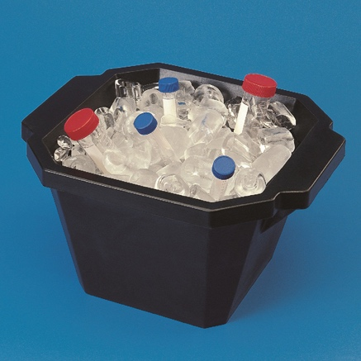

Large Challenges to Overcome
Conventional wisdom of decades long traditional laboratory practices
Fluid handling over 6 orders of volumetric magnitude (Liters to uLs)
Diverse user needs, expectations and environments
0.45 + 5.0 um filters, 100 mL to 2L,
SHA arrays + PCR +
sequencing
Notes:
Some of the reasons that it has been difficult to develop these class of instruments is due to some long standing challenges that still exsist to this day.
First, proving to ourselves and others that we circumvent the traditional laboratory paradigms of sterile environments, large instrumentation, perishable reagents and strict laboratory regimes
Second, there are 6 orders of volumetric magnitude in which these instruments have to perform fluidic measurements. We often start with liters of water which is concentrated into several uLs of nucleic acid that are analyzed.
Finally, there are really diverse user needs. If we asked researchers at this meeting what they want to measure and how, you would get the kitchen sink. From microbes to whales, every conceivable filter choice and filtration volume, and then you add on in-situ analysis. It is difficult to design an instrument with so much flexibility.

Slide 4
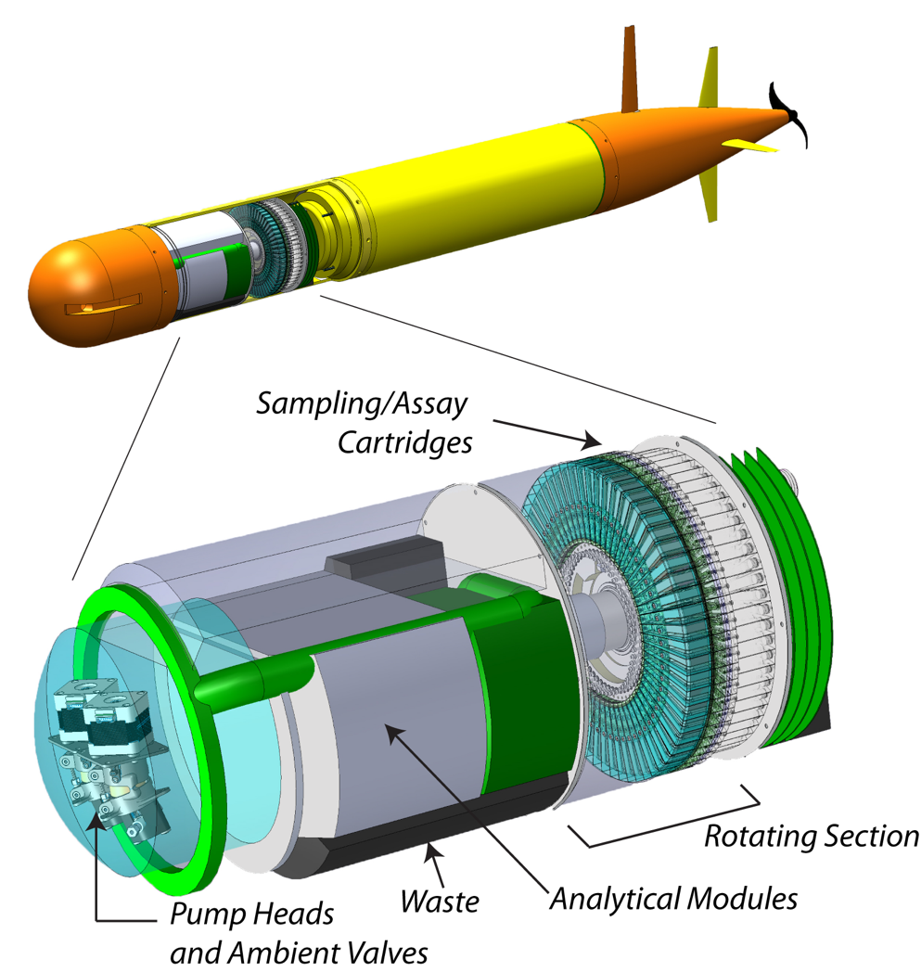
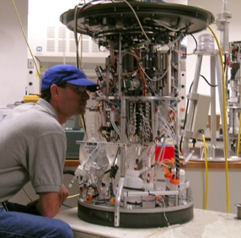
Environmental Sample Processor
2nd Generation ESP
3rd Generation ESP
Specific design requirements:
Submerged or Autonomous Vehicle Deployments with in situ analysis
Notes:
For almost 3 decades our team has been developing the ESP or environmental sample processor. Starting with the 2G ESP on the left and 3G ESP on the right. I am happy to discuss these instruments with folks, but I really want to hone in on their design requirements
Both of these instruments were designed with the idea providing in situ analytical capabilities. Where we are no longer returning samples back to the lab but instead sending back data. Moreover, functional these instruments were designed for submerged deployments in the ocean either on stationary moorings, in the case of the 2G ESP or mobile deployments on 3G ESP using AUV.
These are very specific requirements that enable us to ask and solve different scientific research questions.

Slide 5







Sampling robots have enabled good science
Ottesen, E.A., et al. Metatranscriptomic analysis of autonomously collected and preserved marine bacterioplankton. 2011. ISME Journal 5: 1881-1895
Saito, M.A., et al. 2011. Examination of microbial proteome preservation techniques applicable to autonomous environmental sample collection. Frontiers in Aquatic Microbiology. 2: 215.
Nowinski, B., et al. Microdiversity and temporal dynamics of marine bacterial dimethylsulfoniopropionate genes. 2019. Environmental Microbiology 21(5): 1687-1701.
Yamahara, K., et al. In situ autonomous acquisition and preservation of marine environmental DNA using an autonomous underwater vehicle. 2019. Frontiers in Marine Science. 6:373.
Den Uyl, P., et al. Lake Erie field trials to advance autonomous monitoring of cyanobacterial harmful algal blooms. 2022. Frontiers in Marine Science. 9:1021952.
Sepulveda, A.J., et al. 2020. Robotic environmental DNA bio-surveillance of freshwater health. Scientific Reports 10:14389.
Zhang, Y., et al. A system of coordinated autonomous robots for Lagrangian studies of microbes in the oceanic deep chlorophyll maximum. 2021. Science Robotics 6: eabb9138.
Truelove, N.K., et al. 2022. Expanding the temporal and spatial scales of environmental DNA research with autonomous sampling. Environmental DNA. 4: 972-984.
Notes:
And over the years, we have shown that the ESP and sampling robots in general have enabled robust science and provided glimpses of biology that might otherwise not be seen using conventional sampling methods.
reveal the potential of utilizing the ESP to detect taxa from microbes to vertebrates and from RNA and metatranscriptomes to DNA and metabarcoding analyses.

Slide 6
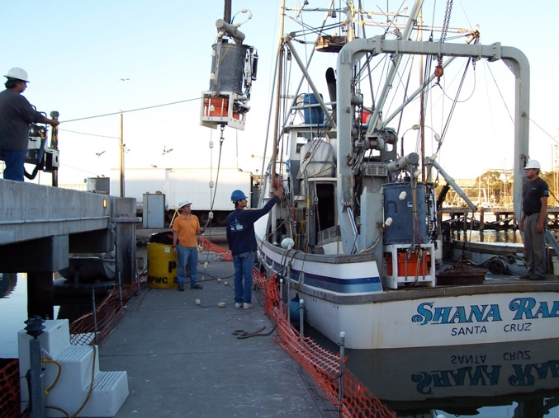
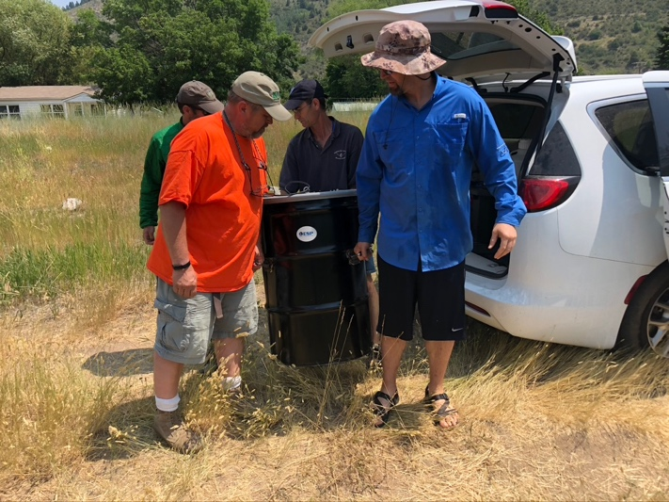
Lessons learned from field demonstrations
Every user/deployment has different requirements
Many collaborators just want samples not analysis
Collect samples over extended periods of time
End Users want access and control of instrumentation
Instruments need to be SIMPLE, CHEAPER & EASY to deploy
Notes:
And through all of this research with collaborators we have learned that these instruments are good for demonstrations but difficult to scale. But that was never their intended purpose based on the requirements.

Slide 7
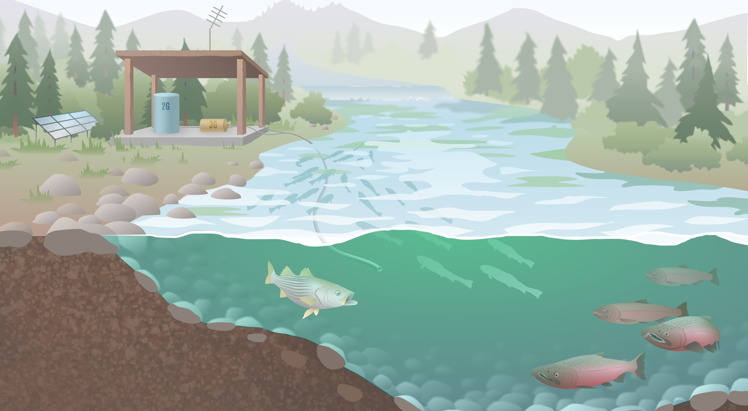
Freshwater Lotic Systems
Notes:
In the last 6 or so years, we have been deploying the ESP in lotic systems.
Many of these projects are in collaboration with the USGS in environments like the Snake, Yellowstone and Sandusky Rivers. Here we autonomously collecting water from river systems to look at eDNA of non-indigenous species and species of conservation concern.
A little over a year ago, after one of these deployments, driving home from Wyoming. Like the result of lugging these 55 gallon drums around for a week, it finally stuck. We are only utilizing ½ of the 2G ESP, the sample collection and preservation half. Leaving the processing side of the instrument idle, which is a significant portion of the instrument size and function.

Slide 8
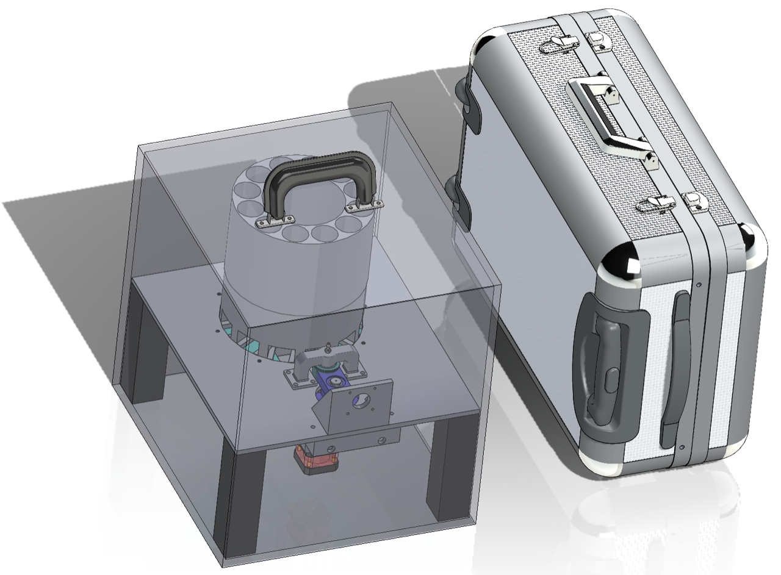
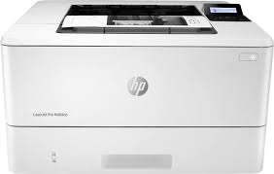
ESP Sampler
Terrestial based deployments (non-submerged)
Portable, easy to deploy and re-supply
Minimum 160 samples
Interactive communication and control
Printer Approach
Easy to Setup
Easy to Use / Operate
Easy to Maintain
Notes:
Based on all of these experiences, we decided it was time to build a new sampler, the ESP sampler.

Slide 9
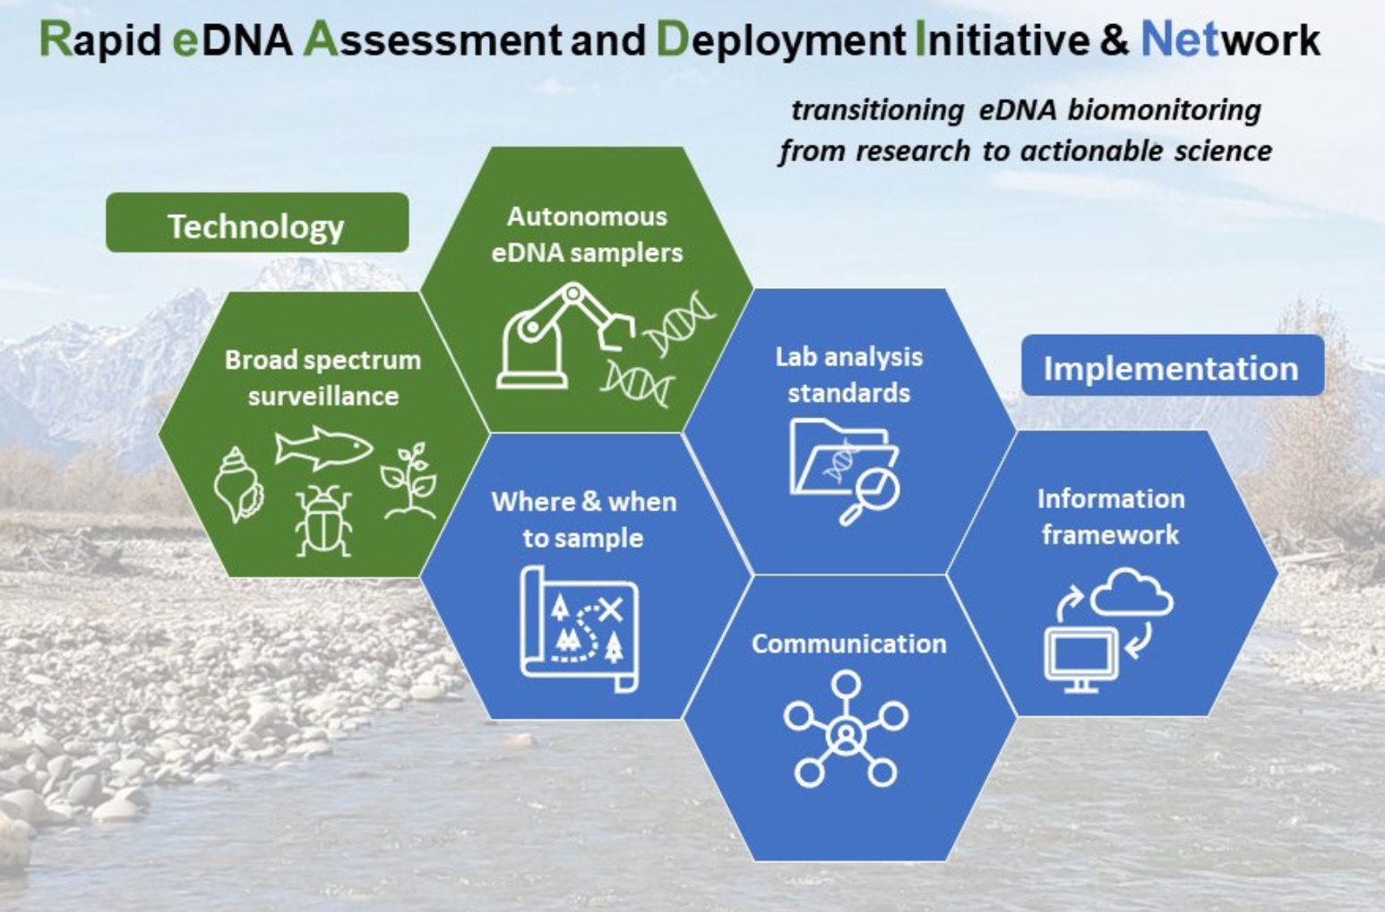
USGS READI-NET PROGRAM
Courtesy of Adam Sepulveda - USGS
Notes:
At the same time, we began conceptualizing this instrument. Our collaborator, Adam Sepulveda at the USGS, was funded to establish the READI-Net Program or the Rapid environmental (e)DNA Assessment and Deployment Initiative & Network (READI-Net) to accelerate the implementation of environmental DNA (eDNA) analysis as a best practice for the early detection of aquatic biological threats.
Utilizing a technology plan based on eDNA methodologies and autonomous eDNA samplers coupled to an implementation plan where standardized procedures are establish and a national framework for coordinating and communicating of eDNA surveillance.

Slide 10
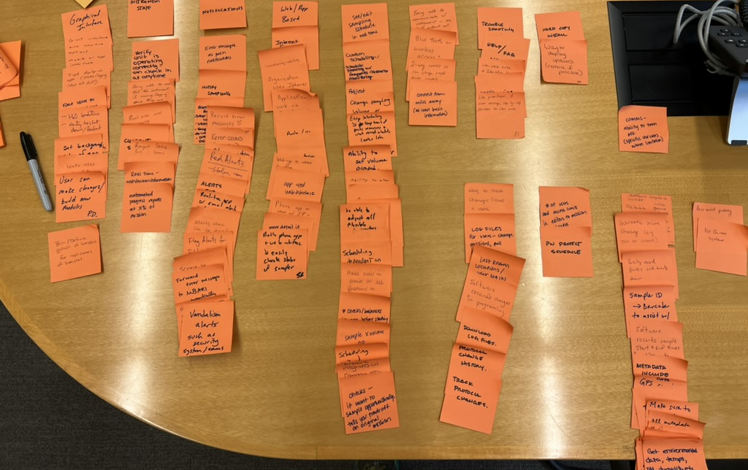
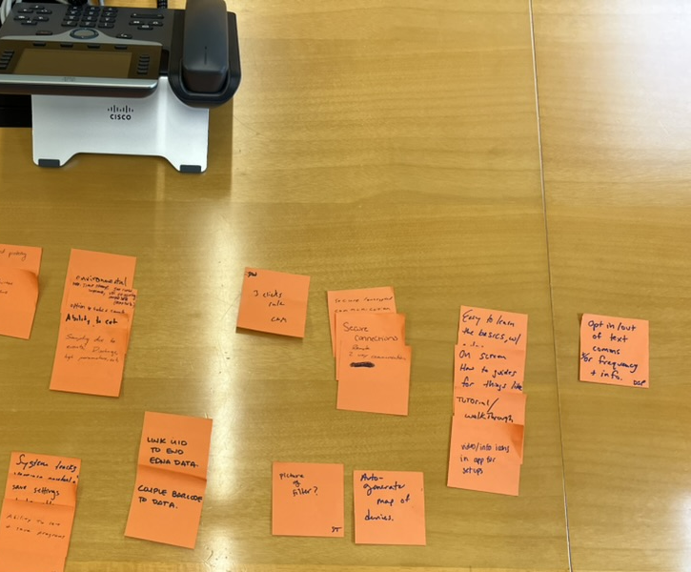
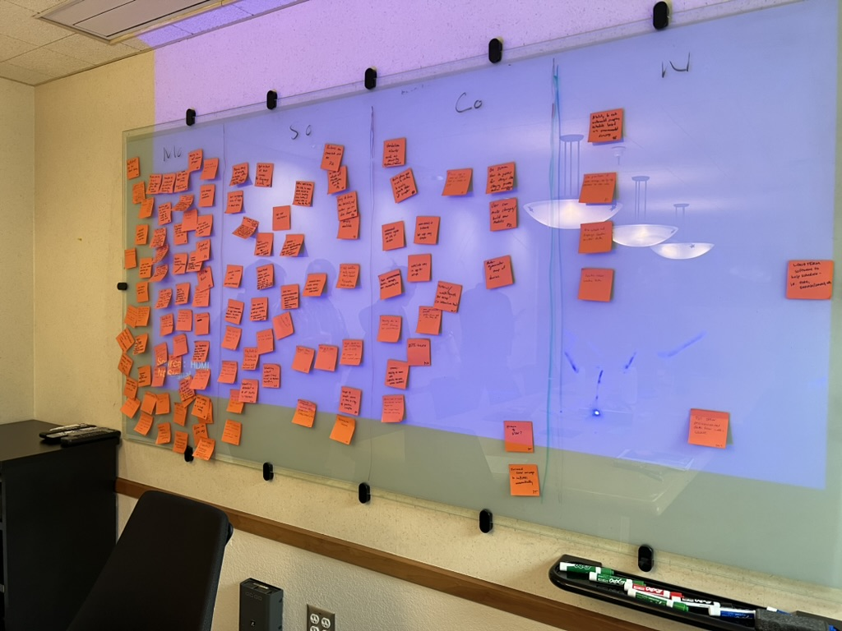
USGS READI-NET PROGRAM – MoSCoW
Must have, Should have, Could have or Won’t have Prioritization
Notes:
We utilized members of the READI-net program to co-design the instrument. We were invited members to prioritize instrument functions and capabilities through a MoSCoW priotization framework. Here we asked readi-net researchers to prioritize instrument functions that were Must Haves, Should Have, Could Haves or Wont Haves. We generated thousands of sticky notes that were distilled down into the functional requirement of the instrument design.

Slide 11
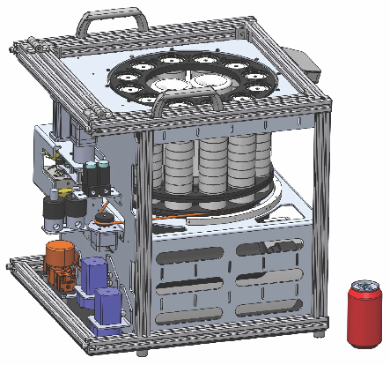
FIDO: Filtering Instrument for DNA Observations
144 samples – 47mm Membranes
Liquid Preservation
Liquid Decontamination
Remote Command & Control GUI
  Wifi, Cellular and Satellite
Sample metadata encoding
Simple servicing and replenishment

Slide 12
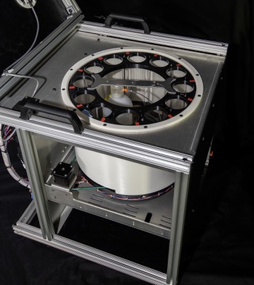
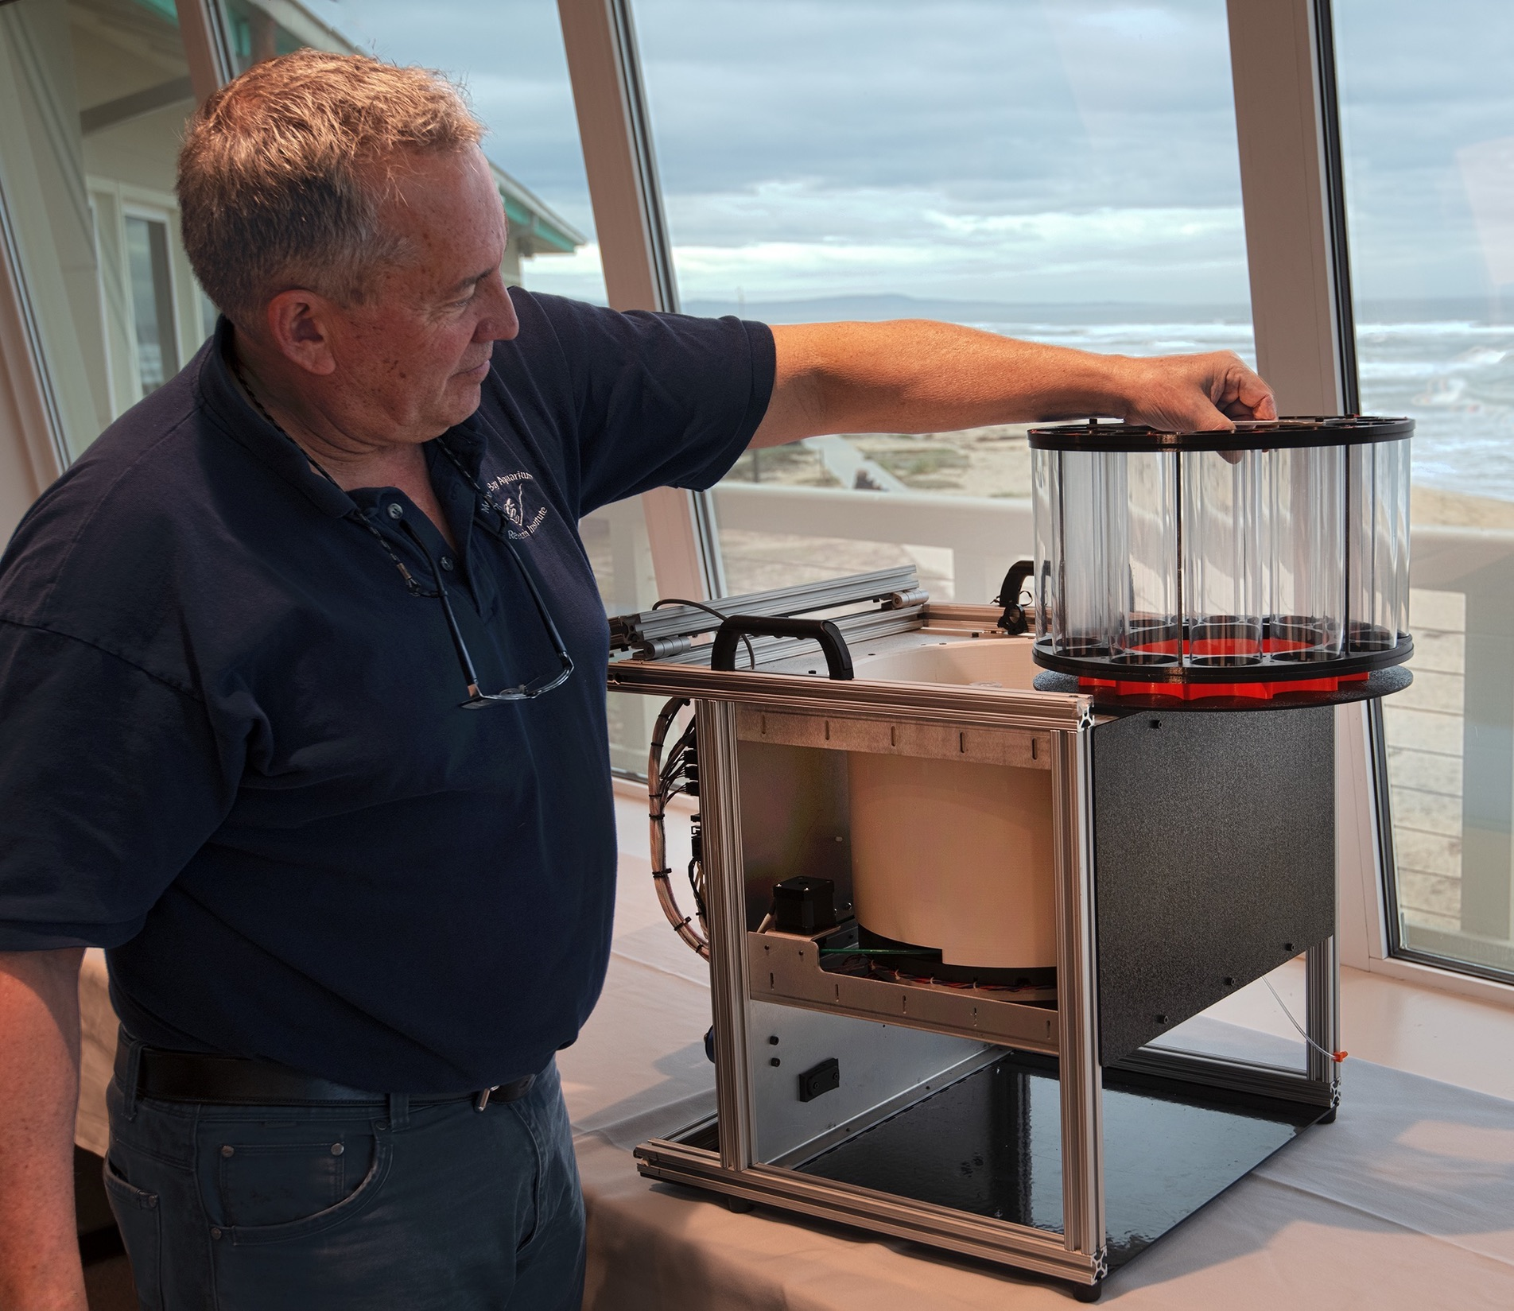
FIDO: Filtering Instrument for DNA Observations

Slide 13
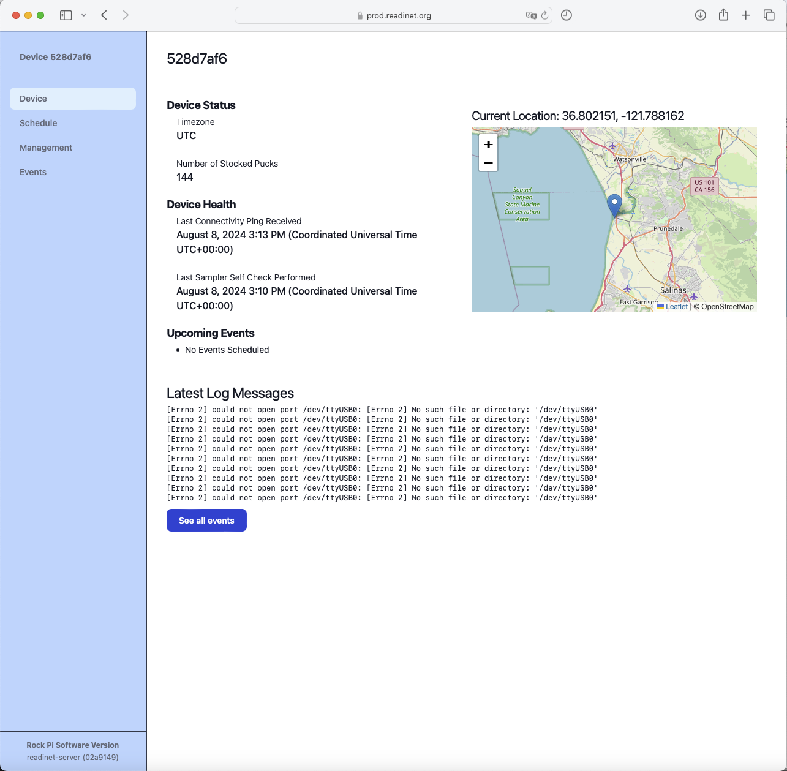
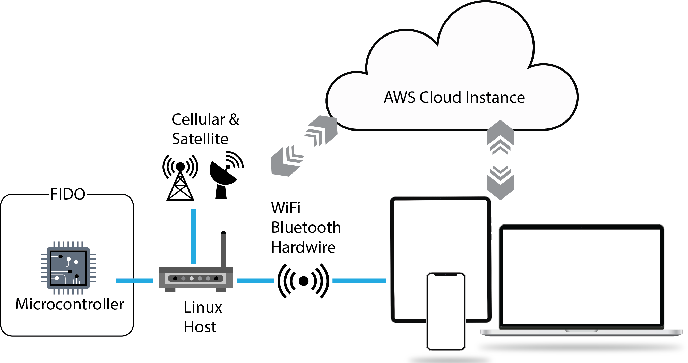
Communications and Web Interface
Notes:
We also utilized the MOSCOW framework to develop the communication and GUI requirements. And these are the end products based around web-based application interface using a cloud instance and satellite or cellular communications we can access and control these instruments anywhere in the world.
And on the left is summary page of the instrumentation provide a bit of instrument state, its location, and any important log information.

Slide 14
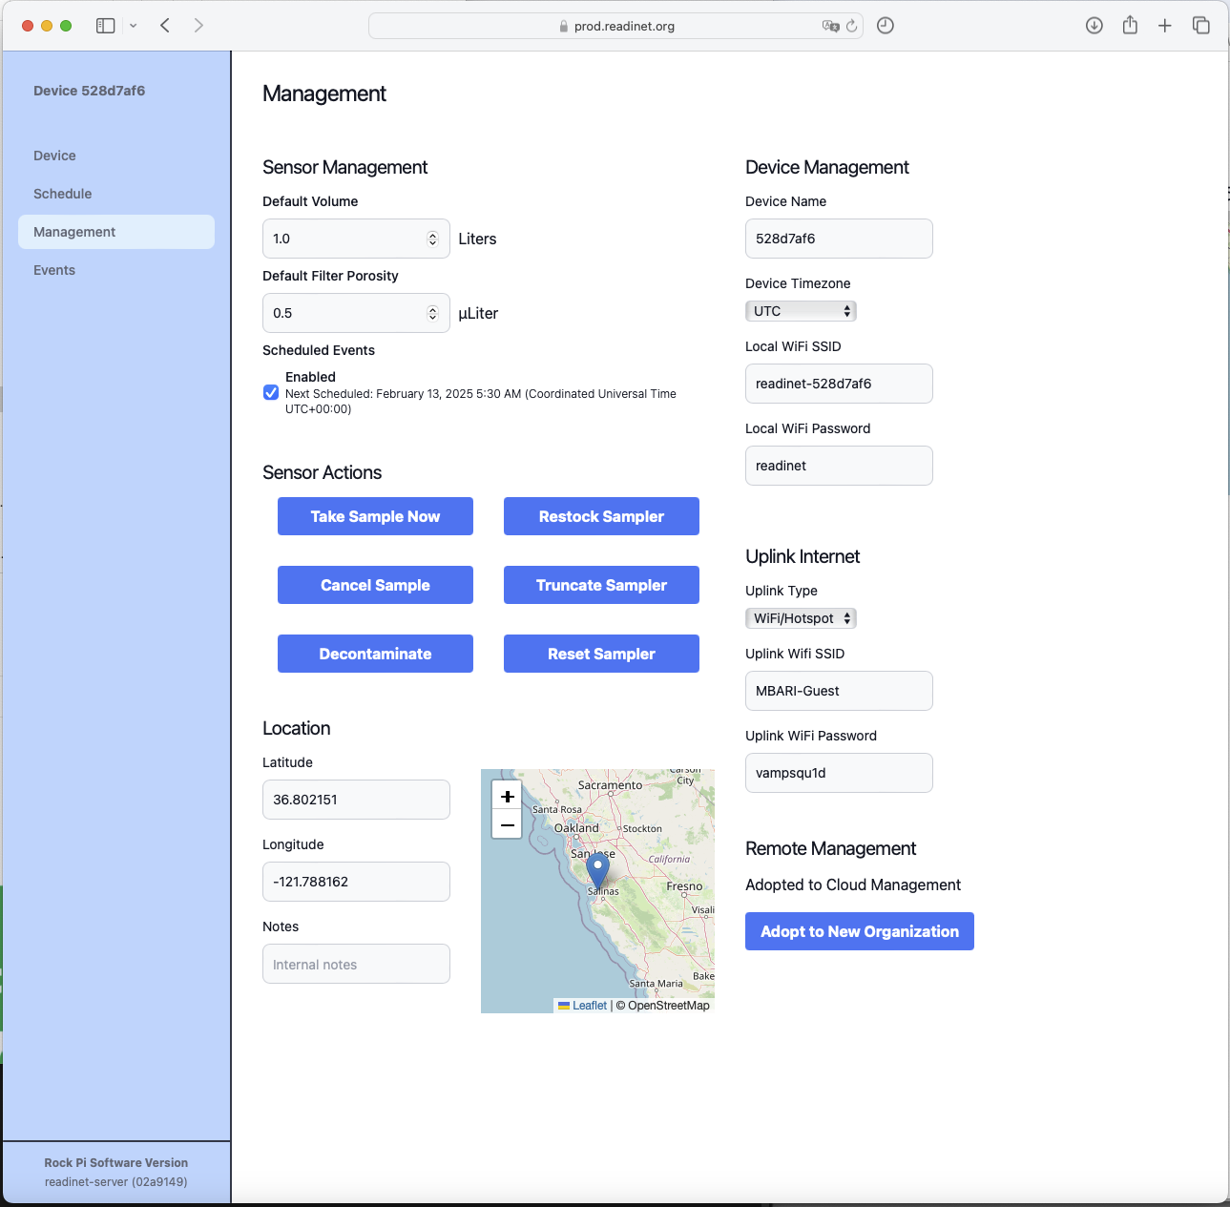
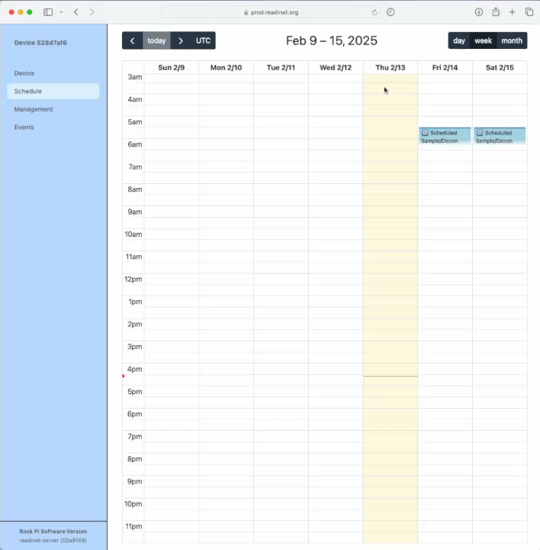
GUI Management and Scheduler
Notes:
Here are two additional screenshots of the GUI, on the left is the management page and the left is the schedule page. The management page allows us to directly interact with the instrument and provides end-users the ability to take a sample, define sample volumes, resupply the sampler and decontaminate the samples. We spent a bunch of time on the GUI scheduler, using a google calendar approach for being able to simply schedule sampling for future events. And this video is showing those functions of scheduling recurring events.

Slide 15
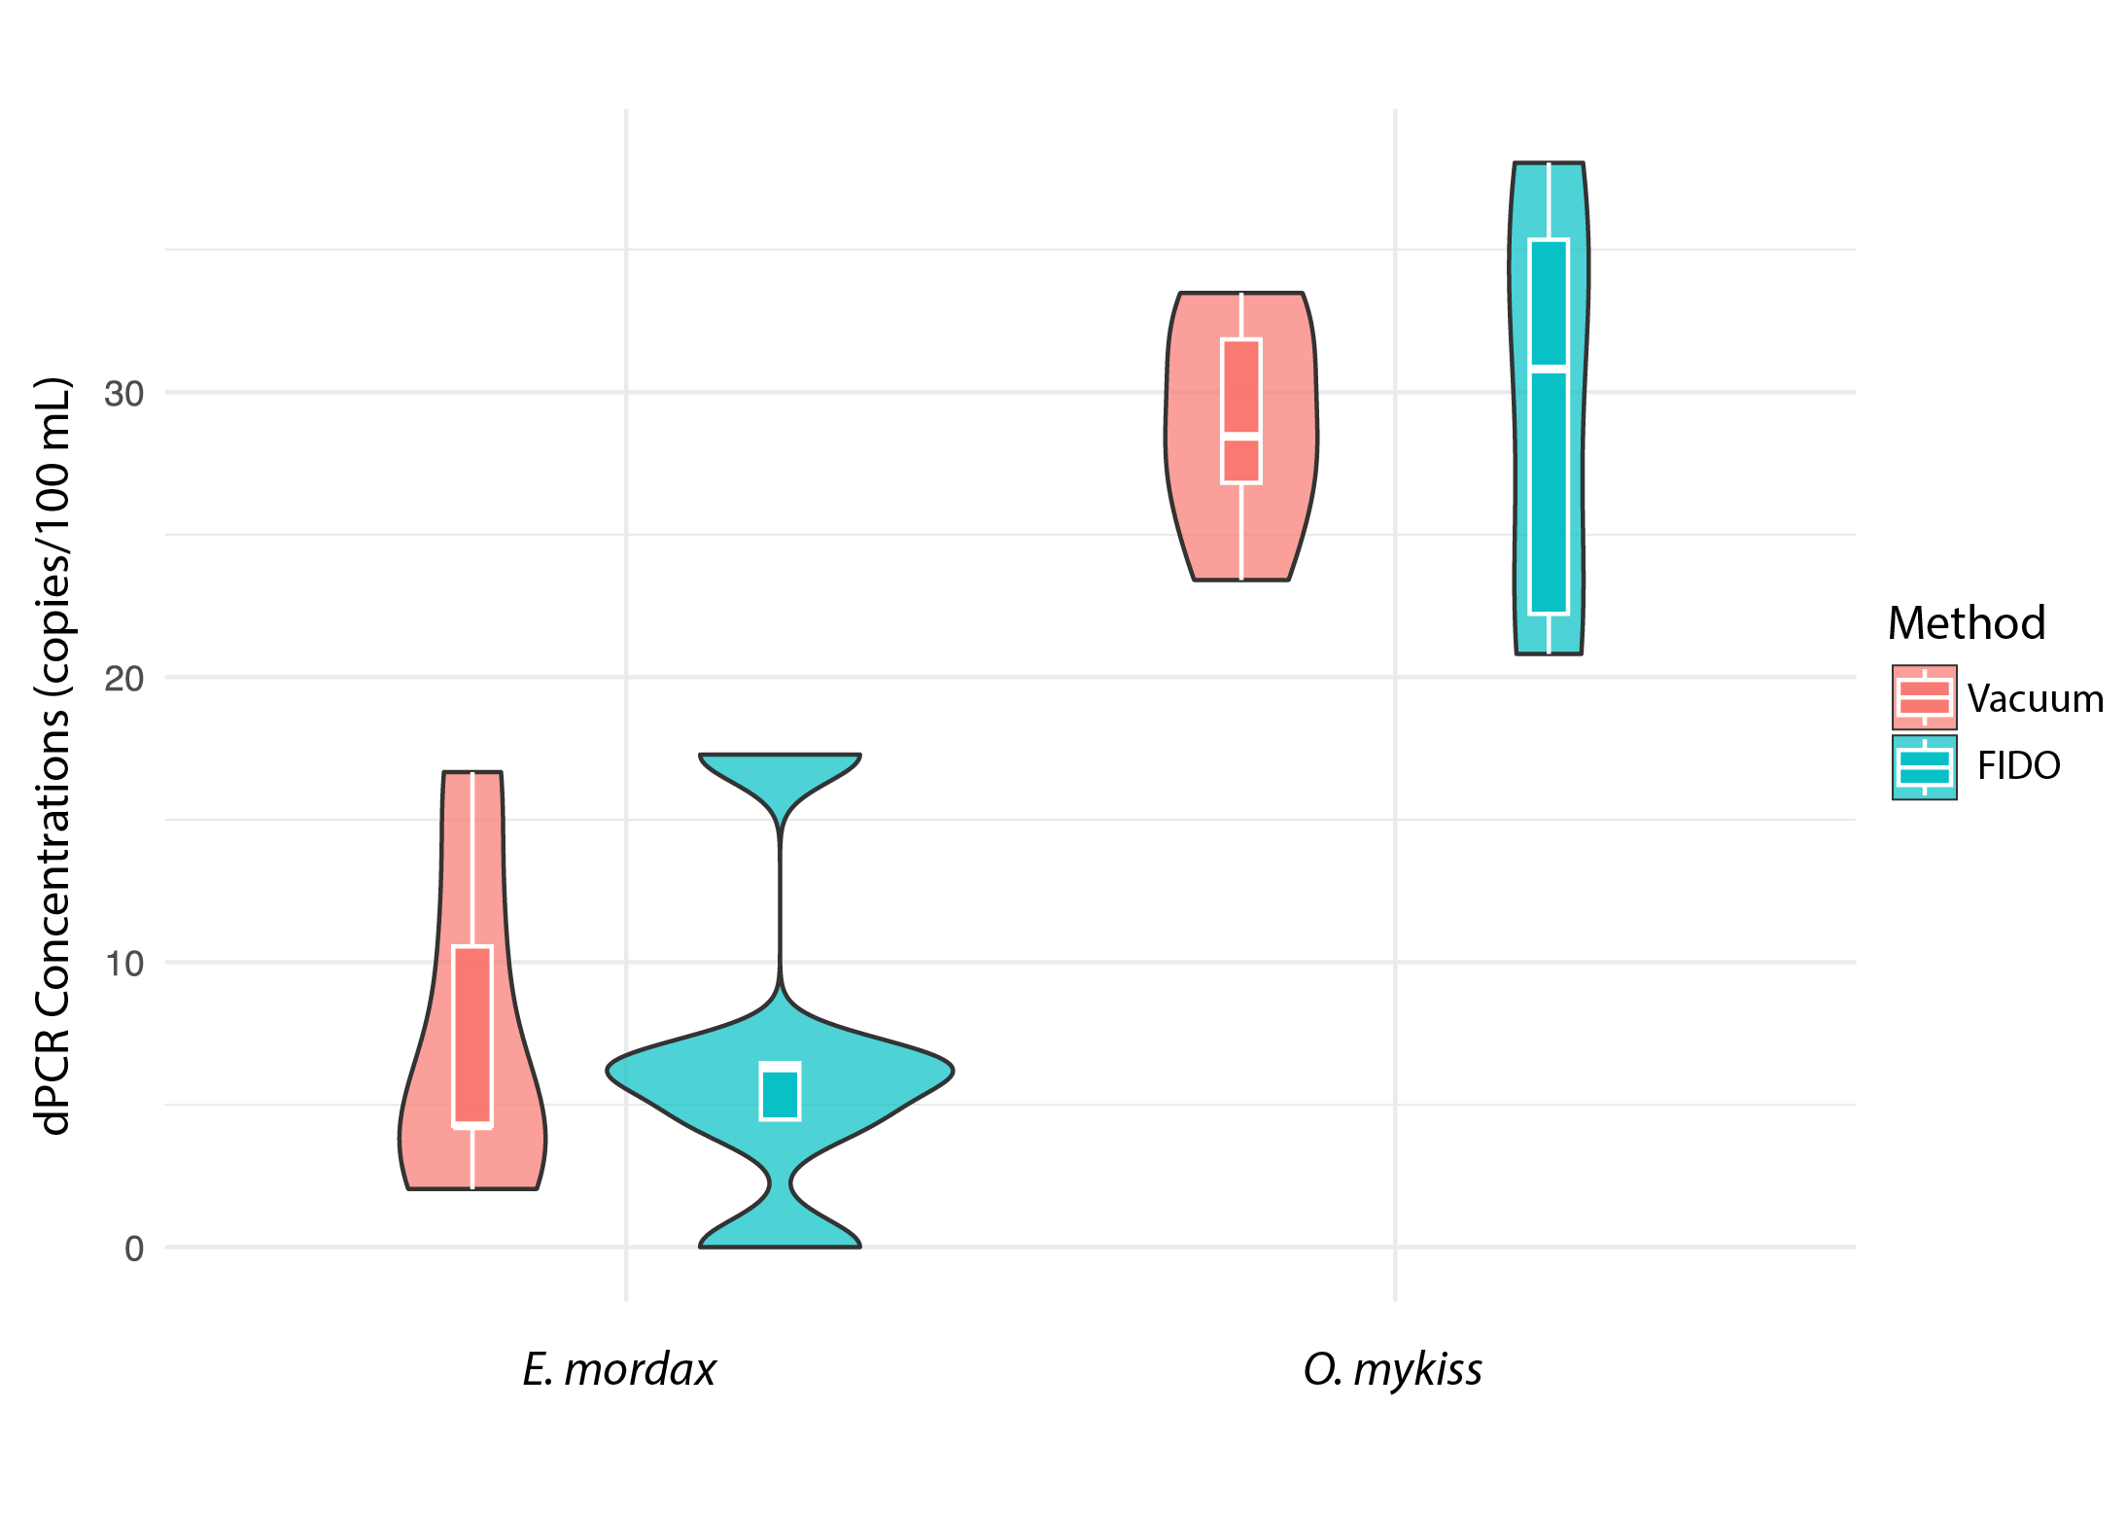
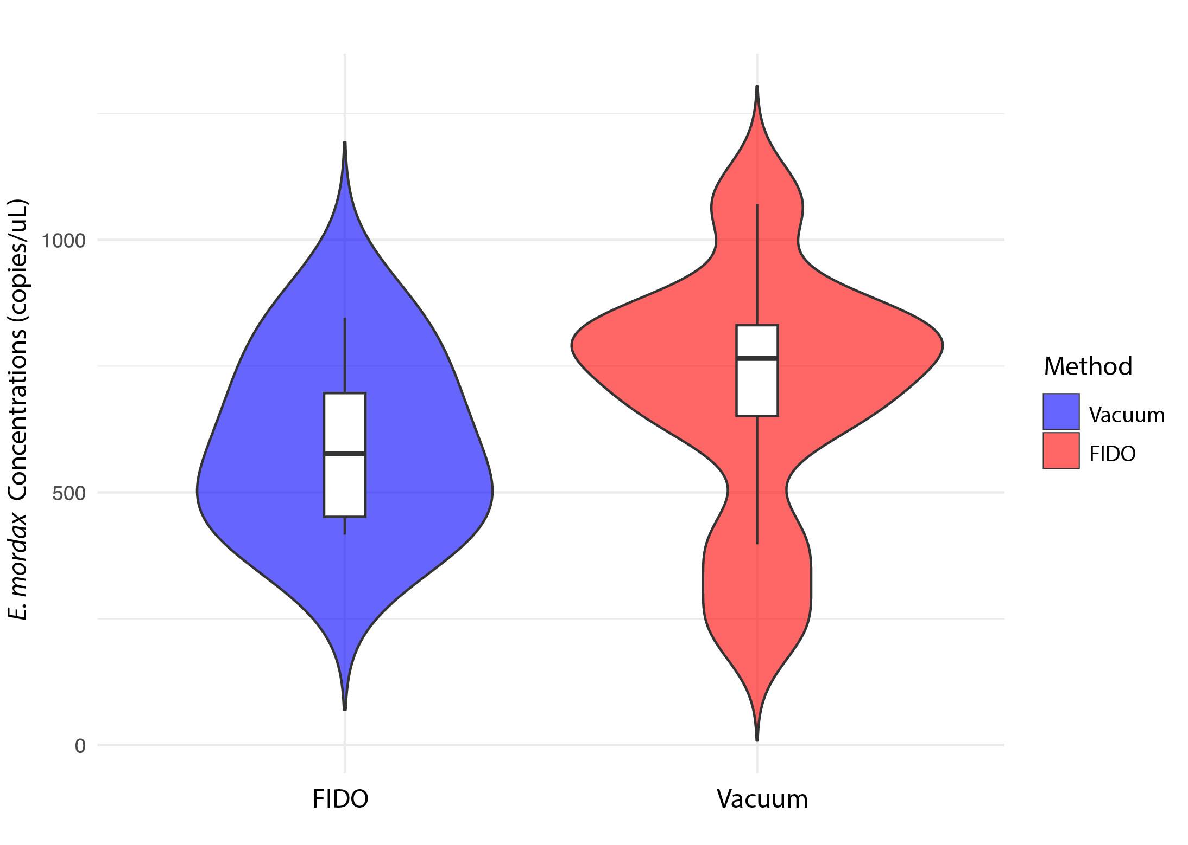
FIDO dPCR and qPCR Validations
dPCR Anchovy and Rainbow Trout
qPCR Anchovy
Notes:
So now onto the data.
Here I am showing some initial digital PCR data for validation filtration of anchovy and rainbow trout. The red violins are the matched vacuum filtration method and the green violin are the FIDO filtrations. dPCR concentration of the target eDNA on the y-axis. This experiment was performed after we had finalized the filtration housing or puck design.
More recently, as part of a larger instrumentation validation study in November. We performed a similar study using qPCR for anchovies, where the vacuum filtration, is now shown in blue and FIDO is show in red.
For all of these comparsons, there was no significant difference between vaccum filtration and FIDO filtrations.

Slide 16
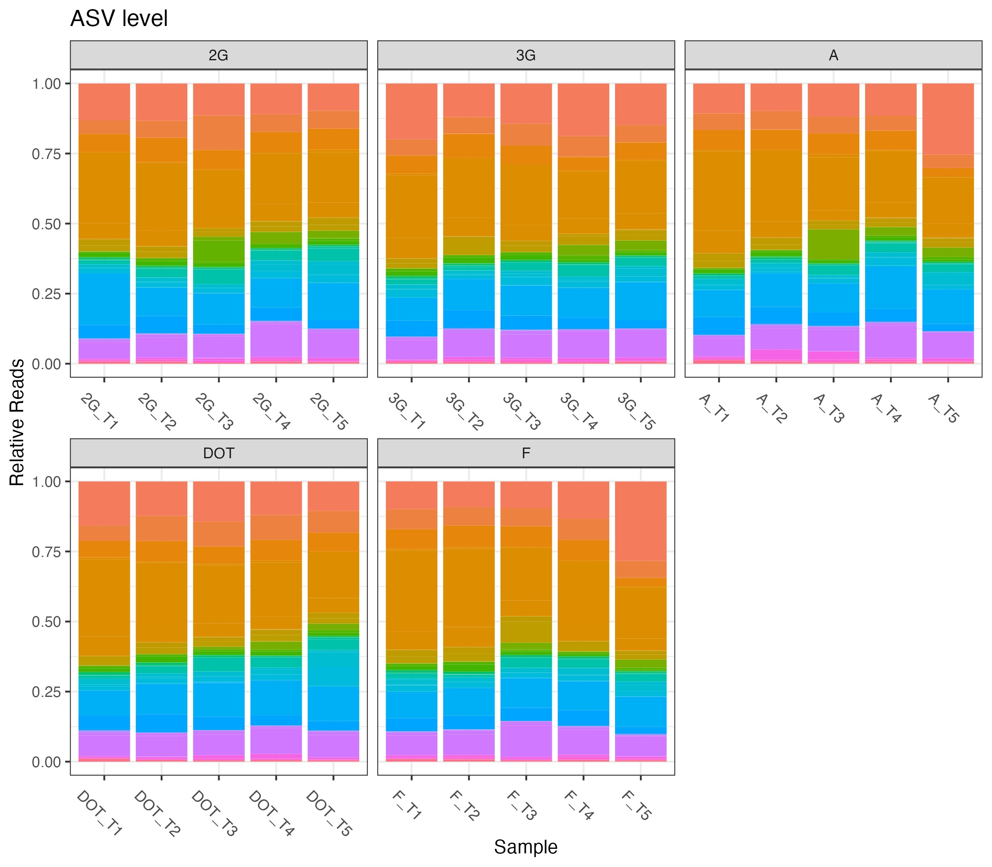
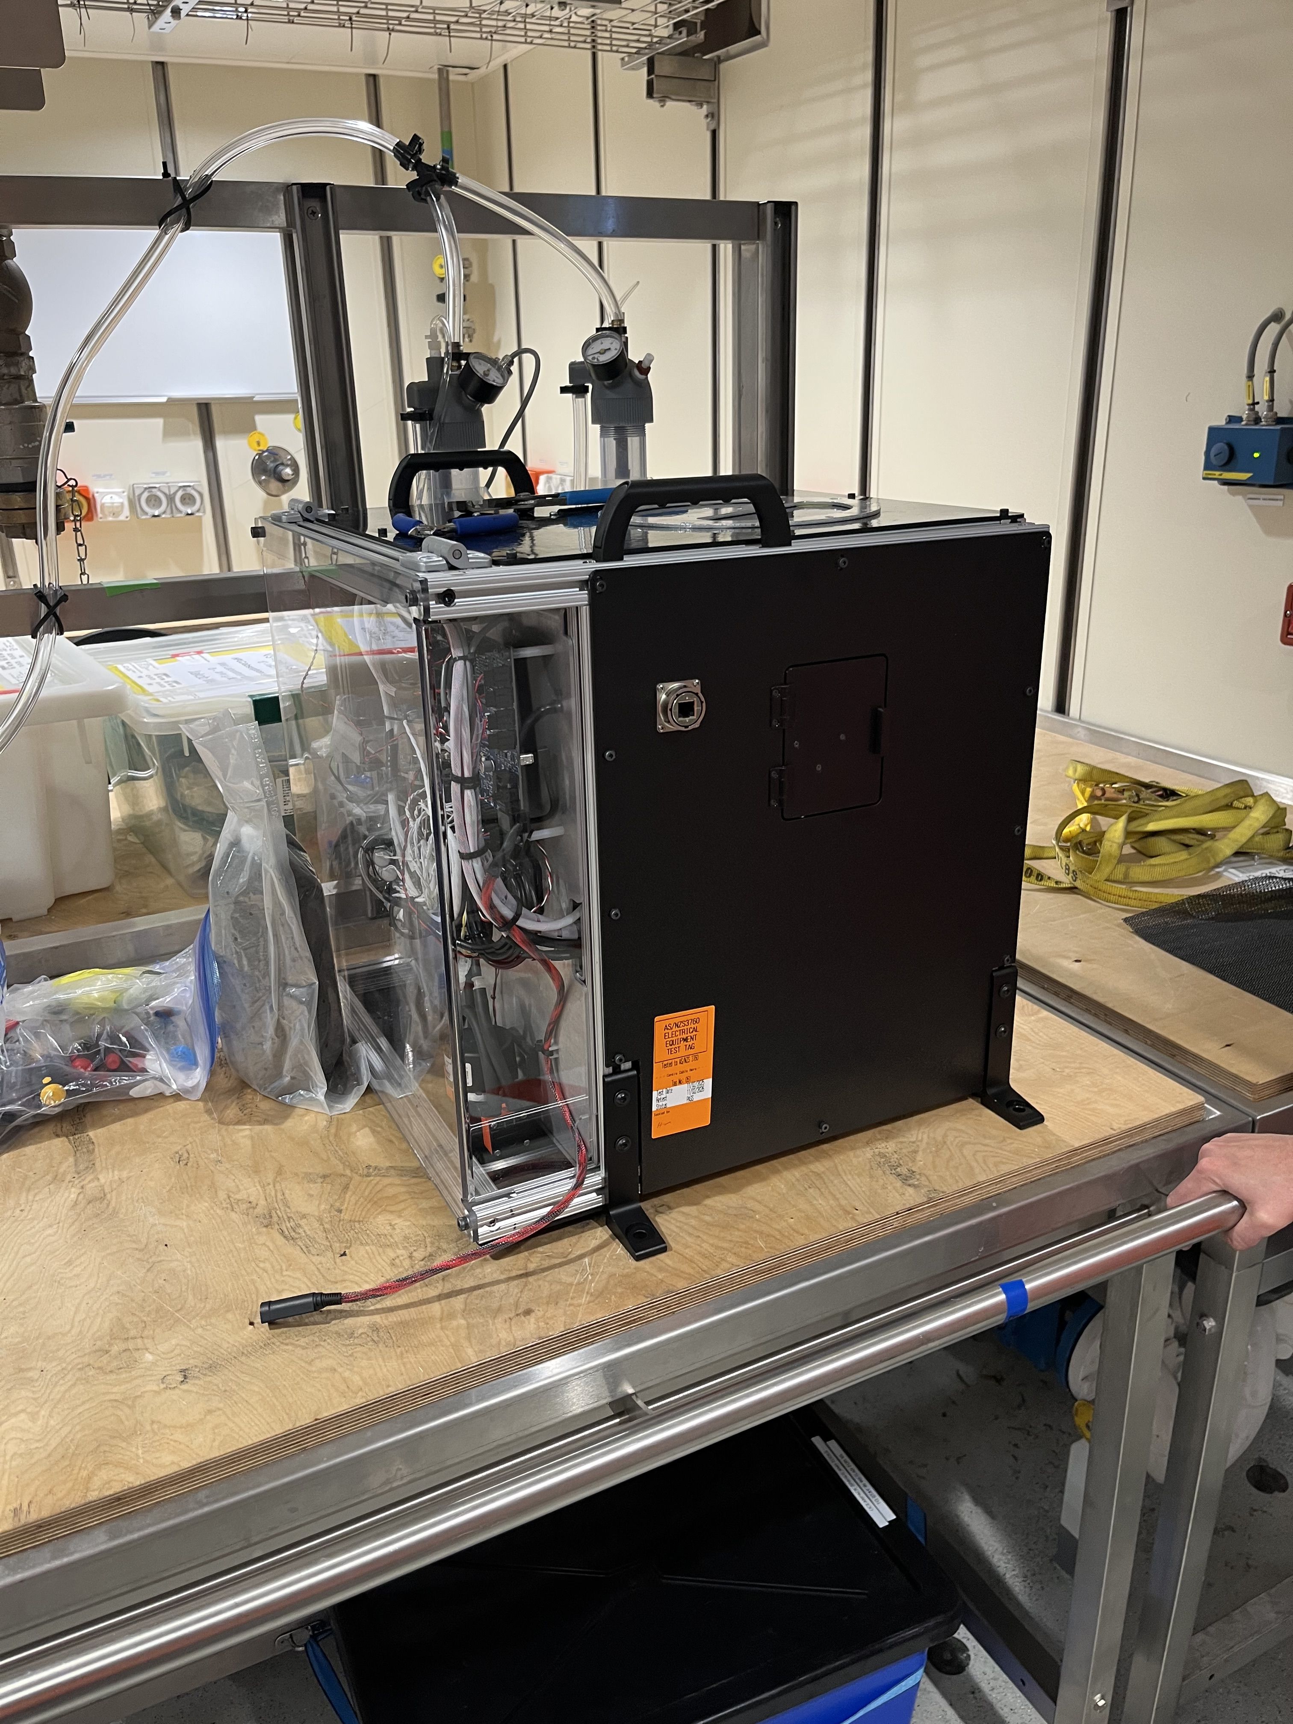
Next Steps
Validation is continuing
  qPCR and metabarcoding
READi-net Implementation in 2025
  10 production units are currently being built
ASV Level – 12S MiFish
Relative Reads
Courtesy of Eily Allan
Integration on-board research vessels
Notes:
So what are the next steps.
As part of a larger instrumentation validation study, we will continue validation of FIDO filtrations with 12S Mifish Metabarcoding and here is the metabarcoding data that we received last week and plotted yesterday by my partner in crime Elizabeth Allen at the eDNA Collabortive.
We are currently building 10 production instruments for the READI-net program that will be field test this year.
And we are currently investigating the installation of these instruments on research vessels to sample underway water during research cruises. In fact, a few members of our team are in Hobart outfitting the Nuryia for their upcoming anartica cruise.

Slide 17
Take Aways
There is no single “silver bullet” instrument for each application or use case
  Each instrument is designed for an intended purpose with specific design requirements
Instruments should be co-designed for intended use cases / applications
  Or applications should be matched to appropriate instrumentation
Proper validation build confidence in data and reduces operational risks

Slide 18
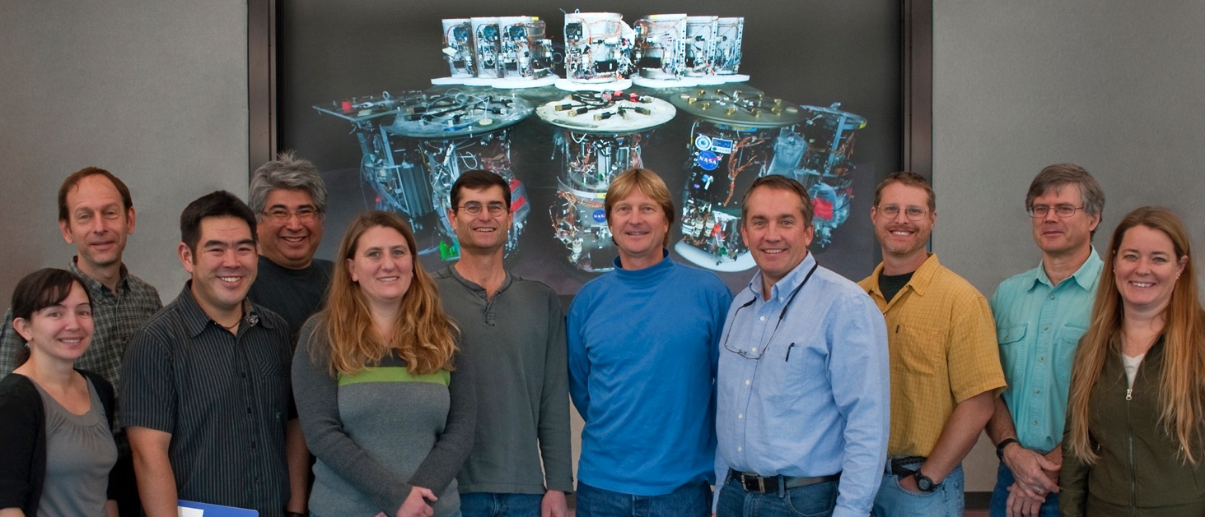
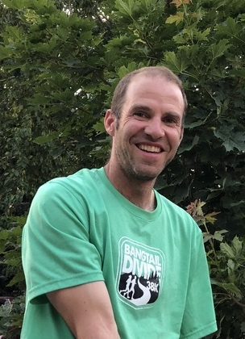


Acknowledgements
MBARI ESP Team
Adam Sepulveda

