Slide 1
FIDO: A Low-Cost, Scalable Autonomous Robot for Environmental DNA Sampling and Preservation
Enoch Nicholson, Scott Jensen, Adam Sepulveda, Kevan Yamahara, James Birch
OCEANS Brest
June 18th, 2025

Slide 2
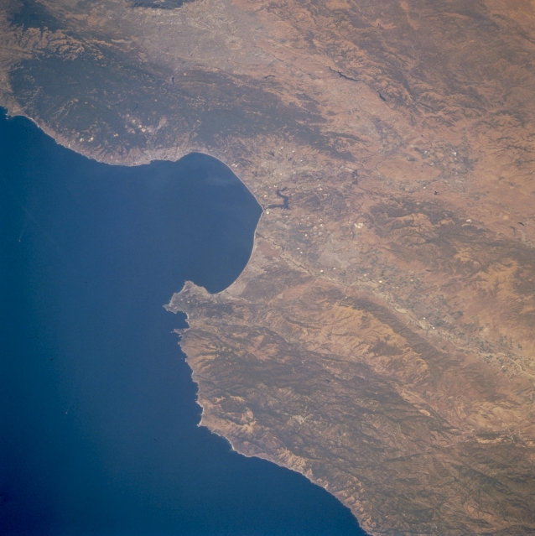

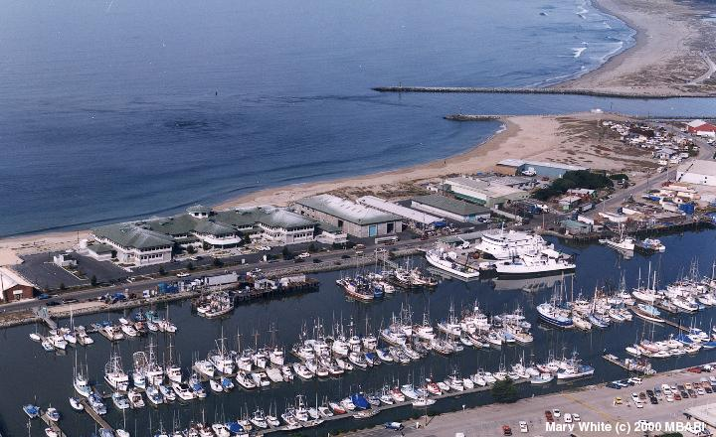
MBARI (Monterey Bay Aquarium Research Institute)
We are here

Slide 3
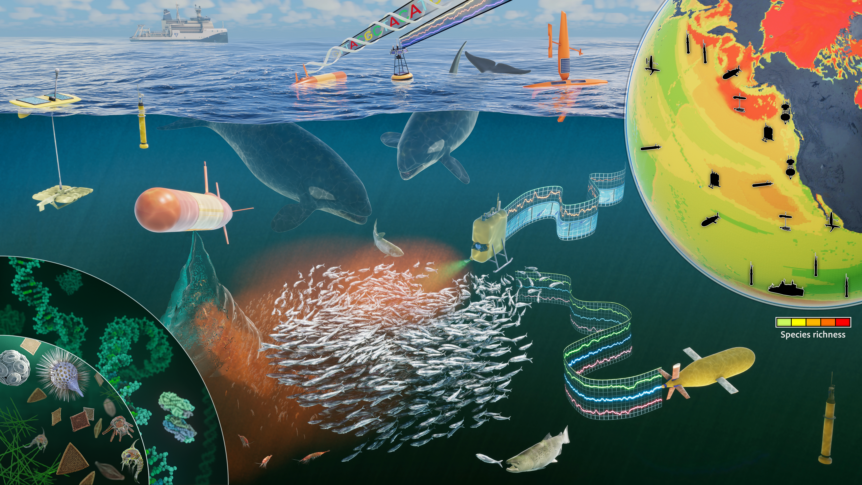
MBARI (Monterey Bay Aquarium Research Institute)

Slide 4
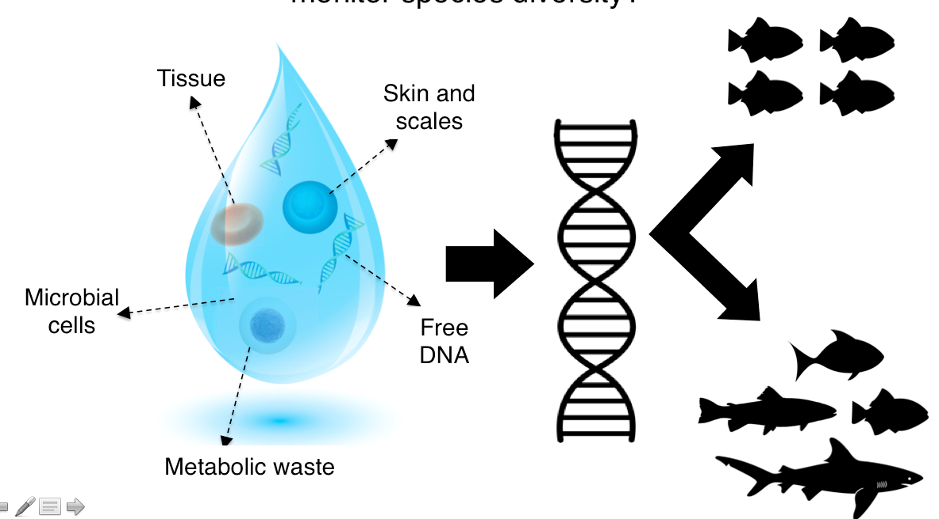
Environmental DNA (eDNA) and marine biodiversity assessments

Slide 5
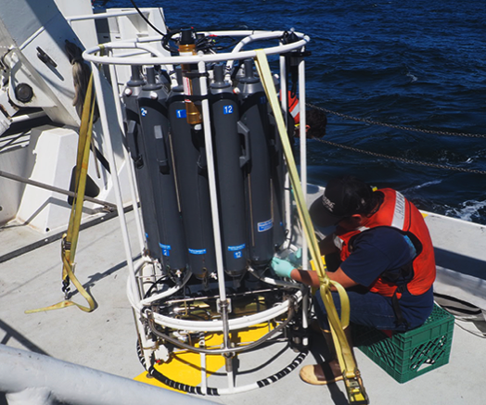
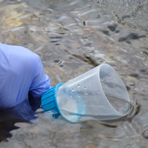
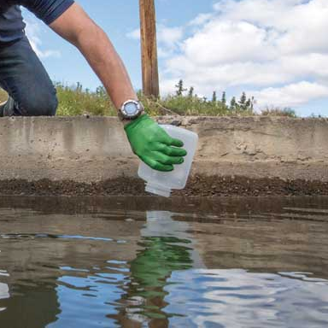
eDNA requires sample collection
In the quest for answers, this is boring…

Slide 6
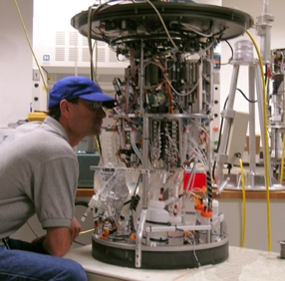
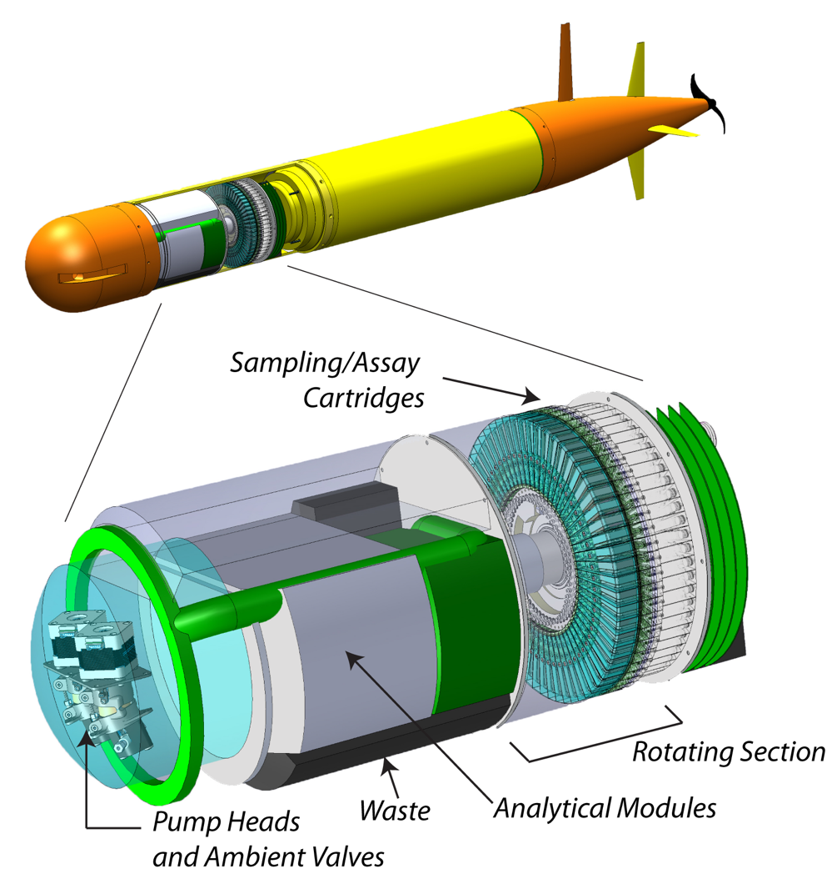
Environmental Sample Processor
2nd Generation ESP
3rd Generation ESP
Notes:
For almost 3 decades our team has been developing the ESP or environmental sample processor. Starting with the 2G ESP on the left and 3G ESP on the right. I am happy to discuss these instruments with folks, but I really want to hone in on their design requirements
Both of these instruments were designed with the idea providing in situ analytical capabilities. Where we are no longer returning samples back to the lab but instead sending back data. Moreover, functional these instruments were designed for submerged deployments in the ocean either on stationary moorings, in the case of the 2G ESP or mobile deployments on 3G ESP using AUV.
These are very specific requirements that enable us to ask and solve different scientific research questions.

Slide 7
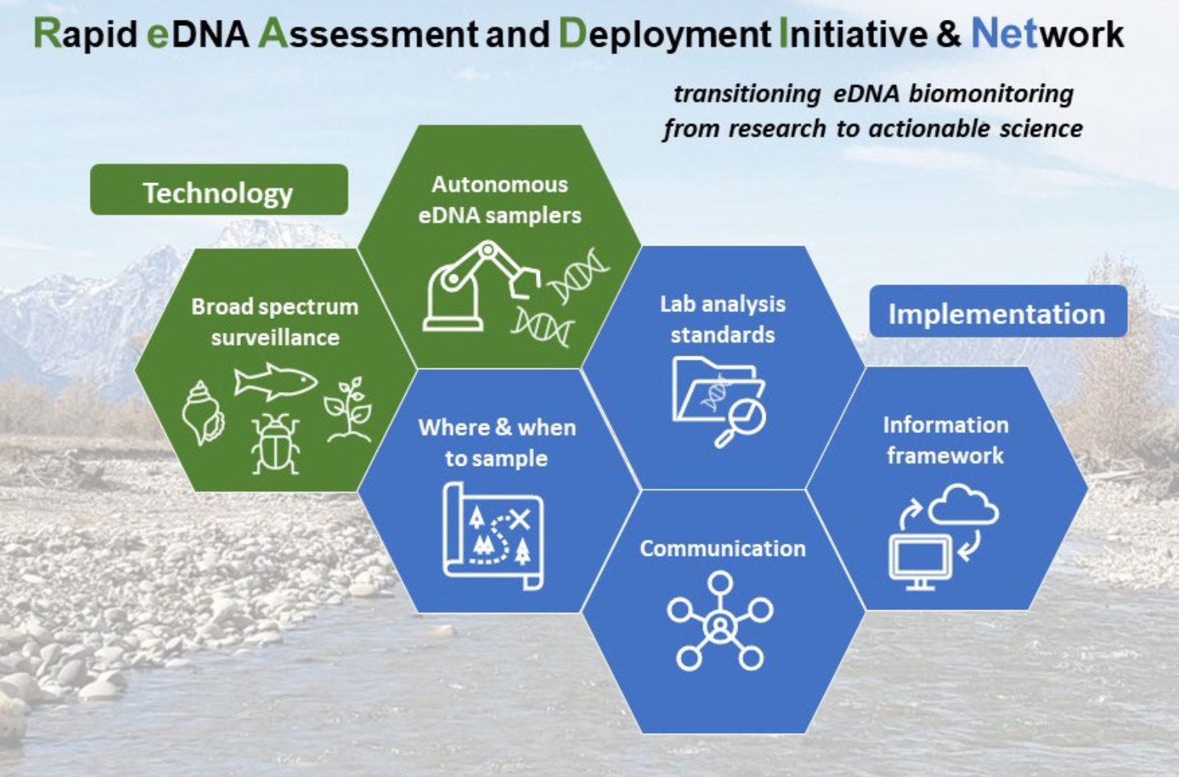
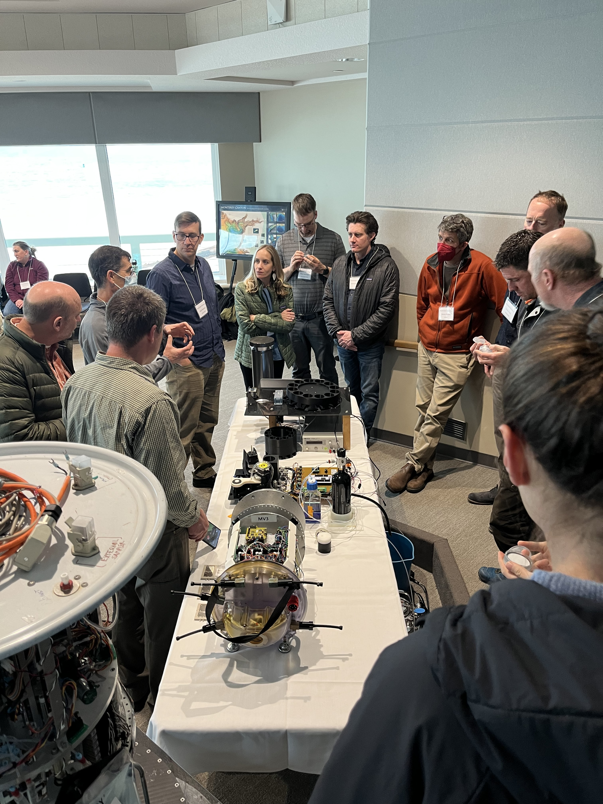
READI-Net
Courtesy of Adam Sepulveda - USGS

Slide 8
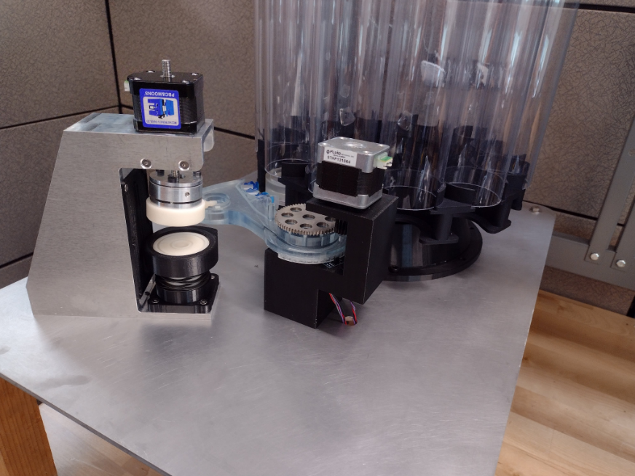
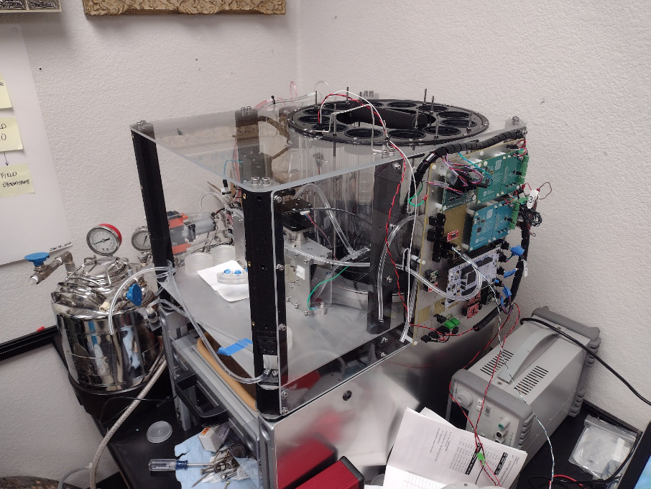
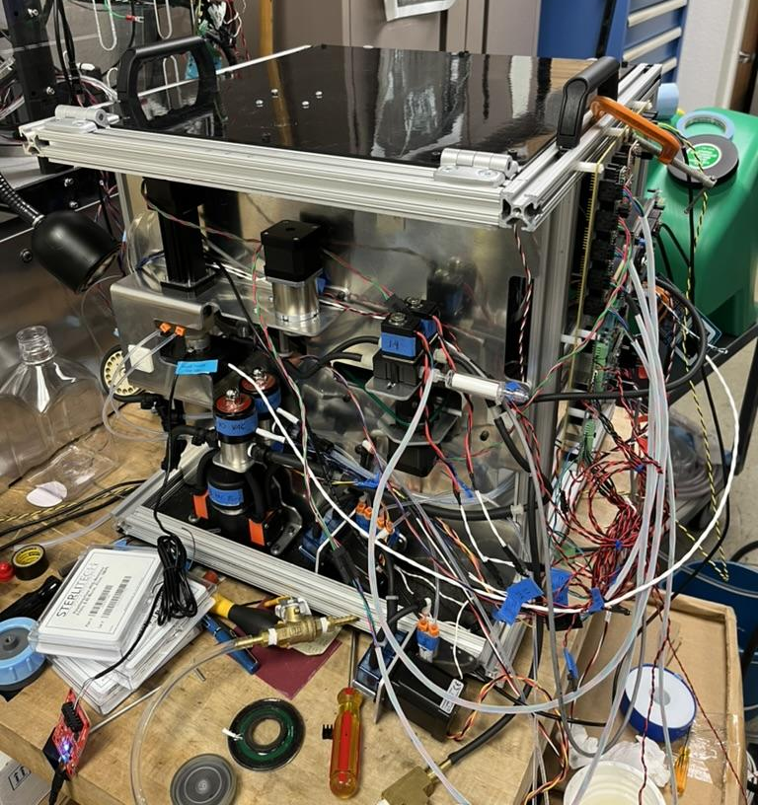
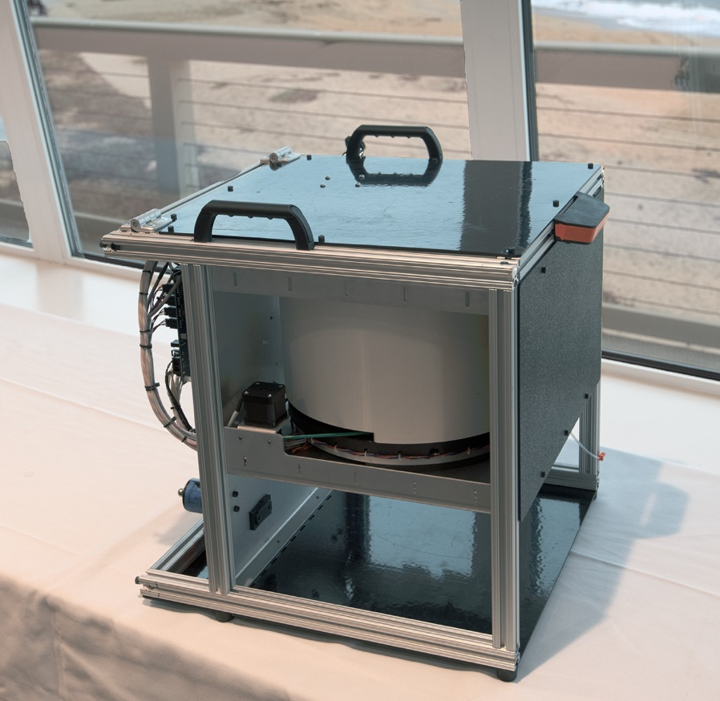
FIDO: Filtering Instrument for DNA Observation
Hardware:
Affordable enough for wide adoption
Acquire at least 100 samples
Deployable by 2 people (max)
Simple setup and maintenance
System must decontaminate itself
Comms options (WIFI, Bluetooth, Cellular, Satellite)
Maximize sample volume
Software:
Device should have two-way communication
Control via simple web-based GUI
Sample data logging (volume, date-time, flowrate)
Manual and Schedule-Based Sampling
Instrument State (Current State)

Slide 9
FIDO: Instrument Overview

Slide 10
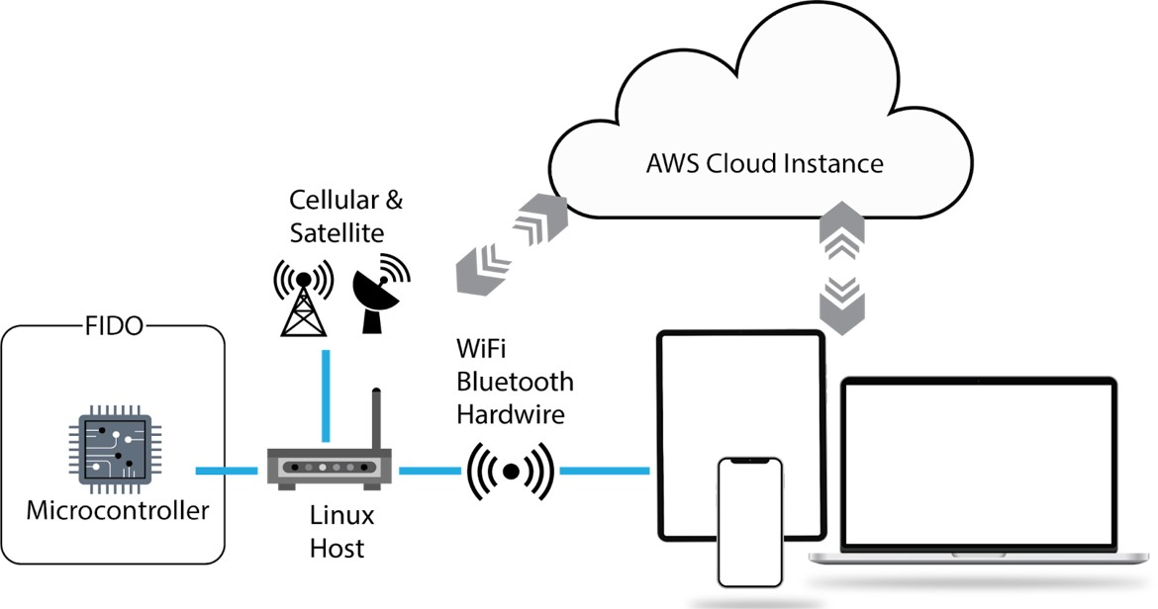
FIDO: System Architecture

Slide 11
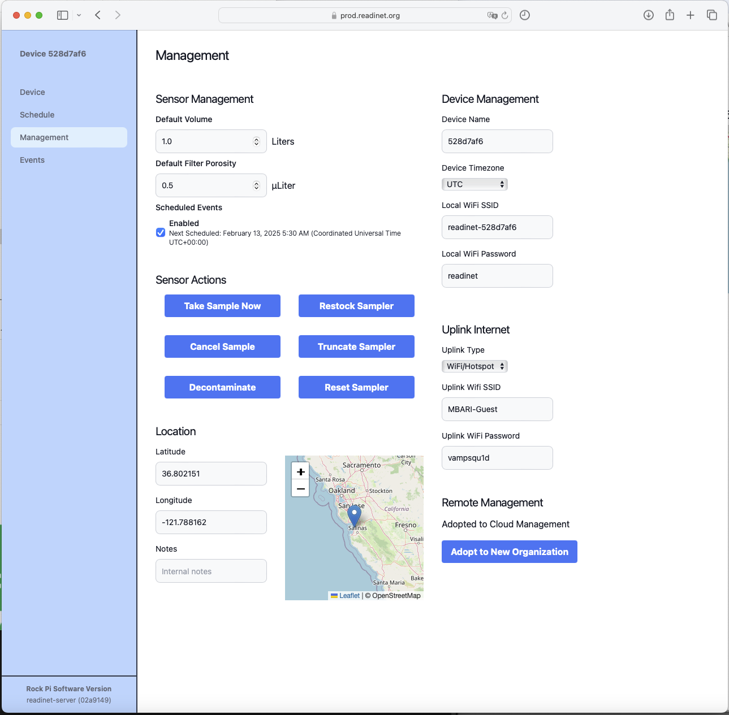
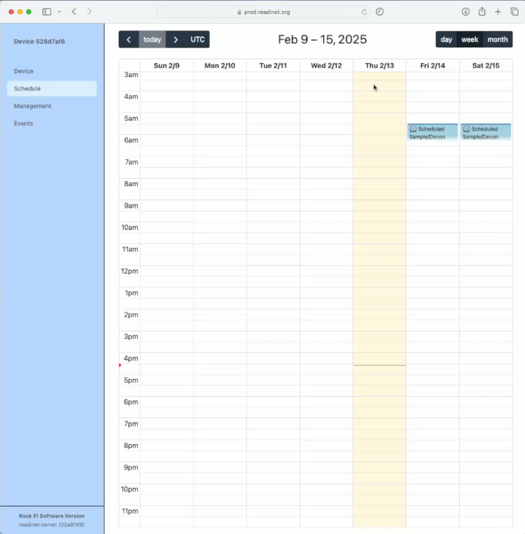
FIDO: GUI Control

Slide 12
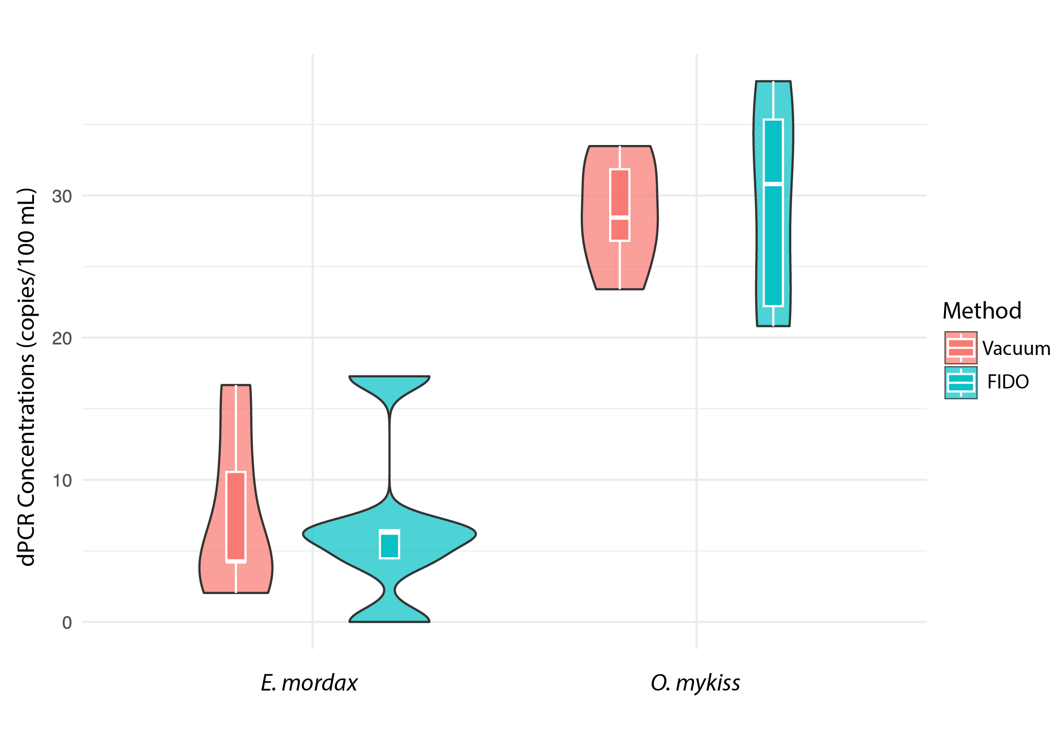
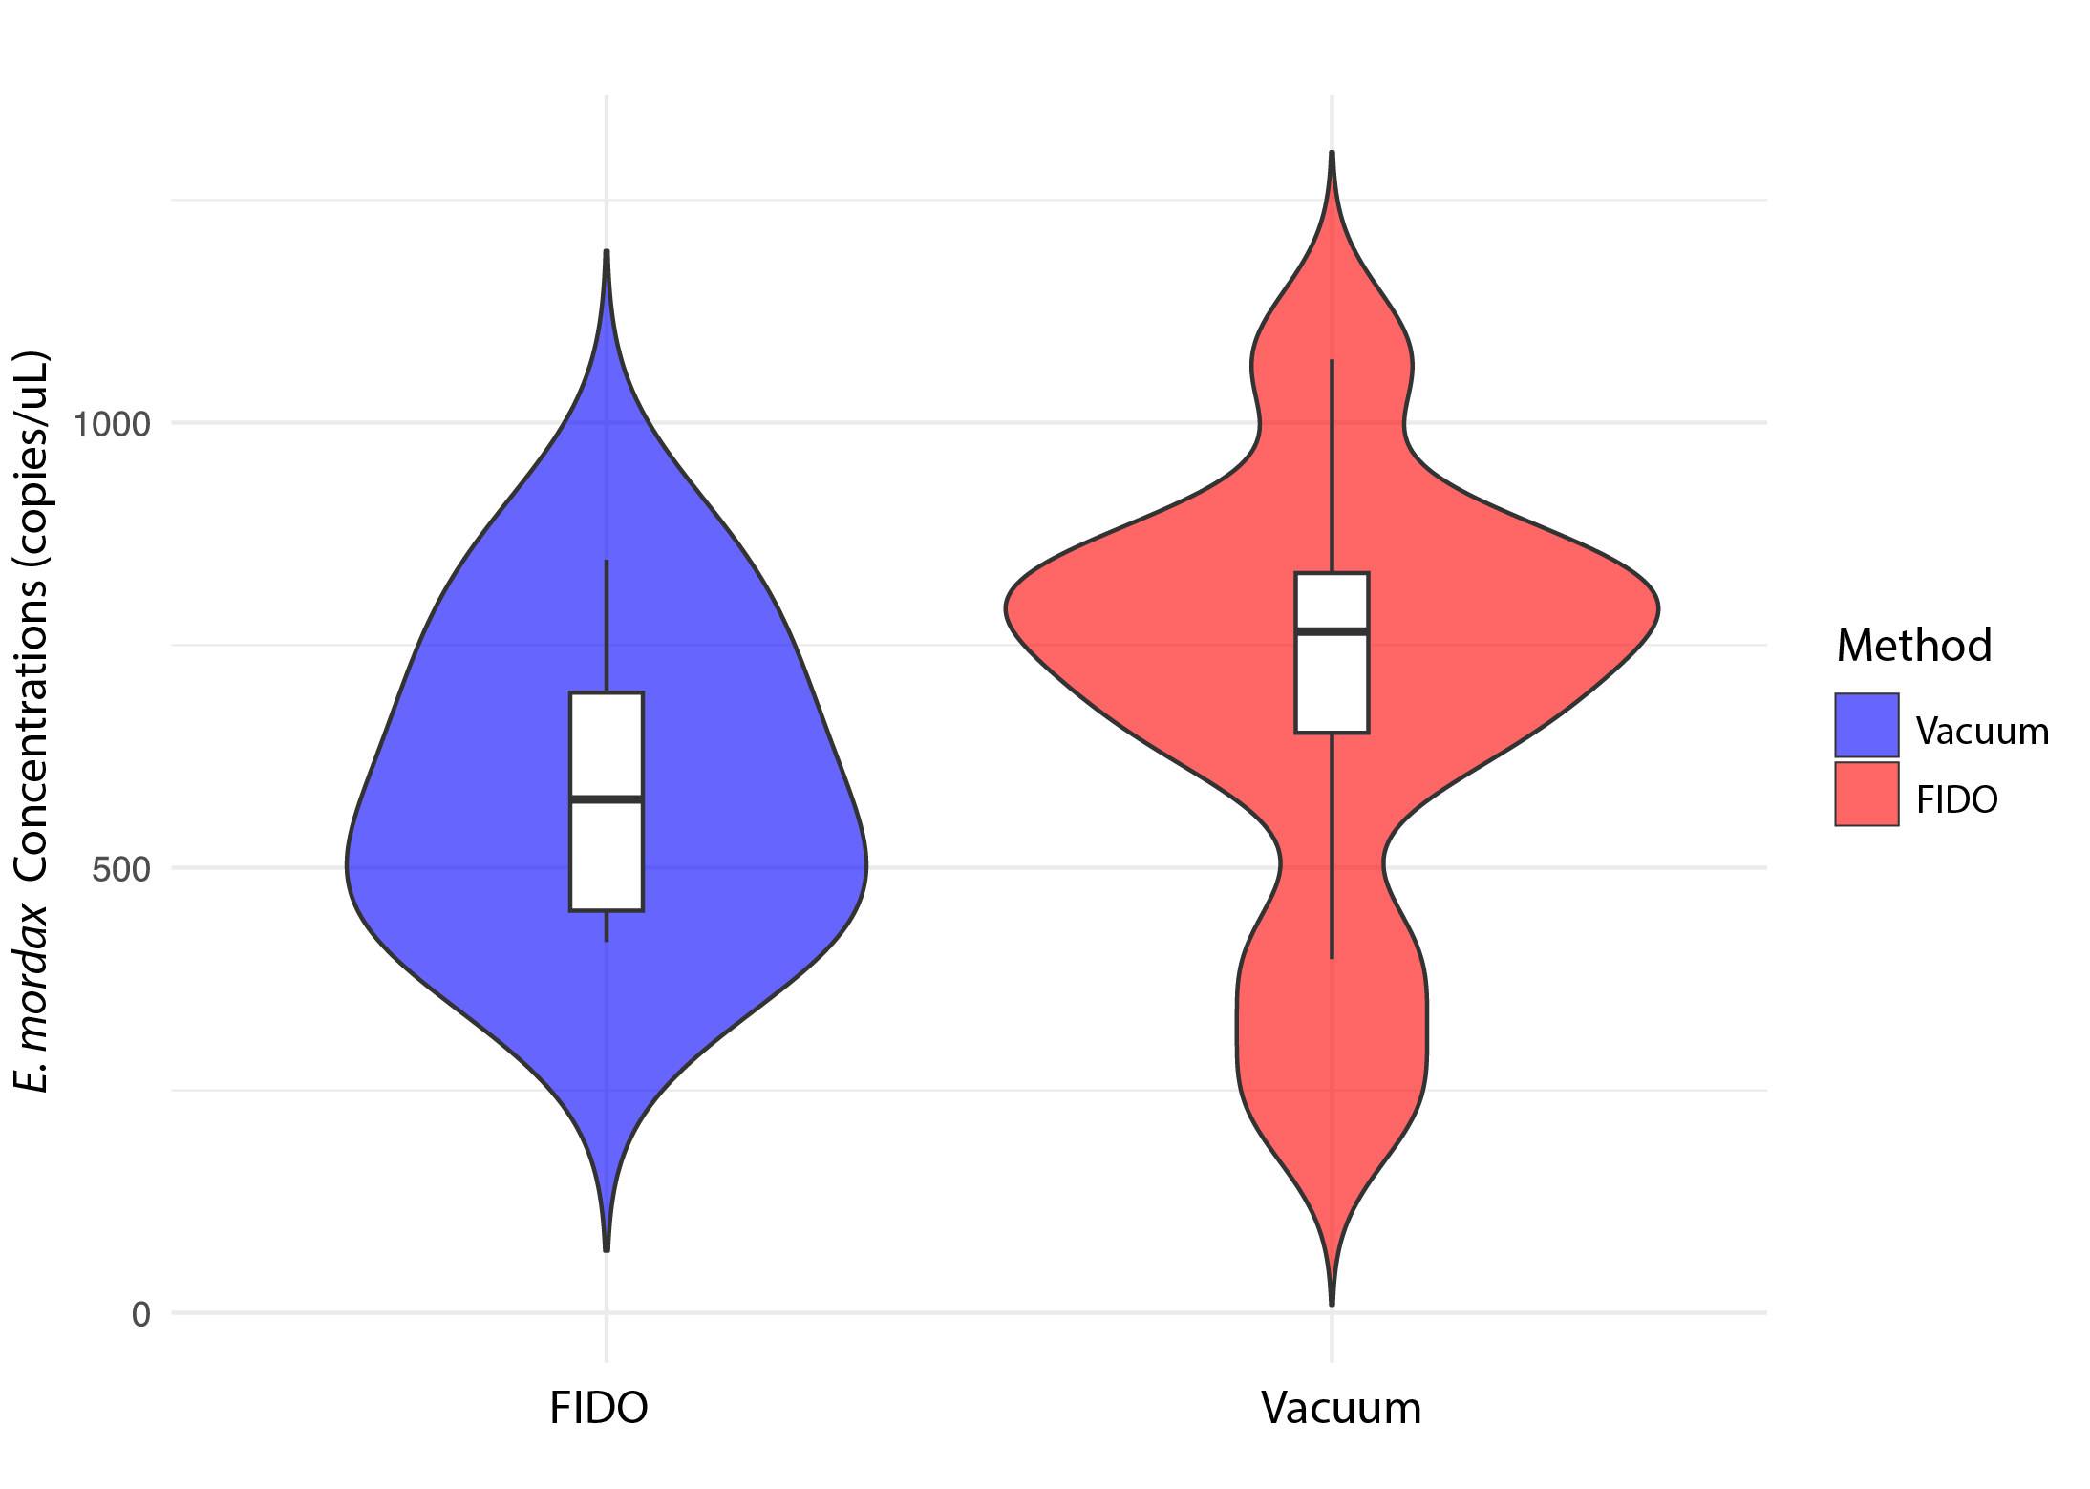
Testing & Validation: Laboratory Work
dPCR Anchovy and Rainbow Trout
qPCR Anchovy

Slide 13
Testing & Validation: Field Tests

Slide 14
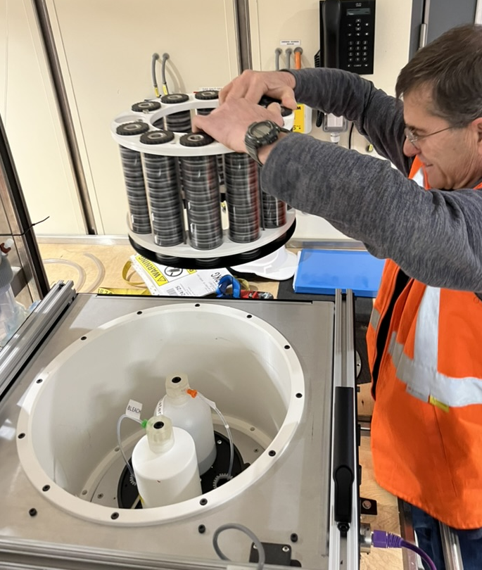
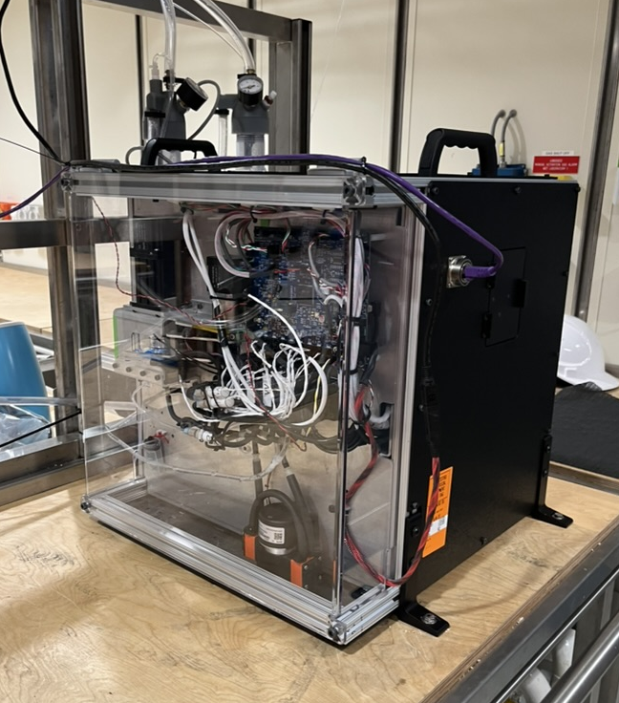
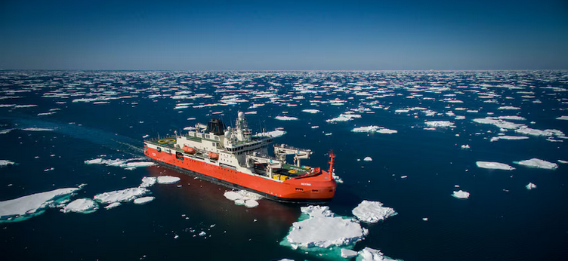
Next Steps
Validation is continuing
  qPCR and metabarcoding
READI-Net Implementation in 2025
  10 production units are currently being built
  Open to collaborate on field deployments
  Looking to license to commercial vendor
PICTURE OF THE BUILD
Integration on-board RSV Nuyina

Slide 15
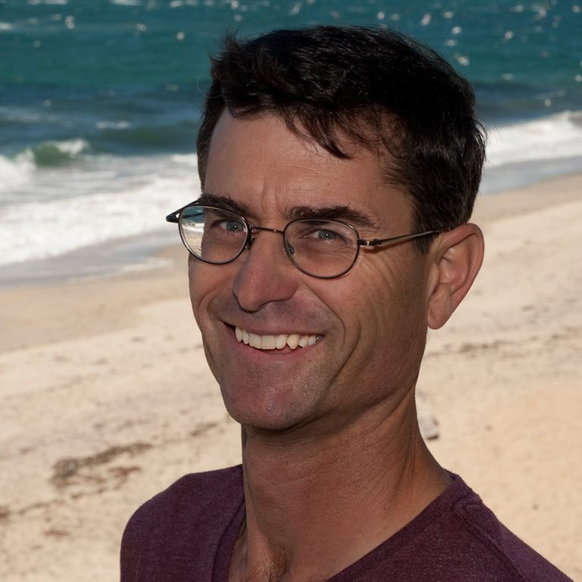

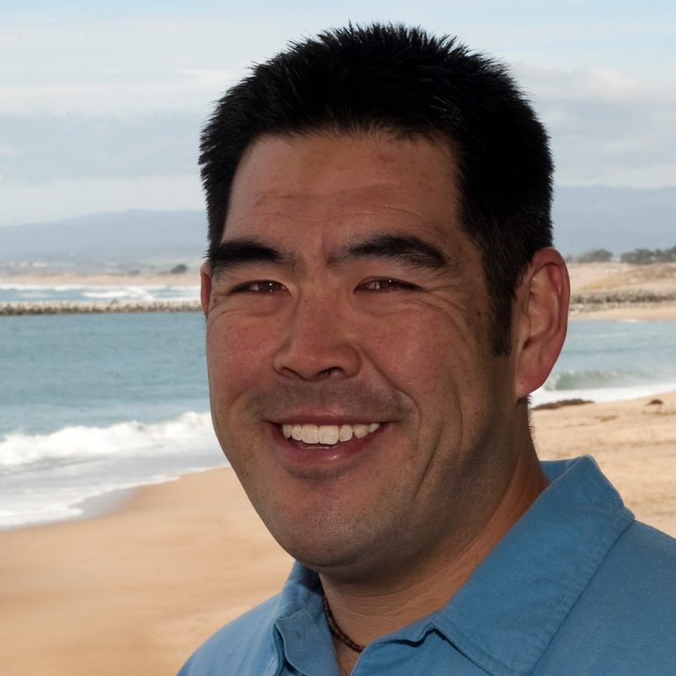
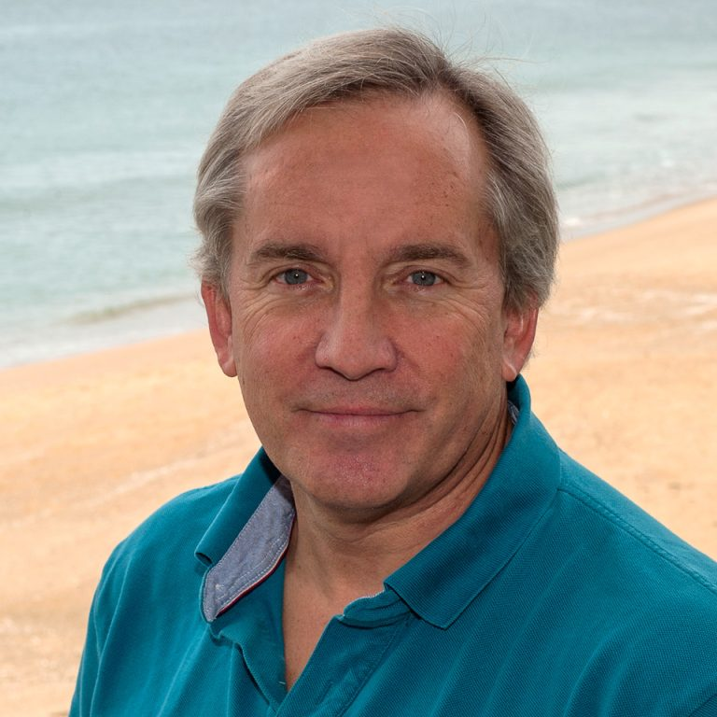
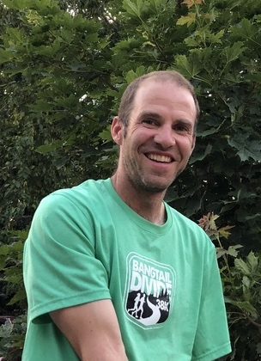
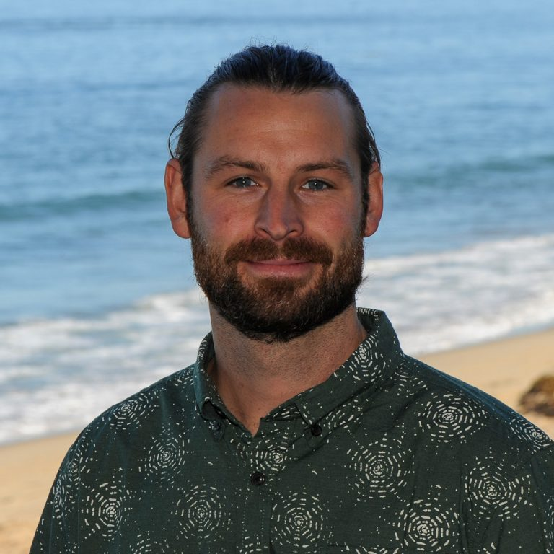
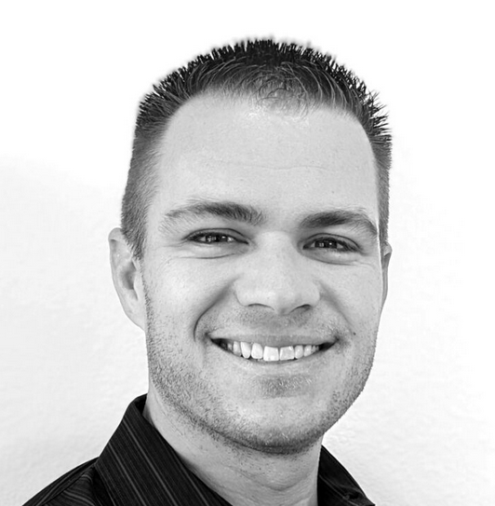
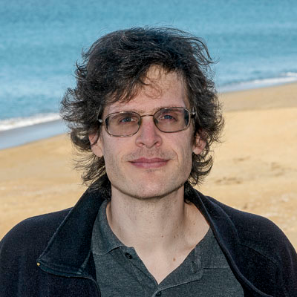
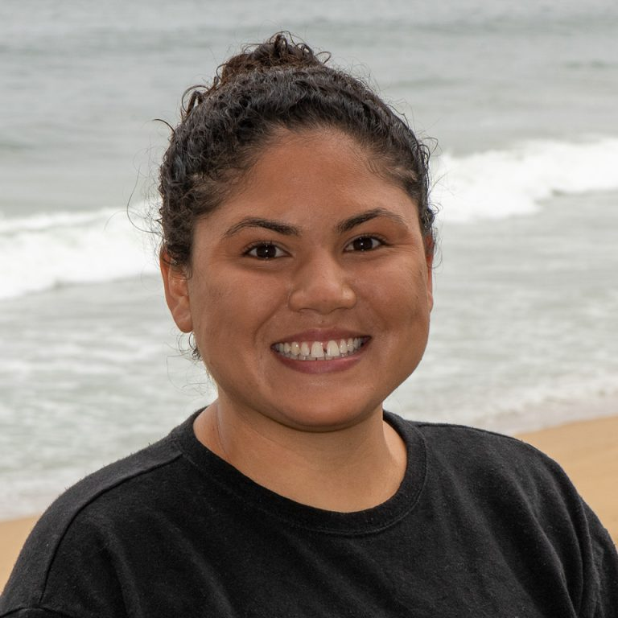


Acknowledgments

