Slide 1
FIDO: A Low-Cost, Scalable Autonomous Robot for Environmental DNA Sampling and Preservation
Enoch Nicholson, Scott Jensen, Adam Sepulveda, Kevan Yamahara, James Birch
OCEANS Brest
June 18th, 2025
Notes:
Good morning, everyone. I'm Enoch Nicholson from the Monterey Bay Aquarium Research Institute, and I'm excited to share our work on FIDO - a low-cost, scalable autonomous robot designed specifically for environmental DNA sampling and preservation. This work represents a collaboration between MBARI and the United States Geological Survey to make robotic eDNA sampling more accessible to researchers worldwide.

Slide 2
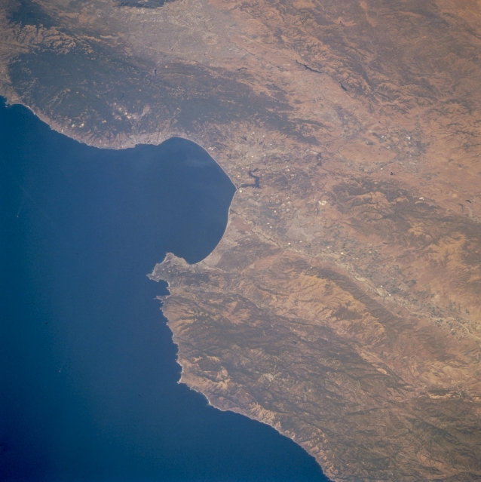

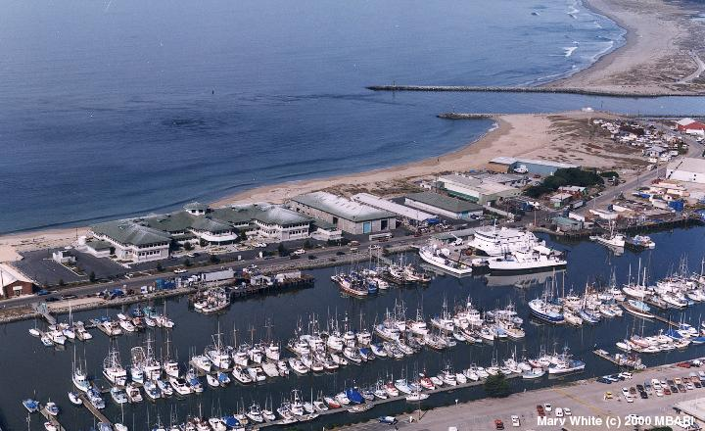
MBARI (Monterey Bay Aquarium Research Institute)
We are here
Notes:
Before diving into FIDO, let me quickly orient you to where we are. MBARI is located in Moss Landing, California, right at the head of the Monterey Bay canyon system. This location gives us unique access to both coastal and deep ocean environments, making it an ideal place for developing and testing marine technology.

Slide 3
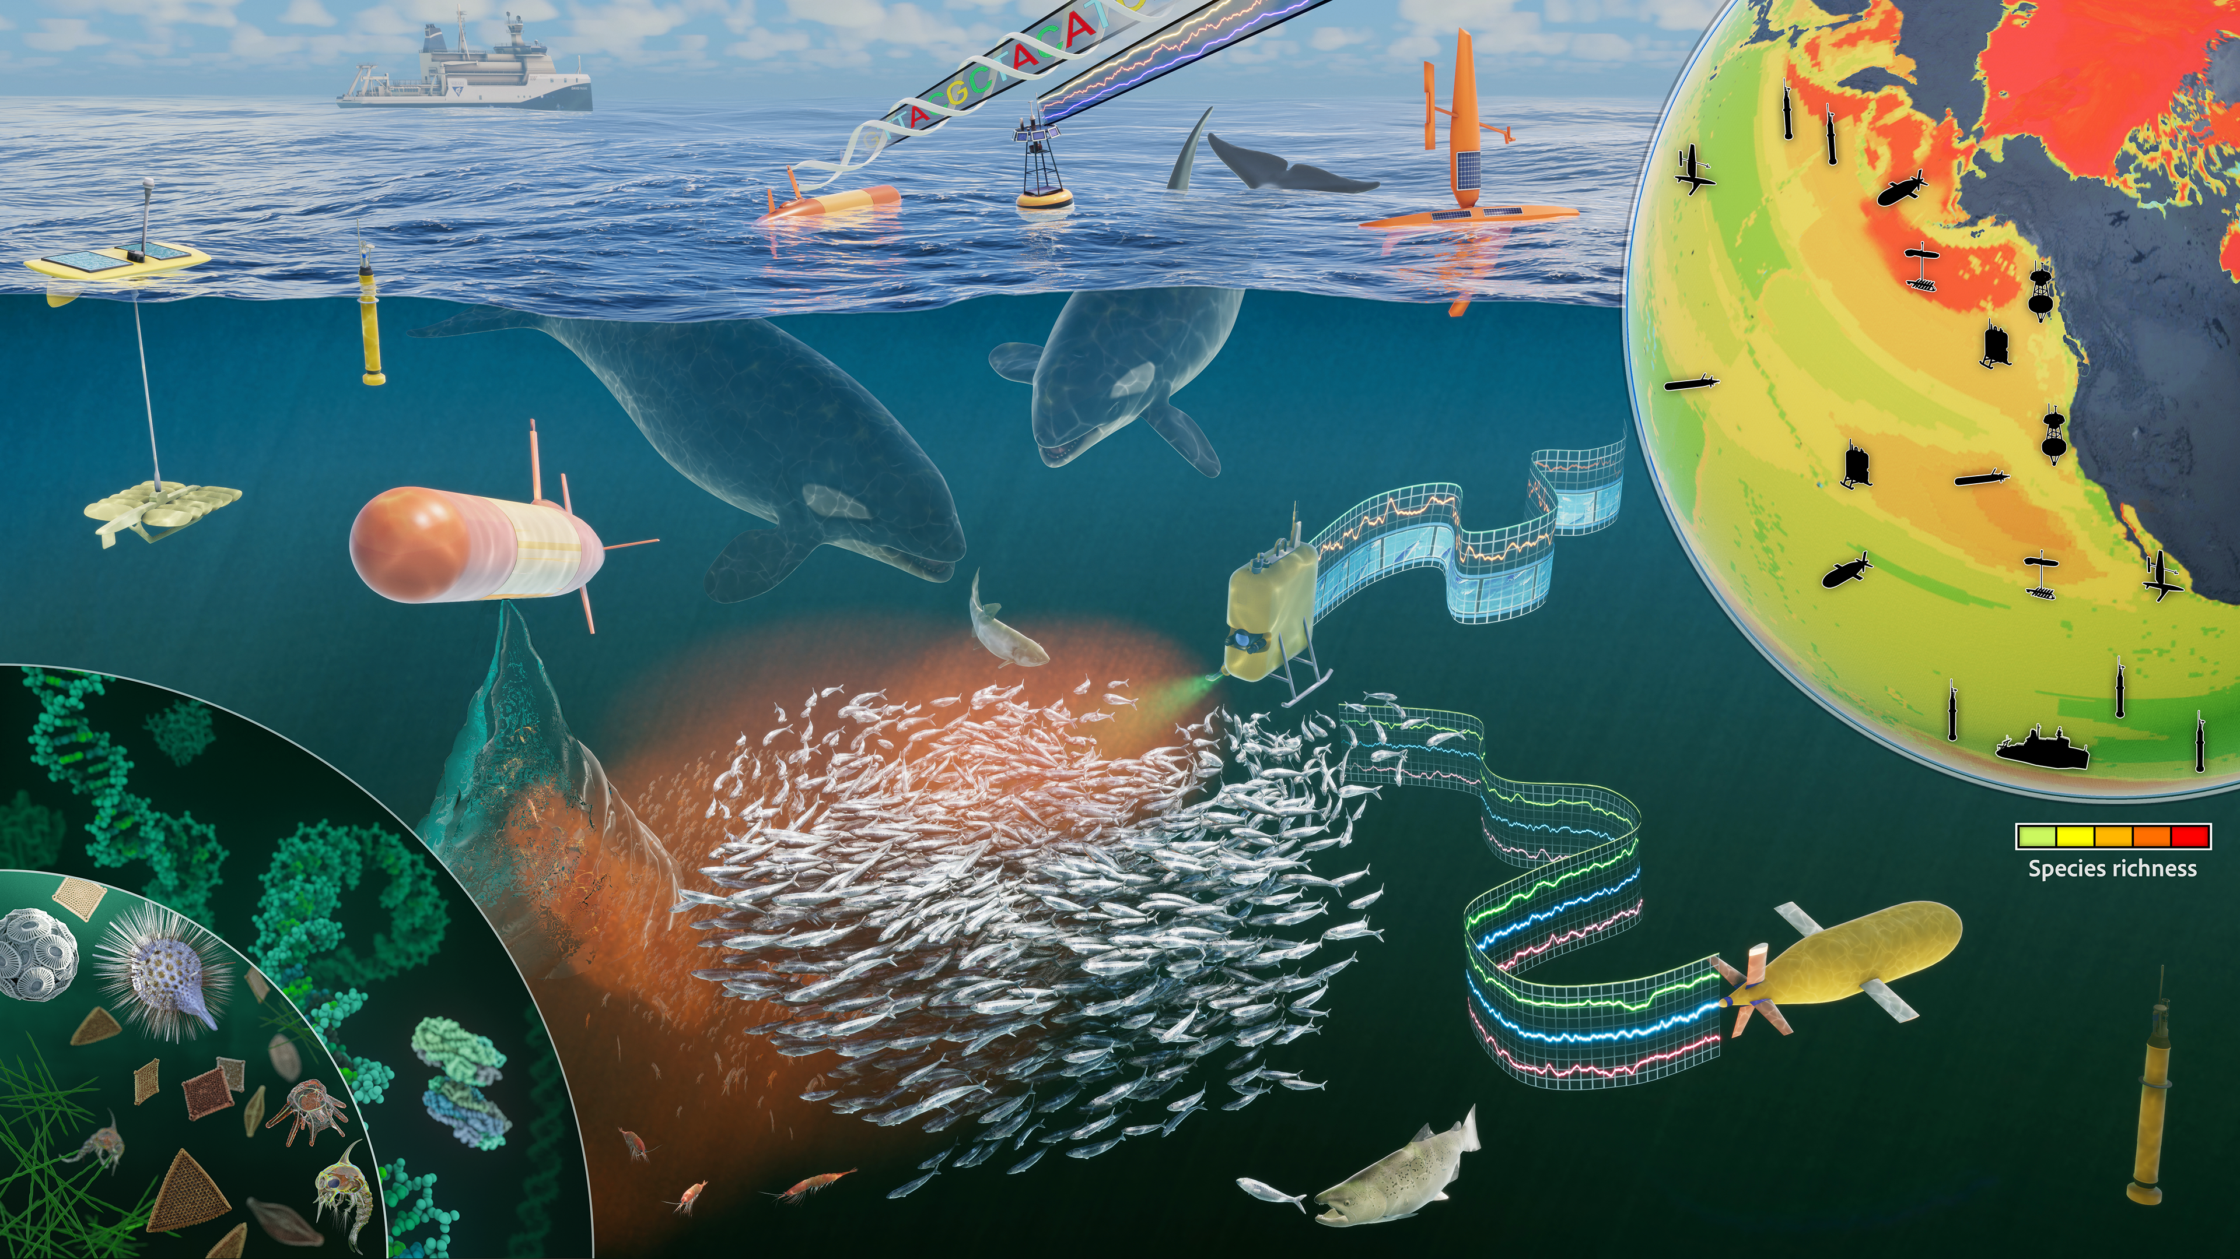
MBARI (Monterey Bay Aquarium Research Institute)
Notes:
MBARI's approach is fundamentally collaborative - we bring together engineers and scientists to develop technology that answers important questions about our oceans. This beautiful visualization shows the kind of interconnected ecosystem monitoring we envision - from surface vessels to autonomous underwater vehicles, all working together to understand marine biodiversity. This vision of comprehensive ocean monitoring directly connects to the power of environmental DNA.

Slide 4
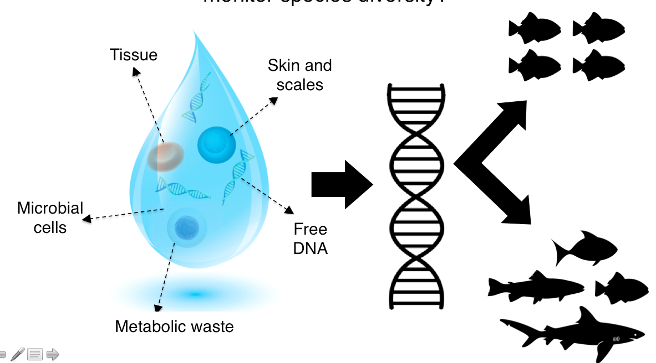
Environmental DNA (eDNA) and marine biodiversity assessments
Notes:
Environmental DNA, or eDNA, has revolutionized how we study marine biodiversity. As organisms move through the water, they continuously shed genetic material - skin cells, scales, metabolic waste, tissue fragments. This creates a genetic 'soup' that we can filter and analyze to identify what species are present. Instead of trying to catch or observe organisms directly, we can simply collect water samples and sequence the DNA to get a comprehensive picture of the biological community. It's like taking a genetic census of the ocean.

Slide 5
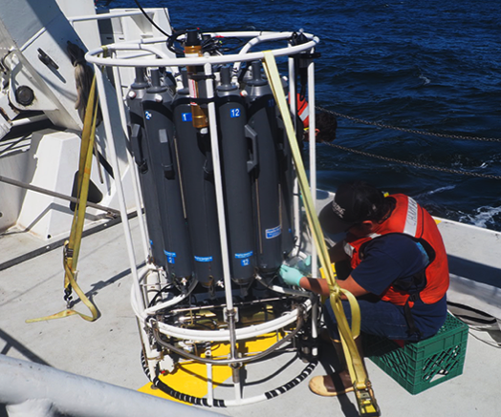
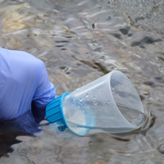
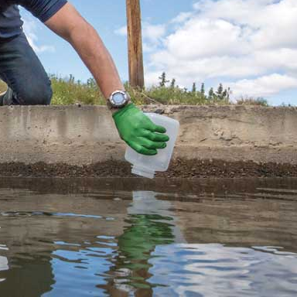
eDNA requires sample collection
In the quest for answers, this is boring…
Notes:
But here's the challenge - eDNA analysis starts with sample collection, and traditionally, this has been labor-intensive, weather-dependent, and frankly, quite boring work. Whether you're collecting from a stream, deploying instruments from a research vessel, or working in challenging field conditions, the sampling process requires significant personnel time and is limited by access, weather, and logistics. As the subtitle says - 'In the quest for answers, this is boring' - but it's also expensive and doesn't scale well.

Slide 6
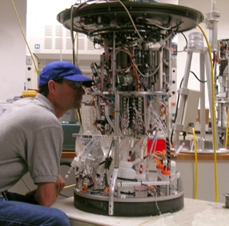
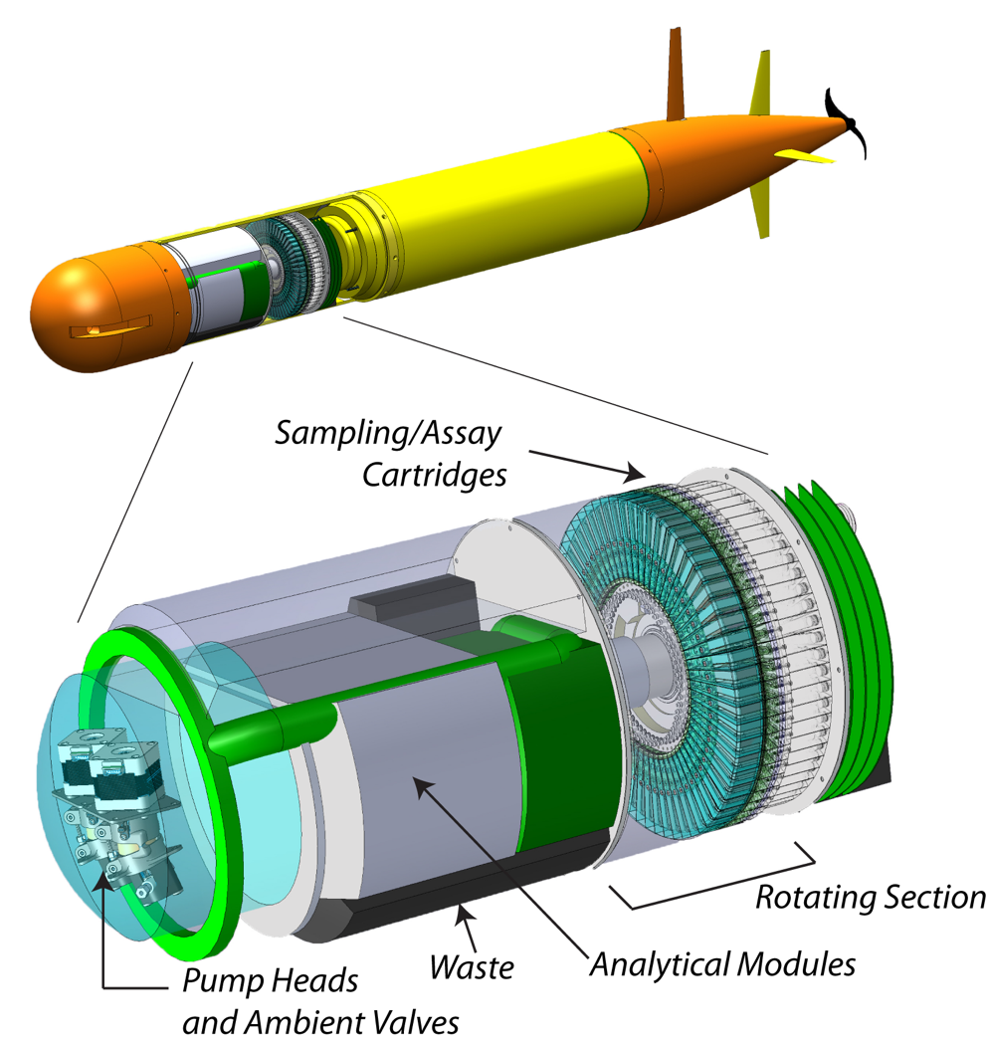
Environmental Sample Processor
2nd Generation ESP
3rd Generation ESP
Notes:
At MBARI, we've been working on this problem for over two decades with our Environmental Sample Processor, or ESP. The 2nd generation ESP was a large, sophisticated instrument designed for long-term autonomous deployments with in-situ analysis capabilities. The 3rd generation ESP pushed this further into autonomous underwater vehicles for truly mobile sampling. These instruments have enabled groundbreaking science, but they share common limitations - they're complex, expensive, and require significant expertise to deploy and maintain. While perfect for certain applications, they haven't been accessible enough for widespread adoption.
---
For almost 3 decades our team has been developing the ESP or environmental sample processor. Starting with the 2G ESP on the left and 3G ESP on the right. I am happy to discuss these instruments with folks, but I really want to hone in on their design requirements
Both of these instruments were designed with the idea providing in situ analytical capabilities. Where we are no longer returning samples back to the lab but instead sending back data. Moreover, functional these instruments were designed for submerged deployments in the ocean either on stationary moorings, in the case of the 2G ESP or mobile deployments on 3G ESP using AUV.
These are very specific requirements that enable us to ask and solve different scientific research questions.

Slide 7
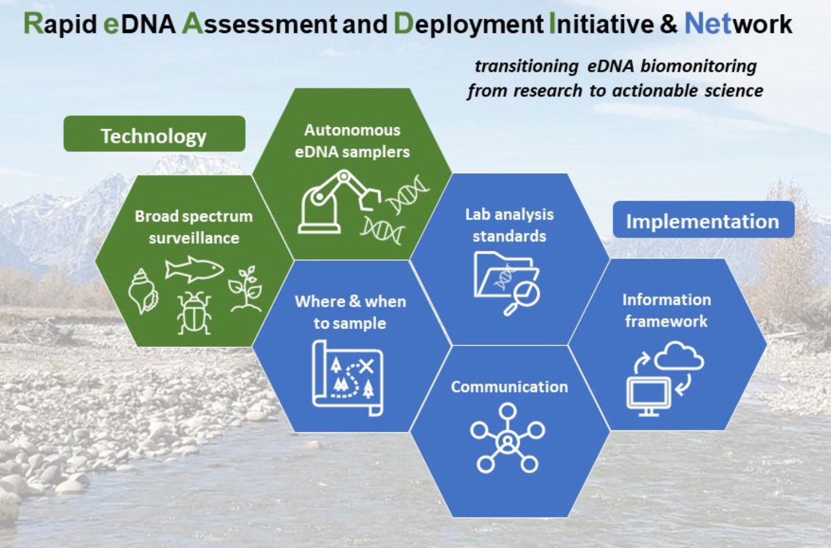
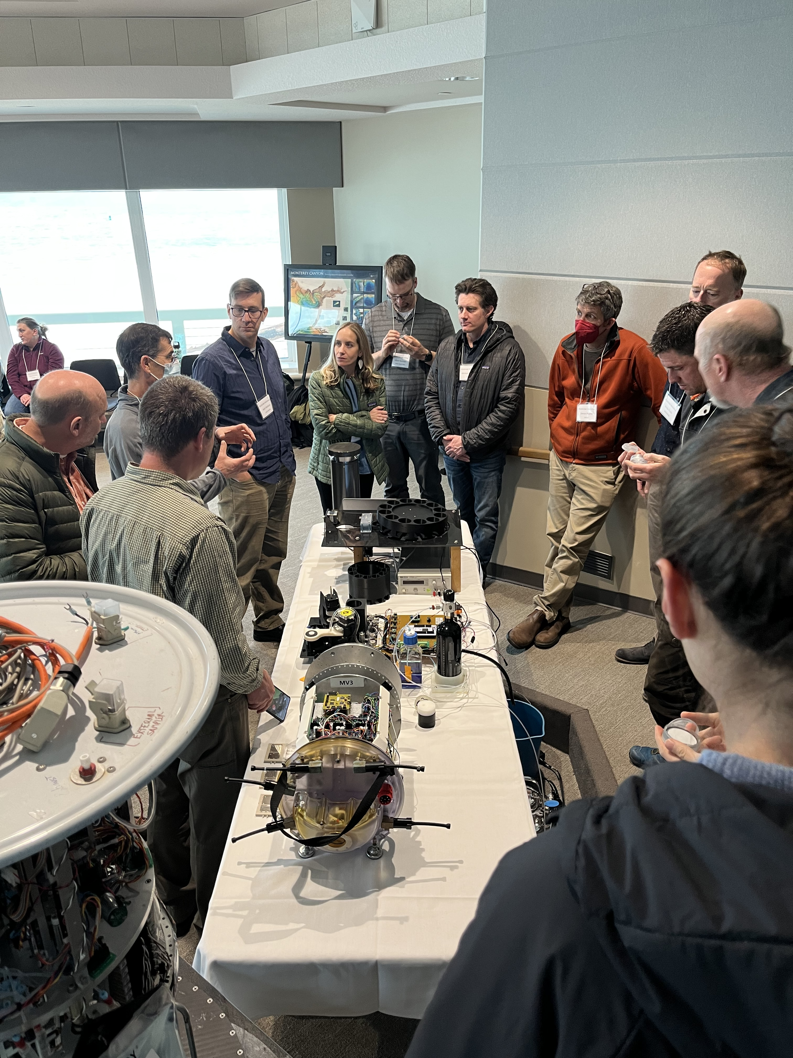
READI-Net
Courtesy of Adam Sepulveda - USGS
Notes:
This challenge caught the attention of our partners at the US Geological Survey, who approached us as part of their READI-Net program - the Rapid eDNA Assessment and Deployment Initiative & Network. READI-Net is designed to enable early detection of invasive species through coordinated eDNA monitoring across entire watersheds. The program has six integrated components, but the key insight was that existing autonomous sampling technology was too complex and expensive for the scale of deployment they envisioned. They needed something simpler, cheaper, and more accessible.

Slide 8
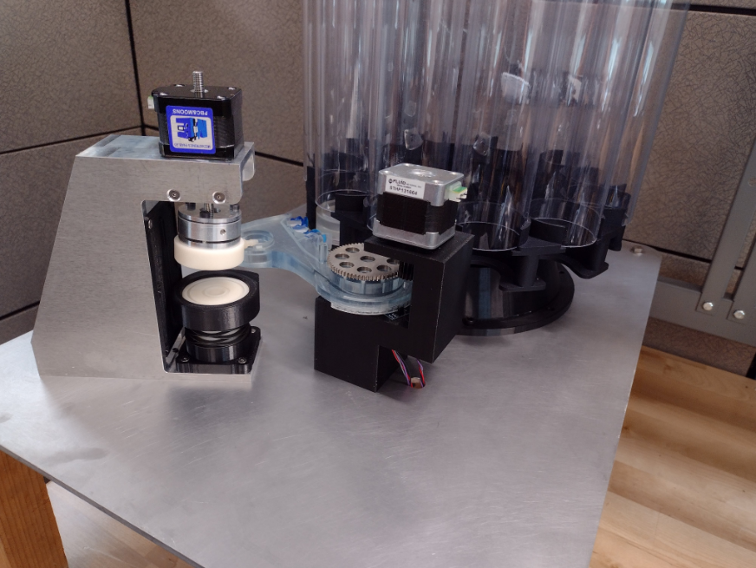
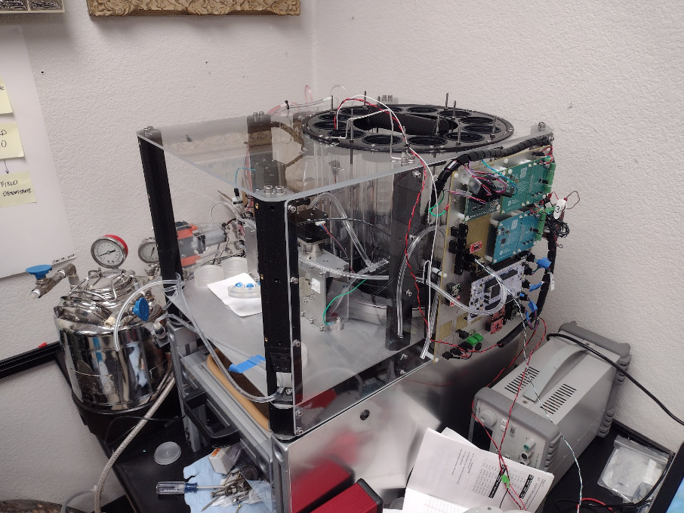
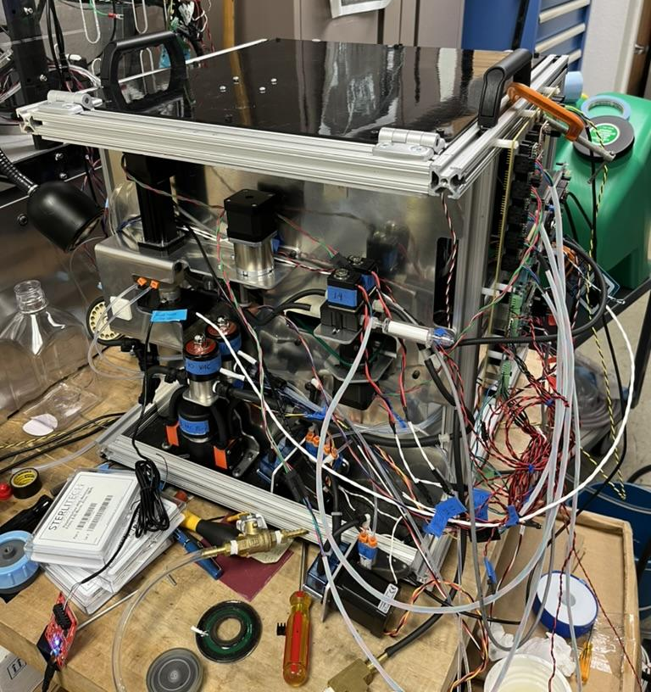
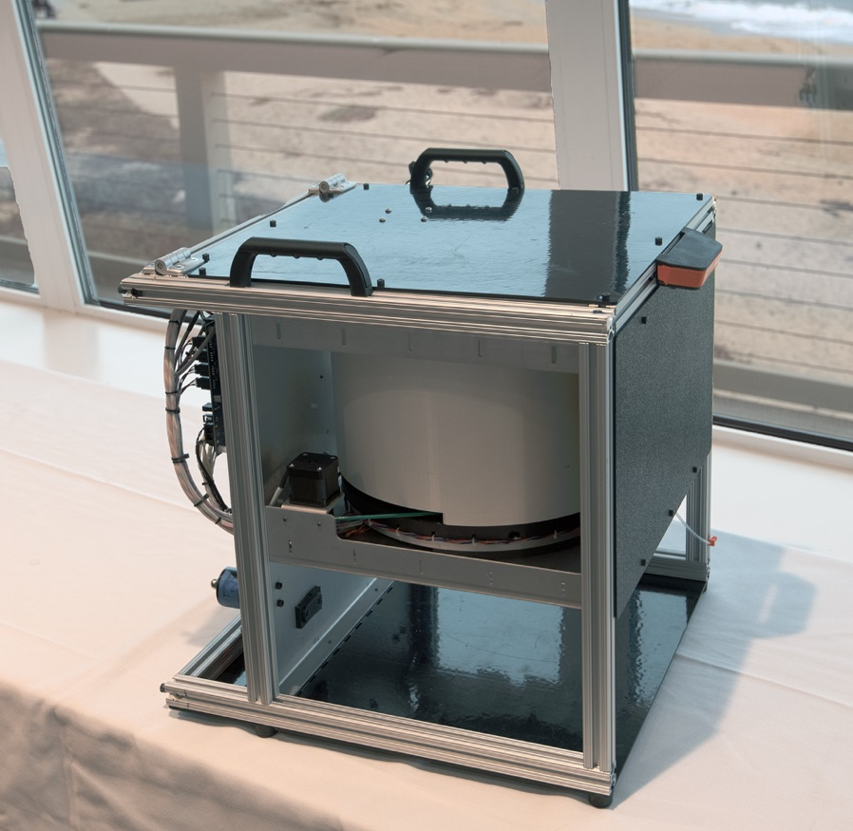
FIDO: Filtering Instrument for DNA Observation
Hardware:
Affordable enough for wide adoption
Acquire at least 100 samples
Deployable by 2 people (max)
Simple setup and maintenance
System must decontaminate itself
Comms options (WIFI, Bluetooth, Cellular, Satellite)
Maximize sample volume
Software:
Device should have two-way communication
Control via simple web-based GUI
Sample data logging (volume, date-time, flowrate)
Manual and Schedule-Based Sampling
Instrument State (Current State)
Notes:
So we went back to the drawing board with a clear set of requirements. On the hardware side, we needed something affordable enough for wide adoption, capable of collecting at least 100 samples per deployment, deployable by just two people, simple to set up and maintain, with built-in decontamination and multiple communication options while maximizing sample volume.
On the software side, we wanted two-way communication, simple web-based control, comprehensive data logging, both manual and scheduled sampling capabilities, and real-time instrument status monitoring. These images show the evolution from early prototypes to our current production design. The key insight was to prioritize simplicity and reliability over sophisticated capabilities.

Slide 9
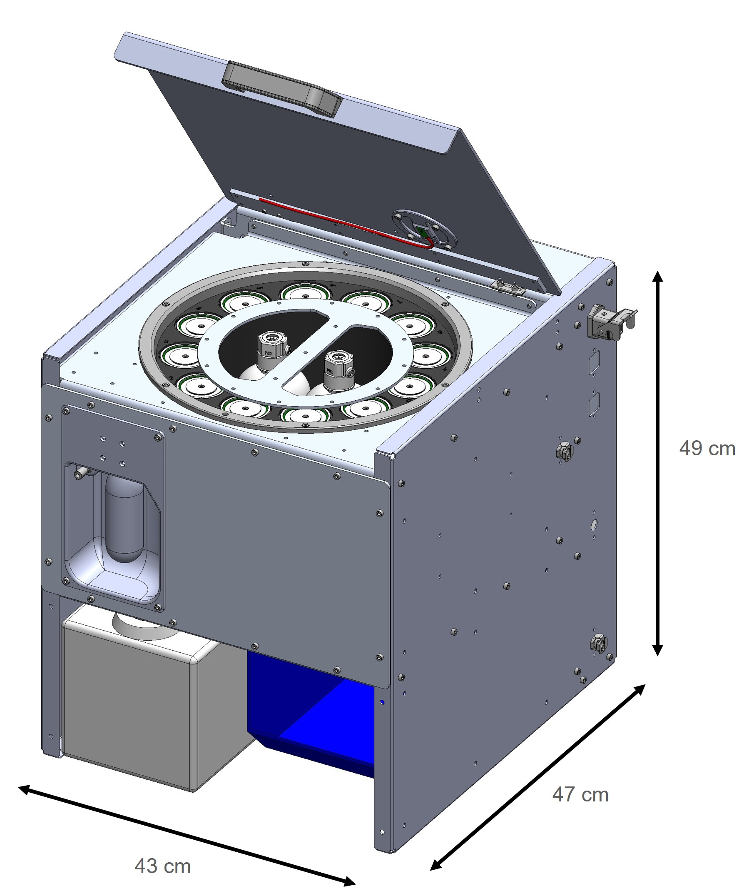
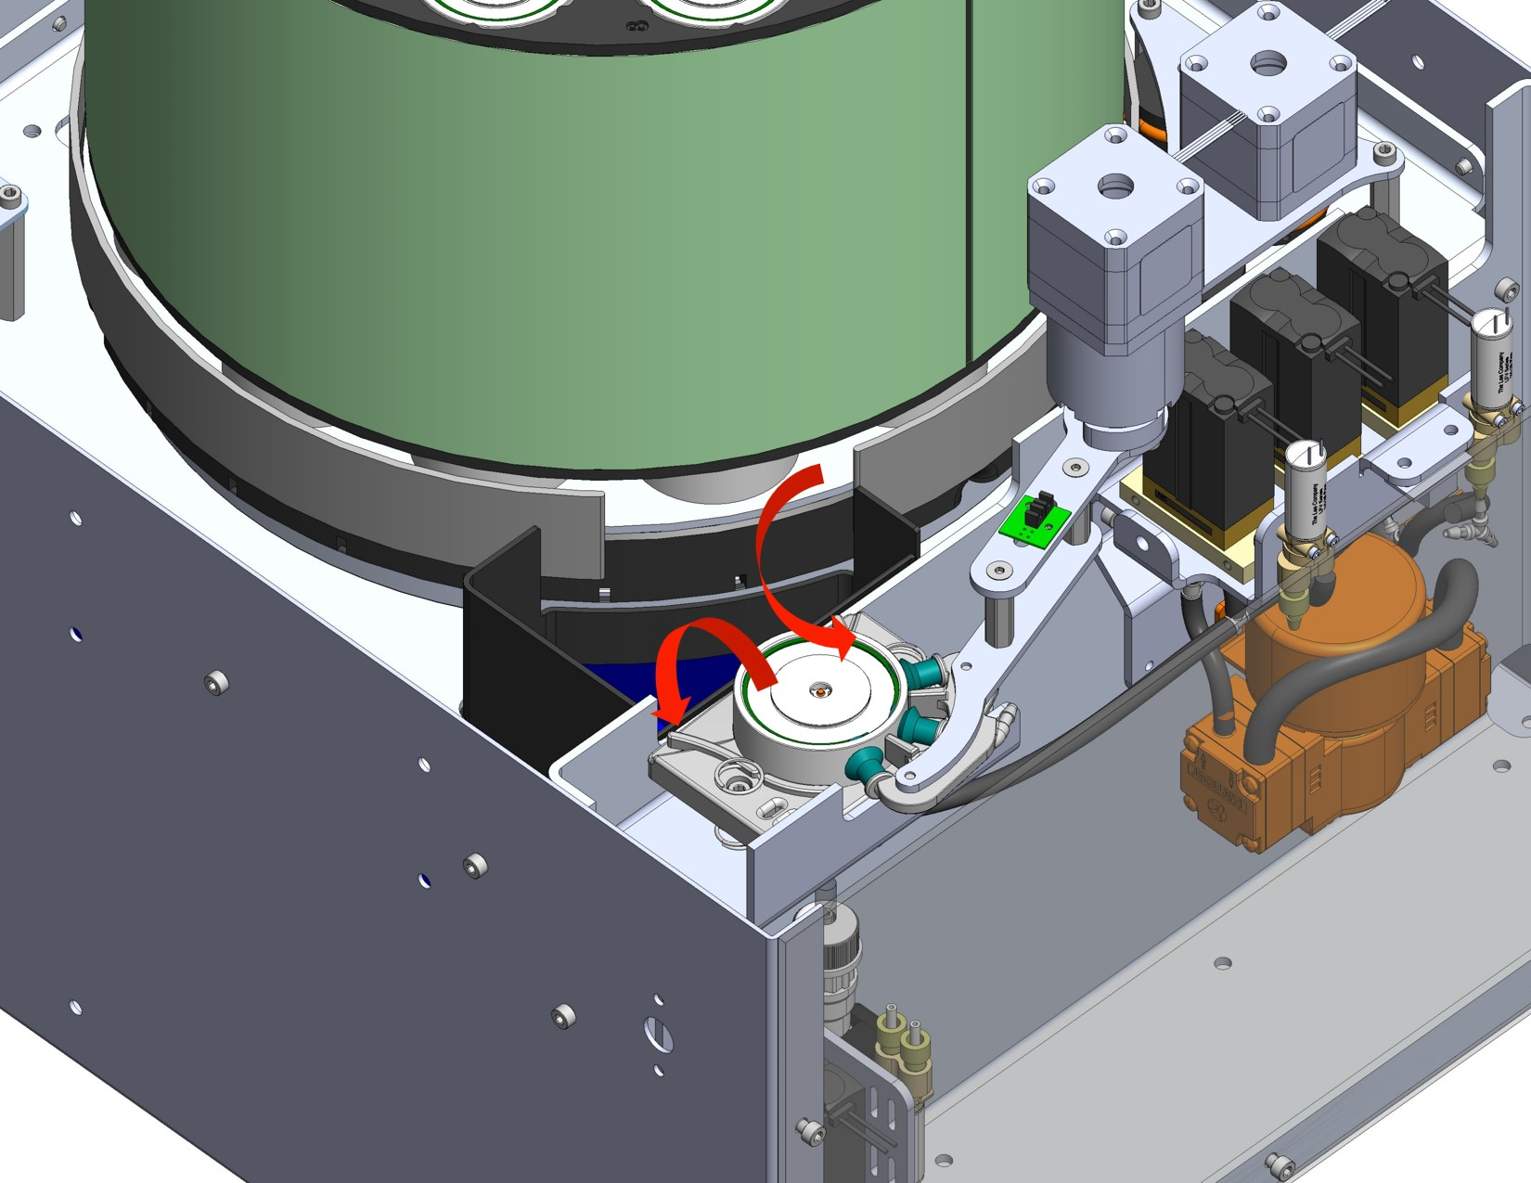
FIDO: Instrument Overview
Notes:
This is FIDO - the Filtering Instrument for DNA Observation. It fits in a 50cm cube, weighs less than 25kg, and can filter and preserve up to 144 eDNA samples with decontamination between each collection. The system has three main components: the carousel that holds 12 tubes of 12 filter pucks each, the robotic arm with suction cups that manipulates the pucks, and the integrated fluidics and control systems. Users access the instrument by simply lifting the lid to load pucks and replace reagents.

Slide 10
FIDO: Instrument Overview
Operational Video
Notes:
Let me show you how FIDO operates...
[If video doesn't work: "While we don't have the video available right now, let me walk you through the sampling process: FIDO rotates the carousel to select a tube, uses a distance sensor to count available pucks, picks up a puck with the robotic arm, places it in the clamp, filters water through it while monitoring flow rate, adds liquid preservative, displaces the preservative with nitrogen gas, writes sampling metadata to an RFID tag in the puck, ejects the used puck to storage, and performs a bleach decontamination cycle before the next sample."]

Slide 11
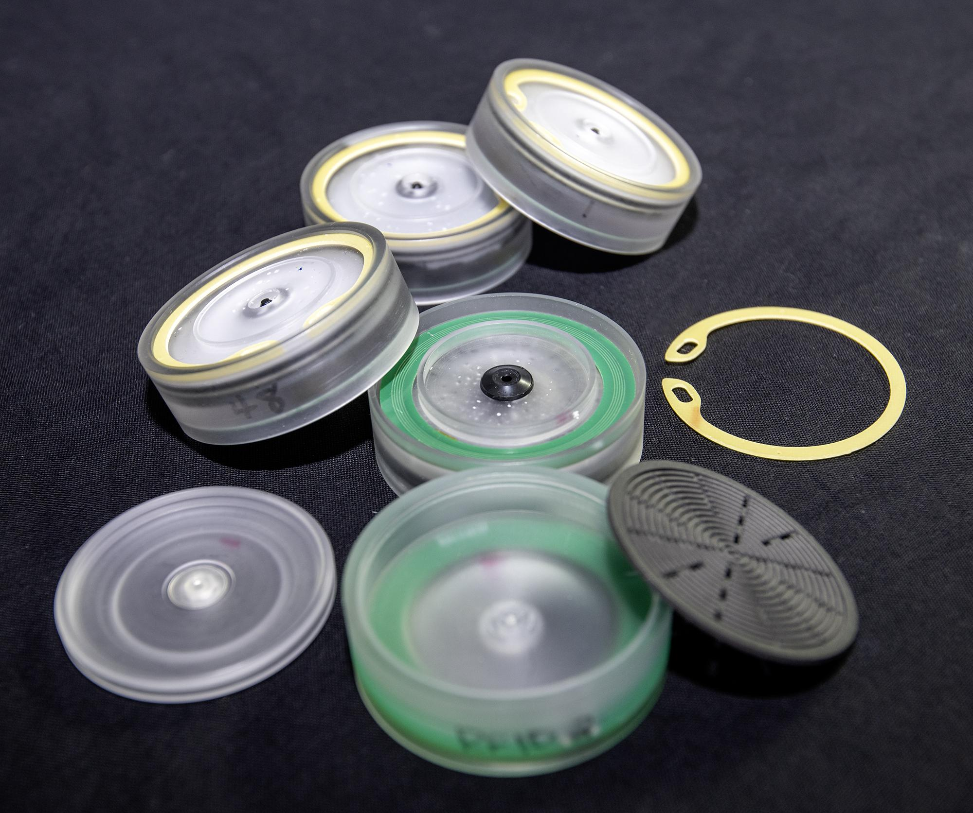
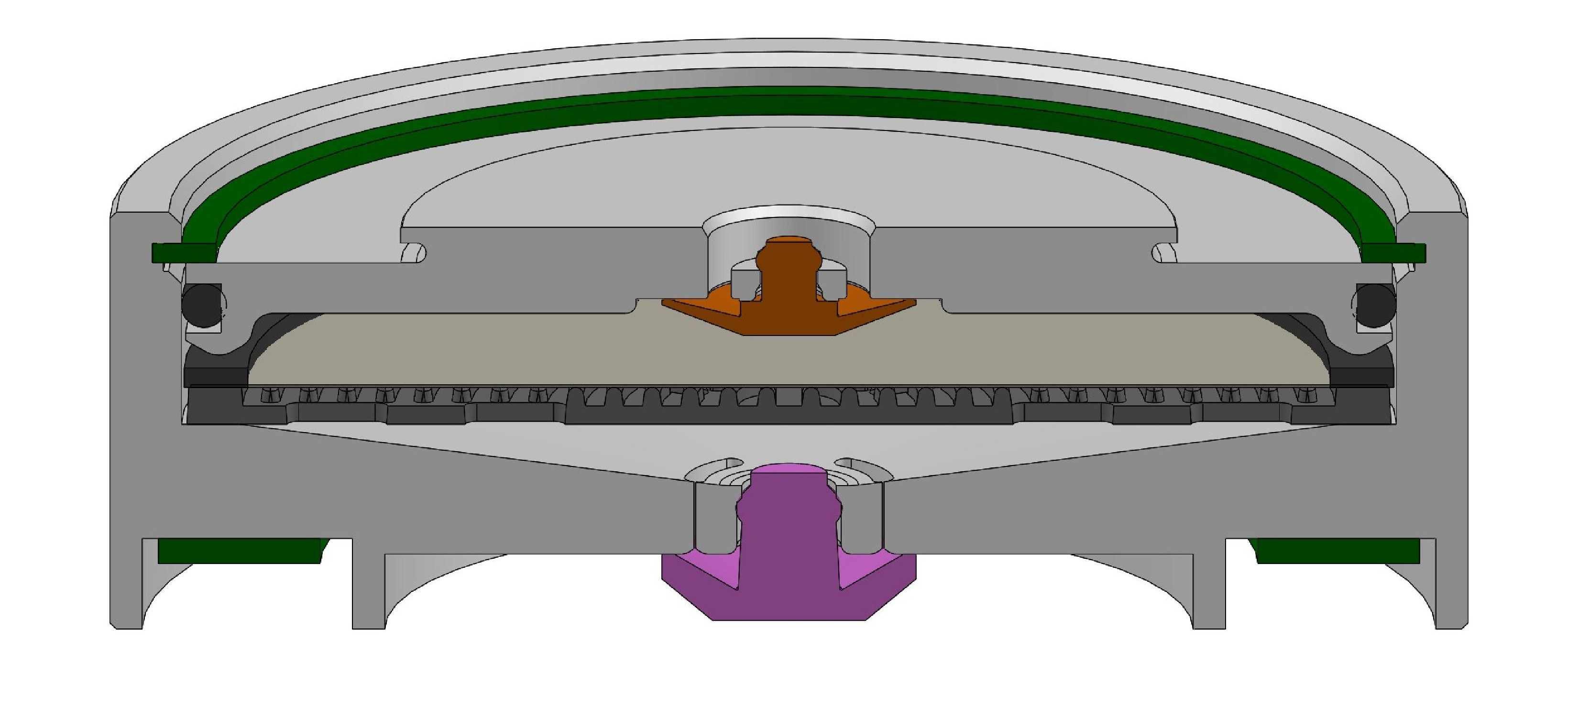
FIDO: Pucks
Notes:
The heart of the system is these filter pucks. Each puck creates a sealed chamber around a standard 47mm filter. The cross-section shows the internal flow path and the integrated mini-valves that maintain the sealed environment after preservation. The pucks are designed to be reusable and sized to standard filter formats after extensive consultation with potential users.

Slide 12
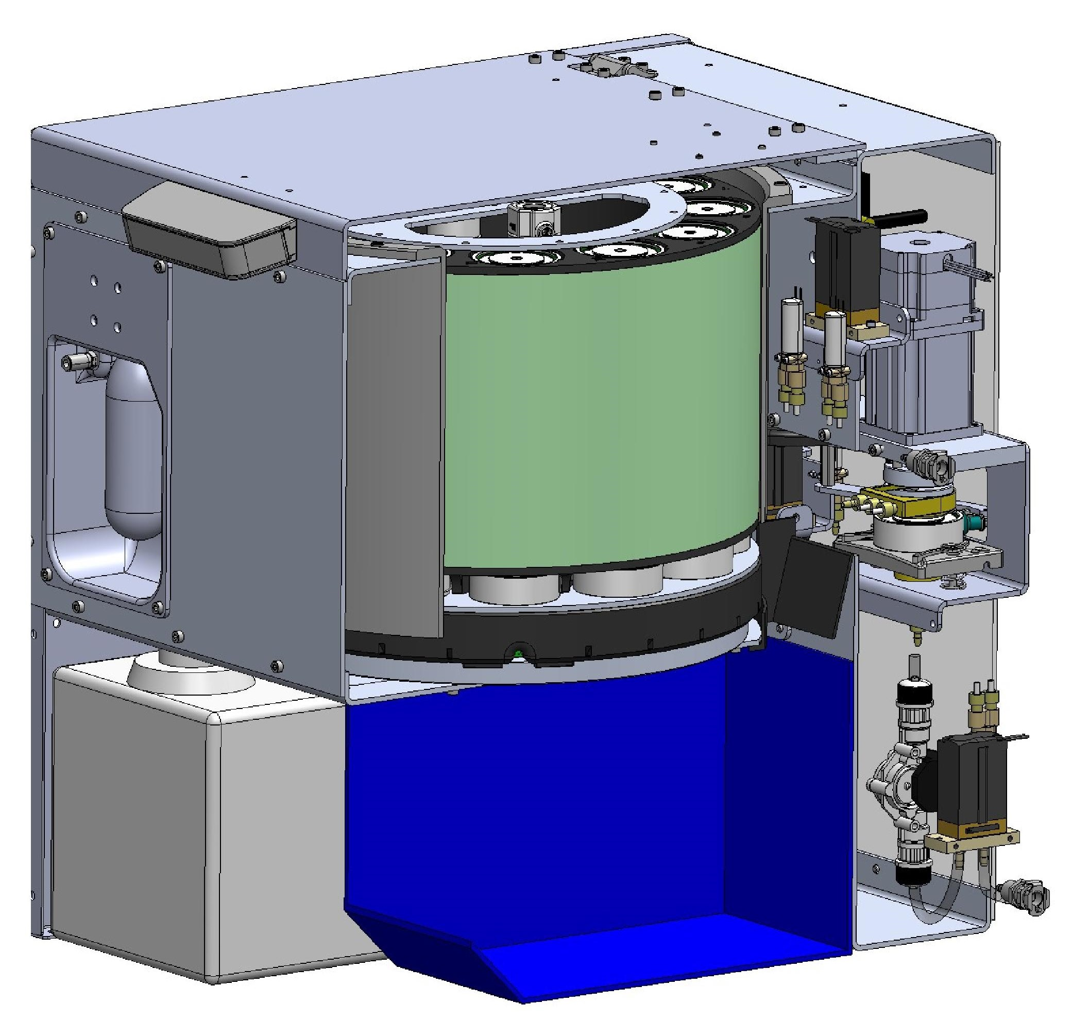
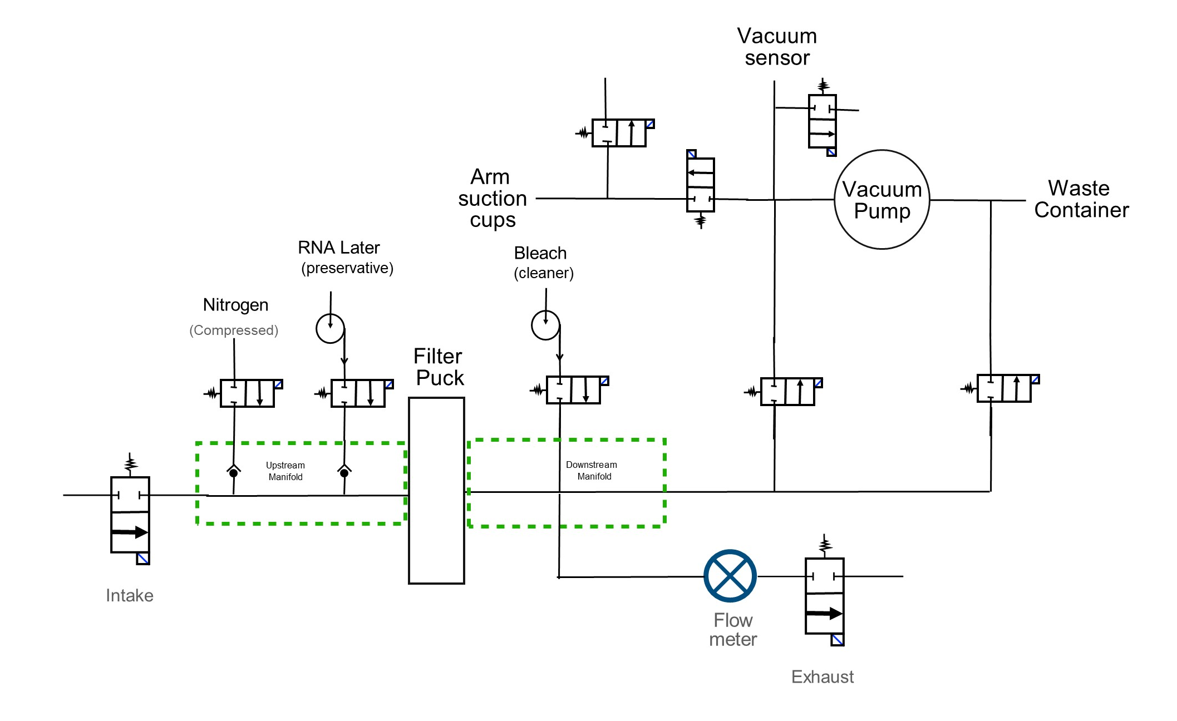
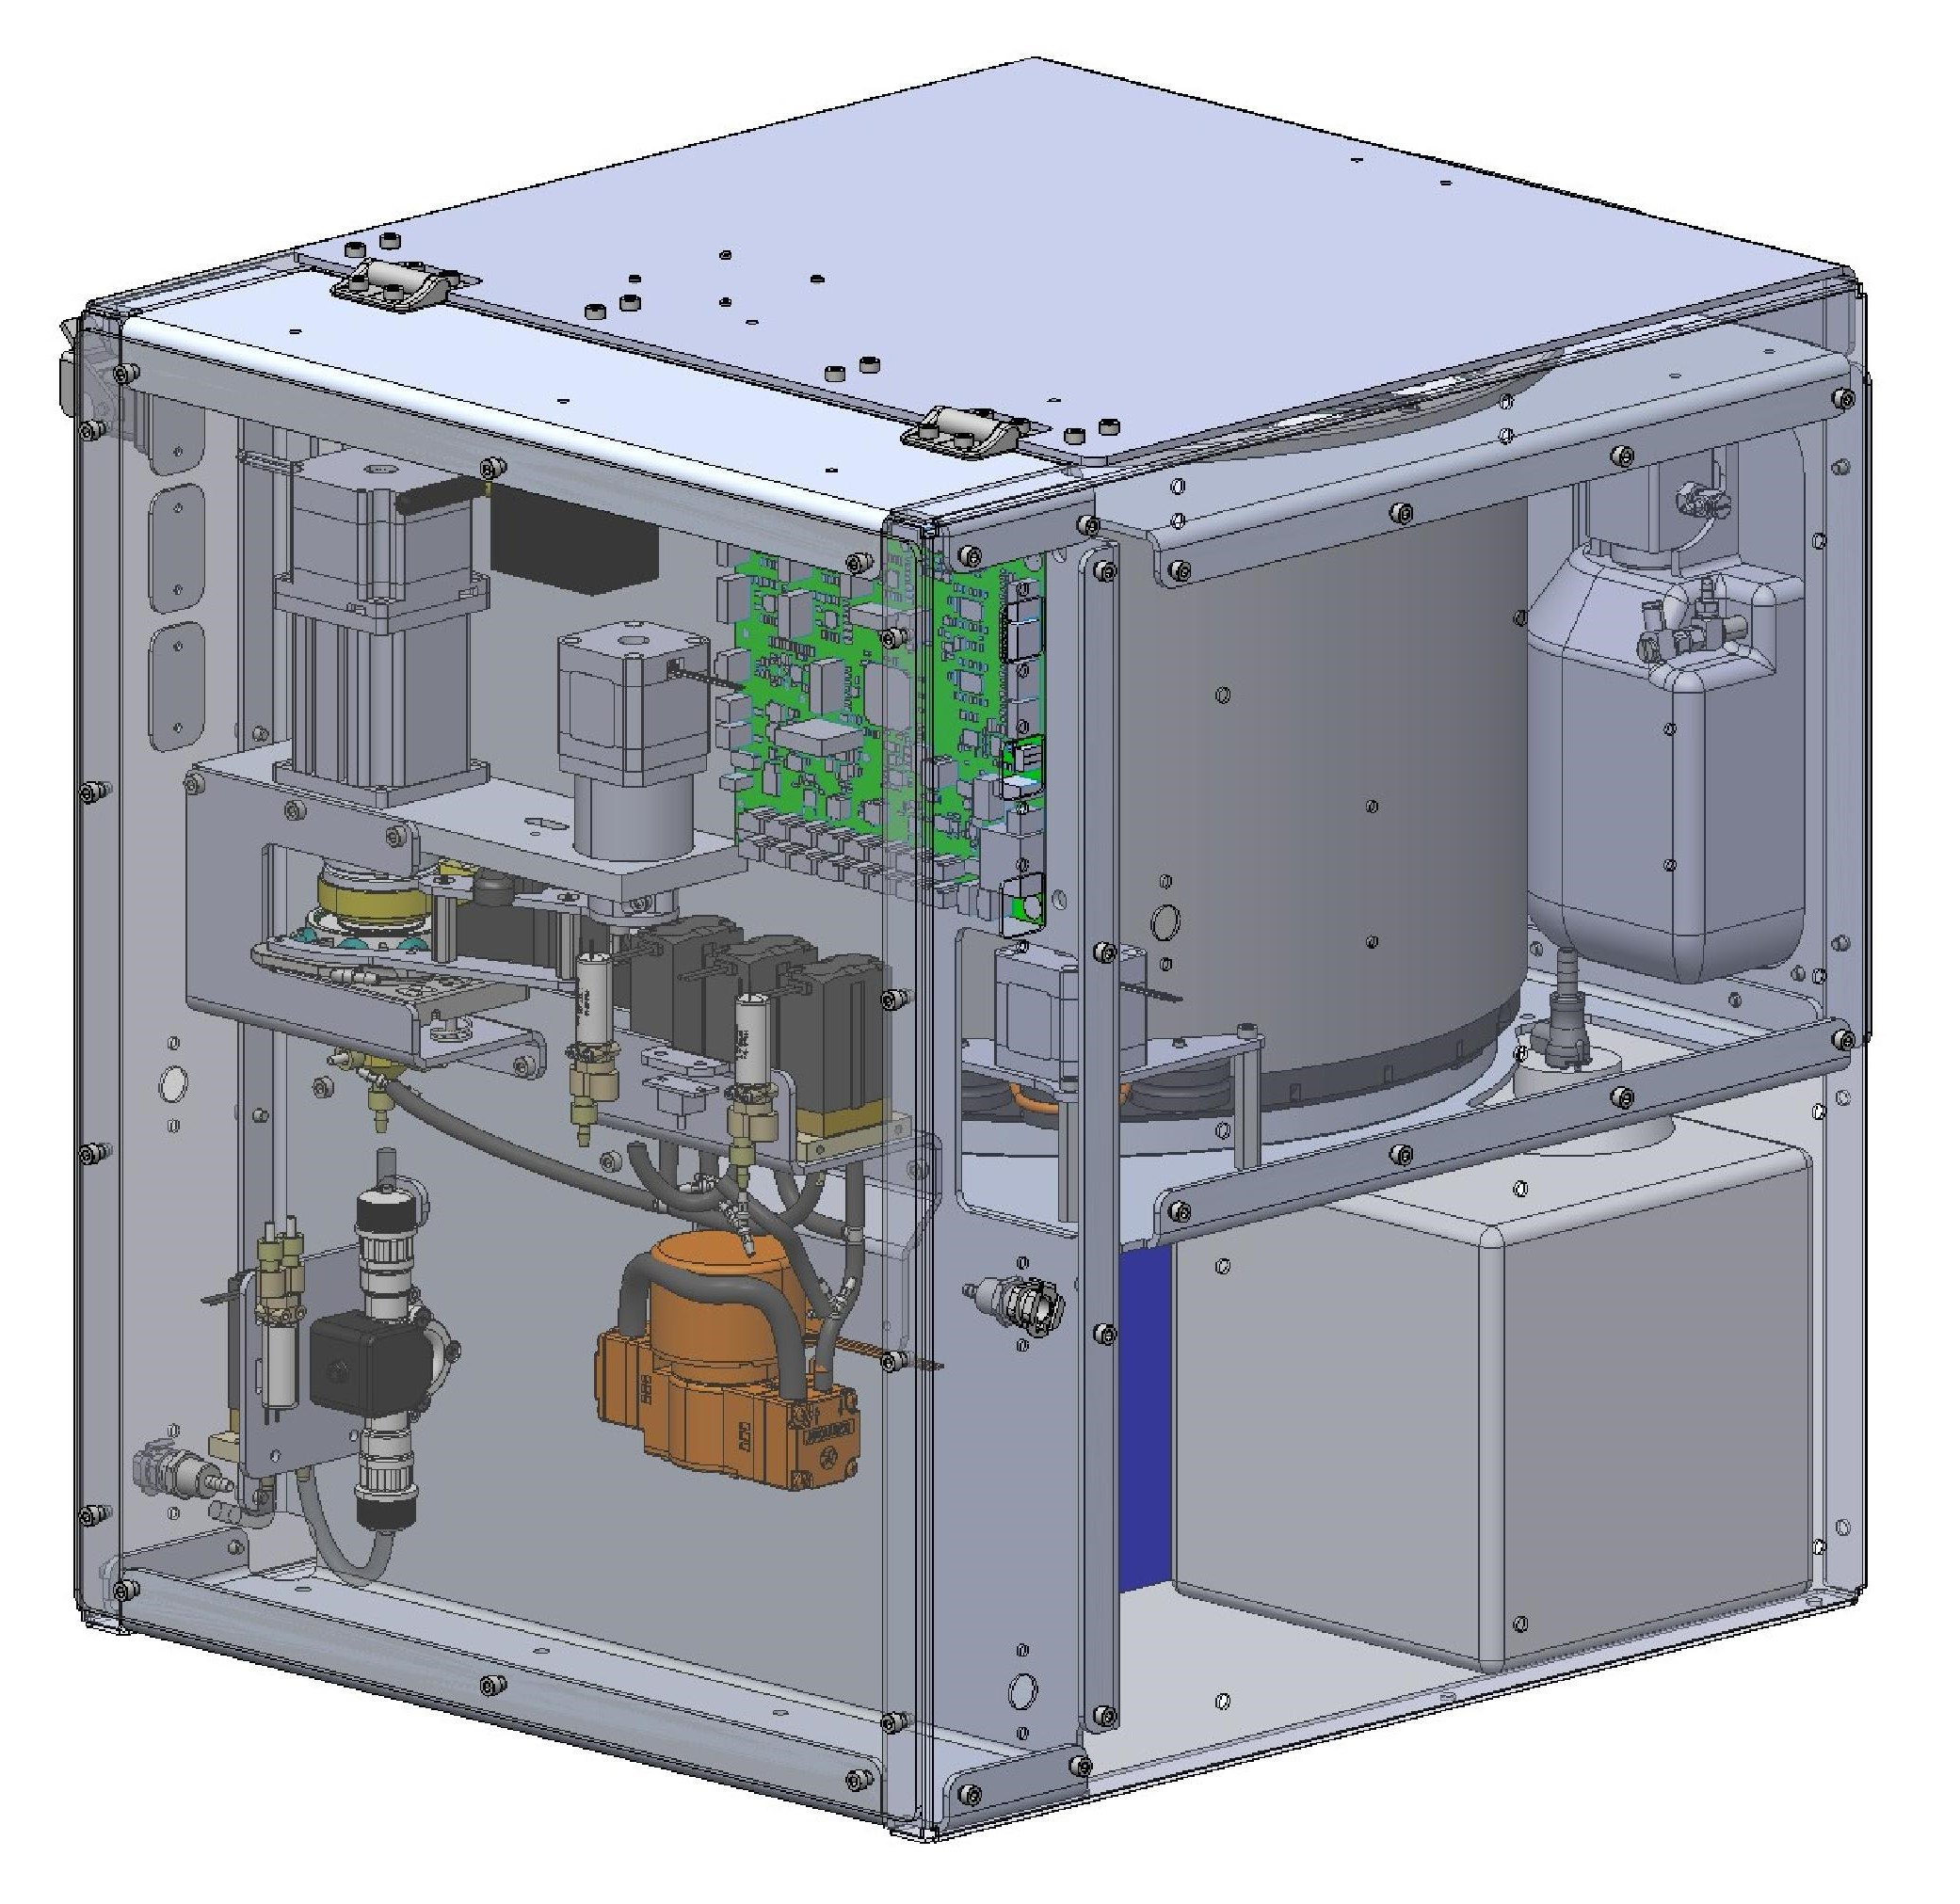
FIDO: Fluid System & Reagents
Notes:
The fluidics system handles multiple reagents - RNA Later preservative, bleach for decontamination, and compressed nitrogen for preservation. We use chemically resistant ceramic piston pumps and PEEK solenoid valves throughout. The system includes a sealed waste container to minimize environmental discharge. The schematic shows the flow paths for sampling, preservation, and decontamination, with the vacuum system supporting both puck manipulation and filtration.

Slide 13
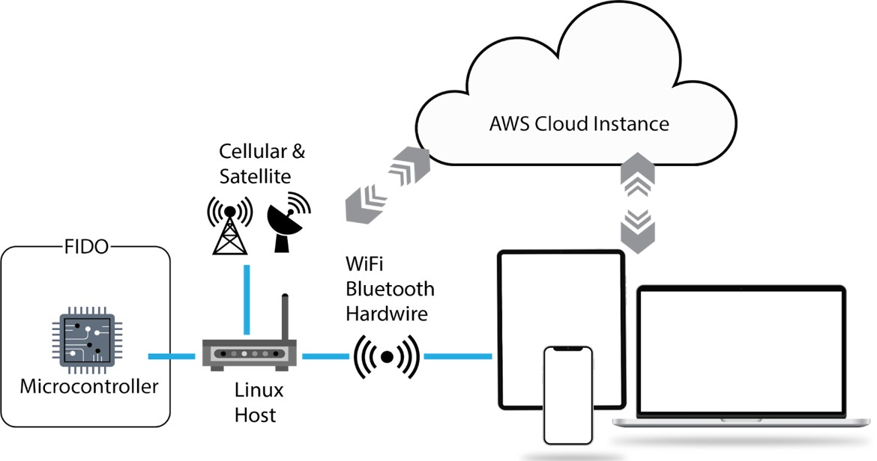
FIDO: System Architecture
Notes:
FIDO's control architecture is designed for remote deployment. The instrument communicates through cellular, satellite, or WiFi connections to an AWS cloud instance. Users can control one or multiple FIDO units through a simple web interface from anywhere in the world. The system continues operating on its last schedule even if connectivity is lost, ensuring reliable autonomous operation.

Slide 14
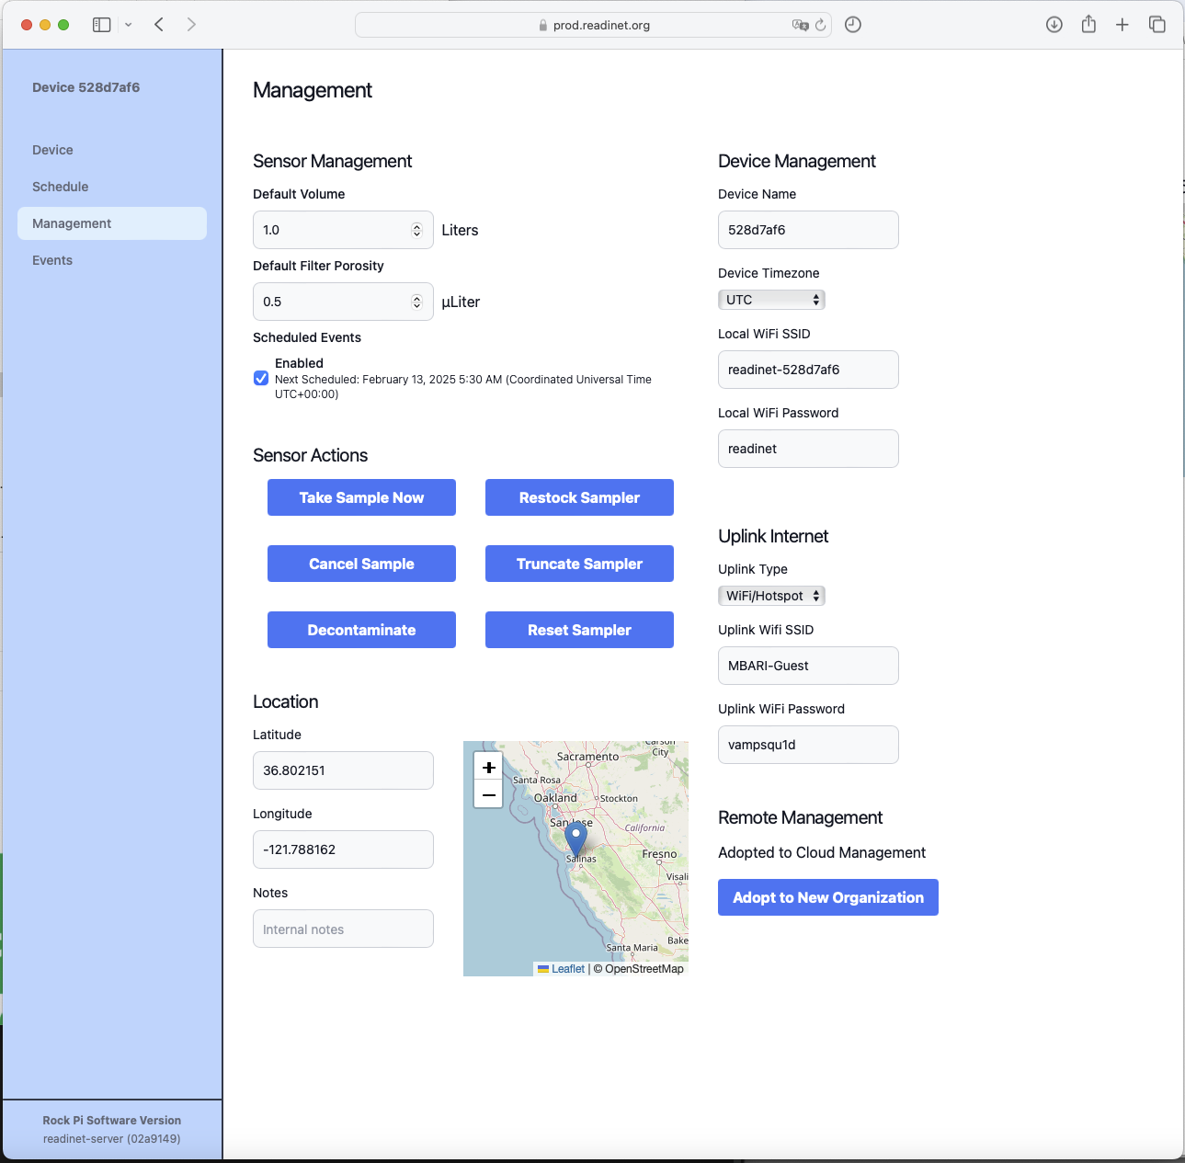
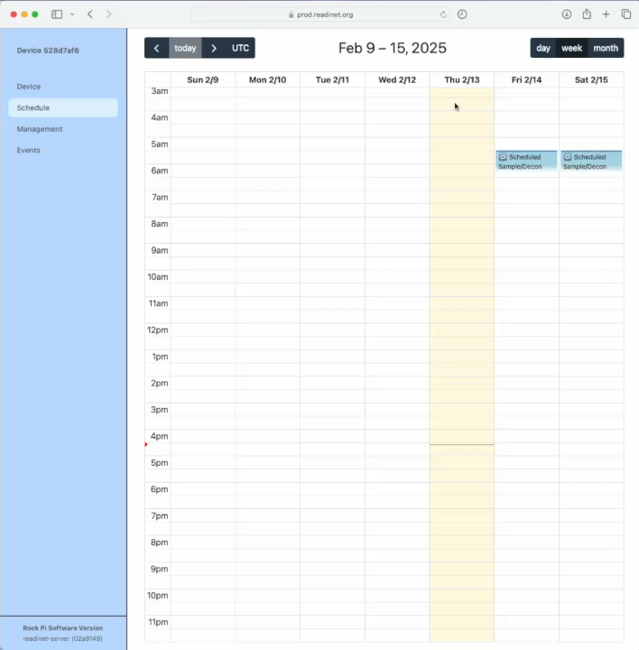
FIDO: GUI Control
Notes:
The web interface provides comprehensive control without requiring any special software - just a web browser. Users can manage instrument settings, manually trigger samples, set up complex sampling schedules, monitor instrument health, and view real-time status. The calendar interface makes it easy to plan extended deployments, and the system automatically logs GPS coordinates and environmental conditions with each sample.

Slide 15
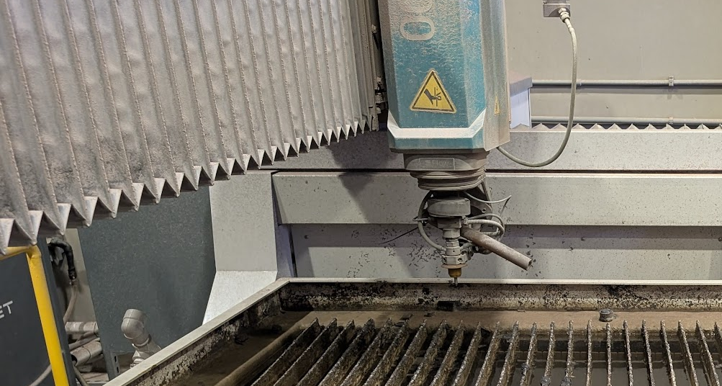
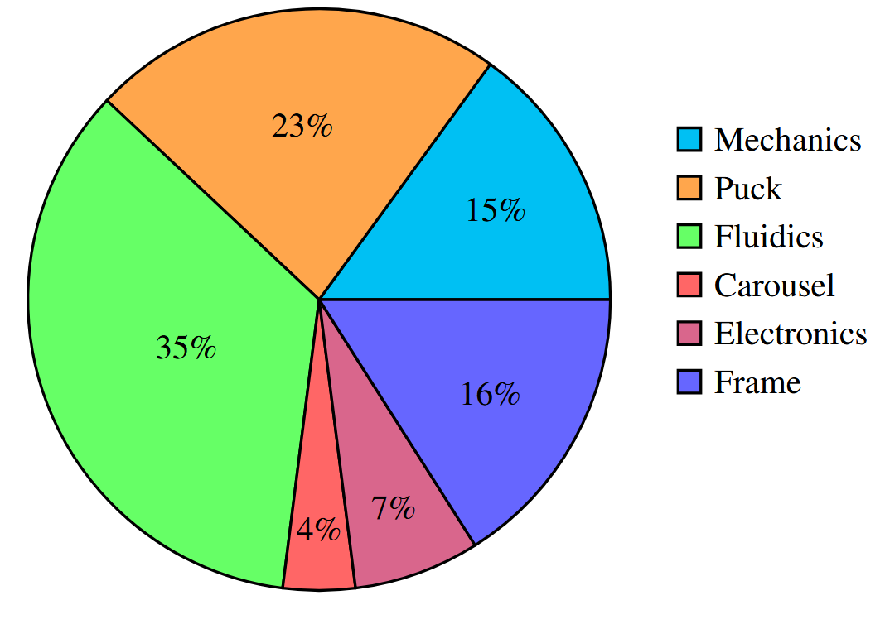
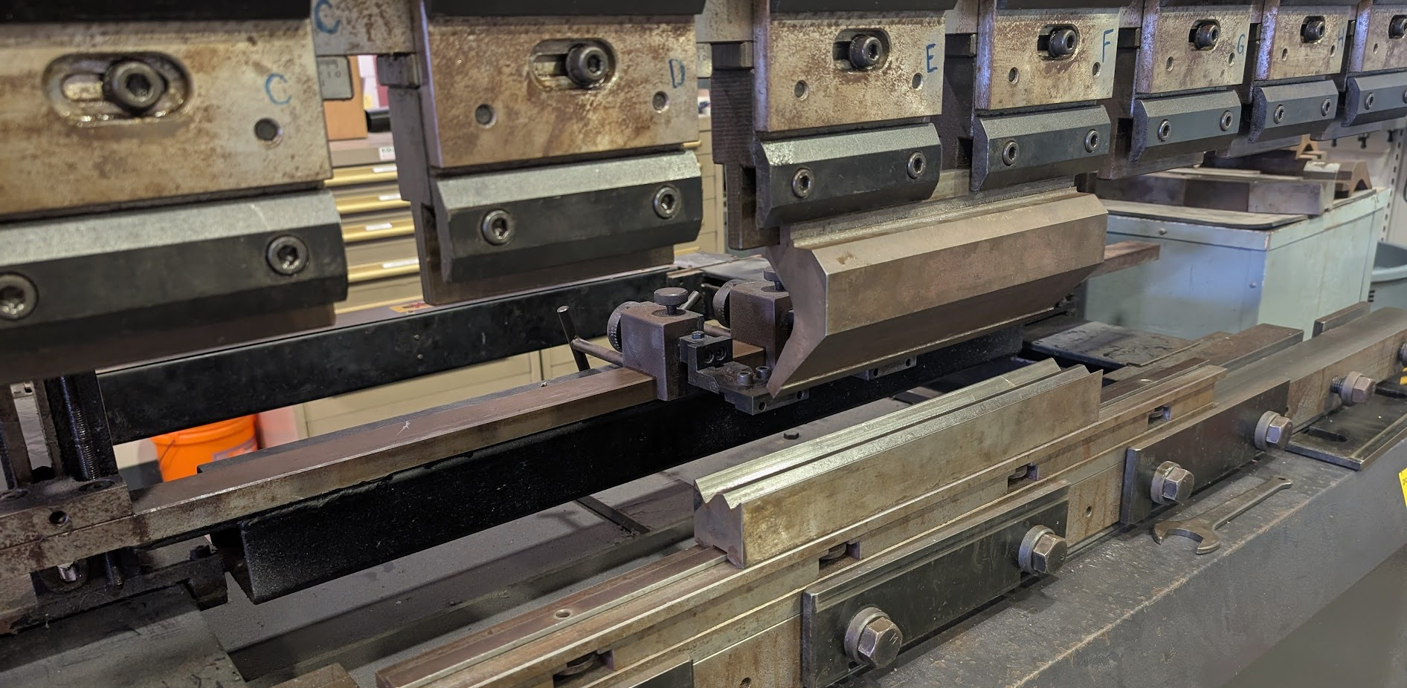
FIDO: System Costs & Manufacturing
Notes:
A key design goal was affordability, and this cost breakdown shows where we focused our spending. Over half the cost goes to fluidics and filter pucks - the components directly responsible for sample quality. We prioritized spending on the parts that matter most for scientific integrity. The manufacturing approach emphasizes off-the-shelf components and leverages online fabrication services for custom parts. We can produce components through multiple vendors without requiring highly detailed drawings, making the system scalable for production.

Slide 16
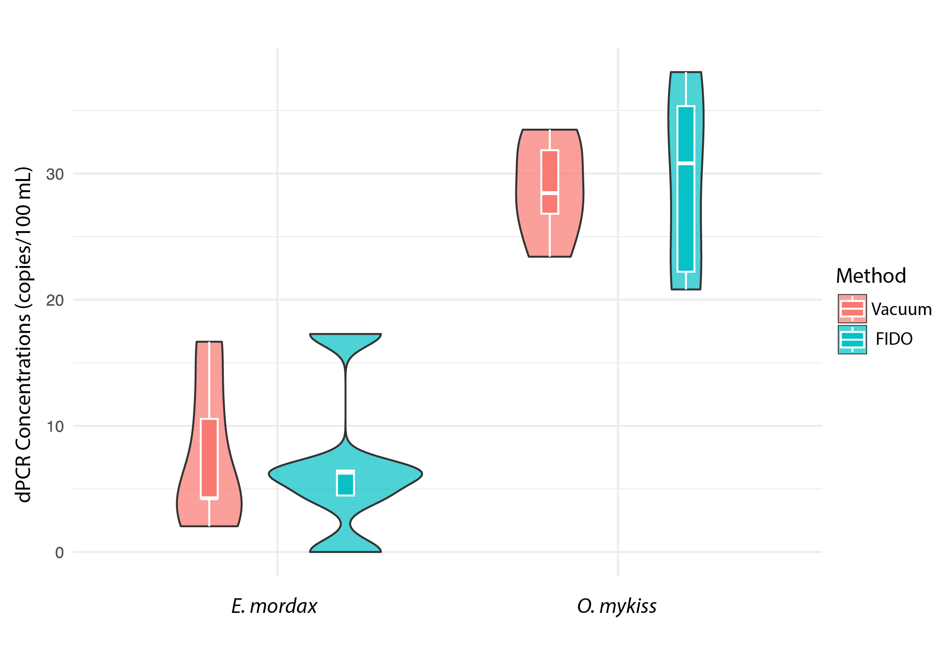
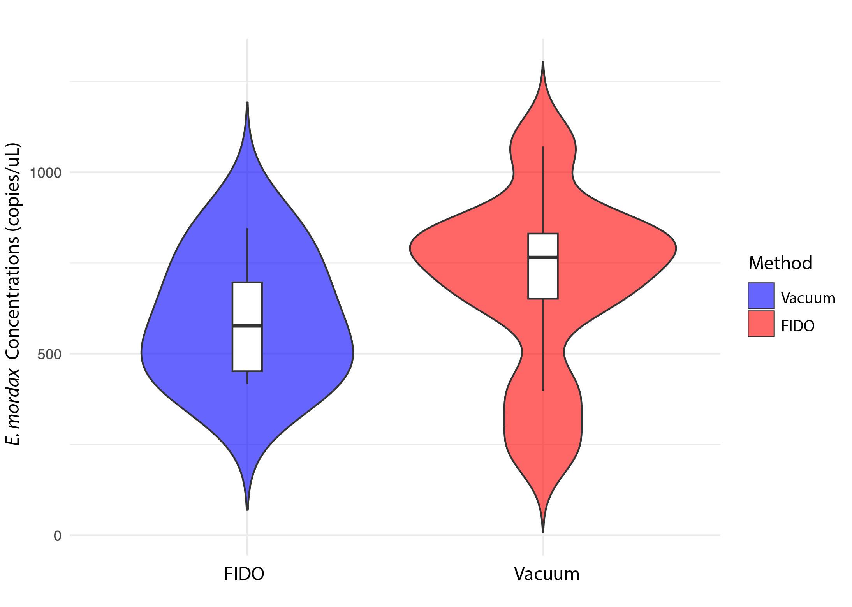
Testing & Validation: Laboratory Work
dPCR Anchovy and Rainbow Trout
qPCR Anchovy
Notes:
Of course, none of this matters if the science isn't solid. We validated FIDO against traditional laboratory vacuum filtration methods using both digital PCR and quantitative PCR on anchovy and rainbow trout eDNA from both fresh and seawater samples. The results show no significant difference between FIDO filtration and traditional methods - the automated system performs as well as careful laboratory work. This gives us confidence that FIDO can serve as a direct replacement for manual sampling in many applications.

Slide 17
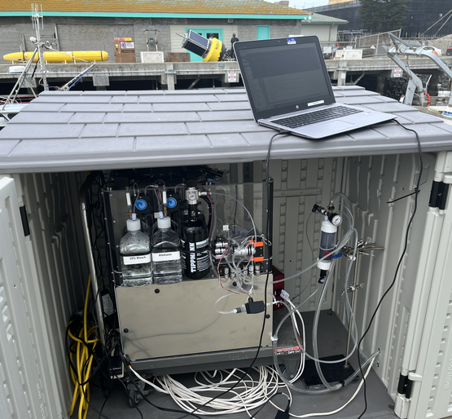
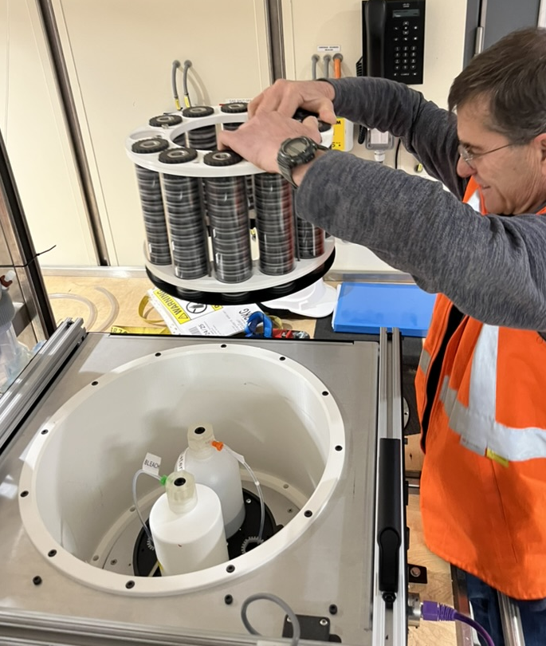
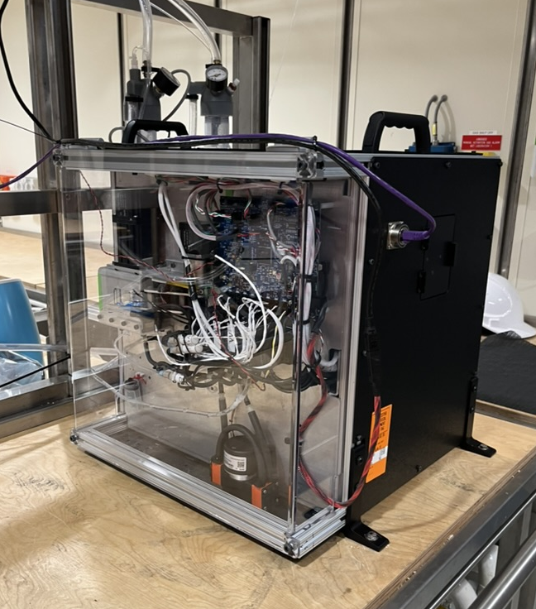
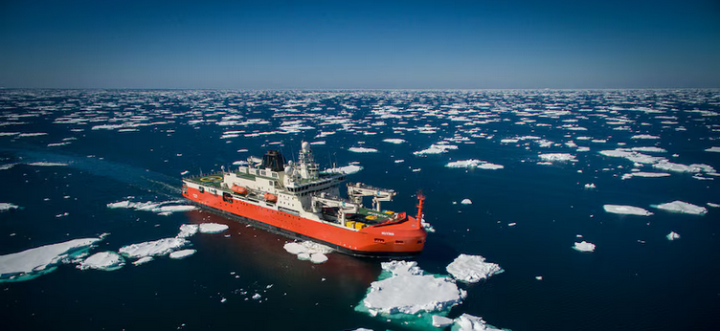
Testing & Validation: Field Tests
Integration on-board RSV Nuyina
Notes:
We've conducted extensive field testing in diverse environments. Most recently, FIDO was deployed aboard the RSV Nuyina research vessel during a 10-week Southern Ocean expedition, where it collected samples twice daily from the ship's underway seawater system. We've also tested it at the MBARI dock, at the Monterey Bay Aquarium alongside other eDNA samplers, and in various freshwater environments. Each deployment has taught us something new and helped refine the design. The Antarctic deployment was particularly valuable as it tested the system under extreme conditions with limited opportunities for intervention.

Slide 18
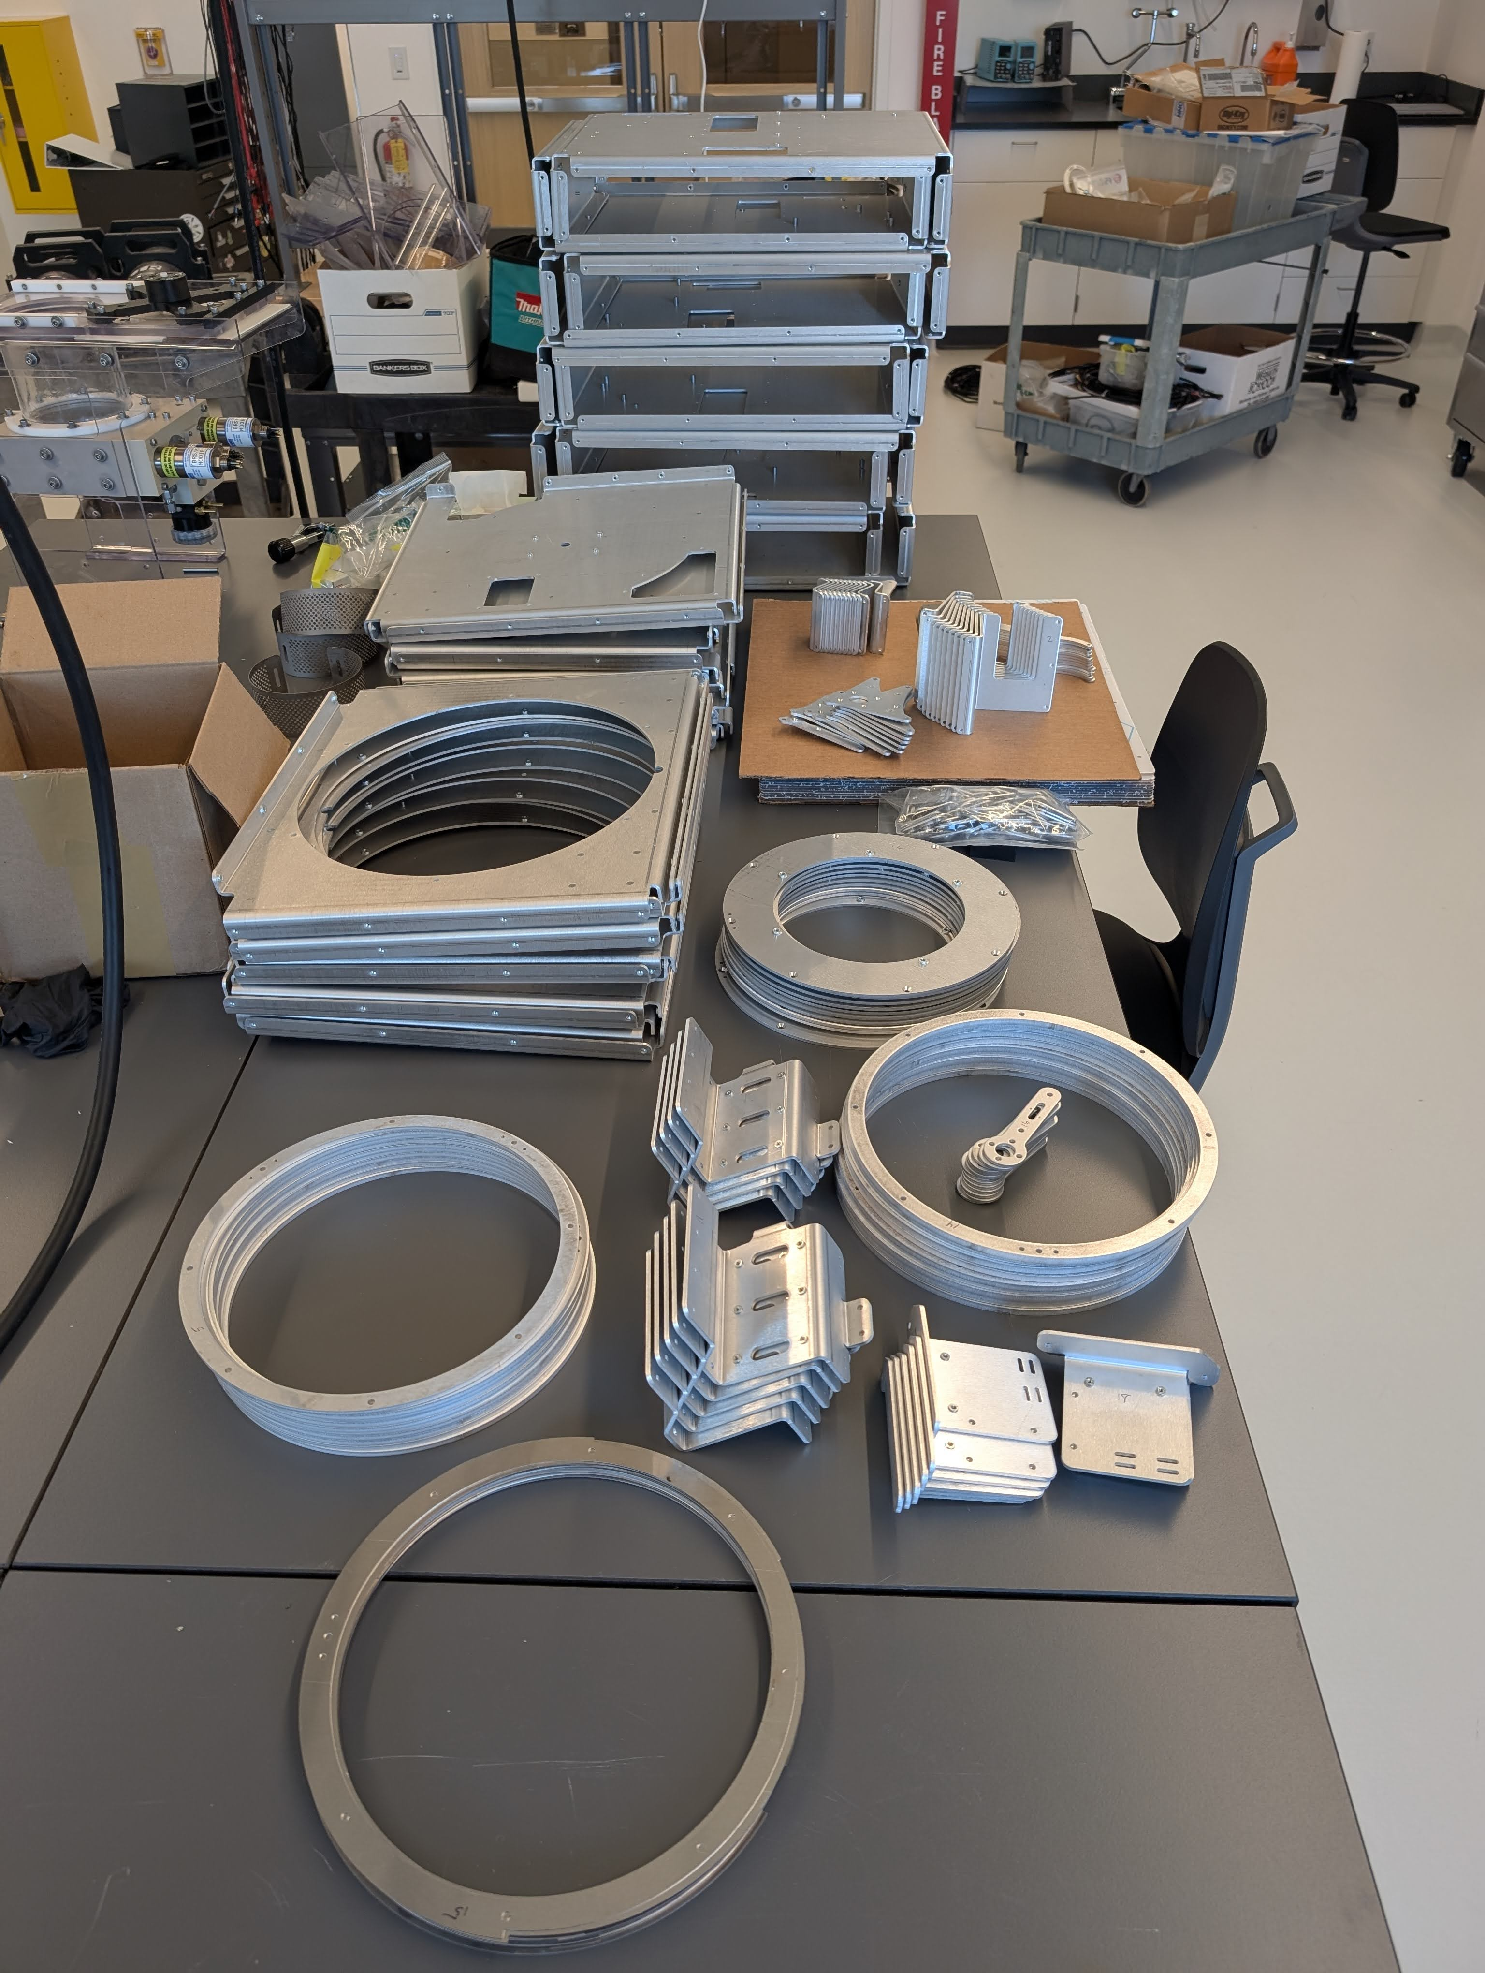
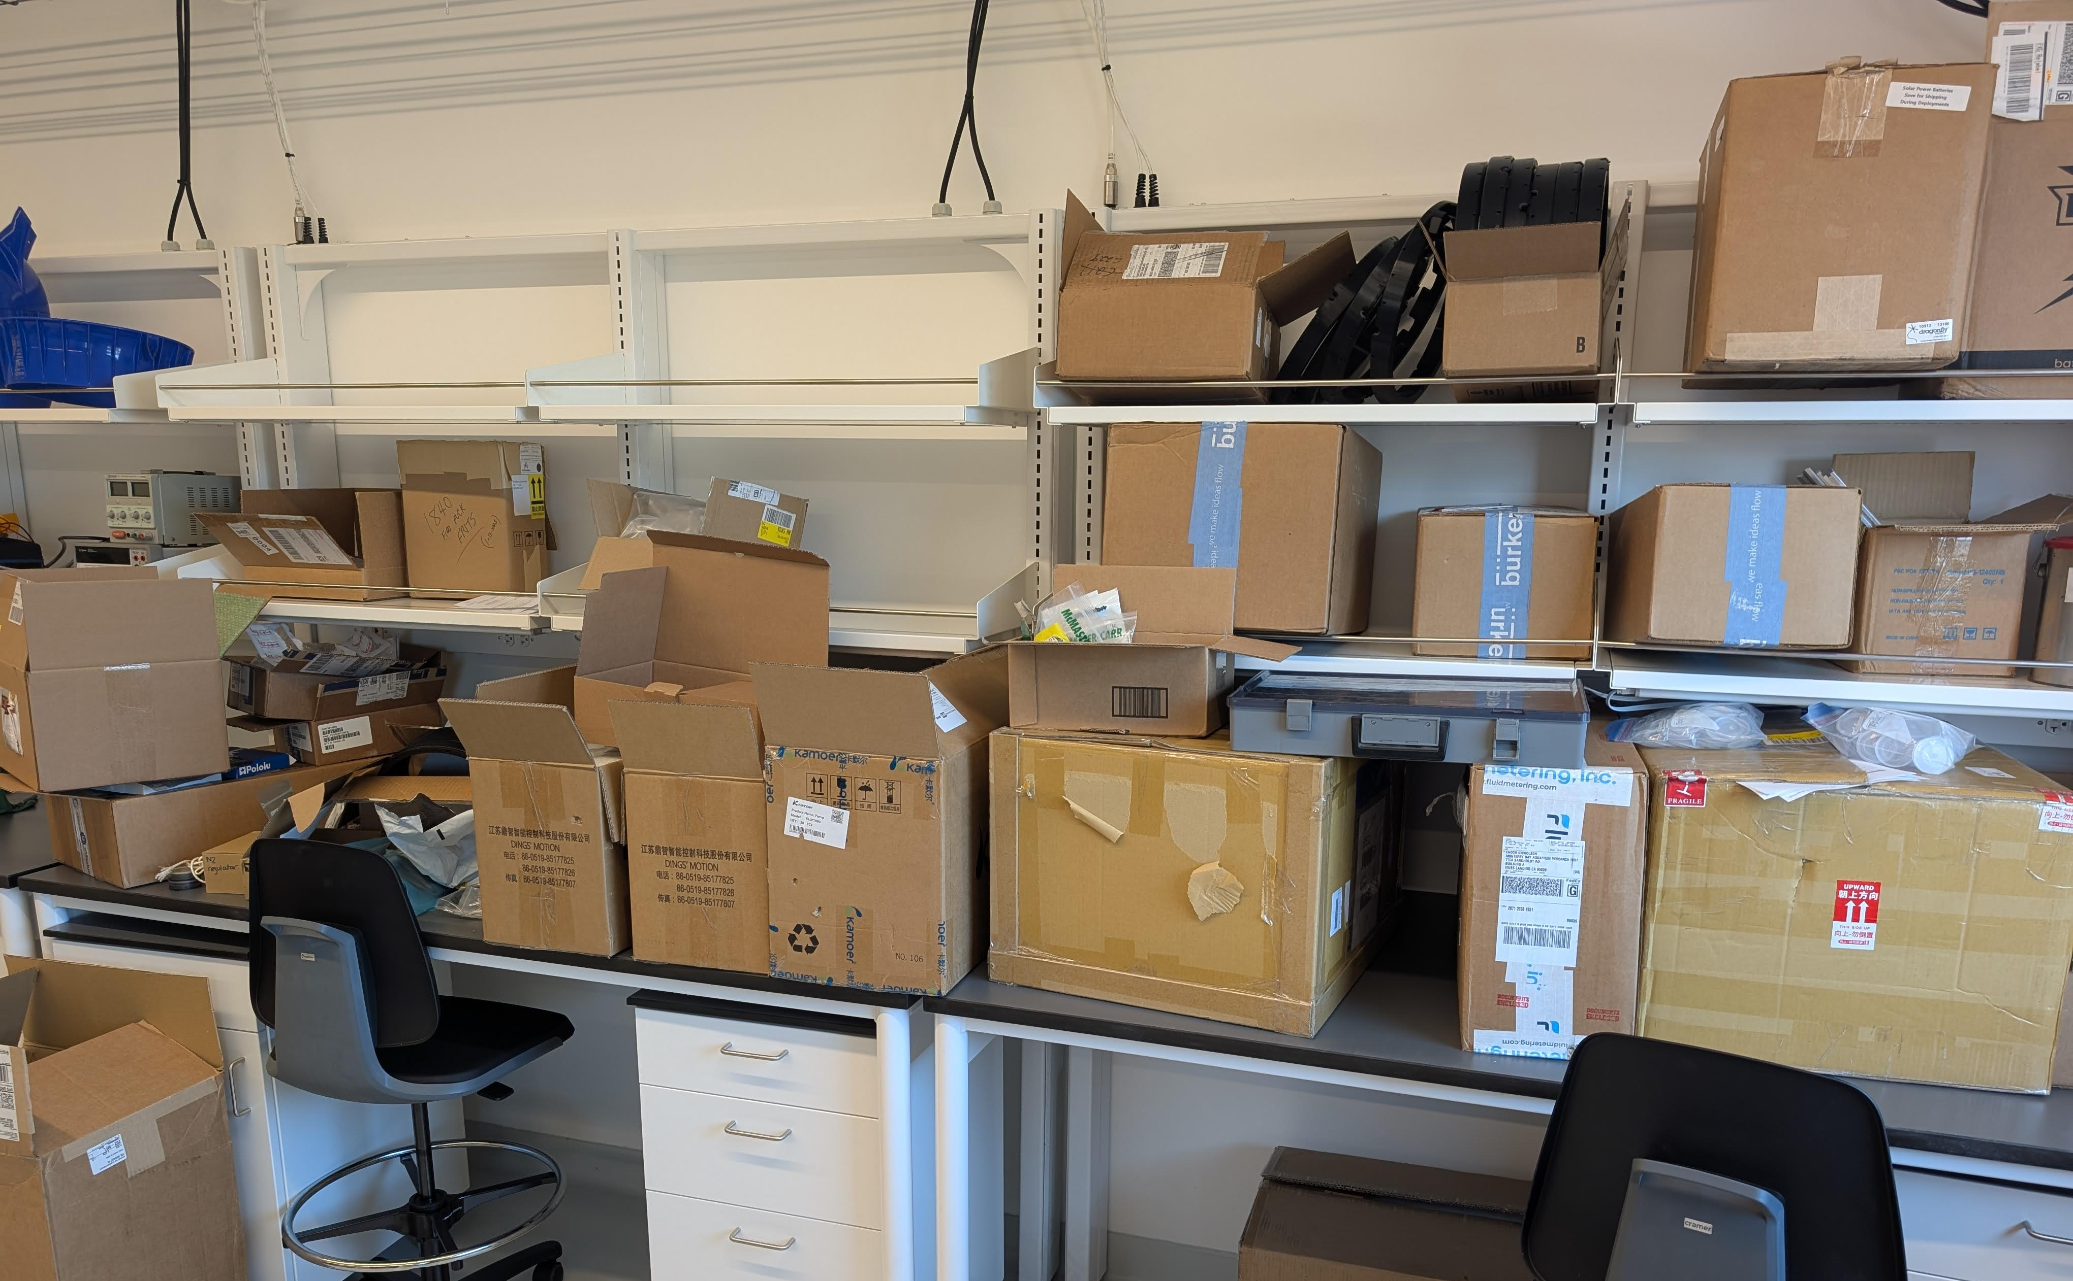
Next Steps
Validation is continuing
10 production units are currently being built
Open to collaborate on field deployments
Looking to license to commercial vendor
Notes:
Looking forward, we're continuing validation work including metabarcoding studies. We're currently building 10 production units that will be deployed through the READI-Net program later this year. We're actively seeking collaborations for field deployments to expand our understanding of FIDO's capabilities across different environments. Ultimately, we're looking to license this technology to a commercial partner who can make it widely available to the research community. If you're interested in collaborating or learning more, please find me after the presentation.
---
Validation is continuing
qPCR and metabarcoding
READI-Net Implementation in 2025
10 production units are currently being built
Open to collaborate on field deployments
Looking to license to commercial vendor

Slide 19
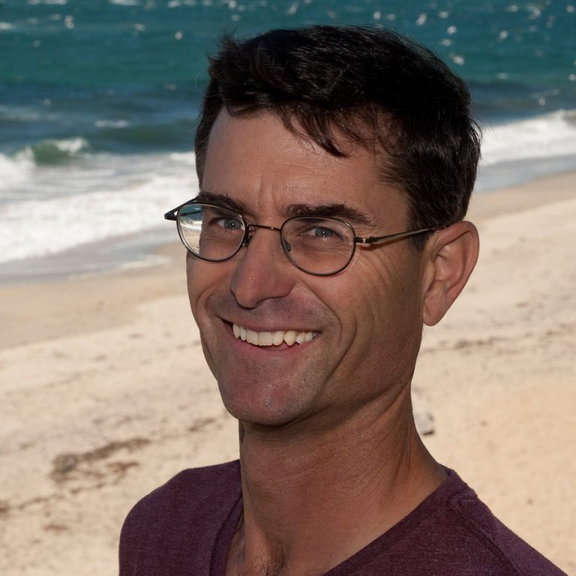
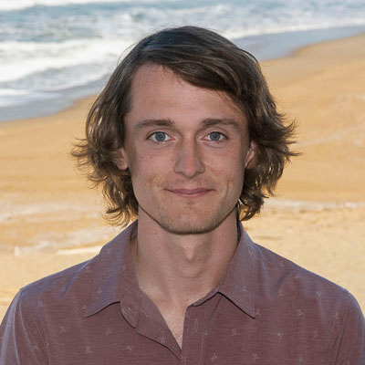
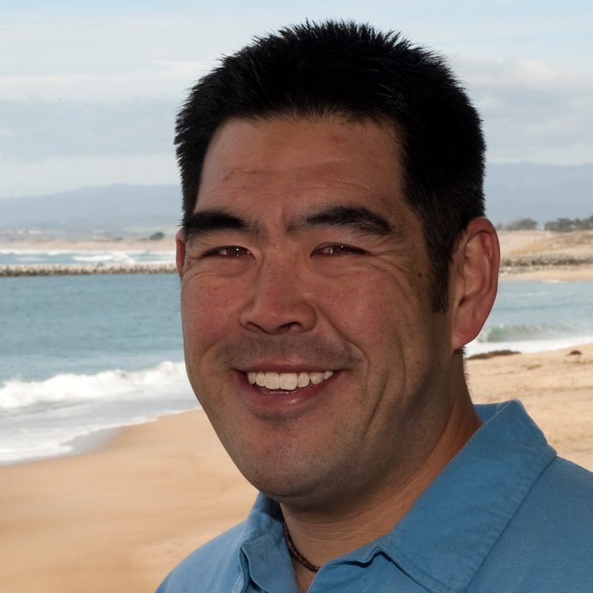
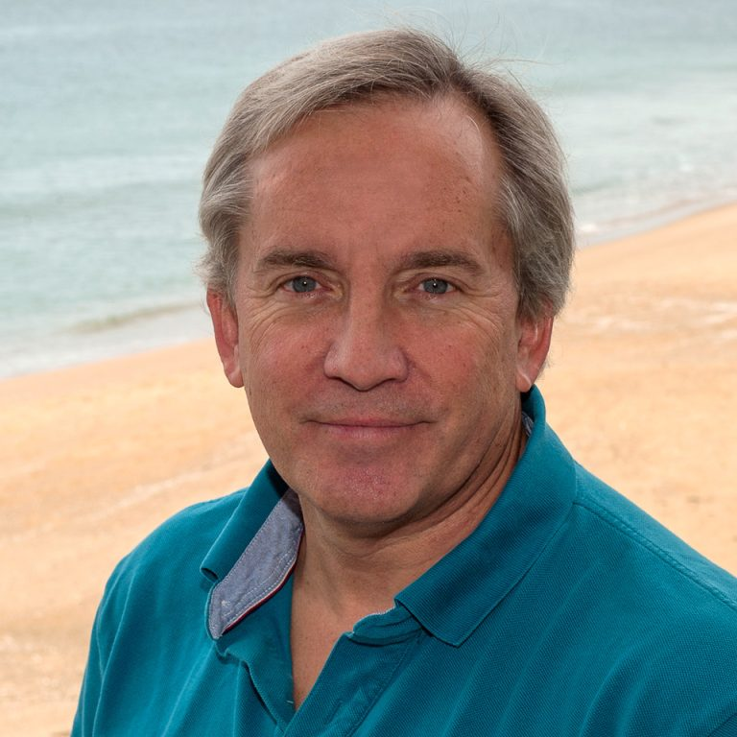
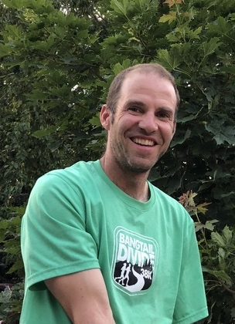
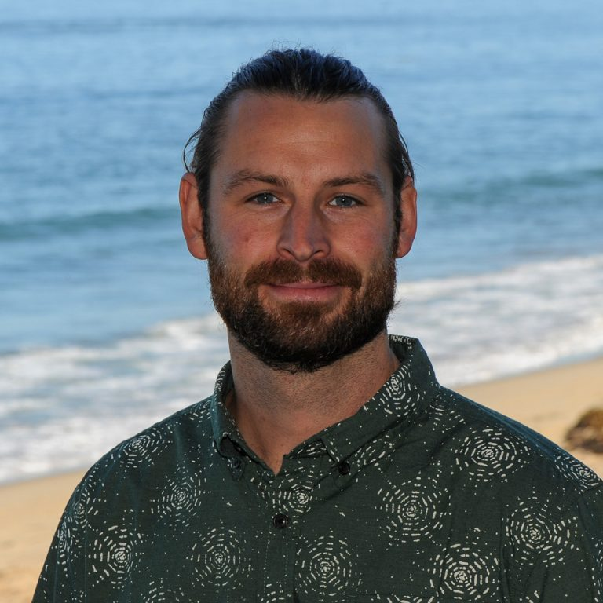
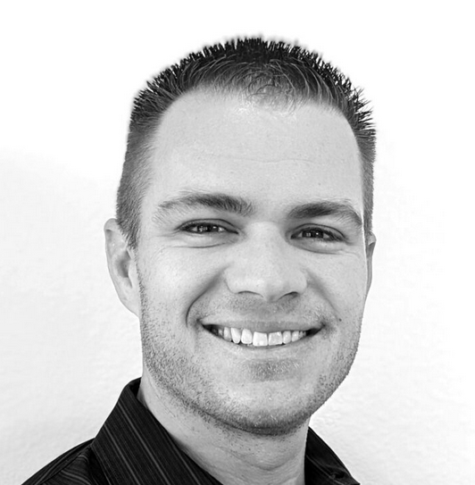
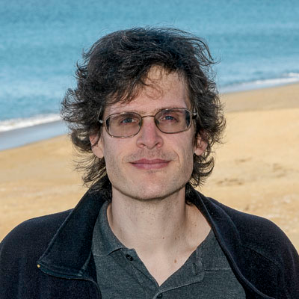
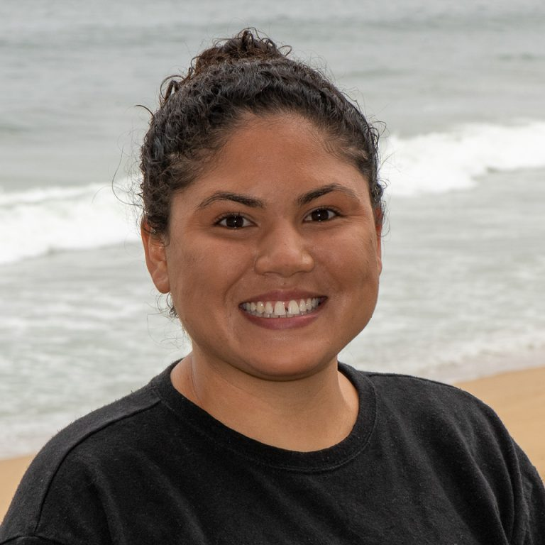


Acknowledgments
Notes:
This work wouldn't be possible without our fantastic team at MBARI and our partners at USGS. Special thanks to Adam Sepulveda for leading the READI-Net initiative. Funding came from the David and Lucile Packard Foundation and the USGS. Thank you for your attention, and I'm happy to take questions.

