Slide 1
3G Cartridge Heater Calibration Fixture

Slide 2
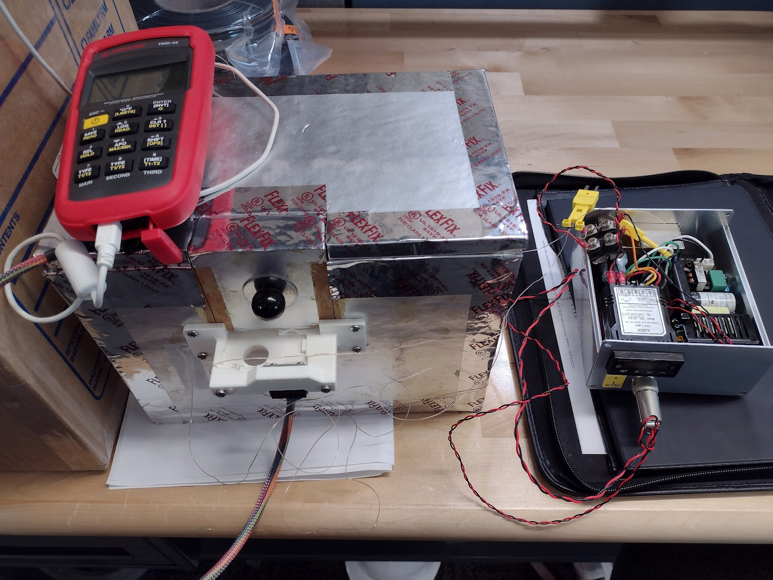
Current: Scott’s Oven
Risk: Low
Calibration Rate: 1 board / 2 hours
Accuracy: ~<0.5 ⁰C ?

Slide 3
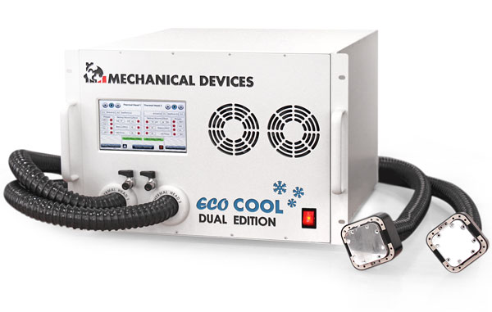
Path A: Eco Cool
Cost: $19,000 Single Head, $28,000 Dual Head
Hardware Lead Time: 2-3 weeks ARO
Engineering Required:
Machined thermal plates to fit heater board(s).
Fit insulation around plates.
Pogo Pin Fixture to hold cartridge control board.
Setup & program Eco Cool calibration profile / data logging.
Set Up Time: ~1mo
Risk: Low
Calibration Rate: ~4 boards / hour
Accuracy: <0.5 ⁰C

Slide 4
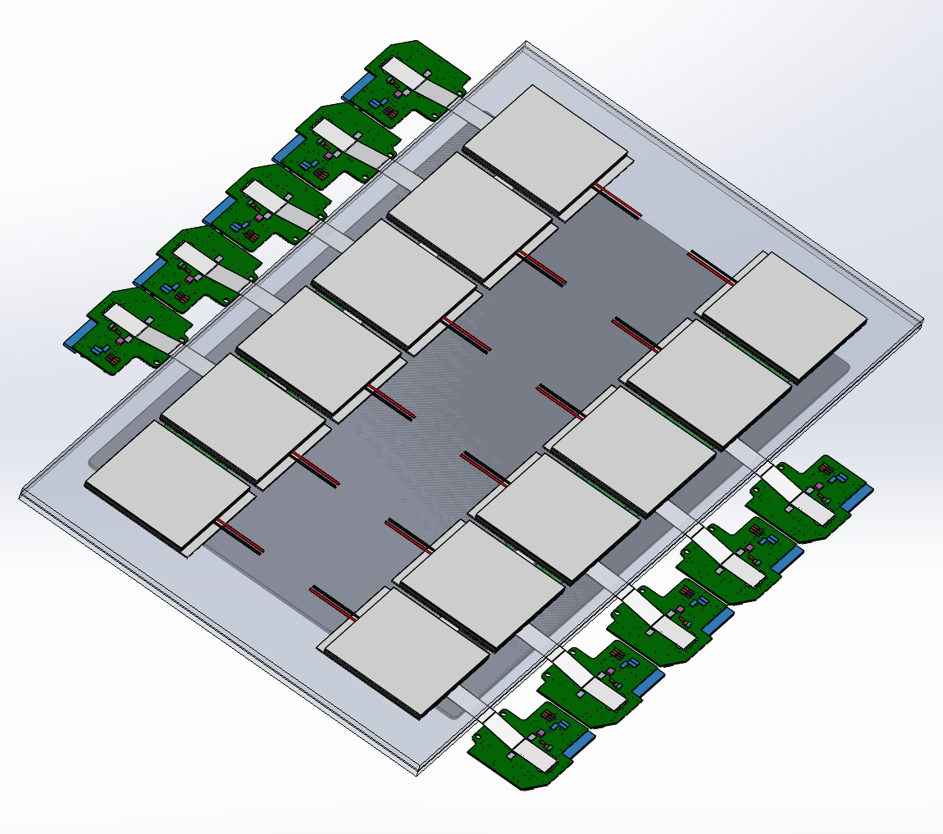
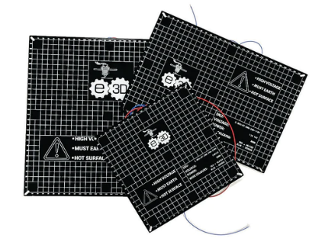
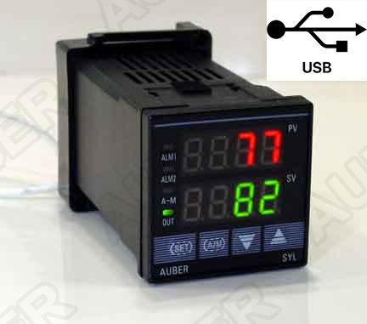
Path B: Build Fixture
Cost: $2000 - $3000 (Heat Only), $4000 - $5000 (Heat & Cool)
Hardware Lead Time: 1 weeks ARO
Engineering Required:
Machined thermal plates to fit heater board(s).
Fit insulation around plates.
Pogo Pin Fixture to hold cartridge control board.
Setup & program controller (with or without profile).
Setup Temp Logger.
Set Up Time: ~1mo
Risk: Medium – Temp uniform & stable?
Calibration Rate: ~10 boards / 1.5 hours
Accuracy: ~0.5 ⁰C

