Slide 1
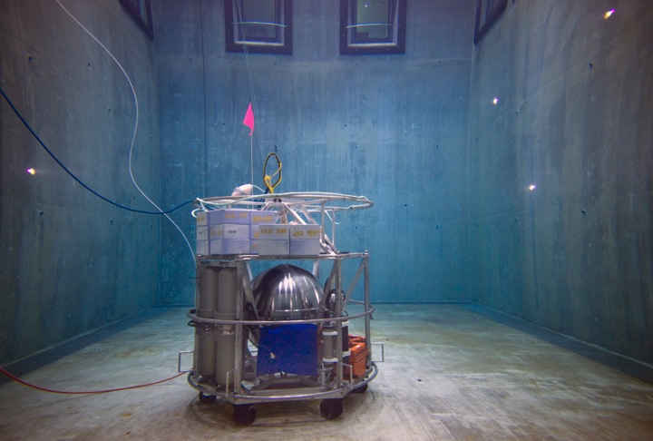

Deep Water Instrument for Microbial Identification, Quantification, and Archiving
Doug Pargett

Slide 2
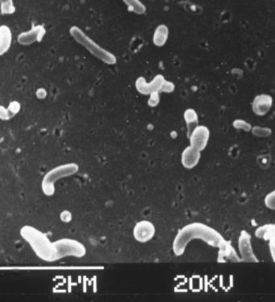
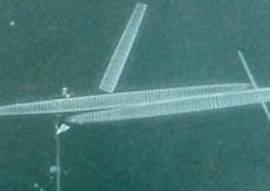
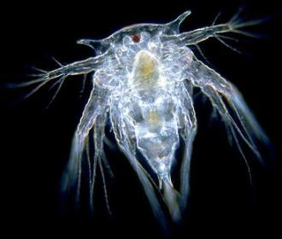
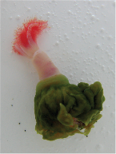
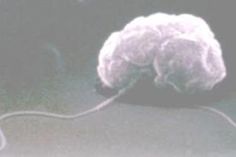
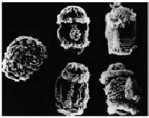
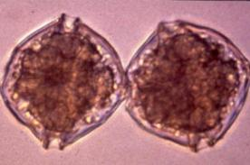
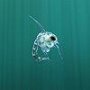
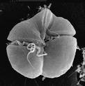
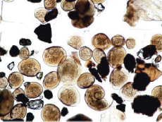
Ocean Microbes
Notes:
Deep Ocean microbes live in environments that we didn’t really know about 50 years ago. Their life cycles, distribution and niche in the environment are still poorly understood. As technology evolves we can build tools to help us understand their bio-geochemical cycling, how the populations change and react to inputs that drift down from the light dominated euphotic zone, as well as how the microbial populations differ with subsurface inputs, such as thermal vents.

Slide 3
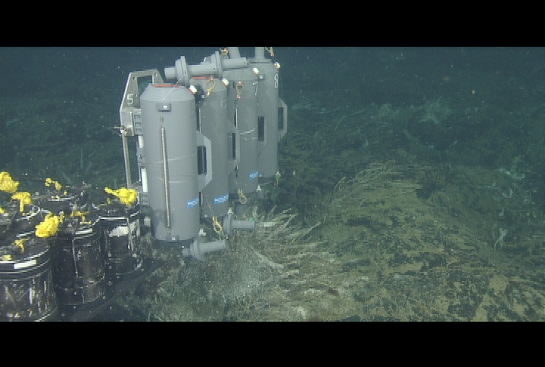
Sample to surface
Time and Environment sensitive
Notes:
The deep ocean is a difficult place to get to and to get samples back from.
With subs and ROVs we can occasionally collect water samples and microbes from these locations, but they are hours old by the time they reach the surface, and have traveled through conditions very different from where they were collected.
Some benefits of an in situ microbial instrument are that it avoids the time lag and environment change and exposure that occur when a sample is collected to when it is processed. It can be present for long periods of time, collecting numerous samples so that we can consider the dynamics of the microbial population.
Show a niskin bottle, or titanium major sampler.

Slide 4
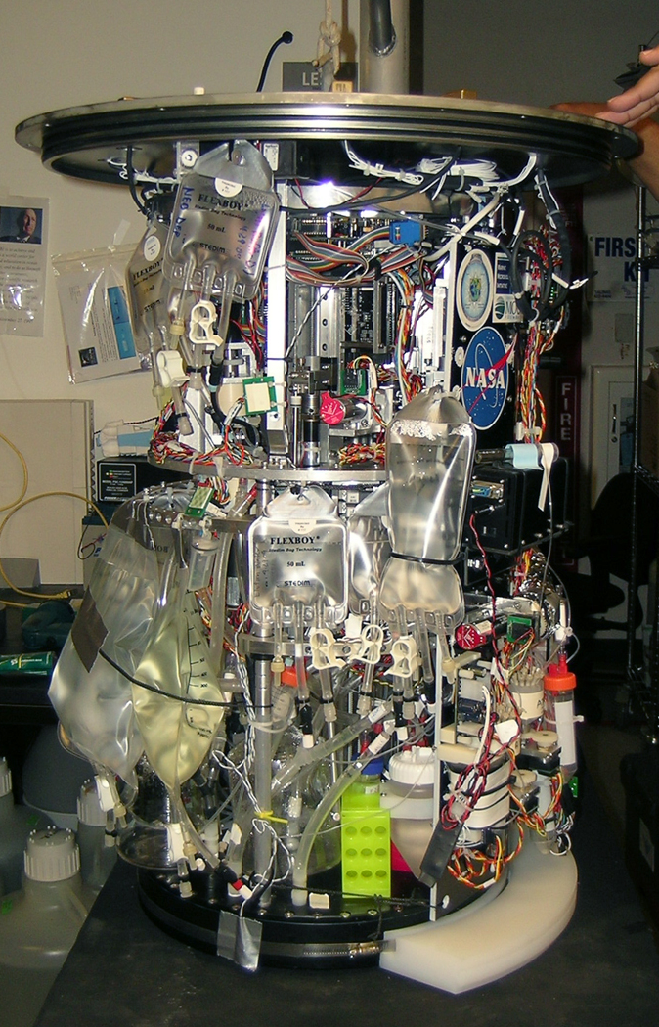
Environmental Sample Processor
Robotic
Lab
in a can
Notes:
The Environmental Sample Processor, ESP for short, is essential a robotic genetics labs in a can. And it kind of looks like that. It filters microbes from raw seawater and can immediately processes that sample, adding reagents and quantitatively detecting what microbes are there by RNA or DNA sequences. The results can get transmitted to shore in near real time, but the machine can also archive a sample, preserving the whole cells for follow up analysis in the lab.
Since it is fully robotic, it is well suited as a core detection instrument for Deep Water microbial research.
(slide)

Slide 5
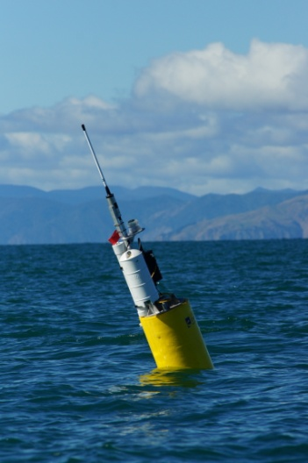
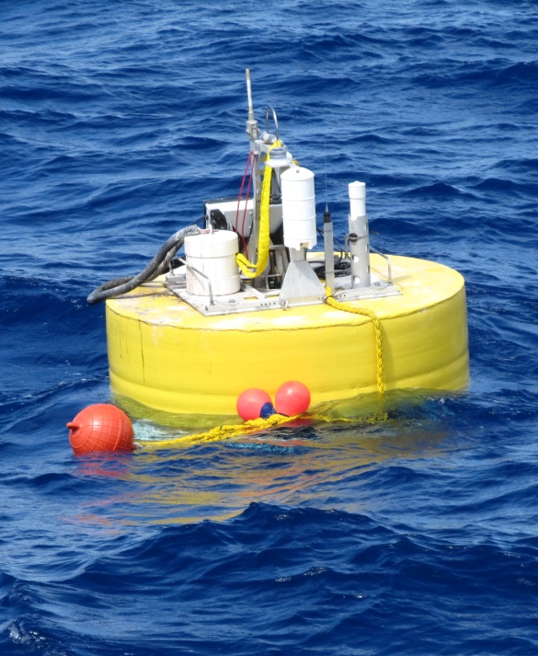
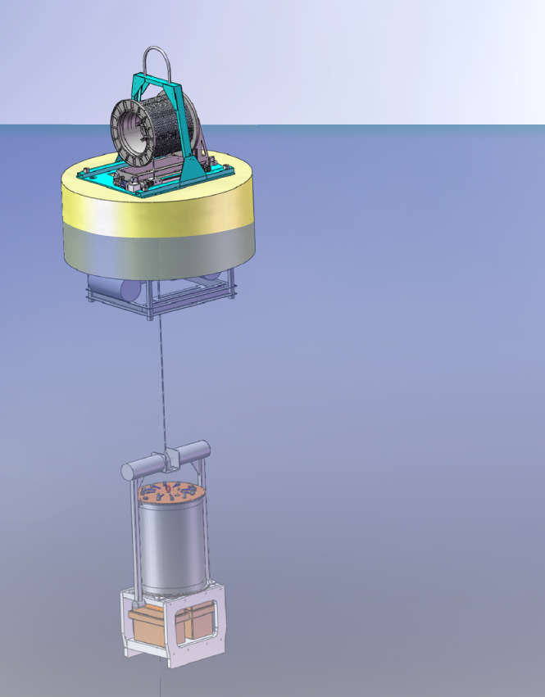
Deployment Platforms
Deep?
Mooring
Drifter
Notes:
The ESP is the detection instrument. To operate in the ocean, it needs a platform or system to support it.
We have moorings and drifters that place the ESP typically between 5-30m deep.
However, one of MBARI’s major goals is to use new technology for deep ocean, so we wanted to develop a deep ESP platform so we could use the ESP instrument at depths to 4000m.

Slide 6
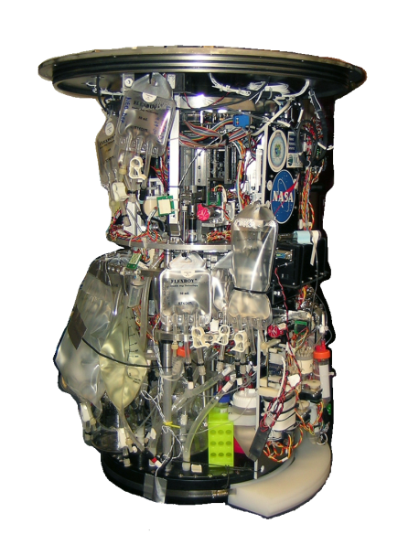
Deep ESP Components
Microbe detection instrument
Notes:
I’m going to walk thru the parts that we needed to develop for the Deep ESP.
First we need a Microbe detection instrument.. Go that.

Slide 7
Deep ESP Components
Microbe detection instrument
4000m rated pressure housing

Slide 8
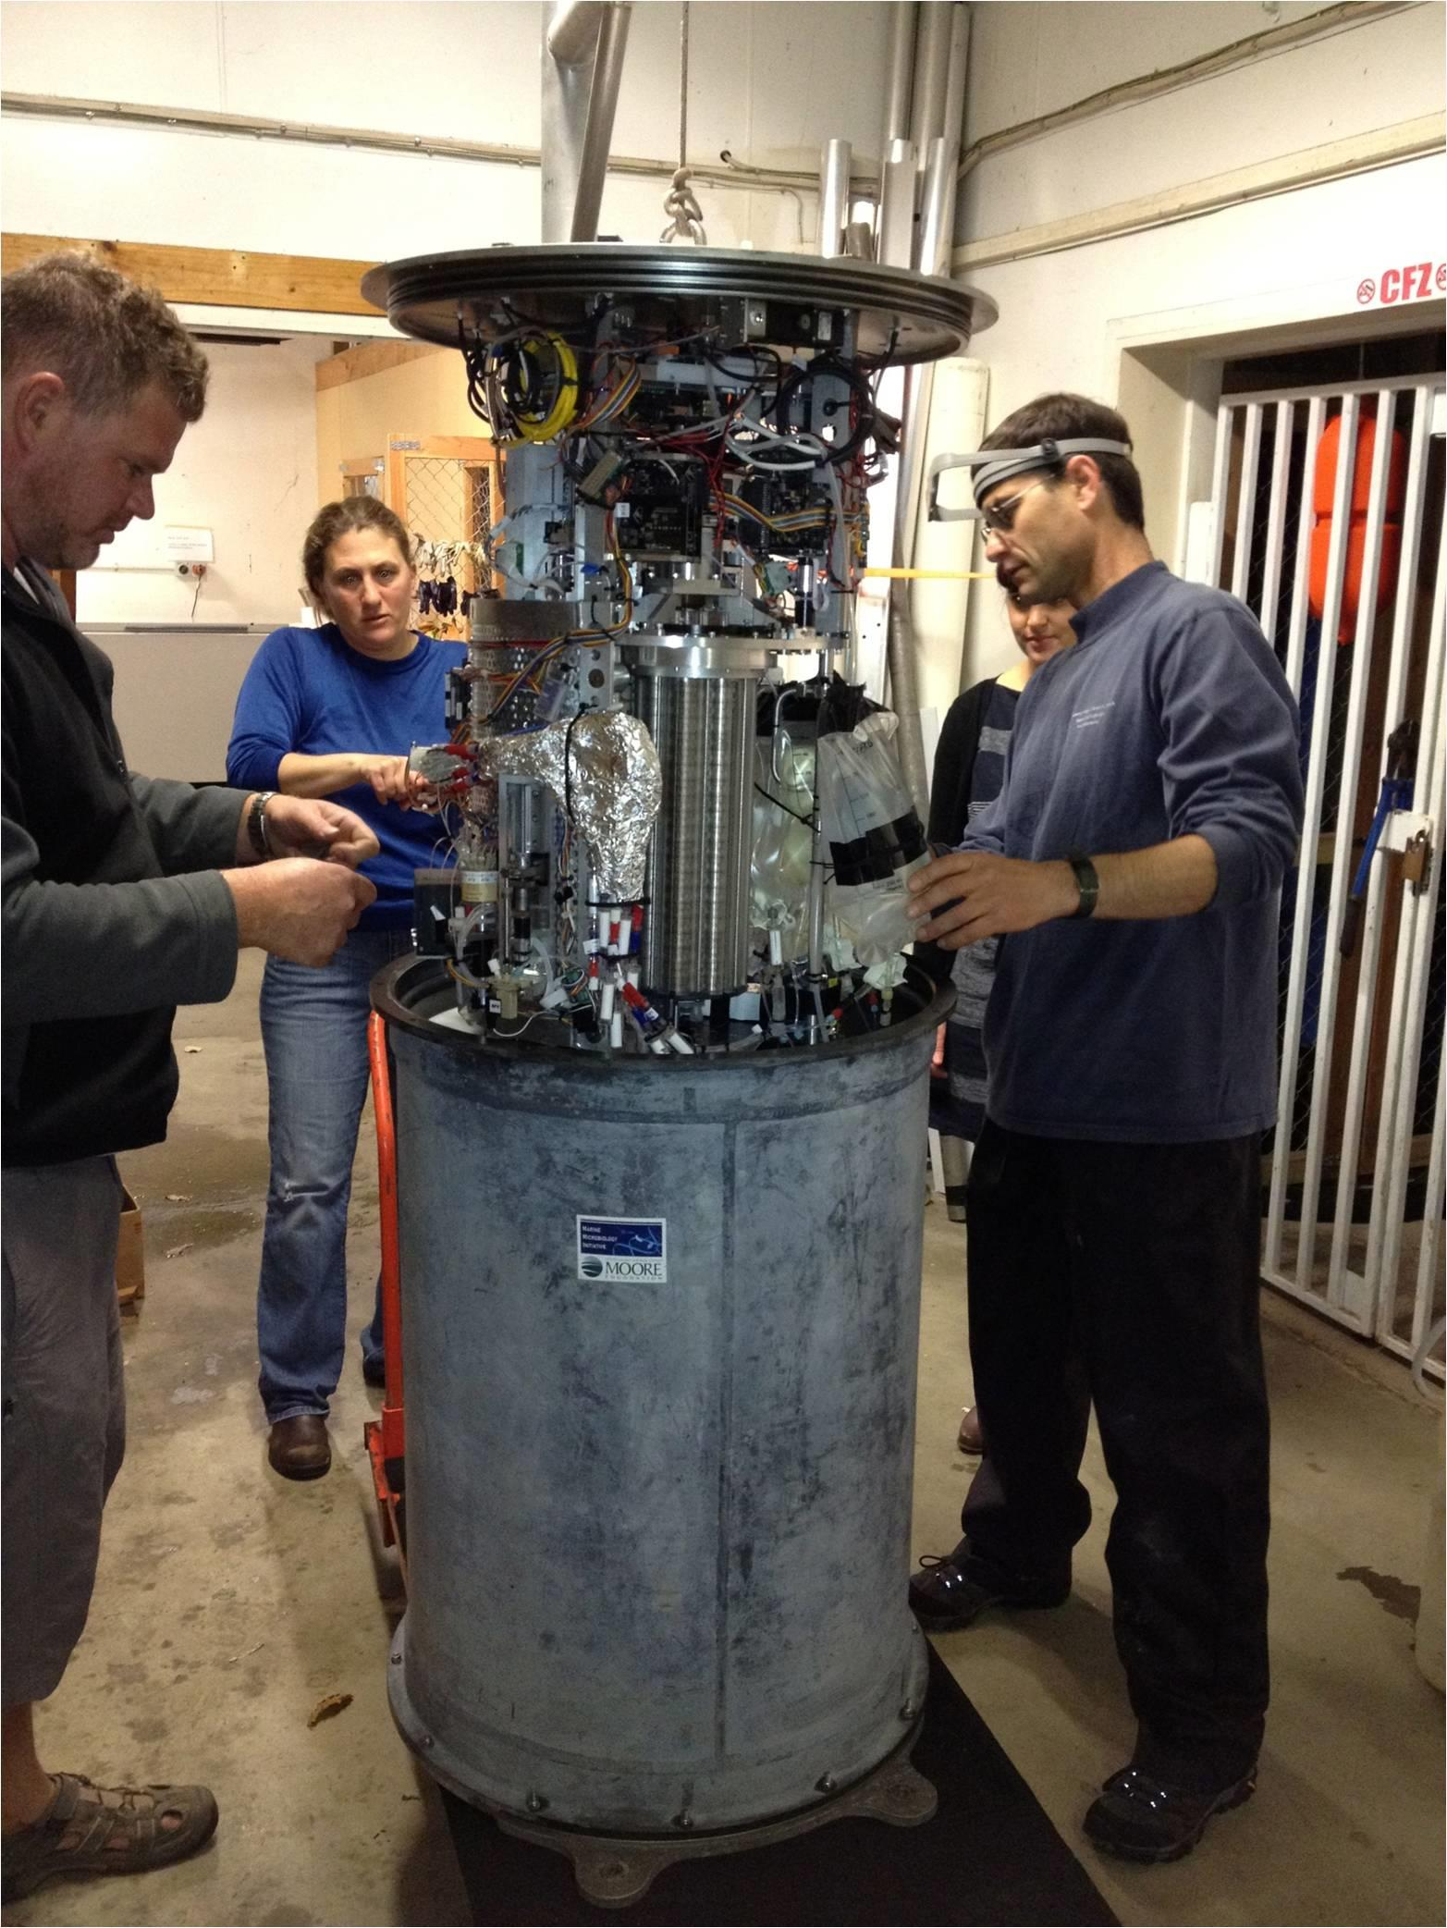
Notes:
The ESP instrument is not “small”, and is typically deployed near surface in a can about the size of a 50 gallon drum. The dashed line is the scale of a 43cm sphere.
It took years to develop the instrument, so rather than attempt to miniaturize this instrument to be 1/10th the volume, we built a pressure housing for the scale of the instrument.

Slide 9
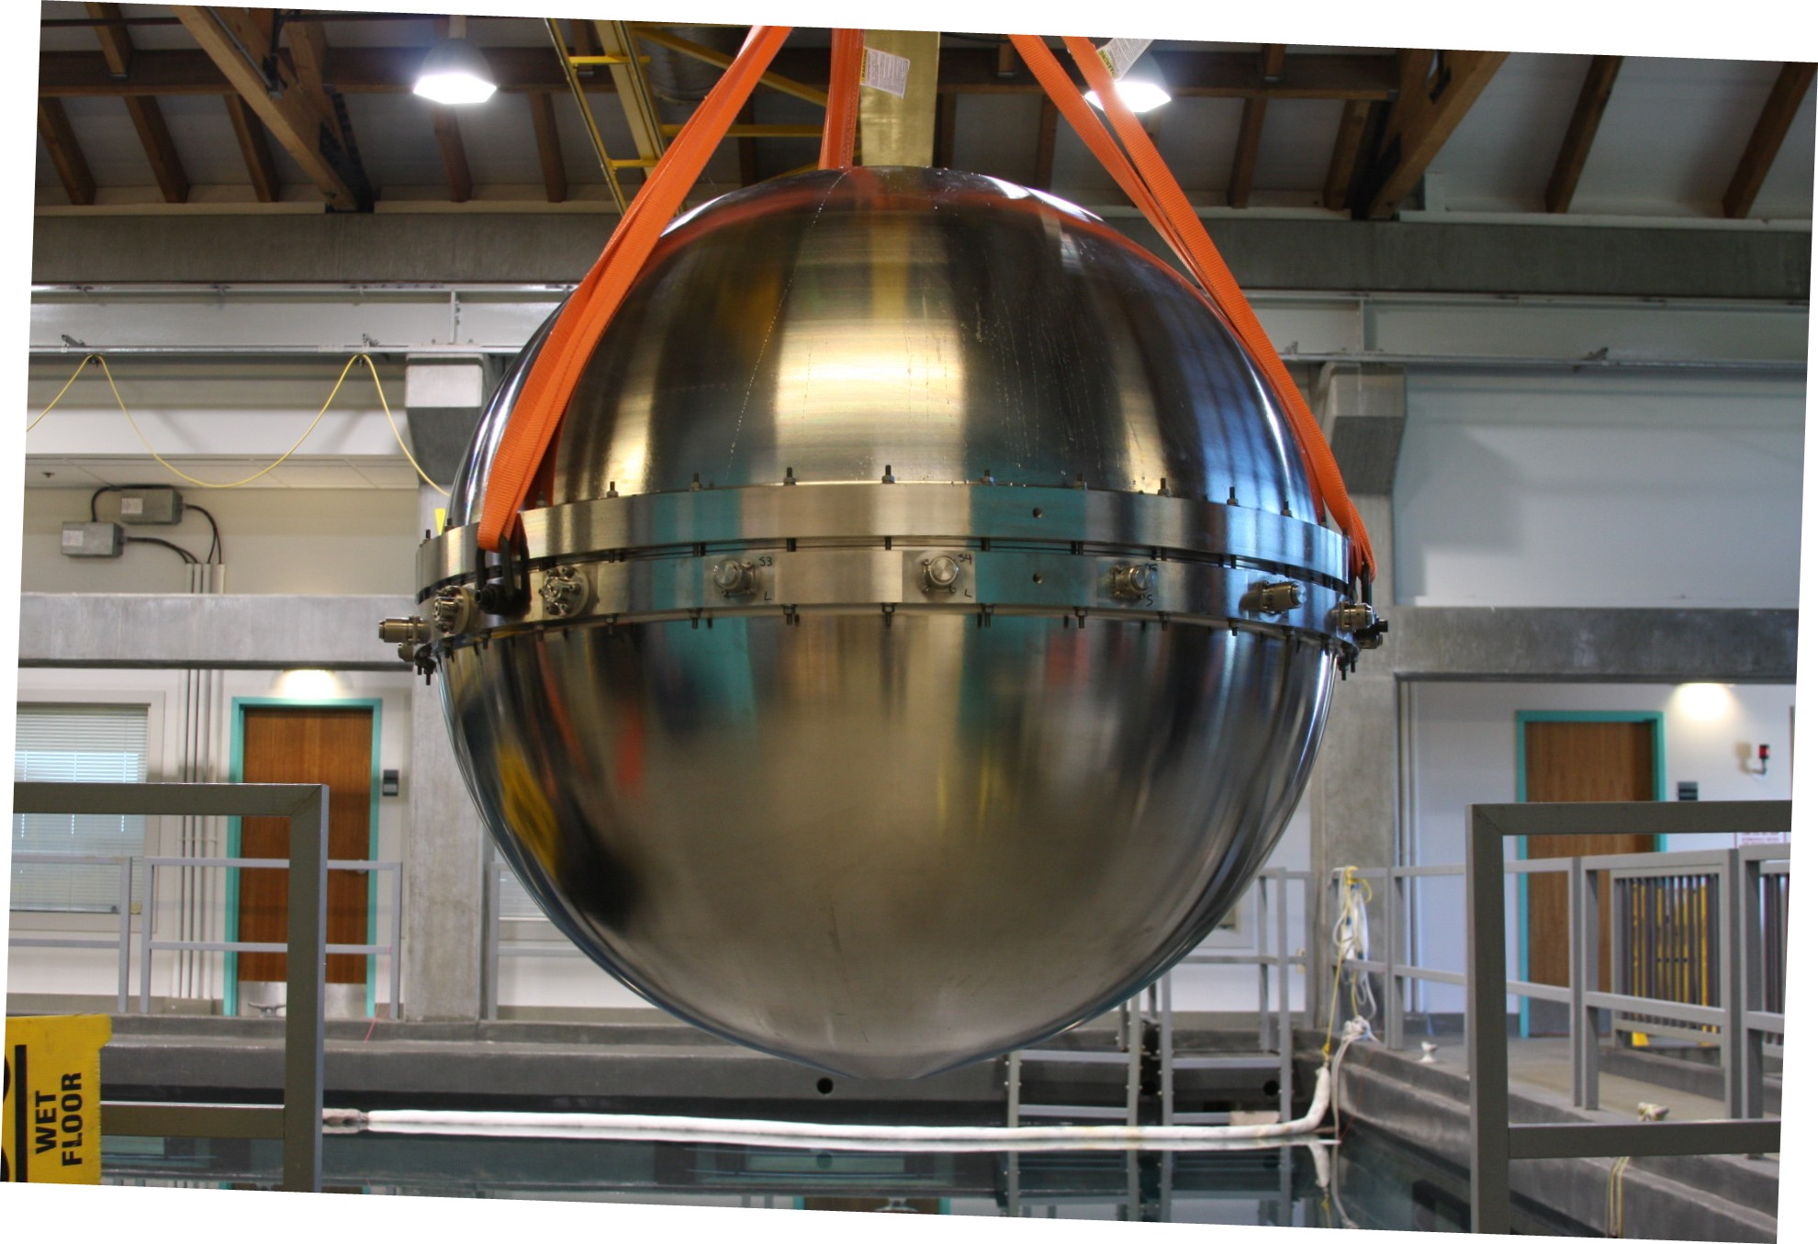
4000m Pressure Sphere
1 m
Cast Titanium
Notes:
It’s spherical housing, machined from cast titanium, and is just over 1m in inside diameter.
There’s a more detailed talk about this sphere tomorrow.

Slide 10

Deep ESP Components
Microbe detection instrument
4000m rated pressure housing
Ambient pressure interface
Notes:
The instrument filtration step requires that raw seawater flow through the core of the ESP. However, the ESP is a wet chemistry machine that mixes and doses reagents using commercial lab fluidics, valves and syringes. And these are pressure limited to 5 atmospheres. So we developed an interface system called the Deep Water Sampling Module.

Slide 11
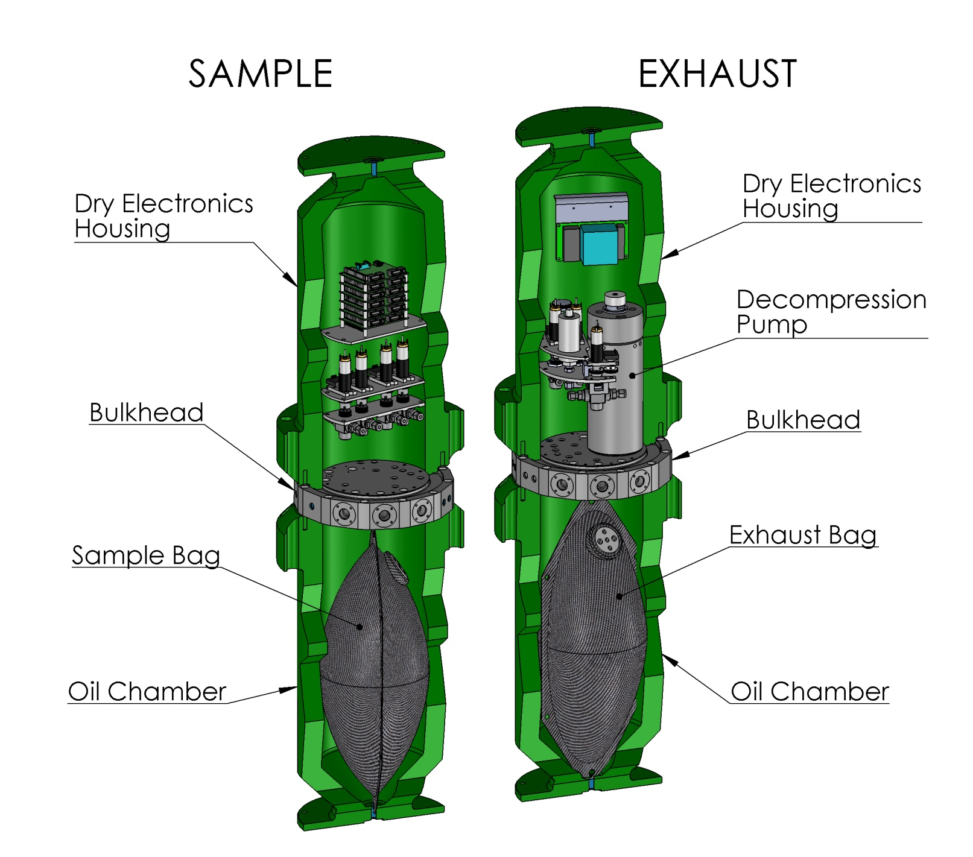
Deep Water Sampling Module
Notes:
The Deep Water Sampling Module functions as a pressure gateway between the ESP instrument (at 1 atm in the sphere) and the ambient ocean pressure, which could be 400 atmospheres. The system can intake a 10L sample of seawater and isolate that volume from ocean pressure. The water sample is depressurized by slightly expanding that closed volume over a couple of minutes. The now low pressure seawater sample can be fed to the ESP instrument for processing and analysis. Afterwards, the filtered seawater is returned to ambient pressure and emptied out so the sampling module can collect and decompress the next sample.

Slide 12
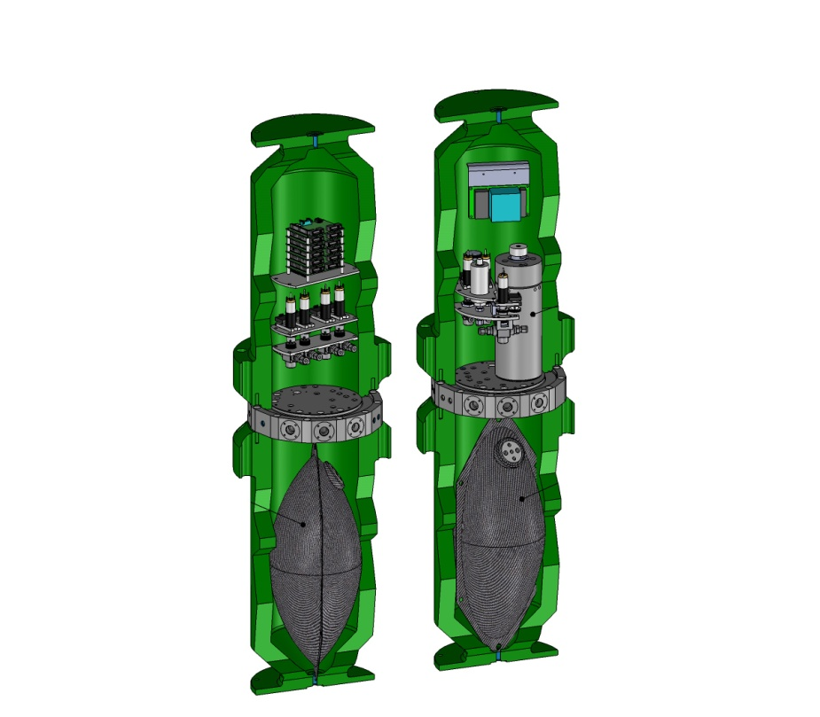
Deep ESP Components
Microbe detection instrument
4000m rated pressure housing
Ambient pressure interface
Source wand
Notes:
We wanted the ESP to be able to collect water from two places, the ambient water around the ESP and a vent source some distance away

Slide 13
Source Wand
DWSM
Ambient
ESP
Wand
15 m
Context Sensors
Vent
Notes:
We developed an intake wand system that could select from two source locations, and feed that specific water to the ESP (via the deep water sampling module) as well as the platform context sensors so they are recording the chemical composition of the water the ESP is sampling.
A wand can be deployed up to 15m away from the platform, since the ESP instrument needs to stay in cool ambient water, away from potentially very hot water of the vent field. The wand tip includes an additional temperature sensor that monitors and records the temperature of the vent water right where it is being collected.

Slide 14
Deep ESP Components
Microbe detection instrument
4000m rated pressure housing
Ambient pressure interface
Source wand
Deployment platform

Slide 15
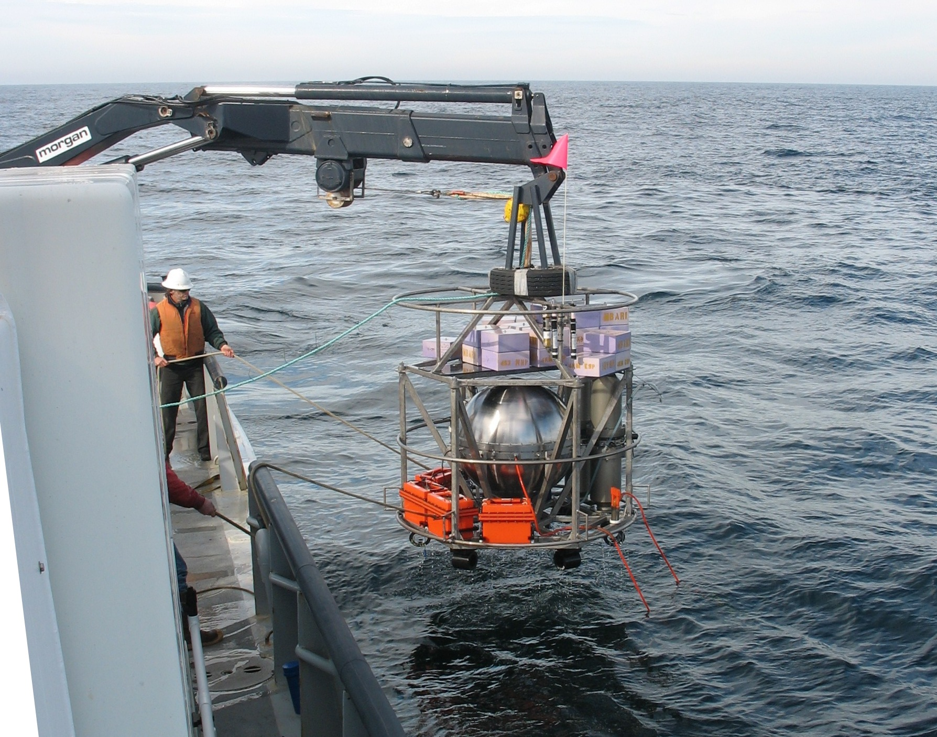
Freefall Benthic Lander
Notes:
The whole system, instrument, sampling module, wand and context sensors, gets packaged as a free fall benthic lander with a drop weight. We set it into the water over a relatively smooth area nearby our target site, cut it loose and it sinks to the seafloor.

Slide 16
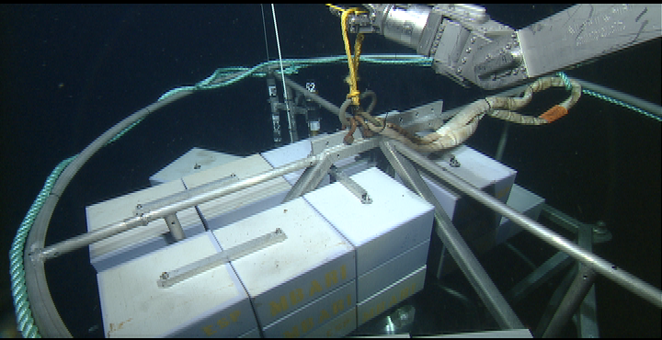
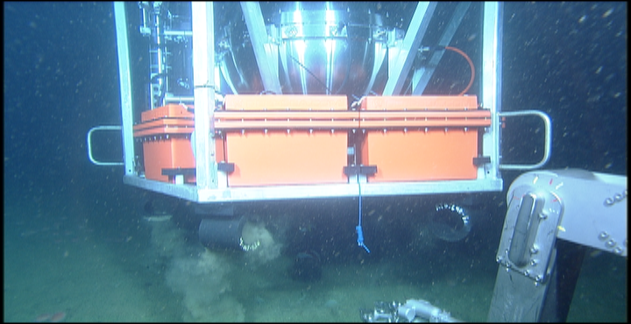
Reposition to site
with ROV
Release
drop weight to Recover
Notes:
We track the lander acoustically, and dive the ROV to pick up the Lander and reposition it to our research site.
To recover the lander, the drop weight is released (either by acoustic signal or manual action by the ROV) and the lander becomes buoyant and ascends.
At the surface, beacons and GPS trackers tell us that it has surfaced and where to find it.
(ROV image of repositioning)

Slide 17
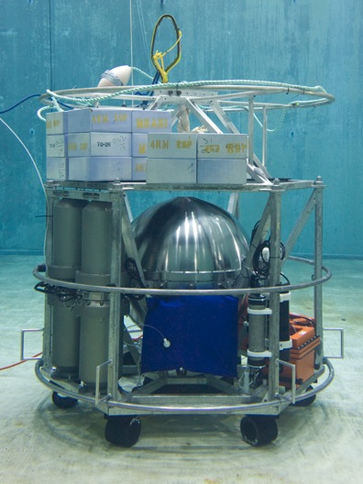
Deep ESP Components
Microbe detection instrument
4000m rated pressure housing
Ambient pressure interface
Source wand
Deployment platform
Power source
Notes:
We obviously need electrical power for this.

Slide 18
Deep ESP Power
Average: 170 W
Peak: 600 W
ESP+DWSM
20 W
In Situ
Mass Spec
100 W
Heater
50 W
Notes:
This is not what you would consider a low power instrument

Slide 19
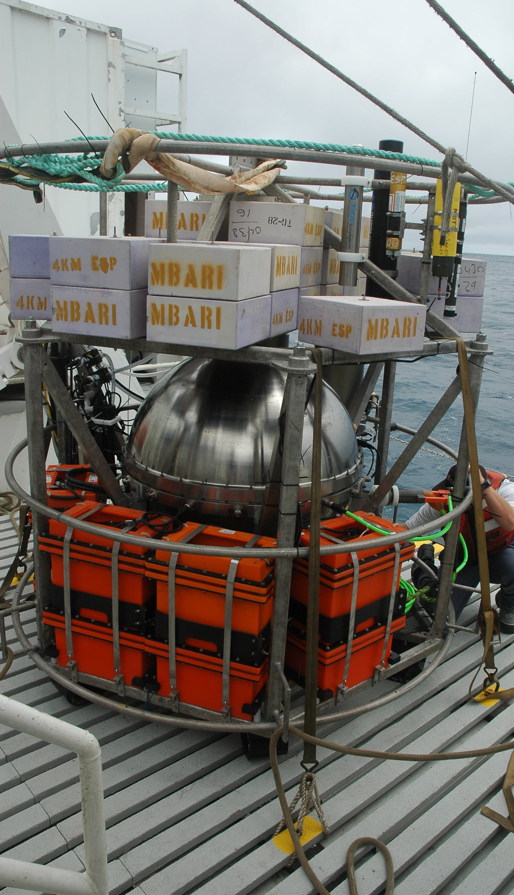
Power Option 1:
Batteries
On Lander
Oil filled
Lead Acid
8 kW-hr
Notes:
Option 1 –Batteries
Oil Compensated Lead Acid
8 kW-hr
This gives us just under 2 days of power with the mass spec, almost 5 days without it.

Slide 20
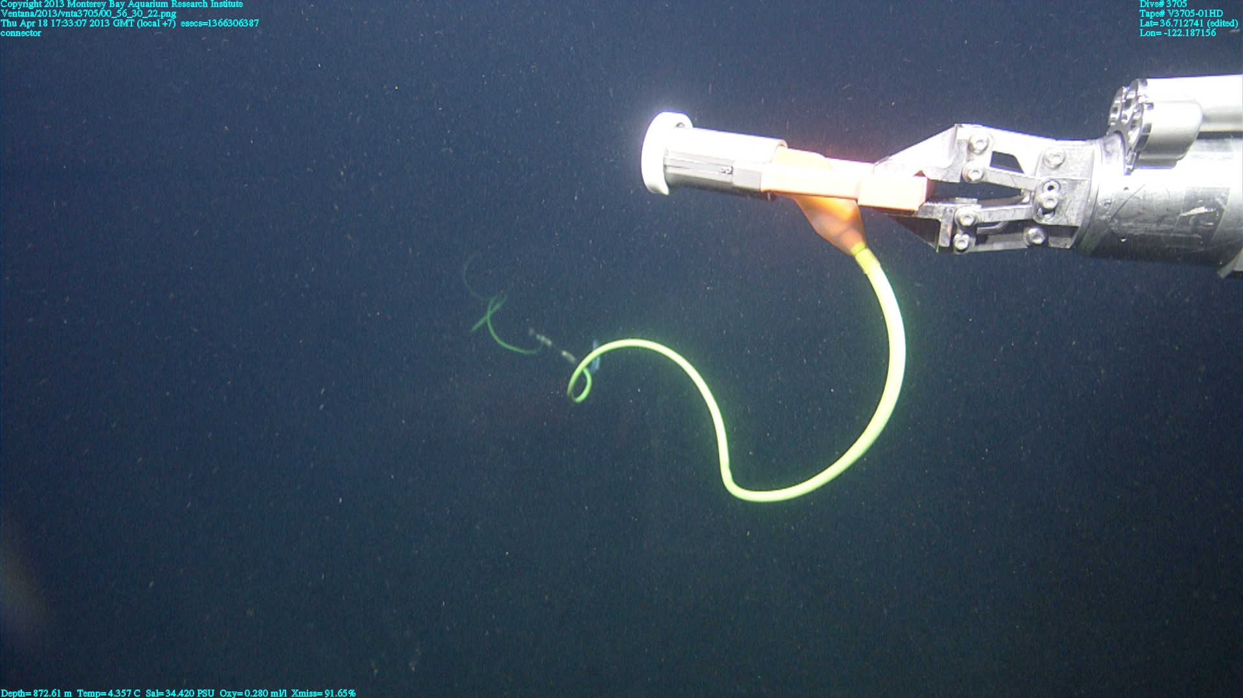
Power Option 2:
Plug In
Cabled Node
ROV
Continuous power
Need batteries to buffer
Notes:
This system can also be plugged into a cabled node.
That seems easy, oh wait you need to have a submarine cable at your site of interest.
Configured appropriately, an ROV can supply the power, but then you spend all the expedition time and resources as a power source.
And you still need batteries, back charging them with the ROV so the ESP keeps running overnight operation when the ROV is aboard ship.
Even when plugged in to a submarine cable, batteries are still needed. There are times that the peak draw can exceed the incoming power, and the batteries buffer that load. Also, if a node or shore side issue were to cause a power loss, the ESP will need the batteries to complete processing the current sample and set the instrument to a “safe” state.

Slide 21
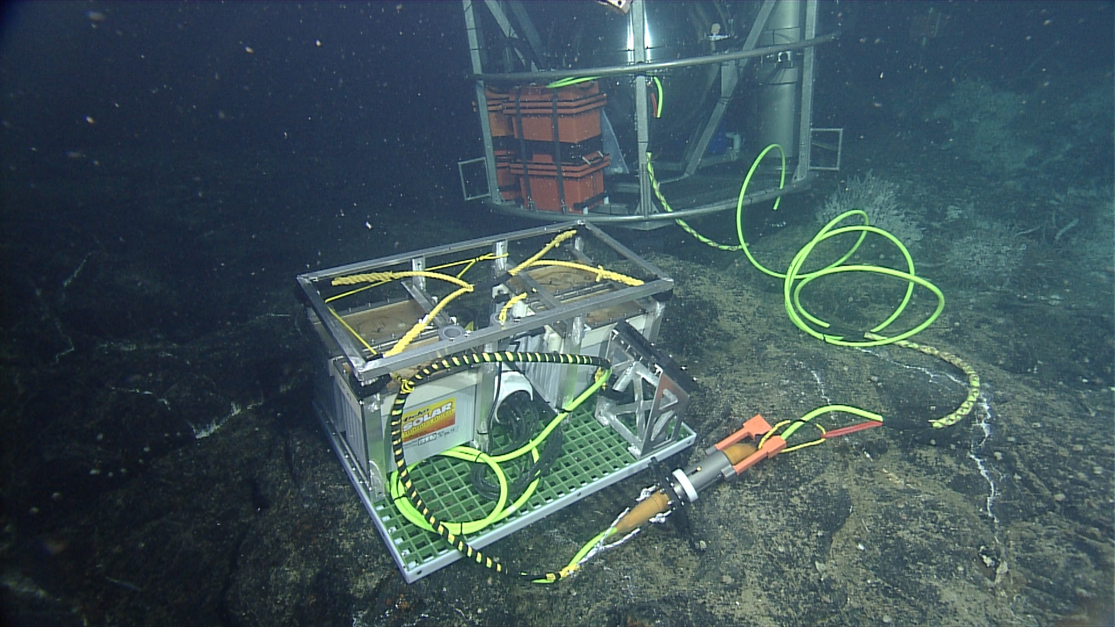
Power Option 3:
Battery Sleds
ROV Swappable
Oil filled
Lead Acid
4 kW-hr each
Notes:
So there’s a third option we developed. A swappable battery pack or sled which the instrument sees as if it were DC power from a submarine cable. The ROV carries one down, swaps out the depleted pack. The ROV can then be used to collect samples or do other science elsewhere in the area. At the end of the dive day, the depleted battery sled stays on the vehicle, gets recharged over night, and is ready for the next day’s swap.
Each sled is about 4 kW-hr or energy, so a swap a day lets the ROV go and play.

Slide 22
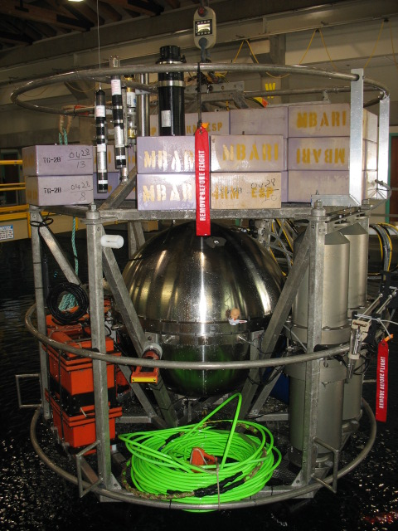
Deep ESP Ready!
Microbe detection instrument
4000m rated pressure housing
Ambient pressure interface
Source wand
Deployment platform
Power source
On to Axial Seamount
Notes:
Now we have our instrument, housing, sampling module, source wand, lander, batteries and cables, some 4000 pounds.

Slide 23
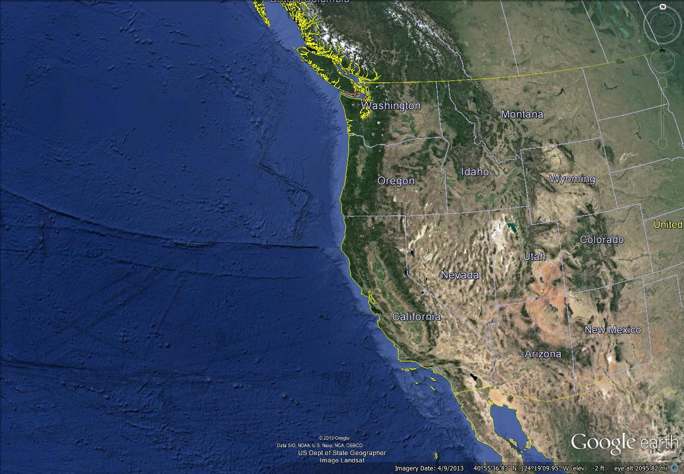
Axial Seamount
Notes:
Axial Seamount is an active underwater volcano ~470km west of Oregon, along the Juan de Fuca ridge.

Slide 24
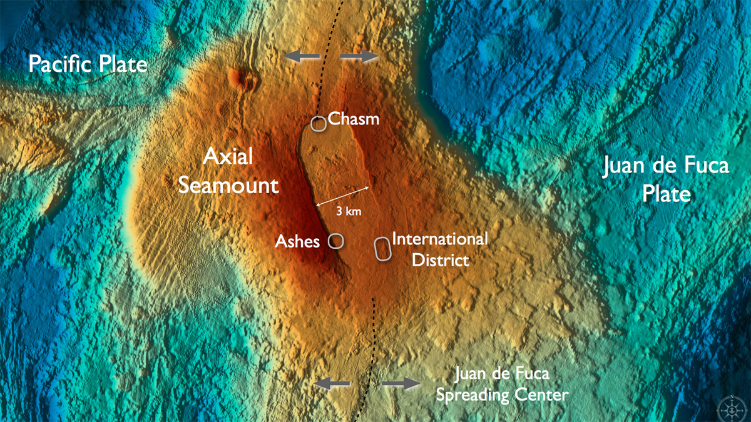
Notes:
In the southwest part of the caldera floor, nearly 1600m deep, is a diffuse vent field known as ASHES which is a future site for submarine cabled instrumentation.
In the summer of 2011, we deployed the Deep ESP instrument at the ASHES vent field. Our primary goal was to demonstrate that the Deep ESP could quantify vent field microbes, both directly at a diffuse vent and in the ambient seawater for comparison.

Slide 25
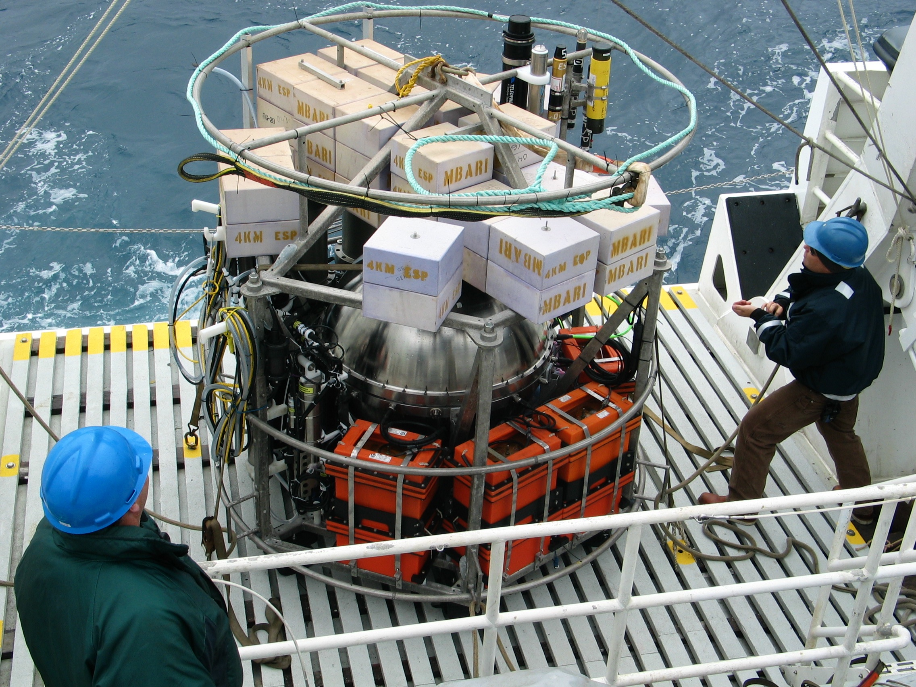
Deploy the Deep ESP
Notes:
I’m going to roll through the mission steps with a little photo montage.
We deployed the Deep ESP, and dove the ROV.

Slide 26
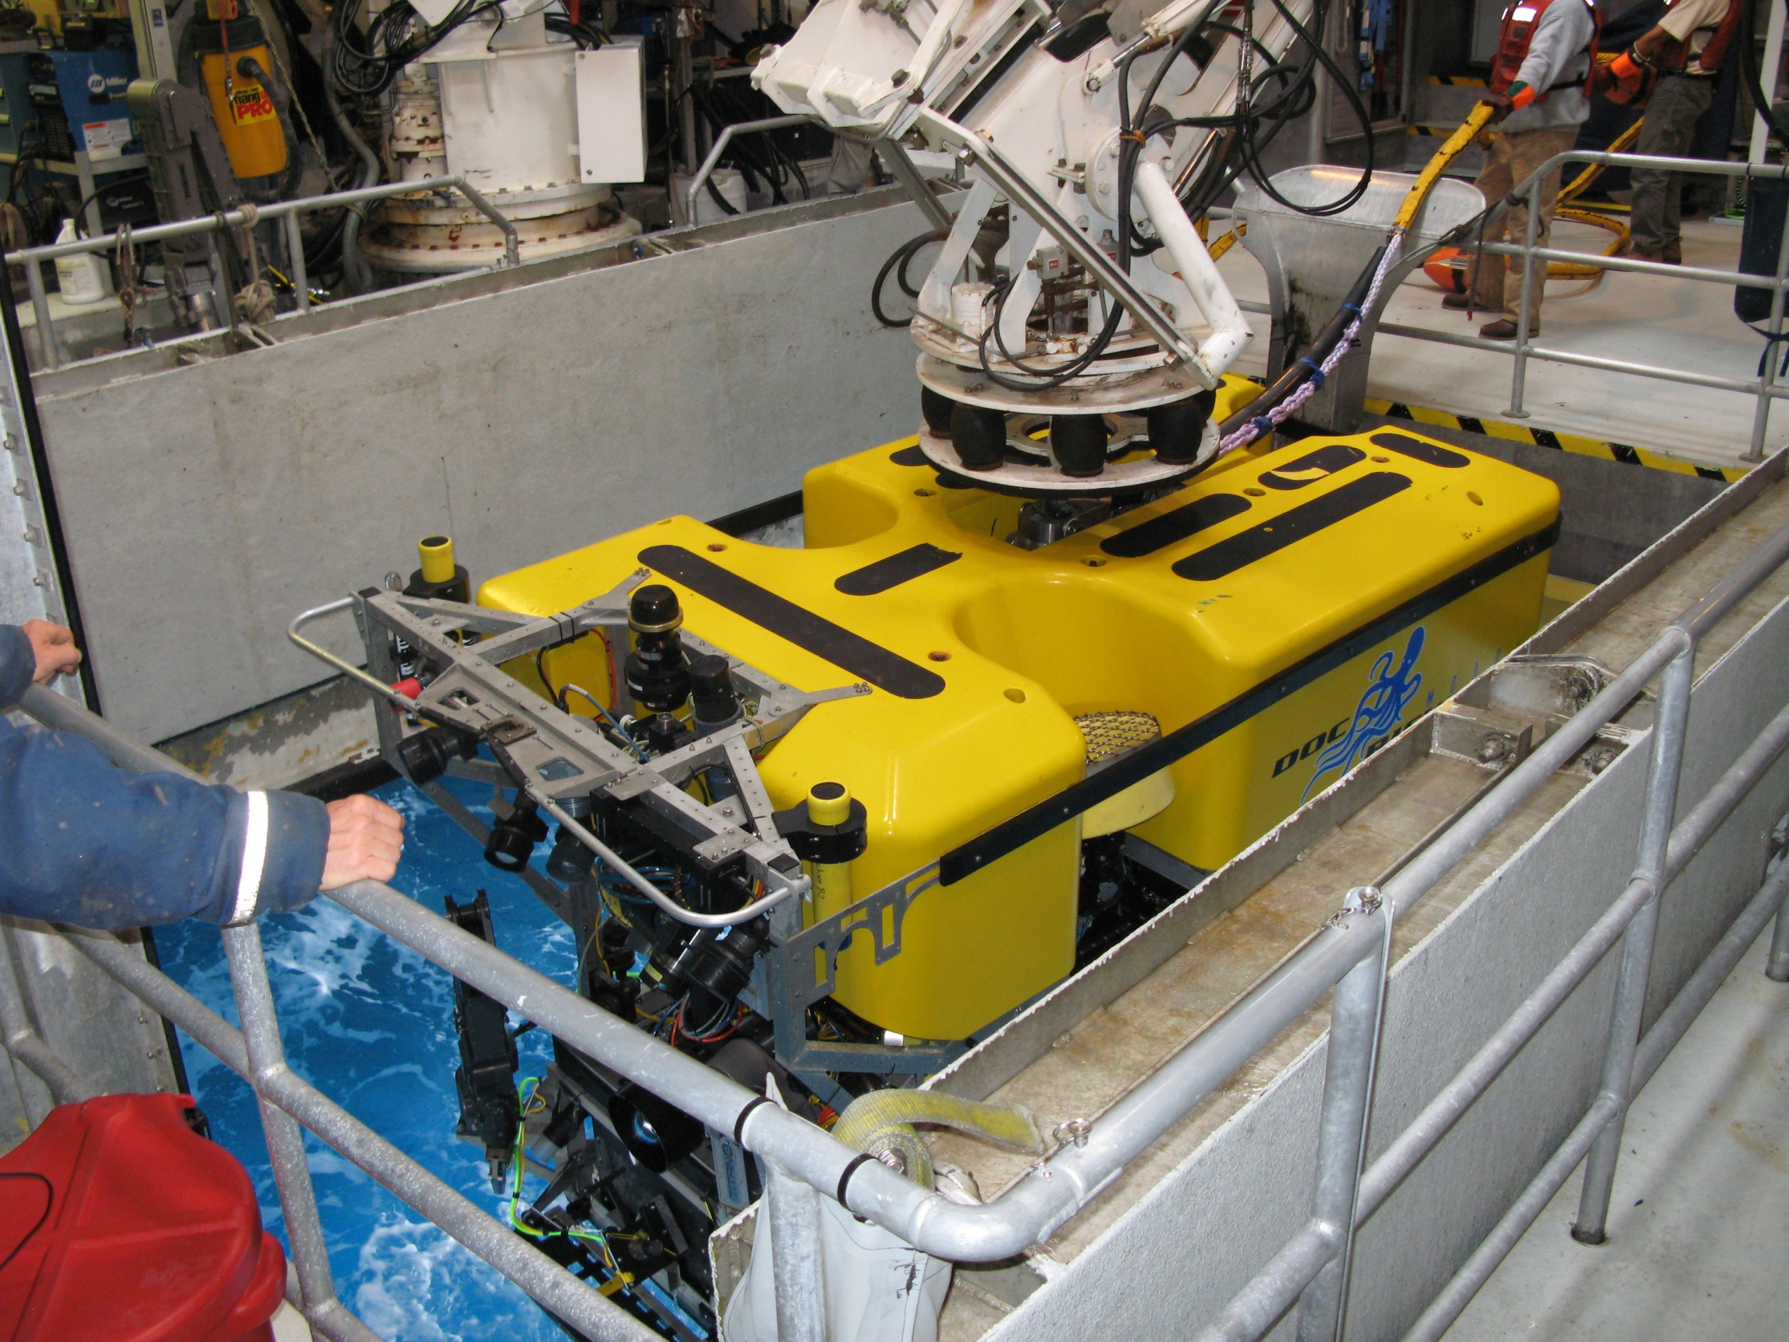
Dive the ROV
Notes:
And dove the ROV.

Slide 27
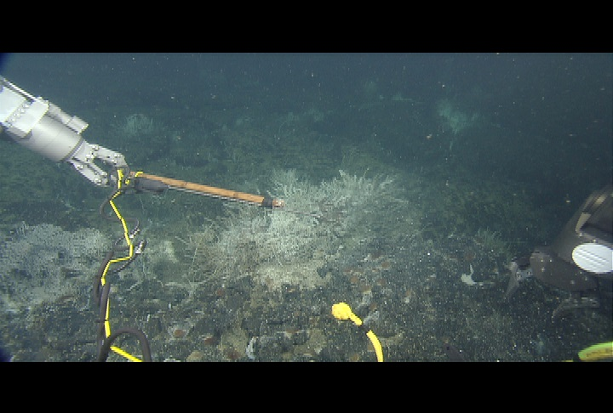
Locate suitable vent
Notes:
After finding a suitable diffuse flow vent,

Slide 28
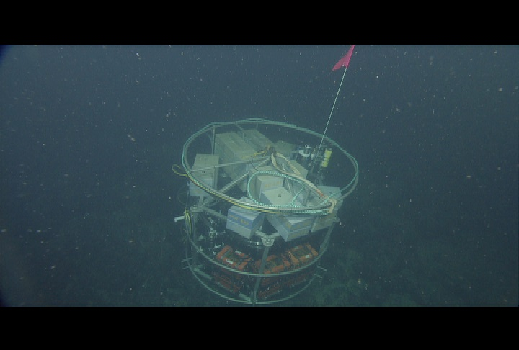
Relocate the Deep ESP
Notes:
And relocate the Lander to be within the wand’s reach

Slide 29
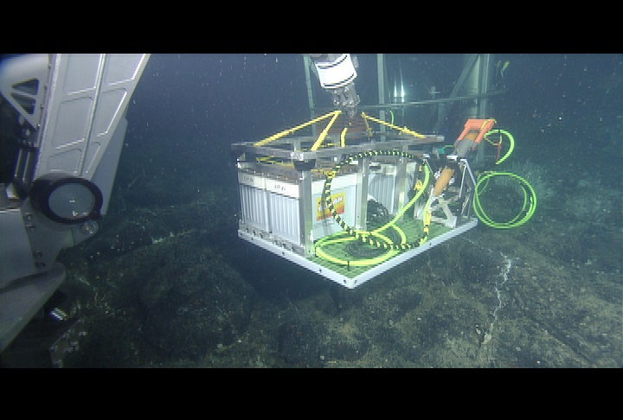
Deploy battery sled
Notes:
Deploy the battery sled

Slide 30
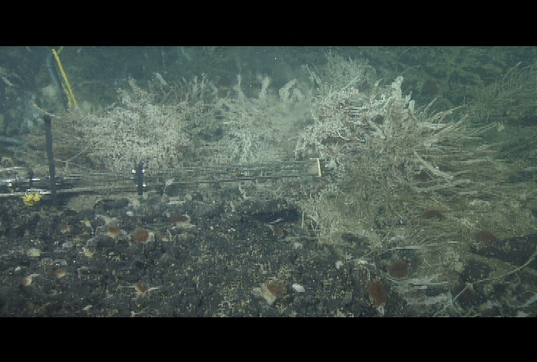
Set wand into vent
Start Deep ESP sampling
Notes:
Set the wand into the vent and start the Deep ESP mission.
For the next five days it will sample from the ambient water and the vent water, processing samples for in situ analysis as well as taking and preserving several archive samples.

Slide 31
ROV free for other science
Deep ESP sampling
Notes:
The ROV is now free to do other things… like traditional water collection.
ESP is filtering and processing the samples.

Slide 32
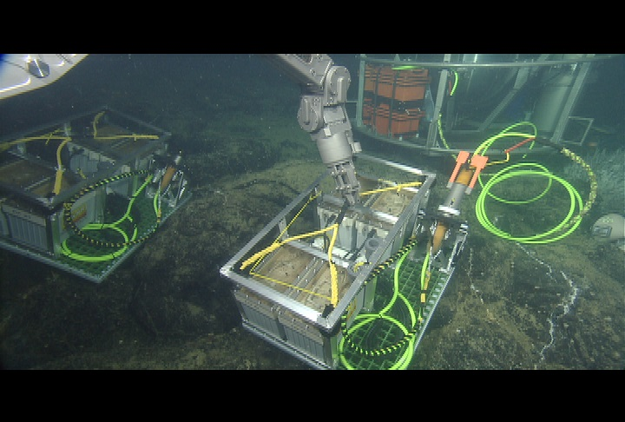
Next day: Swap battery sled
Deep ESP sampling
Notes:
The next day we top off the Deep ESP’s energy, by swapping the battery sled.
The Deep ESP has been running all night and keeps running during the swap.

Slide 33
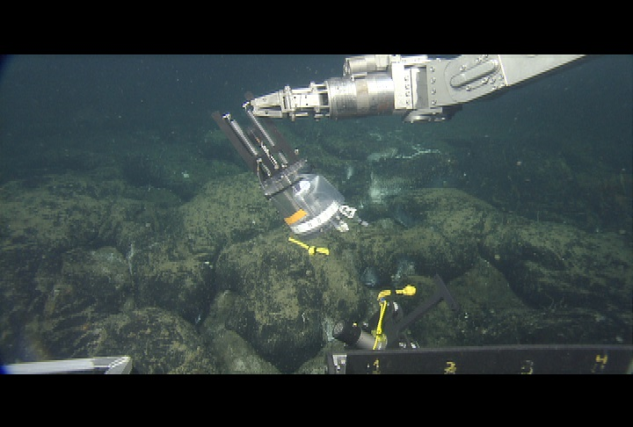
ROV available for other science
Deep ESP sampling
Notes:
The ROV is free again for other science missions.
The DEEP ESP is still sampling.

Slide 34
ROV dives cancelled
Deep ESP still sampling
Notes:
We did have a couple days that we were unable to dive the ROV They had run down after a two day window where the ROV could not dive and swap the sleds.
The DEEP ESP continued to sample, exhausting the battery sled, and most of the onboard batteries.

Slide 35
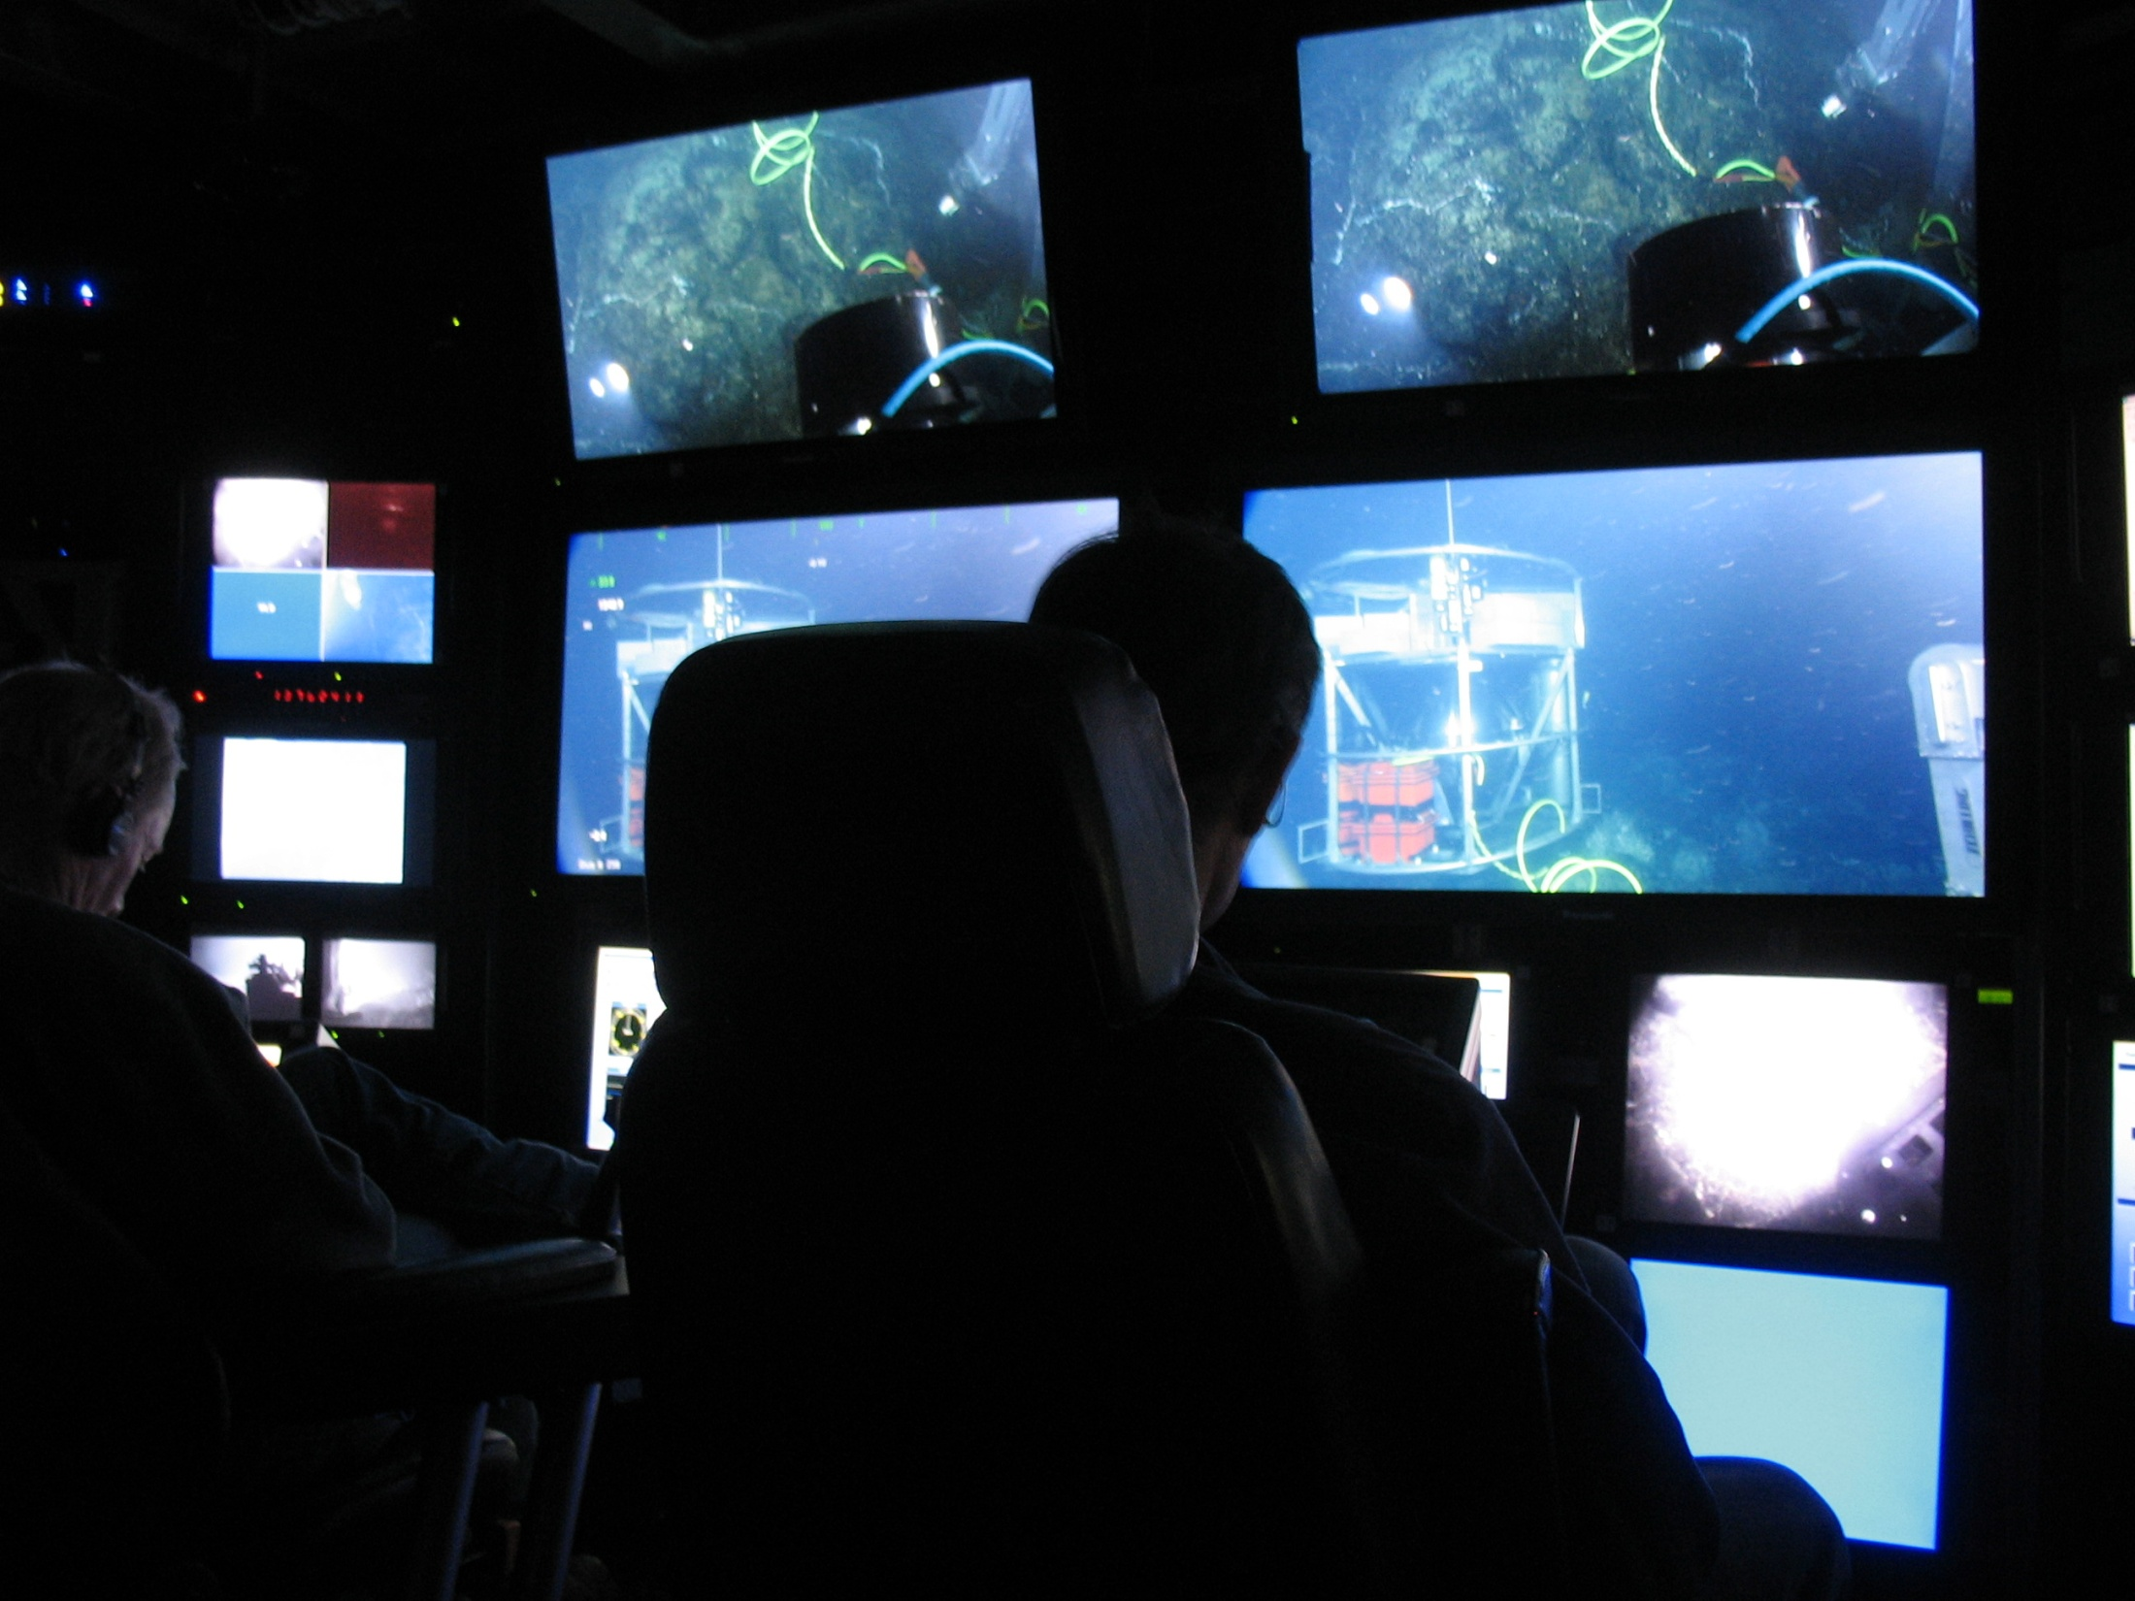
Plug-in, charge batteries
Deep ESP sampling
Notes:
We needed to recharge the Deep ESP batteries so we plugged into it with the ROV providing power from the tether.
We sit there and sit there and sit there, charging the batteries. We try not to fall asleep.
We use this plug in time to download the full data set from the Deep ESP. But the ESP keep running,

Slide 36
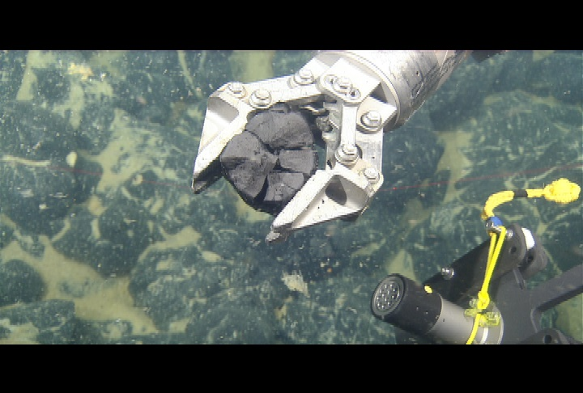
ROV available for other science
Deep ESP sampling
Notes:
Eventually we stop charging, swap the battery sled and the ROV and got pick up rocks.
The DEEP ESP keeps sampling.

Slide 37
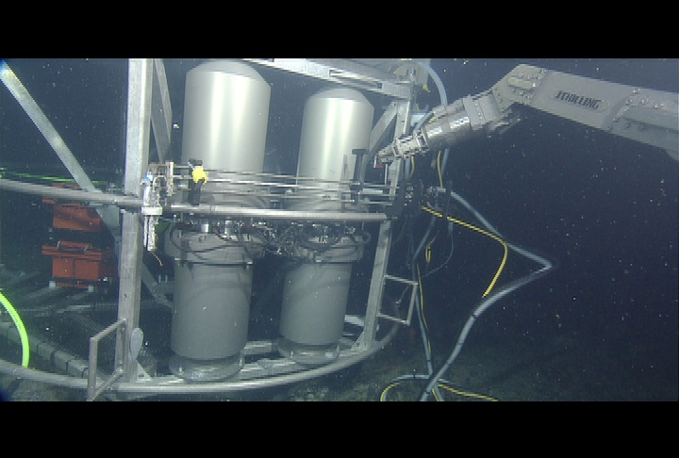
Deep ESP Mission over
Package up lander
Notes:
The mission finally finishes, and we repackage the lander

Slide 38
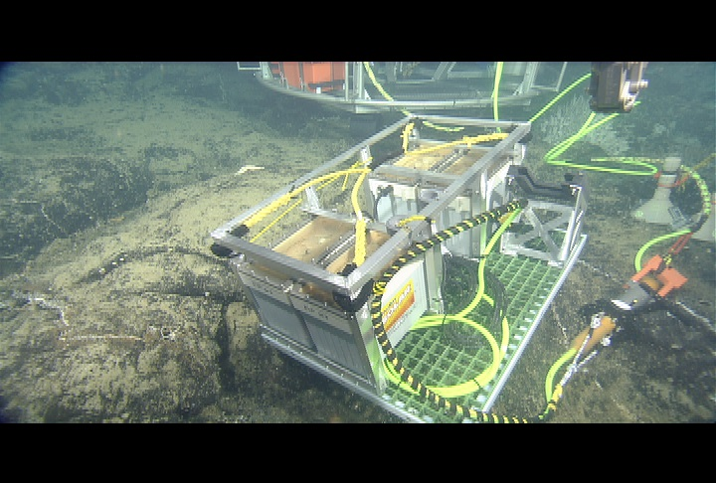
Recover last battery sled
Notes:
Recover the last battery sled.

Slide 39
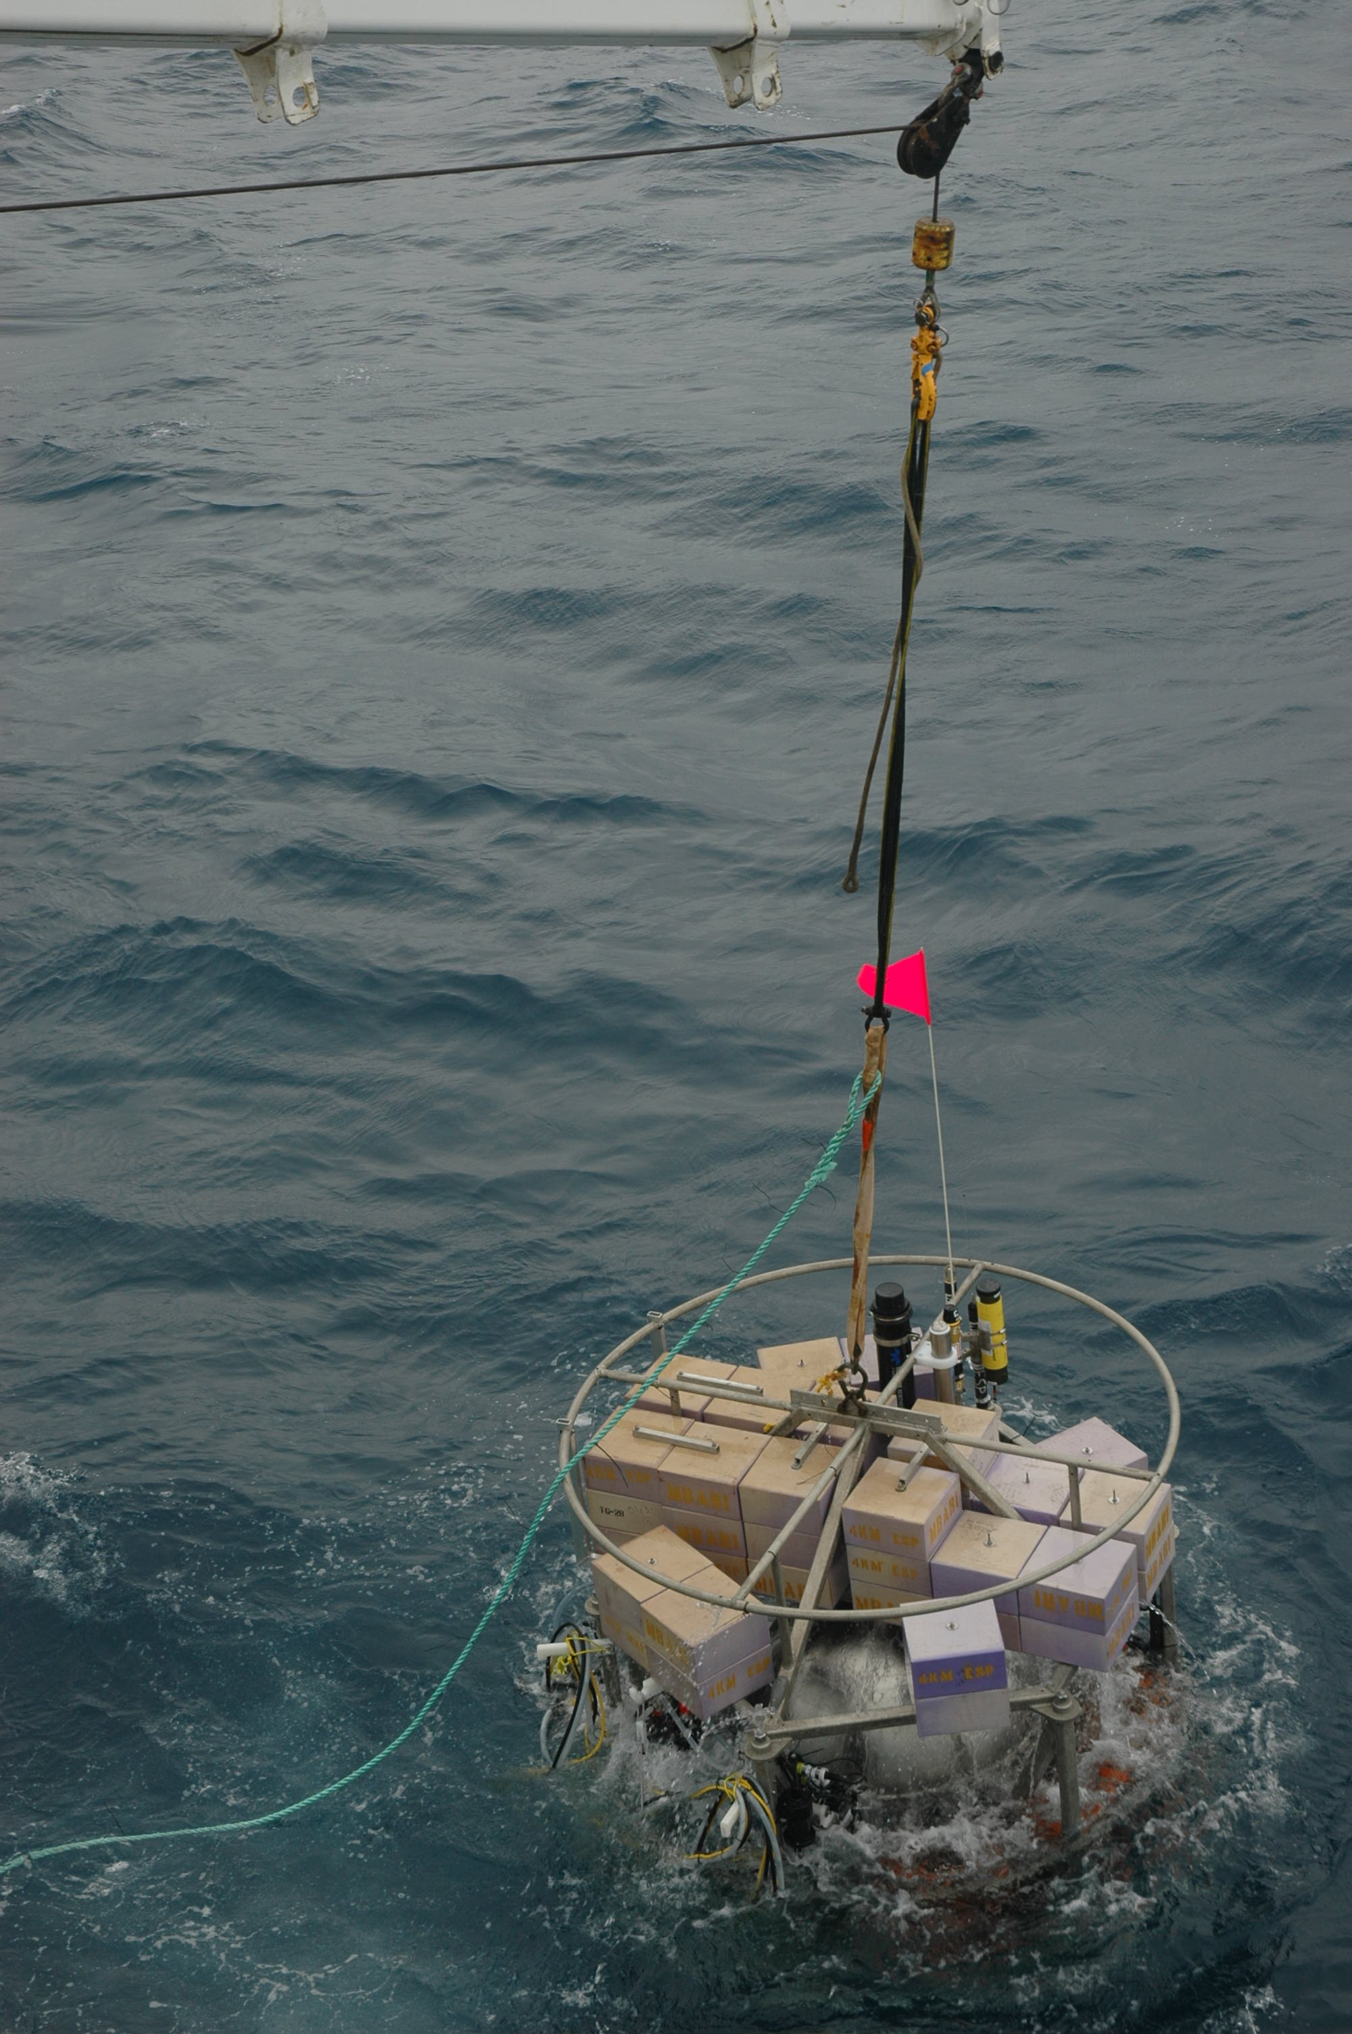
Recover the Deep ESP
Notes:
Release the drop weight and recover the lander at the surface.
That is a nut shell was our operations at Axial seamount.

Slide 40
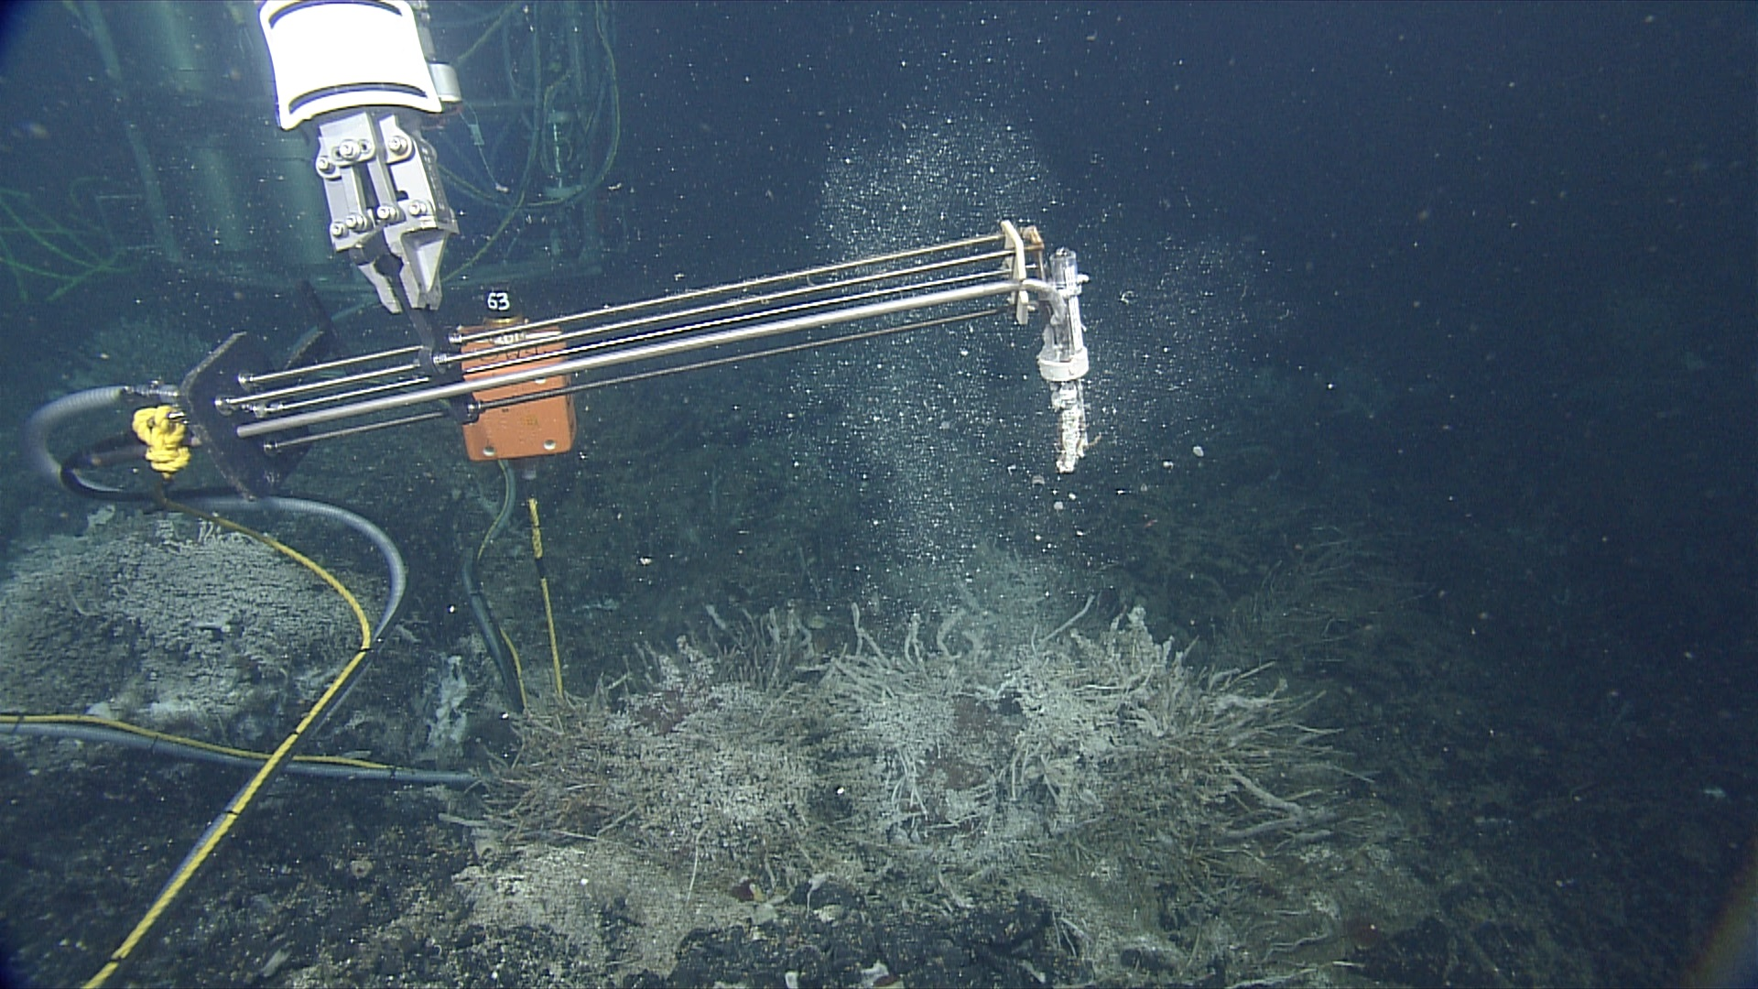
Results
Notes:
Moving onto results.

Slide 41
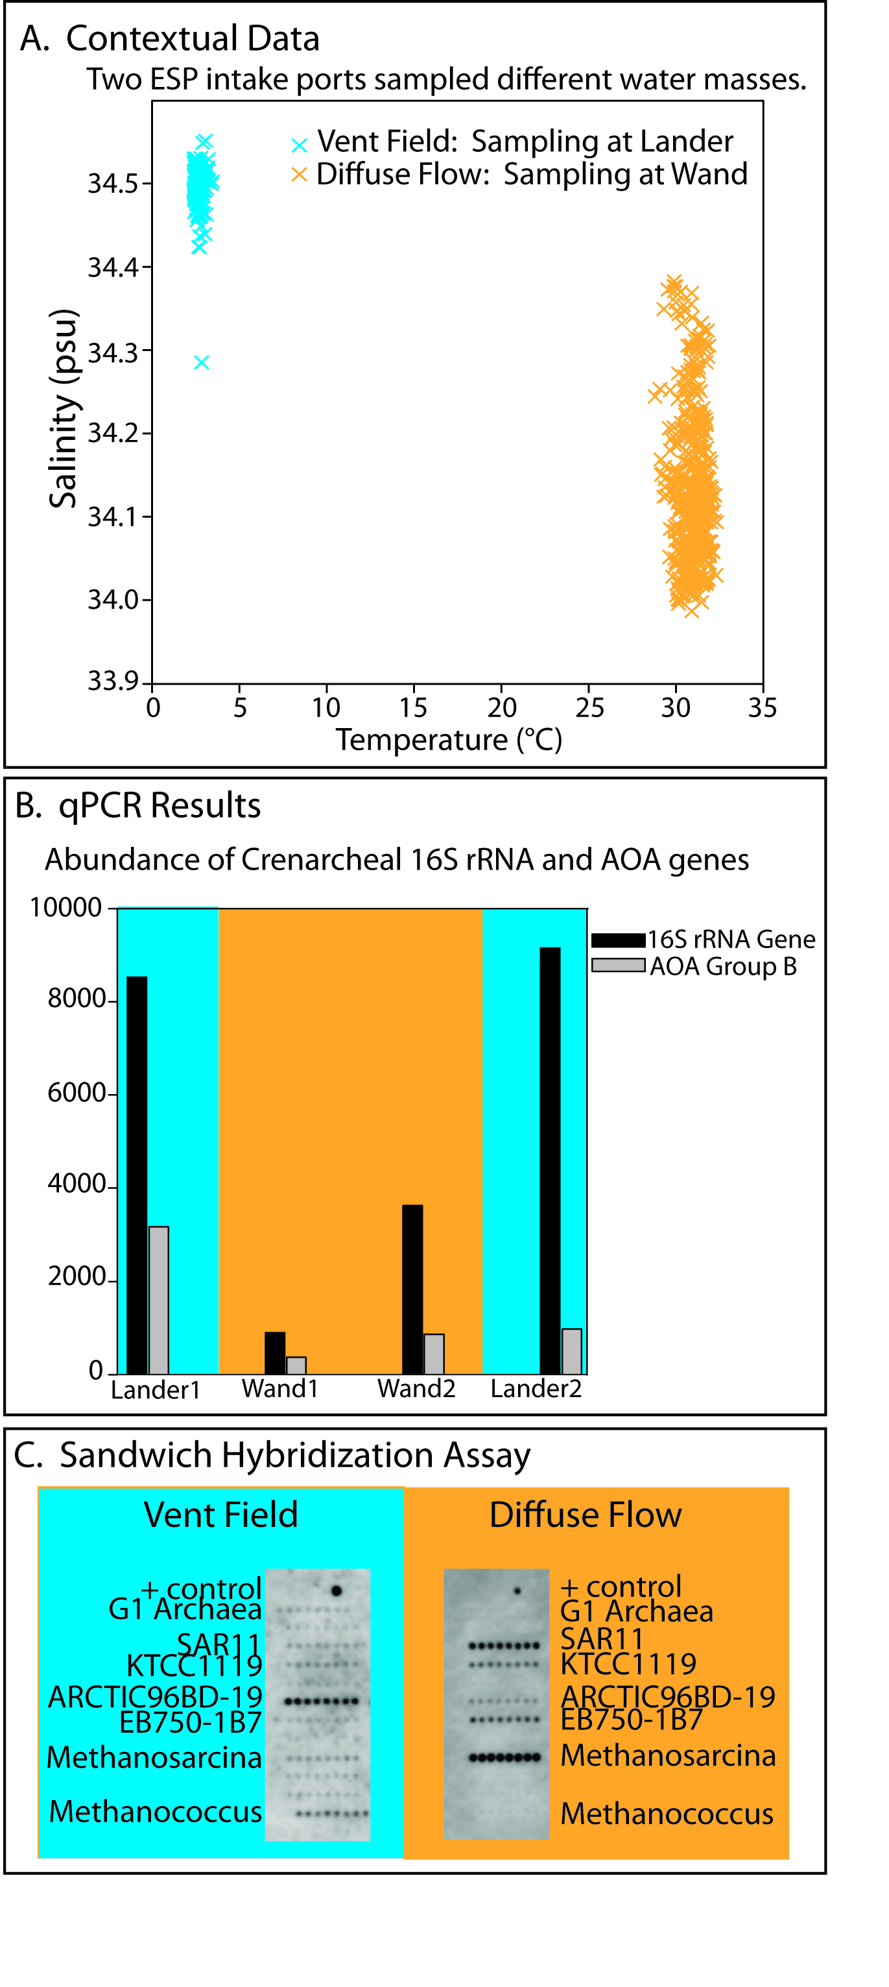
Different Sources
Notes:
This chart shows the salinity and temperature at the collection points as it was being sampled by the ESP.
The blue here is the cold ambient seawater, and the orange is the water at the vent being collected by the wand.
This shows that we were collecting samples form two different sources.

Slide 42
Different Abundance
Notes:
This is the quantitative PCR results that were performed in situ, blue is the ambient water and orange is the vent. This shows that we did detect and quantify different abundance of these two genes between these two sources.

Slide 43
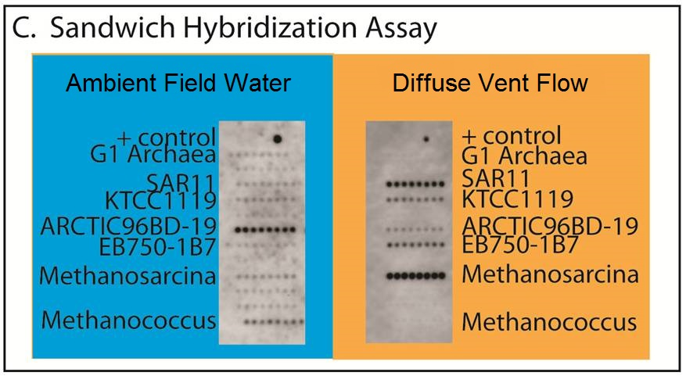
Different Populations
Notes:
This is the Sandwich hybridization results performed in-situ. This is an imaged array of dots that get stronger the more prevalent the organism is.
Very definitely, these are two different populations of microbes.
So, Yeah. We met our goal and quantified two different microbial populations in situ.

Slide 44
Summary
We have developed a deep water instrument to do in situ microbial detection and quantification, from multiple sources, and minimized the ROV support required .
Notes:
In summary…

Slide 45




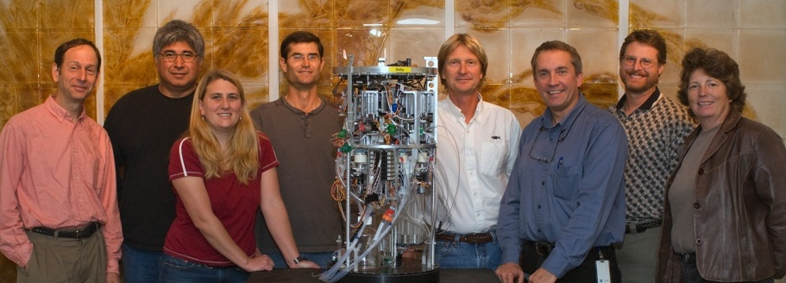
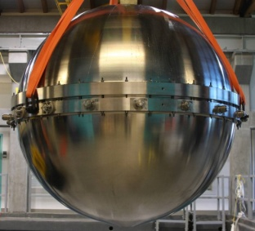
Thank You
Related Talk at IEEE Oceans 2013
Design and Fabrication of a 1m Titanium Sphere for 4000m Ocean Depth
Thurs, 9/26
11:10 am
Royal Palm Salon 5
Notes:
I’d like to acknowledge the team of people who pour their blood sweat and tears into these building and deploying these robotic machines.
Chris Scholin for leading this technology innovation, and our funding agencies MBARI, Moore Foundation, NASA, NSF, and the C-MORE group.
Thank you.

