Slide 1
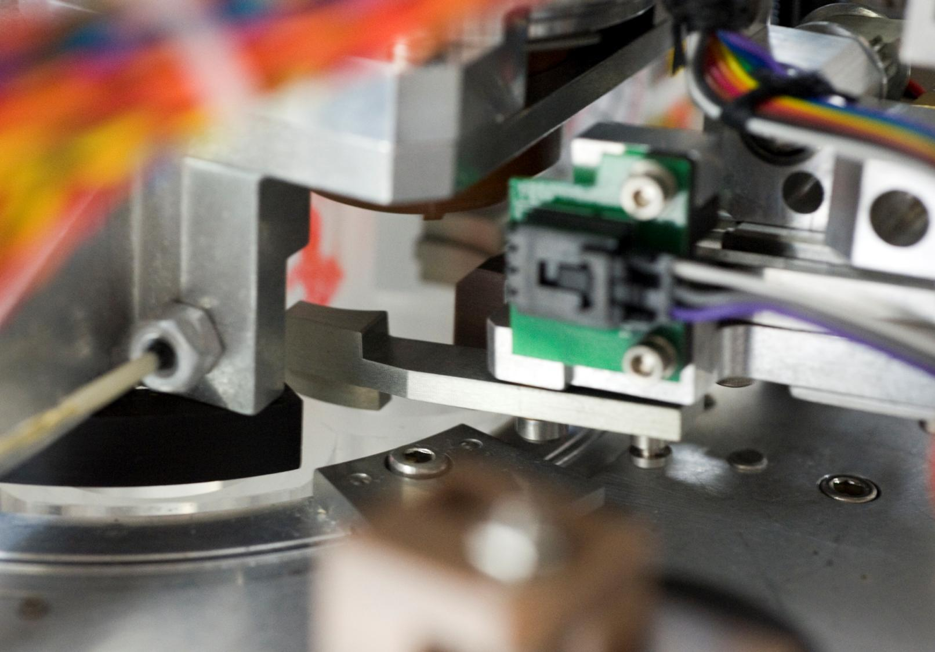
Doug Pargett
Technology Grows
Notes:
Good afternoon, I’m …..
Technology grows is an odd title, but underneath, this is the concept I want people to walk away with cause its applicable to all technology, not just my work.
David Packard… founded MBARI over 25 years ago.
Go Deep
Stay Long
Take Risks
Ask Big Questions

Slide 2
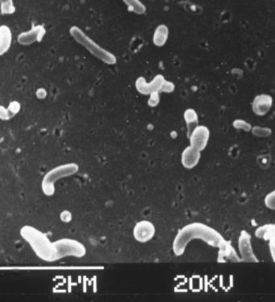
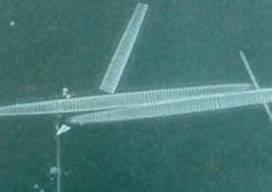
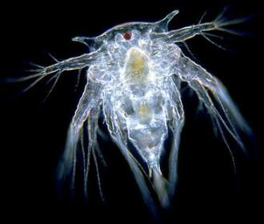
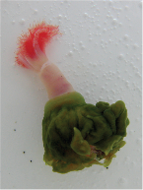
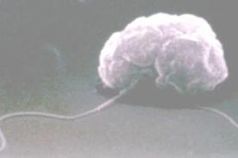
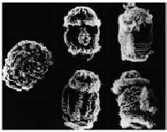
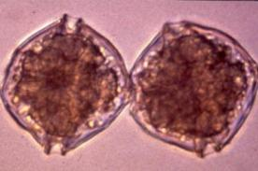
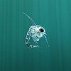
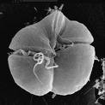
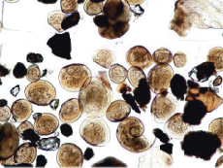
Big questions - Tiny life forms
Notes:
And we are asking big questions, regard tiny life forms.
From the microbial perspective, the ocean is a soup of many, many, different critters.
In many ways the organic chemistry of the oceans (and possibly our planet) is primarily an output of this microbial soup.

Slide 3
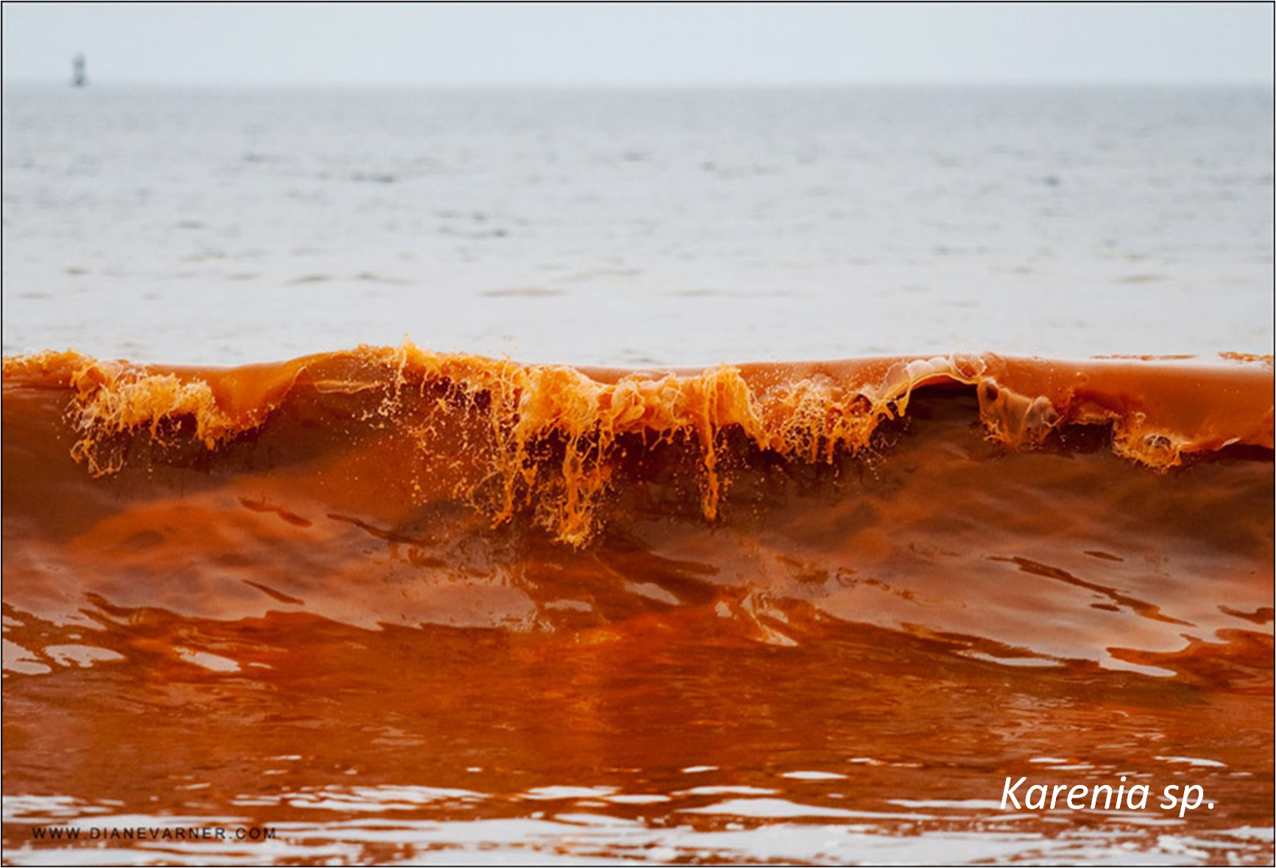
Static or
Dynamic
Notes:
Doesn’t mean its always nice.
Manually collecting a sample that gets processed hours or days later in a lab, is not only time consuming, but only provides a snap shot of the microbial population.
That works for mostly static conditions, but the ocean doesn’t always look like this. Thank Goodness.
When did this bloom start, how is it changing, are dynamics questions; and a few snap shots can’t tell us the story.
(slide)

Slide 4
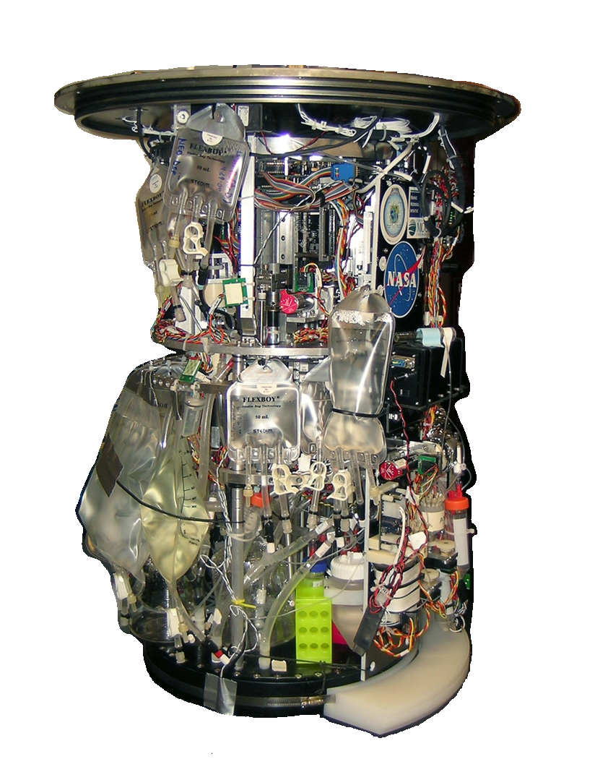
Environmental Sample Processor
Robotic
Lab
in a can
Notes:
To take a risk on technology MBARI has been working on innovations that detect microbial populations in-situ. We call these Environmental Sample Processors, ESP for short and are essential a robotic DNA lab in a can. Which is what it kind of looks like that.
The initial idea was to monitor for algal blooms. But since technology grows, it grows from experiences.
(slide)

Slide 5
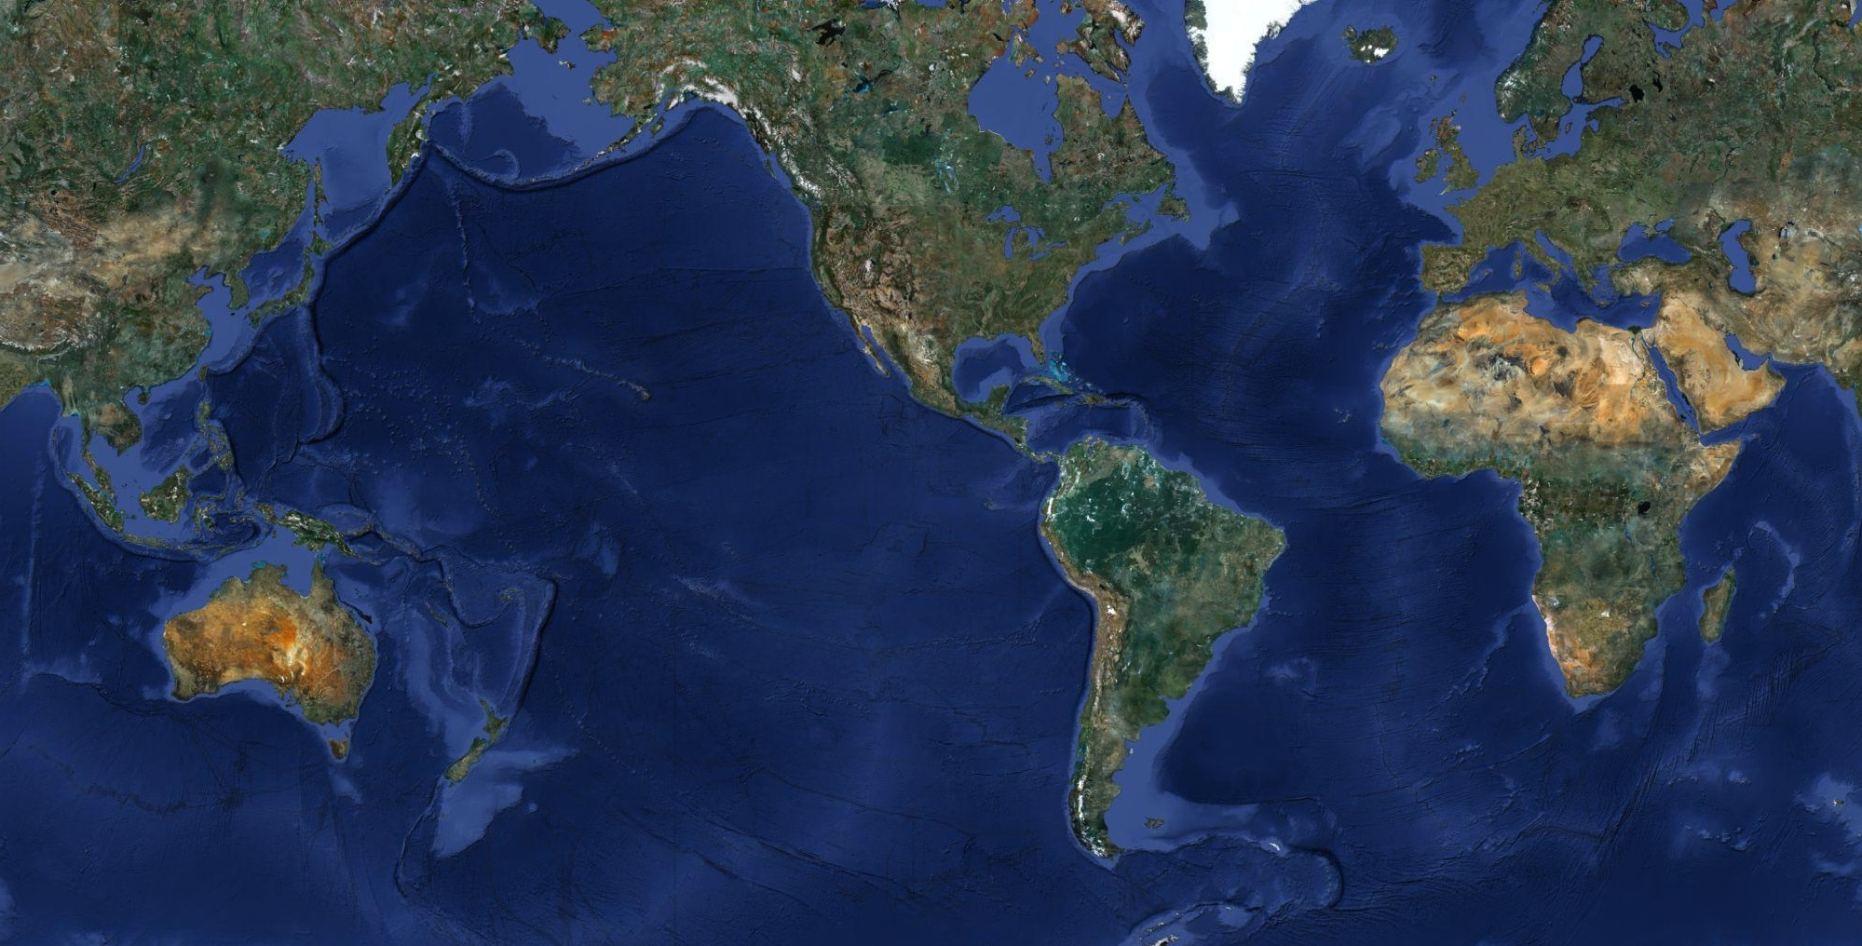
Notes:
Lets look at some places where these instruments have been tested and new opportunities found… First up is, New Zealand.

Slide 6
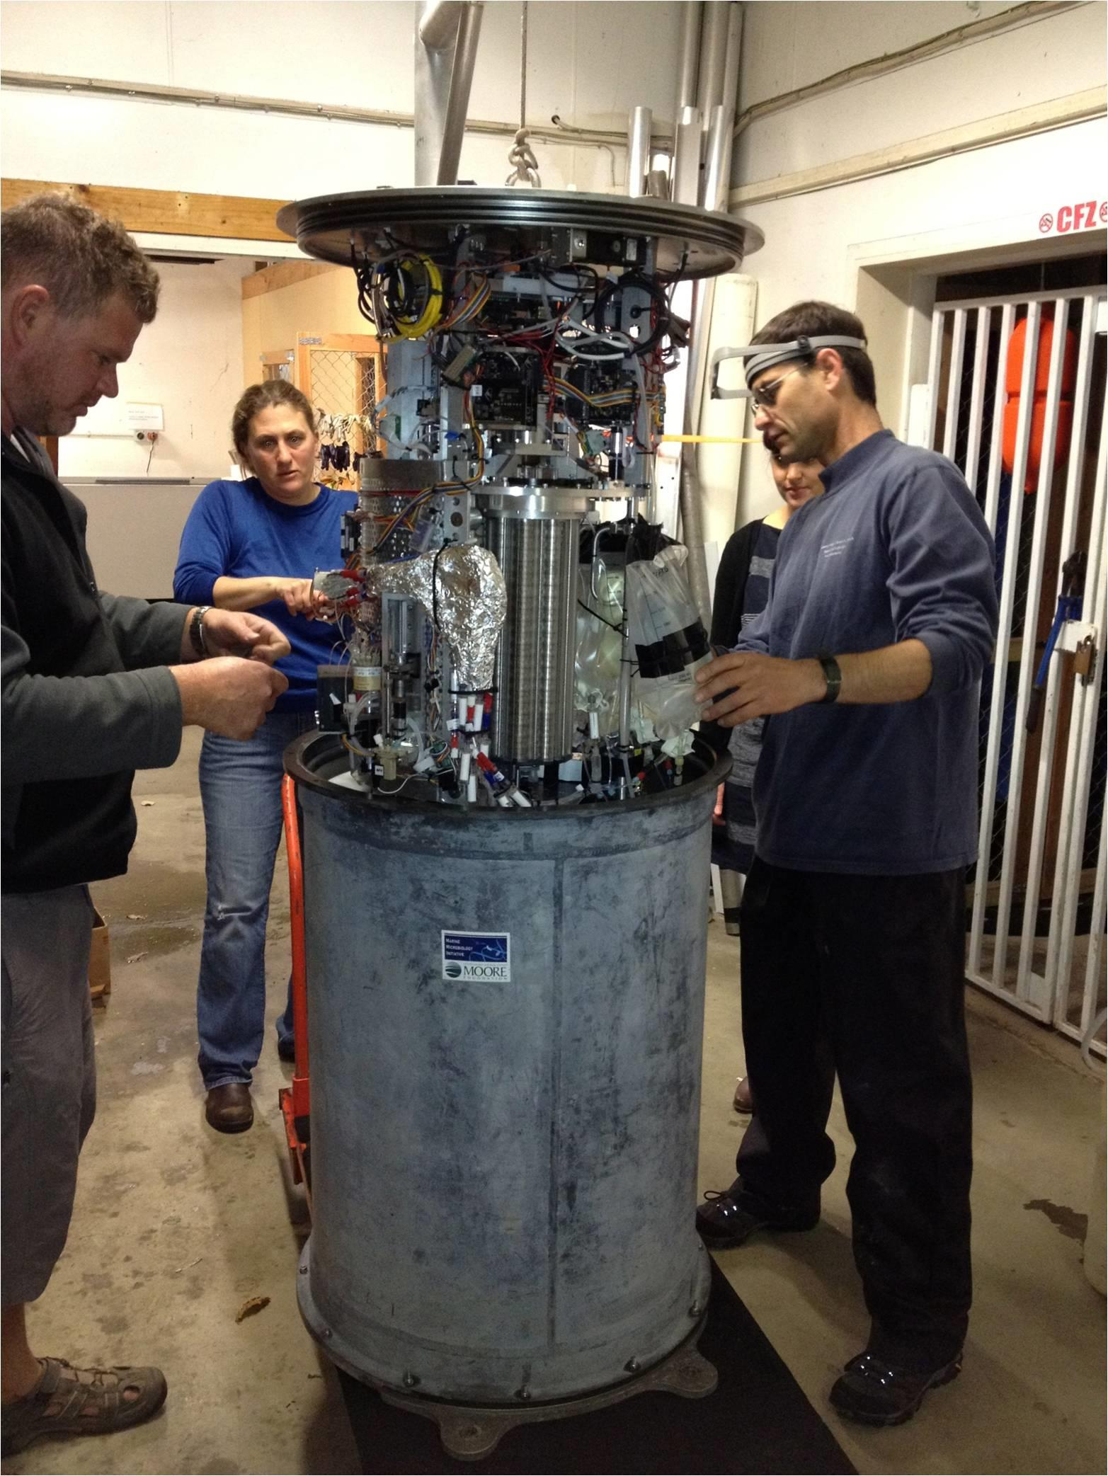
Notes:
This is an instrument getting prepared for a month long deployment.
Both agriculture and aqua culture are important to the New Zealand economy, but they intersect at the coast line.
(slide)

Slide 7
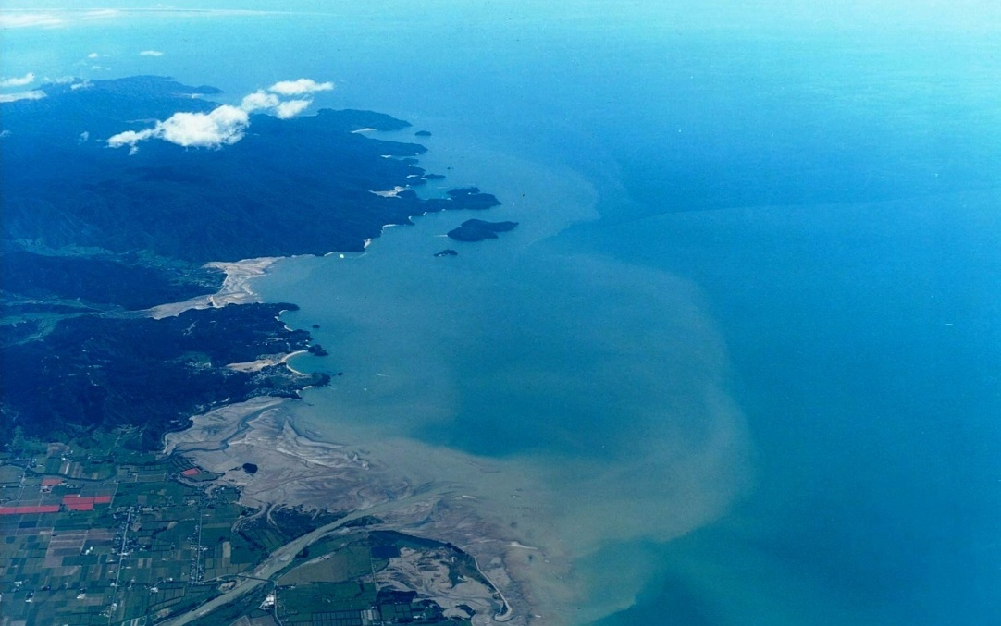
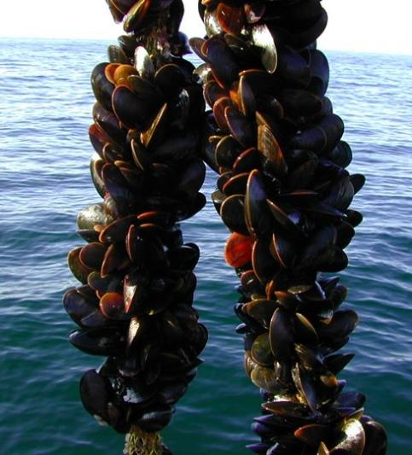
Tasman Bay, New Zealand
Notes:
In cooperation with the Cawthron Institute, this ESP was deployed in Tasman Bay near shellfish farms, to see how it might monitor for algal blooms.
But we also tested using it to detect shore side pollutants such as livestock and farm runoff coming down the Motueka River during heavy rains.

Slide 8
Notes:
Mr Packard said go deep, and as a robotic instrument, this technology can expand into the field of deep water microbial research. Off the coast of Santa Monica, at 900m depth, is a large carbonate mound.

Slide 9
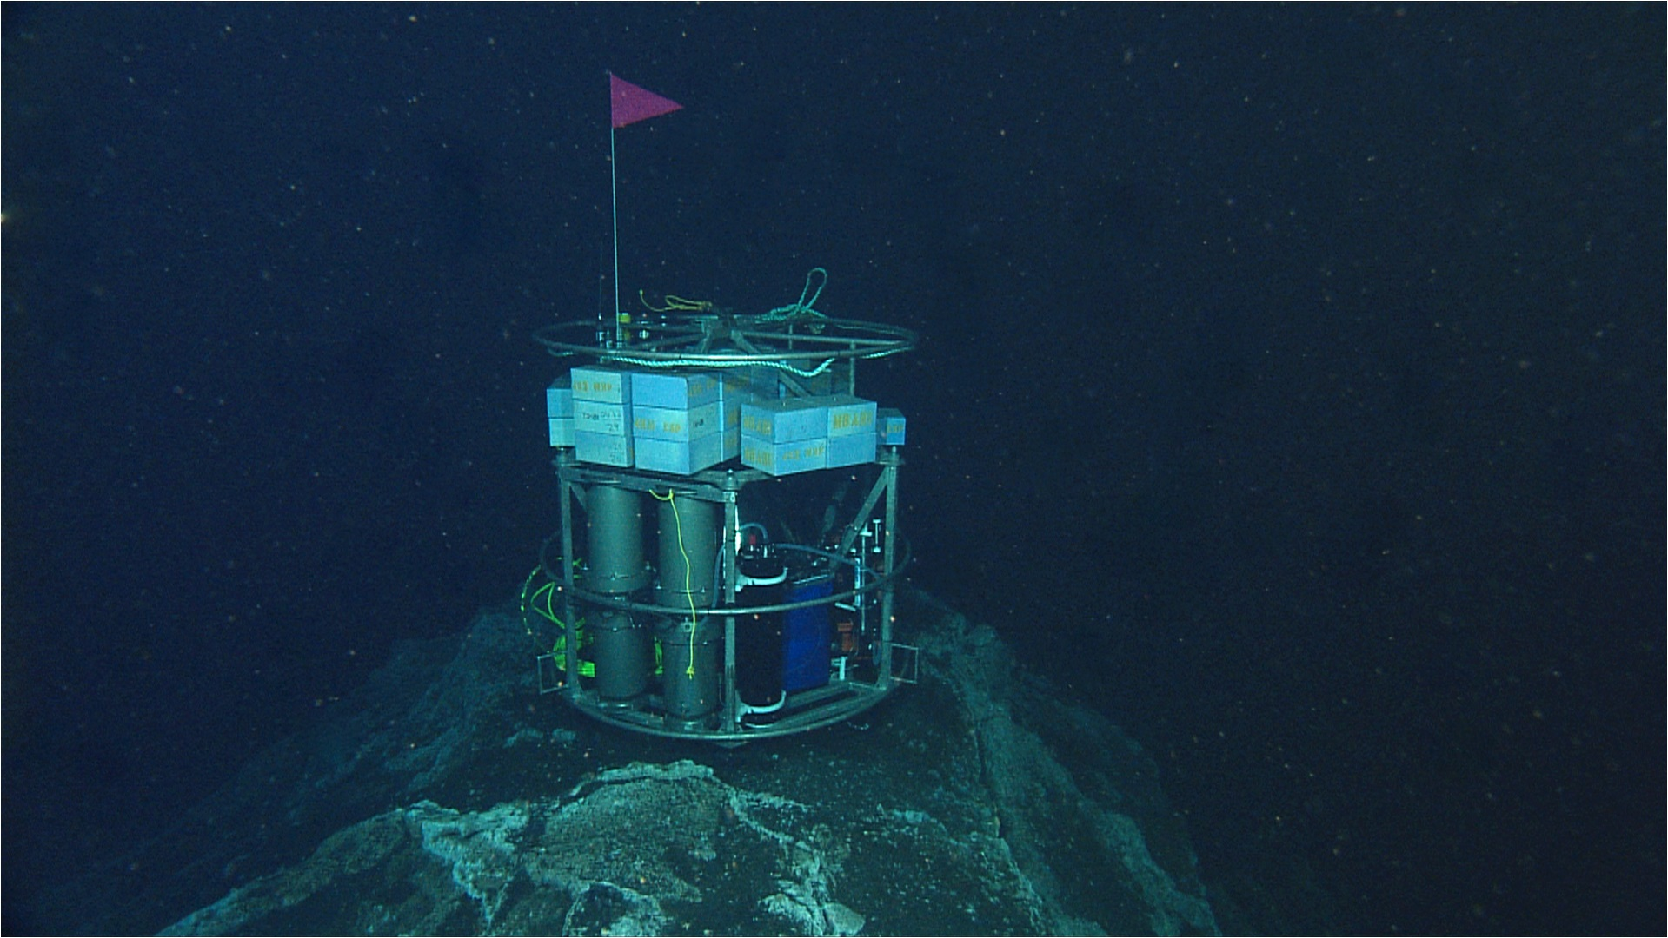
Carbonate Methane Mound
Ussler et al., 2013
Notes:
Here, methane is actively bubbling out of the sea floor. But it gets intercepted by microbes that consume it, creating the carbonate. In 2010, we tested a deep version here, so scientists might compare the microbial activity directly on the mound with sites at increasing distances away. These microbes could be preventing some 80% of the methane from reaching the atmosphere.

Slide 10
Notes:
Last up, Santa Cruz… As it’s a robotic instrument we could have an ESP in water the continuously.
Since it can detect microbes, it can also detect for human pathogen risks, such as sewage spills

Slide 11
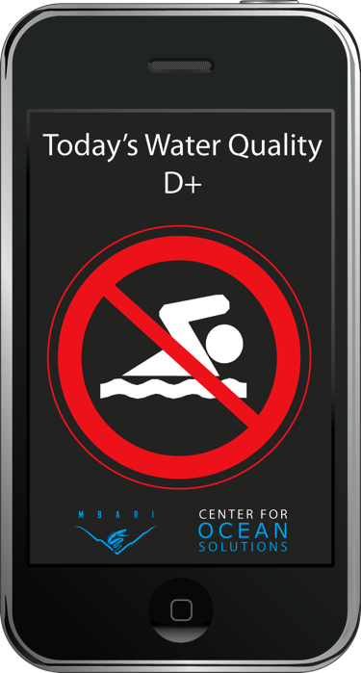
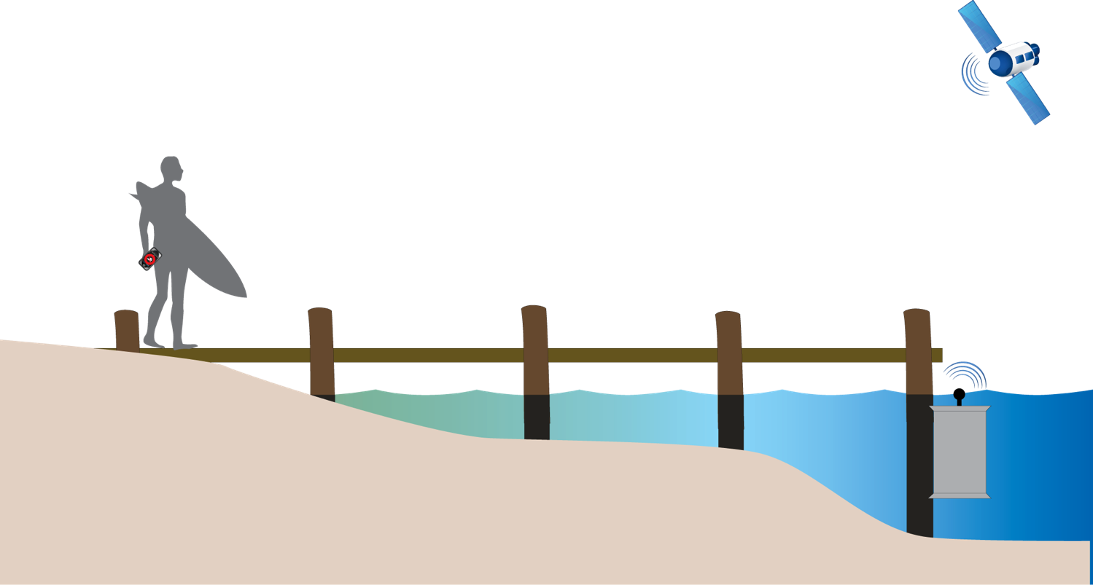


Water Quality Monitor
Kevan Yamahara et al. Center for Ocean Solutions
Notes:
We can consider how it might alert beach and ocean users of the water quality that day.
Whereas manual methods tend to issue a warning a couple days after the event.

Slide 12
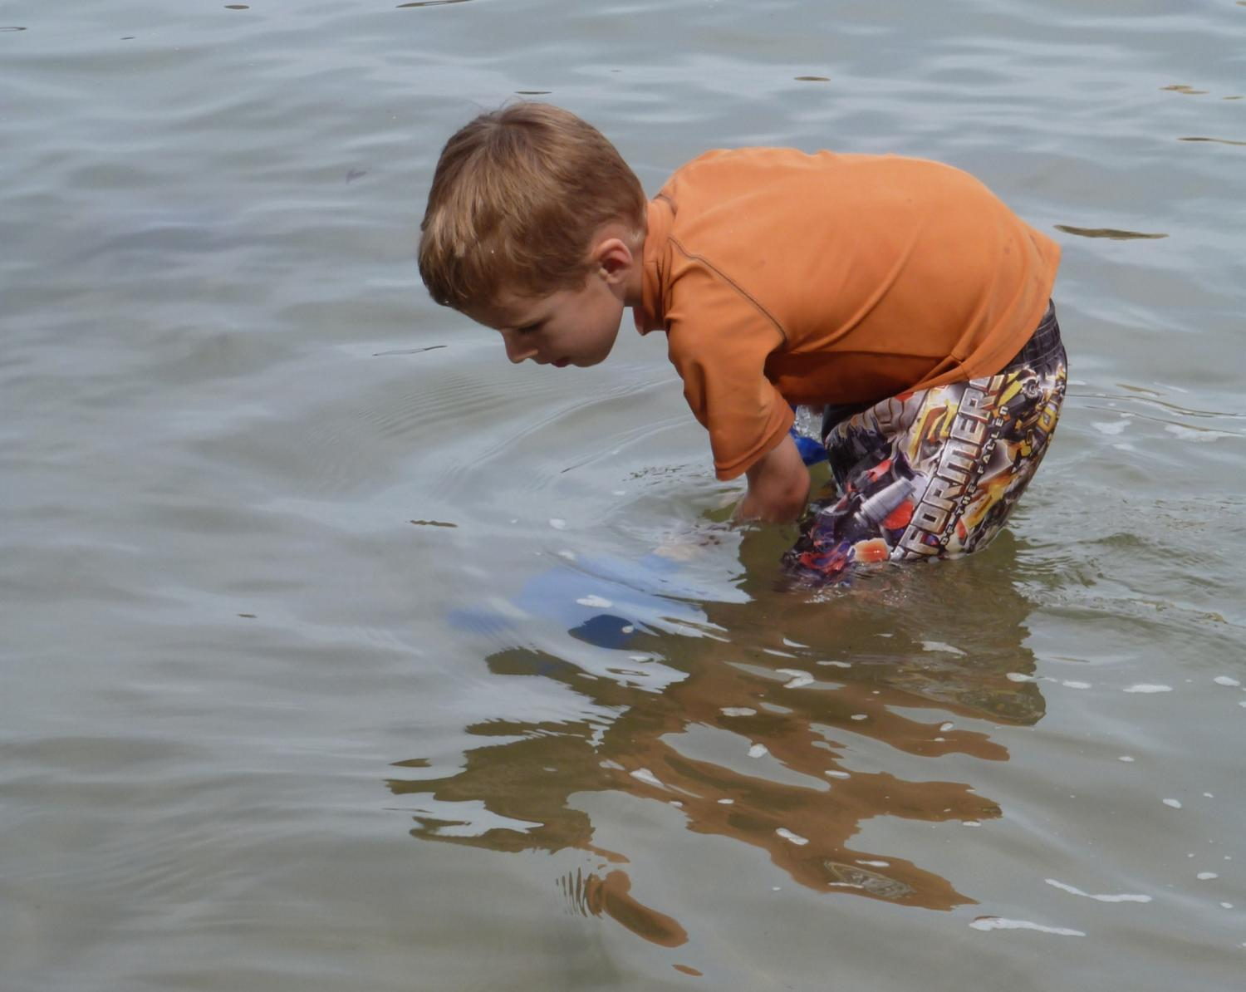
Notes:
I wouldn’t say that this technology is in it’s infancy, but it is in the child years. Which are the most fun.
As it gets it’s feet wet with real application in the environment, we learn, find new opportunities and the technology grows.
Thank you.

