Slide 1
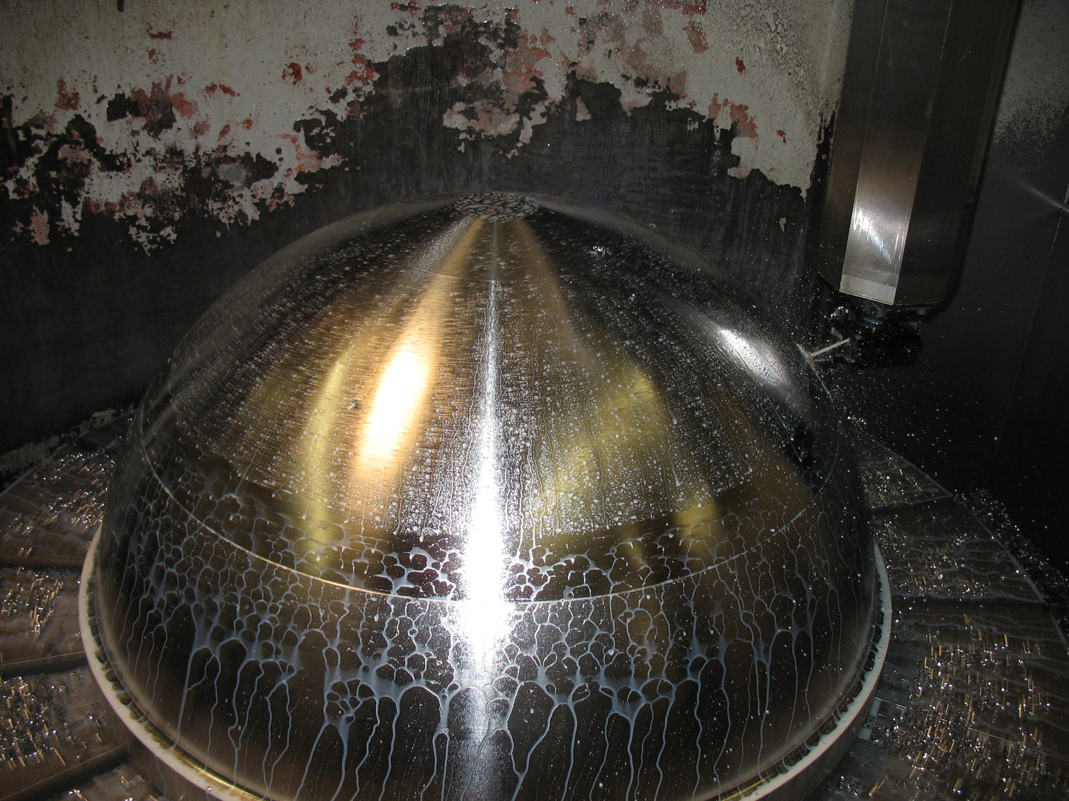

Design and Fabrication of a 1m Titanium Sphere for 4000m Ocean Depth
Doug Pargett
Notes:
The purpose of this talk to mostly to present what I did to build this, and try to convey the knowledge that might be useful if other projects were considering a similar path.

Slide 2
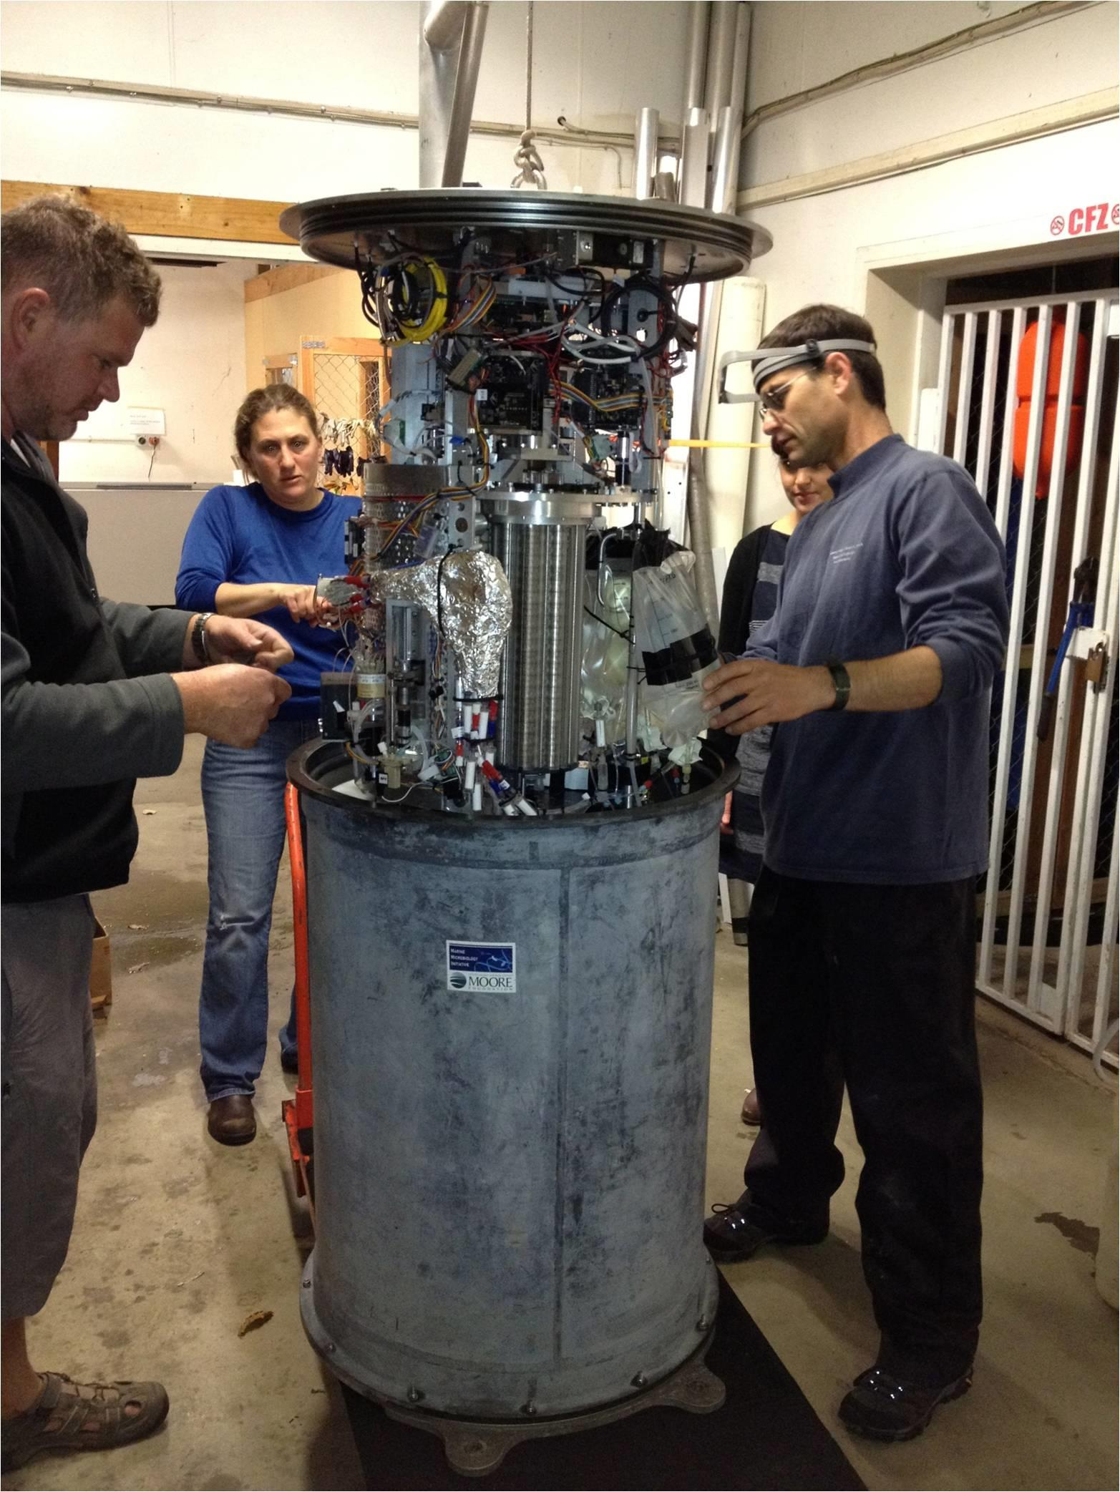
Environmental Sample Processor
Notes:
MBARI has developed an instrument called the Environment Sampling Processor with is essentially a robotic genetics lab that we put into a can and deploy into the ocean. It measures seawater microbes in situ based on their genetic signatures.
And it looks about what you would expect it to look like.

Slide 3
4000m Deep ESP?
Pressure Housing
Notes:
The ESP is typically deployed where it is less than 30m deep. However, one of MBARI’s major goals is to use new technology for deep ocean, so we wanted to develop a deep ESP platform for depths to 4000m.
One critical component is the pressure housing.

Slide 4
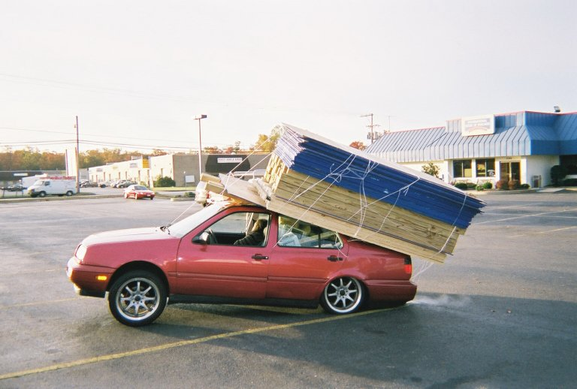
Joke: How do you put 4 tons of stuff into a 2 ton car?

Slide 5
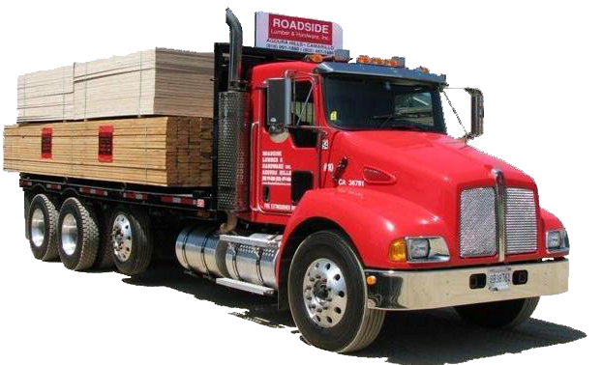
You don’t.
You get a 10 ton truck.

Slide 6
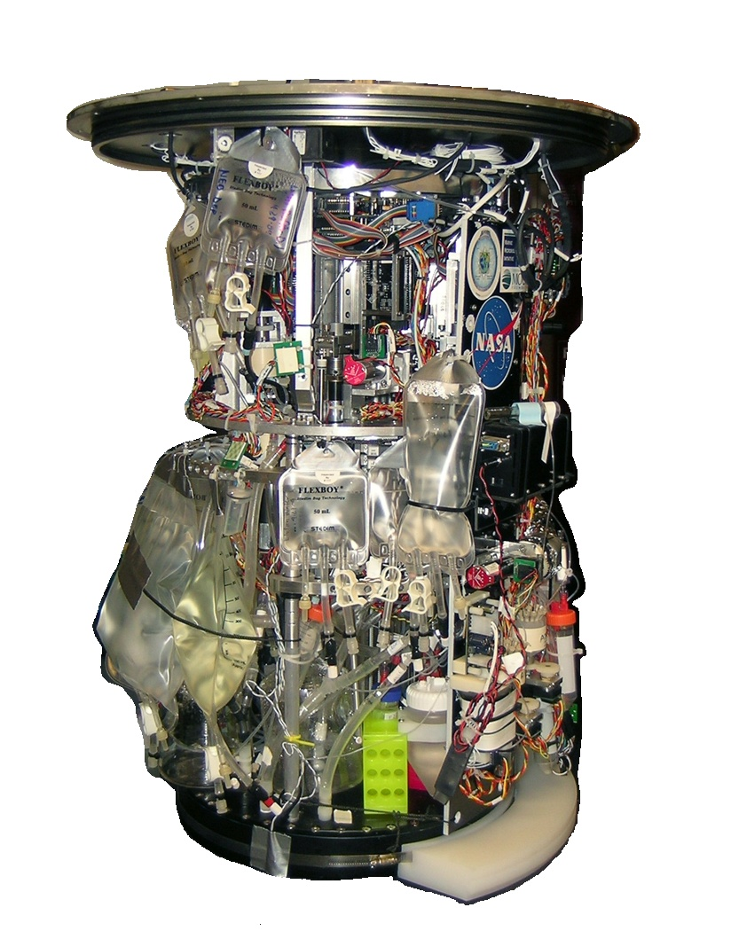
Miniaturize ESP or
Big Housing?
Notes:
We decided that we could get the “10 ton truck” option by casting the hemispheres.

Slide 7
Minimum
or
GO BIG?
Notes:
Do we make the housing just large enough, or do we go big?
1m would allow for any upgraded instrument that could deploy in the shallow water cans to deploy unmodified in the deep housing.
Costs are not hugely different.
Machining about the same
Casting pattern costs about the same
Casting materials proportional to weight.
Roughly, the cost would have been 15% more for 60% more volume.

Slide 8
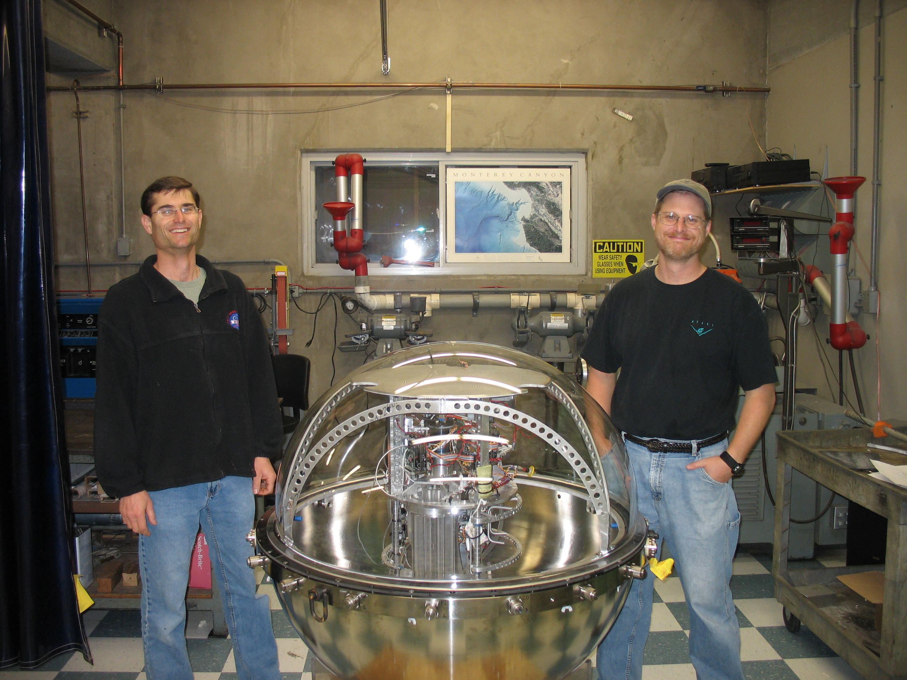
Notes:
And there it is. Easy.

Slide 9
Design Standard
4000m Robotic Operations
41.4 Mpa (6000 psi) hyperbaric test
Notes:
These probably a few more things that people may want to know.
Design standard is for robotic operation, so we’ll hydro test to the rated depth.

Slide 10
Design Factors
Buckling:
2.0
Yield Strength
1.5
1.375
1.1
Notes:
A design factor of 2.0 for critical pressure buckling was used on the spherical shell, and subsequently became the limiting condition for the spherical wall thickness.
A factor of 1.5 was applied for the pressure shell. Although most of the shell is design limited by buckling, stress risers in the shell were limited to this.
A 1.375 factor was applied for regions that require dimensional stability, but yielding will not likely affect stability of the pressure shell. Such stress concentrations are mostly around holes and sealing faces for the fittings and penetrators; places where yielding might affect the fitting, but would be unlikely to result in a leak or buckling deformation due to the pressure.
A 1.10 factor was applied for regions that are not dimensionally critical, nor likely to affect the pressure shell stability. The stress concentrations around holes that pass wires and fluid plumbing from the penetrators and fittings into the sphere are designed to this factor. If yielding occurs, the result is a smaller, somewhat deformed hole with minimal residual strain.

Slide 11
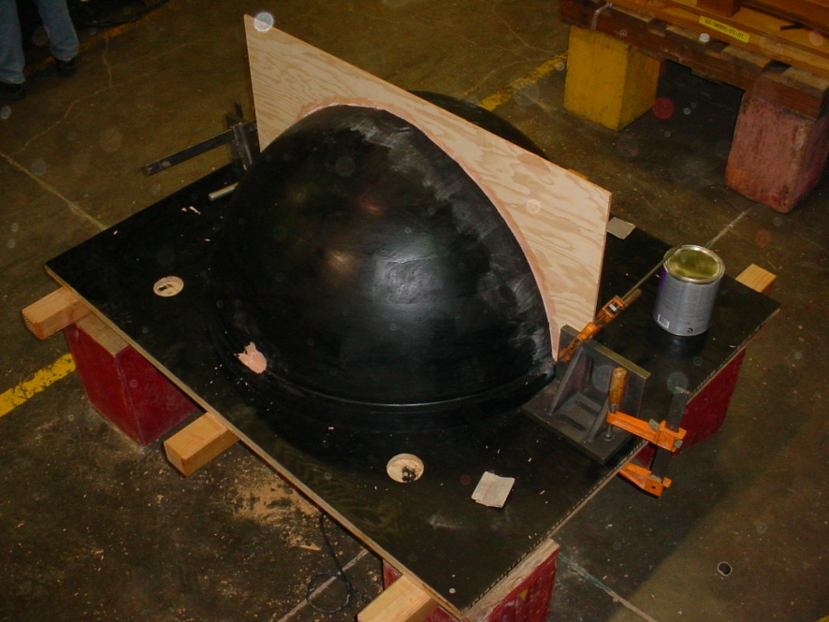
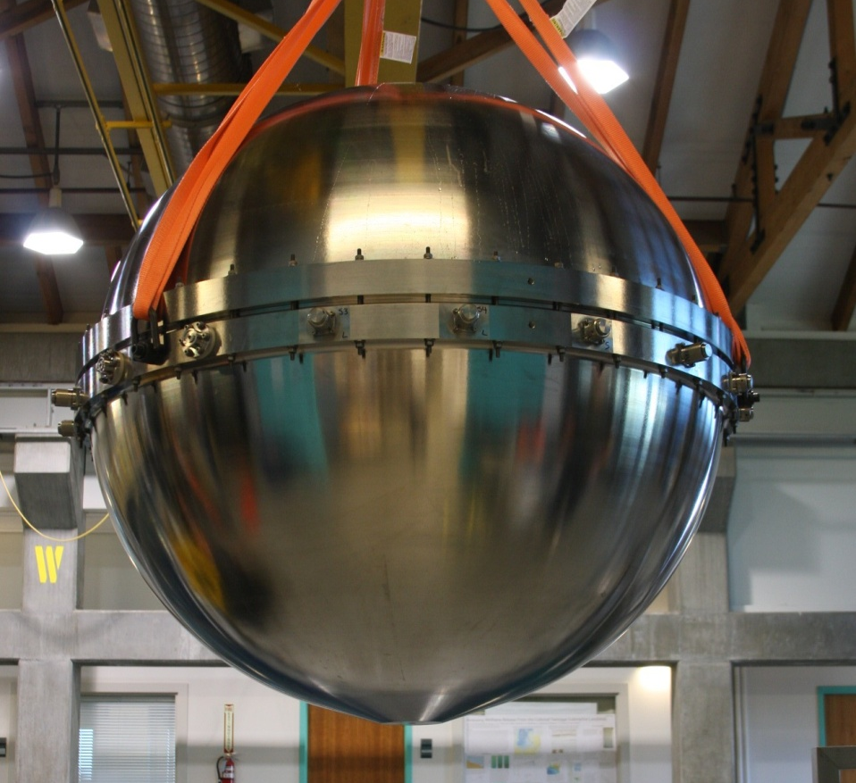
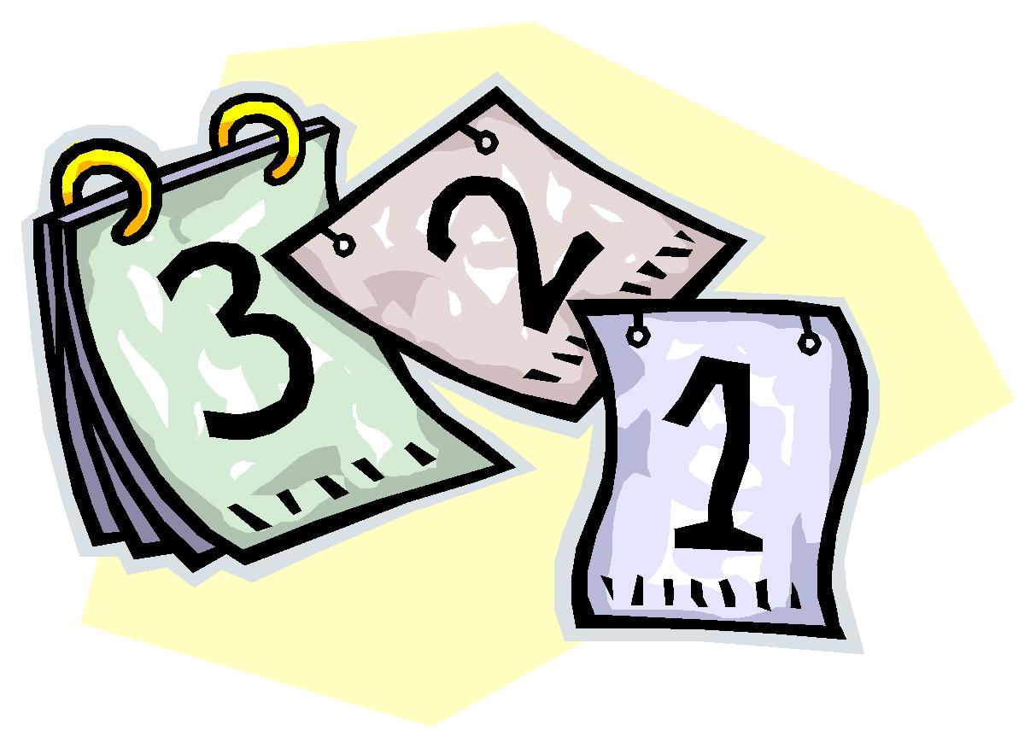
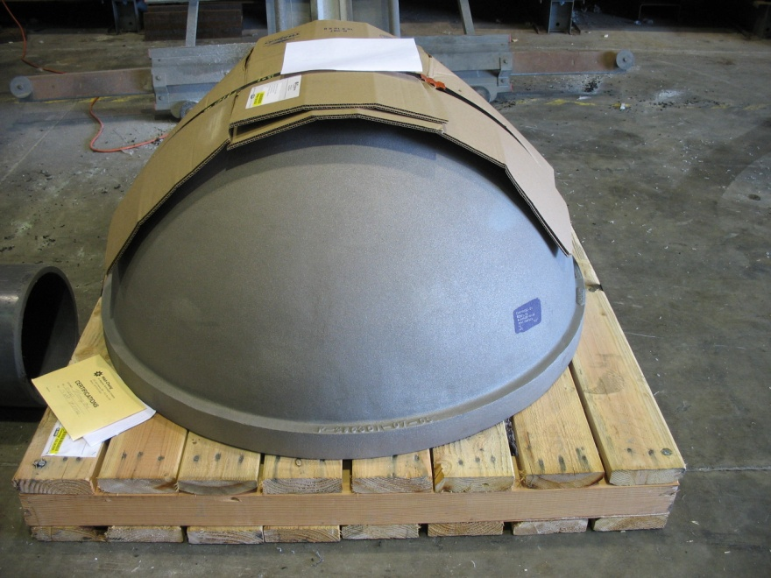

Manufacturing process
Design
Pattern
(In queue)
Casting
Machining
Notes:
Completed designs are nice, but then comes that job of actually building the thing.

Slide 12
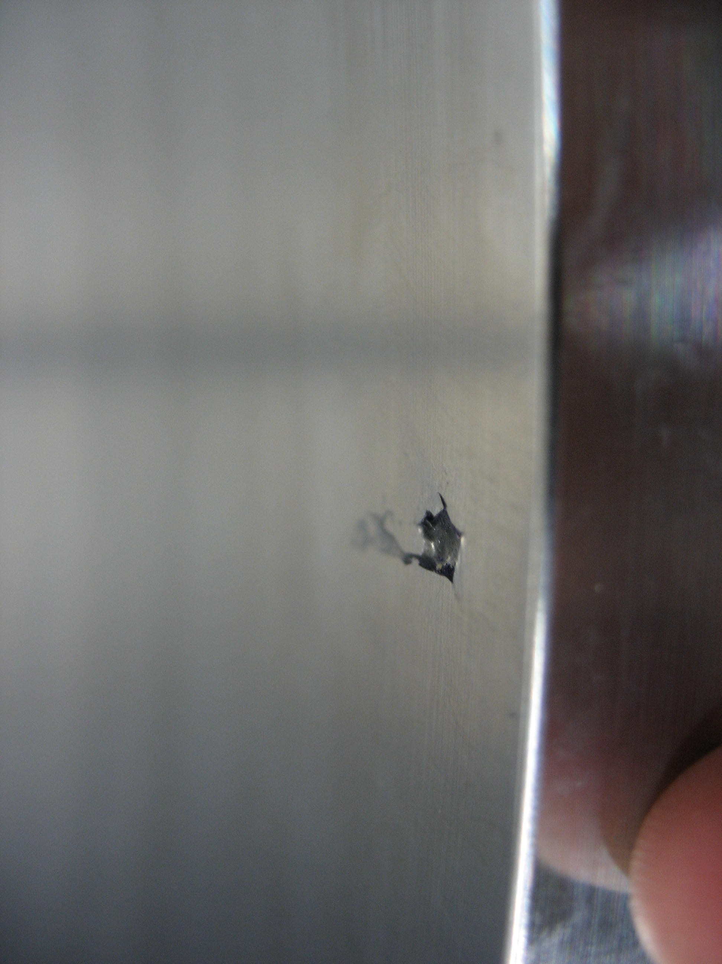
Dye penetrant test for voids

Slide 13
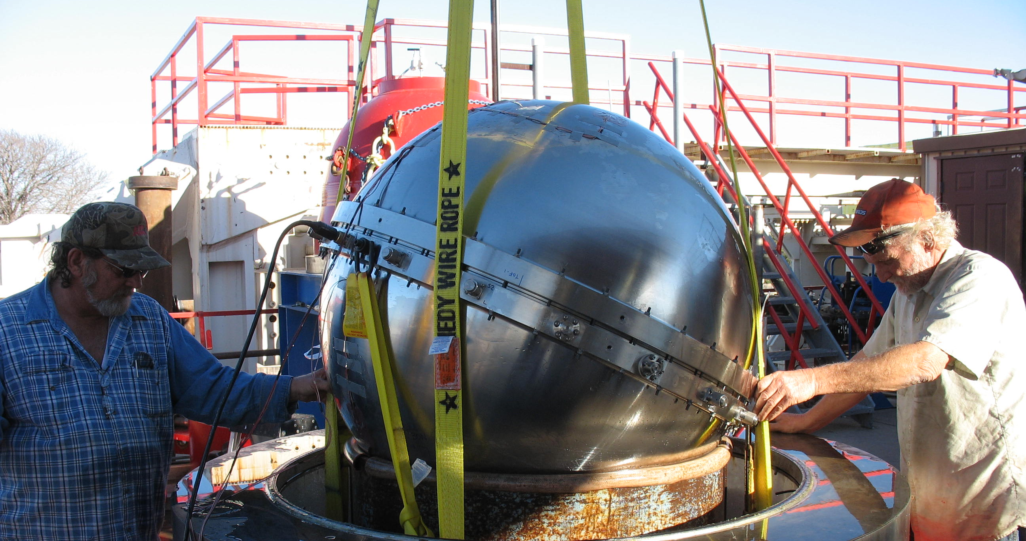
Hyperbaric Testing

Slide 14
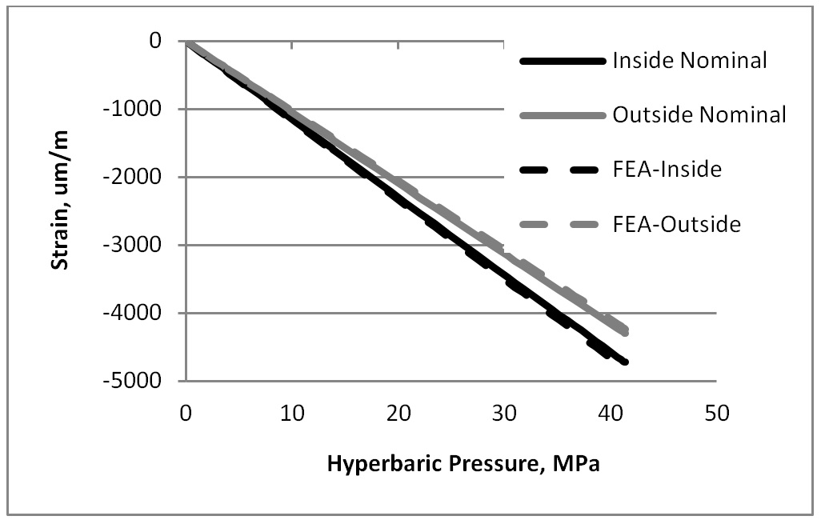
Hyperbaric test Finding
Uniformly high strains
Modulus of Elasticity near low end of range
Buckling factor: 1.8
Notes:
elasticity of 104 GPa, very near the low end of the 100-130 GPa range.

Slide 15
Other Valuable Notes

Slide 16
Inside Mounting
Internal frame
6 radial pins
Concentric motion only

Slide 17
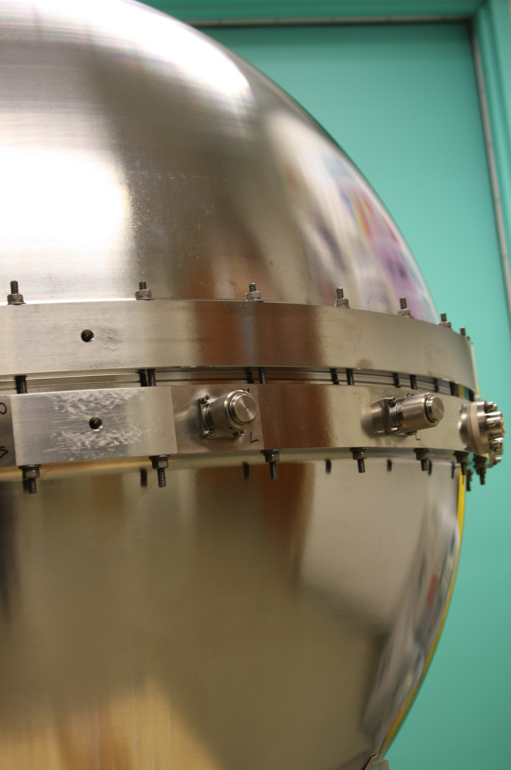
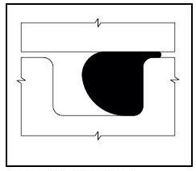
Gauge Test the Assembly
Notes:
GTA does not always stand for grand theft auto… it’s Gauge Test the Assembly.

Slide 18
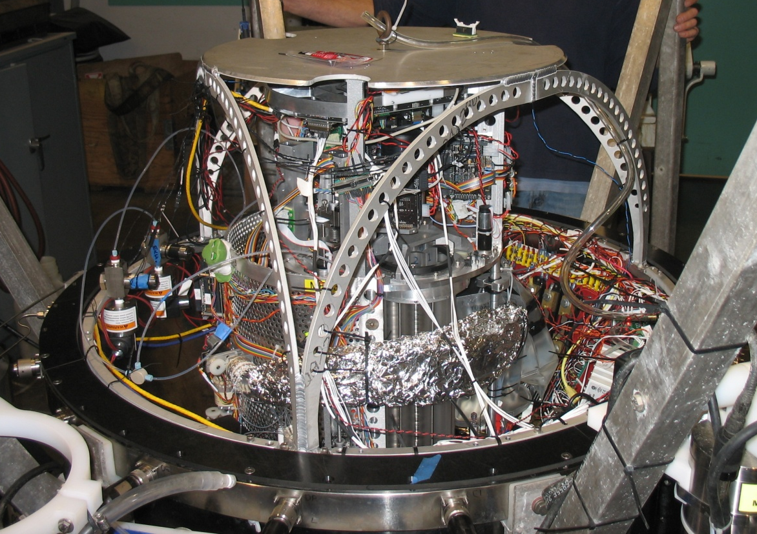
Summary
Large housing way better.
Go-Big size was worth it
Radial mounting
Gauge testing

Slide 19
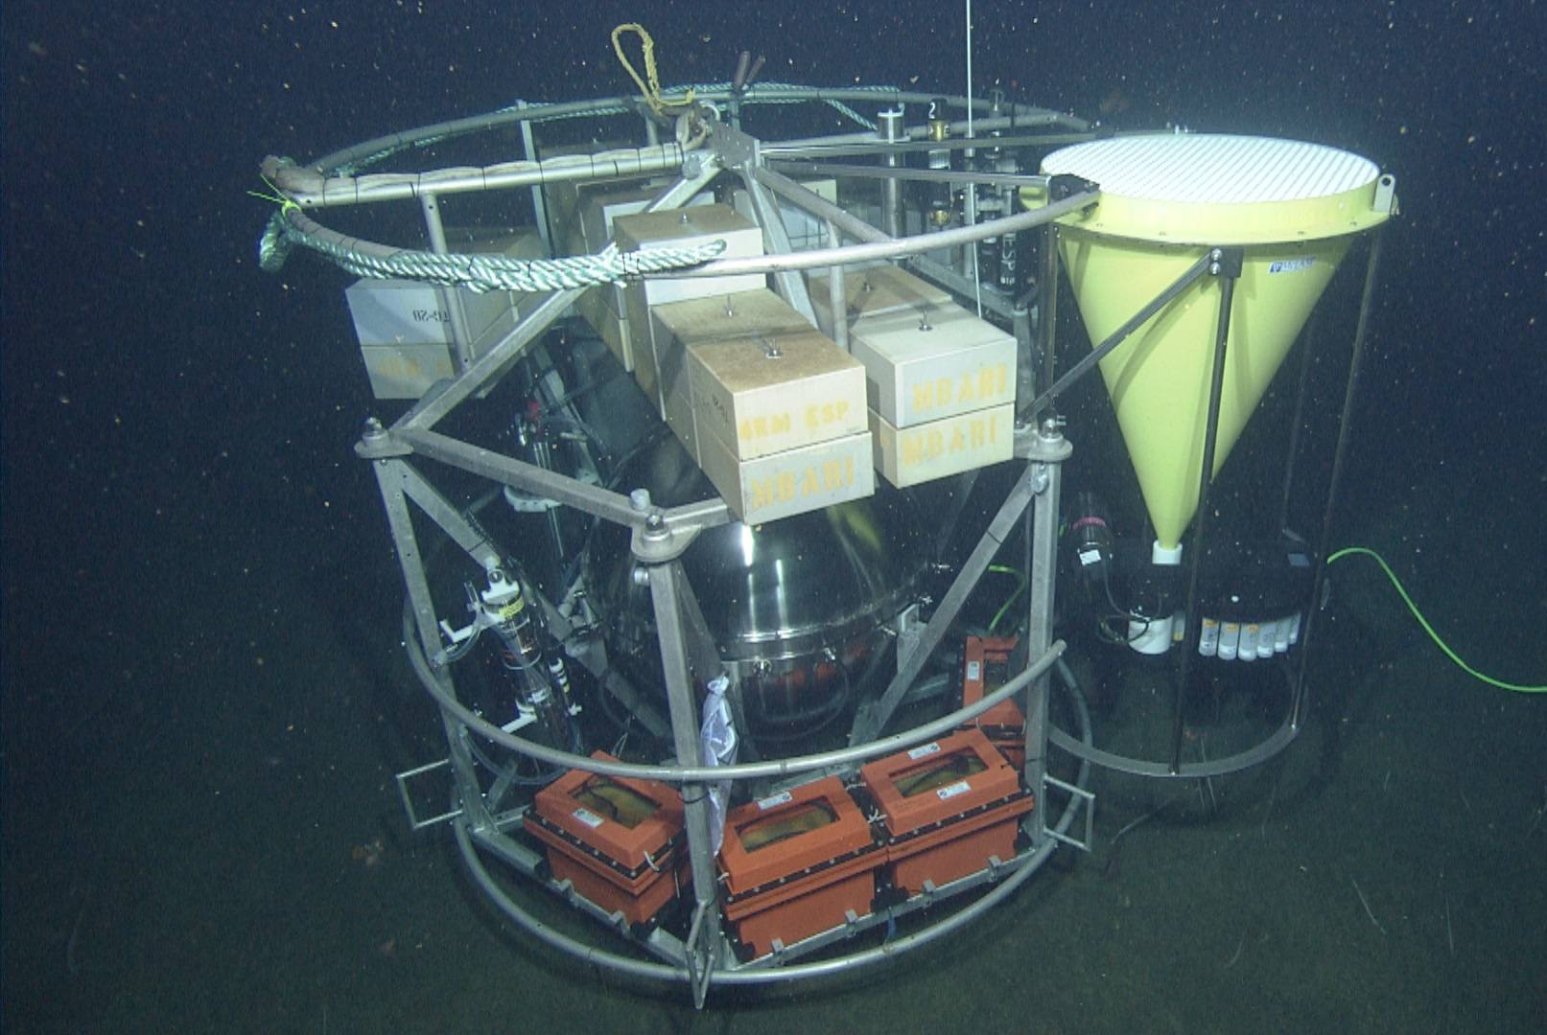
Currently: 900m
Monterey Canyon

Slide 20




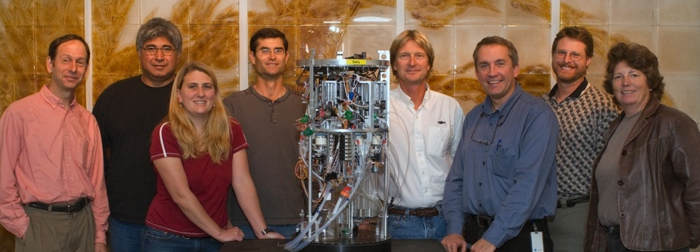
Thank You

