Slide 1
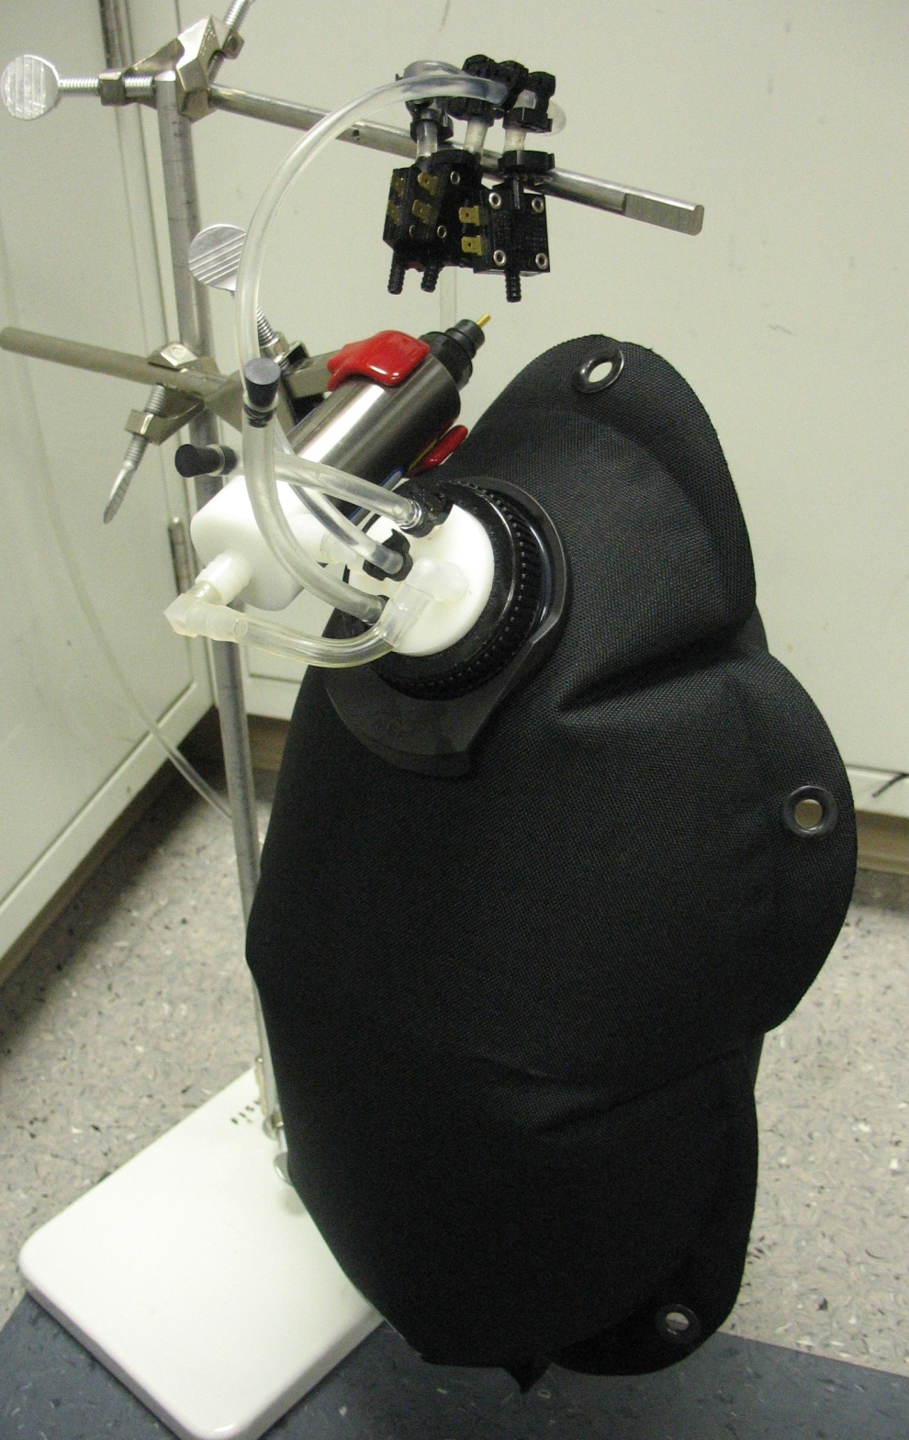
Pressure Switches
Filling Tube
Bag Cap
Sampling Tube
Stirring Pump Suction Tube
Stirring Pump
10L Water Bag

