Slide 1
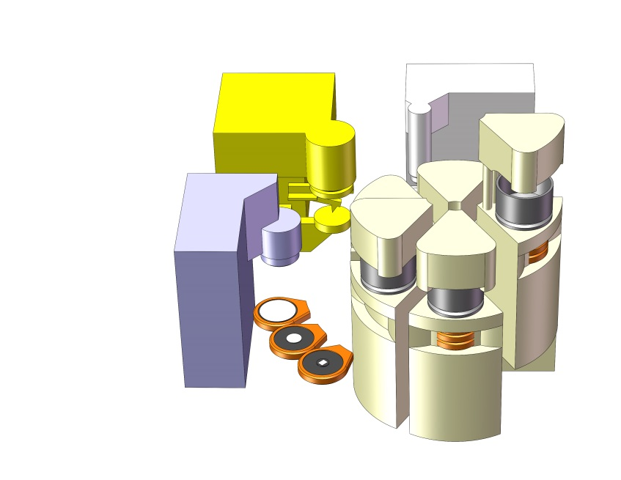
AFM
3rd Stage
(a)
OM
(d)
(b)
(c)
Sample
Puck
Filter
Wafers
Cartridge
Carousel
Fig. 2. Concept Instrument (exploded view shown)
A carousel mechanism holds six sample processing cartridges. Each cartridge can process sample particulates onto three size fractionated filters, held on extendable wafers. The filters can then be placed into imaging and analysis instruments.
The EG ESP opens a sampling cartridge, and an ice filled sample puck is loaded.
The cartridge is closed and drawn into the instrument. The sample is melted and any particulates collected onto size fractionated filters.
The loaded filter wafers are separated, and extended from the cartridge
The carousel is rotated to present each filter to each analysis stage. Optical Microscope; Atomic Force Microscope; and a potential 3rd Stage instrument. The wafers can be moved back and forth for repeated measurements by any of the instruments. After analysis, the wafers are retracted back into the cartridge, and the carousel rotates an unused cartridge to the loading position.

