Slide 1
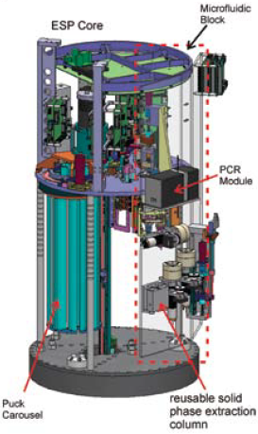
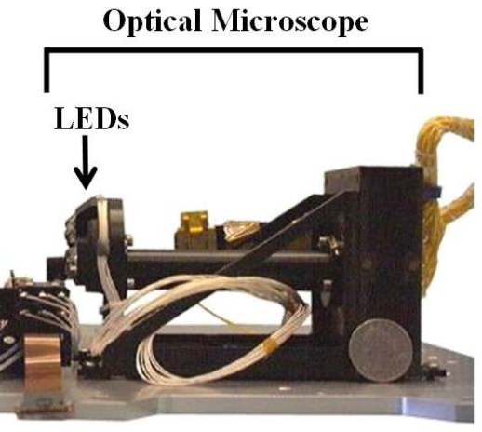
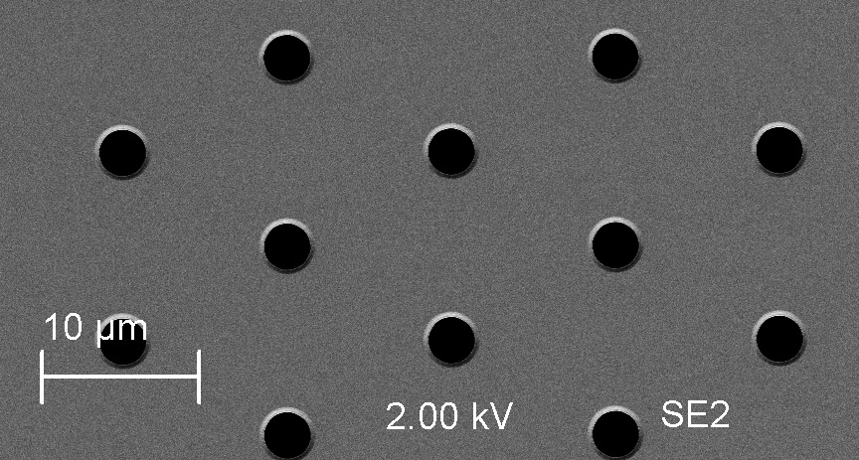
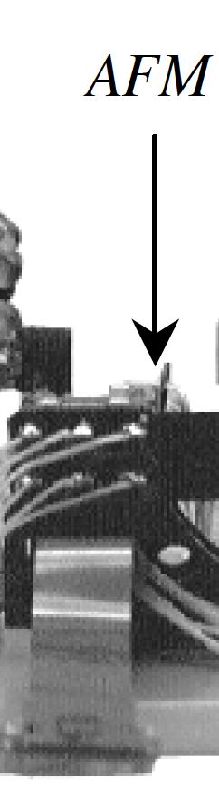
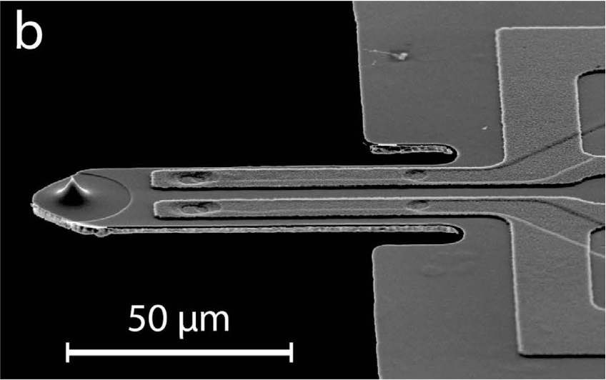
To be revised: ANTONIE Schematic
Requirements | Sample melted
Sample hydrated | Insolubles removed
Sample characterized (e.g. conductivity, transmissivity) | Sample size fractionated (Pressure monitored)
1.
Sample processing system (based on heritage ESP) [temp]
Heritage MECA
Magnification | 5.75
CCD | 256 x 512 pixel
Imaged area | 1 mm x 2 mm
Resolution | 4 microns/px
Light source | 3 red, 3 green, 3 blue and 3 UV LEDs
Sample deposited on membrane (e.g. 0.2 micron SimPore microporous membrane that has surface area of total of ~ 5 mm²)
2.
stage
3.
Optical Microscope images (minimally) the 0.2 micron substrate; also the 10 micron pre-filter (and larger one if used)
Motorized stage capable of x, y dimensional movement holds membrane cartridge; contains calibration substrates (?).
FOV 1 image
AFM low resolution scanning : Small squares (100 x 100 μm) are scaled to the large rectangle
4.
1.02 mm
2.48 mm
Piezoresistive cantilever
Sample Imaging Scenario:
2 low resolution OM images required under this configuration with 4 microns per pixel resolution to image 5 mm² substrate.
Analyisis: JPEG compression identifies high information regions; alternatively use autonomous, AI-driven software for image analysis and decision-making to direct AFM to areas of interest in OM image.
AFM images at low resolution ## 50 to 100 μm sectors (representing 12-25 pixels from OM image). {optional ]
Analysis: JPEG/Machine Learning/AI decision making on AFM subsector selection.
Targeted subsectors at 10 x 10 μm or 5 x 5 μm are scanned for topography and force spectroscopy.
Analysis: process mechanical force data and volatilize soft/adhesive particles.
Soft or adhesive particles are volatilized and ingested into the Mass Spec (Baseline)
5.
AFM high resolution subsector imaging 5-10 μm squares
Motorized AFM scanner moves in x, y, z dimensions to approach sample
Imaged area – low res | 50-100 micron square {optional}
Pixel density | 256 x 256 or 512 x 512 pixel?
Resolution | 390 or 195 nm/pixel
Imaged area –high res | 5 x 5 or 10 x 10 um
Pixel density | 256 x 256 pixel [lowest]
Resolution | 40 nm/pixel [req: image 100-200 nm cells/virus particles]
Cantilever | Piezoresistive ~ 20 nm tip
Scanner | x,y,z dimensions; precision req?
Calibration targets | Size and force detection
Notes:
To be edited and updated with relevant images; and specs

Slide 2
Requirements | Sample melted
Sample hydrated | Insolubles removed
Sample characterized (e.g. conductivity, transmissivity) | Sample size fractionated (Pressure monitored)
1.
Sample processing system (based on heritage ESP) [temp]
Heritage MECA
Magnification | 5.75
CCD | 256 x 512 pixel
Imaged area | 1 mm x 2 mm
Resolution | 4 microns/px
Light source | 3 red, 3 green, 3 blue and 3 UV LEDs
Sample deposited on membrane (e.g. 0.2 micron SimPore microporous membrane that has surface area of total of ~ 5 mm²)
2.
stage
3.
Optical Microscope images (minimally) the 0.2 micron substrate; also the 10 micron pre-filter (and larger one if used)
Motorized stage capable of x, y dimensional movement holds membrane cartridge; contains calibration substrates (?).
FOV 1 image
AFM low resolution scanning : Small squares (100 x 100 μm) are scaled to the large rectangle
4.
1.02 mm
2.48 mm
Piezoresistive cantilever
5.
AFM high resolution subsector imaging 5-10 μm squares
Motorized AFM scanner moves in x, y, z dimensions to approach sample
abiotic evidences biogenic
G3: Characterize Surface properties:
Putative abiotic particle characteristics
Morphology supporting hypotheses for crystaline vs. amorphous particles
Size distribution
Mechanical properties
G2:Assess Habitability:
Particle aggregates suggest oceanic origin
G1: Search for biosignatures:
Cell-like or organic particle morphology
Size distribution of cell-like & organic particles
Mechanical properties suggest soft/adhesive objects
Particle or bulk sample is carbon-containing

Slide 3
Antonie system components
Sample fractionation
Ice chip melting, filtration and distribution on to substrates for Optical and Atomic Force Microscopy
Low risk/High TRL
Heritage scale
Optical microscopy
Particle identification and size distribution. Fluorescence, other low res optical ideas?
AFM
Extends size distribution to below 3um. Fluorescence, other low res optical ideas?
High risk/Low TRL

Slide 5
top view sample stage
substrates:
100µm pore membrane
10µm pore membrane
0.2µm pore membrane
textured with pillars
calibration
sample delivery
OM
notch to prevent
contact with AFM
during flight,
landing etc.
AFM
U. Staufer

