Slide 1
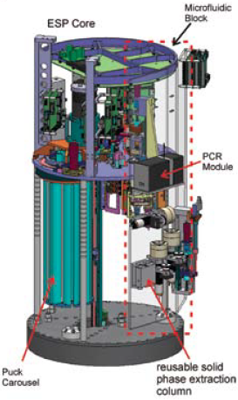
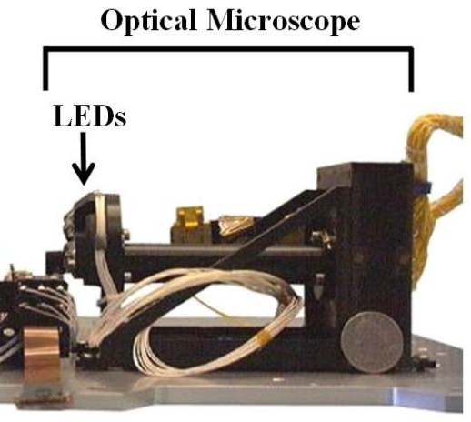
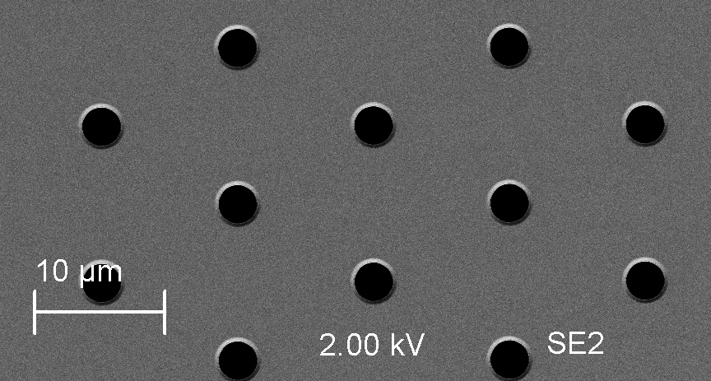
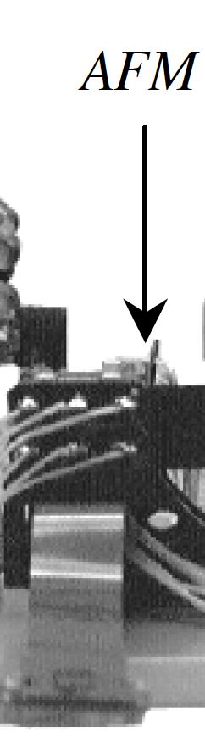
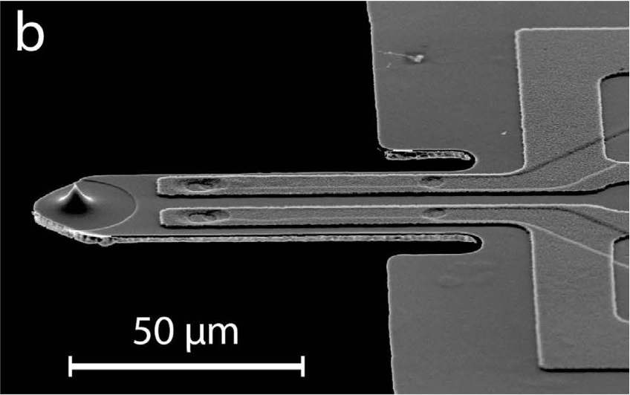
To be revised: ANTONIE Schematic
Requirements | Sample melted
Sample hydrated | Insolubles removed
Sample characterized (e.g. conductivity, transmissivity) | Sample size fractionated (Pressure monitored)
1.
Sample processing system (based on heritage ESP) [temp]
Heritage MECA
Magnification | 5.75
CCD | 256 x 512 pixel
Imaged area | 1 mm x 2 mm
Resolution | 4 microns/px
Light source | 3 red, 3 green, 3 blue and 3 UV LEDs
Sample deposited on membrane (e.g. 0.2 micron SimPore microporous membrane that has surface area of total of ~ 5 mm²)
2.
stage
3.
Optical Microscope images (minimally) the 0.2 micron substrate; also the 10 micron pre-filter (and larger one if used)
Motorized stage capable of x, y dimensional movement holds membrane cartridge; contains calibration substrates (?).
FOV 1 image
AFM low resolution scanning : Small squares (100 x 100 μm) are scaled to the large rectangle
4.
1.02 mm
2.48 mm
Piezoresistive cantilever
Sample Imaging Scenario:
2 low resolution OM images required under this configuration with 4 microns per pixel resolution to image 5 mm² substrate.
Analyisis: JPEG compression identifies high information regions; alternatively use autonomous, AI-driven software for image analysis and decision-making to direct AFM to areas of interest in OM image.
AFM images at low resolution ## 50 to 100 μm sectors (representing 12-25 pixels from OM image). {optional ]
Analysis: JPEG/Machine Learning/AI decision making on AFM subsector selection.
Targeted subsectors at 10 x 10 μm or 5 x 5 μm are scanned for topography and force spectroscopy.
Analysis: process mechanical force data and volatilize soft/adhesive particles.
Soft or adhesive particles are volatilized and ingested into the Mass Spec (Baseline)
5.
AFM high resolution subsector imaging 5-10 μm squares
Motorized AFM scanner moves in x, y, z dimensions to approach sample
Imaged area – low res | 50-100 micron square {optional}
Pixel density | 256 x 256 or 512 x 512 pixel?
Resolution | 390 or 195 nm/pixel
Imaged area –high res | 5 x 5 or 10 x 10 um
Pixel density | 256 x 256 pixel [lowest]
Resolution | 40 nm/pixel [req: image 100-200 nm cells/virus particles]
Cantilever | Piezoresistive ~ 20 nm tip
Scanner | x,y,z dimensions; precision req?
Calibration targets | Size and force detection
Notes:
To be edited and updated with relevant images; and specs

Slide 2
Requirements | Sample melted
Sample hydrated | Insolubles removed
Sample characterized (e.g. conductivity, transmissivity) | Sample size fractionated (Pressure monitored)
1.
Sample processing system (based on heritage ESP) [temp]
Heritage MECA
Magnification | 5.75
CCD | 256 x 512 pixel
Imaged area | 1 mm x 2 mm
Resolution | 4 microns/px
Light source | 3 red, 3 green, 3 blue and 3 UV LEDs
Sample deposited on membrane (e.g. 0.2 micron SimPore microporous membrane that has surface area of total of ~ 5 mm²)
2.
stage
3.
Optical Microscope images (minimally) the 0.2 micron substrate; also the 10 micron pre-filter (and larger one if used)
Motorized stage capable of x, y dimensional movement holds membrane cartridge; contains calibration substrates (?).
FOV 1 image
AFM low resolution scanning : Small squares (100 x 100 μm) are scaled to the large rectangle
4.
1.02 mm
2.48 mm
Piezoresistive cantilever
5.
AFM high resolution subsector imaging 5-10 μm squares
Motorized AFM scanner moves in x, y, z dimensions to approach sample
abiotic evidences biogenic
G3: Characterize Surface properties:
Putative abiotic particle characteristics
Morphology supporting hypotheses for crystaline vs. amorphous particles
Size distribution
Mechanical properties
G2:Assess Habitability:
Particle aggregates suggest oceanic origin
G1: Search for biosignatures:
Cell-like or organic particle morphology
Size distribution of cell-like & organic particles
Mechanical properties suggest soft/adhesive objects
Particle or bulk sample is carbon-containing

