Slide 1
Cartridge idea design history
December 20, 2013

Slide 2
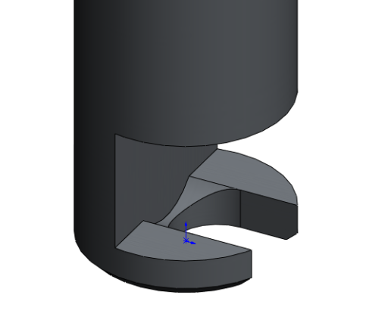
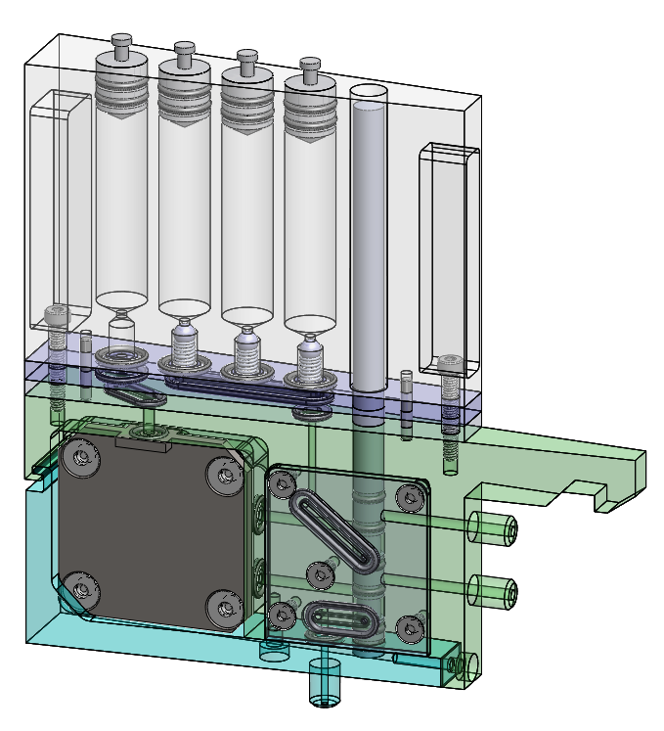
Cartridge
April 12, 2013
Push/Pull Plungers
Actuator Example
Dowel Pins for Location
Sea Water In
Sea Water Out
Clamp
Waste

Slide 3
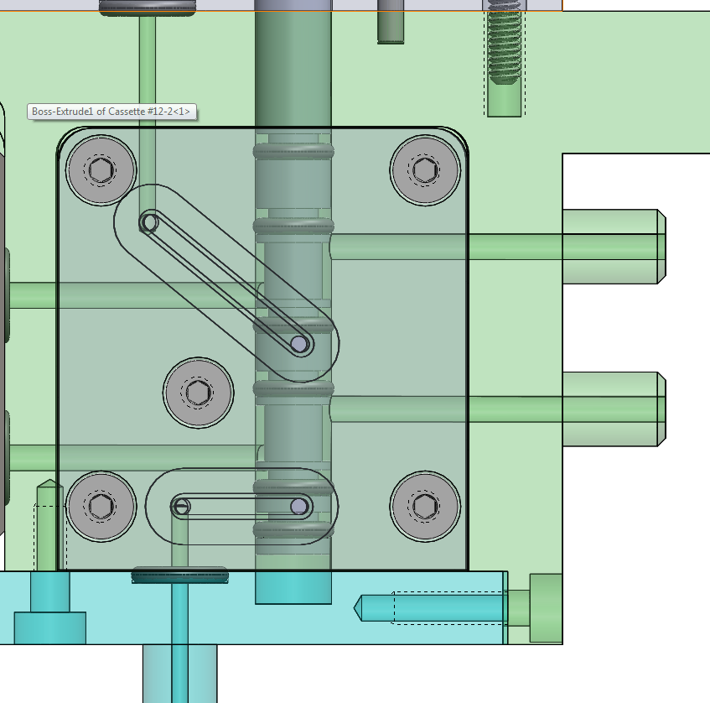
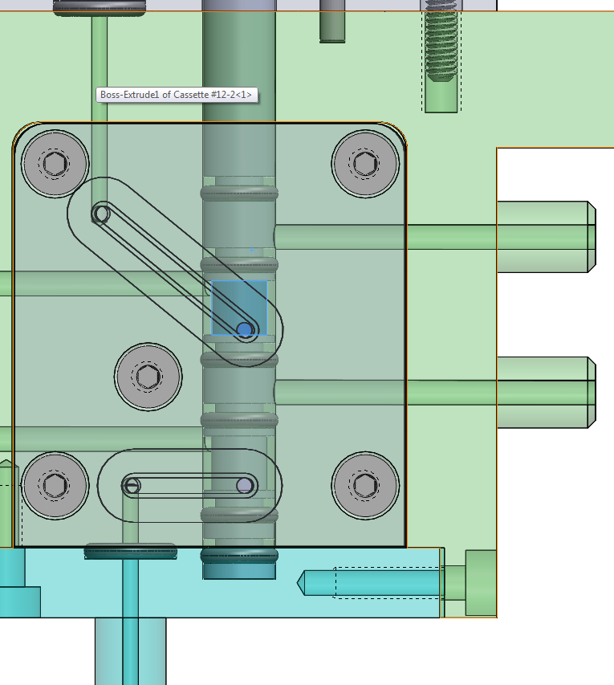
Valving
April 12, 2013
Filtering Position
Processing Position

Slide 4
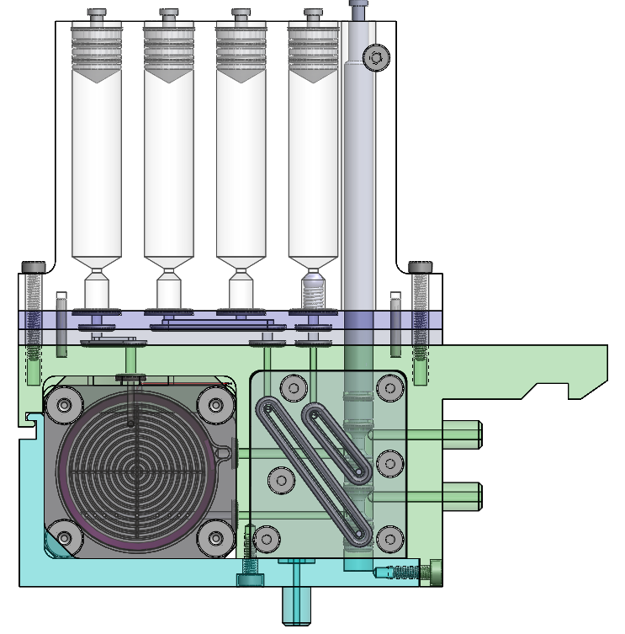
Archive Cartridge Overview
May 23, 2013
Reagent Syringe
Evac Syringe
Waste Syringes
Syringe Manifold*
Cartridge Manifold*
Manifold Plate*
Out Port-Not Used
* Archive specific part

Slide 5
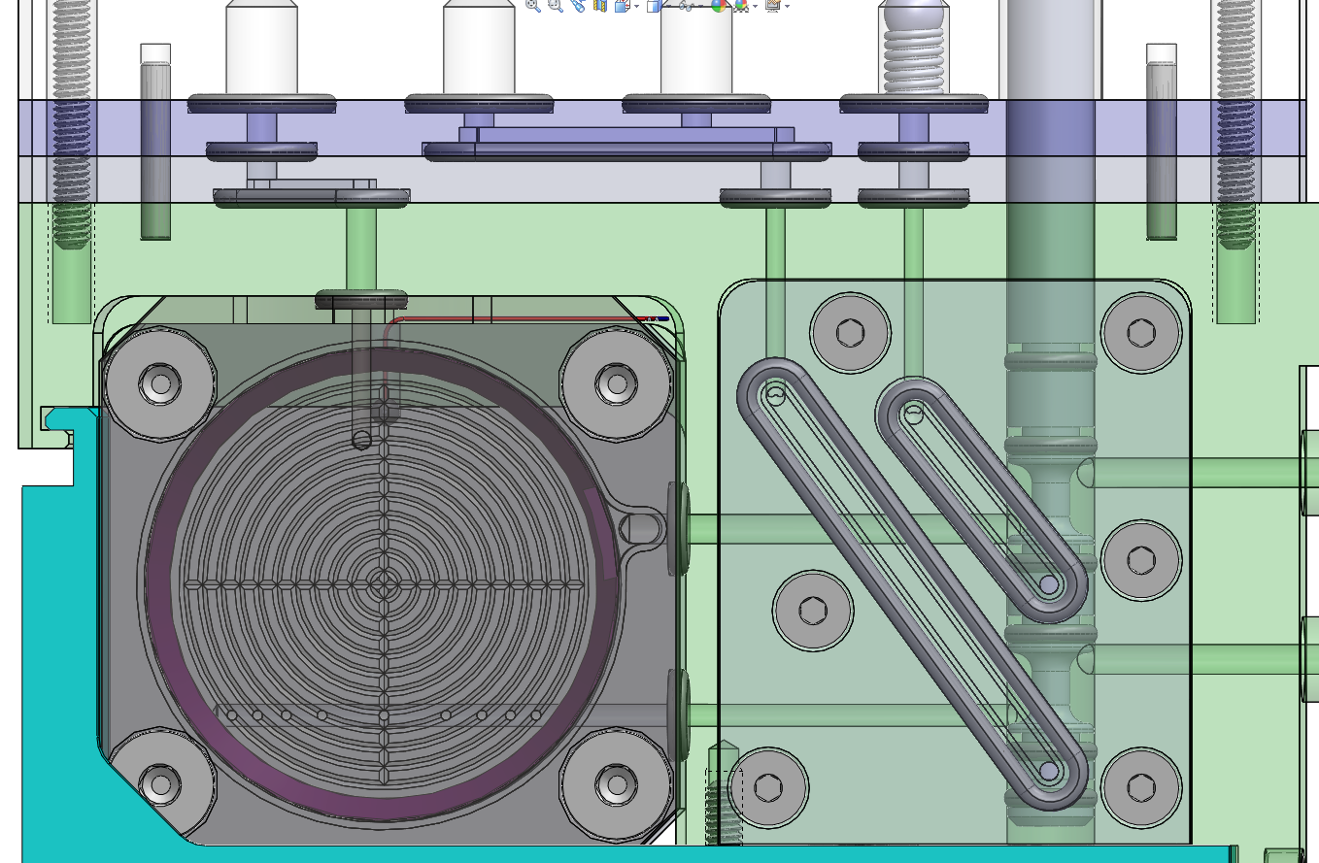
Archive Cartridge Fluid Path
May 23, 2013
Reagent In
Reagent Out

Slide 6
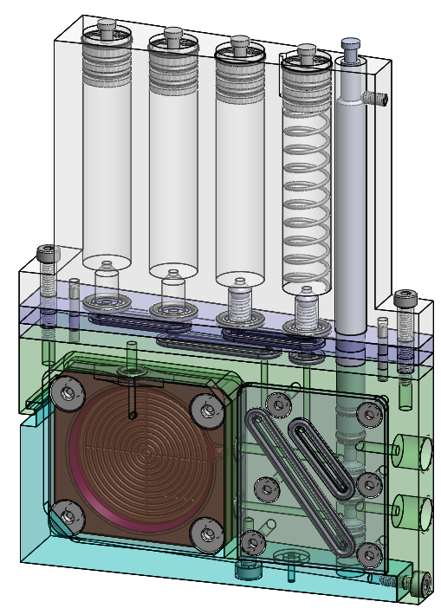
Cartridge Delivery
August 13, 2013 – Phase 2 end
Reagent
On-Board Storage
Evacuation Spring
Check Valve
V1 Puck
¼-28 Ports

Slide 7
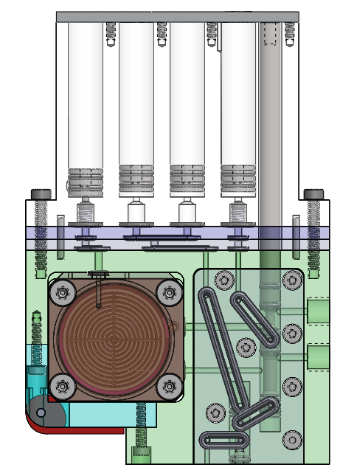
Lyse-n-Go Layout
December 17, 2013
Storage/Dilution
Evac & Vent
Reagent
Reworked syringe manifold plates
Extended Manifold Plate
CAM Latch
Cartridge extended by 10mm
Need lower actuator!
Additional Valve
Interface plate?

