Slide 1
MBARI Tech Specifications
ESP Platform in a Nose Cone for deployment
  11.5” x 24” (the total system) but scalable, modular
  30 degree deviations from normal
  14v, ?amp, ~36 watts, 40% LRAUV power for 10 day deployment
  0-300m depths, 15psi-450psi
  0 -50 C inactive, 2-40 C active
  3g acceleration inactive, 0.5g active (plus 1g rolls)
Interface Specifications -TBD
  Port Size
  Etc.

Slide 2
Overall Requirements
Physical Space Constraints
  General
    Cartridge Angle – 6 °
    Height: 91.25mm
    Width: 95.25mm
    Depth: 14.48mm
Fluid Volumes
  Filter – 1ml +/- 10%
  Reagent – .1 - 1ml +/- 5%?
  Lysis Agent – .1 - 1ml +/- 5%?
Port Locations
  See Envelope Drawing

Slide 3
Puck Filter Requirements
Envelope
  Thickness: 8.80mm
  Diameter: 25.40mm
Dead Volume: 5%
Filter Media Thicknesses
  .8 – 1mm
  .3 – .5mm
Port Size
  In: 1.59mm
  Out: 1.35mm
Materials
  Top: Titanium (Ti-6AL-4V)
  Base: Acrylic
  Diaphragm: Silicone Rubber
  Spacer Ring: Titanium (Ti-6AL-4V)

Slide 4
Cylindrical Filter Requirements
Max Outer Diameter 10mm
Max Height 41mm
Dead Volume 5%
Filter Media Thickness: <1mm
Materials
  Body - Stainless Steel 316
  End Caps - Stainless Steel 316
  Filter Frame - Stainless Steel 316
  Filter Media – Varies
  Balloon - Silicone Rubber

Slide 5
Archive Cartridge Reqs.
Separate from lysis?
Pre-filters?
Ports (out port?)
Reagents Onboard?

Slide 6
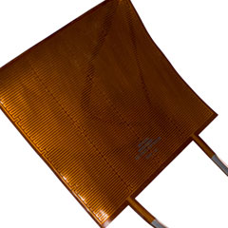
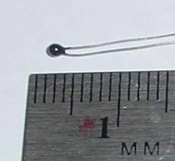
Lyse’NGo Cartridge Reqs.
Heating
  Reach 85 °C in less than 10 min
  Watlow Polyimide Heater
    5W/in^2
    0.2mm Thick
PCB Mounting
3 Reagent Syringes
Heater
Bead Thermistor

Slide 7
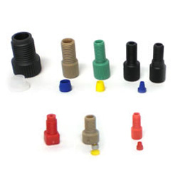
Test Bed Reqs.
Connection Types
  Upchurch ¼-28 Flat Bottom
Manual Fluid Metering
Manual Evacuation
Independent Heating

Slide 8
Materials Request
Filters
  Sintered Titanium
  25mm disks of 2G (3 of each)
Salt water mixture for testing (seachem)
  Pump and filter vs unfiltered

Slide 9
Envelope Drawing

