Slide 1

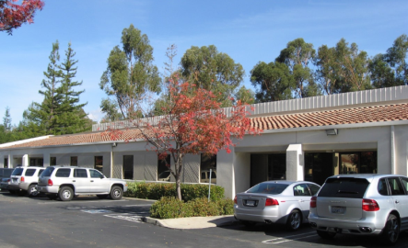
MBARI Cartridge and Filter Project
Mission
Our mission is to provide clients throughout the world with product development for medical, diagnostic, biodefense and biotech products. Accel’s skilled team of engineers, designers and technicians will work together to provide services from concept to development to manufacturing support
Date: 03-14-13
By: Accel Biotech Team

Slide 2
Agenda
Action Items Review
MBARI G3 Overview
Thermal Analysis
Concept Review
  Cylindrical filters
  Puck filters
  Integrated concepts
Recommendations
Phase 2 Plans Discussion

Slide 3
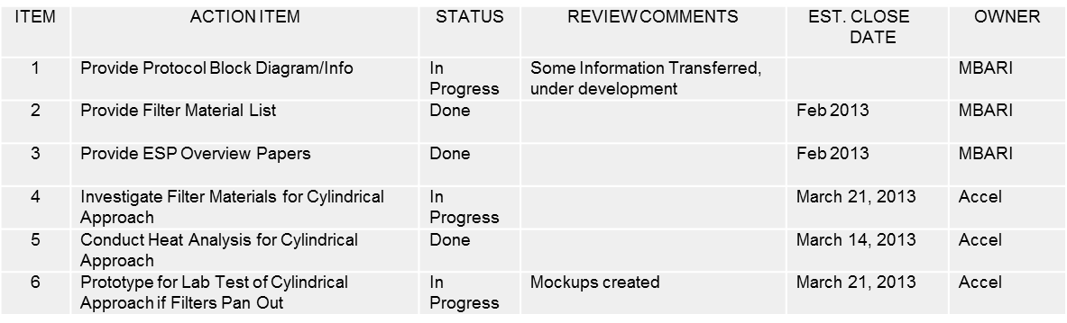
Action Items

Slide 4
MBARI Tech
ESP Platform in a Nose Cone for deployment
  11.5” x 24” (the total system) but scalable, modular
  30 degree deviations from normal
  14v, ?amp, 40% LRAUV power for 10 day deployment – system power ~36watts
  0-300m depths, 15psi-450psi
  0 - 50 C inactive, 2-40 C active
  3g acceleration inactive, 0.5g active (plus 1g rolls)

Slide 5
MBARI Tech Conti…
Genetic Marker Classification (algae, bacteria, viruses, invertebrate larvae, biotoxins) – Nucleic Acid Prep
  30 Samples, 30 Archive
  Save sample before and after lysis
  Expression and translation of specific genes
  mRNA
  DNA
  2ml-2L of raw seawater @ rates of 1L/hr using 0.2 um filters
  Exclude particles larger than 0.5mm
  Variable filter (two types)
  300-500 ul lysate (30 minute processing)
  6 Reagents for sample processing – 4 samples per cartridge max
  Temperature Cycling up to 85C

Slide 6
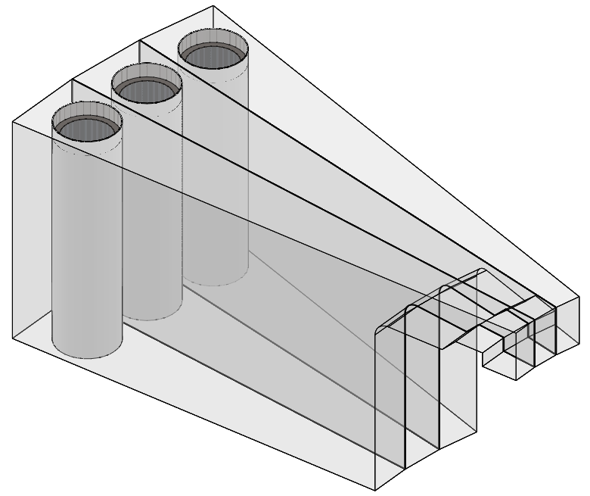
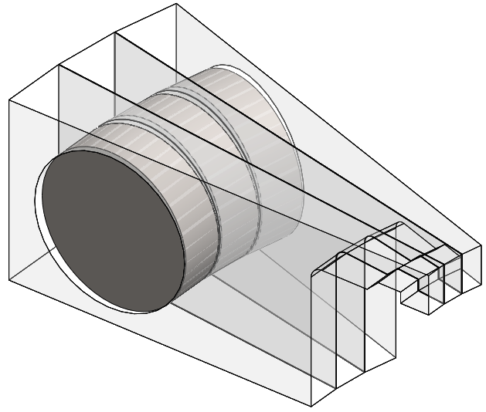
Thermal Dynamic Analysis
Puck
  One Sided
    Water Flowing Adjacent
    Empty Adjacent
Cylinder
  Exterior Sleeve
    Water Flowing Adjacent
    Empty Adjacent

Slide 7
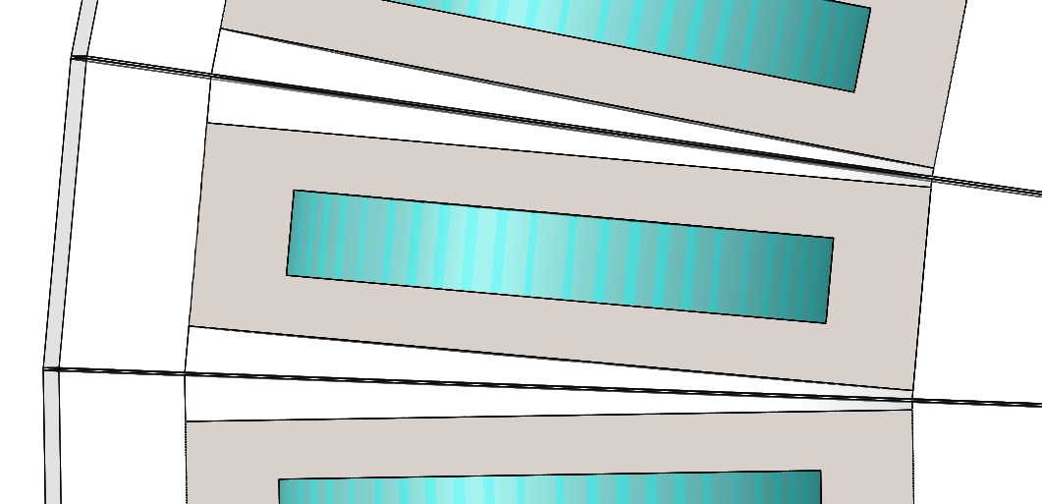
Puck Model Details: Multi Sample
Multi Cassette w/ water flowing through adjacent cassettes
  Convection: 15 W/m^2*K
    All exposed faces
  Initial Temp: 2°C
    All components
  Constant Temperature: 2°C
    Outside face of puck insulator
  Heat Power: 12-13 Watts
    Puck face (one side)
Titanium Puck
Insulator
Water
Heat Source
Air Gap

Slide 8
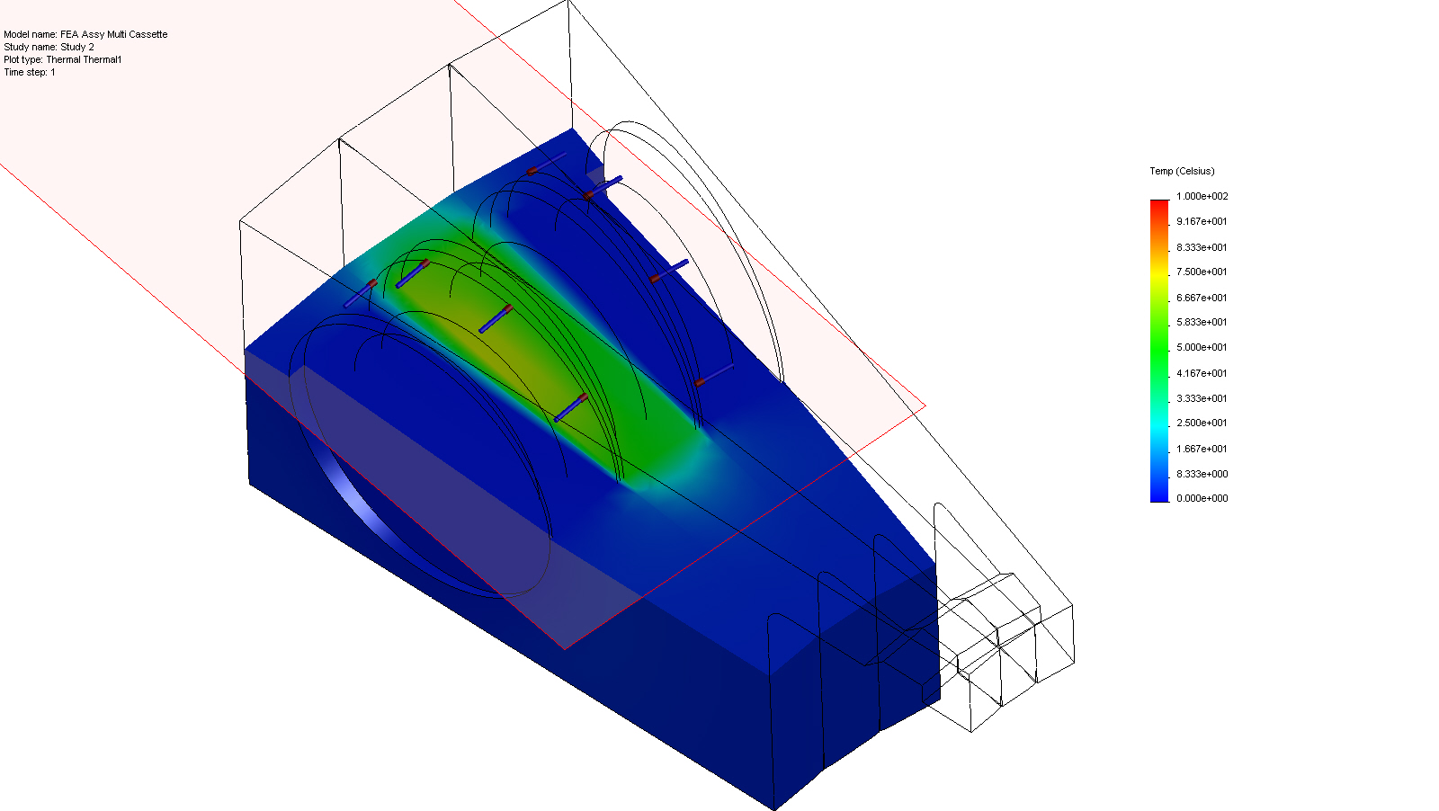
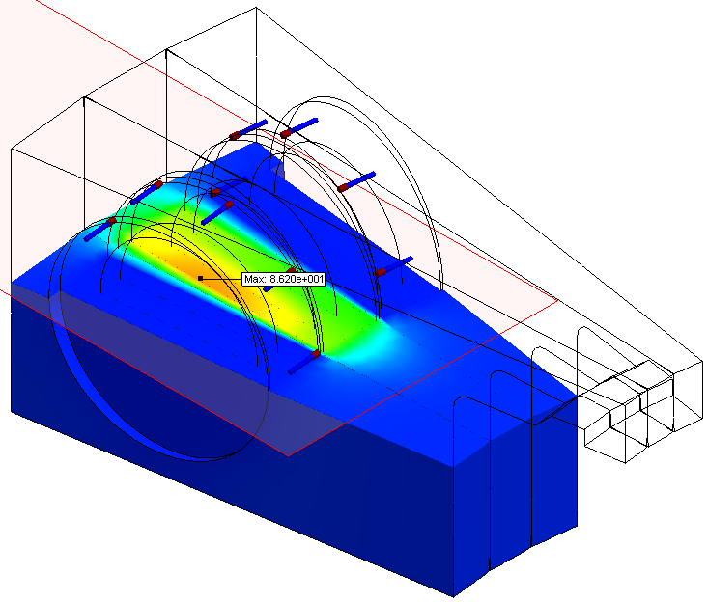
Puck Model Details: Multi Sample
Results
  Max Temp: 86.2° C @ 10 minutes
  Requires 13 Watts

Slide 9
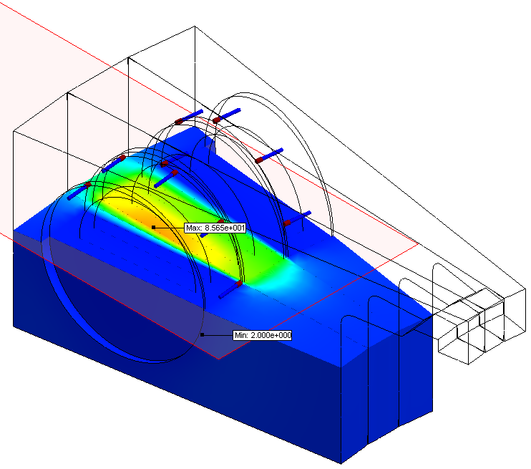
Puck Model Details: Multi Sample
Results
  Max Temp: 85.7° C @ steady state
  Requires 12 Watts

Slide 10
Puck Model Details: Single Sample
Multi Cassette w/ empty adjacent cassettes
  Convection: 15 W/m^2*K
    All exposed faces
  Initial Temp: 2 ° C
    All components
  Heat Power: 9-11.2 Watts
    Puck face (one side)
Titanium Puck
Insulator
Water
Heat Source
Air Gap

Slide 11
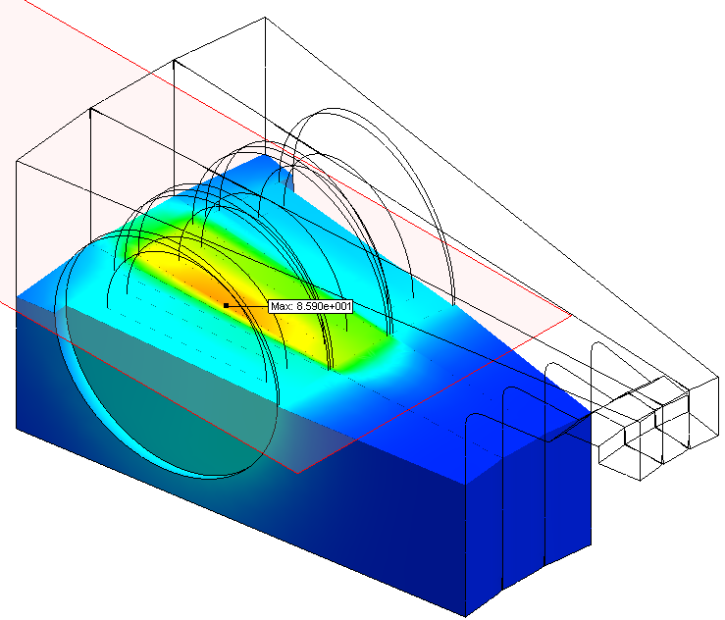
Puck Model Details: Single Sample
Results
  Max Temp: 85.9° C @ 10 min
  Requires 11.2 Watts

Slide 12
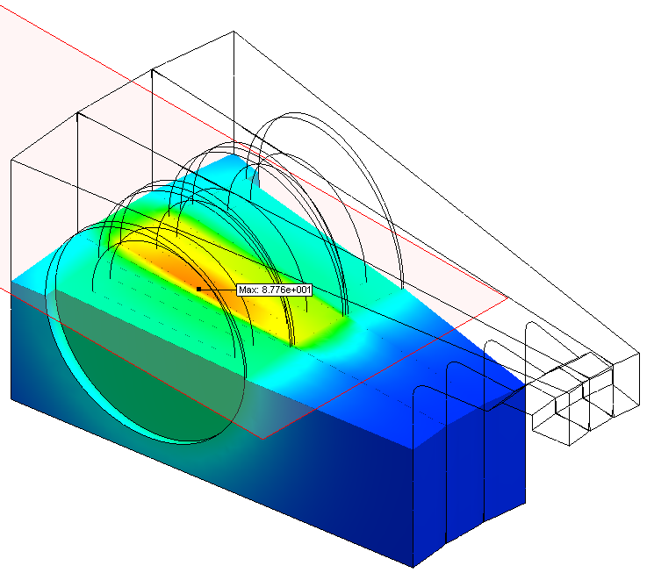
Puck Model Details: Single Sample
Results
  Max Temp: 87.7° C @ steady state
  Requires 9 Watts

Slide 13
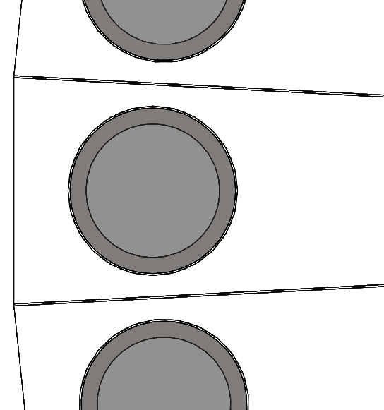
Cylinder Model Details - Multi Sample
Multi Cassette w/ water flowing through adjacent cassettes
  Convection: 15 W/m^2*K
    All exposed faces
  Initial Temp: 2C
    All components
  Constant Temperature: 2C
    Adjacent Cylinders
  Heat Power: 6.1-7 Watts
    Interior Sleeve Face
Titanium Shell
Water
Sleeve Heater
Air Gap

Slide 14
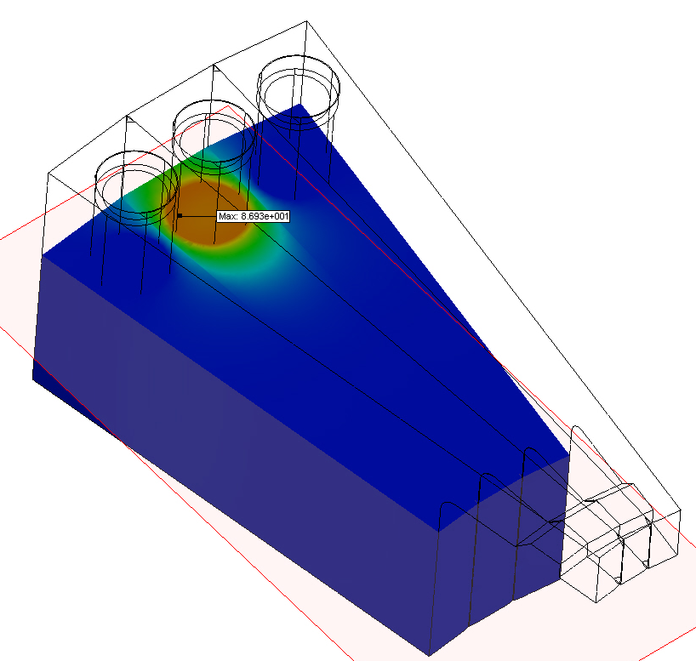
Cylinder Model Details –Multi Sample
Results
  Max Temp: 87° C @ 10 minutes
  Requires 7 Watts

Slide 15
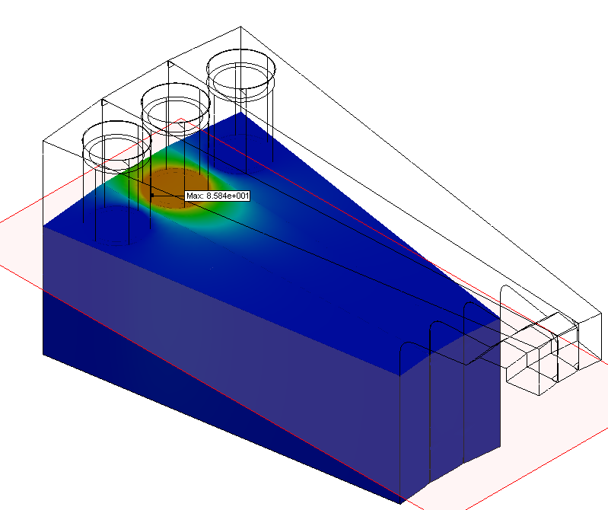
Cylinder Model Details –Multi Sample
Results
  Max Temp: 85.8° C @ steady state
  Requires 6.1 Watts

Slide 16
Cylinder Model Details - Single Sample
Multi Cassette w/ empty adjacent cassettes
  Convection: 15 W/m^2*K
    All exposed faces
  Initial Temp: 2C
    All components
  Heat Power: 5.5-6.6 Watts
    Interior Sleeve Face
Titanium Shell
Water
Sleeve Heater
Air Gap

Slide 17
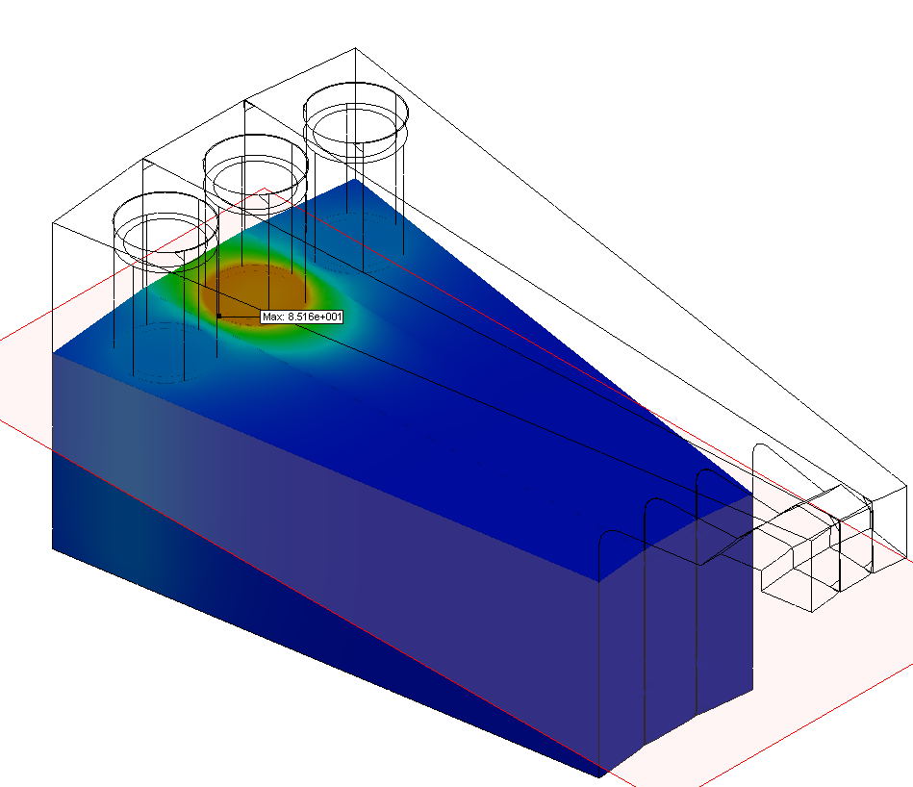
Cylinder Model Details –Single Sample
Results
  Max Temp: 85° C @ 10 minutes
  Requires 6.6 Watts

Slide 18
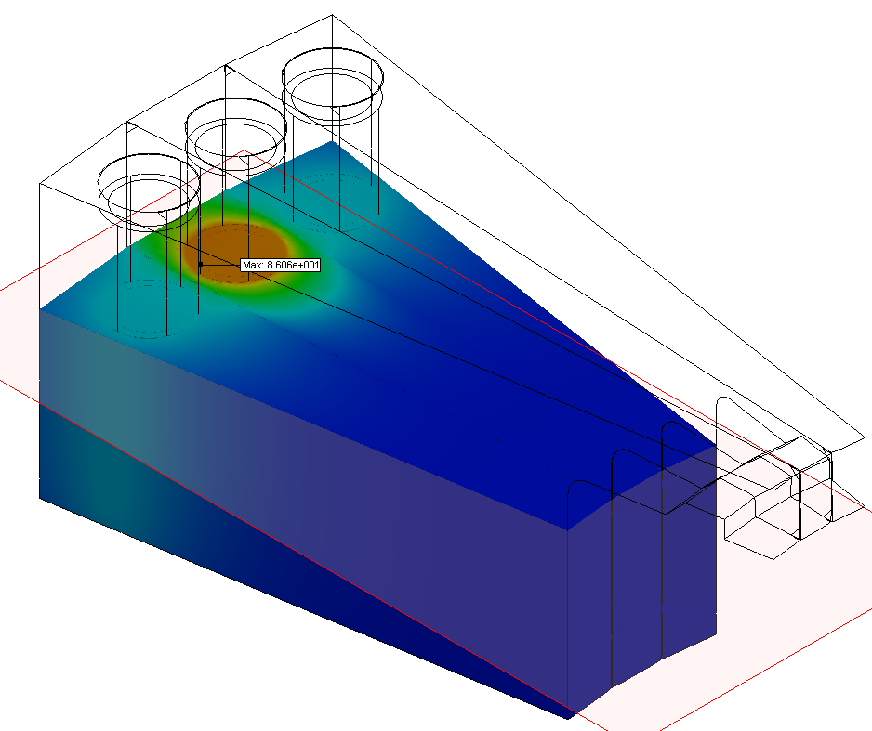
Cylinder Model Details –Single Sample
Results
  Max Temp: 86° C @ Steady State
  Requires 5.5 Watts

Slide 19
Filter Heating Review
  Cylinder design requires 39-46% less power to heat than puck design

Slide 20
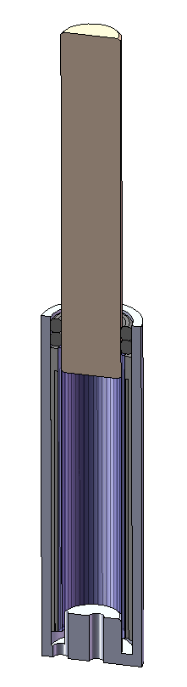
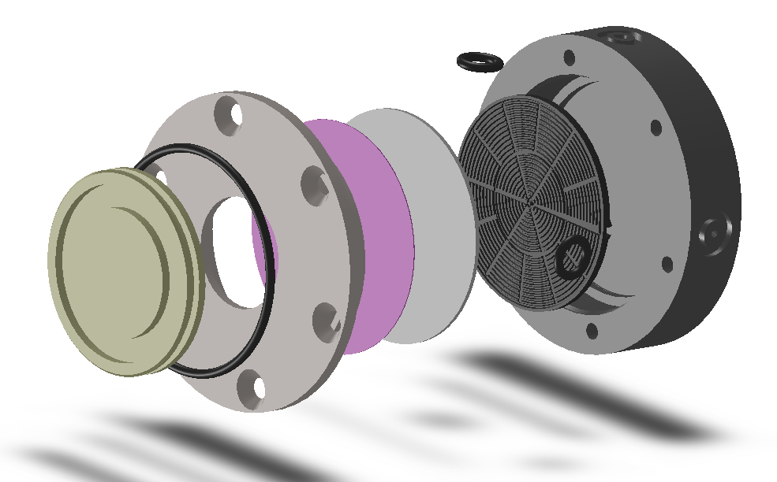
Cylindrical Filter Concepts
Concept #1 – Piston Evacuation
  Volumes
    Disk – 500ul
    Cylinder ~200ul
  Disk
  Cylinder

Slide 21
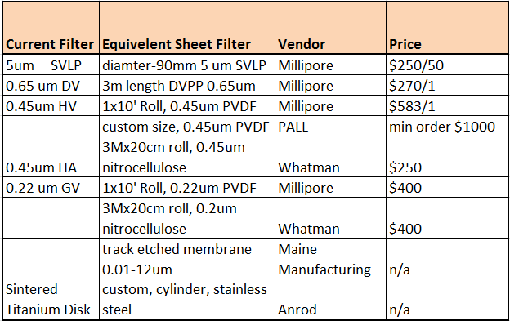
Cylindrical Filter Concepts
Supplier Options
  Maine Manufacturing
  Other Vendors
  Assemble in house

Slide 22
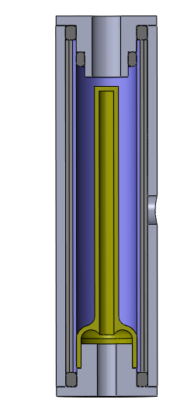
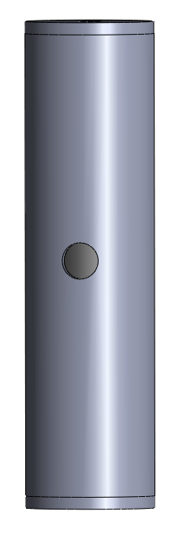
Cylindrical Filter Concepts
Concept #2 – Expanding Bladder Concept
  Expands under pressure for evacuation
  Benefits:
    Requires less heat energy
    Less space is required
Sea Water
Inlet
Expanding
Bladder
Sea Water
Outlet
Bladder
Fill Inlet

Slide 23

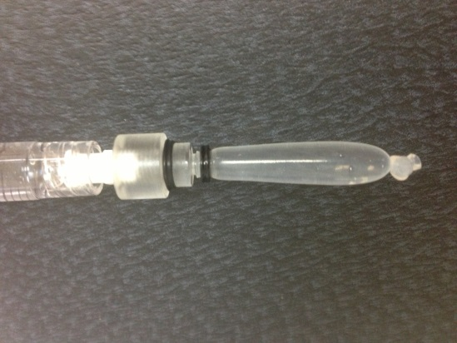
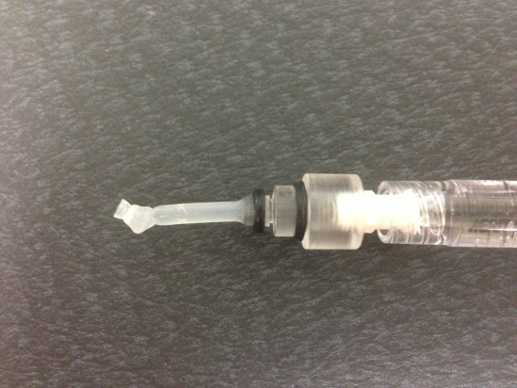
Cylindrical Filter Concepts
Bladder Overview
  Benefits
    Compliant – expand under pressure
    Used to apply force or occlude
    Ultra high-strength, thin walled
    Size range from 0.5-50mm in diameter, any length
    Expand > 100%
  Medical Balloons
    Material – Urethane Very Low Durometer
    ~$20 per balloon
  Silicone tubing
    See test setup

Slide 24
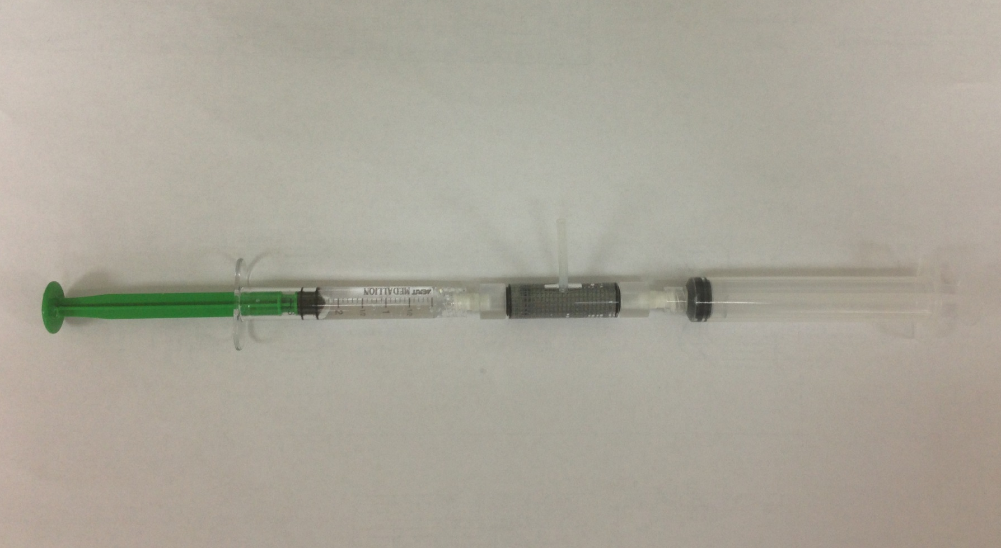
Cylindrical Filter Concepts
Concept #2 – Expanding Bladder Concept
  Test Setup Overview
Water Out
Syringe –Expand the Bladder
Syringe –Water In
Filter Housing

Slide 25
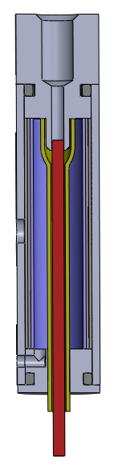
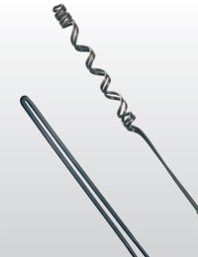
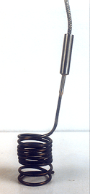
Cylindrical Filter Concepts
Bladder
Fill Inlet
Concept #3 – Internal Heater Design
  Versatile micro tubular heaters
  Seema Heaters
    Max Heating power 30W/in^2
    650 Deg. C max temperature
  Rotfil Micro-Rollmax 1.1x1.9mm
    Max Heating Power 15W/cm^2
    700 Deg. C max temperature
Expanding
Bladder
Sea Water
Outlet
Sea Water
Inlet
Heater

Slide 26
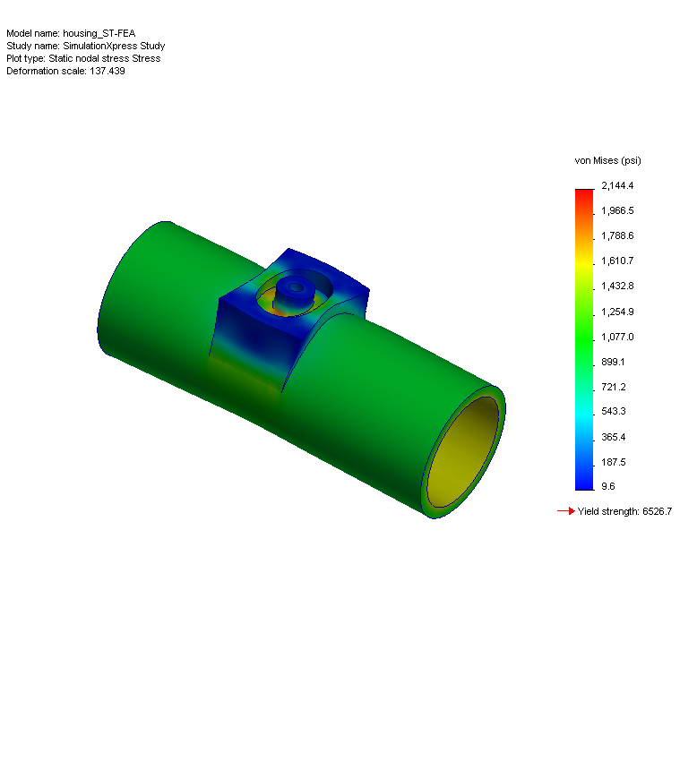
Cylindrical Filter Concepts
Cylindrical Filter – FEA Analysis
  Boundary Conditions
    Fixed center
    400 PSI
    Material – Acrylic
  Results
    Max stress = 2,200 psi
      Yield stress – 6,500 psi
    Max Displacement = .003” (75um)
    Plastic will work as a housing

Slide 27

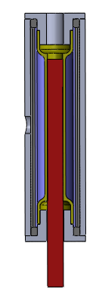
Cylindrical Filter Concepts
Trade-off Study (1 = Bad & 5 = good)
Concept | Risk | Dev. Cost | Man. Cost | Performance | Size | Total
Piston | 2 | 2 | 4 | 3 | 4 | 3.0
Bladder | 4 | 3 | 3 | 4 | 4 | 3.6
ID Heater | 1 | 2 | 4 | 4 | 4 | 3.0
Other
Bladder
ID Heater
Piston

Slide 28
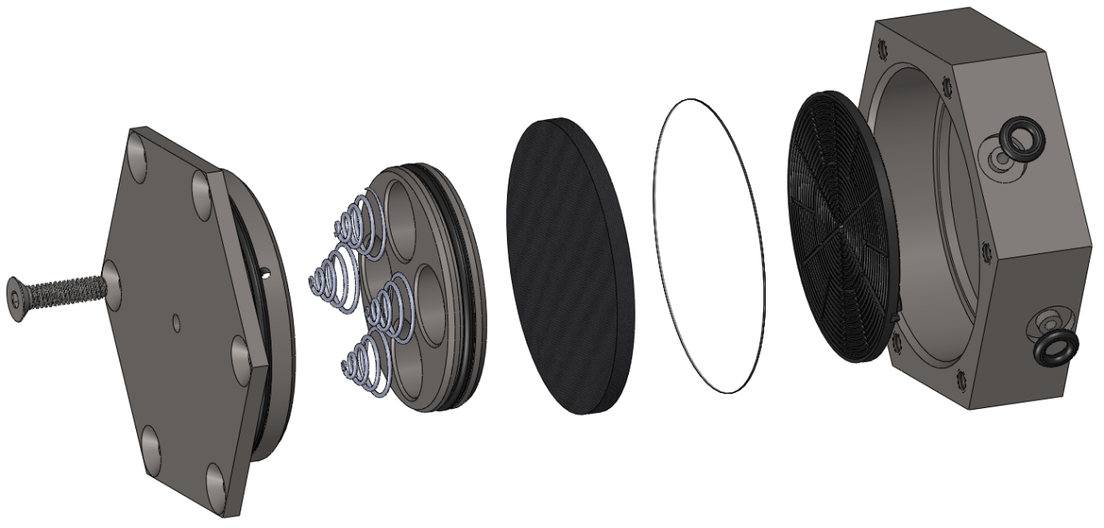
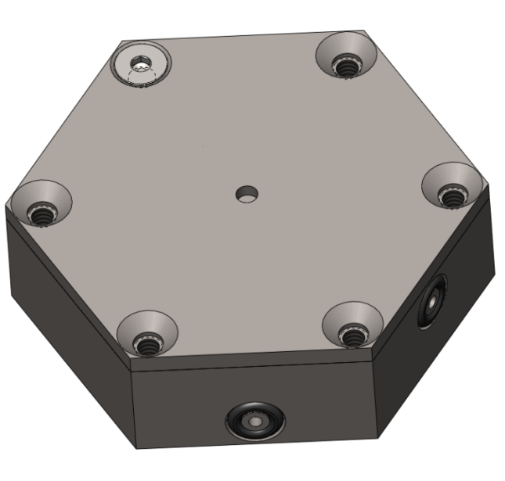
Puck Concepts
Concept #1 – Spring Loaded
  4 springs are used to evacuate the puck
Inlet
Outlet
Filter
Housing
Springs
Sintered Titanium Disk
Filter Support
Cover / Cylinder Bore
(metal)
Piston

Slide 29
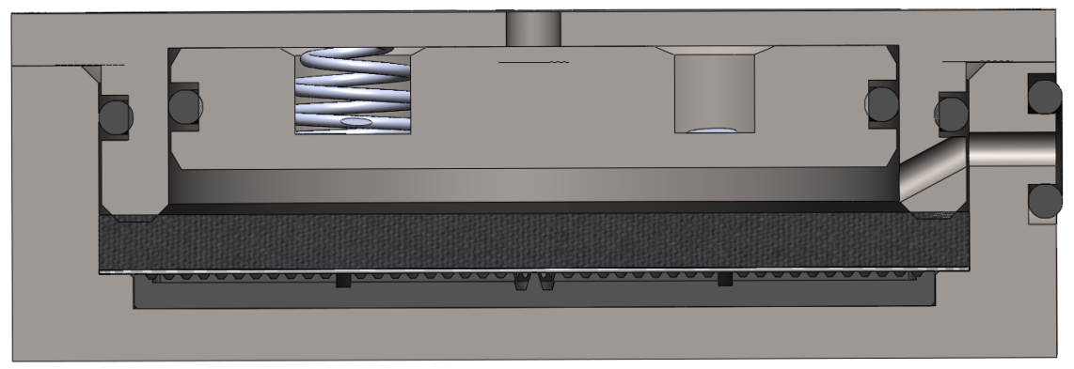
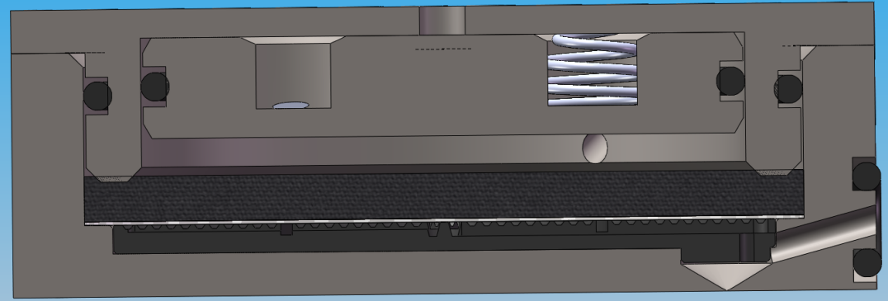
Puck Concepts
Concept #1 – Spring Loaded
  4 springs are used to evacuate the puck
  Internal pressure will be required to retract the piston
Inlet
Air Vent
Outlet

Slide 30
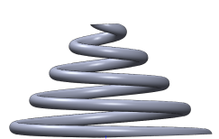
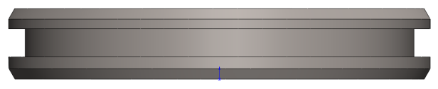
Puck Concepts
Concept #1 – Spring Loaded
  Spring calculations
F_{spring}
Friction = 1.8 lbs
F_{spring} = -kX*4
F_{friction}
F_{friction}
F_{spring} = 3 lbs
(assuming 3 pound spring force to overcome friction and pump pressure of 60 psi)
X
K = 14.7 lbs/in
Pressure
X = 0.051 in

Slide 31
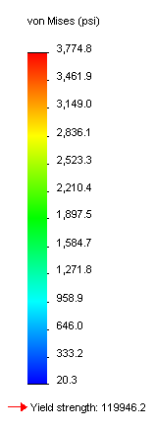
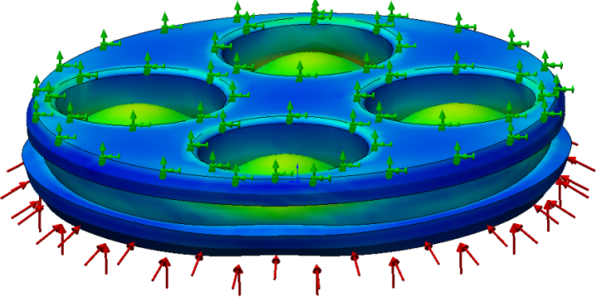
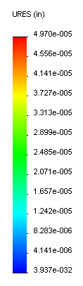
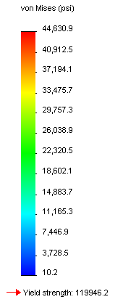
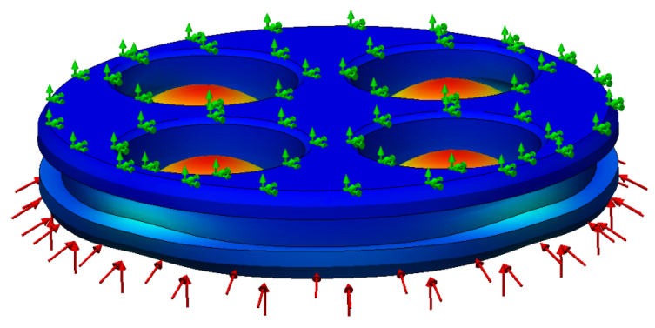
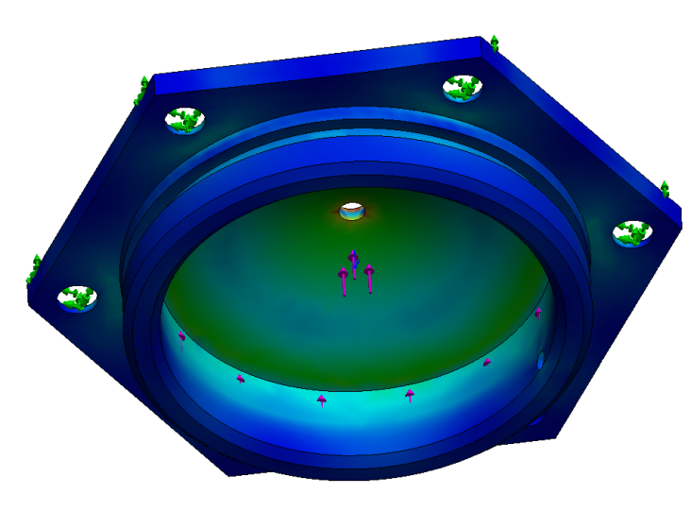
Puck Concepts
Concept #1 – Spring Loaded – FEA Analysis
  Boundary Conditions
    Fixed outer sealing surface
    400 PSI
    Material – Titanium
  Results
    Max stress = 3,775 psi
      Yield stress = 119,946 psi
    Max Displacement = 4.97 x 10^-5 in
Fixed Surface
400 PSI

Slide 32
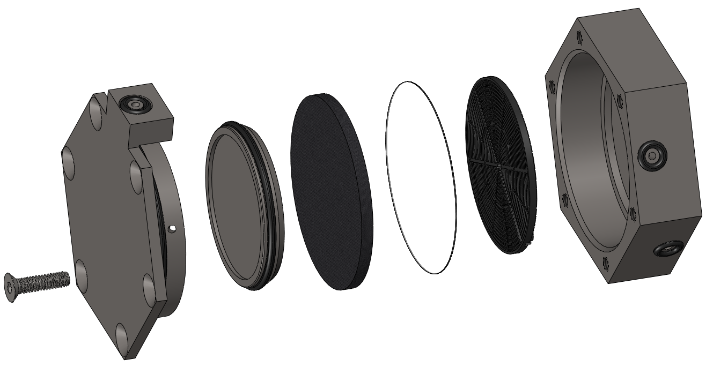
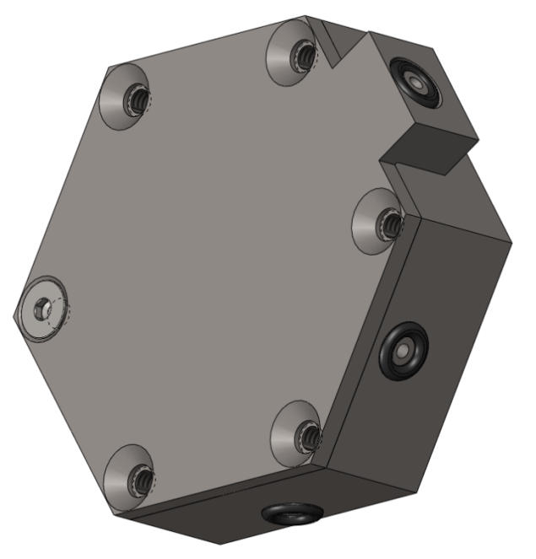
Puck Concepts
Concept #2 – Hydraulic Drive
  Syringe supplies hydraulic pressure to evacuate
Inlet
Hydraulic Inlet
Outlet
Filter
Sintered Titanium Disk
Housing
Cover / Cylinder Bore
(metal)
Piston
Filter Support

Slide 33
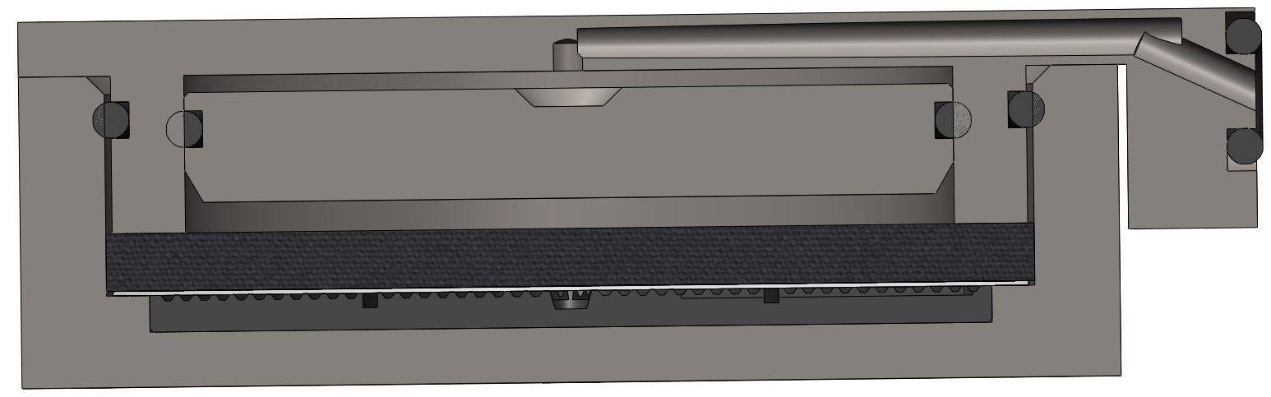
Puck Concepts
Concept #2 – Hydraulic Drive
  Syringe supplies hydraulic pressure to evacuate
Hydraulic Chamber
Hydraulic Inlet
(idealized to show concept)

Slide 34
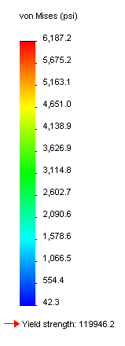
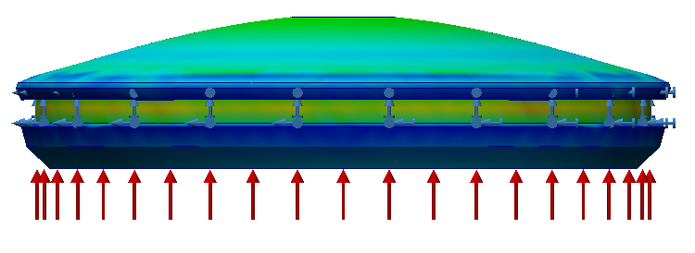
Puck Concepts
Concept #3 – Hydraulic Drive – FEA Analysis
  Boundary Conditions
    Fixed outer sealing surface
    400 PSI
    Material – Titanium
  Results
    Max stress (Piston) = 6187 psi
      Yield stress = 119,946 psi
    Max Displacement = 2.8 x 10^-6 in
Fixed Surface
400 PSI

Slide 35
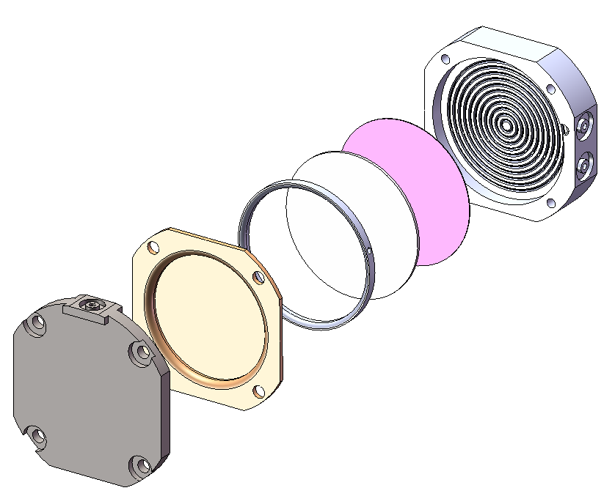
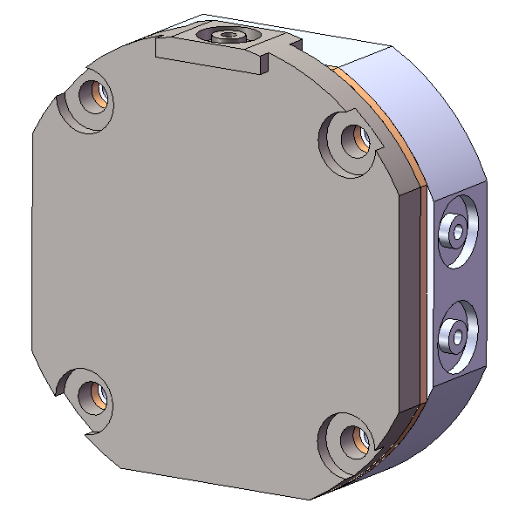
Puck Concepts
Concept #3 – Diaphragm
  A diaphragm is used to evacuate the puck
  Like a diaphragm pump
  Key advantage is a plastic housing to reduce heat loss
Housing
(plastic)
Filter #2
Syringe Port
Spacer
Cover
(metal)
Inlet
Outlet
Filter #1
Diaphragm

Slide 36
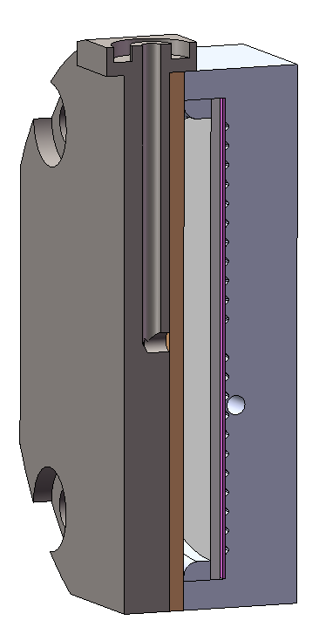
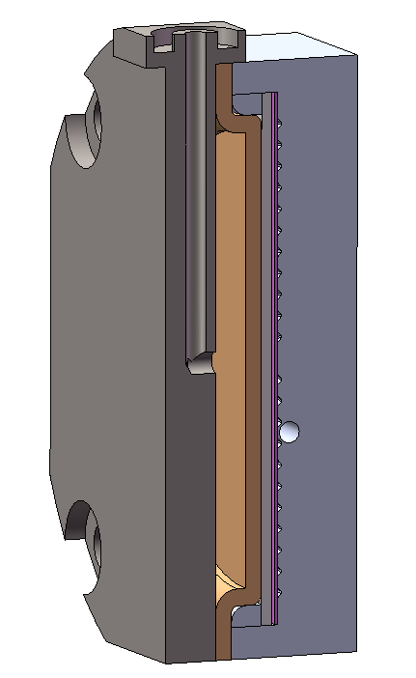
Puck Concepts
Concept #3 – Diaphragm
Syringe Port
Spacer
Filter #1
Filter #2
Housing
(plastic)
Cover
(metal)
Outlet
Drain mesh is a
part of the plastic
Diaphragm
Retracted
Diaphragm
Evacuated

Slide 37
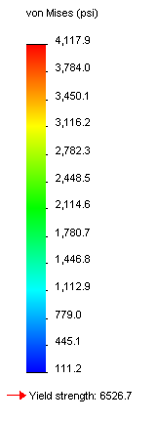



Puck Concepts
Concept #3 – Diaphragm – FEA Analysis
  Boundary Conditions
    Fixed outer sealing surface
    400 PSI
    Material – Acrylic
  Results
    Max stress = 4,200 psi
      Yield stress – 6,500 psi
    Max Displacement = .006” (150um)
Fixed Surface
400 PSI

Slide 38

Puck Concepts
Concept #3 – Diaphragm
  Test prototype overview
  The concept works! – see demo
Evacuate Syringe
Diaphragm
Puck
Outlet Tubing
Supply Syringe

Slide 39



Puck Concepts
Trade-off Study
Concept | Risk | Dev. Cost | Man. Cost | Performance | Size | Heat Power | Total
Spring | 4 | 4 | 3 | 4 | 3 | 3 | 3.5
Hydraulic | 3 | 3 | 2 | 3 | 2 | 2 | 2.5
Diaphragm | 4 | 4 | 4 | 4 | 4 | 4 | 4.0
Other
Spring
Hydraulic
Diaphragm

Slide 40

Cartridge Concept Review
Concept #1 – Rotary Puck Valve
  Fixed syringes for reagent and evacuation
  Check valves to limit backflow
  Rotary puck selects sea water vs. regents
Integrated
Syringes for
all Reagents
Puck Rotates
To select inputs

Slide 41

Integrated Cartridge Concepts
Concept #2 – Stationary Puck
  “L” bracket holds puck into position (alt. solutions possible)
  Syringe is ported into diaphragm
3 Reagent
Syringes
Diaphragm
Syringe Drive
Valve Plunger
Diaphragm
Puck
Inlet
“L” Clamp
Outlet

Slide 42


Integrated Cartridge Concepts
Concept #2 – Stationary Puck
  Section View
Diaphragm
Port
Inlet
Outlet
Puck Interface

Slide 43


Integrated Cartridge Concepts
Concept #3 – Cylindrical Filter
  Designed with a cylindrical filter
Bladder
Syringe Drive
Cylindrical
Filter
Sea Water
Outlet
Sea Water
Inlet
Cylindrical
Filter with
Syringe Plunger
Bottom Clamp
Test Sample
Outlet

Slide 44



Integrated Cartridge Concepts
Syringe Filter Concept Details
Piston
Bladder
Piston
Syringe
body
Syringe
body
O-ring
O-ring
Backing
Bladder
Housing
Housing
Outlet
Filter
O-ring
O-ring
Plug
Plug
Inlet

Slide 45

Integrated Cartridge Concepts
Concept #3 – Cylindrical Filter
  Design Details
Reagent
Syringe
Side Cover Plate
Sea Water
Outlet
Sea Water
Inlet
Bottom Cover Plate
Test Sample
Outlet

Slide 46


Integrated Cartridge Concepts
Concept #3 – Cylindrical Filter
  Fluid Flow
Reagent
Flow
Sea Water
Outlet
Sea Water
Inlet
Test Sample
Outlet
Sea Water Flow
Reagent & Sample Flow

Slide 47


Integrated Cartridge Concepts
Concept #4 – Hybrid Concept
  Designed with a cylindrical filter & puck filter
  Flow thru first filter could be in parallel or series
2 Reagent
Syringes
Diaphragm
Syringe Drive
Valve Plunger
Cylindrical
Filter
Diaphragm
Puck
Sea Water
Inlet
Sea Water
Outlet
“L” Clamp
Test Sample
Outlet
Bottom Clamp

Slide 48




Integrated Cartridge Concepts
Trade-off Study
Concept | Risk | Dev. Cost | Man. Cost | Performance | Heating | Total
Rotary Puck | 2 | 2 | 3 | 2 | 2 | 2.2
Stationary Puck | 4 | 4 | 4 | 3 | 3 | 3.6
Cylindrical Filter | 1 | 3 | 4 | 3 | 5 | 3.2
Hybrid | 4 | 3 | 3 | 5 | 3 | 3.6
Rotary Puck
Stationary Puck
Cylindrical Filter
Hybrid

Slide 49
Open Items
Heater Selection
Temperature Sensor
Thermal Control Concept

Slide 50
Recommendations
Select one or two filter designs to move into proof of concept development targeted towards lab oriented testing.
Select one or two cartridge designs to move into proof of concept development
Upon completion of lab testing, select final design for Phase 2 development

Slide 51
Phase 2 Plans Discussion
Goals
  Update requirements
    Select a position for the analysis outlet port
    Define actuator requirements
  Develop a detailed specification
  Develop a detailed design
  Develop TBD # of working prototypes
Timeline
  Week or months

