Slide 1

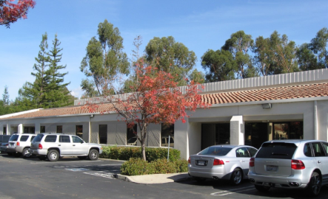
Cartridge and Filter Project
Mission
Our mission is to provide clients throughout the world with product development for medical, diagnostic, biodefense and biotech products. Accel’s skilled team of engineers, designers and technicians will work together to provide services from concept to development to manufacturing support
Date: 04-12-13
By: Accel Biotech Team

Slide 2
Agenda
Action Items Review
Phase 2 Review
Requirements
Design Review
Materials Requested
Schedule Review

Slide 3
Action Items
Open Items
Accel | MBARI
Generate Requirements | Fill In Requirements Gaps
Send Requirements Questions | Deliver Materials
Send Materials Request
Closed Items
Accel
Phase 1
MBARI
Phase 1

Slide 4
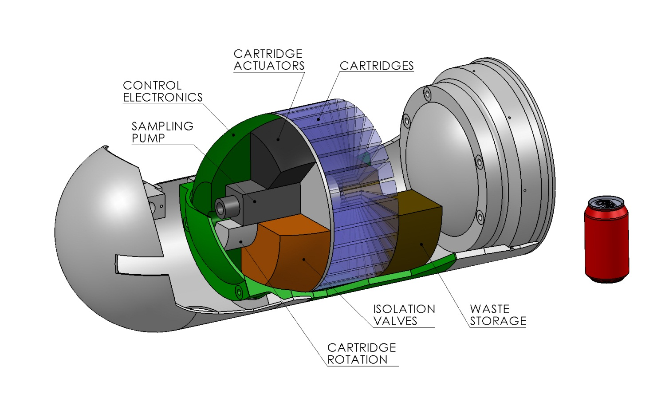
MBARI ESP G3 Concept

Slide 5
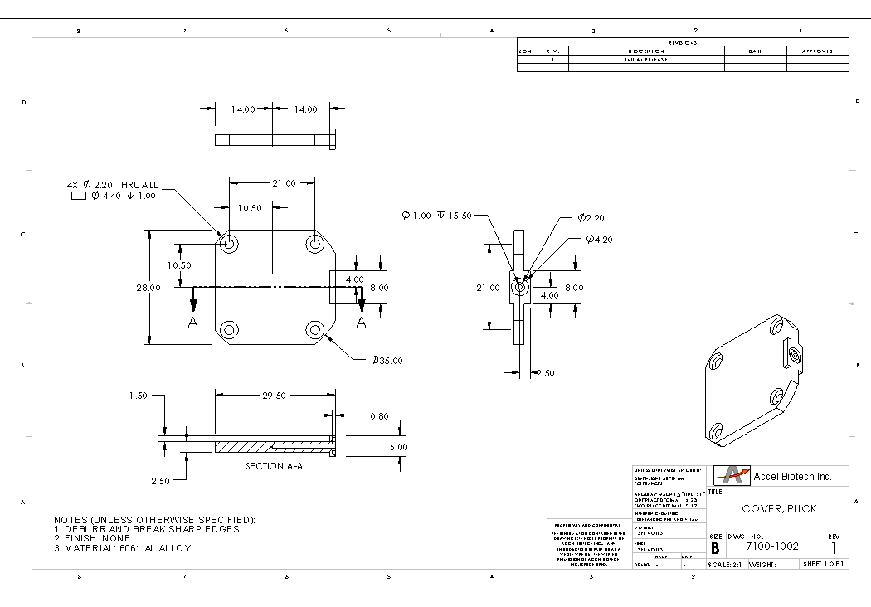
Phase 2 – Key Tasks
  Specifications
  Mechanical
    Puck Filter Design
    Cartridge Filter Interface
    Cylindrical Filter Design
  FEA Analysis
  Drawings
  Design Review
  Procure Parts
  Assembly and Test
  Iterate Design
  Final Assemble and Test
  Review Meetings

Slide 6
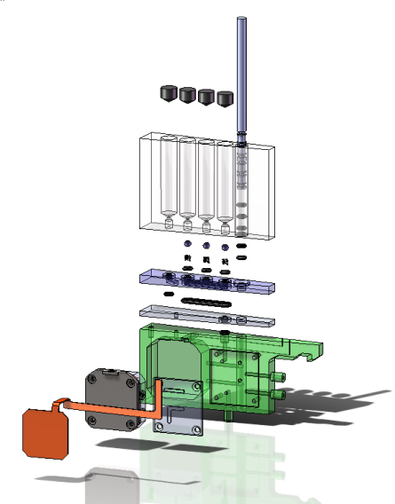
Phase 2 - Deliverables
Mechanical CAD Design and Drawings
  Filter Puck Design & Test Fixture
  Cartridge Design using the Filter Puck
  Cylindrical Filter Design & Test Fixture
BOM – A Bill of Materials for the filters and cartridge
5 Puck Prototypes w/ test fixture
5 Cartridges (used with the puck)
5 Cylindrical Filters w/ test fixture
          ETD: 5-8 Weeks

Slide 7
MBARI Tech Specifications
ESP Platform in a Nose Cone for deployment
  11.125” x 24” (the total system) but scalable, modular
  30 degree deviations from normal
  14v, ?amp, ?watts ->Will be a power budget
  0-300m depths, 15psi-450psi plus pump pressure
  0 -50 C inactive, 2-40 C active
  3g acceleration inactive, 0.5g active (plus 1g rolls)
Interface Specifications -TBD
  Port Size
  Etc.
  PCB Could be the Cartridge Mount

Slide 8
MBARI Tech Specifications
Genetic Marker Classification (algae, bacteria, viruses, invertebrate larvae, biotoxins) – Nucleic Acid Prep
  30 Samples, 30 Archive
  Save sample before and after lysis
  Expression and translation of specific genes
  mRNA, DNA
  2ml-2L of raw seawater @ rates of 1L/hr using 0.2 um filters
  Exclude particles larger than 0.5mm
  Variable filter (two types)
  300-500 ul lysate (30 minute processing)
  6 Reagents (max 4 per cartridge)

Slide 9
Definitions
Cassette: See Cartridge
Cartridge: The removable collection device comprised of a selection of: filter holders, media, reagents, heater, and associated items
Filter: The filter assembly including the media support and pressure vessel
Spool Valve: Seawater valve outboard of the Cartridge
Plunge Valve: Selector valve onboard the cartridge
Filter Media: Any material inserted into a filter for the purpose of isolating sample material
Archive: A filter or cartridge designed exclusively to collect and preserve sample material at ambient temperature
Lyse N’ Go: A filter or cartridge designed to perform real-time sample prep on collected material.
Length – The distance from the top of the cartridge at the piston-actuator interface to the waste port
Thickness – The width of the cartridge (dependent on 6 degree angle and radial distance)
Radial Depth – The height from cartridge turret interface out normal to the turret interface

Slide 10
Overall Requirements
Physical Space Constraints
  General (not including the hook)
    Cartridge Angle – 6 ° (60 total)
    Length: 91.25mm
    Radial Depth: 68.38mm
    Thickness: 14.48mm
Fluid Volumes
  Filter Receptacle – 1ml +/- 5%
  Reagent Volume per 1 Syringe – 1ml +/- 5%
Dispense Range
  0.1 -1 ml target 1% precision
Port Locations
  See Envelope Drawing

Slide 11
Puck Filter Requirements
Envelope for Filter Media
  Thickness: 2.30mm
  Diameter: 25.40mm
Dead Volume for residual seawater: 5% or less of Lysate
Filter Thicknesses Options:
  1.3 – 1.5 mm?
  .3 – .5 mm?
Port Size
  In: 1.59mm
  Out: 1.35mm
Materials
  Top: Titanium (Grade 2)
  Base: Polycarbonate
  Diaphragm: Silicone Rubber
  Spacer Ring: Titanium (Grade 2)
  O-rings: Buna or Viton

Slide 12
Cylindrical Filter Requirements
Filter Surface Area: >0.785 in^2
Dead Volume for residual seawater: 5% or less of Lysate
Filter Thickness: <1mm
Materials
  Body - Stainless Steel 316 (Titanium Grade2)
  End Caps - Stainless Steel 316 (Titanium Grade2)
  Filter Frame - Stainless Steel 316 (Titanium Grade2)
  Filter Media – Varies
  Balloon - Silicone Rubber
  O-rings: Buna or Viton

Slide 13
Archive Cartridge Reqs.
Separate from lysis
1 out port
3 Reagents
Waste on board option

Slide 14
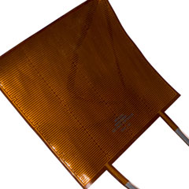
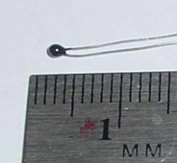
Lyse’NGo Cartridge Reqs.
Heating
  Reach 85 °C in less than X min? Preheat?
  Watlow Polyimide Heater
    5W/in^2
    0.2mm Thick
PCB Mounting
3 Reagent Syringes
1 Diaphragm Actuation Syringe
Heater
Bead Thermistor

Slide 15
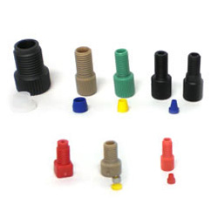
Test Bed Reqs.
Connection Types
  Upchurch ¼-28 Flat Bottom
Manual Fluid Metering
Manual Evacuation
Heating
  Heater and sensor onboard
    Heater: Watlow #K010010C5-0009B
    Sensor: Oven Industries# TR91-1
  External controller (provided by MBARI)
    Recommended Controller: Oven Industries# 5R7-001
Pressure Limit = 90psi (Accel), 450psi (MBARI)

Slide 16
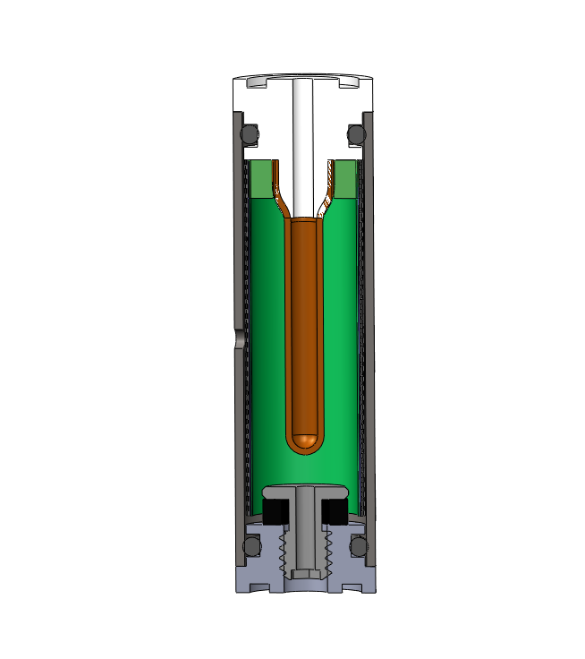
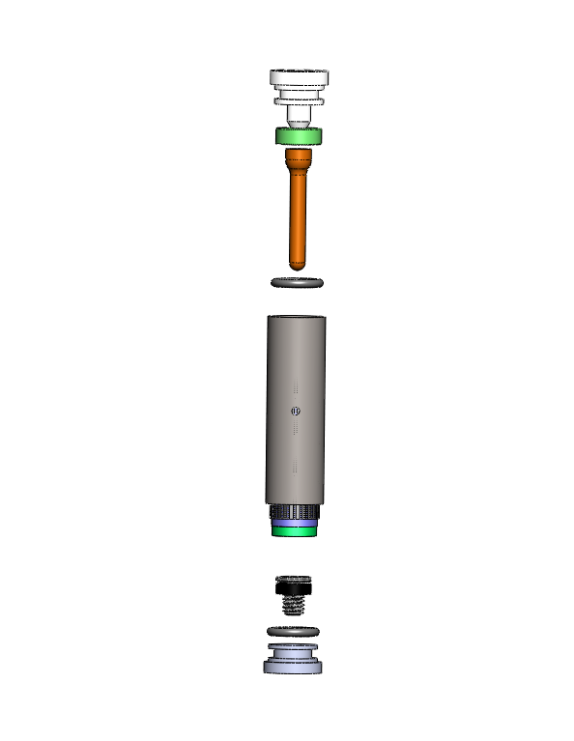
Mechanical Design Review
Cylindrical Filter
Front Plug
Balloon
Balloon Clamp RING
O-Ring
Housing
Mesh Screen
Filter 1
Screw Clamp
Filter 2
Rubber Ring
O-Ring
Rear Plug

Slide 17
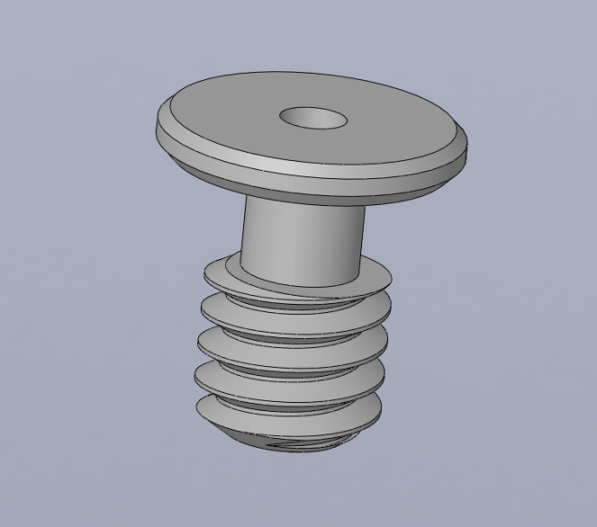
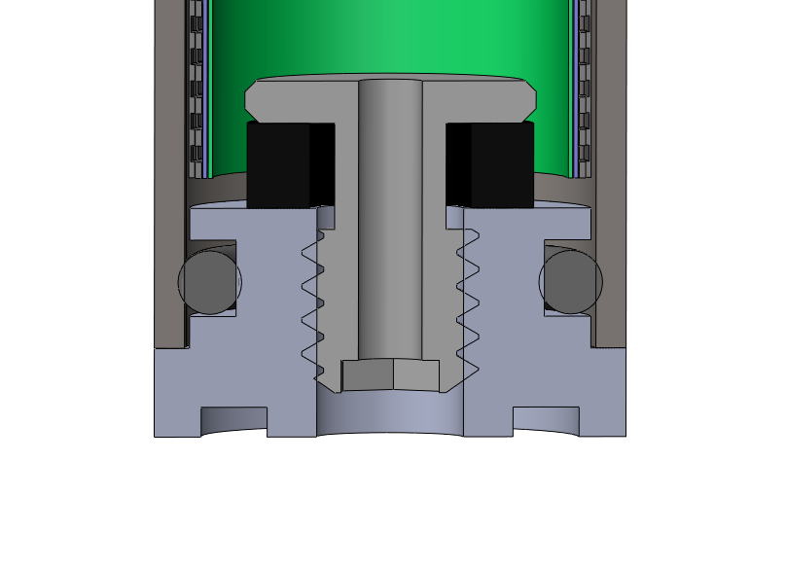
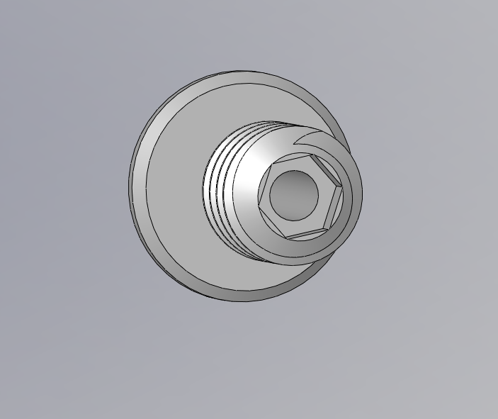
Mechanical Design Review
Tighten the screw to expand
rubber ring to hold filters in place
Modified 8/32 screw hex on the bottom

Slide 18
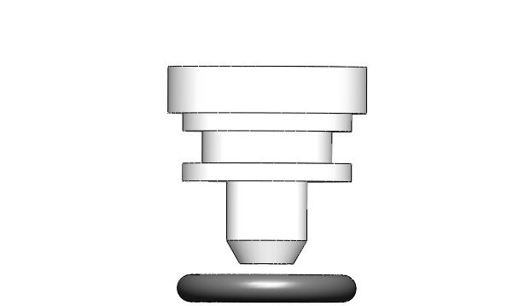
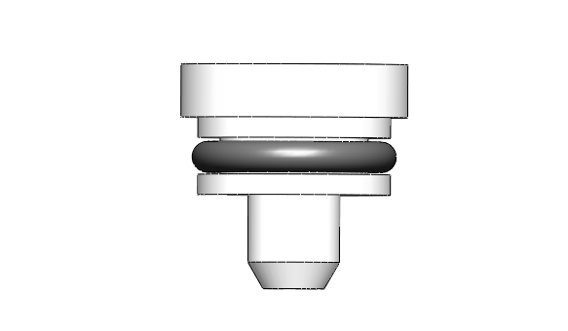
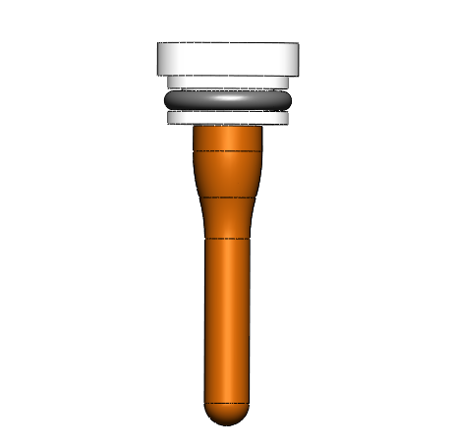
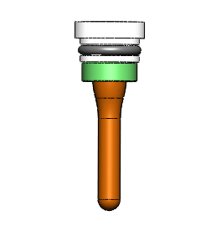
Mechanical Design Review
Proposed Assembly
Start with Front Plug

Slide 19
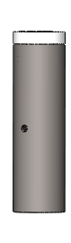
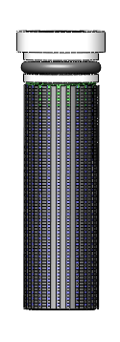
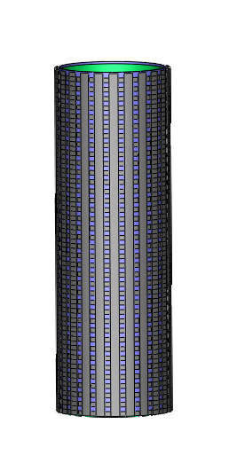
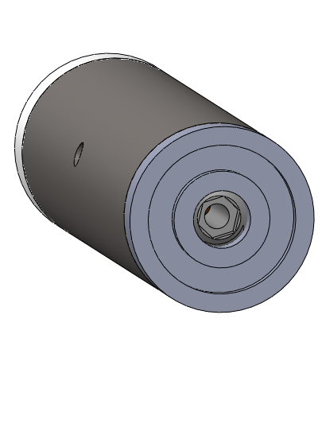
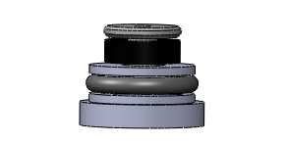
Mechanical Design Review
Proposed Assembly
Tighten the hex screw to expand and seal rubber ring
Pre-Assemble Mesh Screen with Filters

Slide 20
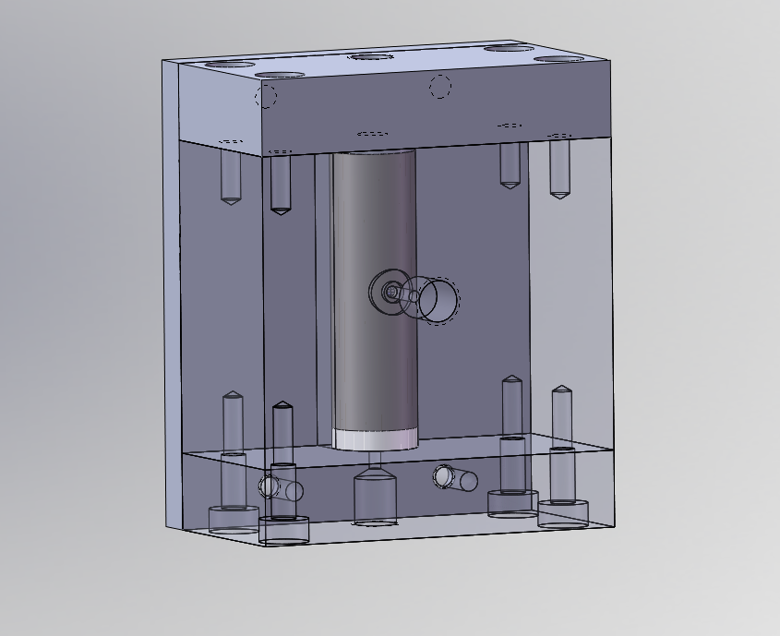
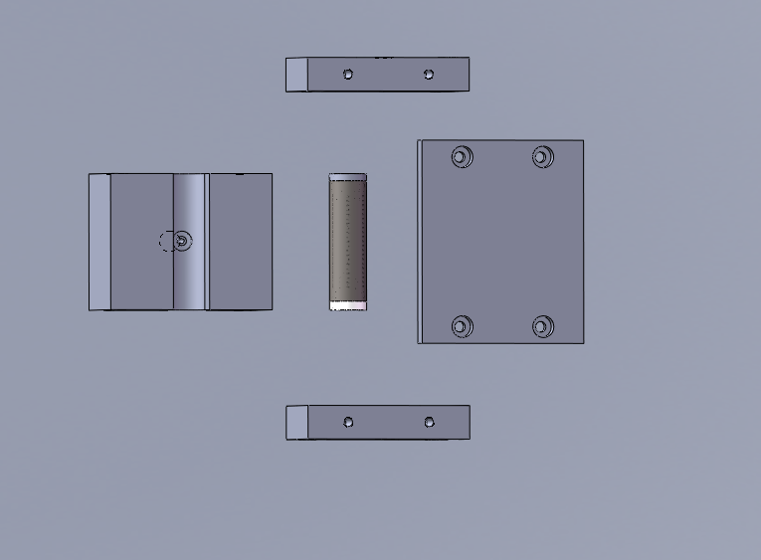
Test Bed -Cylinder
Upchurch ¼-28 fitting for balloon expansion, inlet and outlet
Buna O-rings for sealing
Top Plate
Cover
Cylinder Block
Bottom Plate

Slide 21
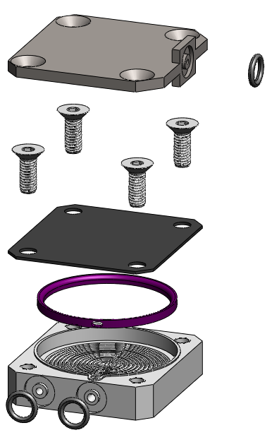
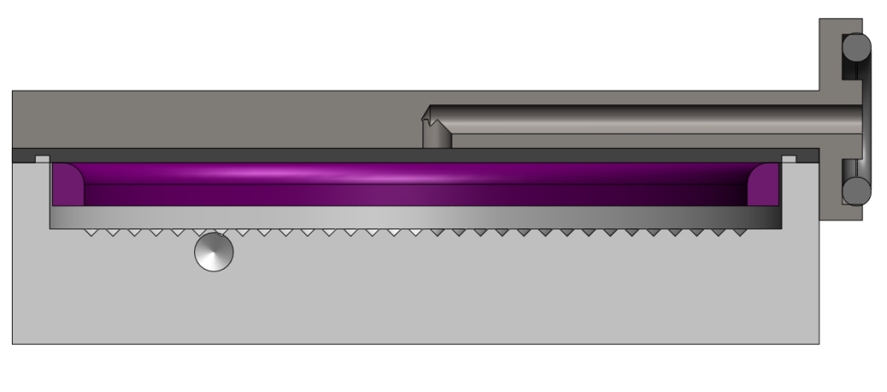
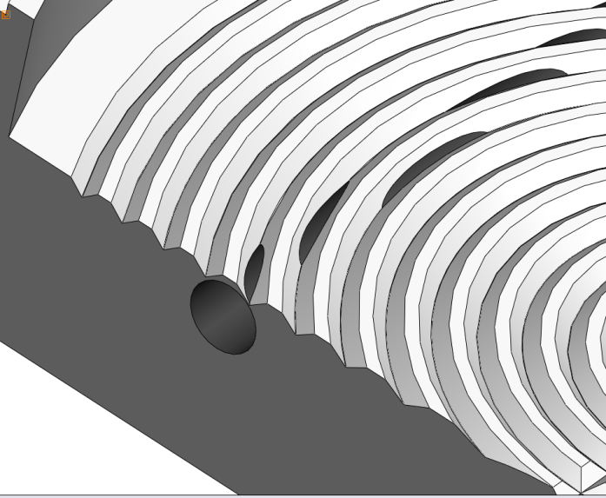
Puck Filter
Filter Media Space
Spacer (multiple sizes depending on media)
Fluid Exit Path

Slide 22
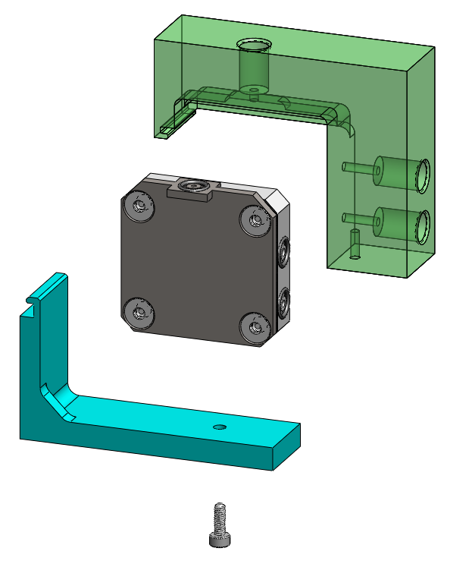
Puck Test Bed
Housing
¼-28 Upchurch
Puck w/ no modifications
Clamp

Slide 23
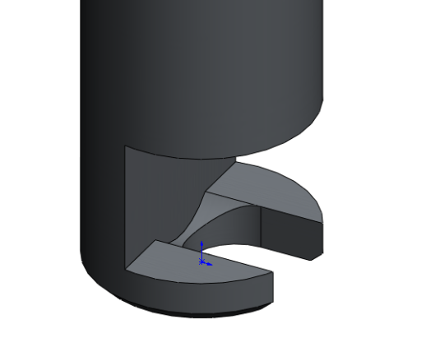
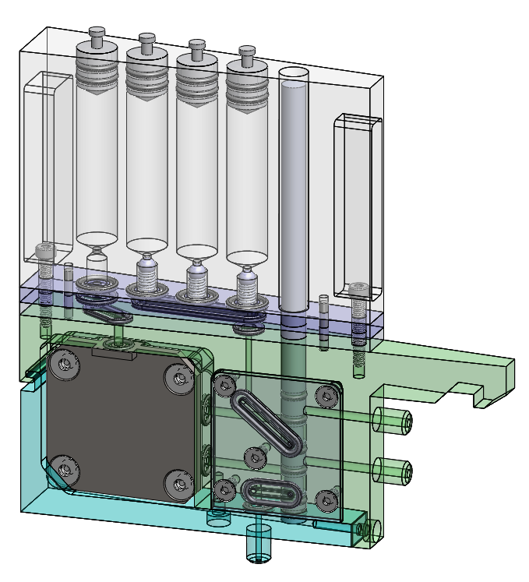
Cartridge
Push/Pull Plungers
Actuator Example
Dowel Pins for Location
Sea Water In
Sea Water Out
Clamp
Waste

Slide 24
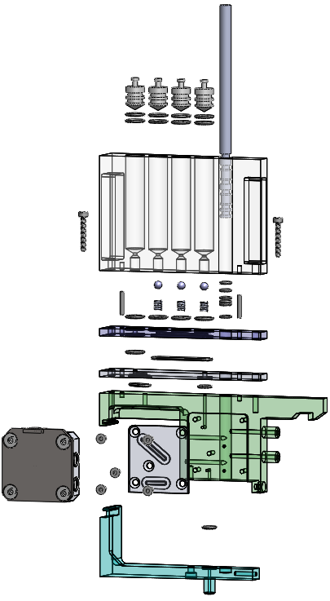
Cartridge

Slide 25
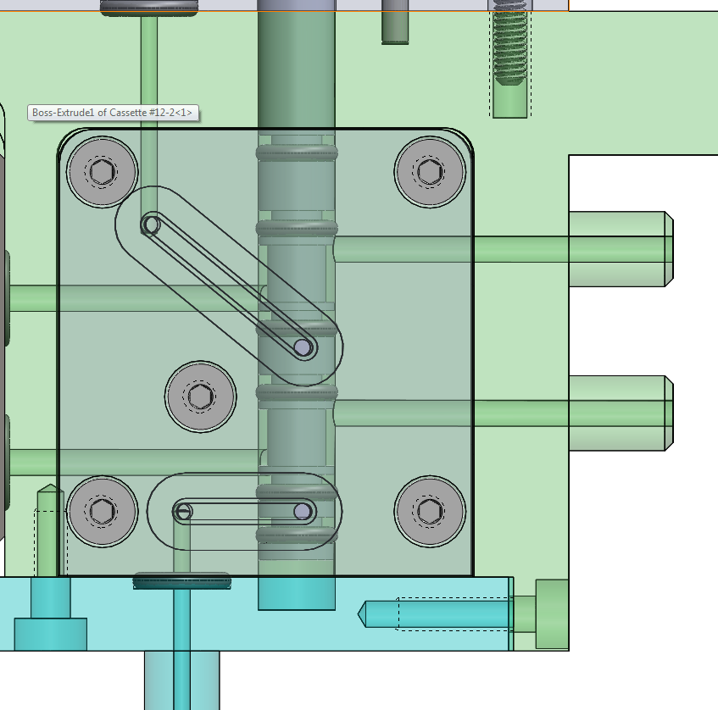
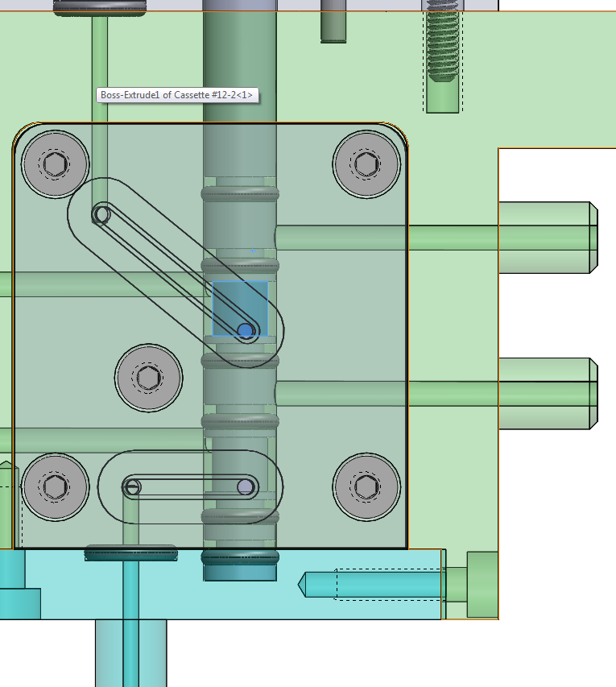
Valving
Filtering Position
Processing Position

Slide 26
Test Materials
Filters
  Sintered Titanium
  25mm disks of 2G (3 of each)
Salt water
  Seachem or equivalent
  Unfiltered seawater
Fresh water
  Tap water
  Vasona Lake algae bloom water sample

Slide 27
Schedule Review
Project Gantt Chart
  Project is on schedule

