Slide 1
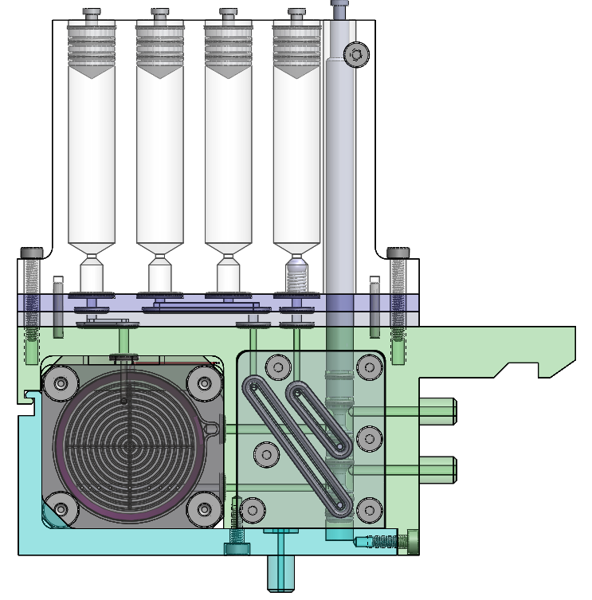
Archive Cartridge Overview
Reagent Syringe
Evacuation Syringe
Plunge Valve
Storage Syringes
Syringe Manifold
Cartridge Manifold
Filter Puck
Sea Water In
Sea Water Out
Manifold Plate
Sample Out Port

Slide 2
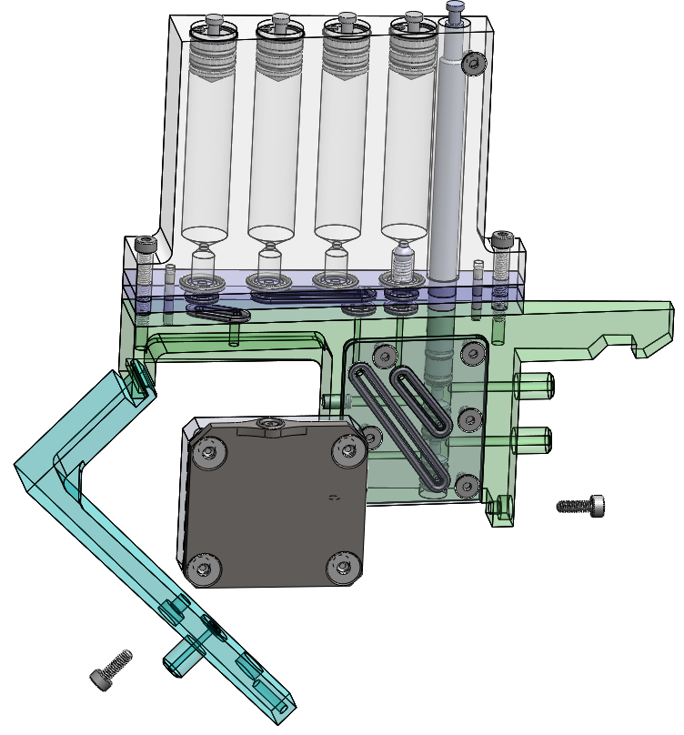
Archive Cartridge Overview

