Slide 1
3G ESP
General Overview of Cartridges
Archive and Lyse-n-Go
MBARI, Monterey Bay Aquarium Research Institute
2019 MBARI, Confidential Information

Slide 2
3G ESP Overview
Archive
(add preservative,
bring home)
Sampling
(filter water)
Process
Hand-off
Send Results Home
Analyze
(create
homogenate)
Analytical Module
Cartridge
3G ESP Sampler
2019 MBARI, Confidential Information
Notes:
Points
1. First part: focus on the cartridge.
2. Each cartridge is specialized. Allows the user to develop own pathway. Process from encompassing filtration, and processing all on board.

Slide 3
Archive Process
Water Sample:
Concentrate Particulates
Preserve Sample
Requirements
  Pressure range 0-500 psi
  Temperature 3C – 30C
  Multiple 25 mm filter porosities/types
    30 µm – 0.1 µm
  Chemicals: seawater, freshwater, 10% bleach, 10% HCl, silicone oil
  Deliver fixative across/through whole filter (No bubbles)
2019 MBARI, Confidential Information

Slide 4
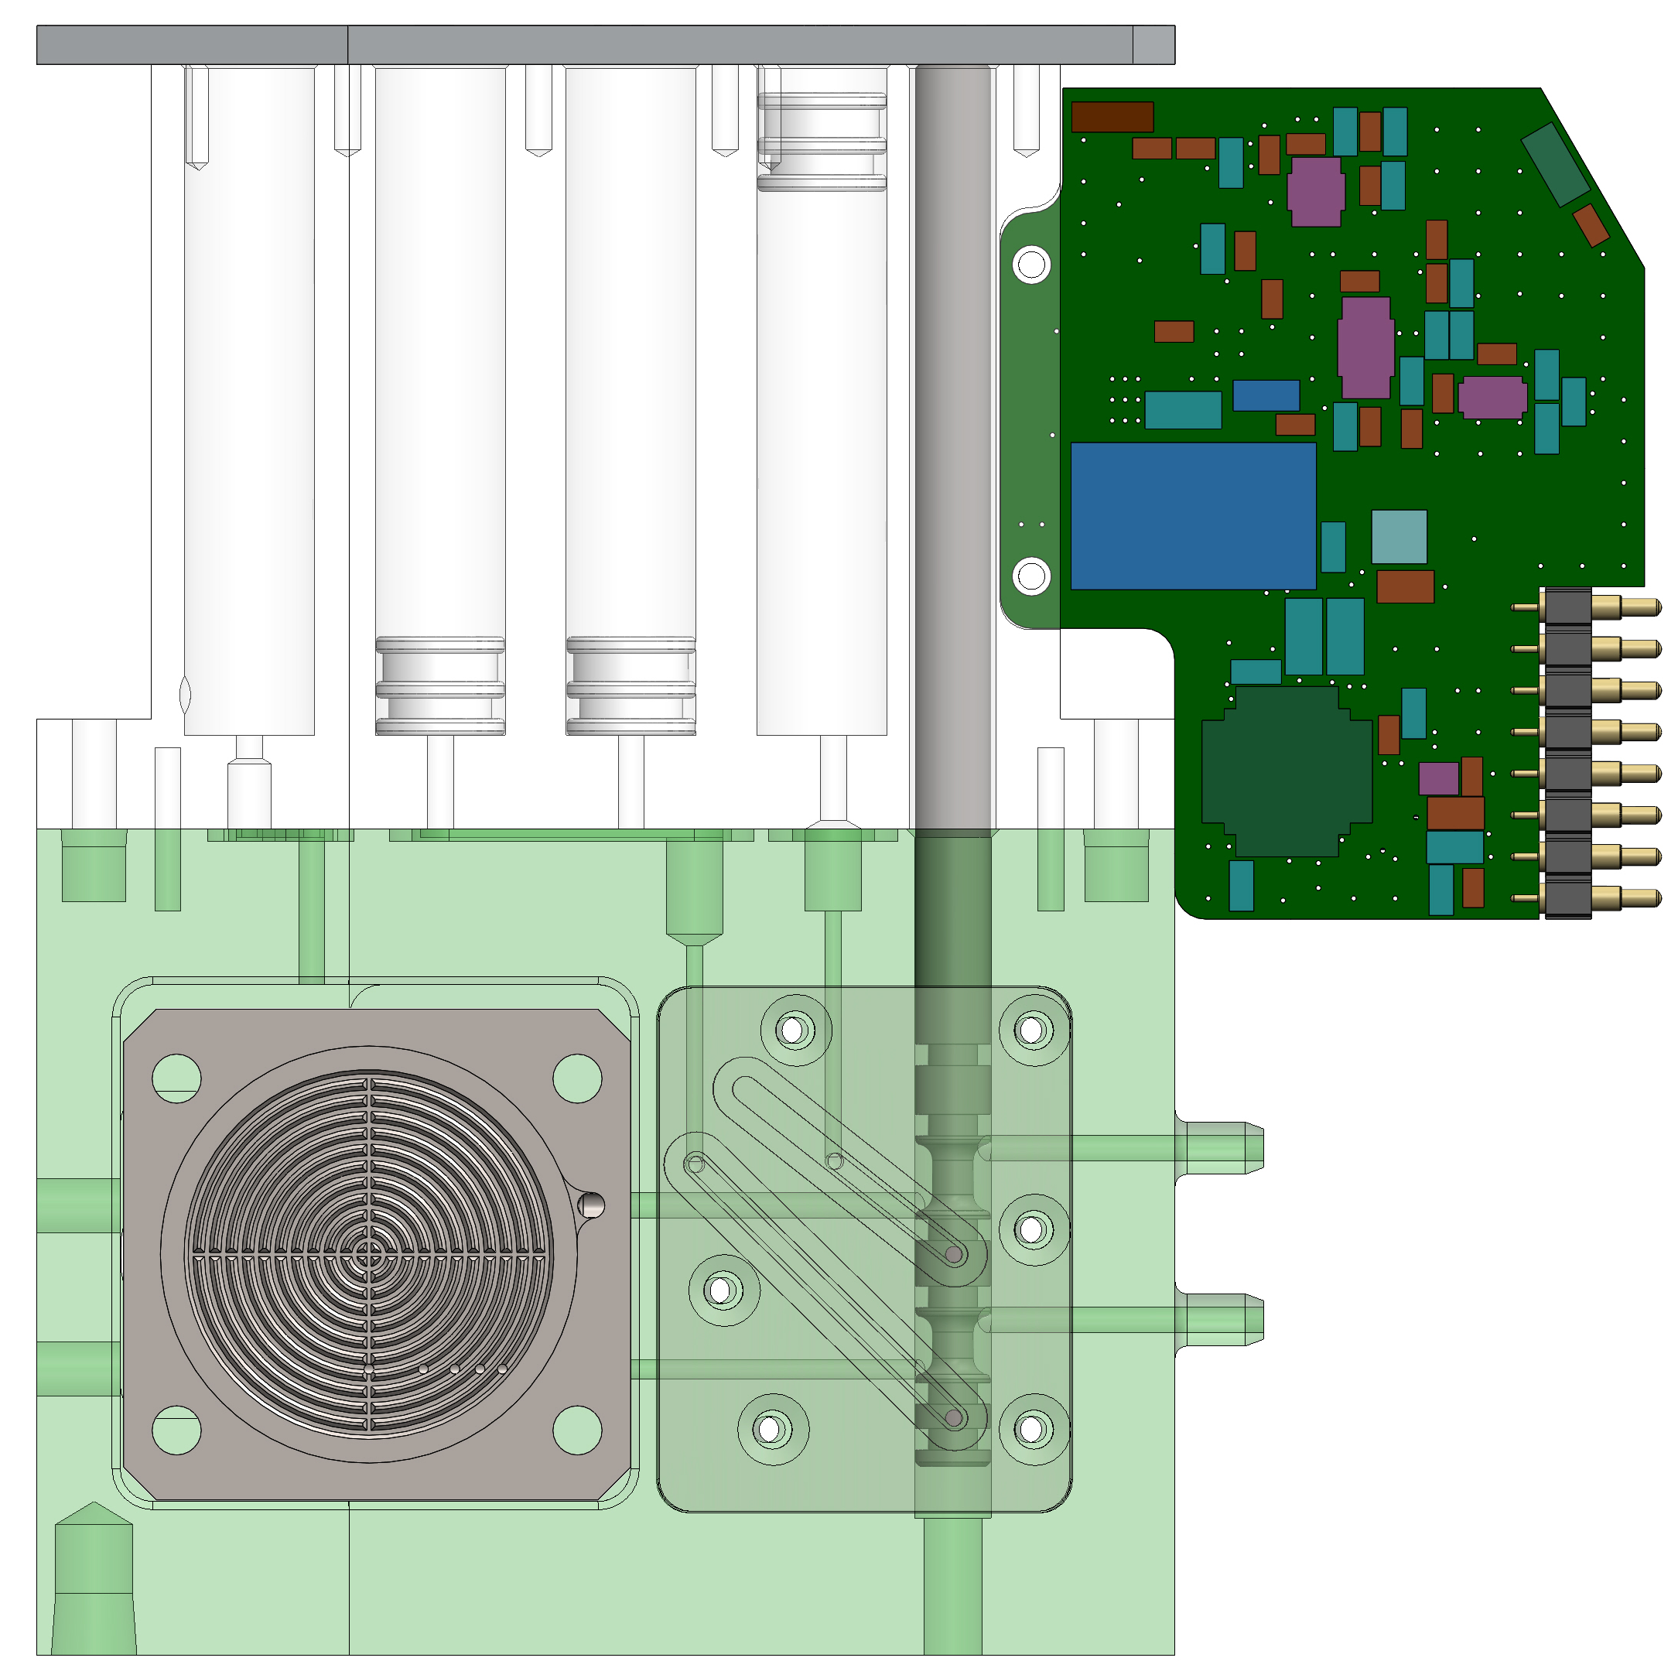
Archive Cartridge -- Features
Actuator Rods
Actuator Rod (magnetic)
Actuator Rod (magnetic)
Actuator Rod
Connection to 3G core Sample Loop
5 Actuator Rods Actuate
  4 Syringes
  1 Valve (sample or reagent)
4 Syringes
  Reagent/Air or waste
Air Refill
Vent
3) Waste
2) Waste
Valve
4) Not in use
1) Preservative/Air
Vent
1/8” EPDM ball w/ spring (1.4lb/in)
1/8” EPDM ball w/ spring (10lb/in)
Filter
Connects to 3G Core Sample Loop
2019 MBARI, Confidential Information

Slide 5
Archive –
Water Filtration Concentrate Particulates
Actuator Rod
Sampling (surface to 300m)
  Test psi range 0-500 psi
  Multiple 25 mm filter porosities/types
  Sample path under vacuum in 3G/LRAUV.
  Sample enters top of filter first before full fluid path through cartridge is opened.
When sampling is complete move valve to reagent position.
Preservative (1.6ml)
Valve Sample Position
Water Sample in
Filter
Filtered water out
2019 MBARI, Confidential Information

Slide 6

Archive – Preserve Sample
Actuator Rod (magnetic)
Preservative pushed in and displaces the water to waste. Preservative reaches >95% concentration.
Incubate
Refill Syringe 1 with air and displace preservative
waste
Air
Preservative (1.6ml)
Valve Reagent Position
waste
Sample
Preserved
2019 MBARI, Confidential Information

Slide 7
Lyse-n-Go Process
Off Cartridge analysis. May involve dilution with reagent(s).
Water Sample:
Concentrate Particulates
Evacuate Water
Add Lysis Buffer and Heat
Recover Extract
Requirements
  Pressure range 0-500 psi
  Temperature 3C – 30C
  Multiple 25 mm filter porosities/types
    30 µm – 0.1 µm
  Chemicals: seawater, freshwater, 10% bleach, 10% HCl, silicone oil
  Deliver lysis buffer and recover cell lysate.
  Perform dilution
  Deliver a bubble free extract off cartridge for analysis.
2019 MBARI, Confidential Information

Slide 8
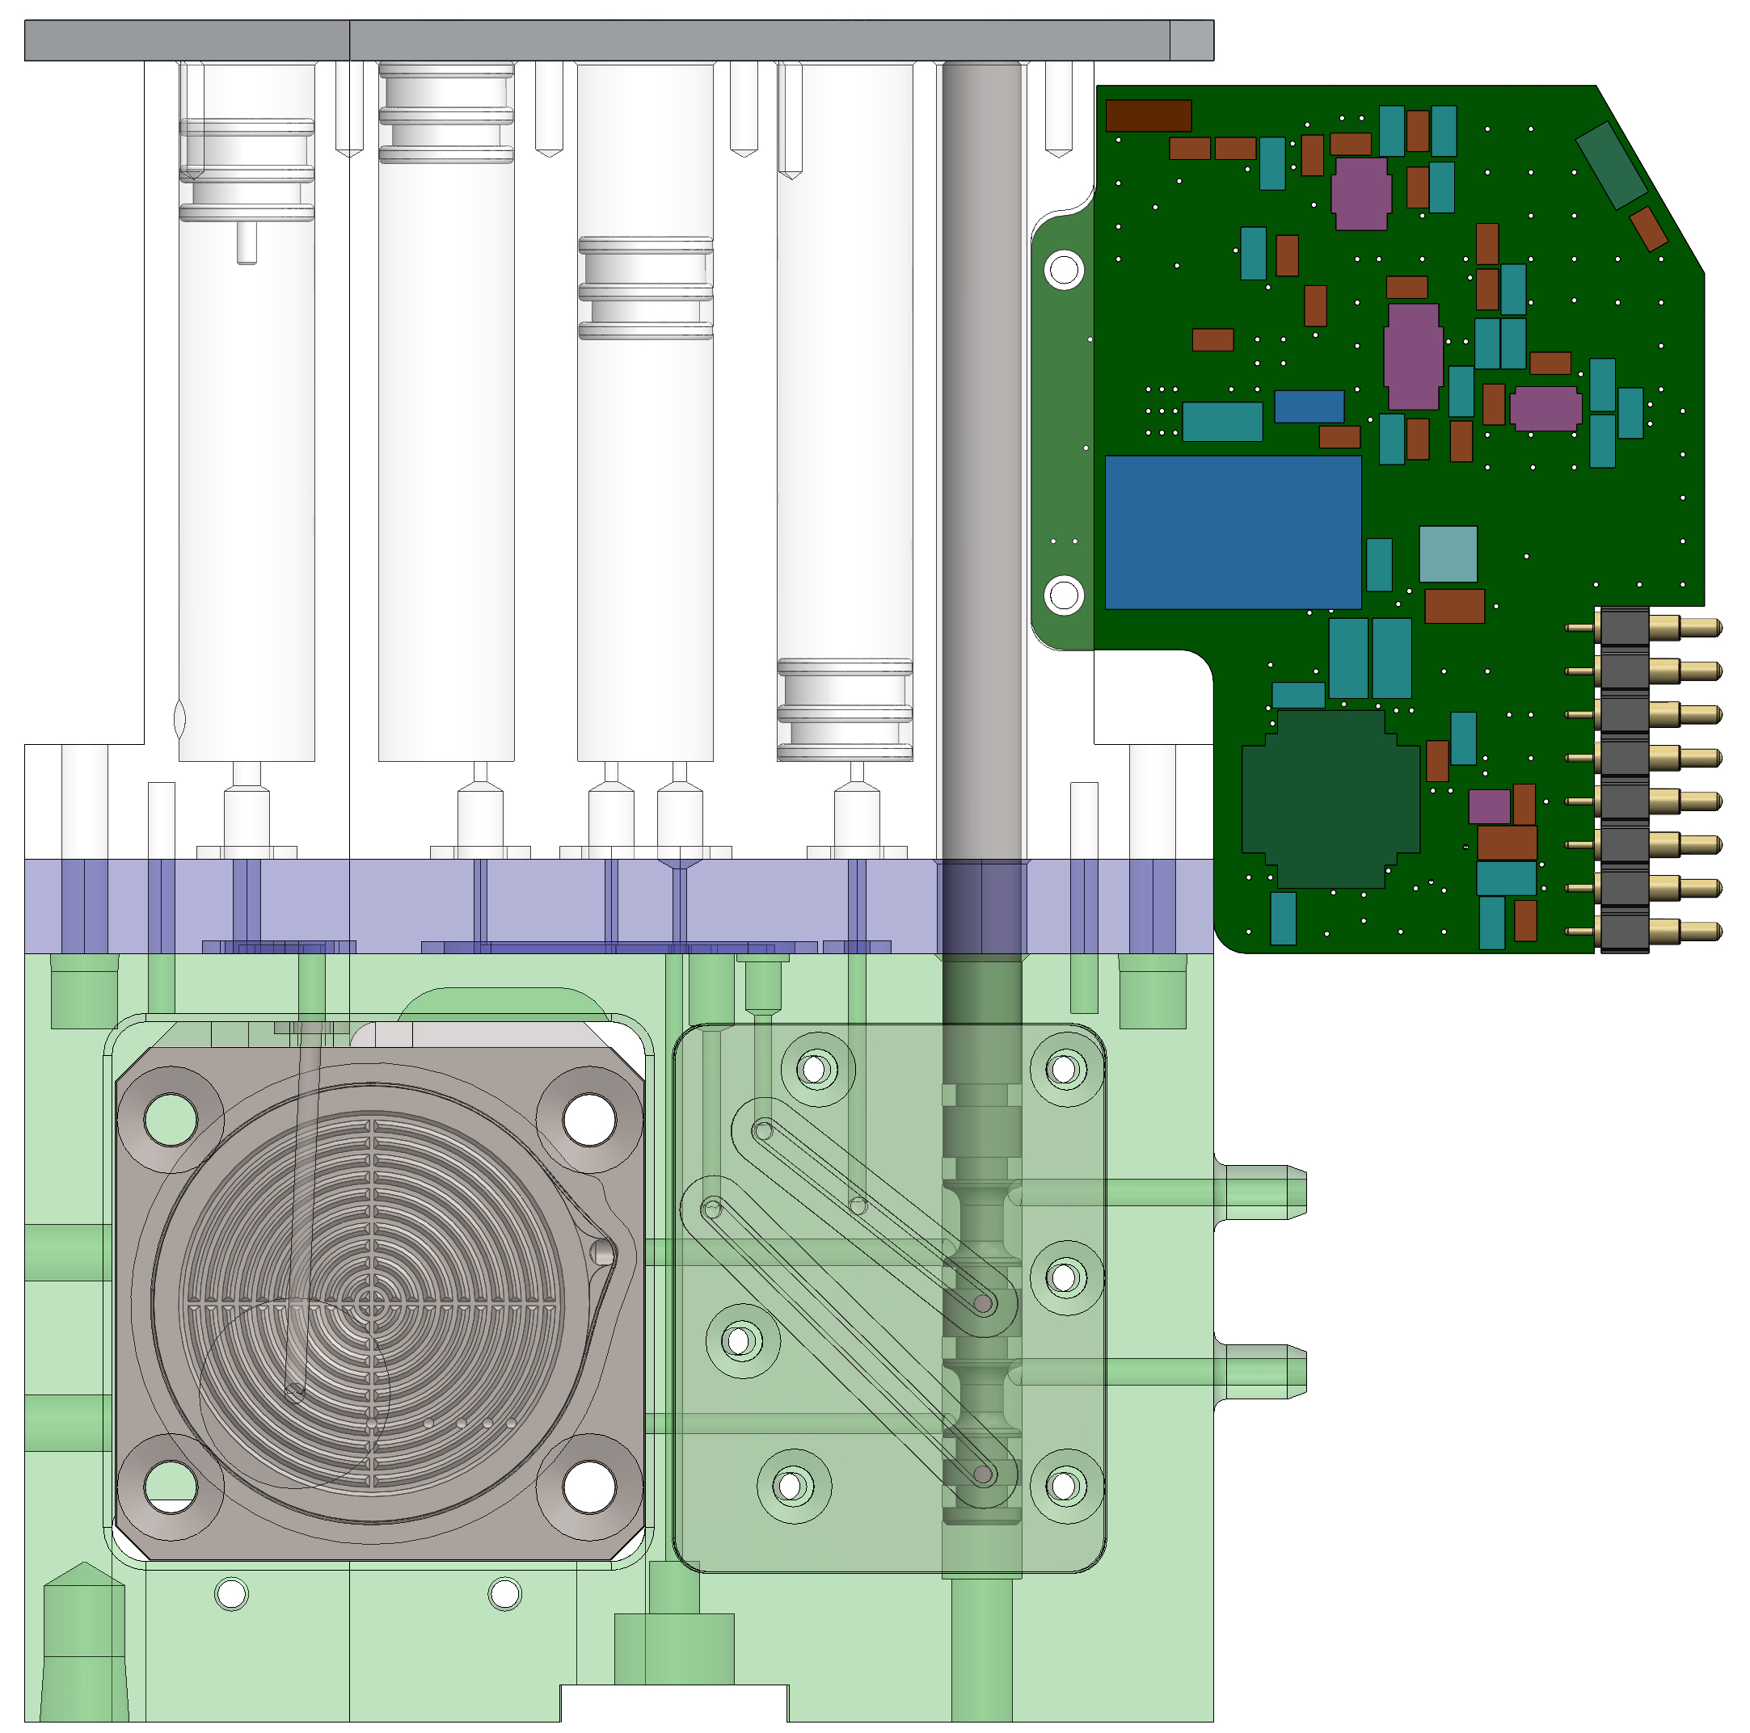
Lyse-n-Go Cartridge -- Features
Actuator Rod (magnetic)
Actuator Rod (magnetic)
Actuator Rods
Actuator Rod
Air Refill Vent
Connection to Sample Loop
5 Actuator Rods
4 Syringes
1 Valve (sample or reagent)
Make/Break cartridge connection to downstream components (waste, analytical module)
3) Diluent
2) Lysis Buffer
/Extract
Valve (Sampling)
4) Air/Vent
1) Not in use
Vent
3x 3/32” EPDM Ball with spring
(10 lb/in)
3/32” EPDM
Ball w/ spring
(4lb/in)
Spacer with DuckBill Valve (FVMQ)
Filter
Connects to 3G Core Sample Loop
Bubble trap/
Puck vent
Make/Break Cartridge Connection w/ pressure sensor
Blocked
Burkert Valve Tree
Analytical Module
p
Waste
2019 MBARI, Confidential Information

Slide 9
Lyse-n-Go Cartridge – Water Filtration Concentrate Particulates
Actuator Rod
Sampling (surface to 300m)
  Test psi range 0-500 psi
  Multiple 25 mm filter porosities/types
  Sample path under vacuum in 3G/LRAUV.
  Sample enters top of filter first before full fluid path through cartridge is opened.
When sampling is complete engage handoff (open to waste) & move valve to reagent position.
1
Valve (Sampling)
*Check valve sees full sea pressure
Water Sample in
Filter
Filtered water out
2
Burkert Valve Tree
Blocked
Analytical Module
p
Waste
2019 MBARI, Confidential Information

Slide 10

Lyse-n-Go Cartridge – Evacuate Water
Actuator Rod (magnetic)
Vent
Refillable air/vent syringe (4) used to push water to waste
  All other plungers in syringes backed up with actuator rods
To remove remainder of water, must break bubble point of the filter.
  Burkert tree at blocked
  Repeated cycles with air/vent syringe (4) until reach specified psi
Drain Water to waste
Vent top of puck
  Plunger below bottom vent & boss of plunger displaces check valve
3
4) Air/Vent
Valve (Reagent Position)
Vent
4
5
6
X
Blocked
Burkert Valve Tree
Analytical Module
p
Waste
2019 MBARI, Confidential Information

Slide 11
Lyse-n-Go Cartridge – Add Lysis Buffer & Heat
Actuator Rod (magnetic)
Vent
7
Fill off cartridge line with lysis buffer (300 µl)
  Puck top vented, open to waste
Fill majority of filter chamber with lysis buffer (syringe 2)
  Puck top Vented (syringe 4)
  Burkert tree at blocked
Pressurize filter chamber & Heat
  Burkert tree at blocked
  Puck top sealed. Plunger moved above vent with pressure balanced move with Syringe 4 & Syringe 2.
  Drive syringe 2 to empty.
  No bubble over filter
  Heat to 85℃, 14 minutes
2) Lysis Buffer (1.4 ml)
8
Vent
9
Heat
X
Blocked
Burkert Valve Tree
Analytical Module
p
Waste
2019 MBARI, Confidential Information

Slide 12
Lyse-n-Go Cartridge – Recover Extract
Actuator Rod (magnetic)
Vent
10
Recover 900 µl of Extract
  Pressure filter chamber with Air/Vent Syringe
  Draw back on actuator rod (2) when pressure exceeds threshold. Plunger moves due to pressure.
Relieve pressure in system
  Open to Waste
  Vent Puck Top
2) Lysate
4) Air/Vent
Vent
11
X
Blocked
Burkert Valve Tree
Analytical Module
p
Waste
2019 MBARI, Confidential Information

Slide 13
Lyse-n-Go Cartridge – Off Cartridge Analysis
Actuator Rod (magnetic)
Vent
12
Syringes 2 & 3 push at different rates to “mix” reagents at appropriate dilution
  Initial mixture pushed to waste before pushing to analytical module
3) Diluent
2) Lysate
Vent
X
Blocked
Burkert Valve Tree
Analytical Module
p
Waste
2019 MBARI, Confidential Information

