Slide 1

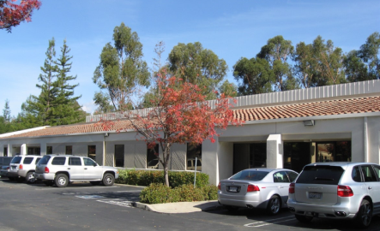
Cartridge and Filter Project:
Lyse-n-Go Design Overview
Mission
Our mission is to provide clients throughout the world with product development for medical, diagnostic, biodefense and biotech products. Accel’s skilled team of engineers, designers and technicians will work together to provide services from concept to development to manufacturing support
Date: 12-17-13
By: Accel Biotech Team

Slide 2
Agenda
Requirements
Cartridge overview
Valve design
Clamp design

Slide 3
MBARI Tech Specifications
ESP Platform in a Nose Cone for deployment
  11.125” x 24” (the total system) but scalable, modular
  30 degree deviations from normal
  14v, ?amp, ?watts ->need soon
  0-300m depths, 15psi-450psi plus pump pressure
  0 -50 C inactive, 2-40 C active
  3g acceleration inactive, 0.5g active (plus 1g rolls)
Interface Specifications -TBD
  Port Size – Screw on ports for testing phases
  Output Port Design/Specs
  Etc.
  PCB Could be the Cartridge Mount – Later Phases

Slide 4
MBARI Tech Specifications
Genetic Marker Classification (algae, bacteria, viruses, invertebrate larvae, biotoxins) – Nucleic Acid Prep
  60 turret slots
  Save sample before and after lysis
  Expression and translation of specific genes
  mRNA, DNA
  2ml-2L of raw seawater @ rates of 1L/hr using 0.2 um filters
  Exclude particles larger than 0.5mm
  Variable filter (two types)
  300-500 ul lysate (30 minute processing)
  6 Reagents

Slide 5
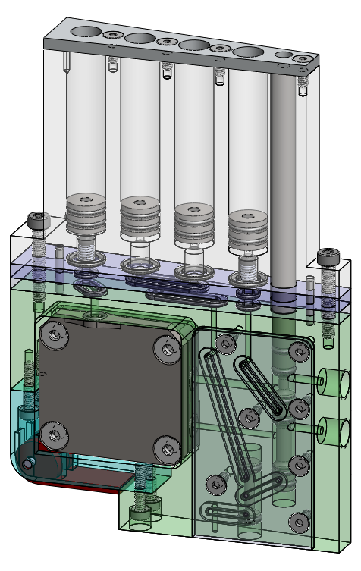
Lyse-n-Go Cartridge Reqs.
Venting of the Puck chamber
Air evac of puck
1 input Reagent
Up to 2 on board dilutions
Waste off board
Sample off board: straight and diluted

Slide 6
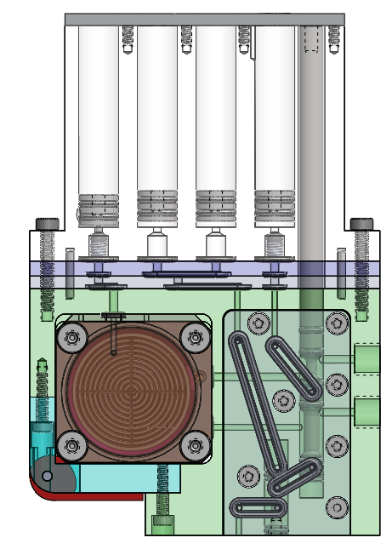
Lyse-n-Go Layout
Storage/Dilution
Evac & Vent
Reagent
Reworked syringe manifold plates
Extended Manifold Plate
CAM Latch
Cartridge extended by 10mm
Need lower actuator!
Additional Valve
Interface plate?

Slide 7
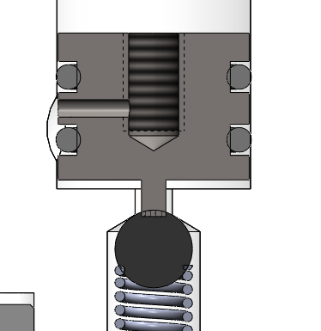
Puck Venting
Venting is part of plunger
Controlled with actuator
Possibly need to add spring washer on bottom to provide a soft stop for evac
Indent in wall allows air to pass over o-ring
Air Path
Boss depresses check valve

Slide 8
Valving Matrix
Per our last meeting:
 | Puck |  |  |  | Cartridge |  |  | Actuators Used
Step | Over Filter | Under Filter | Vent | Pressure | Sea In | Sea Out | Off Board |  | Notes
1 | Sea In | Sea Out | Closed | 500 | Open | Open | Closed* | N/A | Filter Seawater
2 | Evac In | Off Board | Closed | 90 | Closed* | Closed* | Open | Air | Clear residual seawater
3 | Evac In | Off Board | Open | 15 | Closed* | Closed* | Closed* | Vent | Vent off pressure above filter
4 | Reagent In (1st half) | Off Board | Open | 15 | Closed* | Closed* | Closed* | Lysis, Vent | Begin adding reagent, vent displaced air
5 | Reagent In(2nd half) | On Board Storage | Closed | 25 | Closed* | Closed* | Closed* | Lysis, Vent, dil | Close vent and add remaining reagent
6 | ~ ~ ~ ~ ~ ~ ~ ~ ~ ~ ~Heat~ ~ ~ ~ ~ ~ ~ ~ ~ ~ ~ ~ ~ ~ ~ |  |  |  |  |  |  |  | Heat Regent in Puck
7 | Evac In | On Board Storage | Closed | 90 | Closed* | Closed* | Closed* | Air | Move sample to on-board storage to mix w/ additional reagents
8 | N/A | No Back Flow | N/A | N/A | Closed* | Closed* | Open | dil | Move sample off-board to analytical unit, etc.
 | = Changed position |  |  |  | *Only matters if fluid flows past port

Slide 9
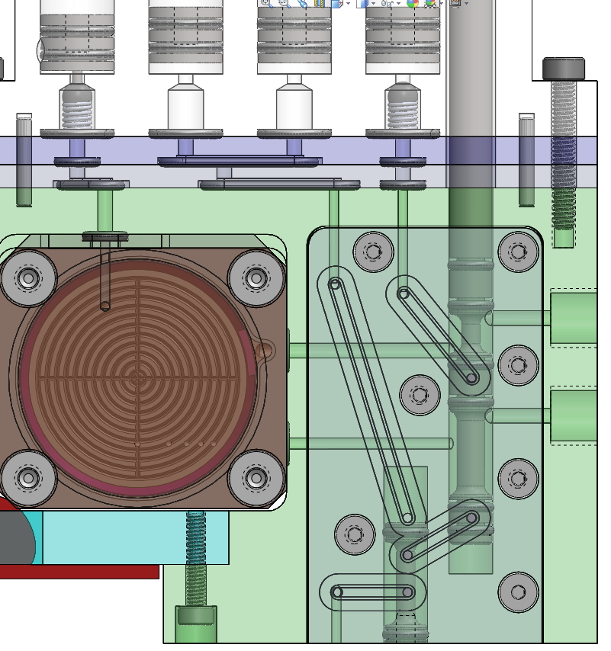
Valving-Step 1
Filter Seawater
Sea In
Sea Out

Slide 10
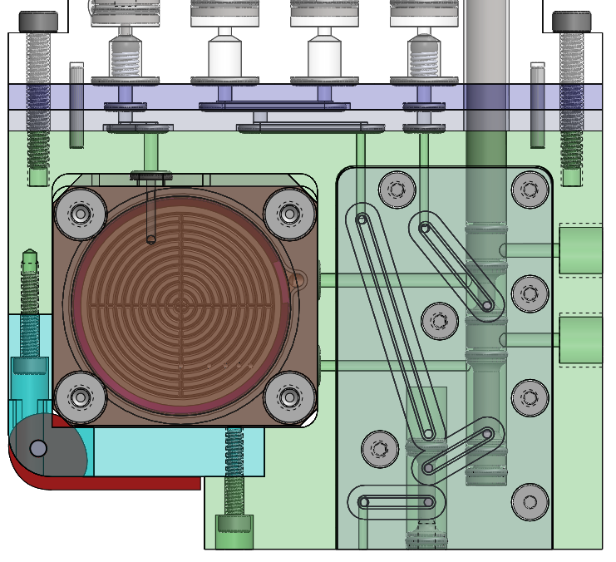
Valving-Step 2
Clear residual seawater
Evac Air In
Off Board Waste

Slide 11
Valving-Step 3
Pressure Out
Vent off pressure above filter

Slide 12
Valving-Step 4
Pressure Out
Reagent In
1st half
Add reagent, vent off displaced air

Slide 13
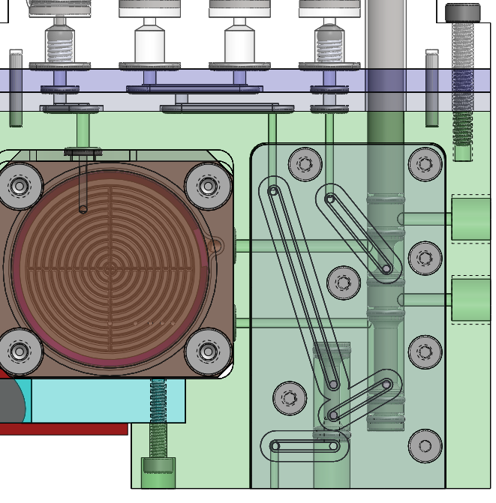
Valving-Step 5
Close vent, add remaining reagent
Tube to puck volume:100ul
Reagent In
2nd half

Slide 14
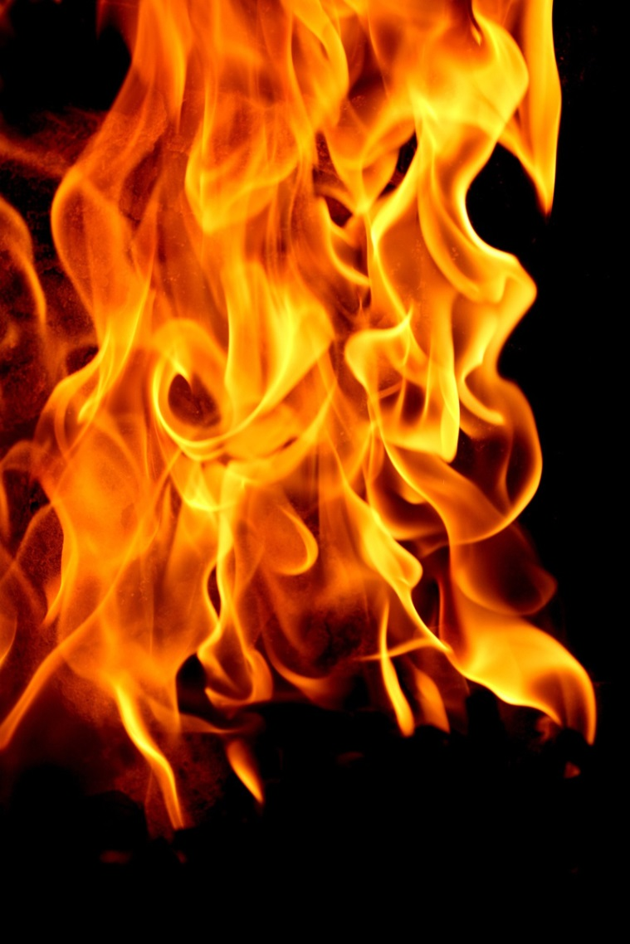
Valving-Step 6
Heat!!!

Slide 15
Valving-Step 7
Move sample to on board storage to mix with additional reagents
Should there be active mixing (pumping)?
Volume from Puck to syringe≈ 300µl

Slide 16
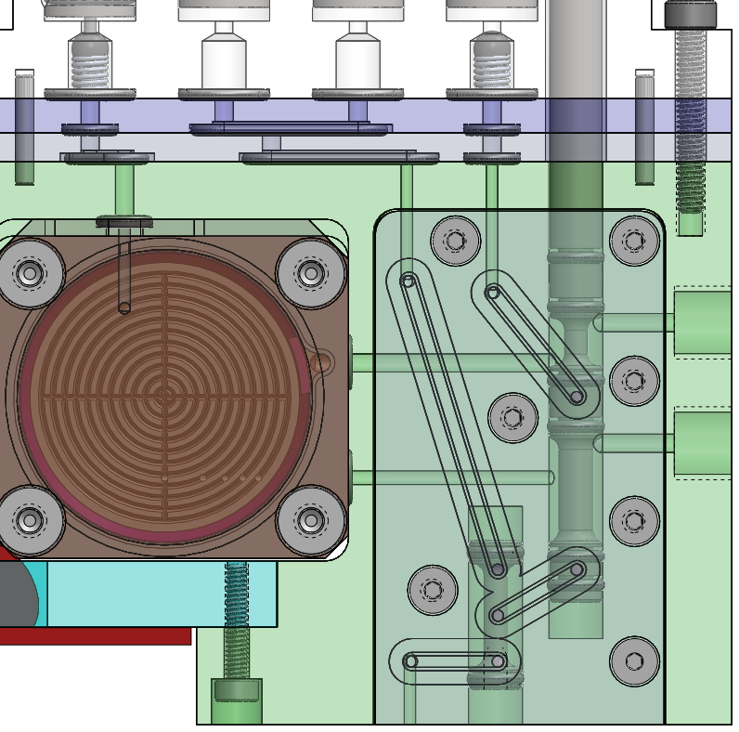
Valving-Step 8
Move sample off board to analytical unit, etc.
Volume from syringe to output is≈ 200µl

Slide 17
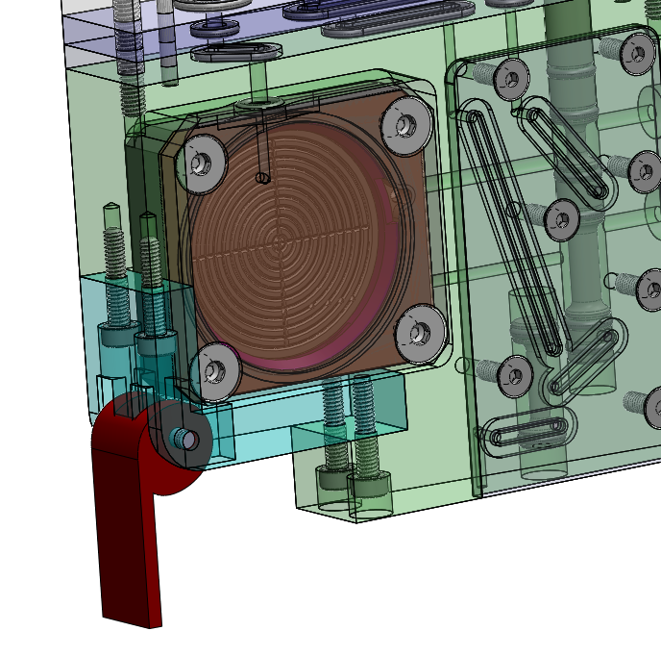
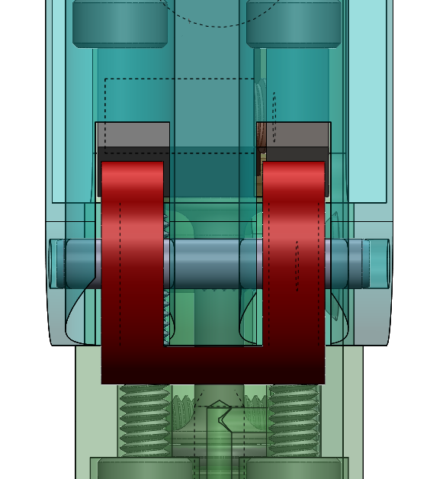
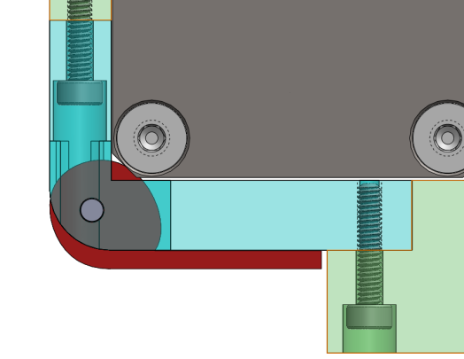
Puck Clamp
Cam style clamp
Quick release
One solid structure
Dual contact points
Finger detent, etc. TBA

Slide 18
Lyse-n-Go
Additional items to address
  O-ring seal for puck
  Custom gaskets for manifold plates
  Decrease puck volume to ideal level
  Heater mounting/wire routing/contact points
  Interface with downstream port
  Evac syringe return mechanism
    Magnets?
    Spring?
    Socket style ball detent?

