Slide 1
Gold Standard
G2 method
  Normal flow filtration
  500: 1 Turndown ratio
    1L of seawater to 2mL of lysate
    Lysate volume also result of puck geometry
    Seawater particle loading affects clog point
Investigating methods:
  Better: higher turndown
  Smaller: total size of equipment

Slide 2
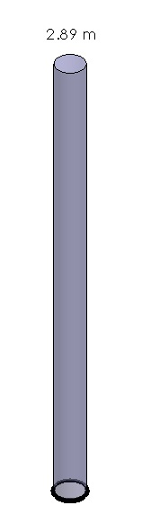
Metrics for Comparison
Compare filter aspects
  Volume/filter area = column of water
    1L in a 21mm dia filter = 2.89m of water
    Only the lysis filter area is used.
  TFF or other particle capture tech
    Use area of final filter or bead bed

Slide 3
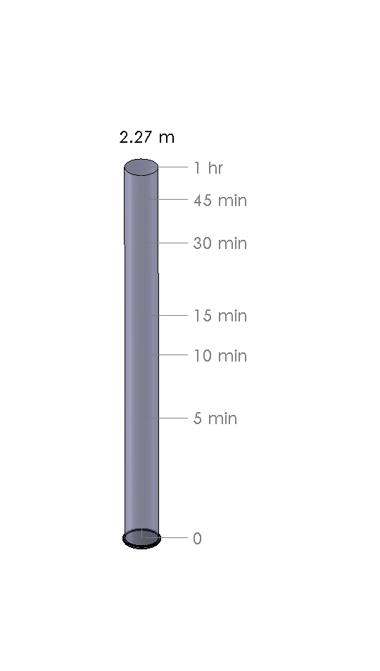
Measurments
Normalize pressure
  10 psig
Flowrate not linear with time.

Slide 4
More Metrics
Volume cost of particle collection hardware
  Direct components
  All associated hardware, pumps, flushing, etc,
Energy costs, Power extremes (V, current)

