Slide 1
ESP Simple
ESP
G2
Concentrate
Lyse
Detect
G3
Concentrate
Lyse
Int.
Analytical Mod.

Slide 2
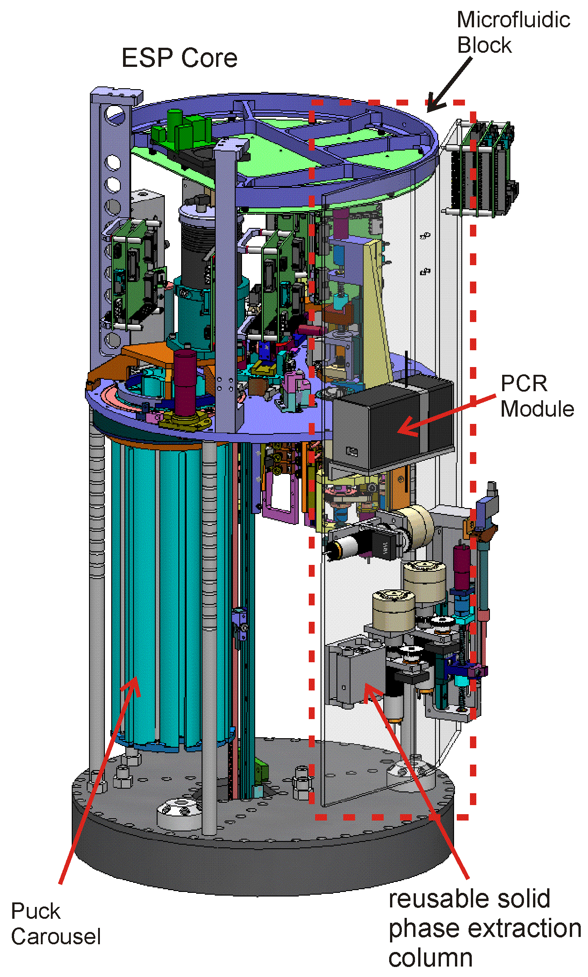
2G Implementation
Concentrate
  Filters raw seawater.
  Single use filter media (puck)
Lyse
  Chemical, bulk storage, metered per sample
  Heat, reused heater pad
Detect
  Sandwich hybridization
  Bulk reagent storage, metered per sample.
  Single use assay (puck)
  Imaged array
  Processed on-shore
  Analytical Module (MicroFluidic Block)
~30”
~16”

Slide 3
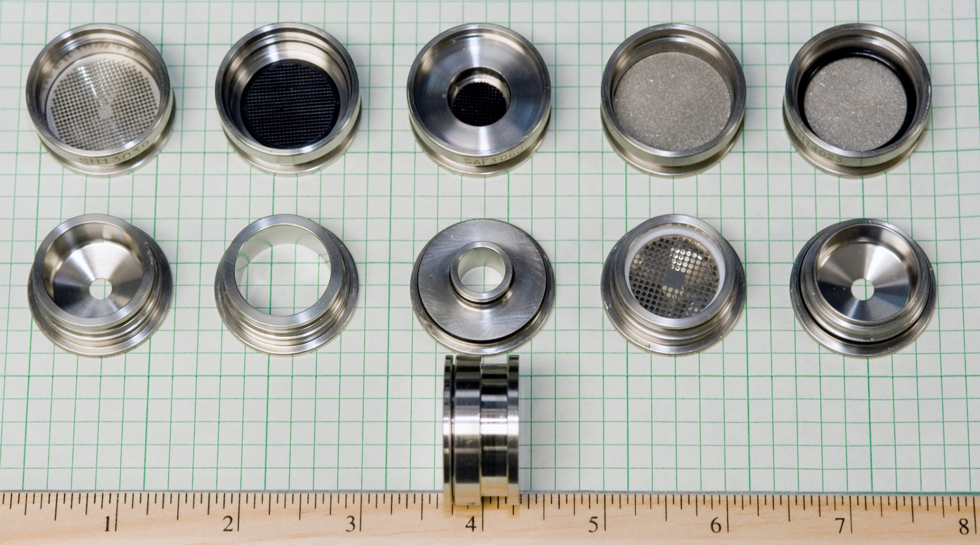
ESP Pucks

Slide 4
2G Design Guidelines
    Isolation of fluidics from mechanisms and electronics
    Robust mechanics: All mechanisms/structures torque sized to stop (on bumper/hard stop) at stall with no damage
    Material selection for chemistry compatibility, corrosion resistance.
    Battery operated: Low power budgets
    Distributed control
        Each modular mechanism/subsystem is run by its own controller.
        This freed host (Unix) processor from real-time constraints
        Minimized mass cable bundling to central control
      Modularity of design
        Aids in maintenance and repairs
        Focused cabling around subsystems
      I2C Bus and protocol
      Software
        Avoid licensing fees
        OS to speed development
        Scripting language, no development system or recompiling.
Notes:
44

Slide 5
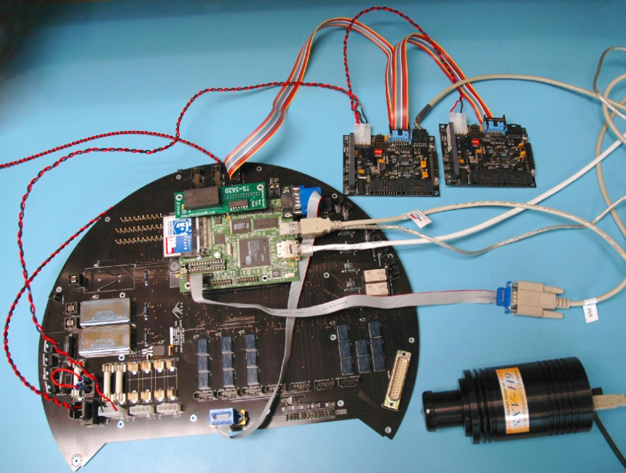
2G ESP
Electrical Block Diagram
PC/104
Host Processor
~2 Watts
External
Sampler
Power 10 - 16V
5V & 3.3V
Power Supplies
RF
RS
-232
Collection
Modem
Interconnect /
Motherboard
I²C
Contextual
3 x
RS
-232
Serial Bus
Process
Sensors
3 x
RS
-232
Manipulator
Analytical Modules
Storage
Distributed Controllers
aka “Dwarves”
~450 mW

Slide 6
Power
    G2 power (Just the Core and no MFB)
      2.5 watts continuous
      30 watt hours per sample at 30 samples
      Typical deployment is 30 days
      2.5Watts *24hours * 30days = 1800 Whr
      30Whr * 30samples = 900 Whr
      66% of energy goes to just keeping the lights on
      G1 was even worse
    G2 Energy source needs to supply 2700Whr
      Lead acid requires about 6 500Whr batteries
      Alkaline requires about 180 D-Cells
    G3 needs to shrink even more
      3500Whr with Rechargeable
      7000Whr with Primary
      Power used by entire vehicle (single source)
Notes:
66

Slide 7
Looking Forward
    G1 to G2
      Lower power hotel
      Modular design
      Easier part changes
      Reuse of hardware
      Distributed control
      25% housing volume reduction
    G2 to G3
      Neutrally buoyant; Volume = Weight = Power
      Even Lower Hotel Load
      88% housing volume reduction.
      Adjust granularity of Distribution of control
      Software; common user environment
      Consider moving to ARM based “dwarf” microcontroller(s)
      Full ARM Linux – move to current (2.6 series) kernels
      better low-power sleep state transition
Notes:
77

Slide 8
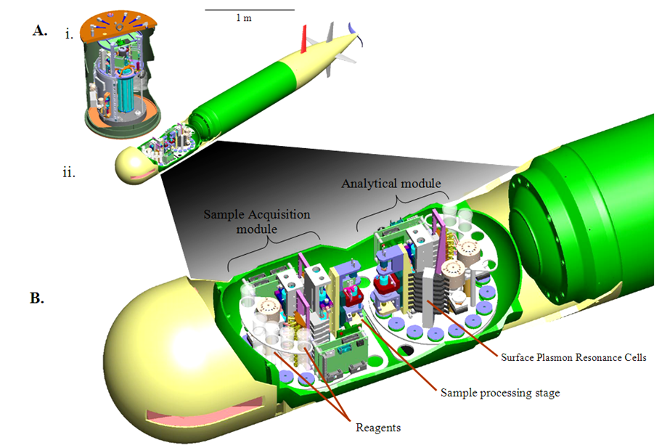
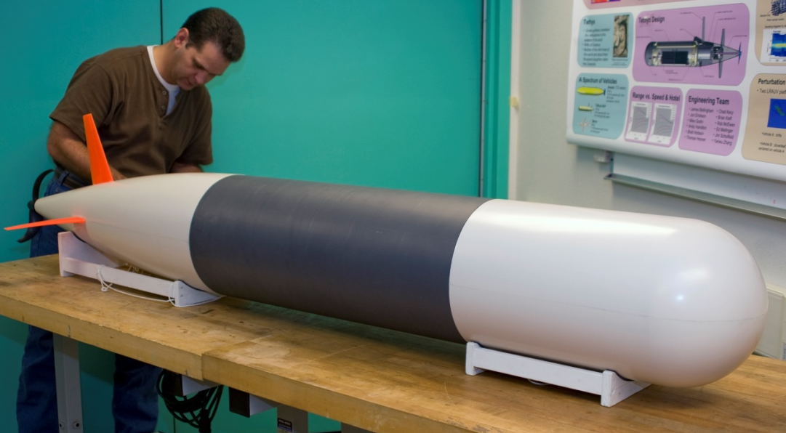
3rd generation ESP on LRAUV

