Slide 1
G3 ESP-LRAUV Integration
12-05-2011

Slide 2
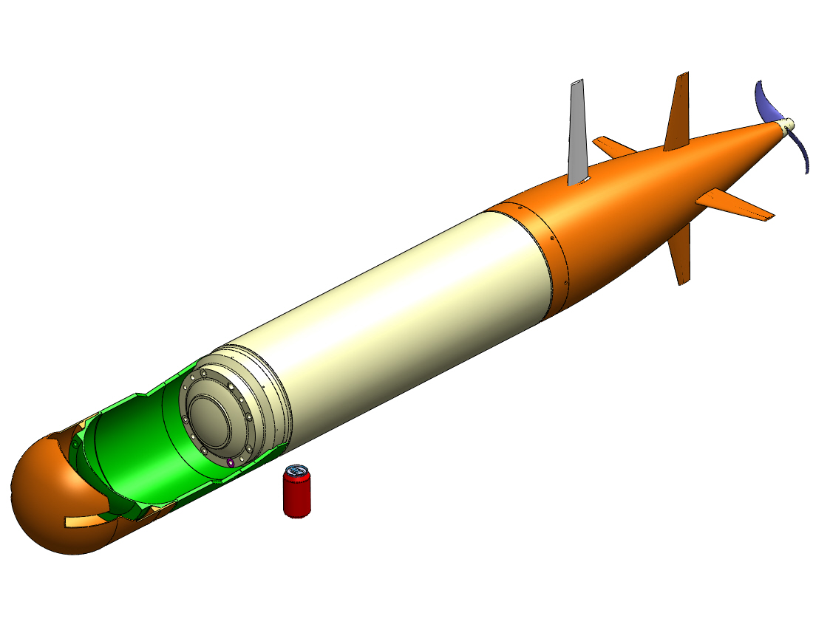
Forward Dry Housing
24” extension
Modeling results?
Consider test hardware

Slide 3
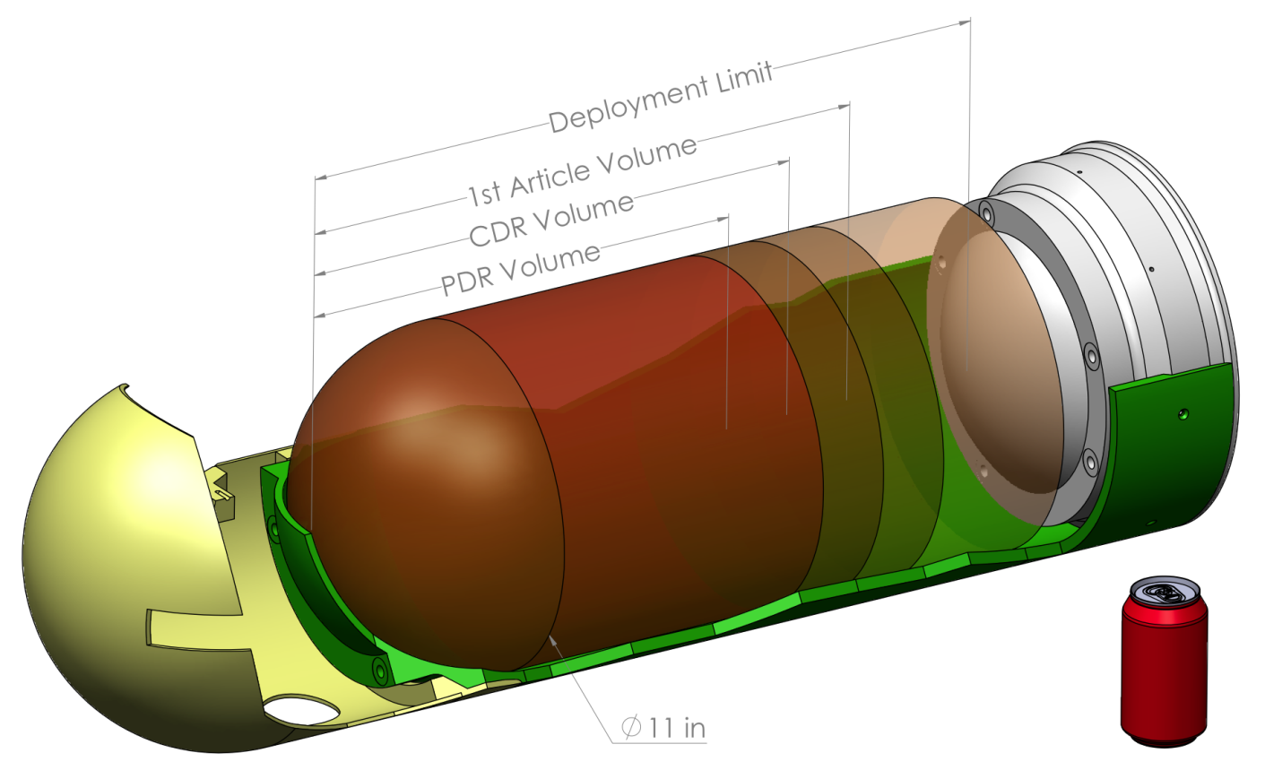
Design Margins
Design Stage | Reserve Margin | G3 “Design To” Volume
Pre-PDR, PDR | 40% | 1220 cu-in (20L)
Pre-CDR, CDR | 30% | 1465 cu-in (24L)
1st Article Build | 20% | 1650 cu-in (27L)
Maximum | 0% | 2060 cu-in (34L)

Slide 4
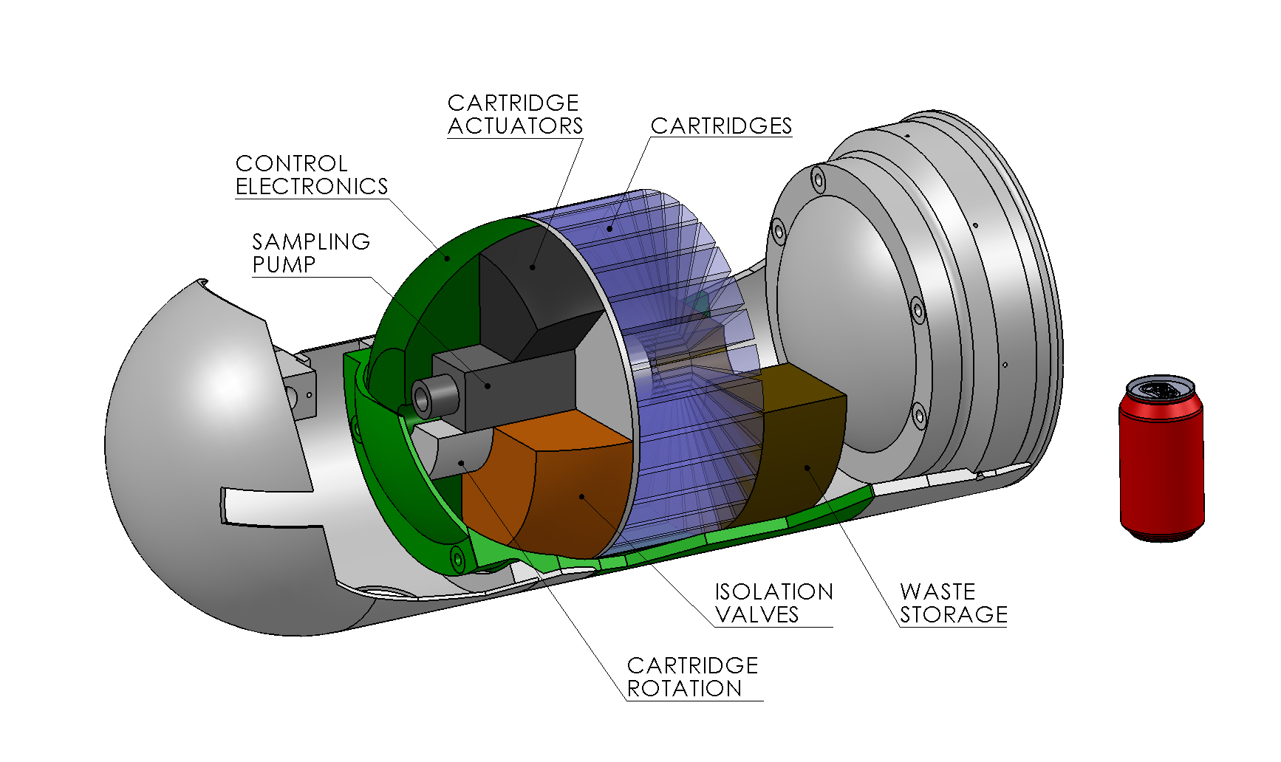
Cartridge System

Slide 5
Space Competition
Space Competition
  Context / platform sensors in nose
  Cable pass way thru ESP housing
  Other water sensors in dry housing (ISUS, etc)
Sensor interference?
  Magnetic couplings, motors, etc

Slide 6
Typical Use Case
Locate a target parcel of water to sample
  pre-determined location/depth/time of day coordinates
  adaptive sampling process using onboard sensors
  initiated adaptively via real-time inputs from an extended networked
At location, LRAUV signals 3G-ESP to start sample collection, (up to 1 hr)
After collection, one or more ESP analytical modules will do analysis. (up to 16 hours)
Based on results, ESP may deliberate on further action
  initiate an additional analysis on material already collected
  inform the LRAUV platform of its findings so that the platform can modify its search/operations behavior accordingly.

Slide 7
Power/Comm
Voltage: 10 to 18V, 24V max (charging)
Current : max 3A cont., 5A (<25ms) in rush
Comms:
  RS-232 signaling, No handshaking, max 115k
  SSH over Ethernet
  Comms ground isolated from Power Ground

Slide 8
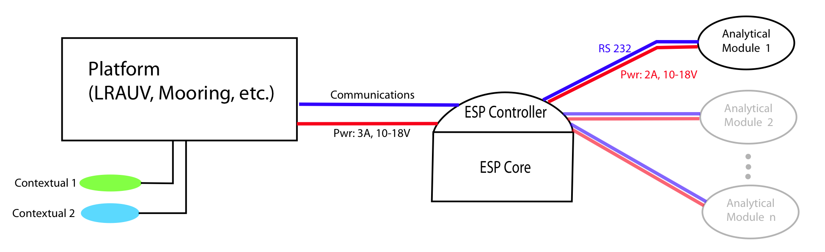
Block Diagram

