Slide 1


MBARI Cartridge
Lyse-n-Go, Hand-off Update
Mission
Our mission is to provide clients throughout the world with product development for medical, diagnostic, biodefense and biotech products. Accel’s skilled team of engineers, designers and technicians will work together to provide services from concept to development to manufacturing
Date: 8-31-2016
By: David Boone

Slide 2
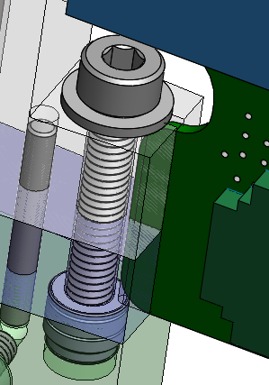
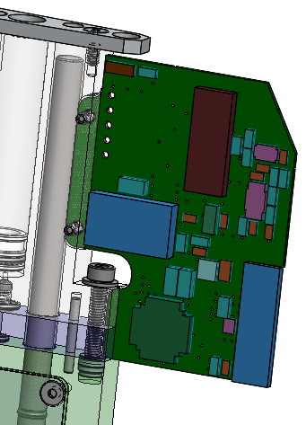
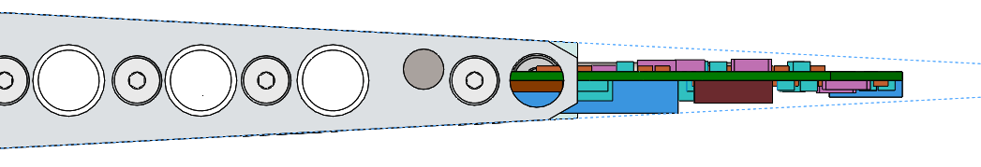
Heater Board Mounting
Bolt board into syringe block
2x M2 screws
Tab in slot for extra support for lower connector
Board-board clearance OK

Slide 3
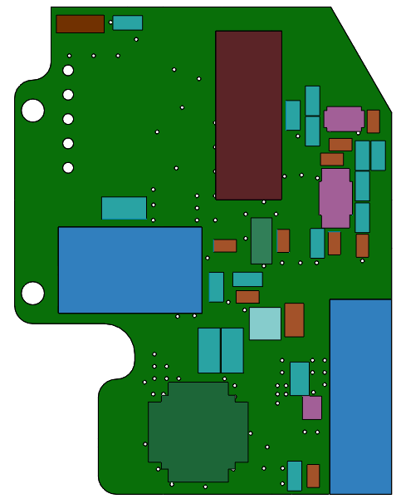
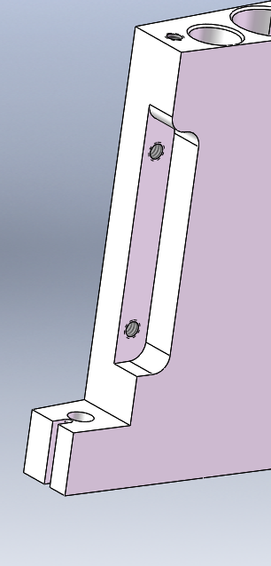
Heater Board Mounting
Adds 1 op to syringe block
Added tabs
Add pocket for board
Lower support

Slide 4
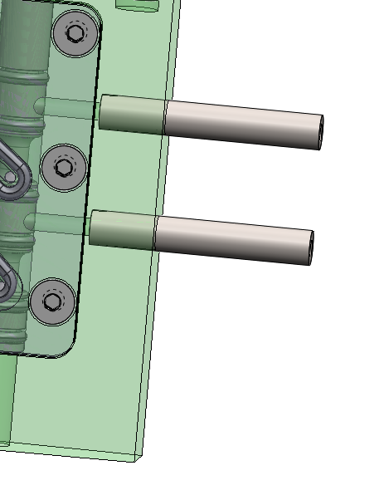
Toroid Connection
Thread-in feature not desirable from cost perspective
Also concerned about cleaning, sealing
Press-in feature testing looks good
Used dowel pin in hole w/ .005” interference and holds to 700+ psi at room temp and freezing
Large margin of interference should help w/ cost

Slide 5
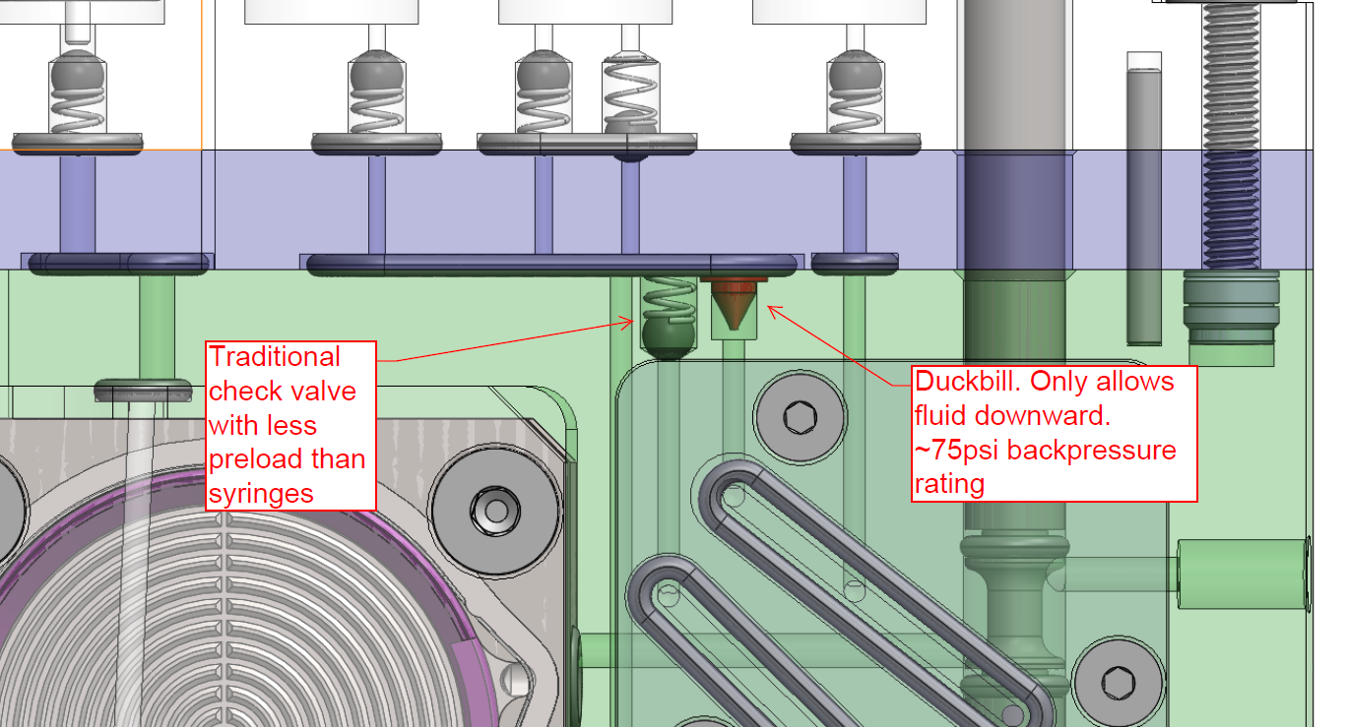
Check Valves
Combination of ball/spring and duckbill
Sensitive to debris (true of all valves)
If over-pressurized they will invert and fail

Slide 6
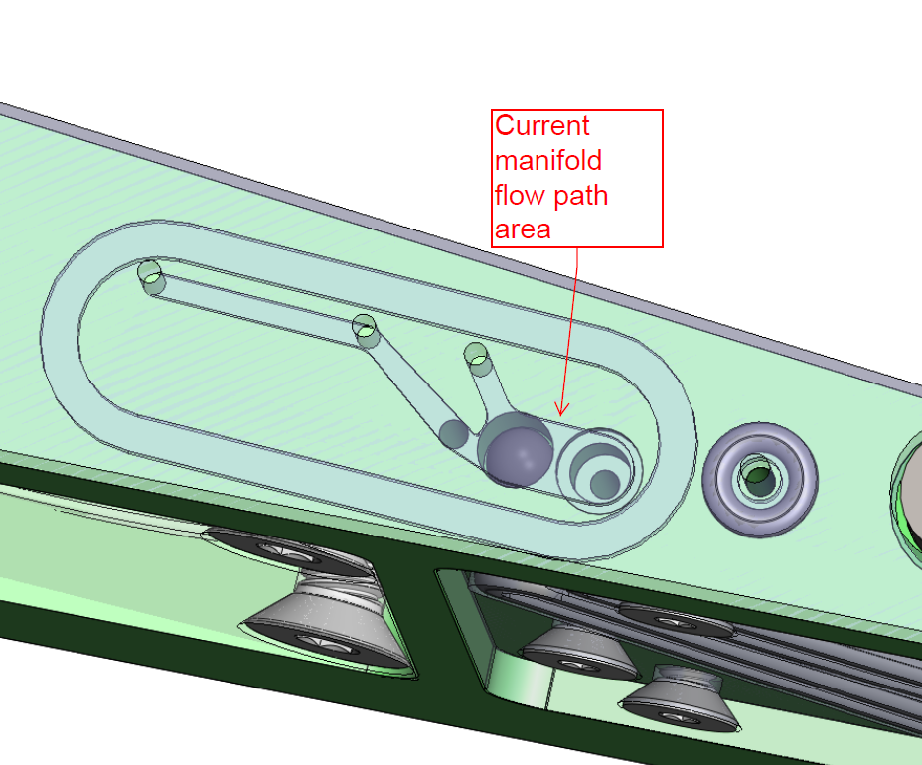
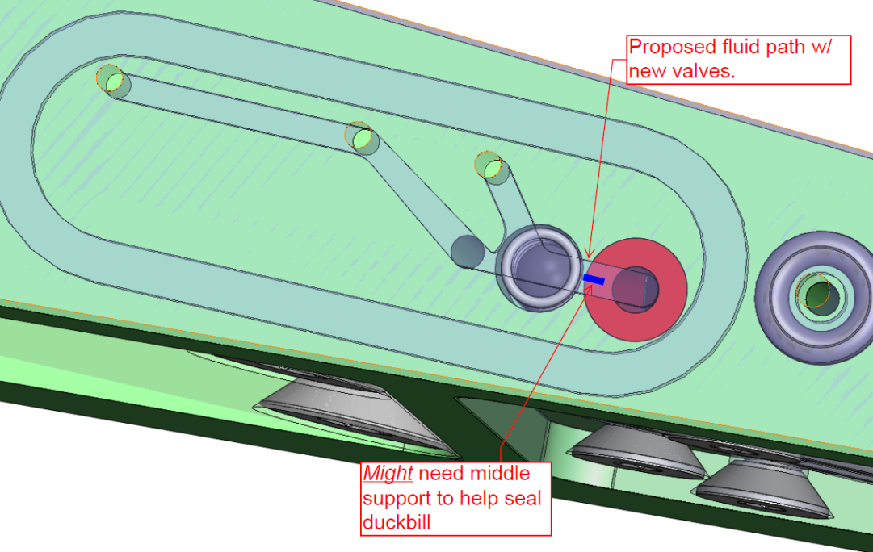
Check Valves
Channel width is reduced to support duckbill
Need to test sealing with partial back support

Slide 7
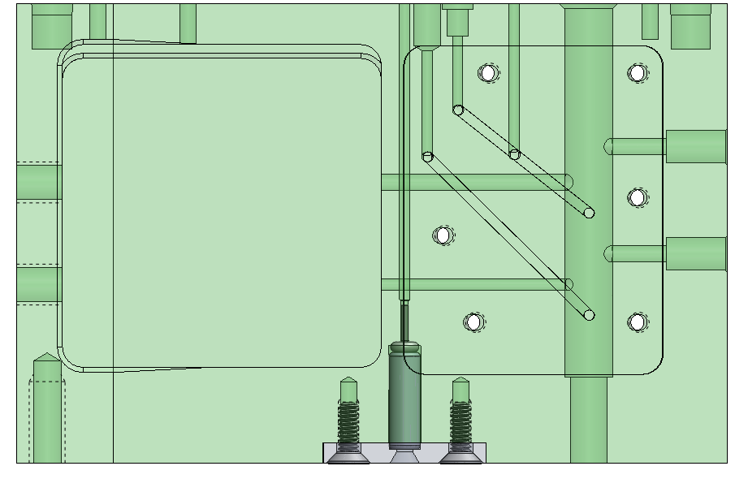
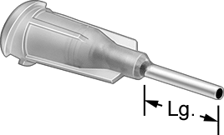
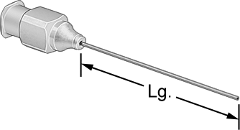
Handoff
Replaceable after each deployment
Use existing actuator w/ 22g, ¼”L blunt needle
Requires no change in cartridge length!

Slide 8
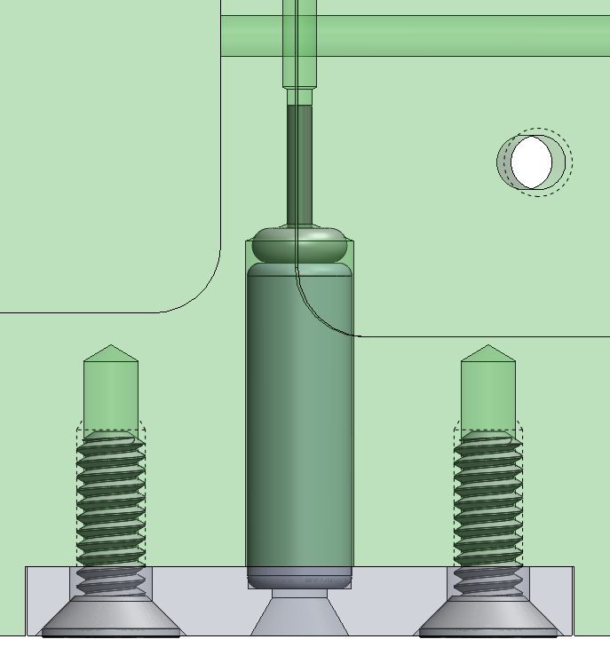
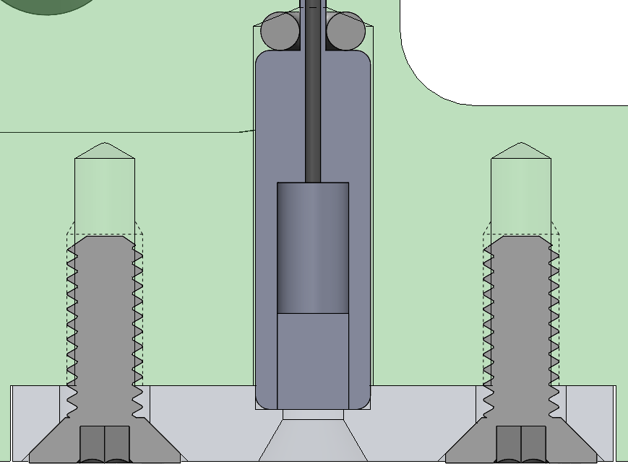
Handoff
O-ring seal on bottom
Dead volume reduced to small area around needle
Septum
Needle Guide

