Slide 1
CARTRIDGE MOLDING ISSUES OF INSERT
6109_NAUTILUS
SEP 6, 2024

Slide 2
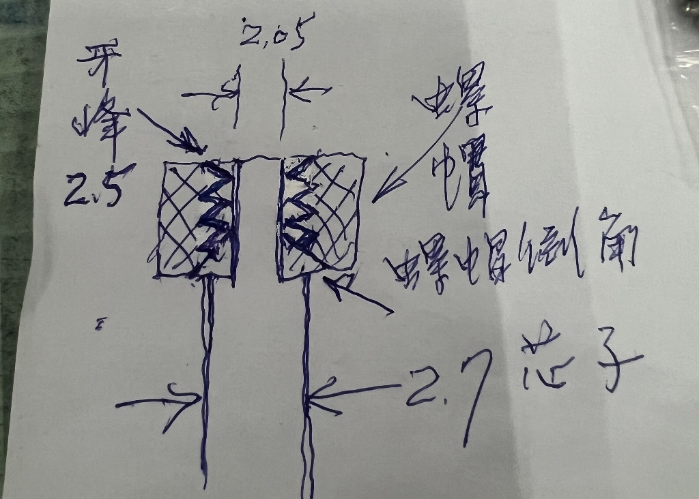
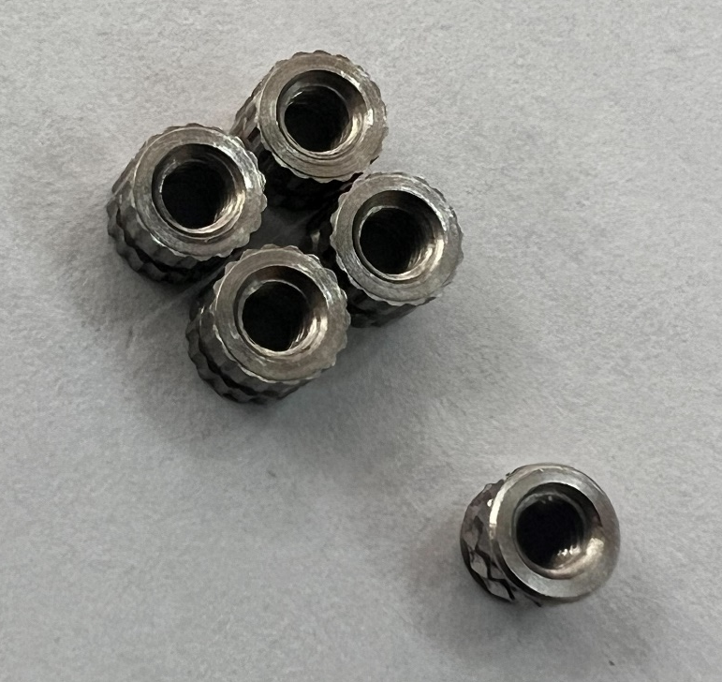
SKETCH OF INVESTIGATION FROM TDTEC- CHAMFER ON INSERT IS TOO BIG
Too big
Insert
Thread Top
Chamfer
Core pin

Slide 3
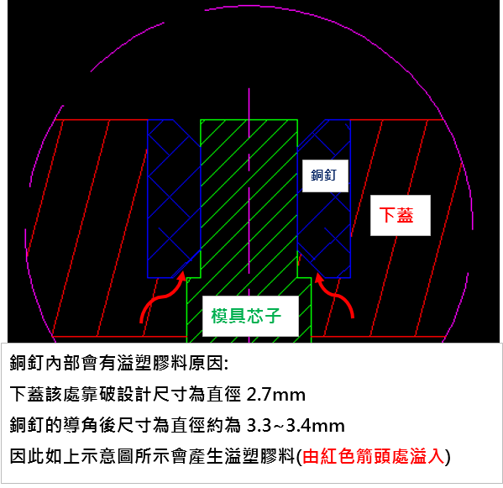
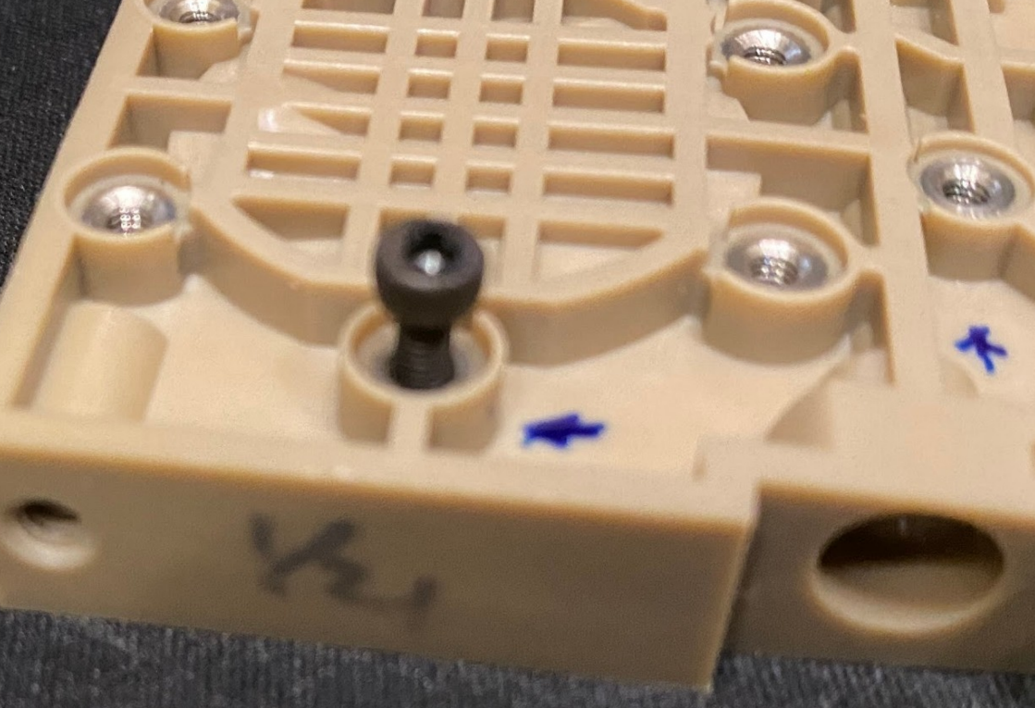
SKETCH OF SECTION VIEW OF INSERT
Screw jam

Slide 4
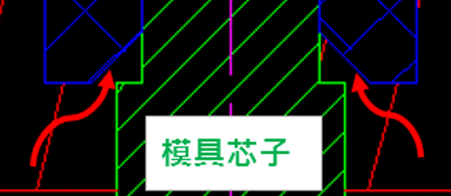
ROOT CAUSE OF THE JAM- PLASTIC RESIN GO ATTCH ON THE THREAD OF INSERT
Plastic resin attach on the thread of insert through gaps during molding.
Gaps
Gaps
2.70
3.30~3.40

Slide 5
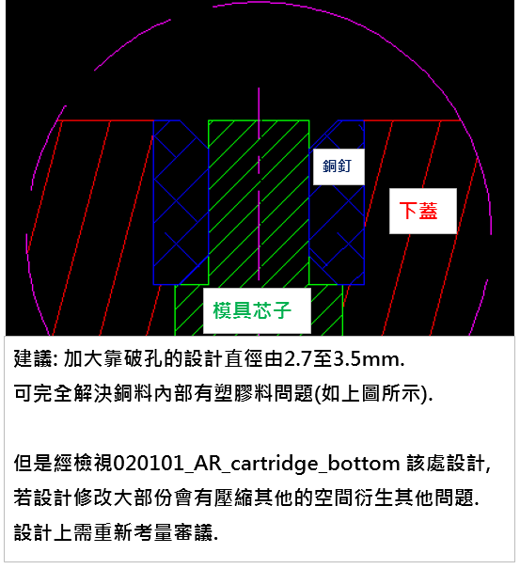
IS THE 2.70MM HOLE CRITICAL? IS IT OK TO ENLARGE IT UP TO 3.5MM?

Slide 6
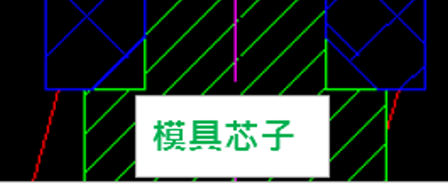
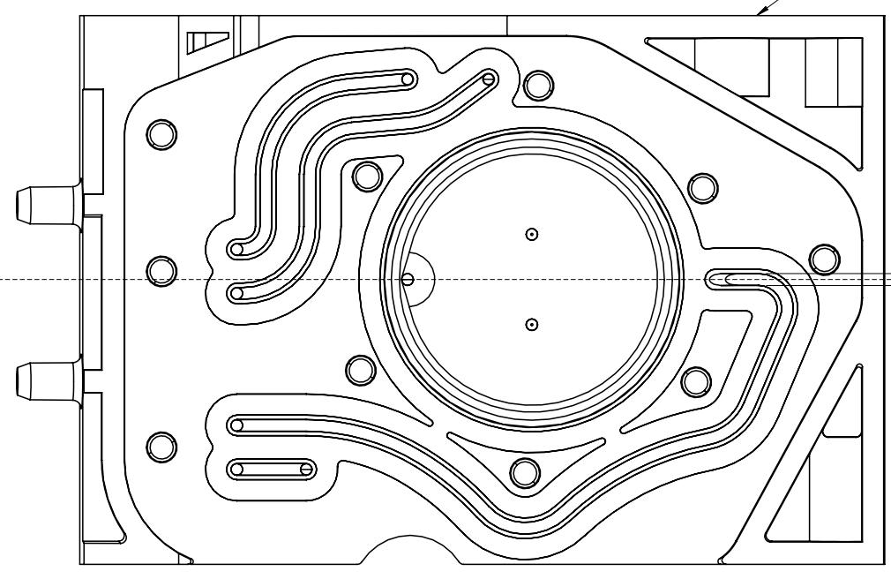
OPTION 1- ENLARGE THE CORE PIN DIEMETER FROM 2.70 TO 3.5MM
Enlarge the diameter from 2.70mm to 3.50mm x 10 plc.
3.30~3.40
3.50

Slide 7
OPTION 2- No change of 2.70 hole. Reduce chamfer size be covered by the 2.70 core pin.
2.60 Max.
2.095
Reduce Chamfer to around 0.20~0.30mm.
Gaps
Gaps
2.70
3.30~3.40

Slide 8
OPTION 3- ENLARGE THE 2.70 HOLE & REDUCE THE SIZE OF CHAMFER
Keep it for 0.2mm mini.
3.0~3.5

