Slide 1
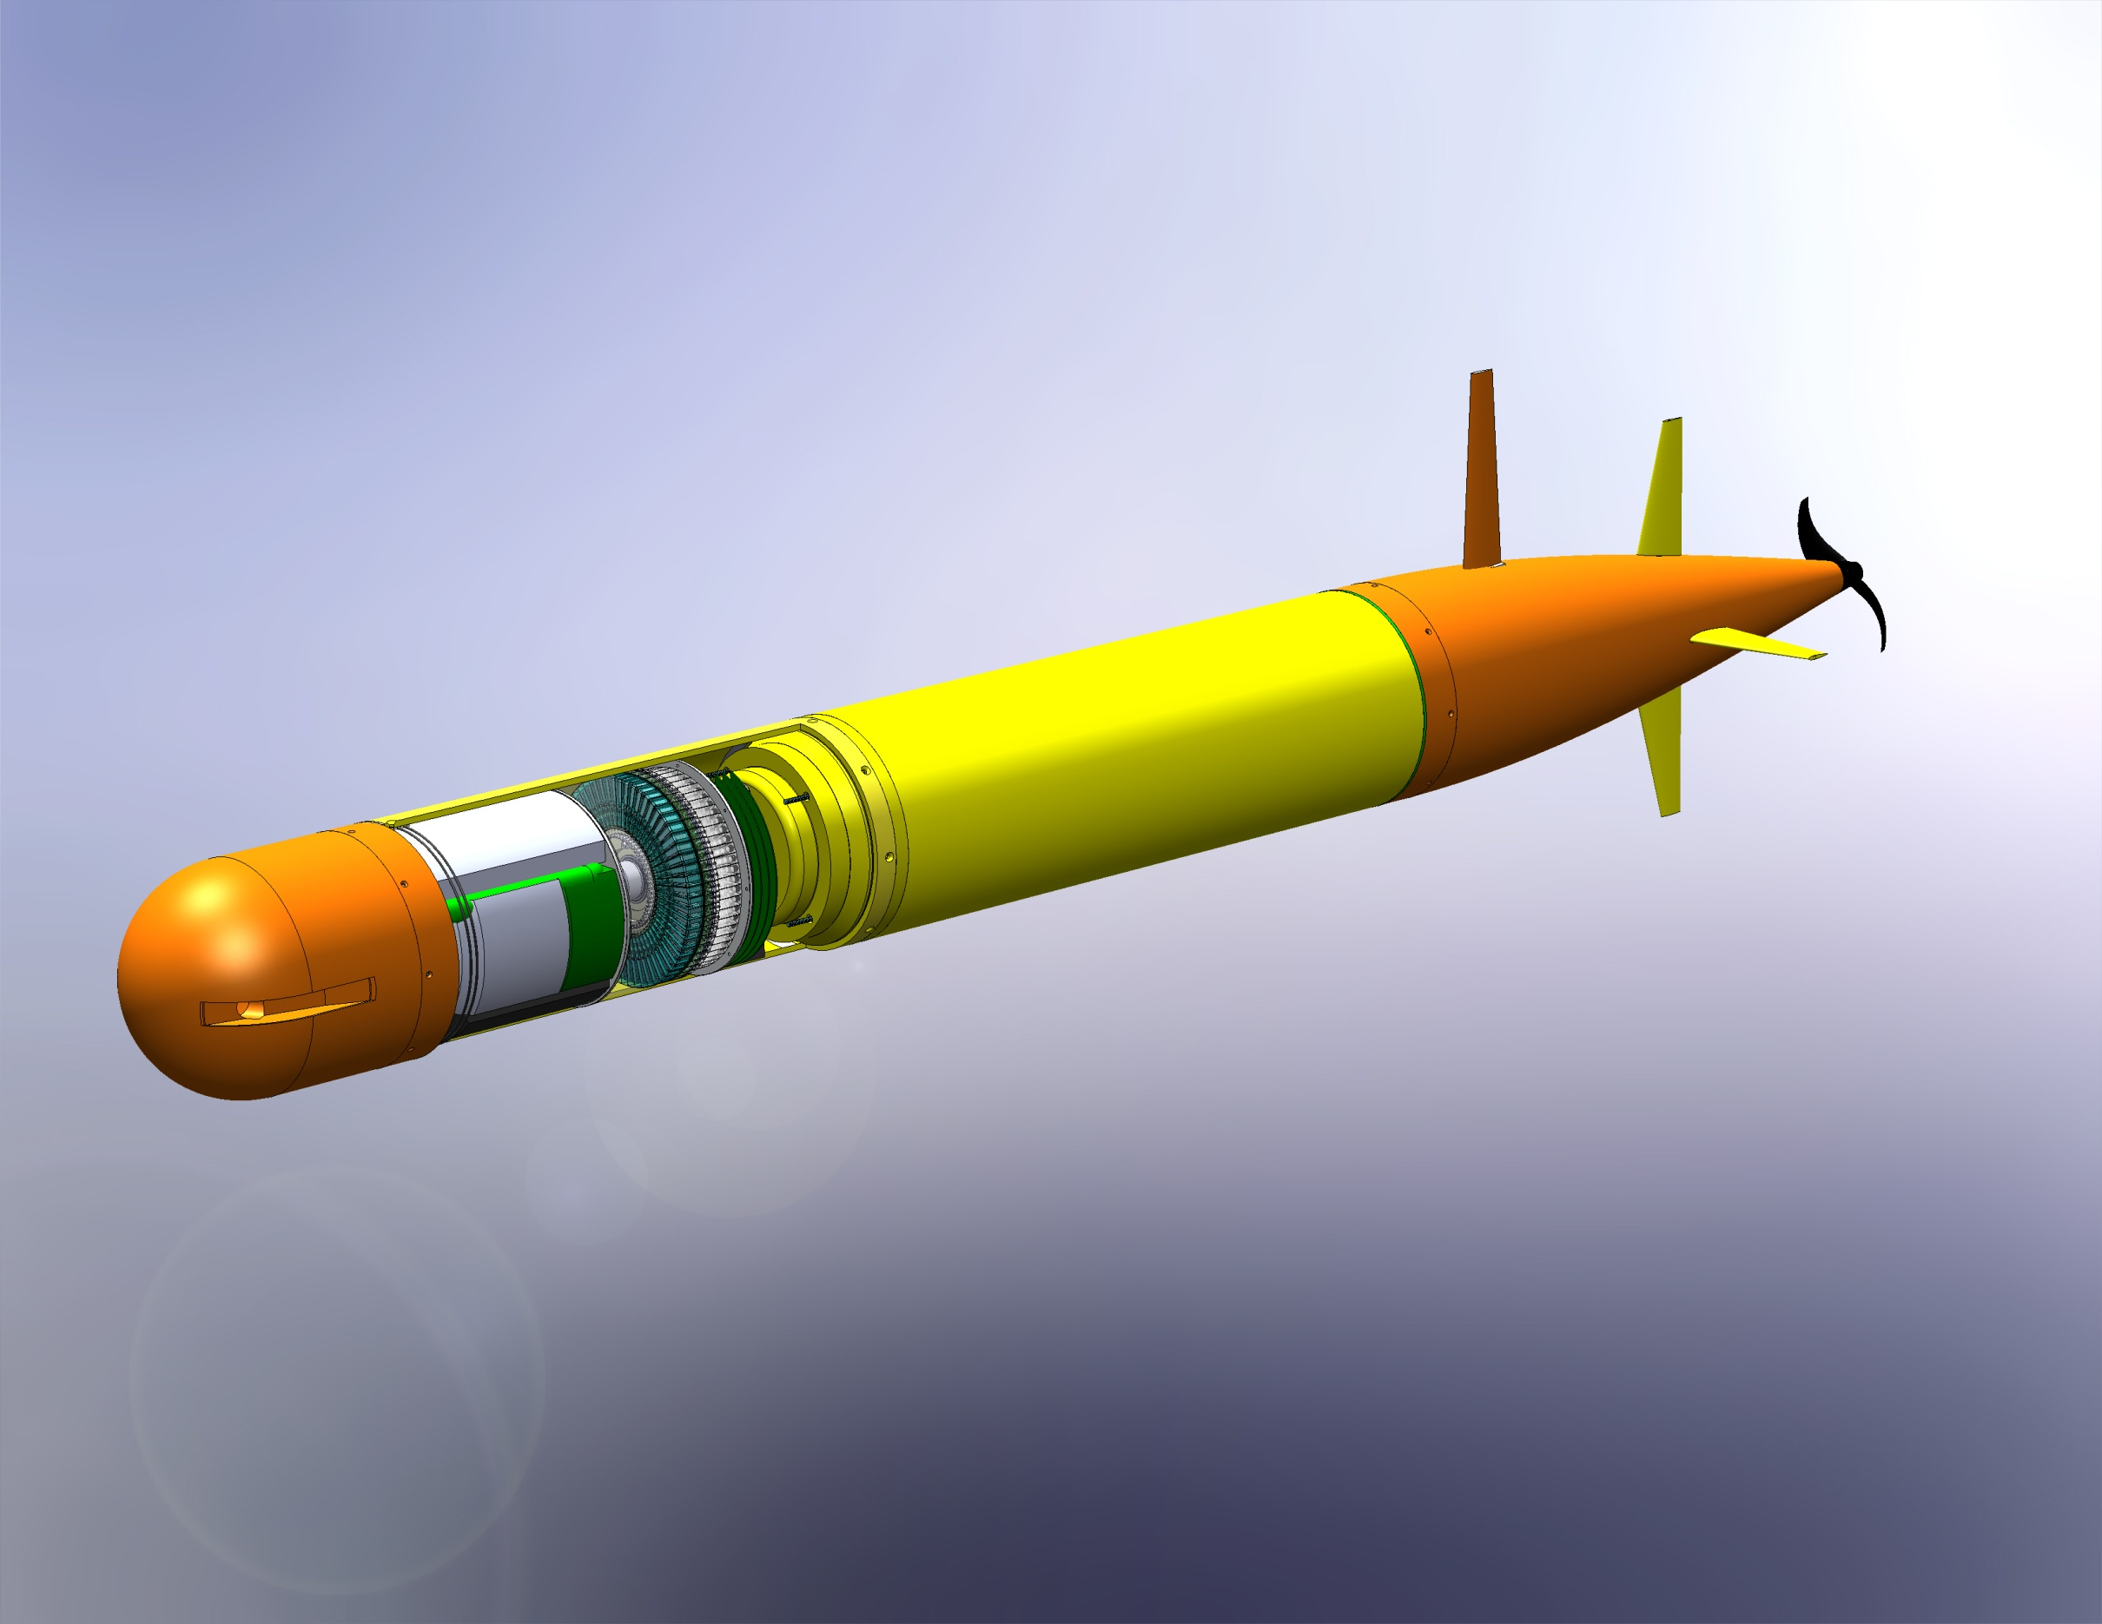
G3 ESP Core and Vehicle Integration
Notes:
Viable AUV Vehicle
Concept is a two pressure chamber design
Provides structural mounting for Tie rods in drive section
Open bay for Turbine ESP
Assembly method is reasonable

Slide 2
ESP-LRAUV Size
28” Extension
119” Vehicle
Notes:
Vehicle Size
28.375” extension to the vehicle
Total vehicle 1” shy of 10’ feet
Deployed and operated a 30” extension, and vehicle maneuvered acceptably.
119 lbs sea water displacement.
35 lbs additional housing weight
Leaves 84 lbs for instrument weight
Maximum weight (including %20 contingency) 77lbs.
7-20 lbs ballast

Slide 3
G3 ESP Mass-Volume
119 lbs additional
displacement
35 lbs pressure housings
64-77 lbs instrument
7-20 lbs ballast
Notes:
Mass-Volume balance
28” extension adds 119 lbs of seawater displacement.
119 lbs sea water displacement.
35 lbs additional housing weight
Leaves 84 lbs for instrument weight
Maximum weight (including %20 contingency) 77lbs.
7-20 lbs ballast

Slide 4
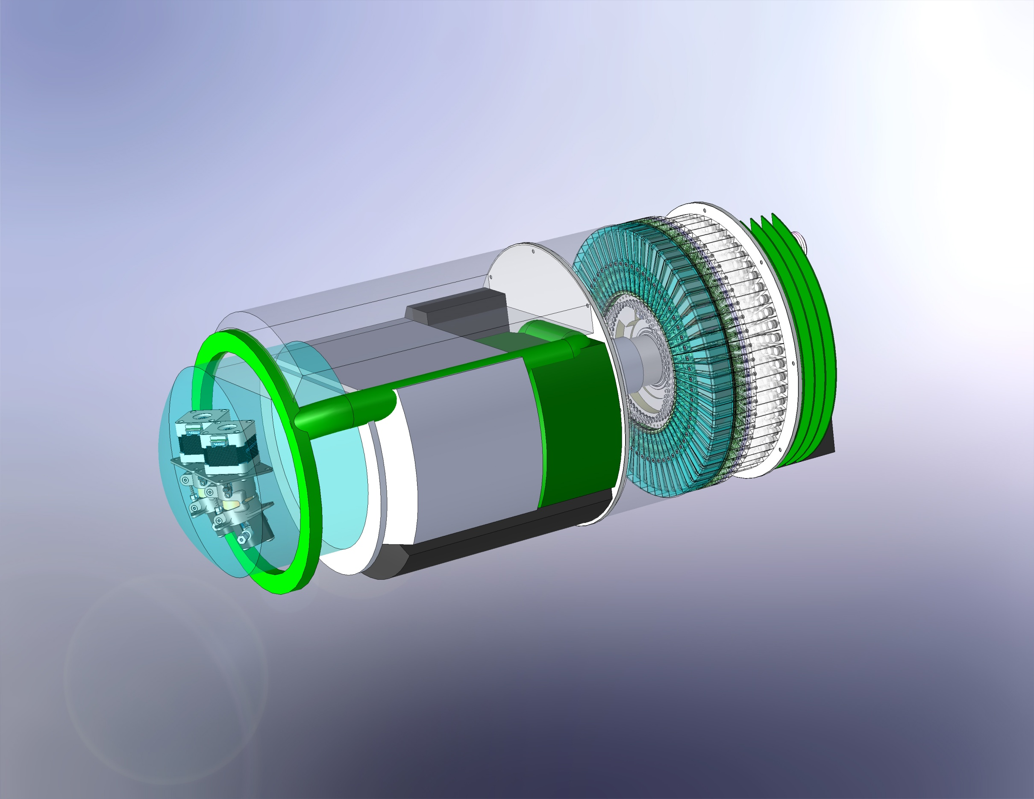
G3 ESP Instrument
Cartridge Wheel
“Optical” sensor
ESP CPU
Analytical Module Bay
Filtering Pumps
Cabling Paths
Common waste storage

