Slide 1
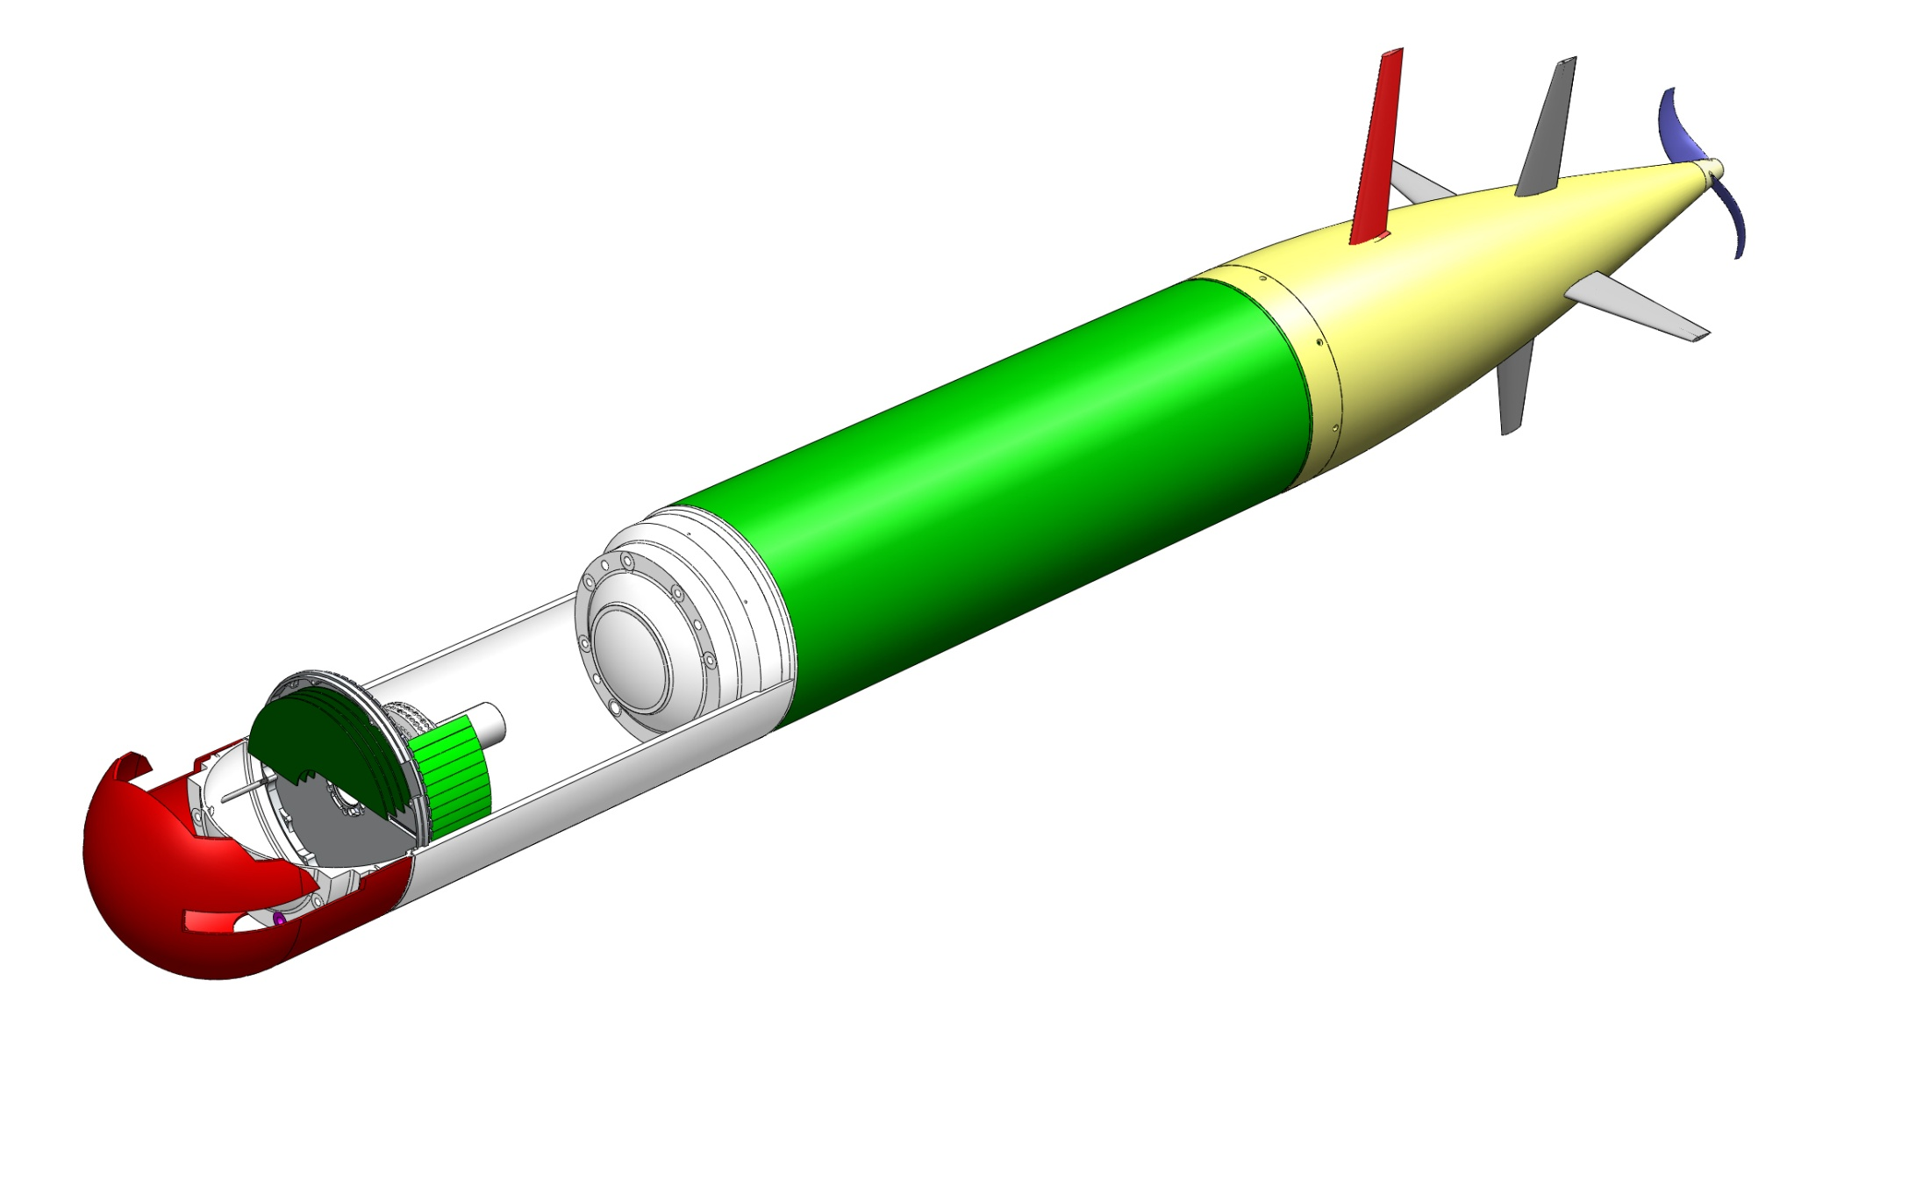
G3 ESP Mechanical Design Update
Viable AUV Vehicle:
Two pressure chamber design
Structural mounting for drive section
Open bay for Turbine ESP
Assembly method is reasonable
Notes:
Viable AUV Vehicle
Concept is a two pressure chamber design
Provides structural mounting for Tie rods in drive section
Open bay for Turbine ESP
Assembly method is reasonable

Slide 2
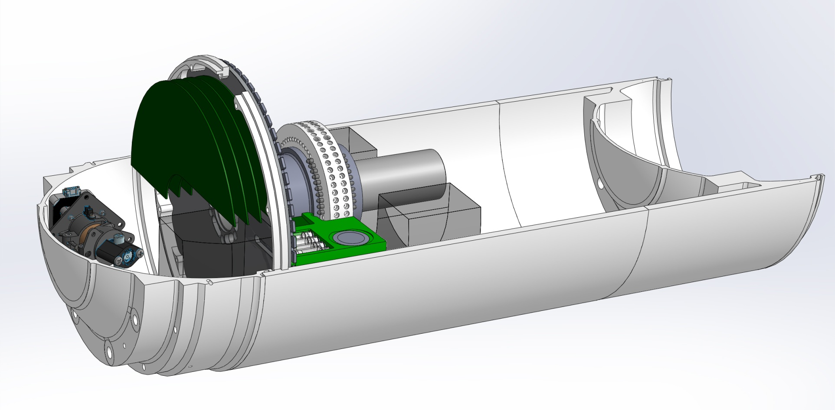
ESP Bay and Components
Instrument
Electronics
Rotating “Turbine”
ESP Housing
ESP “Spine”
Lysate/Extract Handoff
Processing Position
Cartridge Actuators
ESP Forward Dome

Slide 3
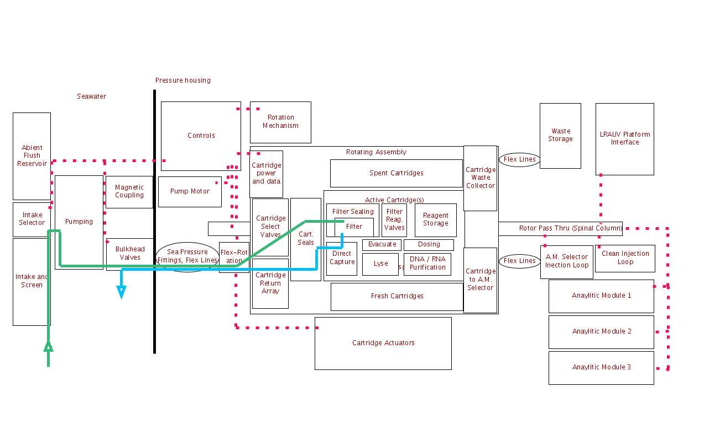
G3 ESP by Functional Block
Notes:
Describe the functional block diagram
Focusing on functional blocks that are high risk, with no COTS solutions.
Walk thru flow path of seawater from intake, thru pump, thru valve array, cartridge, and back to sea.

Slide 4
Filter Pump

Slide 5
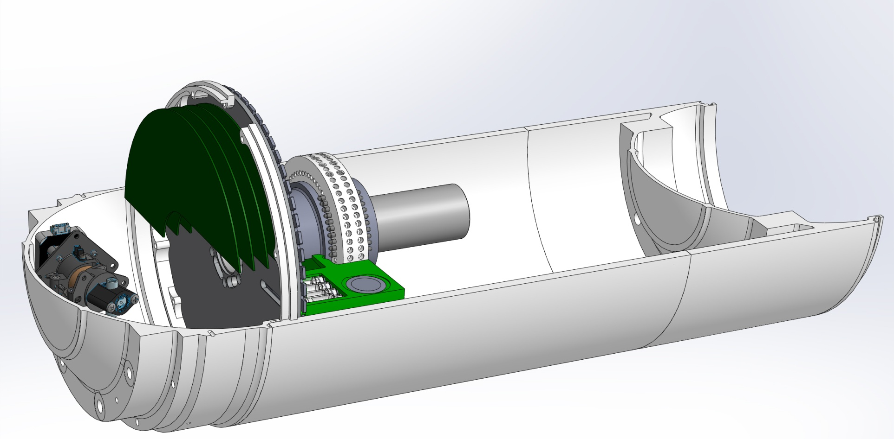
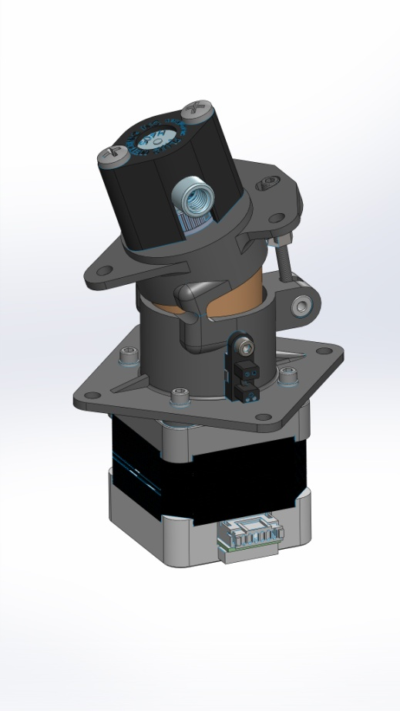
Filter Pump
Rotating piston pump
At ambient pressure (oil compensated)
Passed live culture pumping tests

Slide 6
Spool Valve Array

Slide 7
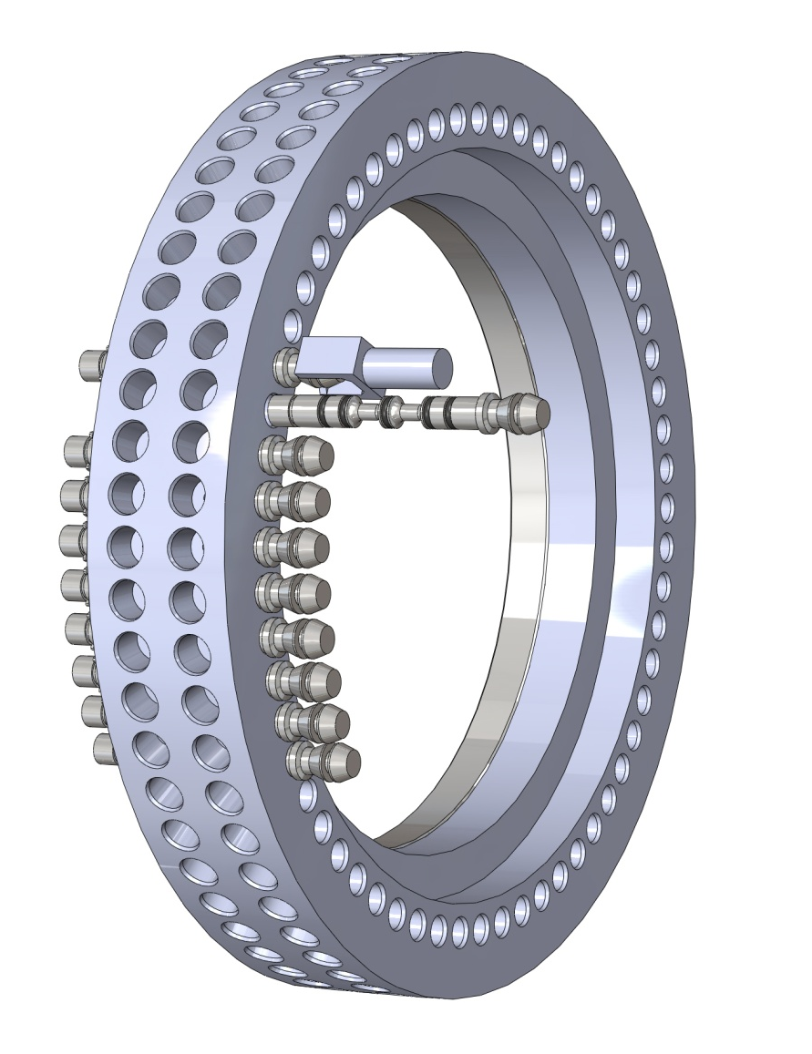
Spool Valve Array
Valve array selects which cartridge(s) get seawater.
Switch flow from bypassing a cartridge, to looping thru the cartridge
Currently design is 60, two position, 4 port spool valves
Notes:
In-house design of a 2 position 4 port valve spool valve
Valves switch seawater flow between bypassing a cartridge, and flowing thru a cartridge.
Current design is

Slide 8
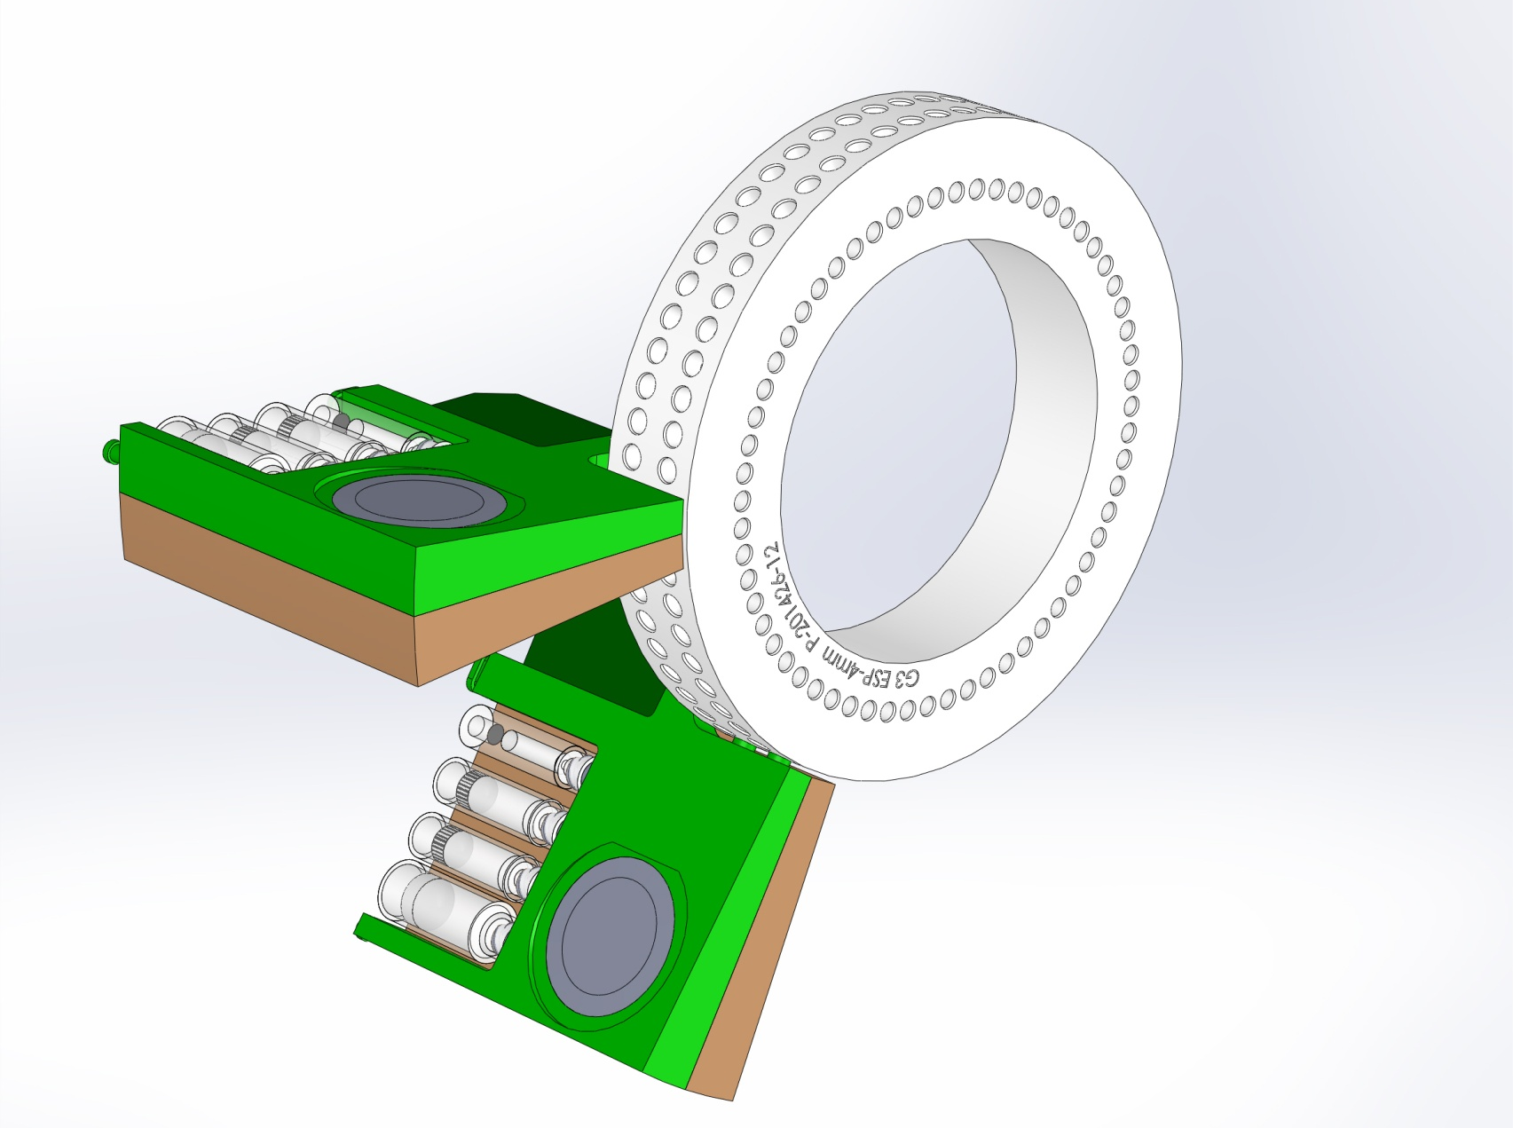
Loop-Bypass Valve Array
Seawater Flow
Filter A
Filter B

Slide 9
Filter Cartridge

Slide 10
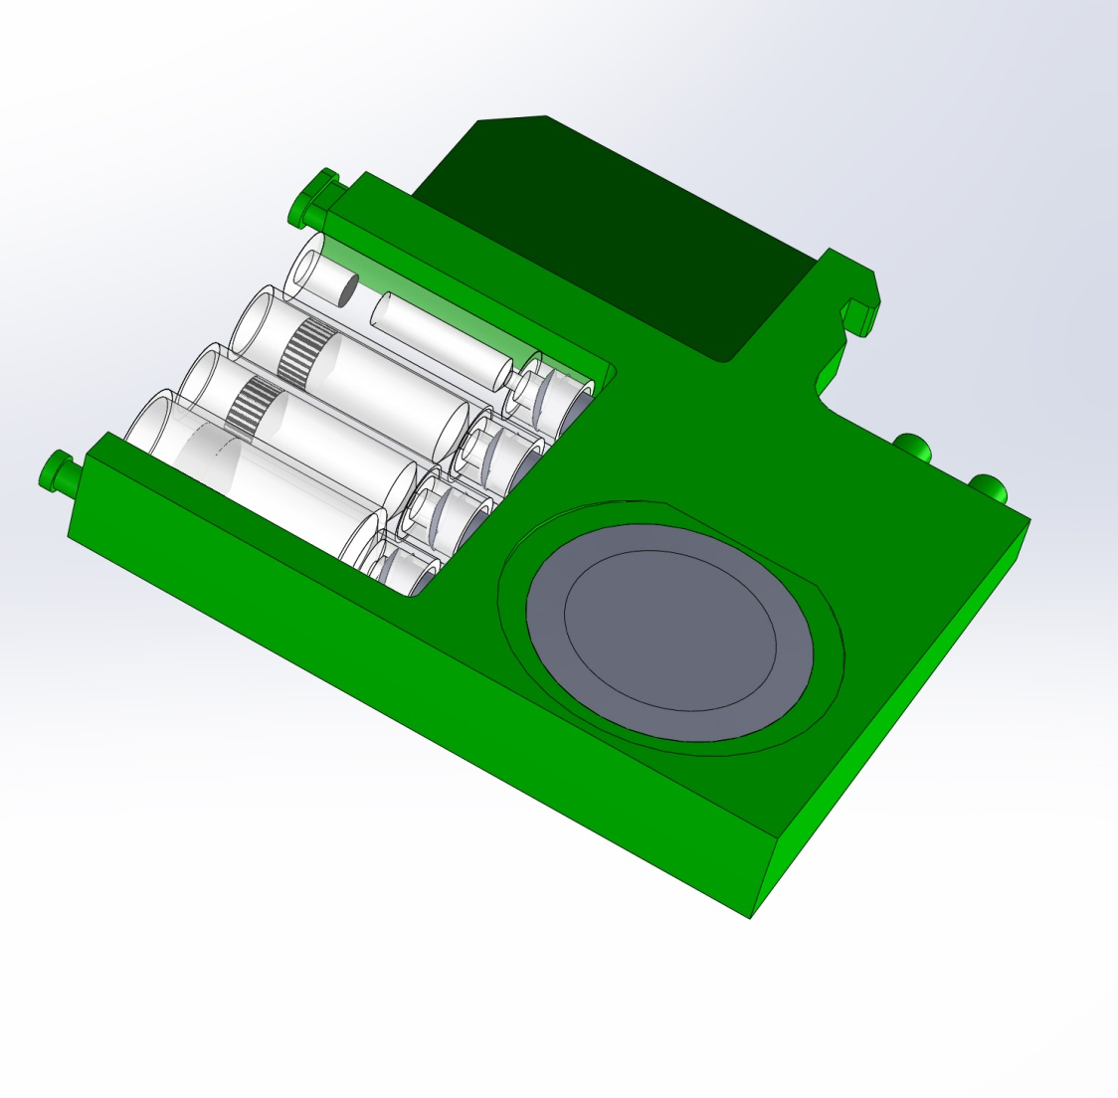
Cartridges
Cartridge CPU
Reagents
Seawater
Ports
Filter holder
“Puck”
Notes:
A lot of things going on in a cartridge, essential a mini-ESP with no power or actuators

Slide 11
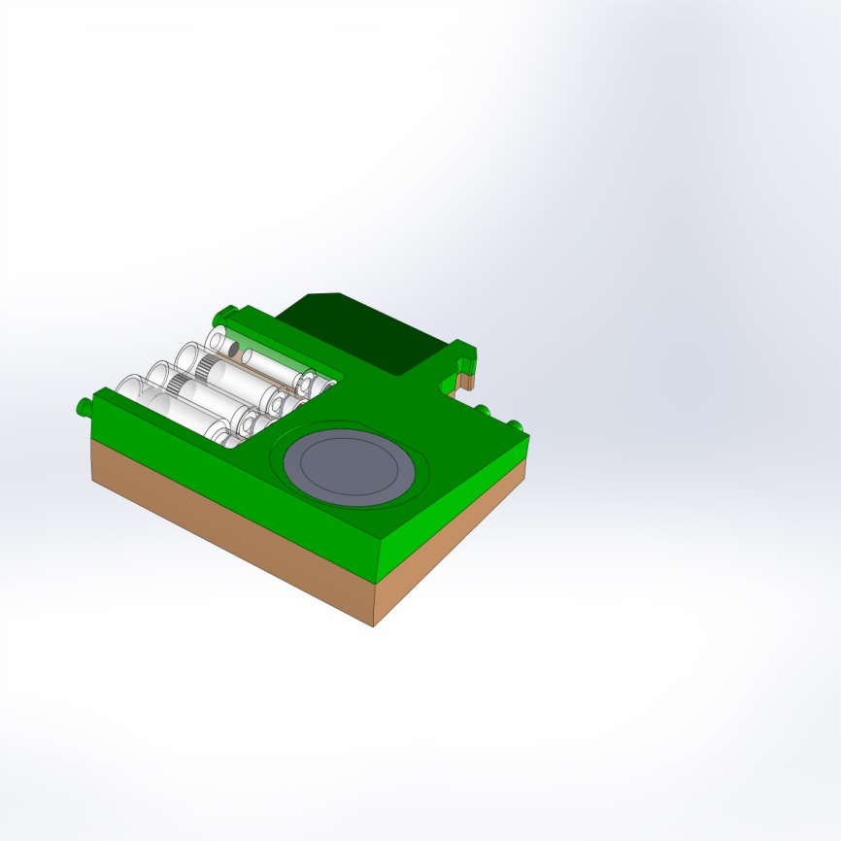
Modular cartridges
Filter
Extract
Seawater
25mm Filter
mixer
Handoff to AM
Filtrate
Extract
mixer
Offboard
Handoff to AM

Slide 12
Series Filtering
Seawater Flow
Filter A
Filter B

Slide 13
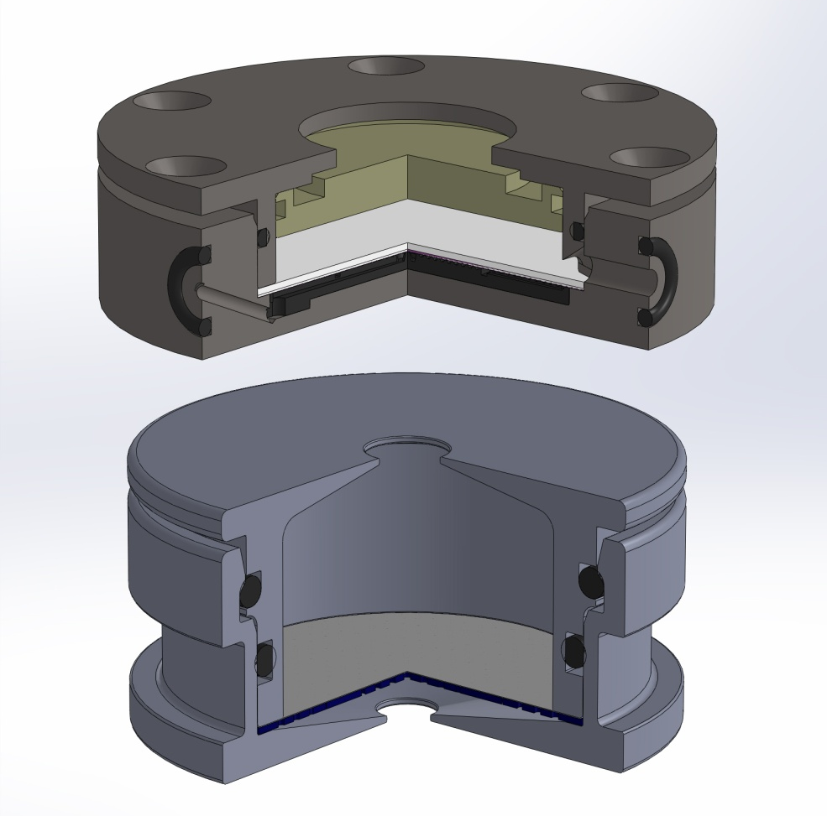
Filter Holder
1mL lysing volume
Filter holder rotates to select between reagent/filtering ports
Contains pressure with no “clamp”
Investigating piston mechanism to empty filter volume
G3
G2
Notes:
Filter holders uses same 25mm filters as the G2 ESP
In the G2, the ambient pressure in the puck is restrained by the clamp assembly. In the G3, each filter holder need to seal and structurally contain the pressure. Up to 6 times that of the G2.
Two additional functions are incorporated,

