Slide 1
Cartridge Testing
September 23, 2013

Slide 2
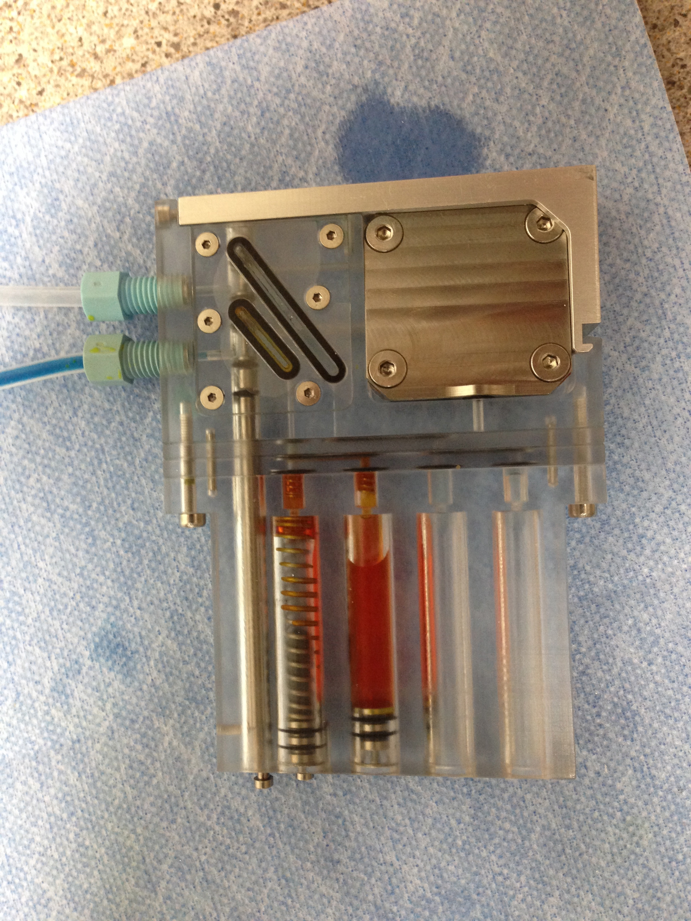
0.22 μm durapore filter
Yellow dye made it
to here during step #2
Inlet line filled
with blue dye, but not pushed through puck
1. Yellow dye bled across check valves during loading = bad check valve
on air syringe
2. Manipulating air syringe against closed cartridge
valve pushed yellow
dye towards puck; but backflow occurred when relaxed = bad check valve
on air syringe
Cartridge
Valve
Sampling
position
#1
#2
#3
#4

Slide 3
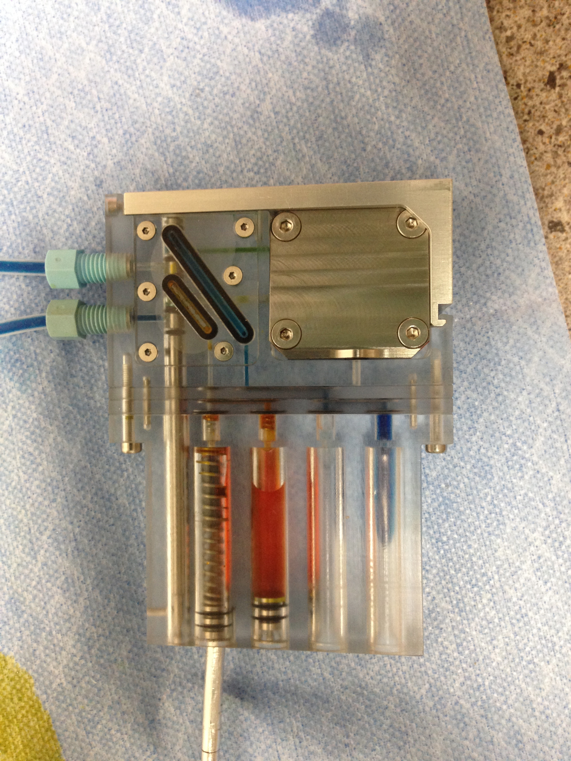
Blue dye pushed
through puck before switching to reagent position; syringe check valves on both lines
1. Internal pressure inside
puck pushed blue dye to
waste when the cartridge
valve was switched
2. Manipulating the air
syringe pushed yellow
dye towards puck
Reagent
position

Slide 4
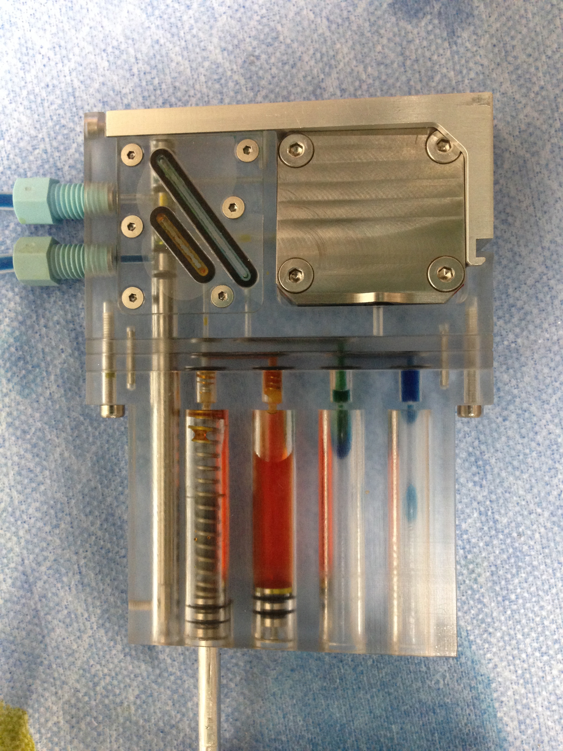
Pumped air syringe
4 times
Yellow dye mixed with blue and exited syr #3, not syr #4 (all blue dye is from when cartridge valve was switched to the reagent position)

Slide 5
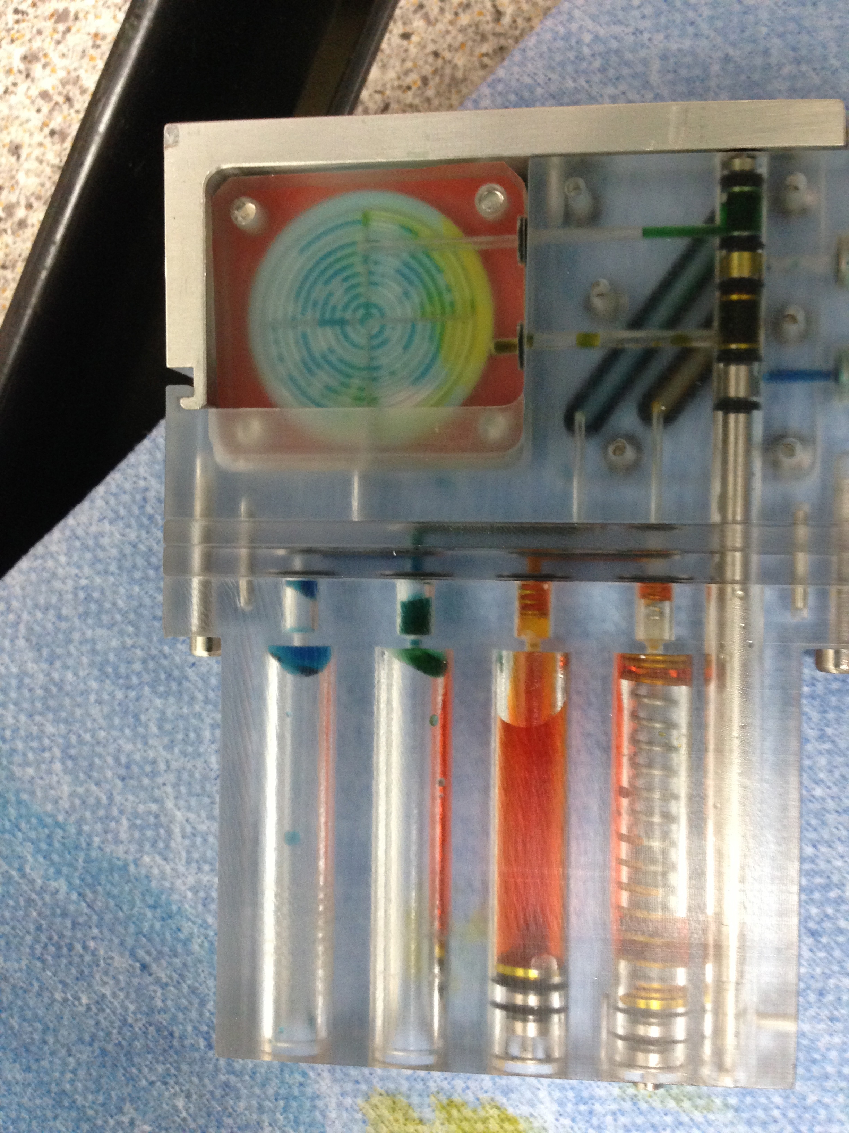
Underside after
4x pumping

Slide 6
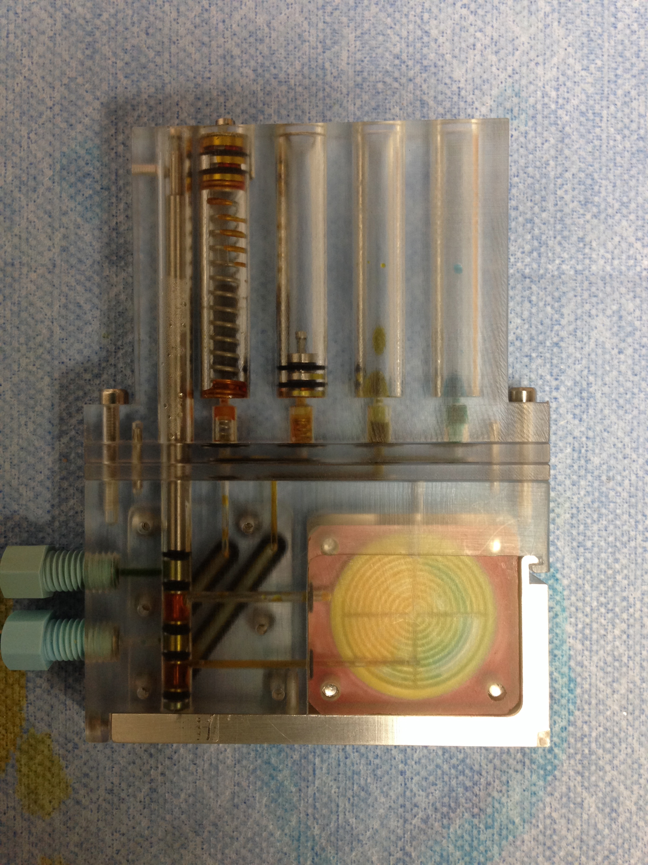
Underside after
injecting all
yellow dye

Slide 7
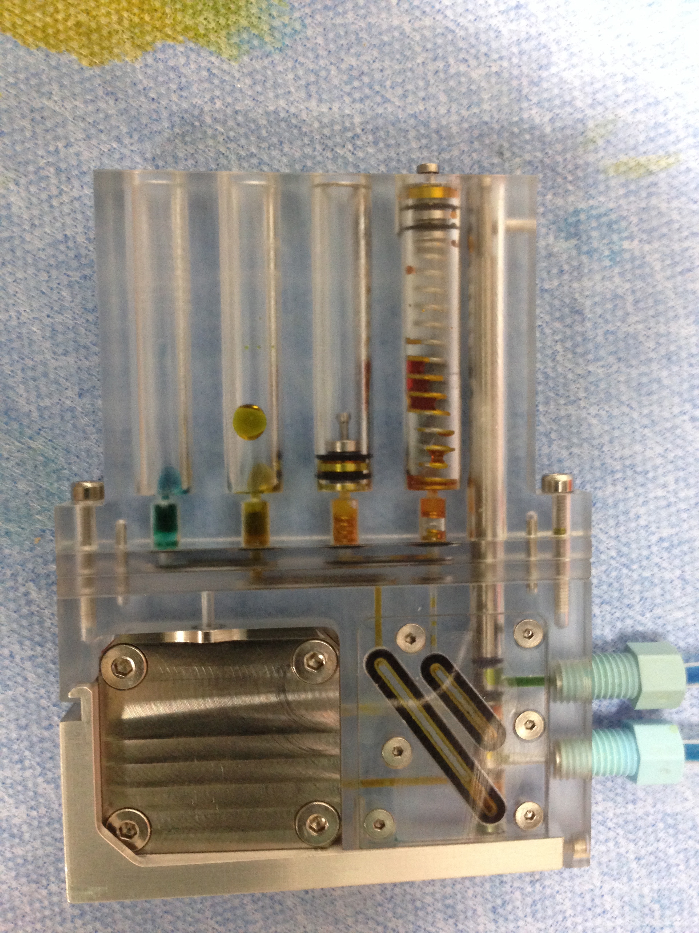
Topside after 4x
air pumps
Where did all the
yellow dye go?

Slide 8
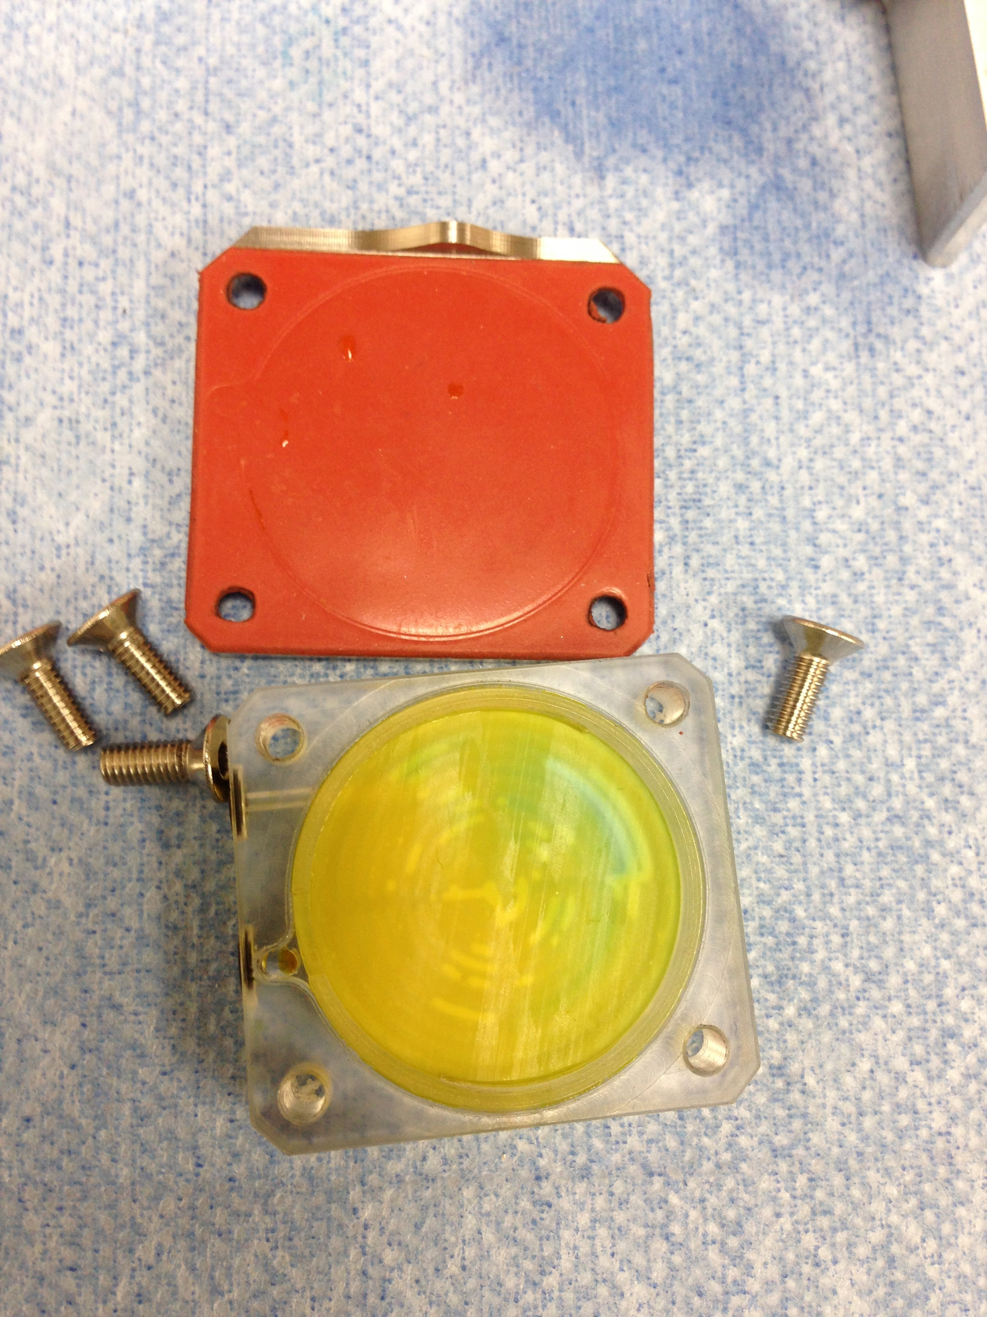
Top of filter appears dry

Slide 9
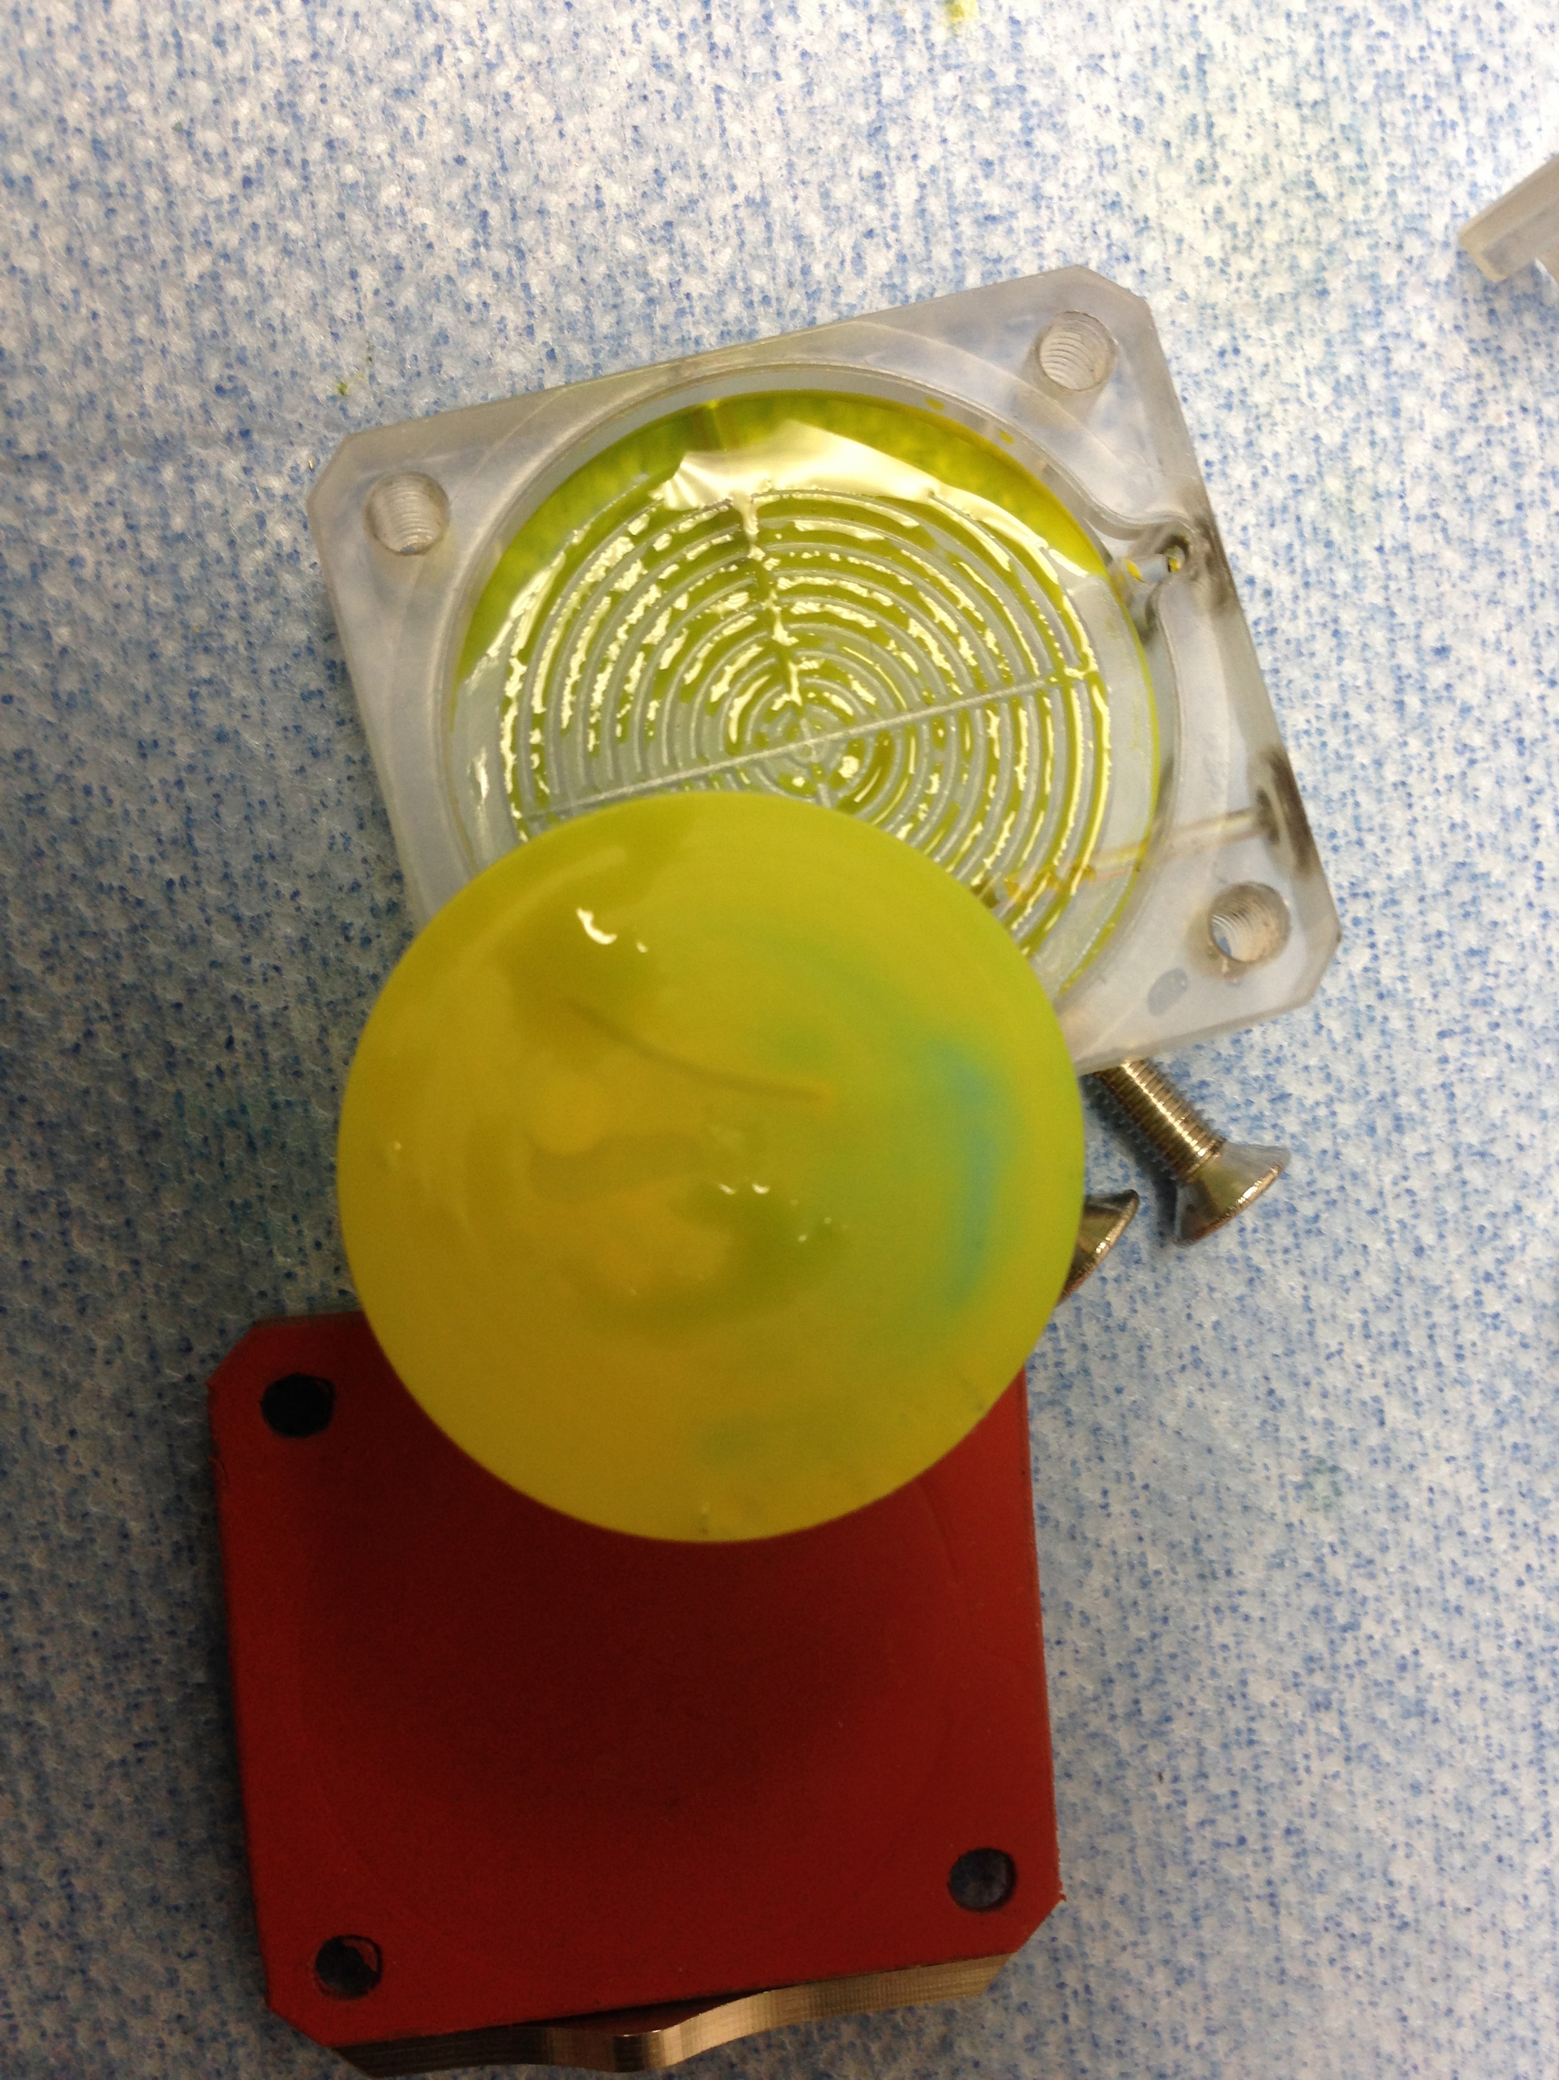
Significant fluid retention below filter

