Slide 1
Phase 2 Cartridge Design Review
September 27, 2013

Slide 2
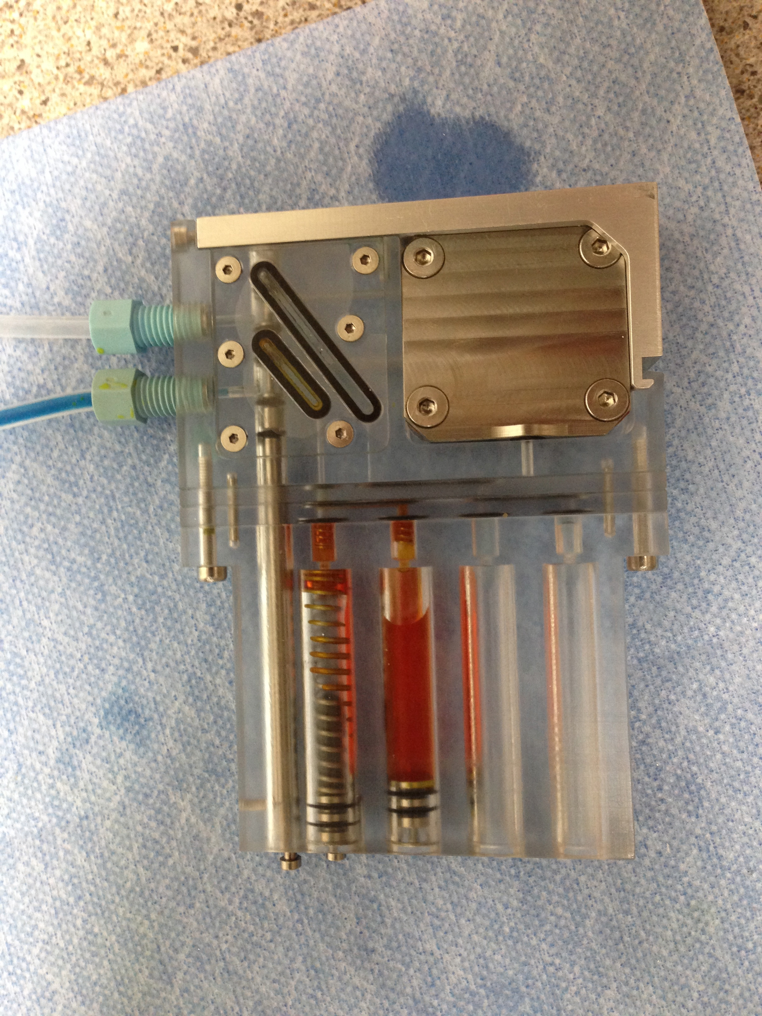
Yellow dye made it
to here during step #2
The check valves do not function properly
Inlet line filled
with blue dye, but not pushed through puck
0.22 μm durapore filter
1. Yellow dye bled across check valves during loading = bad check valve
on air syringe
2. Manipulating air syringe against closed cartridge
valve pushed yellow
dye towards puck; but backflow occurred when relaxed = bad check valve
on air syringe
Cartridge
Valve
Sampling
position
#1
#2
#3
#4

Slide 3
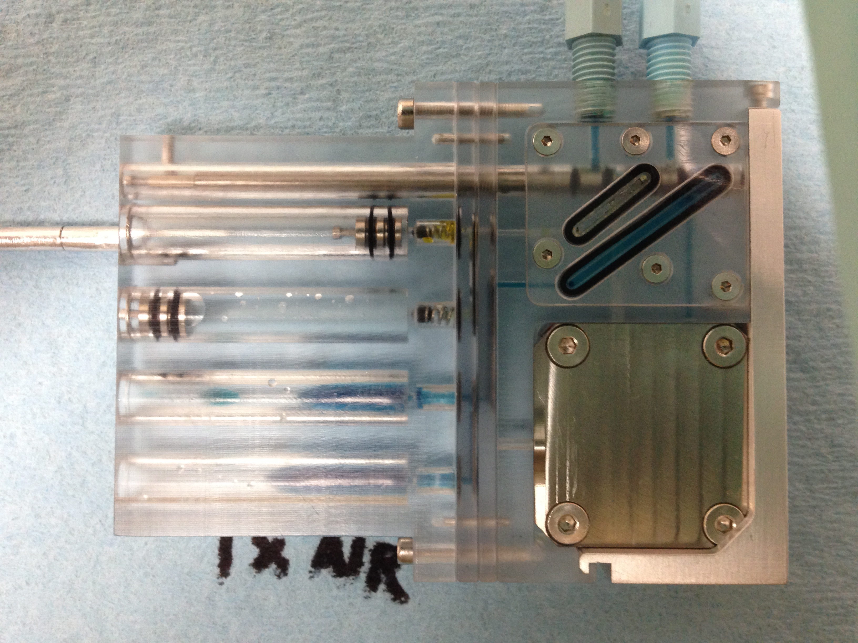
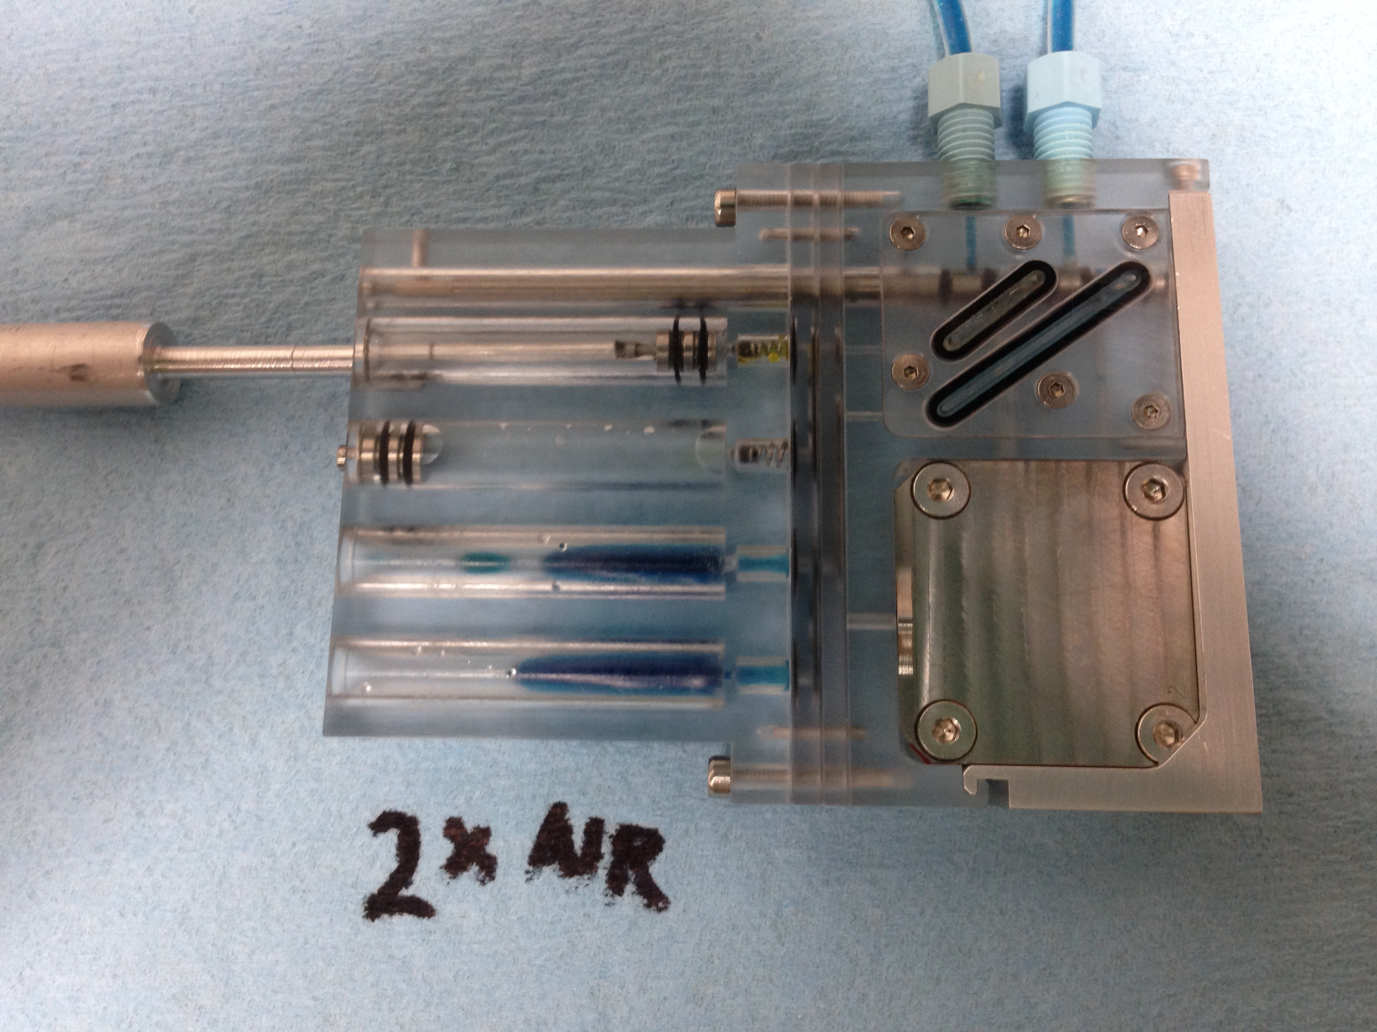
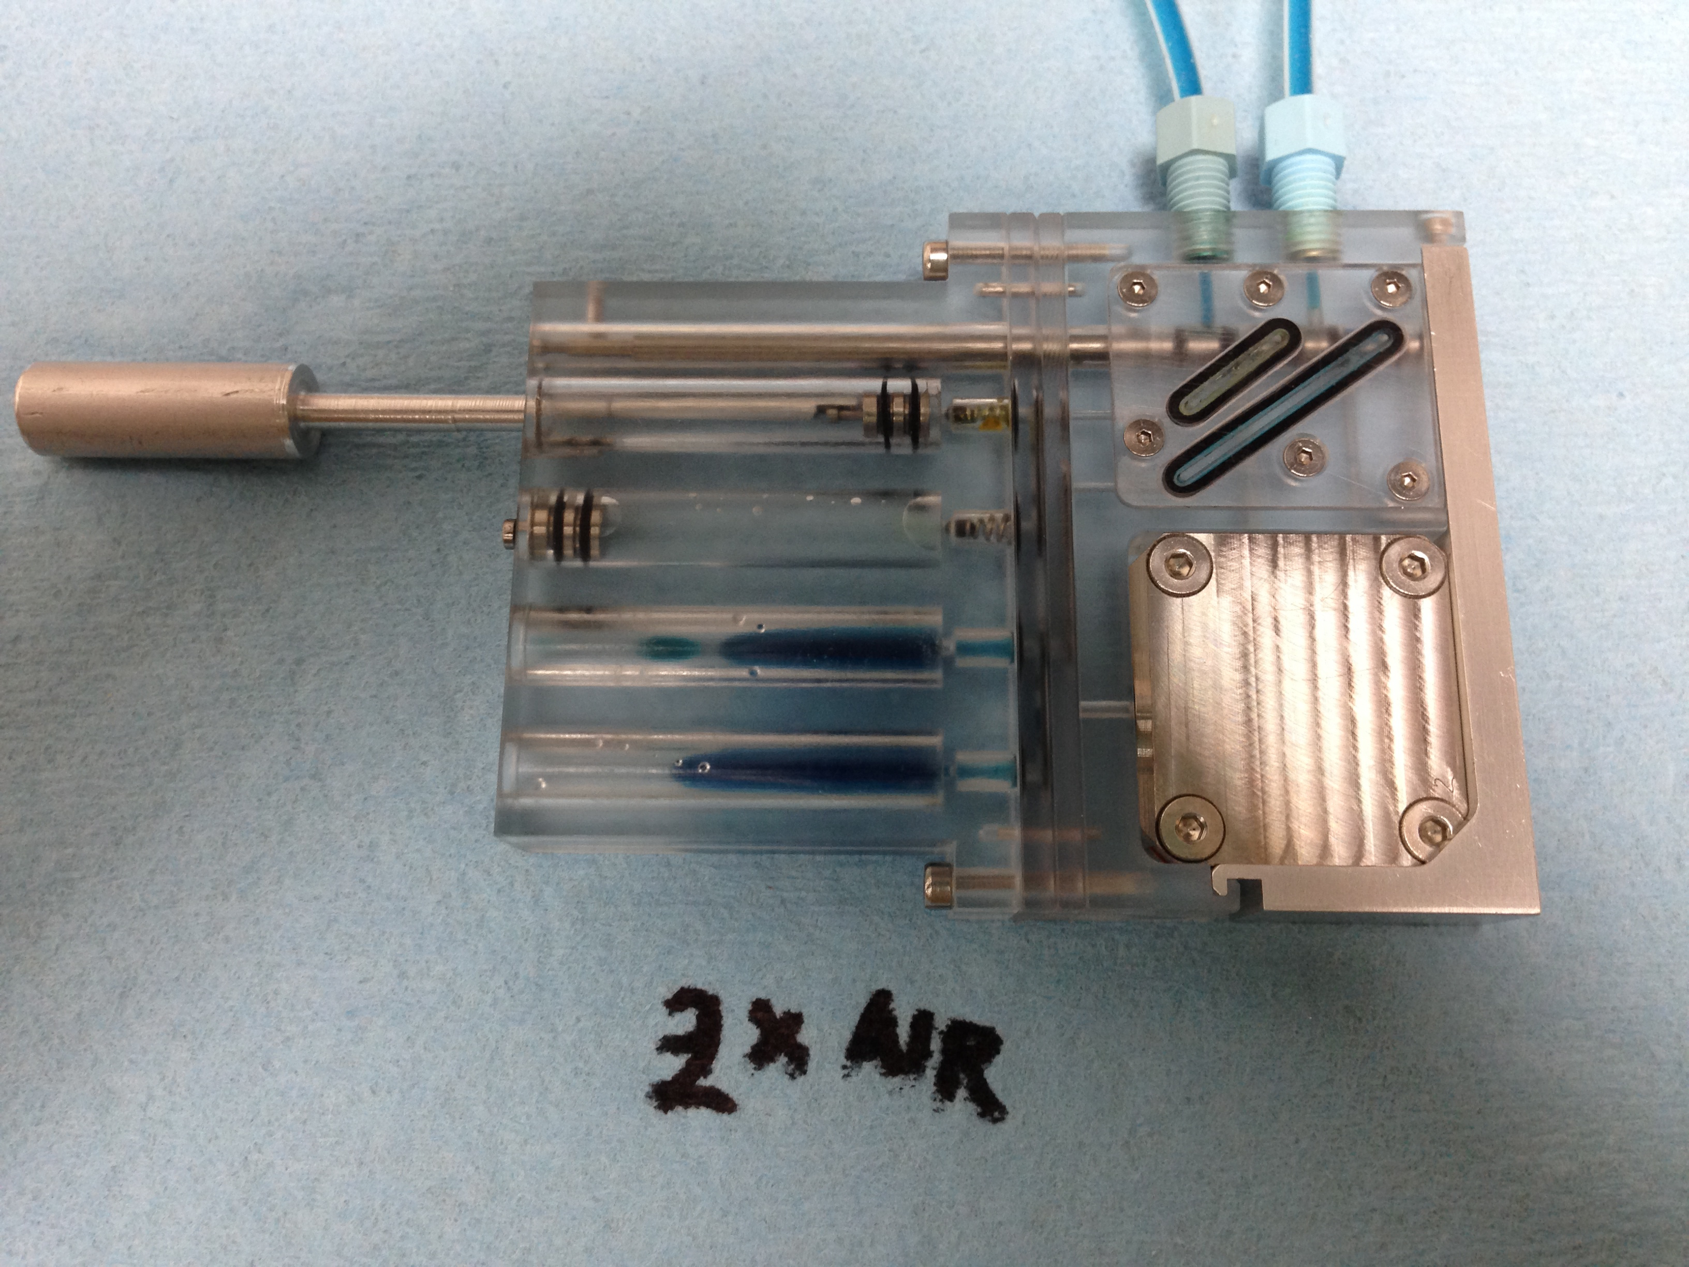
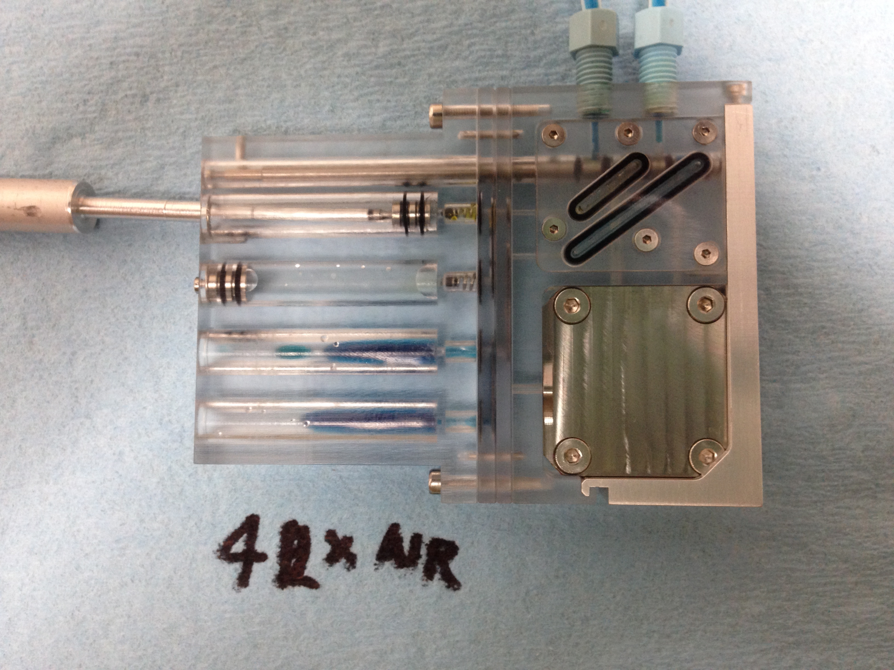
Everything that should happen did happen
with softer check valve balls
Occasional
bubbles
sweep through

Slide 4
