Slide 1
G3 Cartridge Analysis
September 17, 2013

Slide 3
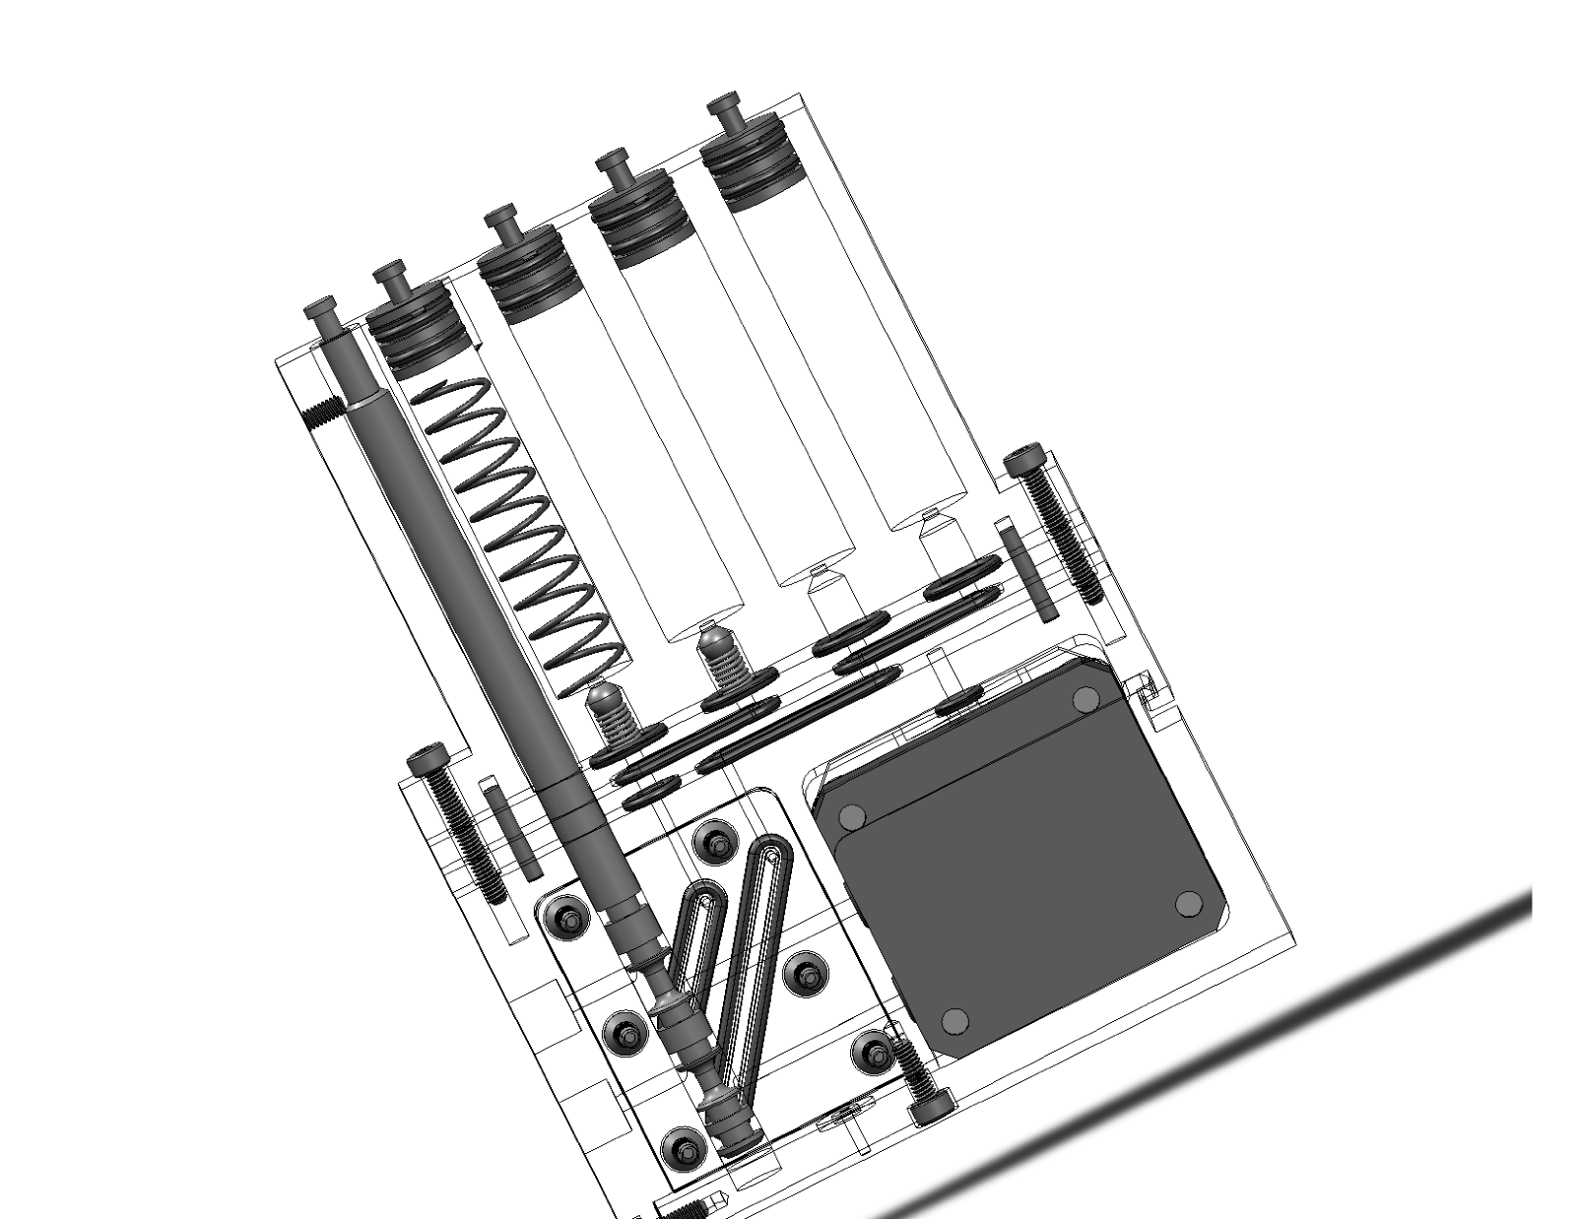

Slide 4
Findings (Cartridge #3)
Check valves leak air and water – microscope inspection shows coarse concentric scoring from machine tool; 2 ‘seats’ have fractures, one has a conchoidal fracture/divot; check valve balls ‘fuzzy’; is spring compression insufficient?
Difficult to reassemble – ‘oblong’ o-rings do not remain in place during assembly – 30+ min to partially reassemble; used plastic sheet – has significant bearing on how to fill syringe(s) with liquid
Piston tool is not functional if piston is inserted more than about 1.5 mm
C-clips easily damaged during removal/re-installation
Plastic puck retention ‘clip’ fragile; loose fit with aluminum bar

Slide 6
To Do
Pressure test filtration circuit
Redesign manifold – eliminate oval-rings; 3D print; issue => aqueous methanol compatibility
Design and test purge port for loading syringe #2 (RNAlater) – 3D mockup for testing
Improve or use different check valve + specify cracking pressure and chemical compatibility

