Slide 1
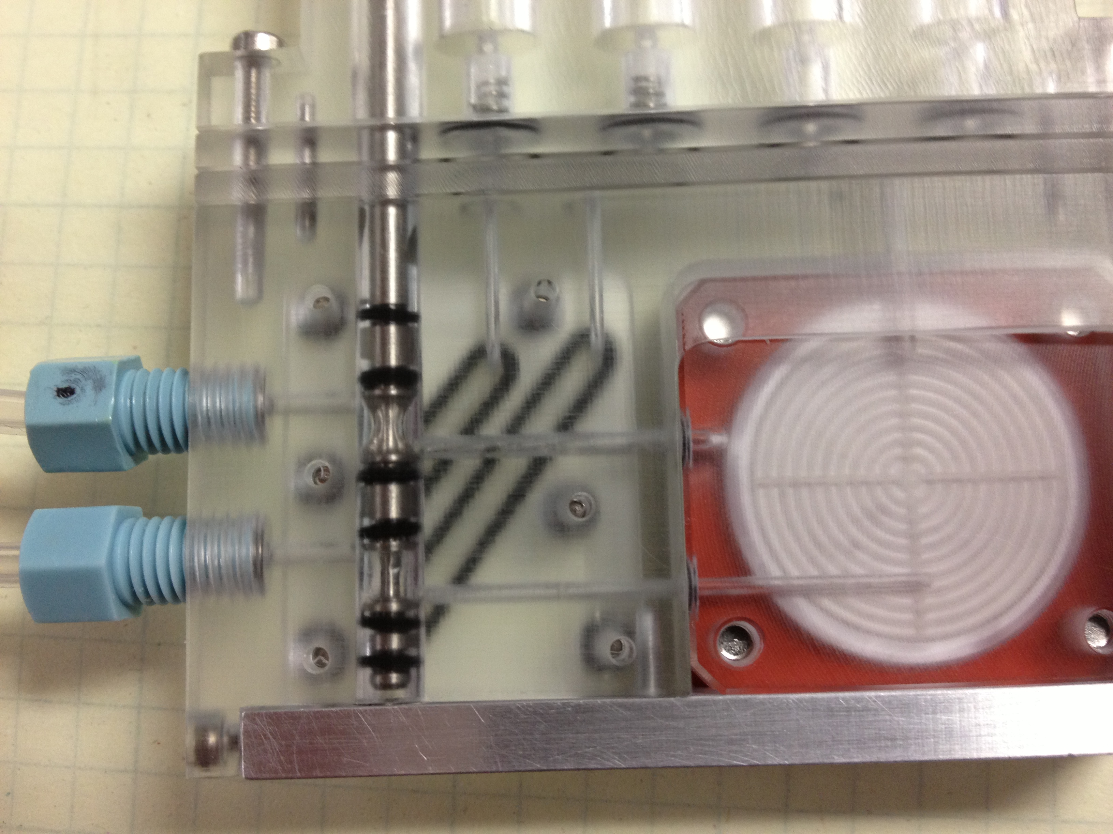
Filtration Test:
Accel VF4 Puck in Cartridge
Spool valve intake/exhaust position. 22psi on Intake only
Evac via intake/exhaust (4X 1.5ml air)
*
*huge bubble on Accel F4-Fixture
Bubble issue less with the puck in the Cartridge than the fixture. Good air clears (0.058, 0.068) and biomass distributed well across the filter.
2. With the Ti Screen the filtration rate (in the Cartridge) is as good or faster than the G2 fixture. The air clear did not work as well (0.204,0.124), mainly due to to a pour seal (Note: could not run a spacer ring). Looks like the filter pushing into the channels is what is reducing our flow rate. Deeping the channels may be the fix.
Image taken after air clear

Slide 2
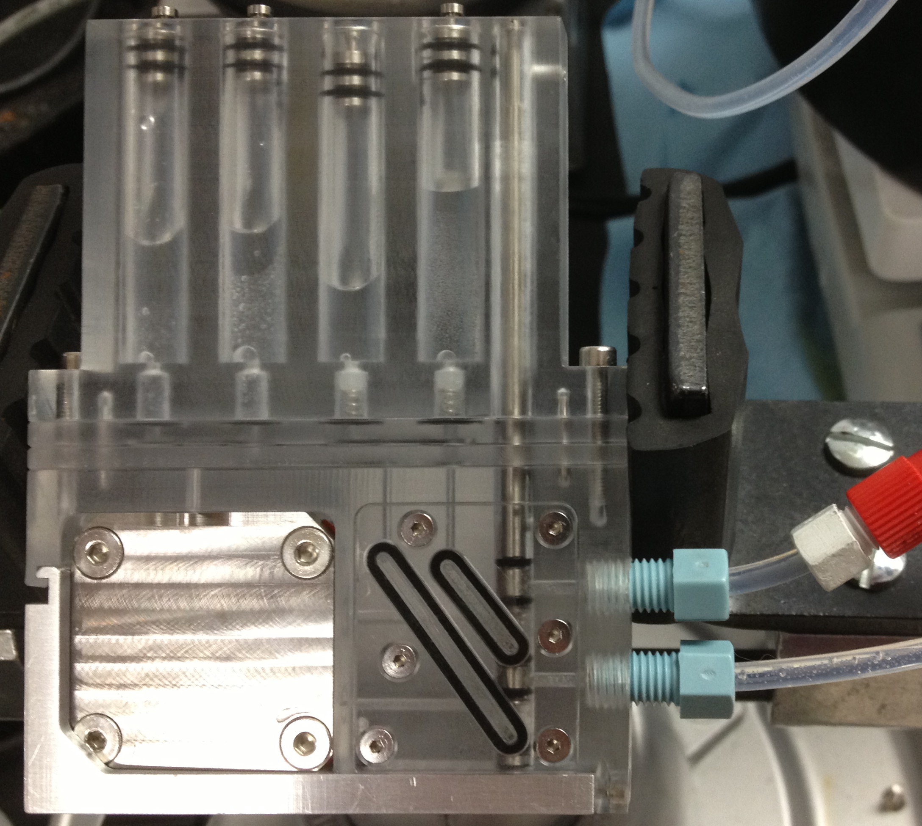
Accel F4 in Cartridge Pressure test Spool Valve Actuation
Spool valve at reagents:
  20psi brought up to 70psi (on intake only). No leak with pressure increase
Changed to intake/exhaust position
  Leaked! Leaked seawater into all syringes, into the plate that makes up the reagent path, and out the bottom of the spool valve.
  No leak out the o-rings on the puck face (70psi).
SW under Reagent path plate
SW out the Bottom spool valve

Slide 3
Proposed Order of Operation
Start w/ Cartridge valve in reagent position (secondary seal)
Actuate cartridge valve to sample position
Open spool valve--- filtering
Close spool valve—finished
Actuate cartridge valve to reagent position

