Slide 1

FIDO: Filtering Instrument for DNA Observations
Jim Birch
Monterey Bay Aquarium Research Institute (MBARI)
Technical
Discussion—Licensing
August, 2026

Slide 2
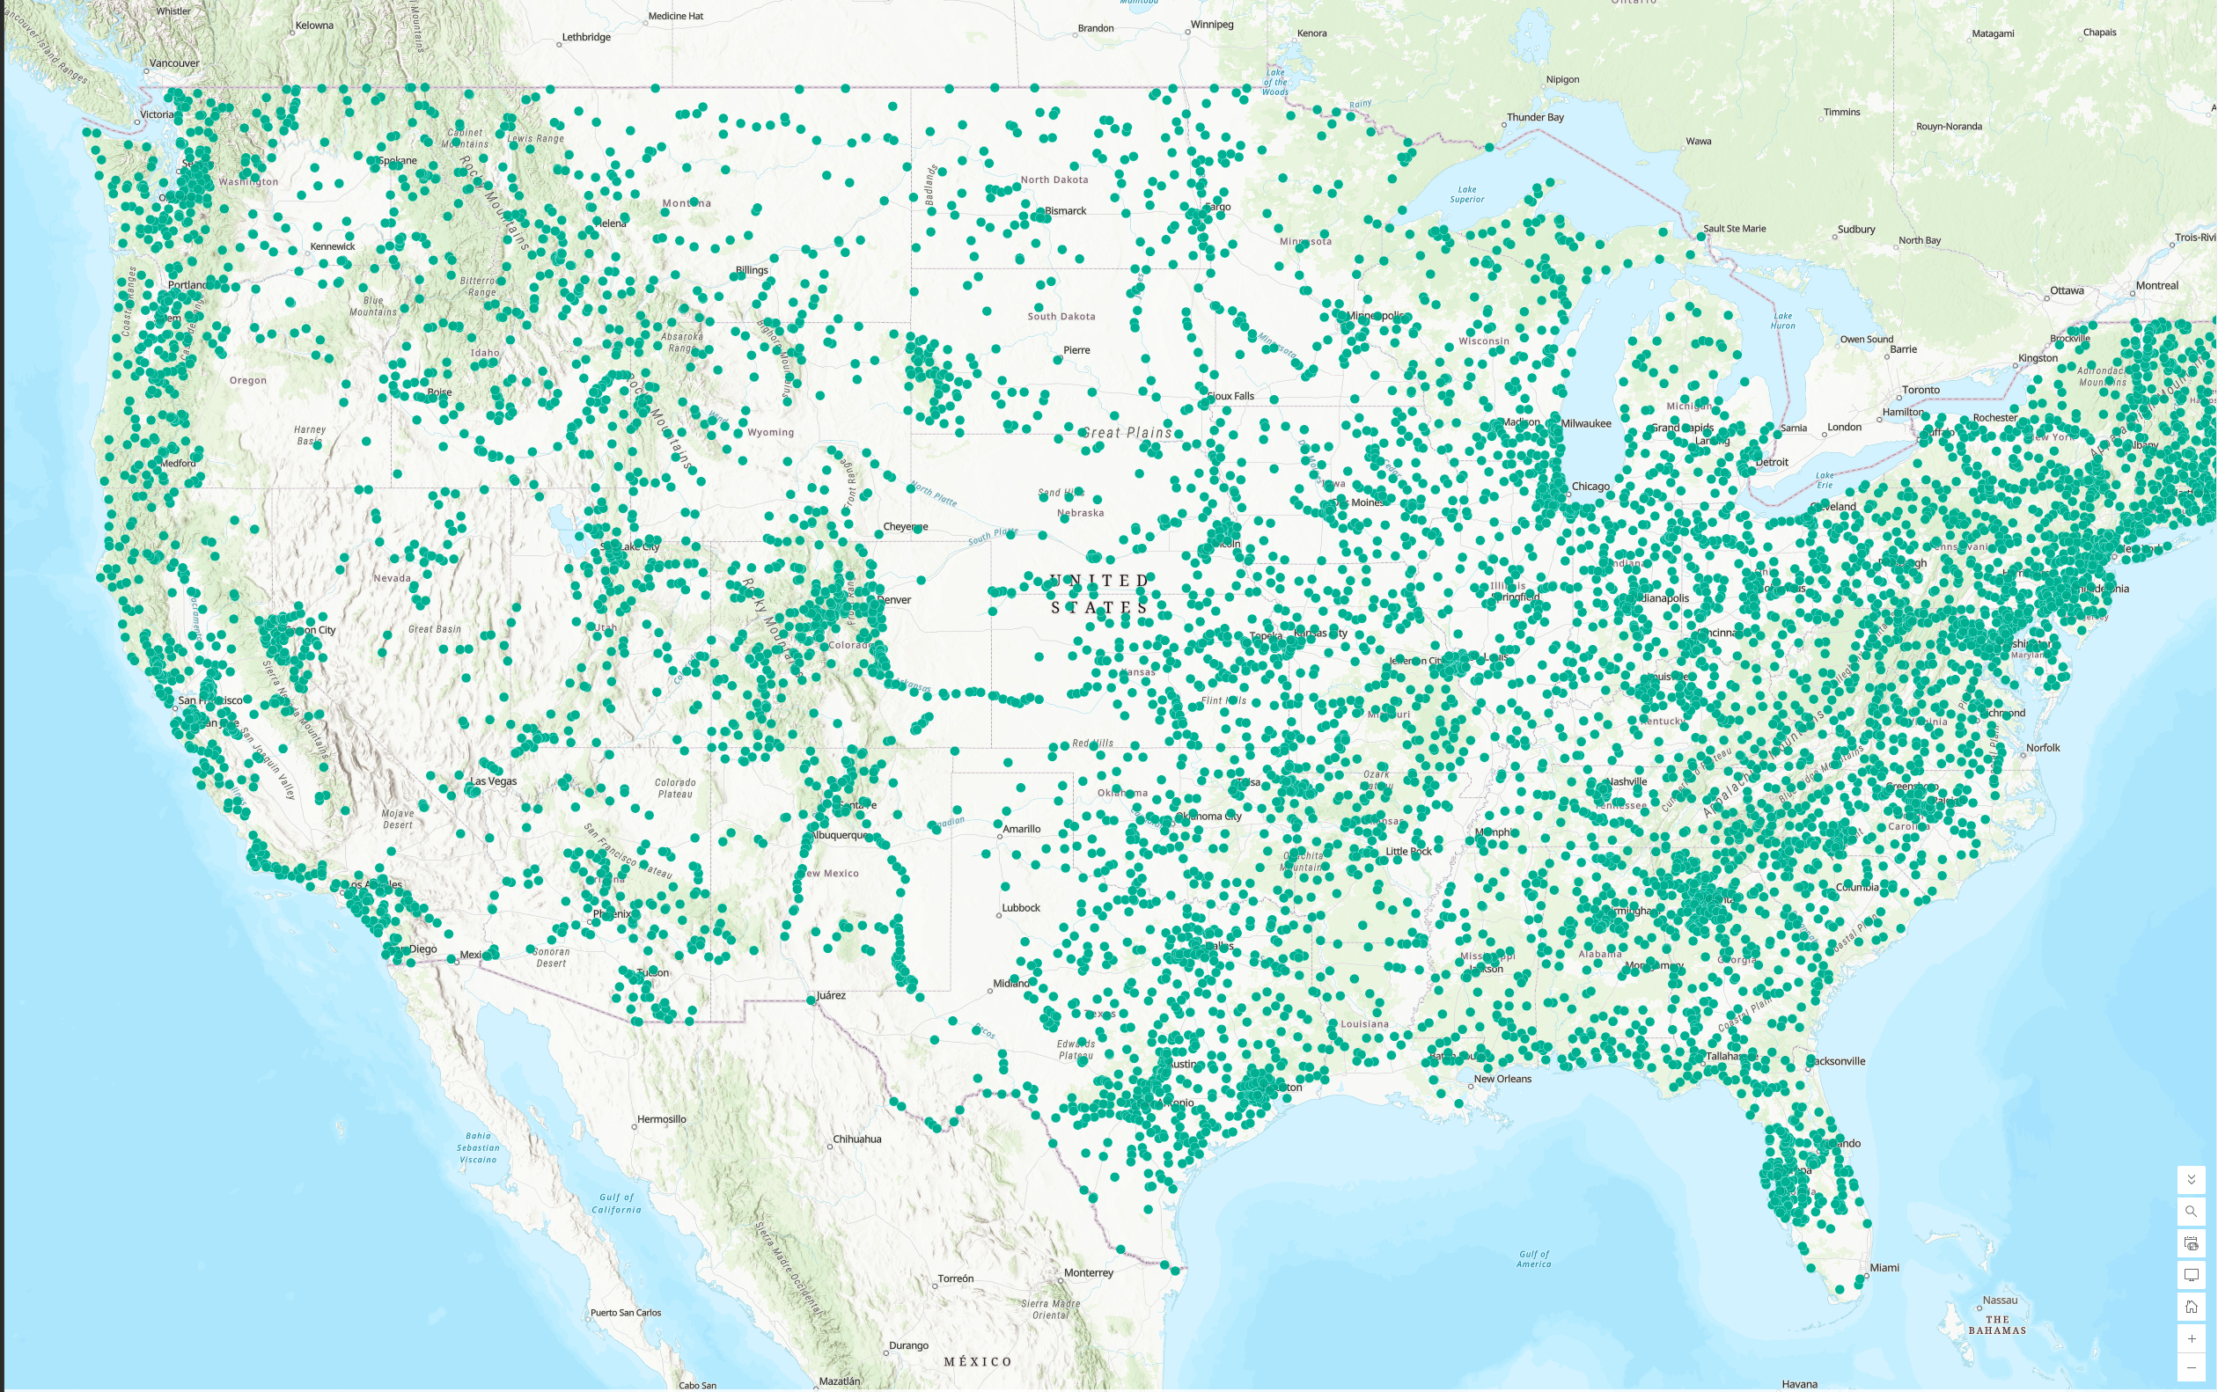
USGS and READI-Net
USGS operates ~12,000 continuous water and ~1500 temporary gage houses.

Slide 3
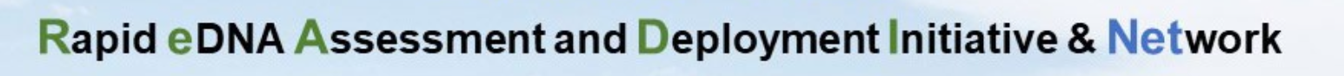
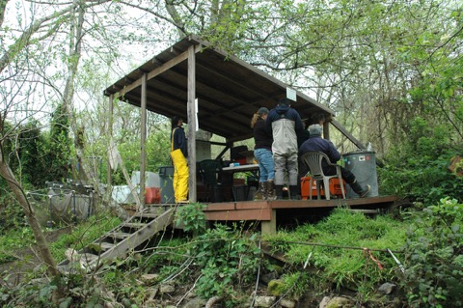
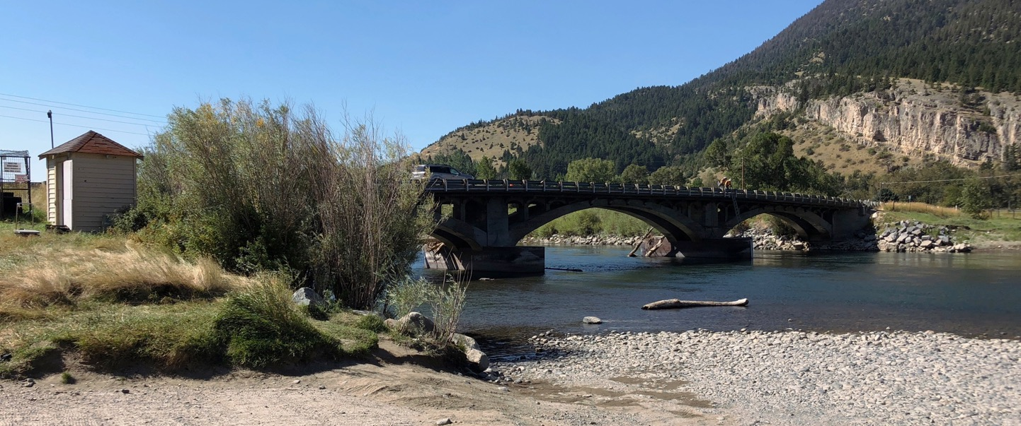
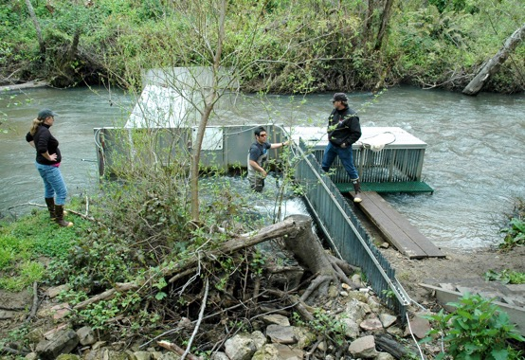
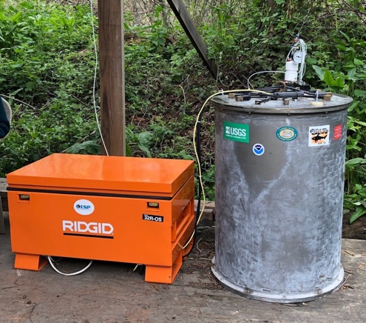
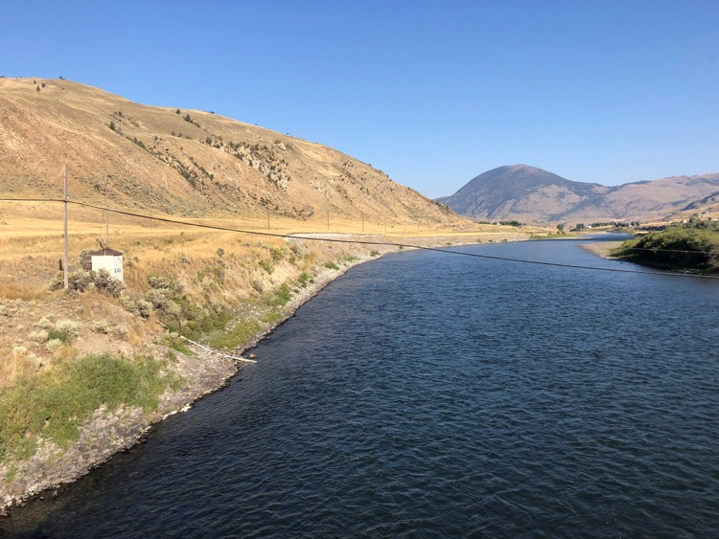
USGS and READI-Net
Carter’s Bridge (Yellowstone R.)
High frequency or long-term sampling
Corwin Springs (Yellowstone R.)

Slide 4
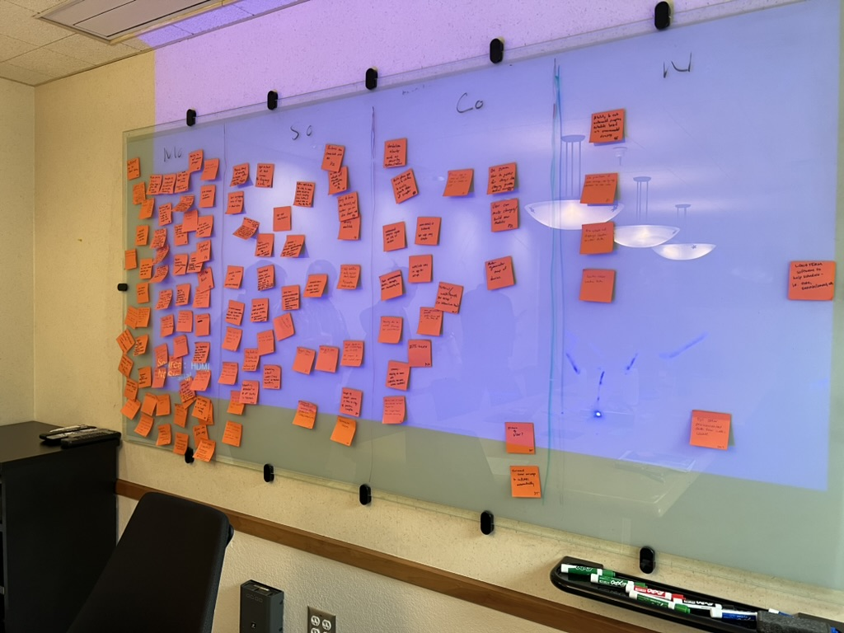
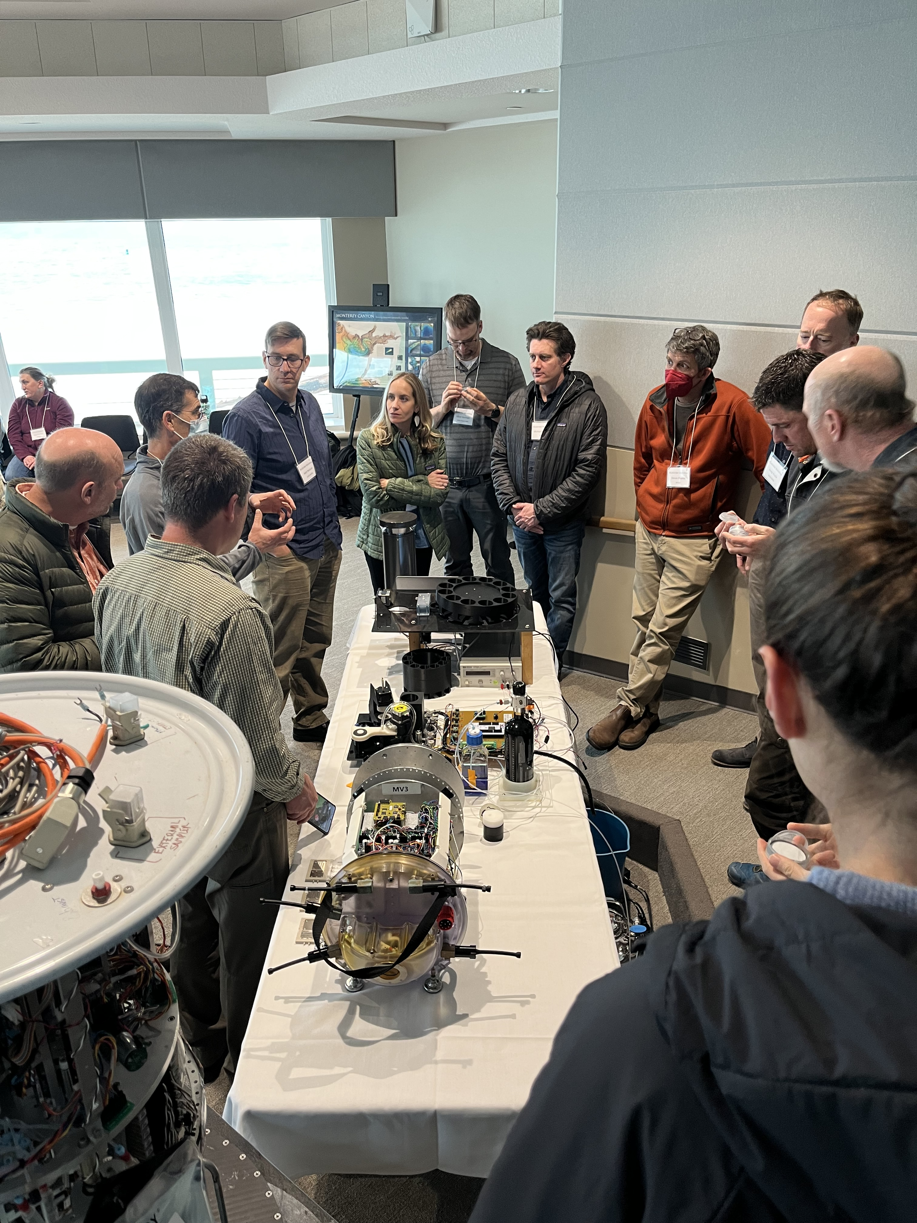
READI-Net
READI-Net Kickoff meeting – March 1-2, 2023
MoSCoW Prioritization
Must have, Should have, Could have or Won’t have
Notes:
We utilized members of the READI-net program to co-design the instrument. We were invited members to prioritize instrument functions and capabilities through a MoSCoW priotization framework. Here we asked readi-net researchers to prioritize instrument functions that were Must Haves, Should Have, Could Haves or Wont Haves. We generated thousands of sticky notes that were distilled down into the functional requirement of the instrument design.

Slide 5
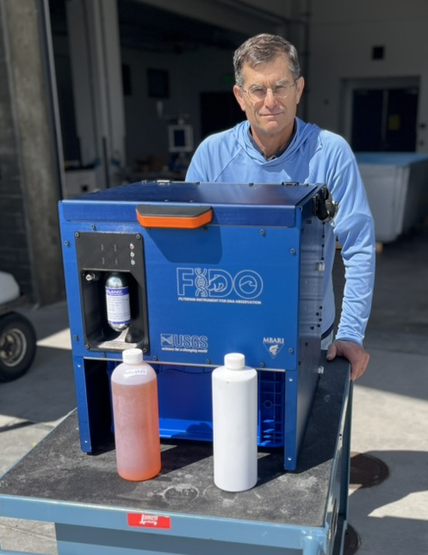
FIDO: Filtering Instrument for DNA Observations
Three inter-related components:
Water acquisition
  Submersible pump & tubing
  Phase separator
  Pump controller & power supply
Sample processing
  Pucks
  FIDO instrument & power supply
  Puck reader
Command & Control GUI
  WiFi and Cellular connectivity
  Website control

Slide 6
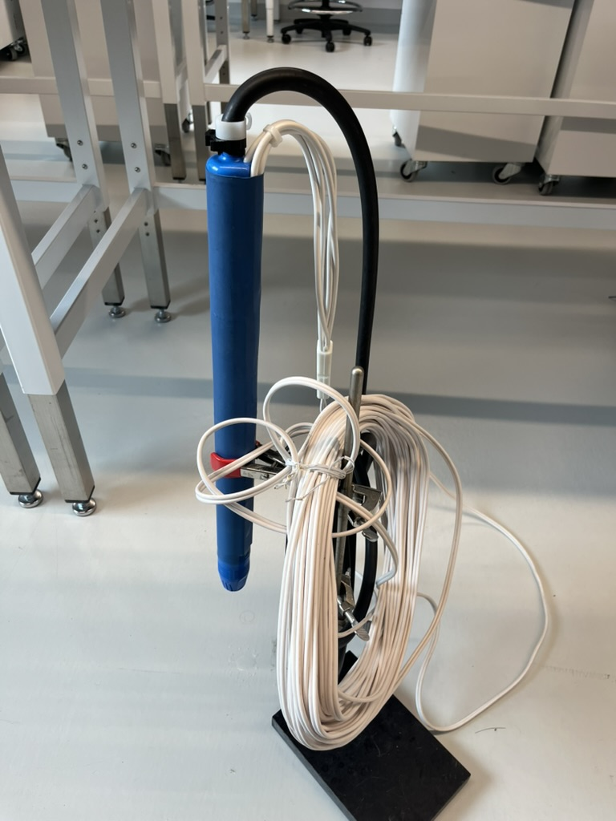
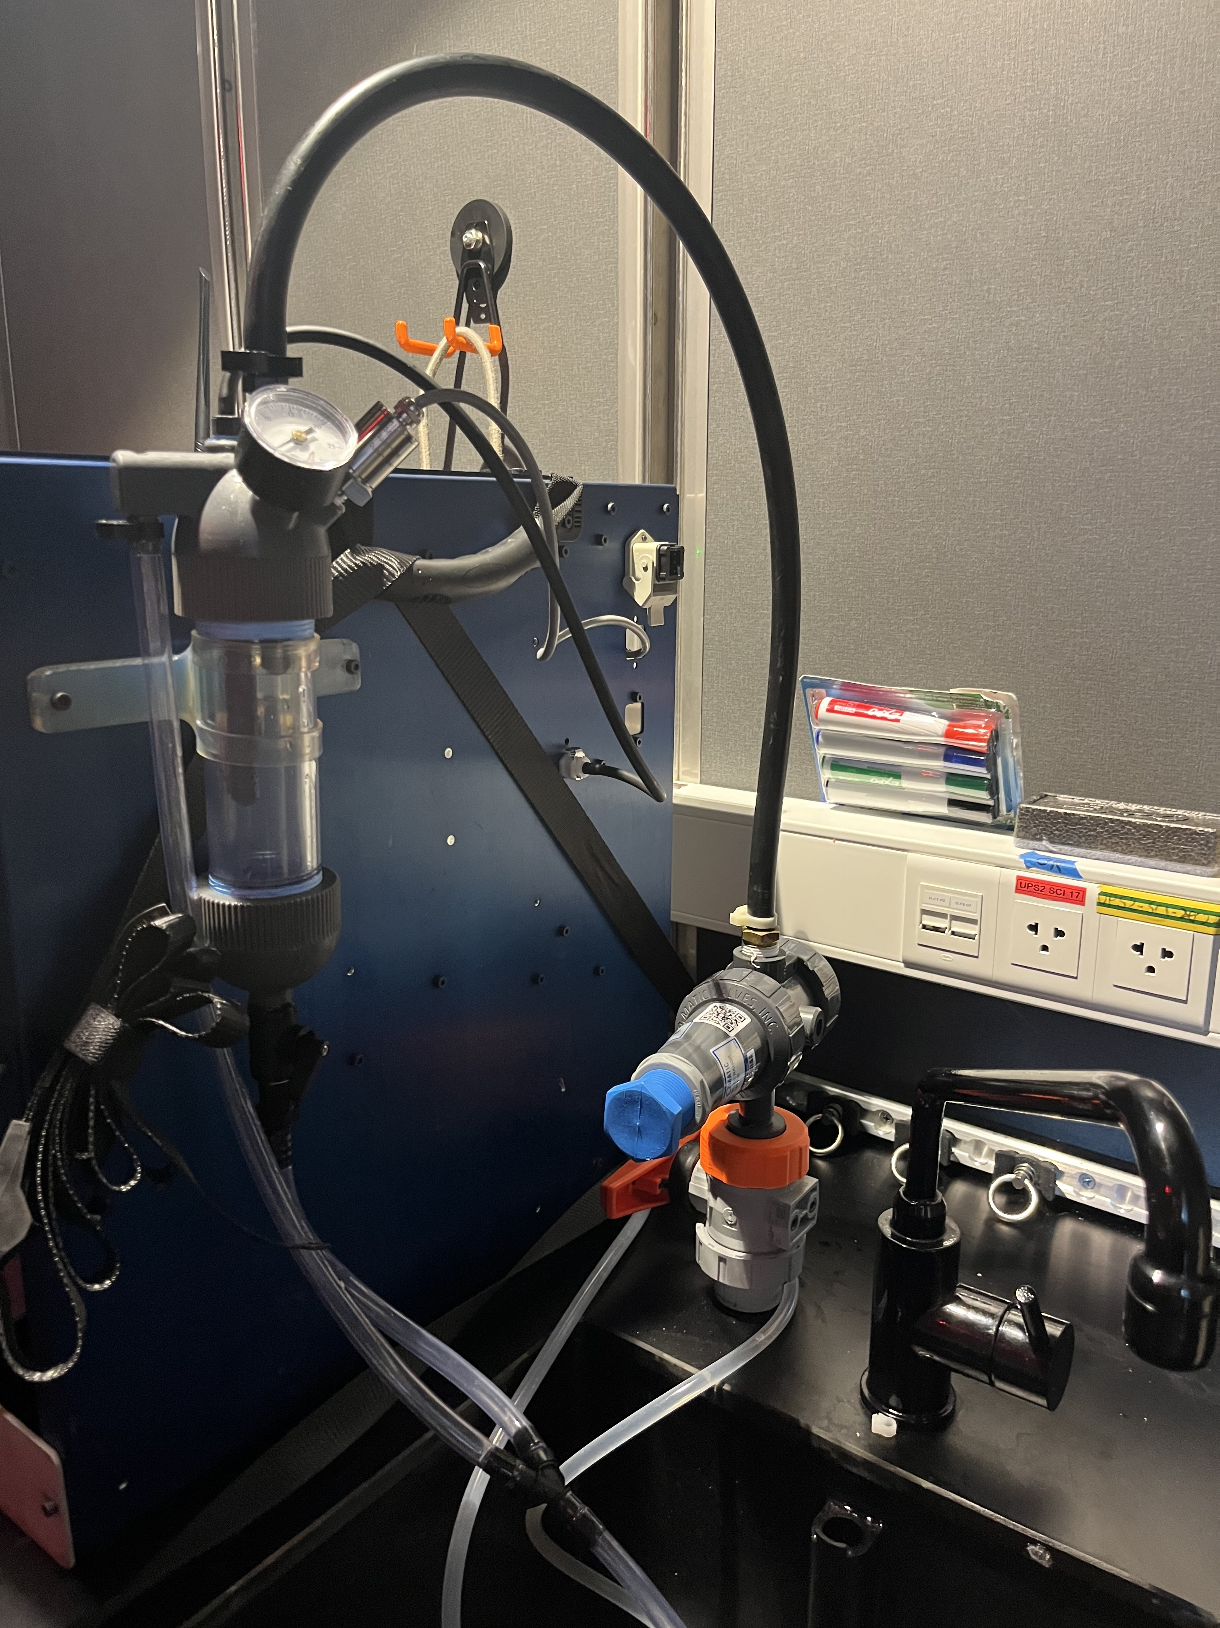
FIDO: Filtering Instrument for DNA Observations
Water Acquisition -- FIDO needs water at 10-20psi
  External submersible pump
  Flow-thru seawater system

Slide 7
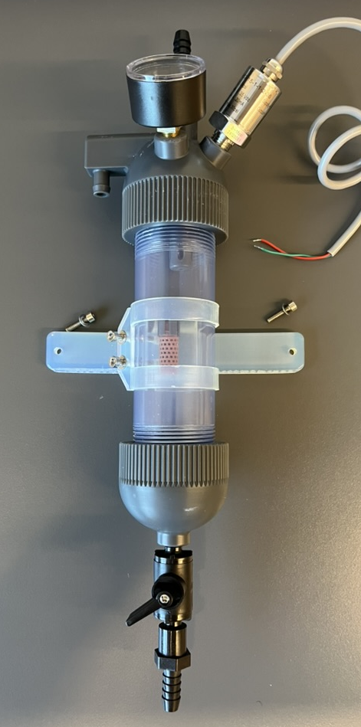
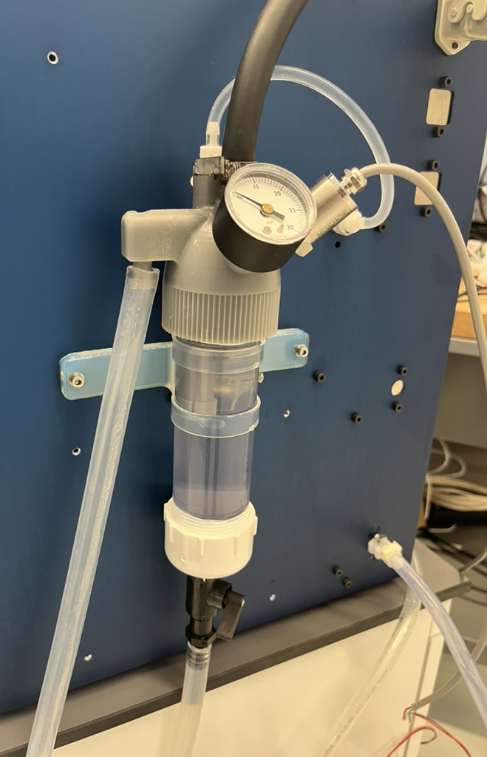
FIDO: Filtering Instrument for DNA Observations
Water Acquisition -- FIDO needs water at 10-20psi
  Pump feeds water to a slow-draining ‘Phase Separator’

Slide 8
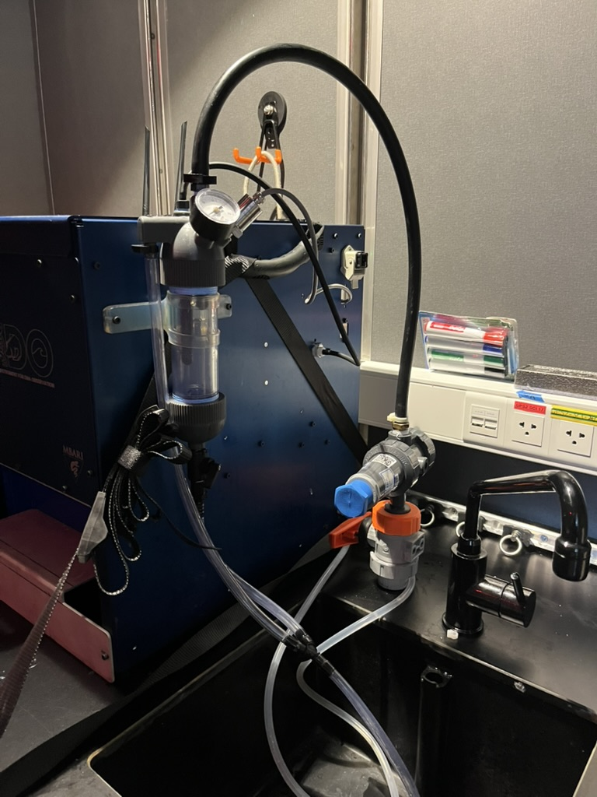
FIDO: Filtering Instrument for DNA Observations
Three inter-related components:
Water acquisition
  Submersible pump & tubing
  Phase separator
  Pump controller & power supply
Sample processing
  Pucks
  FIDO instrument & power supply
  Puck reader
Command & Control GUI
  WiFi and Cellular connectivity
  Website control

Slide 9
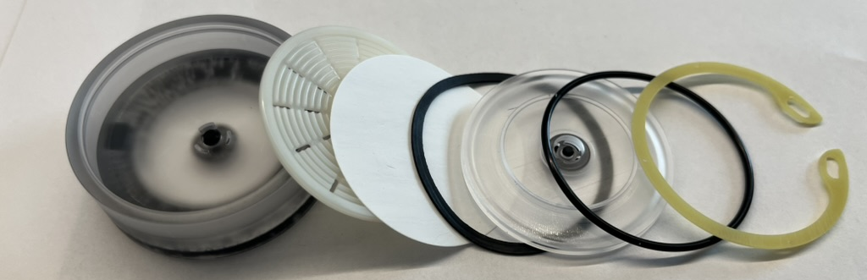
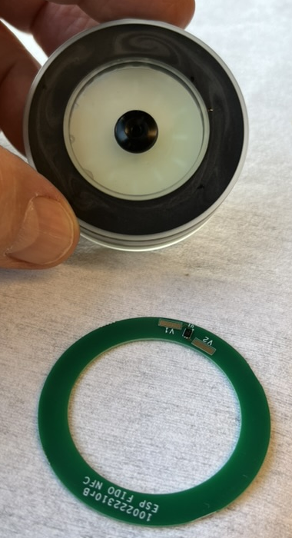
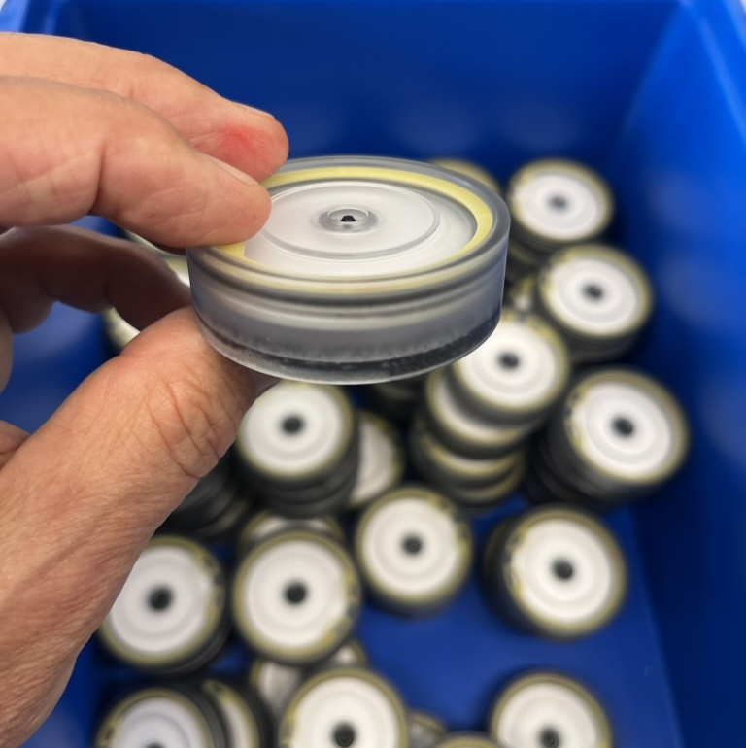
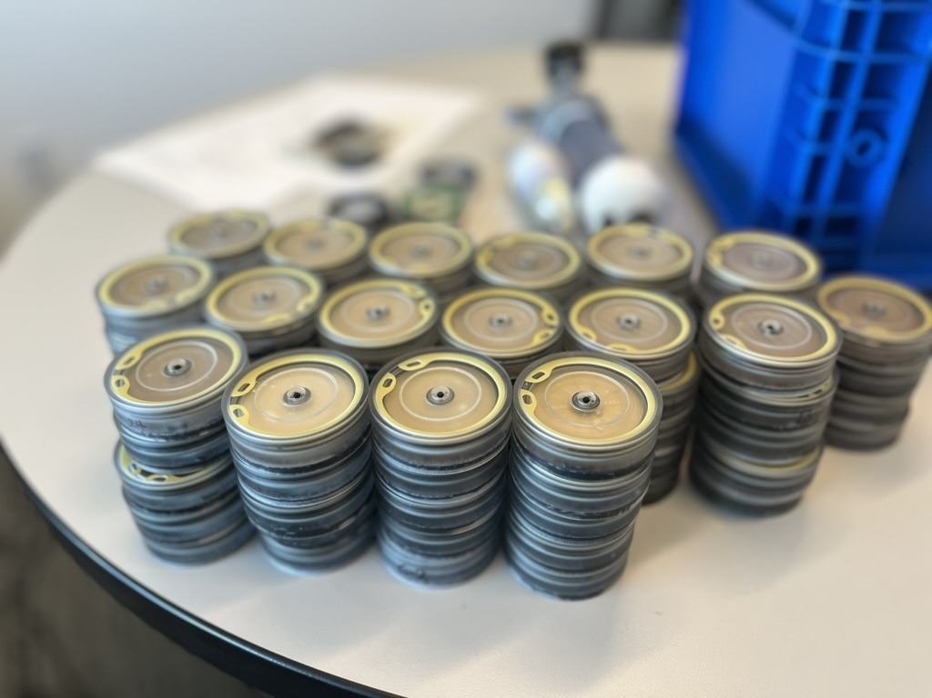
FIDO: Filtering Instrument for DNA Observations
Sample Processing
'Puck’ holds filter material
  47mm filters
  Upper/lower valves maintain humidity
Each FIDO holds 144 pucks
Data written to unique RFID tag in each puck.

Slide 10
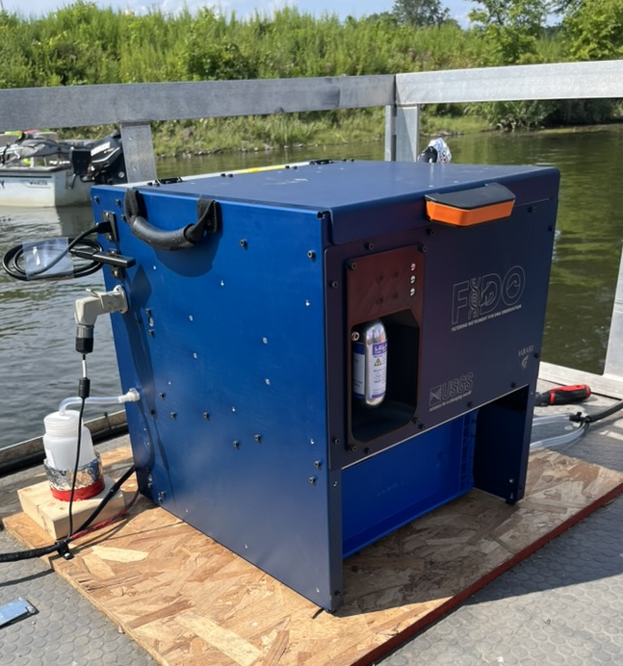
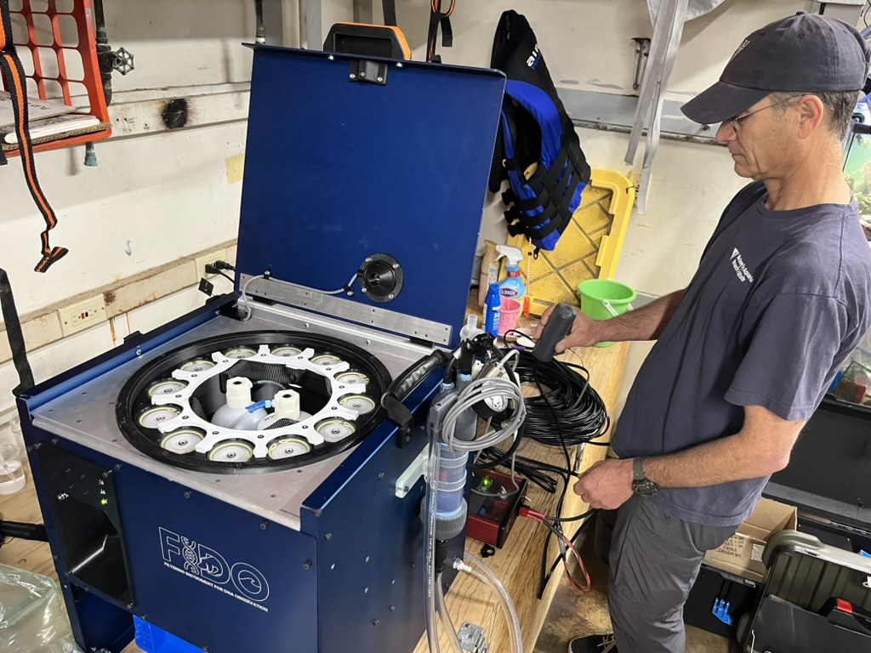
FIDO: Filtering Instrument for DNA Observations
Sample Processing
FIDO device
  3 reagents:
    Nitrogen
    1L preservative
    1L bleach
  Pucks held in stacks of 12 in 12 tubes

Slide 11
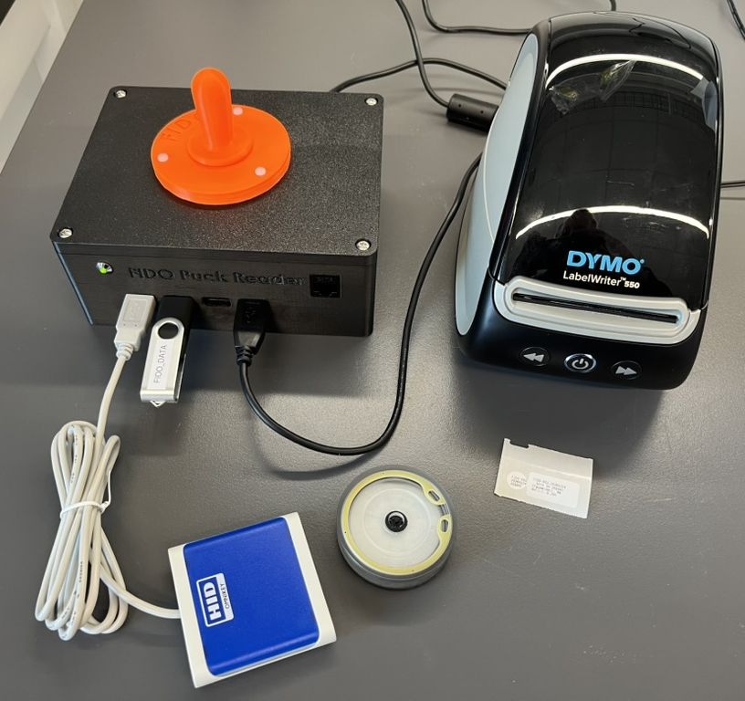
FIDO: Filtering Instrument for DNA Observations
Sample Processing
Puck Reader
  Automatically reads RFID tag
    Writes all data to a file
    Prints specimen label

Slide 12
FIDO: Filtering Instrument for DNA Observations
Three inter-related components:
Water acquisition
  Submersible pump & tubing
  Phase separator
  Pump controller & power supply
Sample processing
  Pucks
  FIDO instrument & power supply
  Puck reader
Command & Control GUI
  WiFi and Cellular connectivity
  Website control

Slide 13
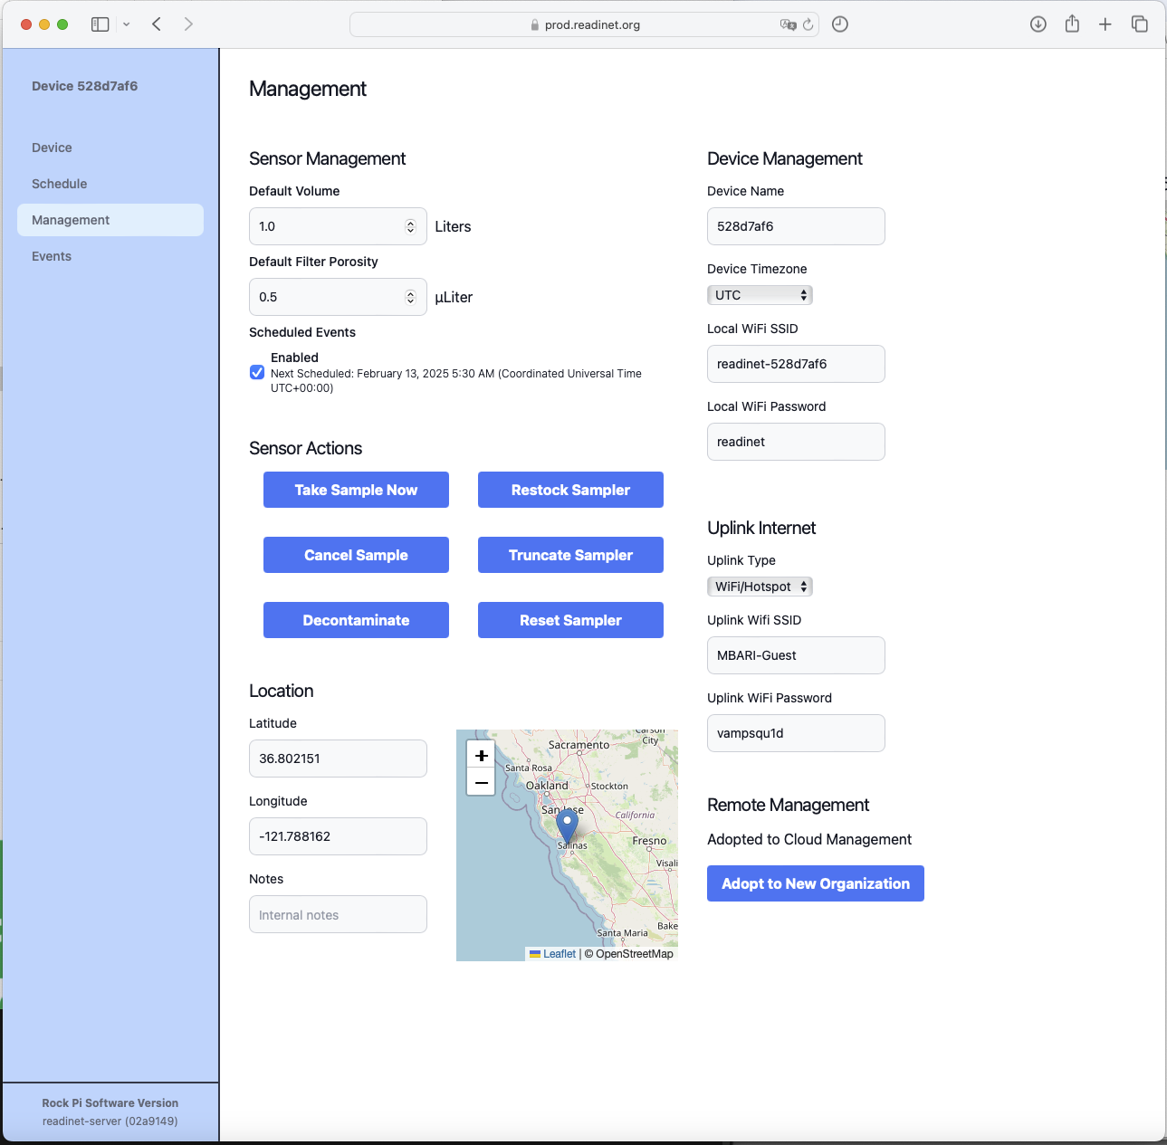
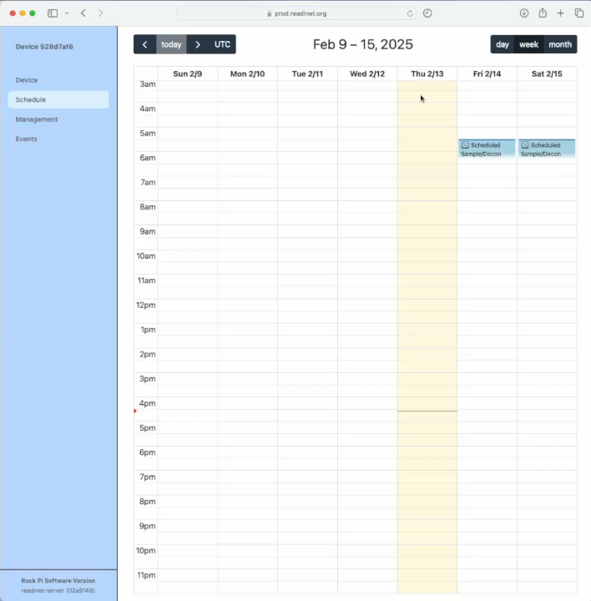
FIDO: Filtering Instrument for DNA Observations
Command & Control

Slide 14
FIDO: Filtering Instrument for DNA Observations
Three inter-related components:
Water acquisition
  Submersible pump & tubing
  Phase separator
  Pump controller & power supply
Sample processing
  Pucks
  FIDO instrument & power supply
  Puck reader
Command & Control GUI
  WiFi and Cellular connectivity
  Website control

Slide 15
FIDO: Filtering Instrument for DNA Observations
BOM:
Approx 220 SKU’s
  67% -- commercial off-the-shelf
  23% -- custom machined
  10% -- custom printed

Slide 17
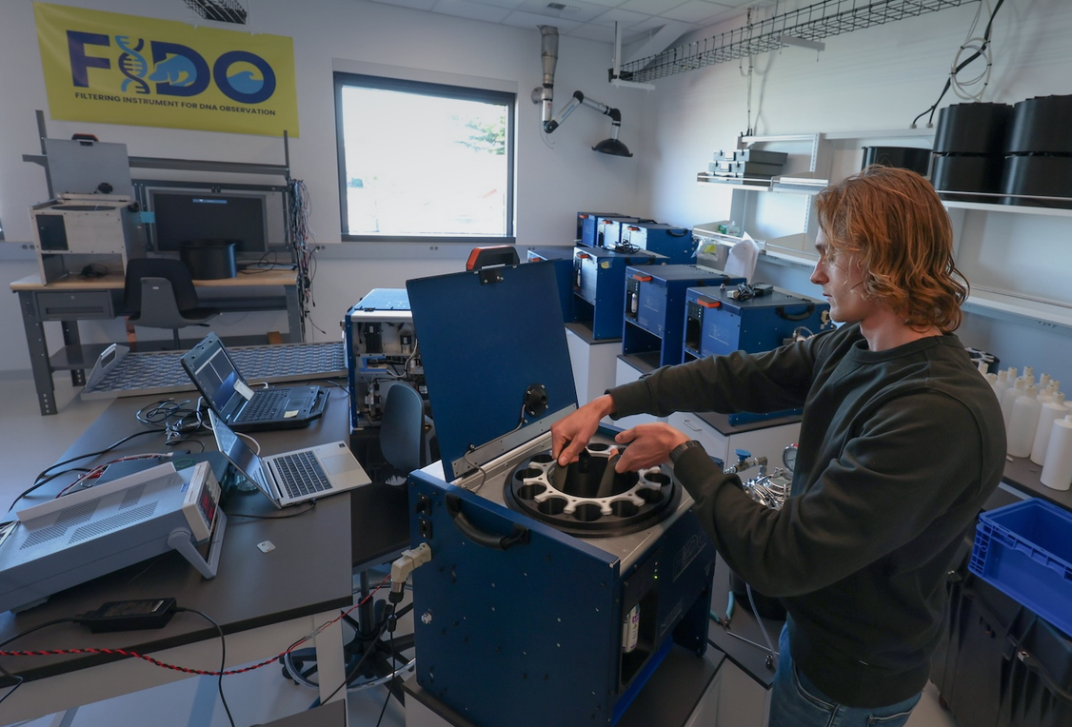
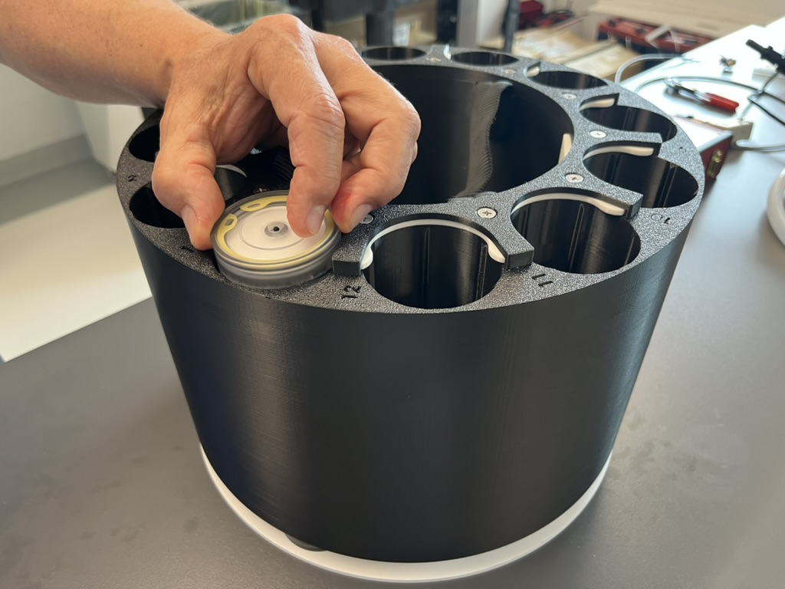
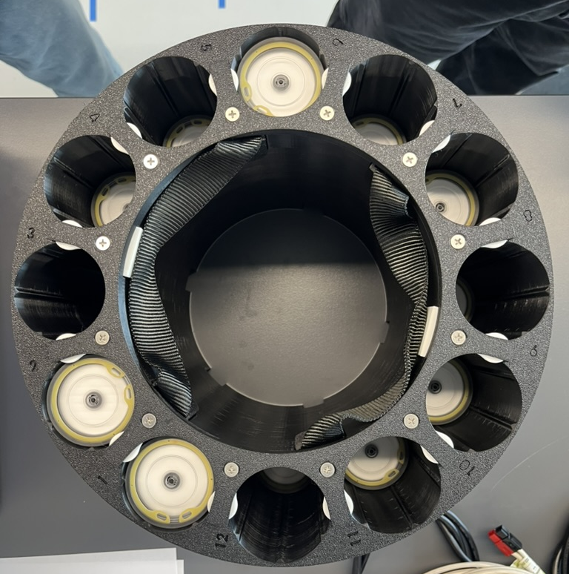
FIDO: Filtering Instrument for DNA Observations
144 samples – 47mm membranes
Liquid preservation & decontamination
Remote Command & Control GUI
  Wifi, Cellular and Satellite
Sample metadata encoding
Simple servicing and replenishment
…simple, simplicity, simpleness, straightforward…

Slide 18
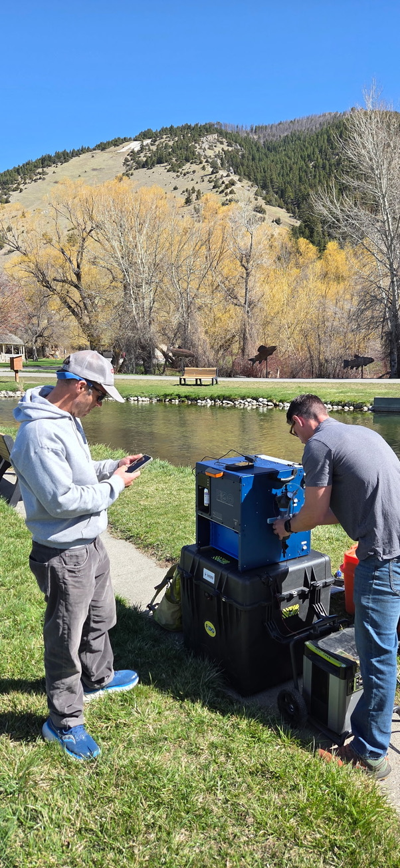
Lessons learned—FIDO build
Use-cases should drive the instrument design.
  There is no single BEST instrument for all use-cases.
  Applications should be matched to appropriate instrumentation
Validation is important!!
  Proper validation builds confidence in data and reduces operational risks
Large number of samples=good, but ‘kicks the can down the road’
  Ideally, in situ processing alleviates laboratory bottleneck.

Slide 19
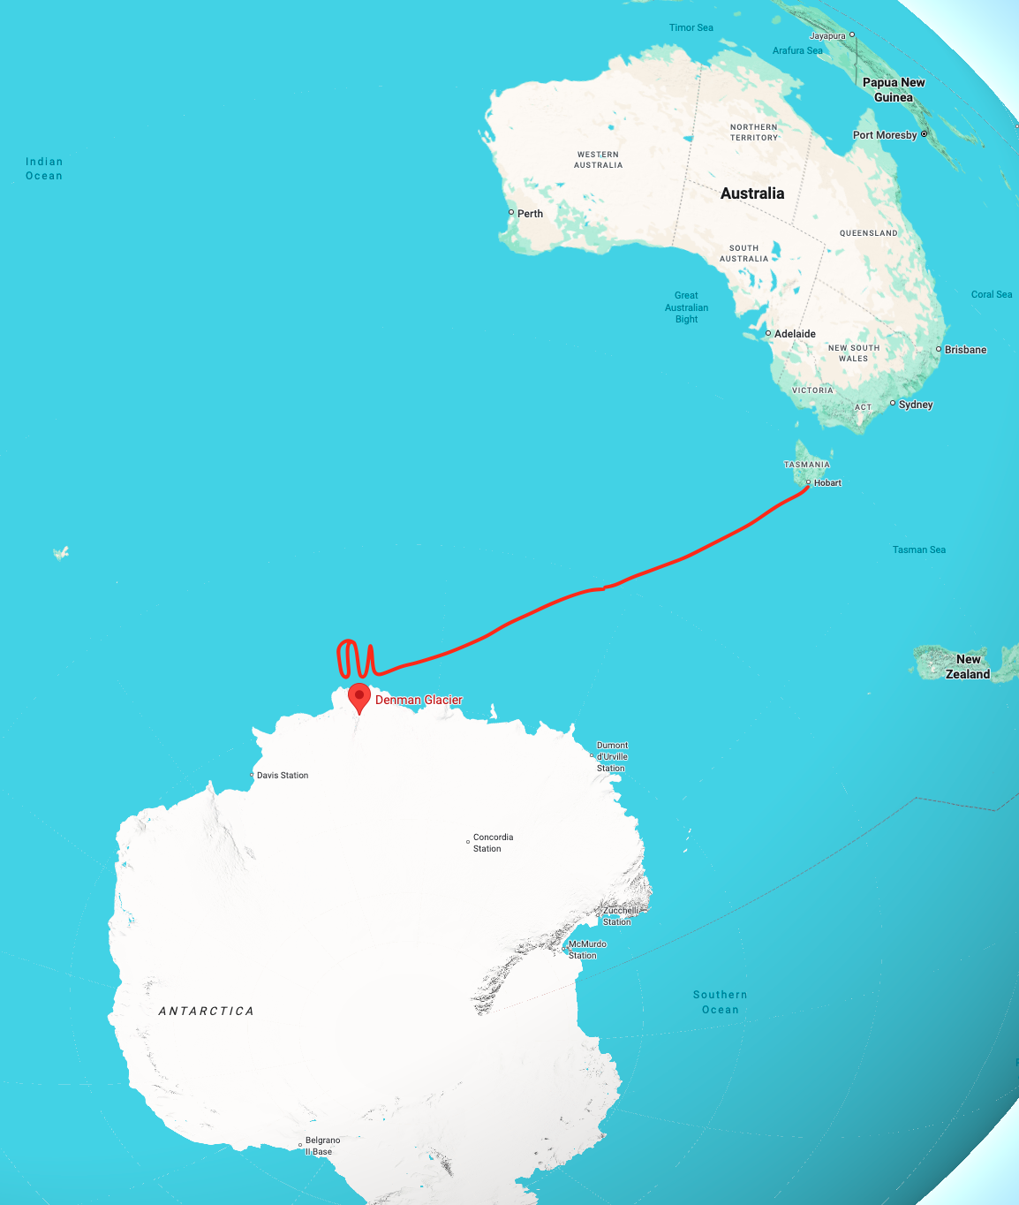
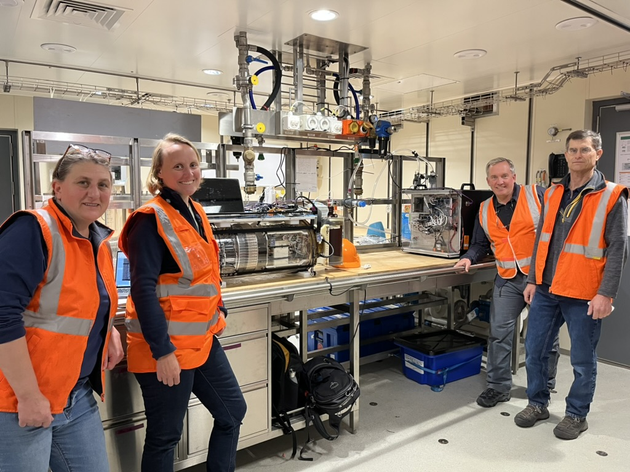
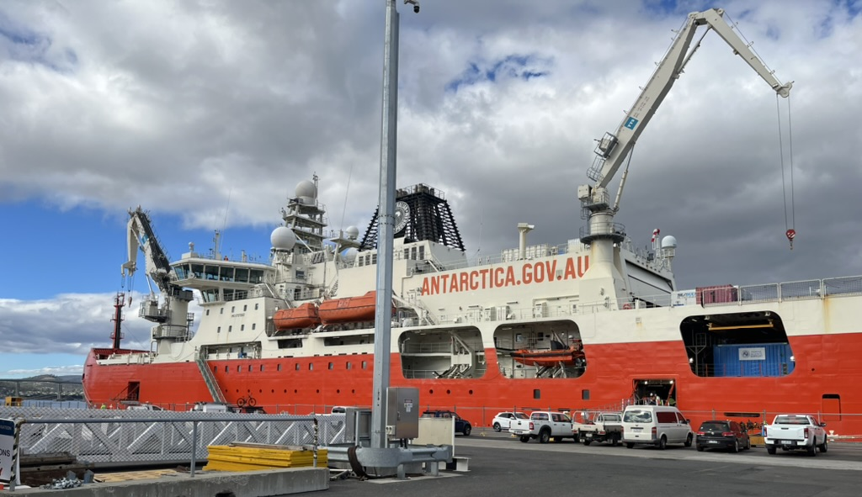
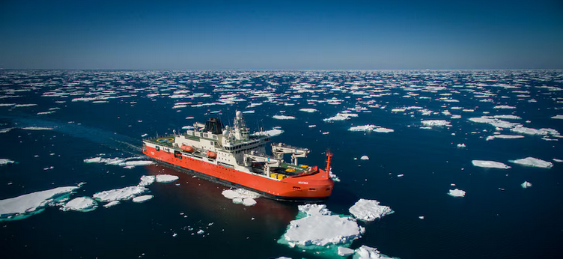
Field Testing
R/V Nuyina Denman glacier cruise–> Feb 20 – April 26, 2025.
Sample twice or thrice/day
Leonie Sutter – Australian Antarctic Program
Notes:
R/V Nuyina
160m (525’)
26,000 tonnes
Can break 1.65m ice
Carries 96 20’ shipping containers
149 personnel (32 crew) for 90 day voyages.

Slide 20
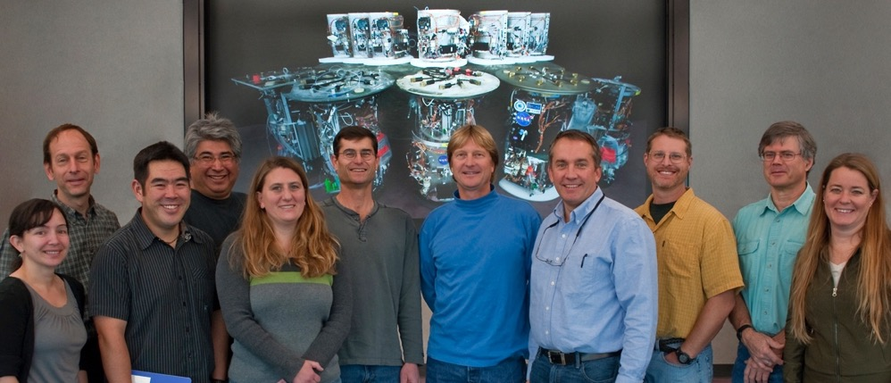
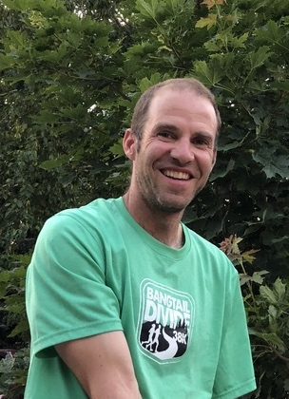



Acknowledgements
Adam Sepulveda

