Slide 1
Major MBARI technology initiatives: Looking back and looking forward
Alana Sherman and Mathieu Kemp

Slide 2
33 Years of Technical Development
Photo collage

Slide 3
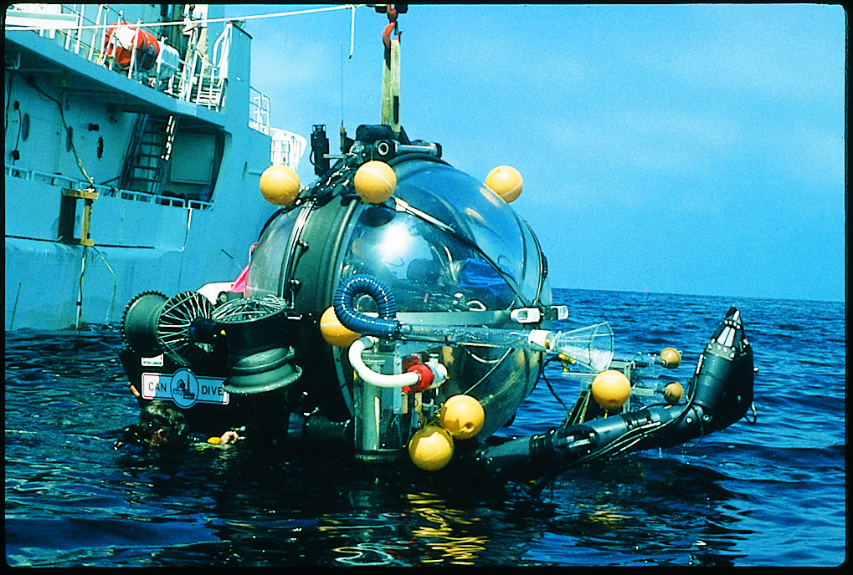
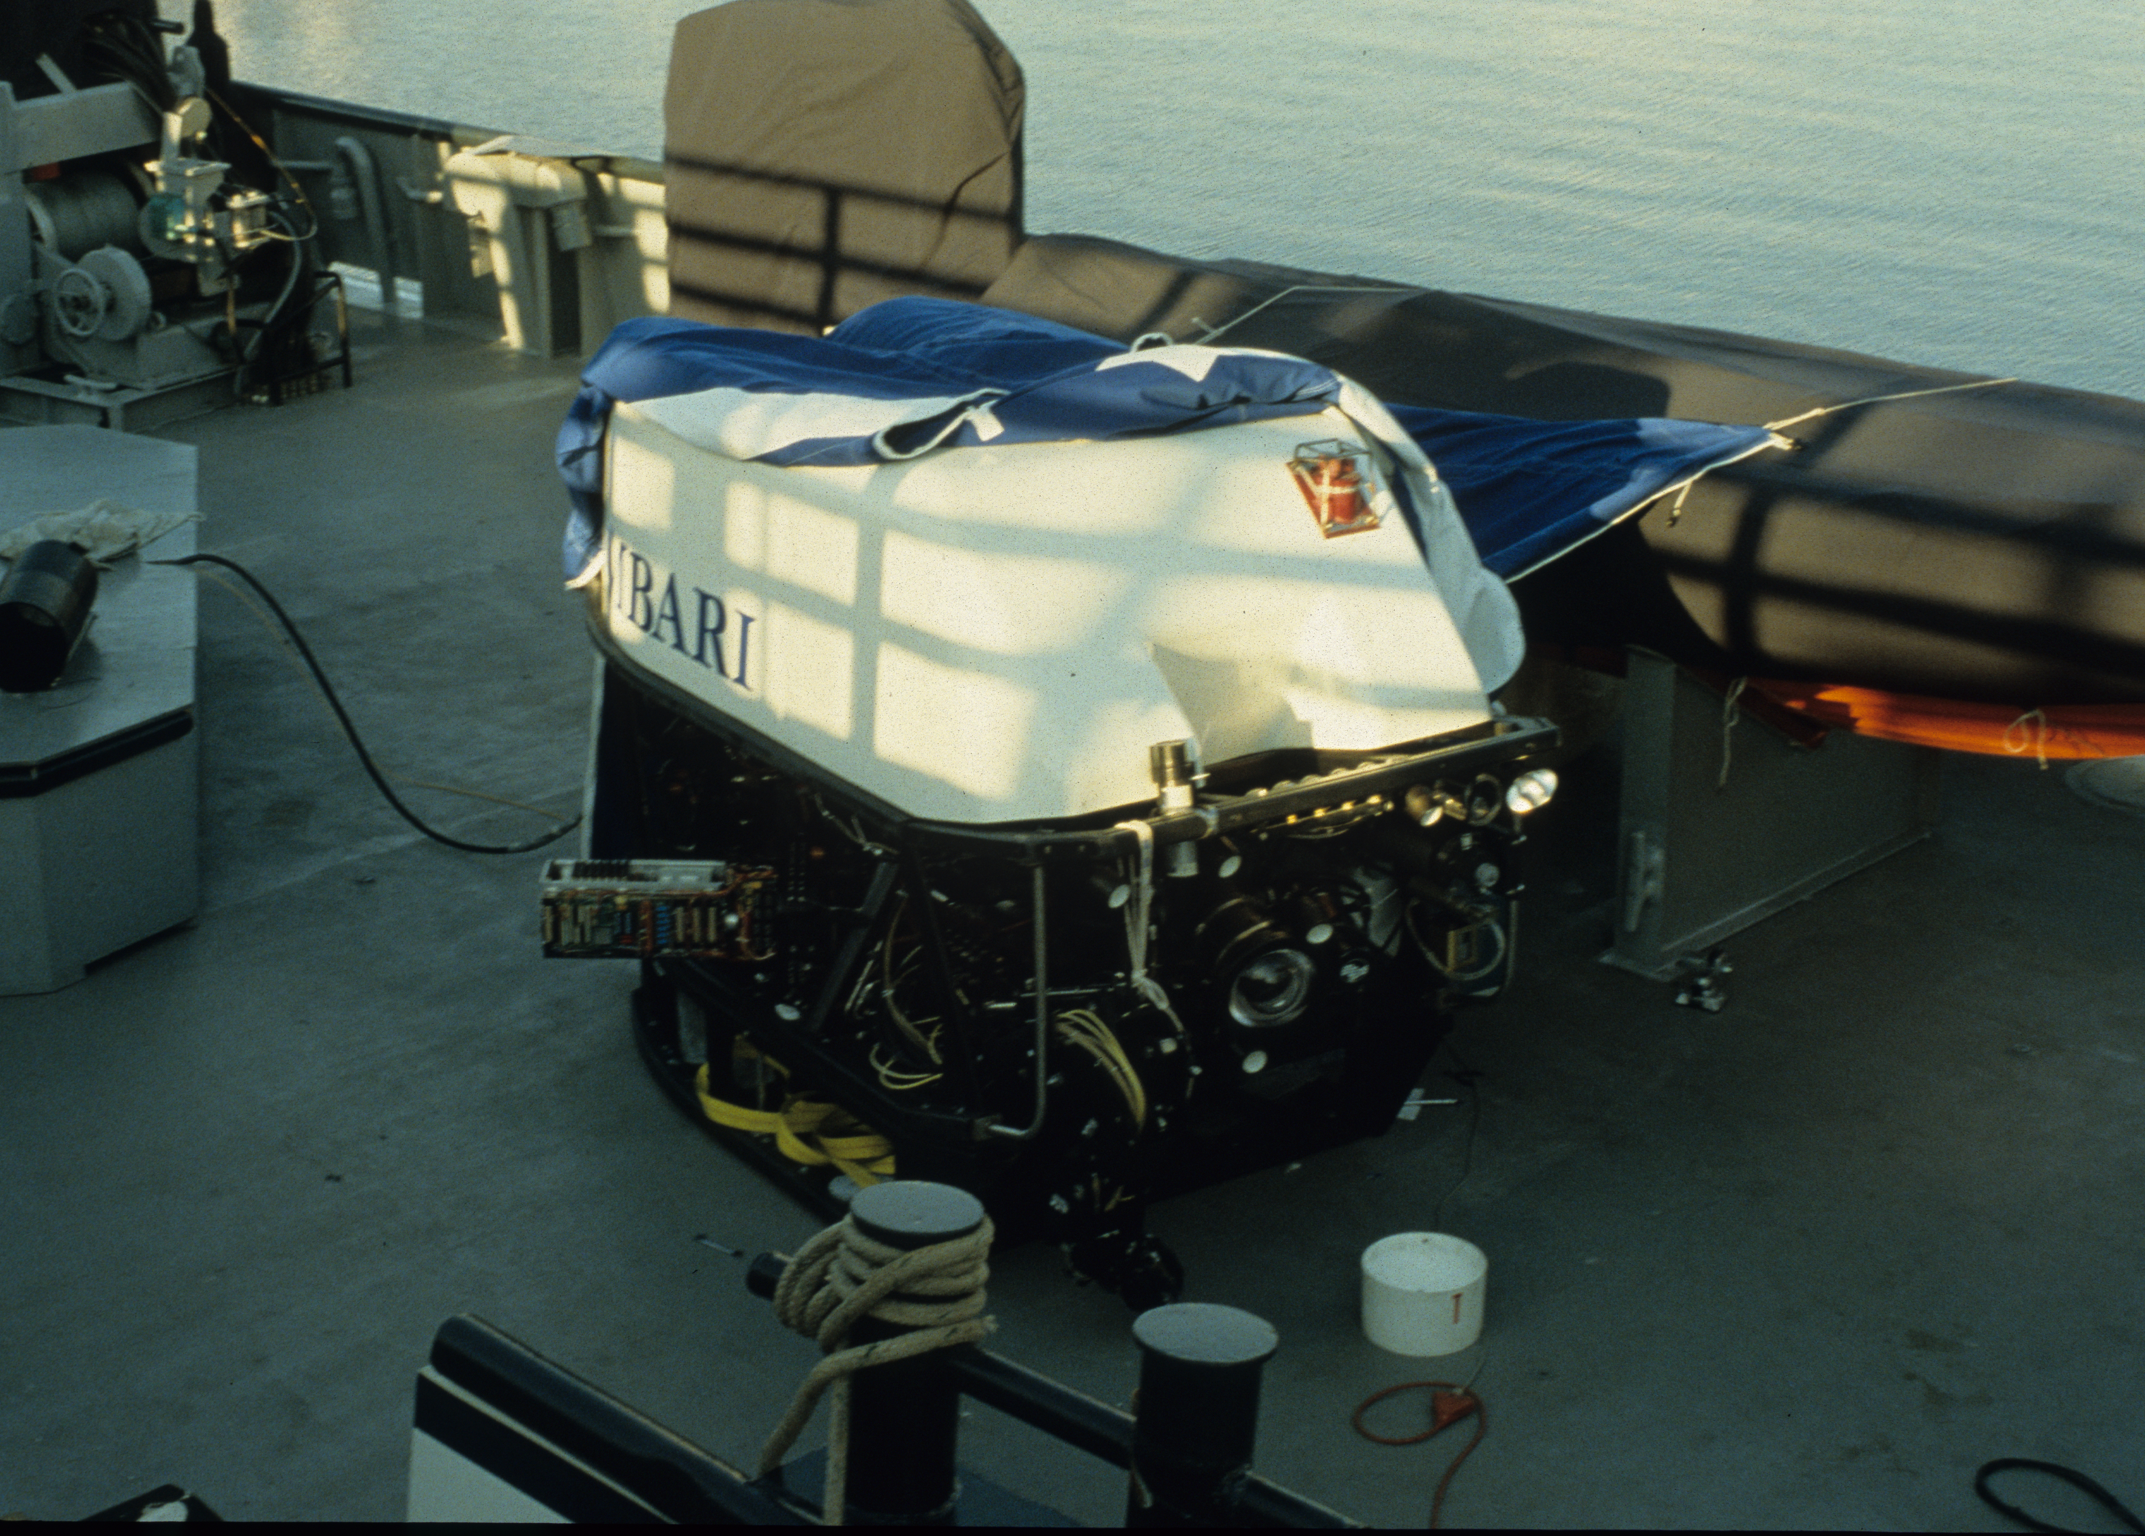
The First Fork in the Road: Manned Submersibles vs. ROVs

Slide 4
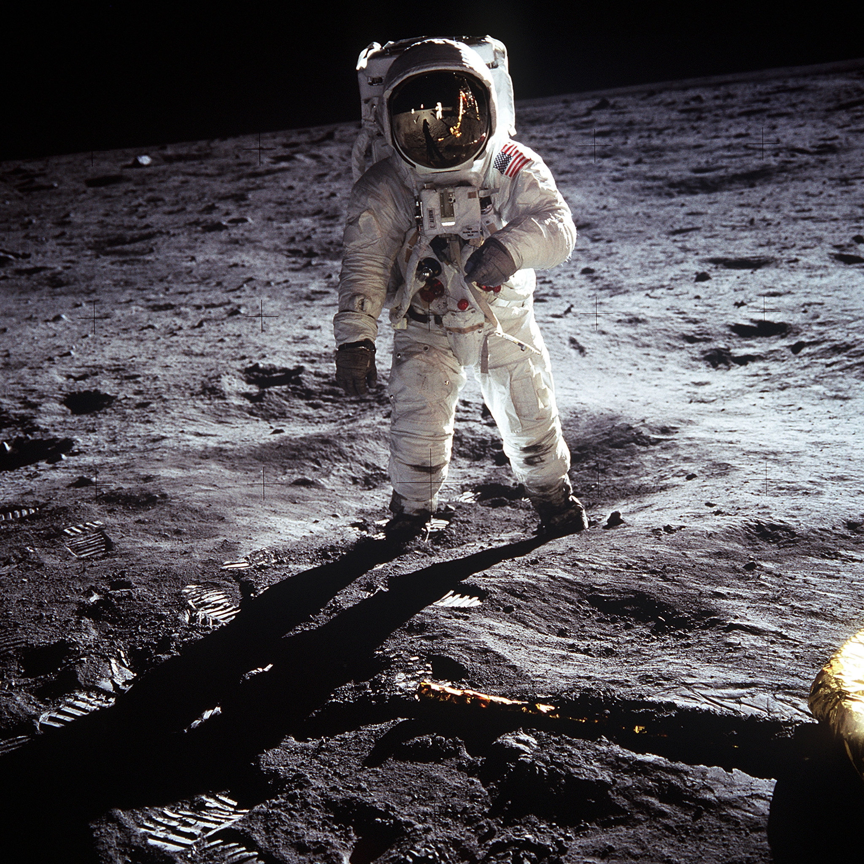
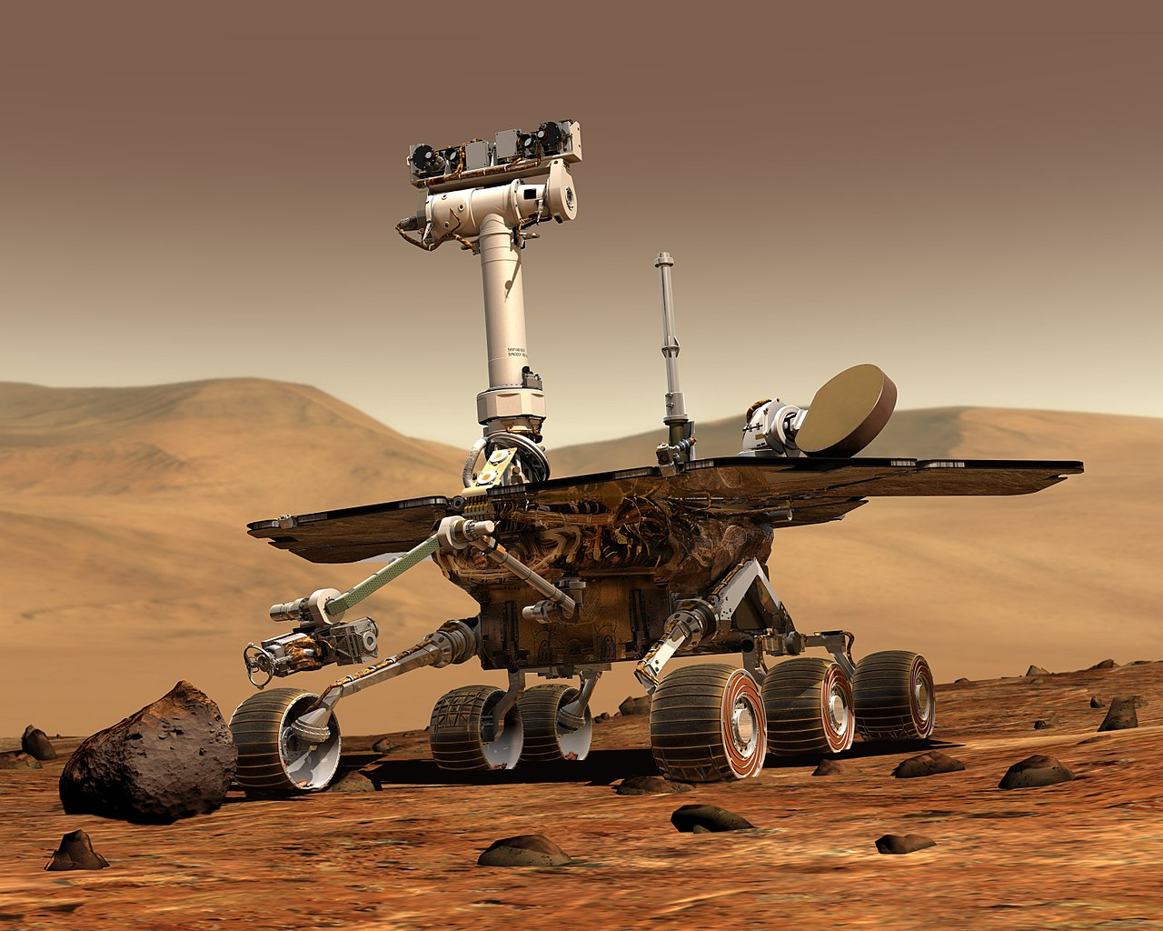
The First Fork in the Road
Images Courtesy of NASA

Slide 5
Successful Investment
MBARI’s Strenghts in Operations and Engineering
Long term Commitment
New and Innovative
R & D
Set Future Direction
Dissemination

Slide 6
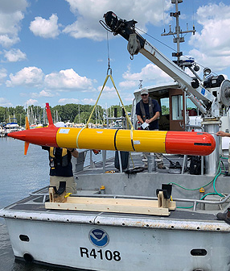
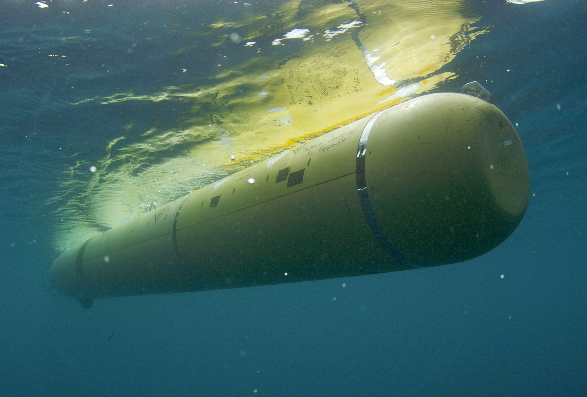
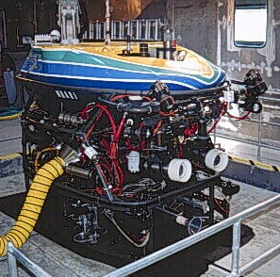
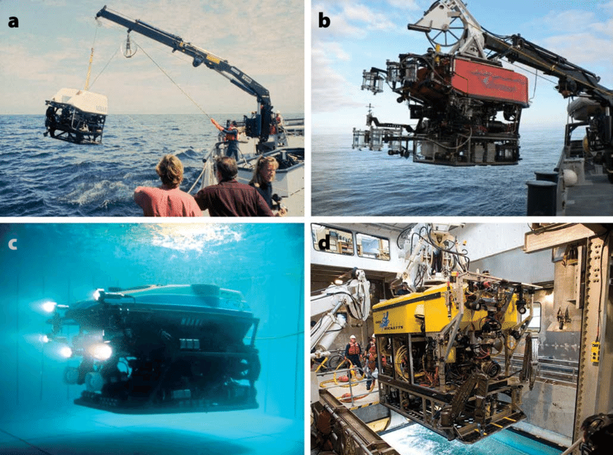
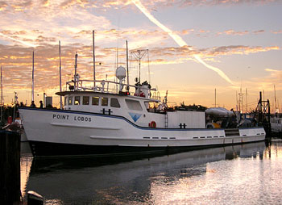
Platform Evolution at MBARI
Date 1
Date 2
Date 3
Date 4
Date 5
Notes:
Add rickets, wave glider on bottom side of time line, mooring (NB)

Slide 7
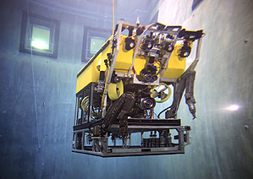
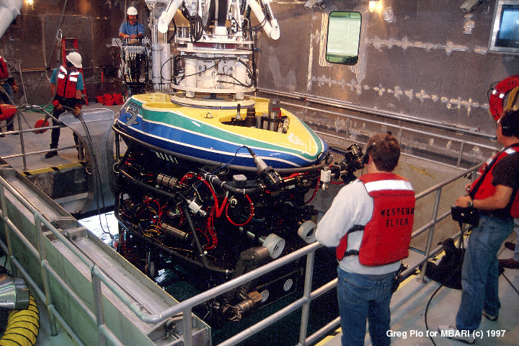
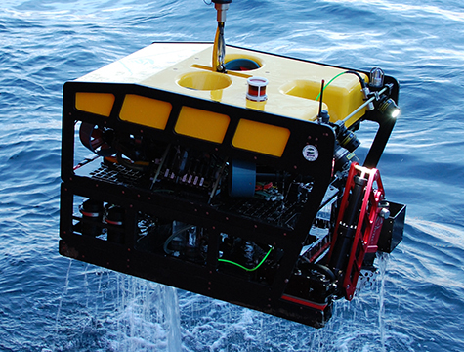
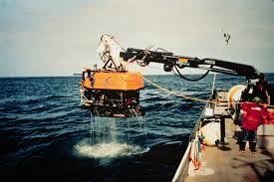
Evolution of MBARI’s ROVs
Notes:
Ventana, modified oil field ROV, Tiburon: first ROV built to do research, things developed on MBARI’s ROVs became the standard such as HD video, Ricketts custom ROV built for MBARI by third party

Slide 8
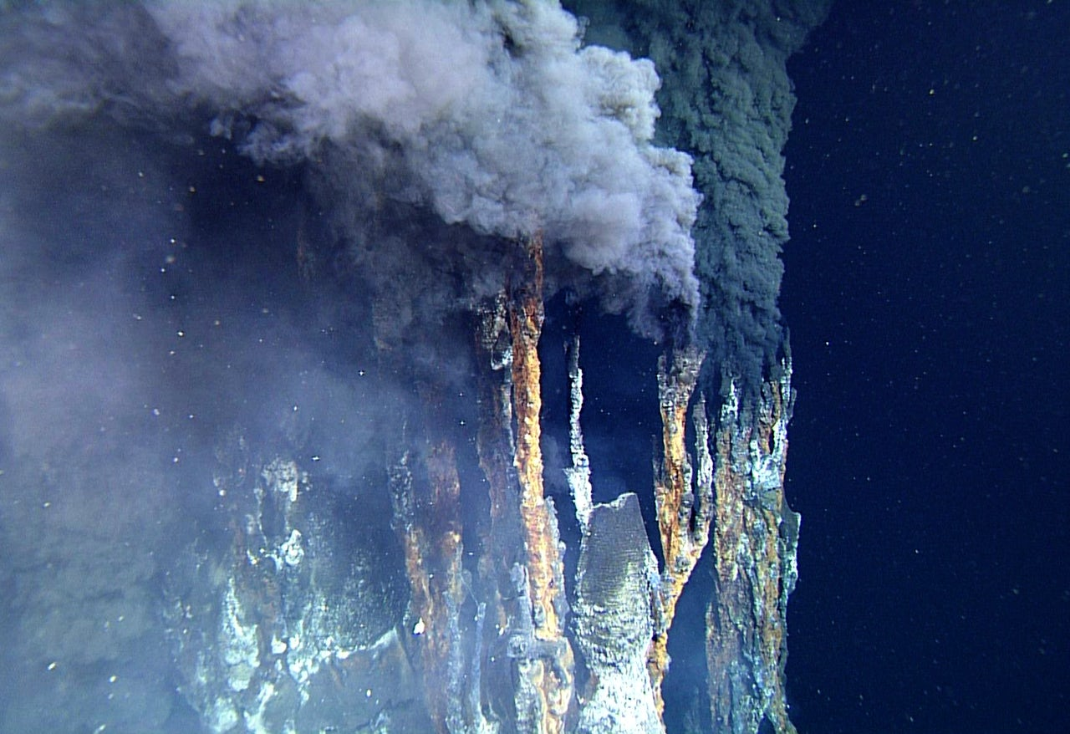
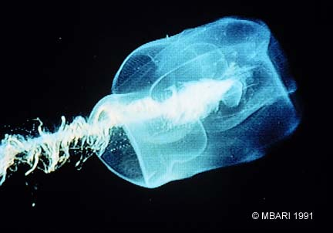
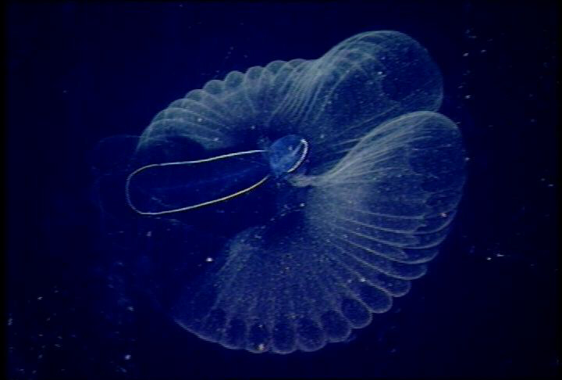
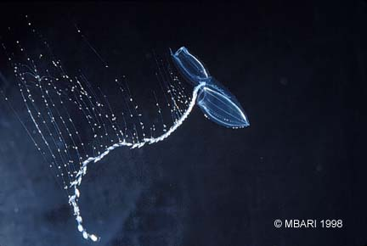
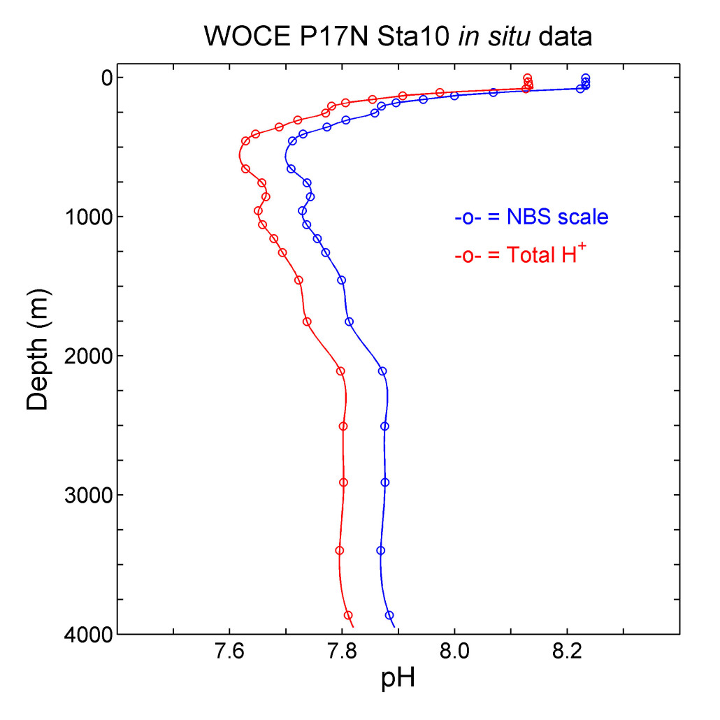
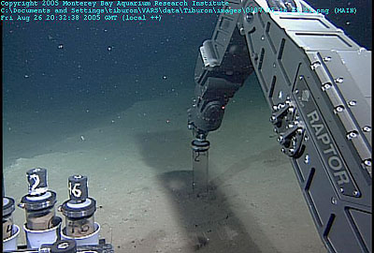
What ROVs Allow Us to Do
See
Sense
Sample
Notes:
Ideally the “seeing” part would be a bunch of images over time showing increased resolution

Slide 9
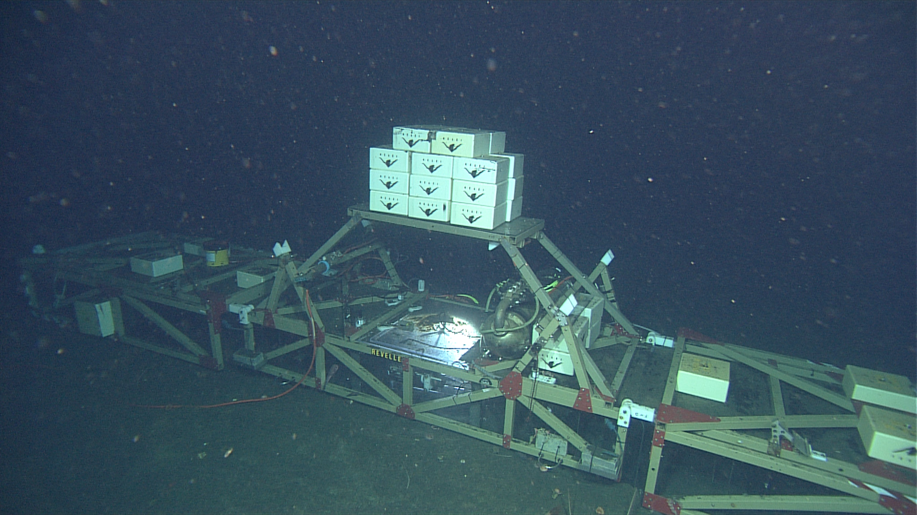
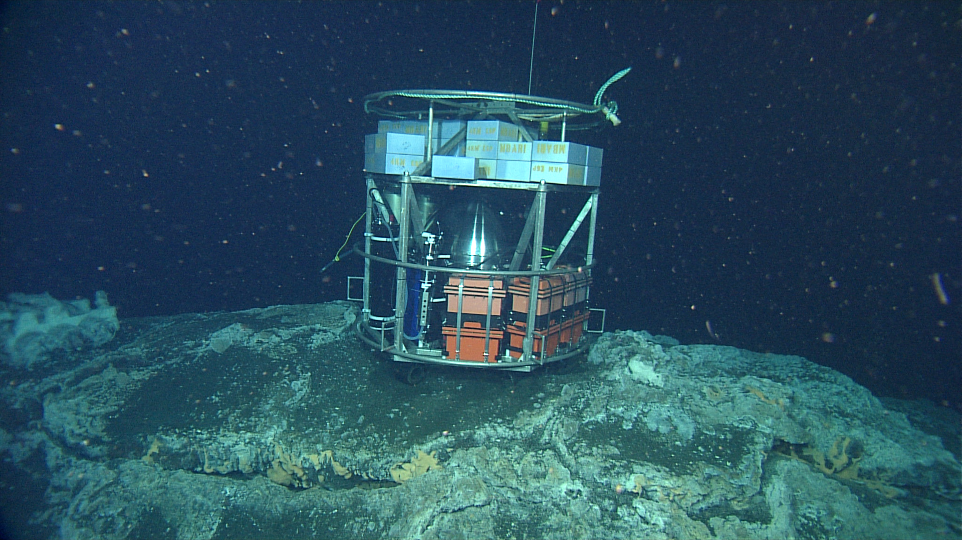
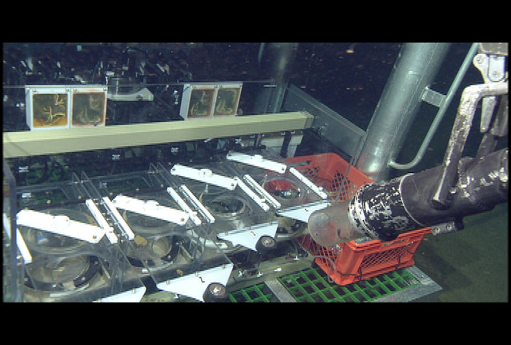
ROVs Enable In Situ Experiments
Deep FOCE
DeepESP
Midwater and Benthic Respirometers

Slide 10
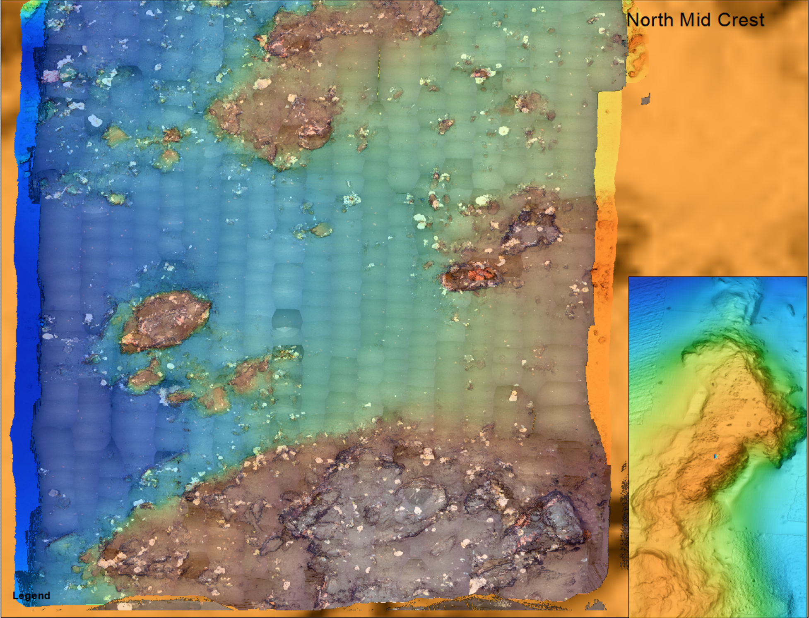
ROV Enable Research Today
Bioacoustics or OI Sur Ridge work?

Slide 11
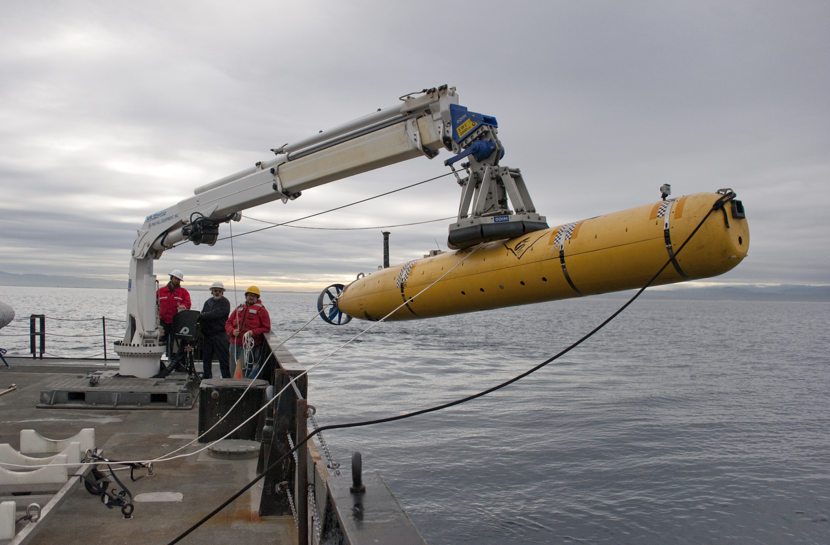
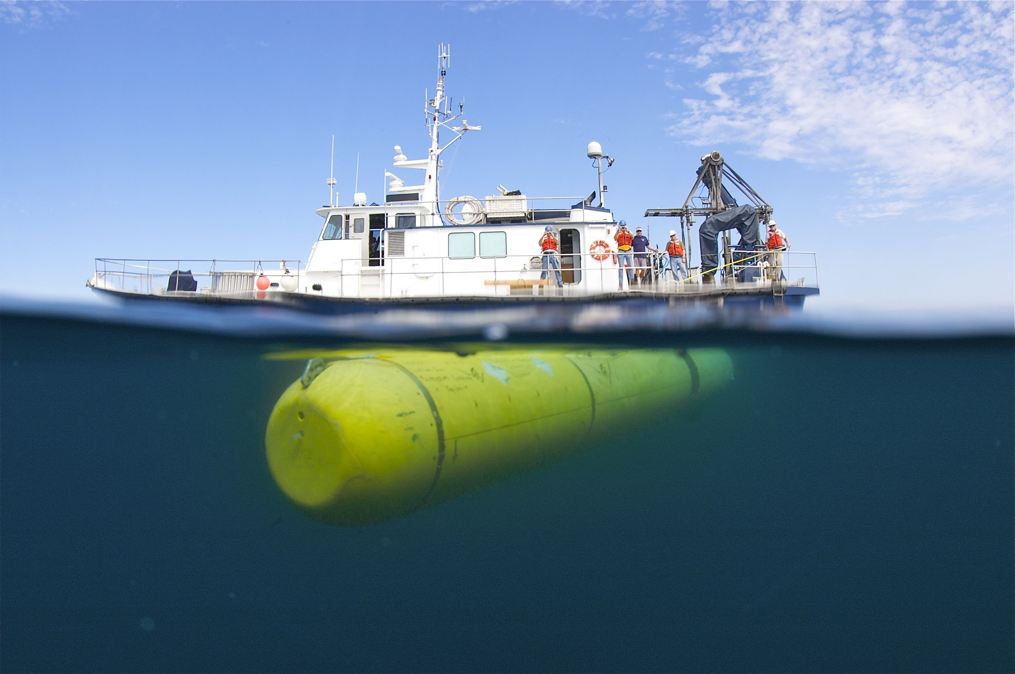
Time to Cut the Cord - AUVs at MBARI

Slide 12
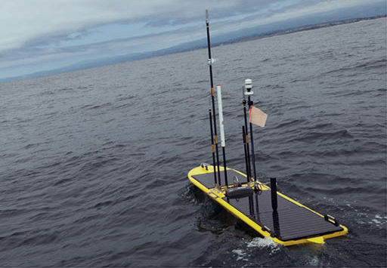
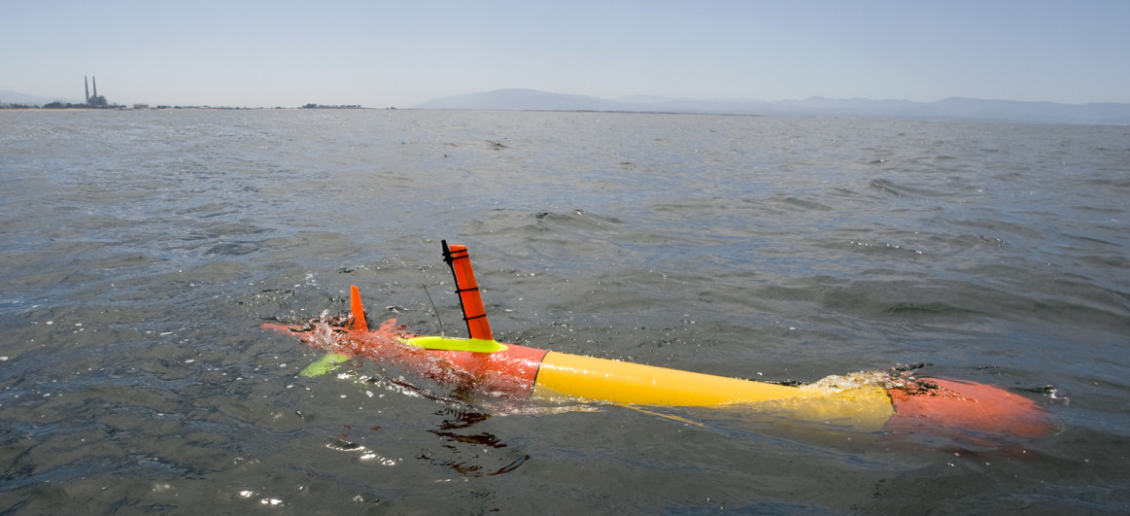
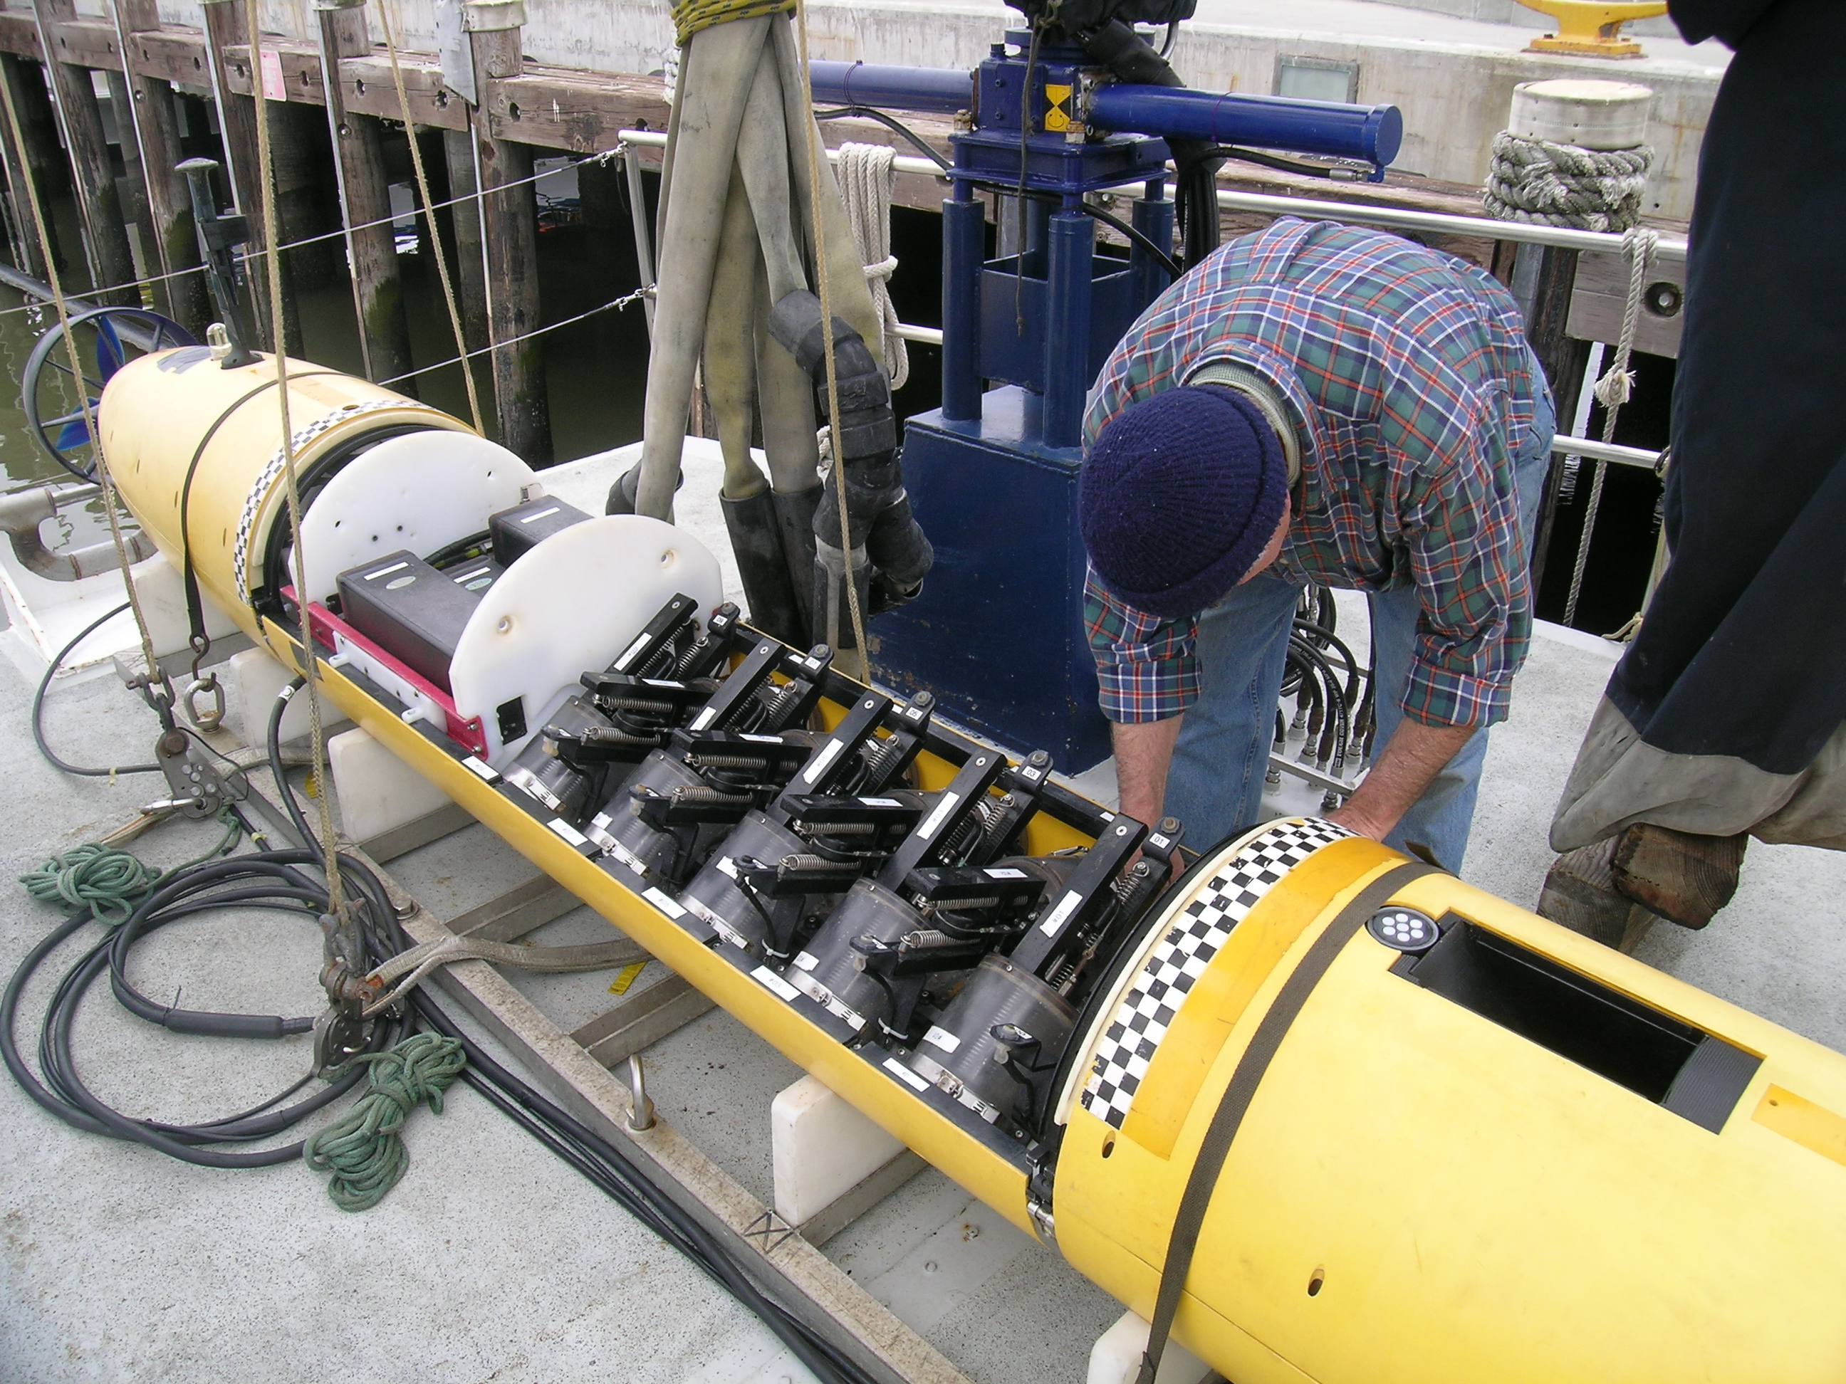
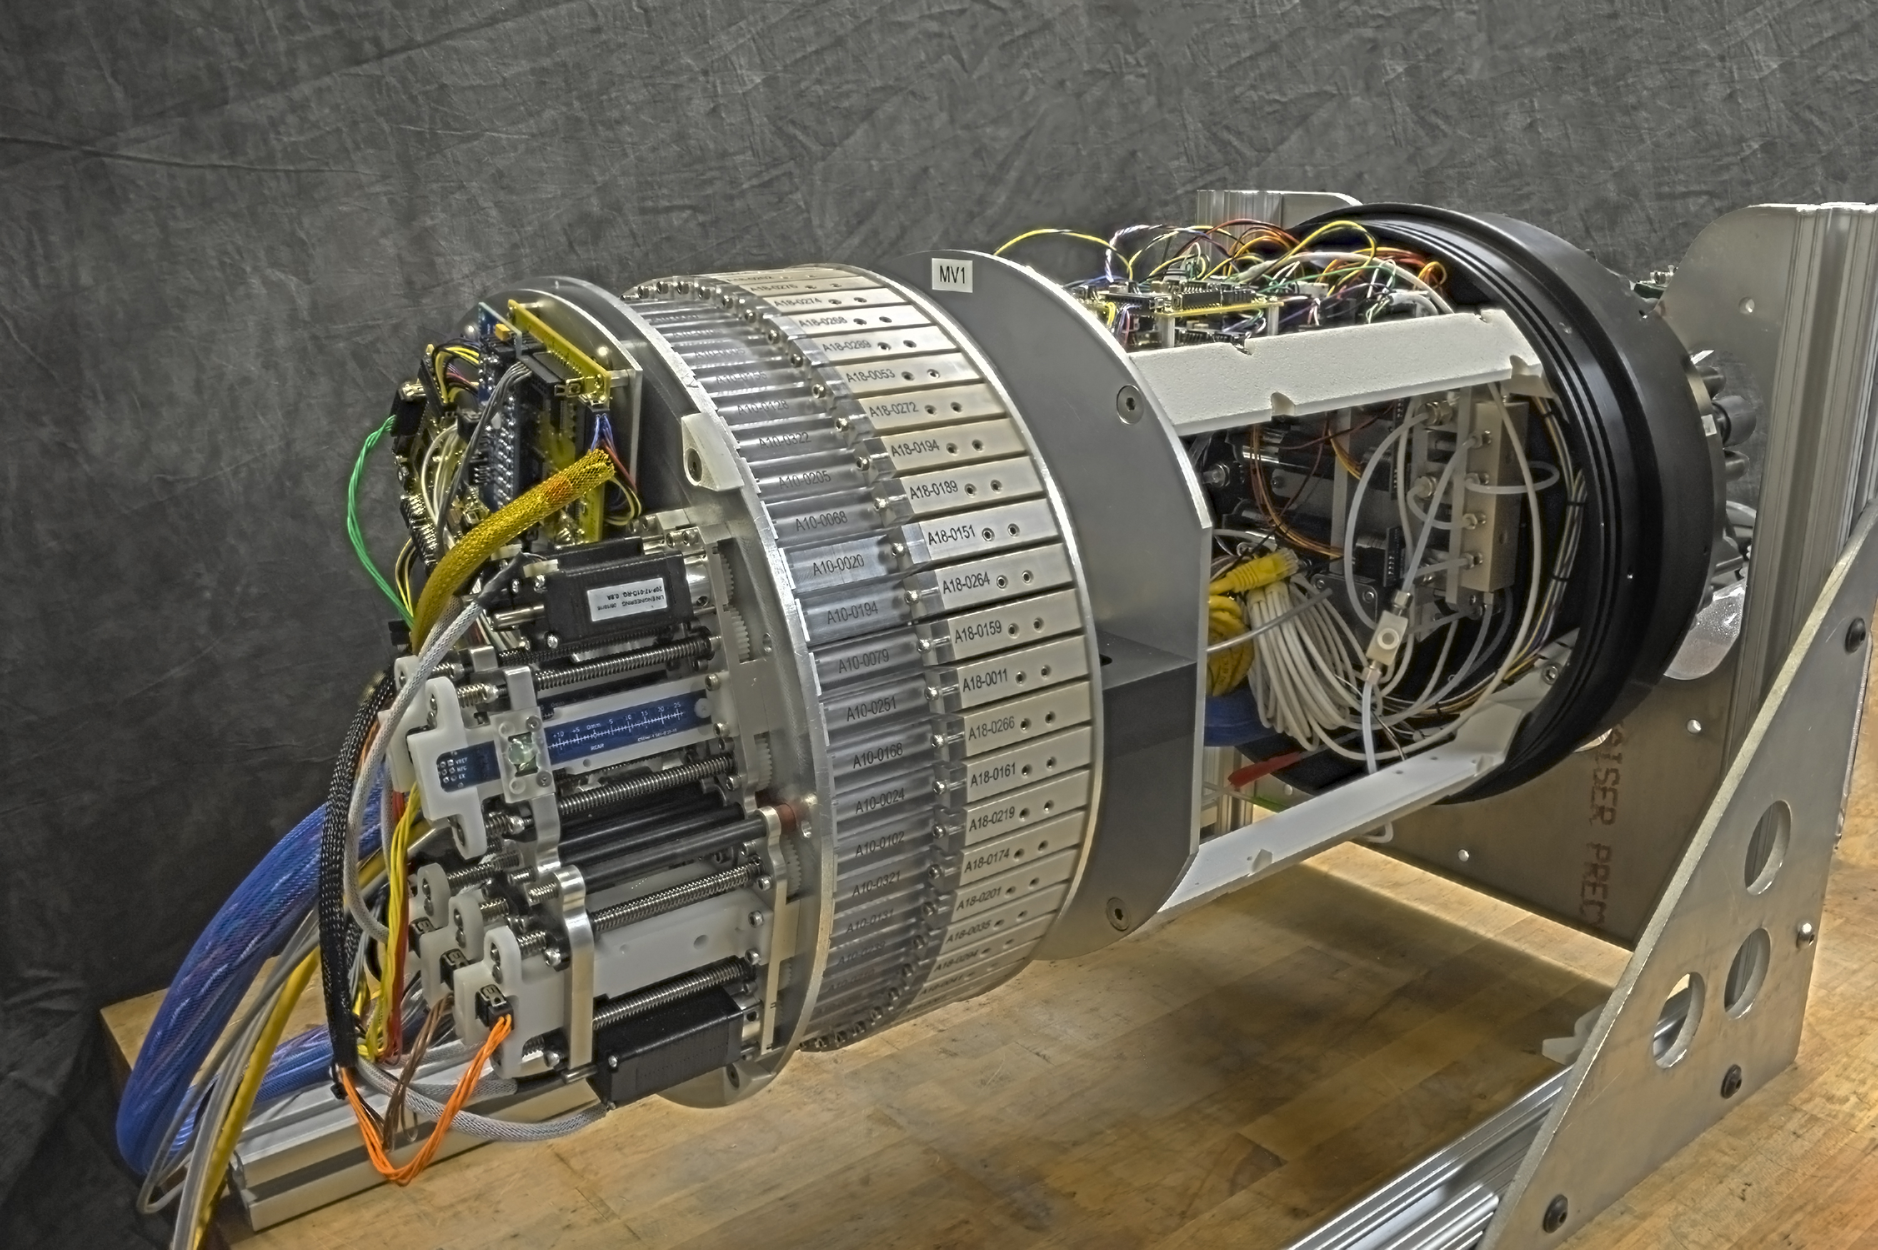
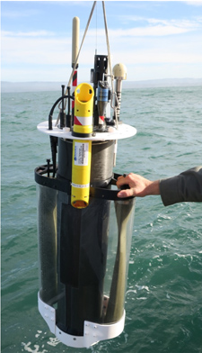
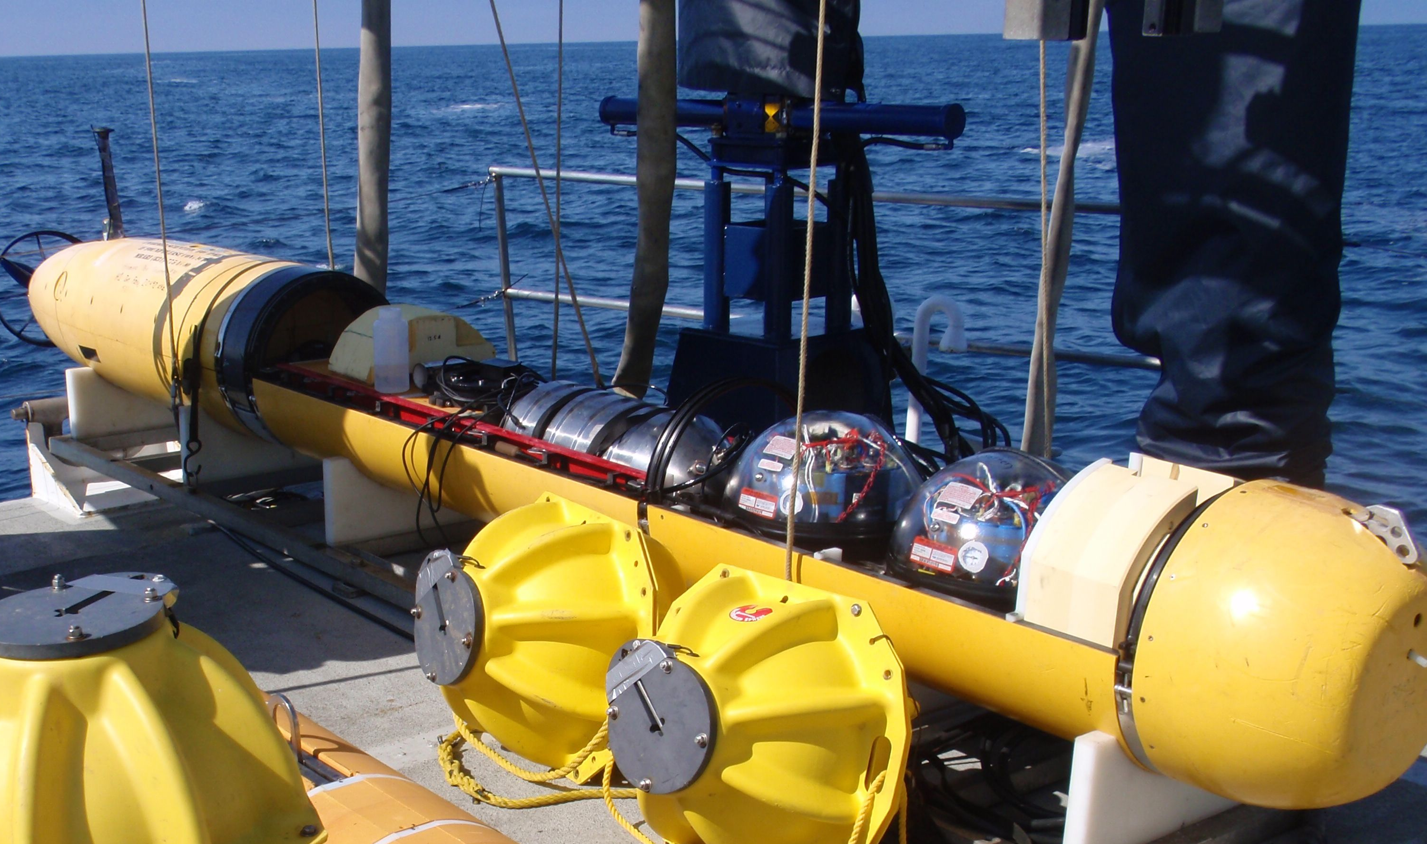
Evolution of MBARI’s AUVs
CTD AUV
Mapping AUV
LRAUV
LRAUV+ 3G ESP
Wave Glider
Coastal Profiling Float

Slide 13
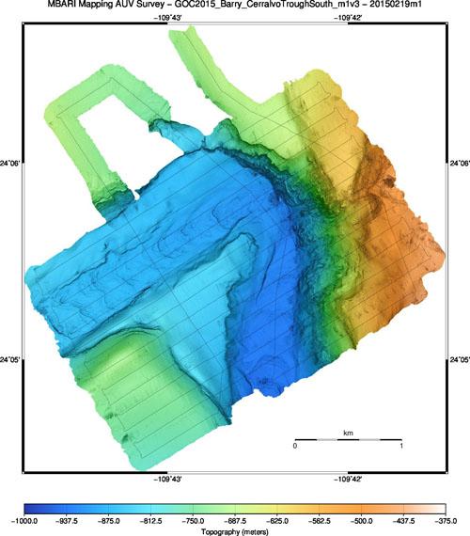
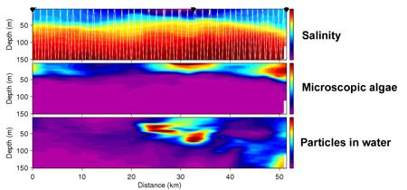
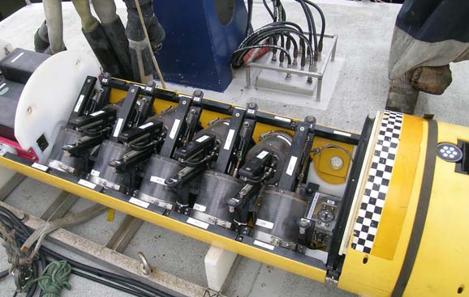
What AUVs allow us to do
“See”
Sense
Sample

Slide 14
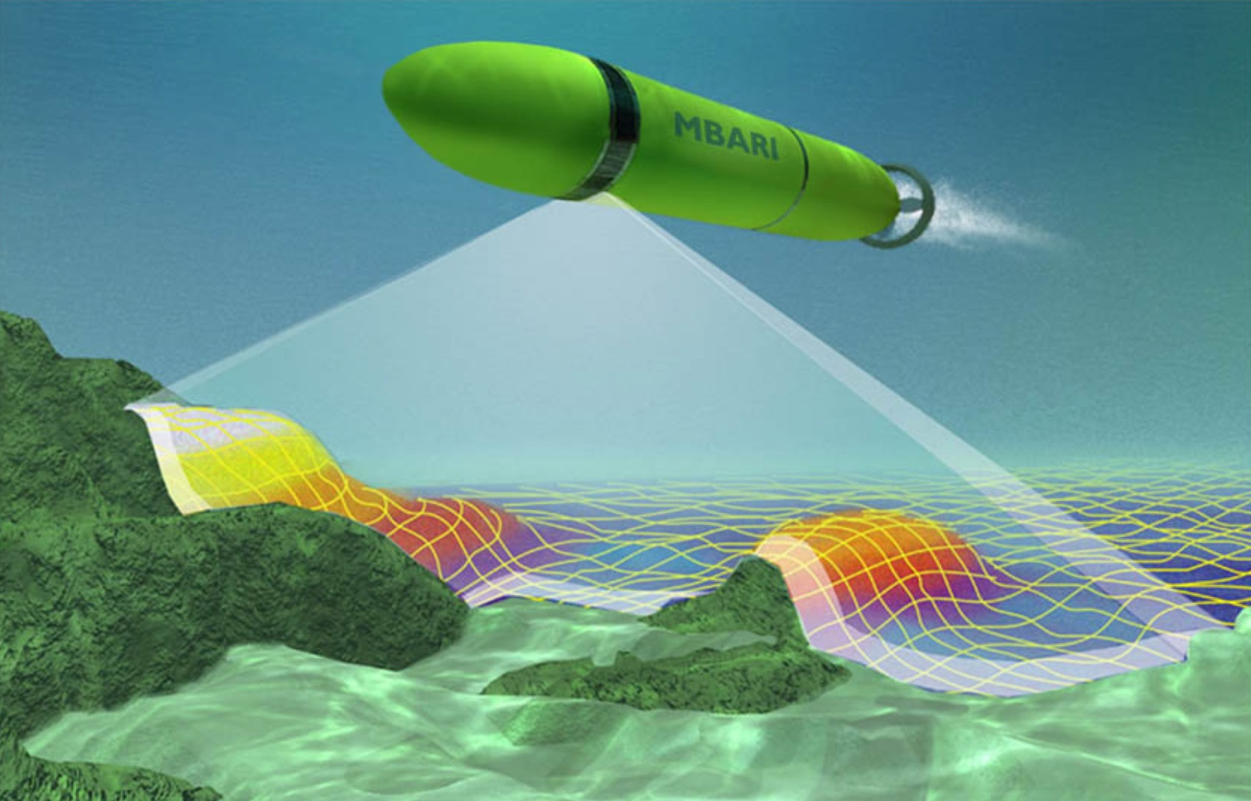
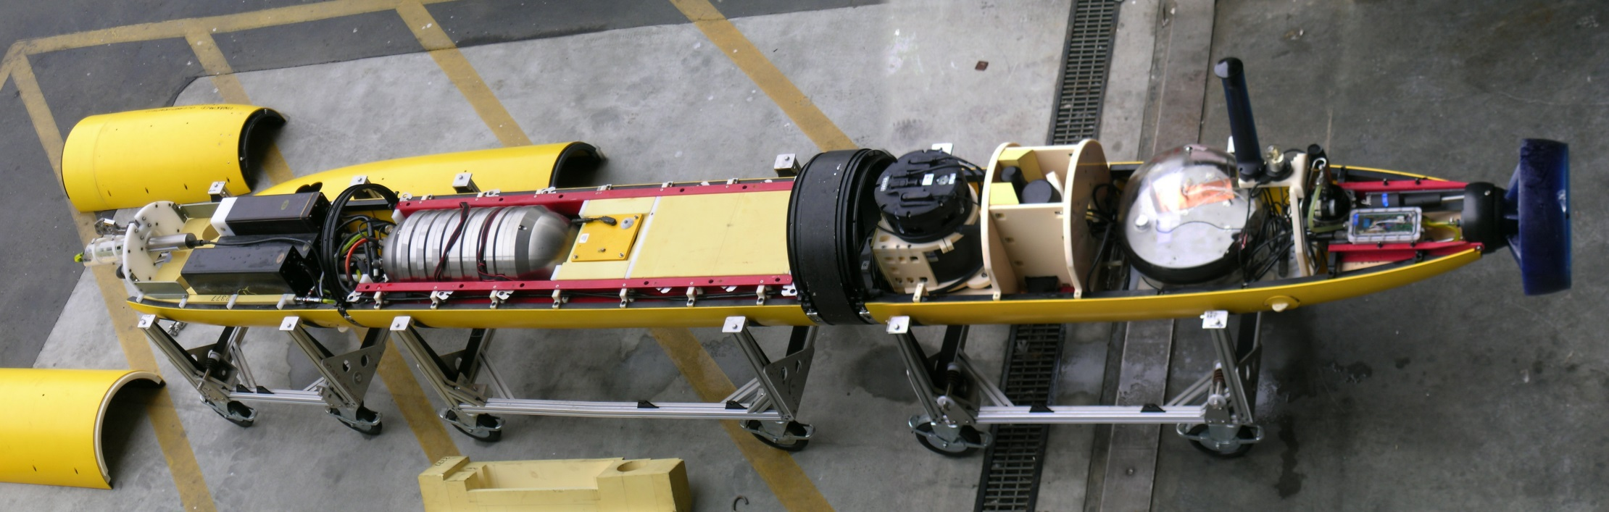
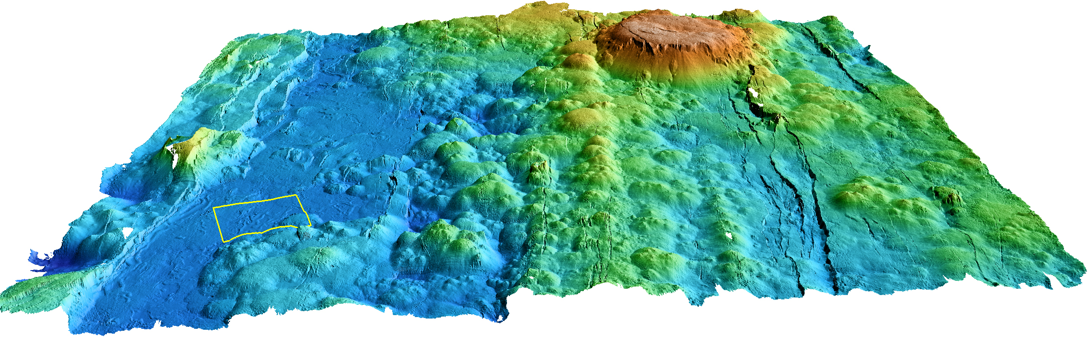
Seeing with an AUV

Slide 15
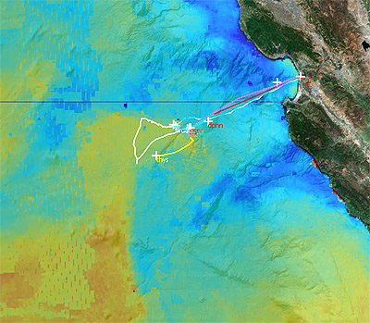
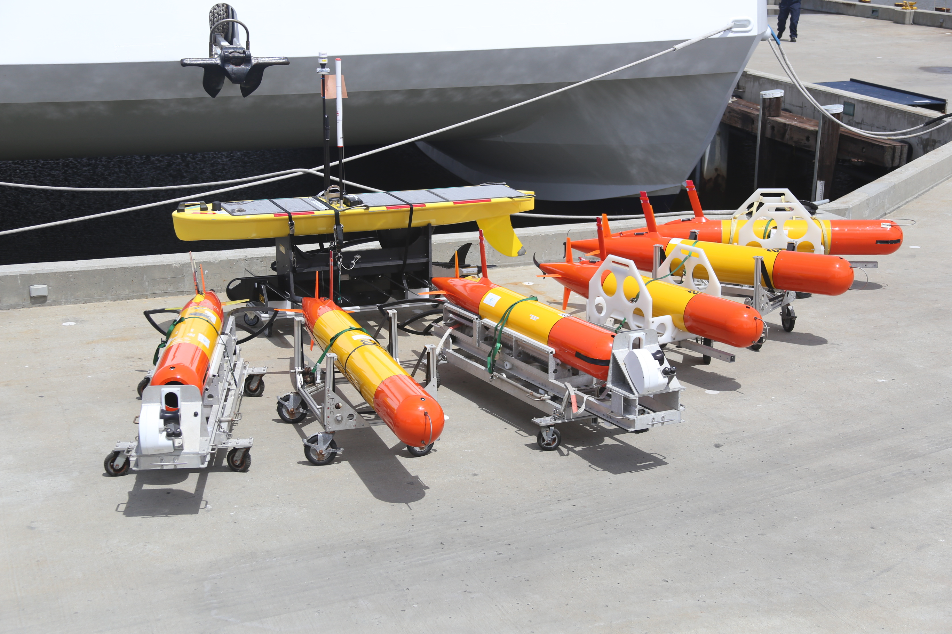
AUVs: Coordinated experiments

Slide 16
Expanding our measurements
Throughout all the technical development one theme is consistent, the desire to expand our measurements spatially and temporally
Illustration??

Slide 17
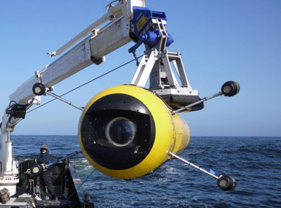
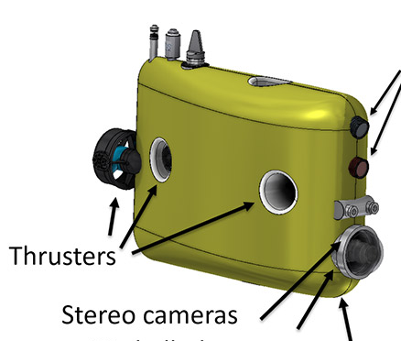
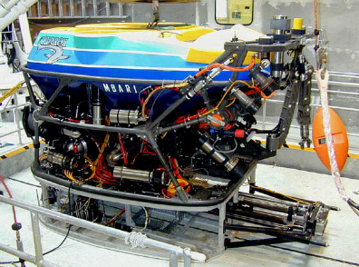
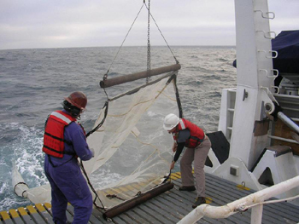
Putting it all together – Visualizing the Midwater
Drop Cam
ROV
I2map
Camera Sled
Mesobot
Net Tow

Slide 18
Making the Measurement When it Counts

Slide 19
Making the Measurement When it Counts
Lab in the Ocean
Adaptive Sampling
Persistance/Endurance

Slide 20
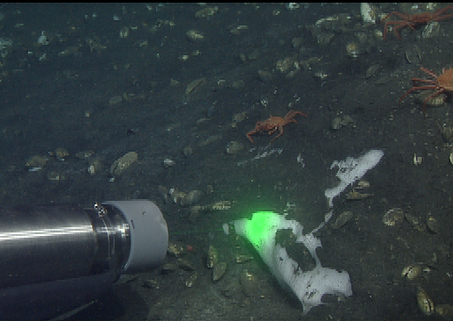
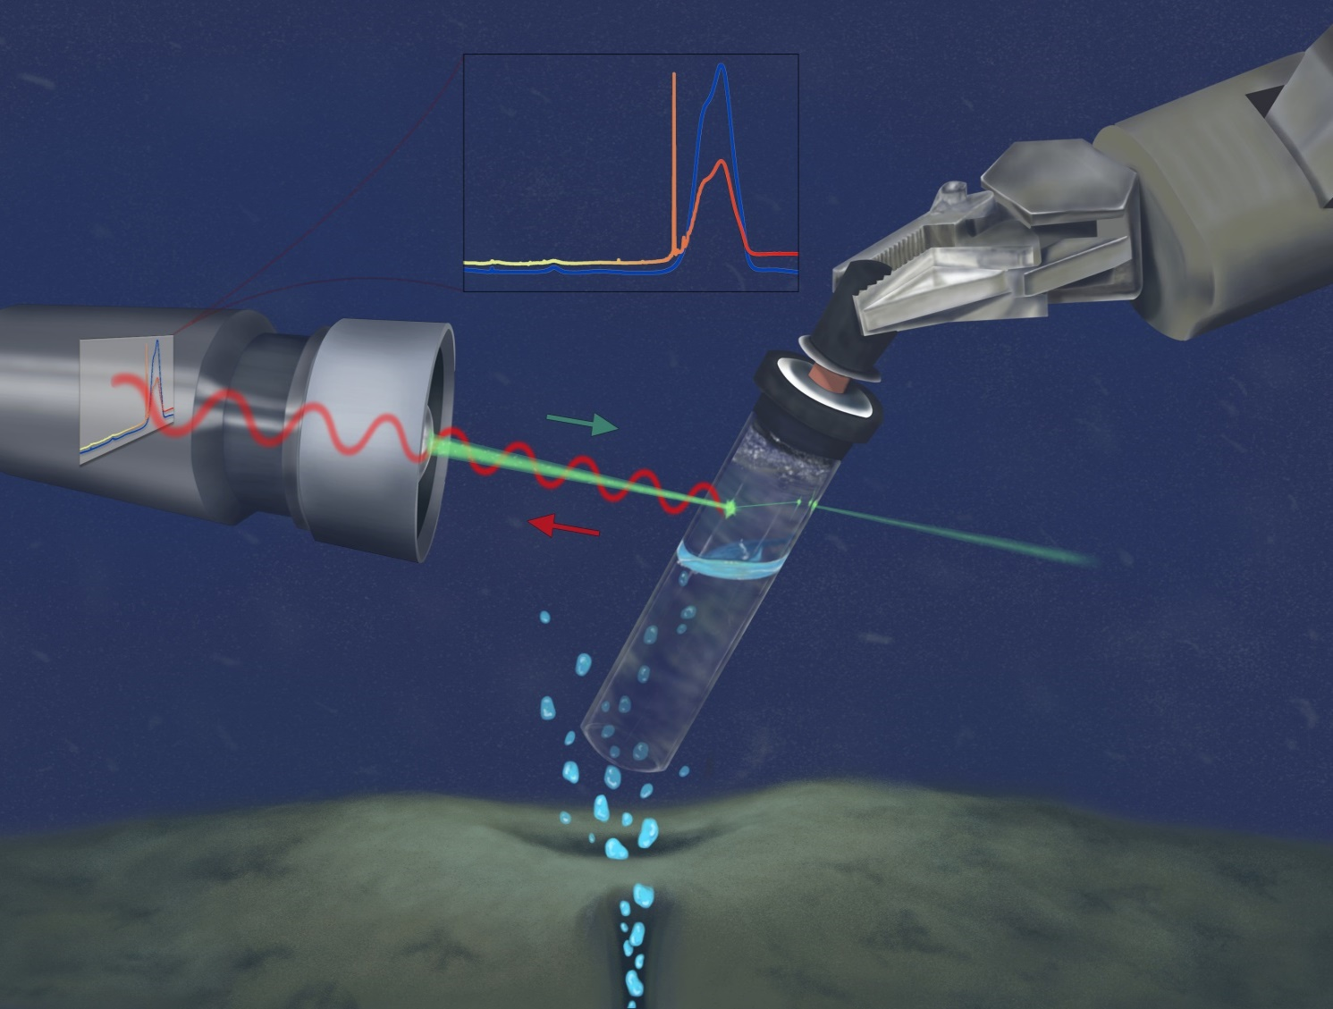
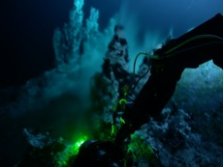
Lab in the Ocean: DORISS
DORISS
Illustration by Kelly Lance

Slide 21
Lab in the Ocean
ESP

Slide 22
Adaptive Sampling
Canon 2019 Field experiment, flying through sampling layers

Slide 23
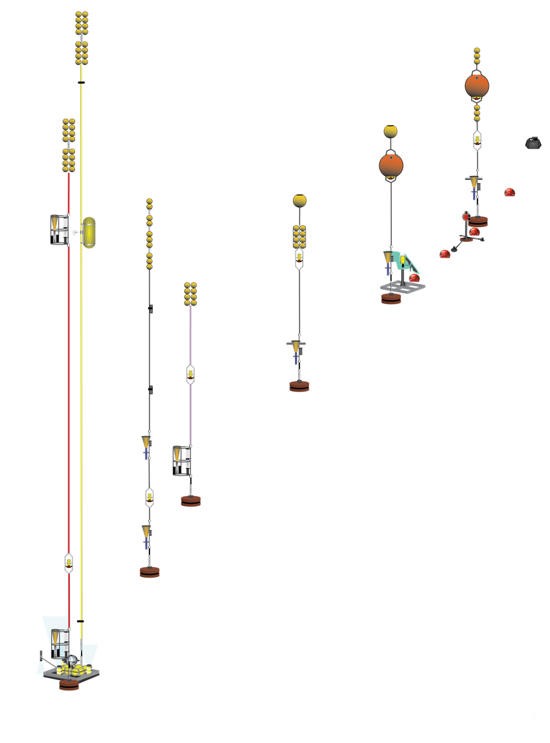
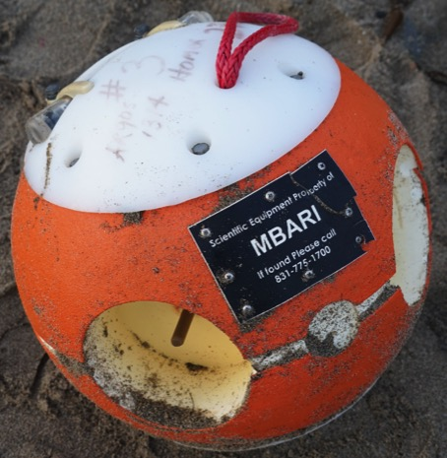
Persistance/Endurance
BEDs
USGS
USGS
Sonardyne
NOC-Hull
USGS
OUC
NOC, RDI

Slide 24
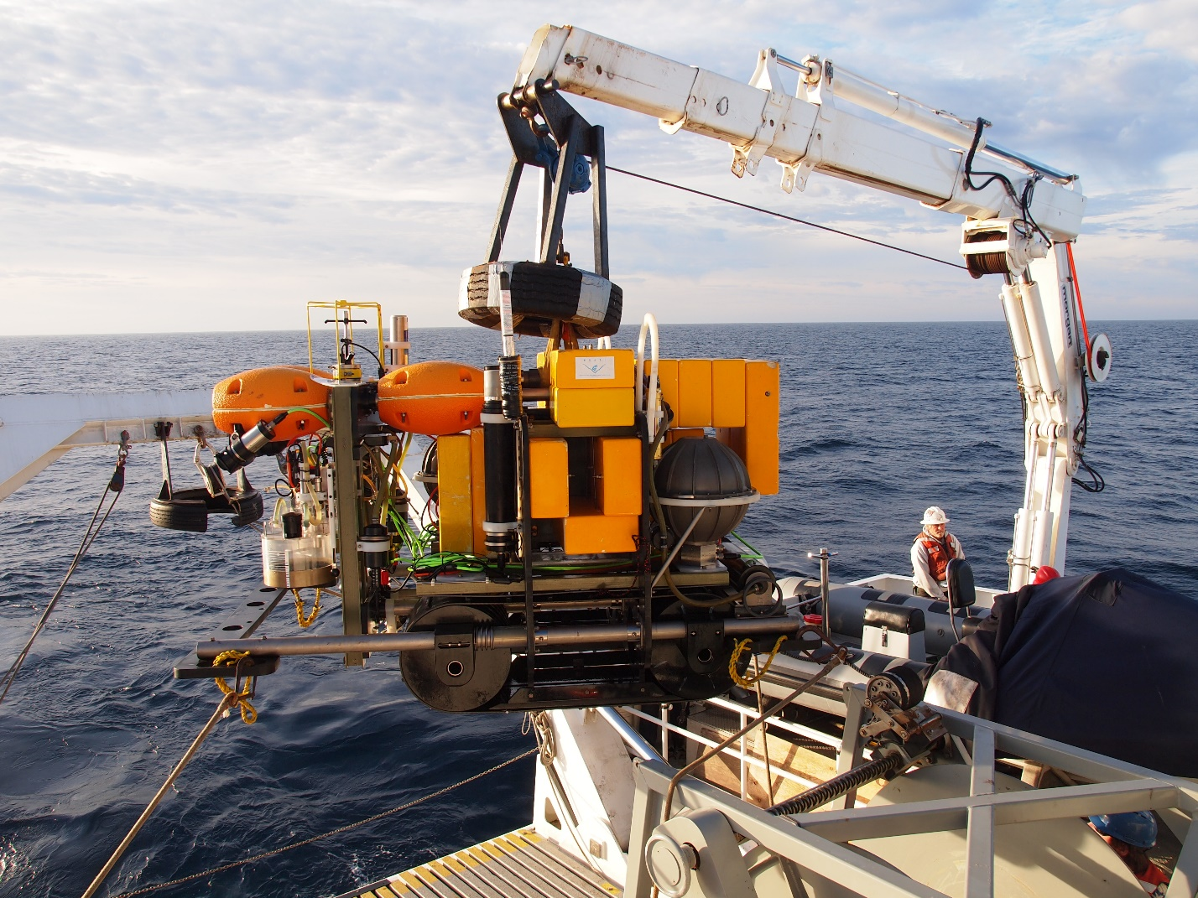
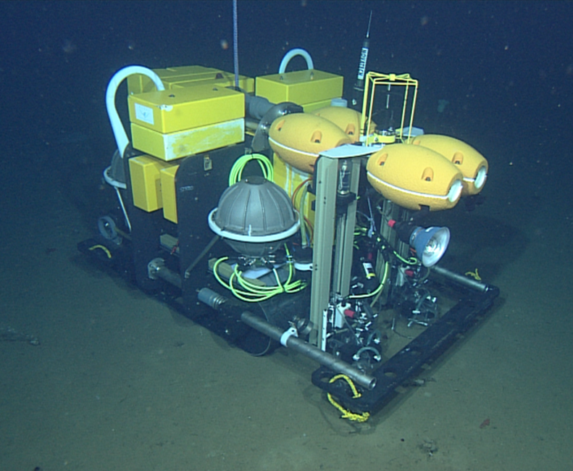
Persistance
Rover

Slide 25
Perisistance
BGC Floats

Slide 26
Putting it all together
Go back to animation and then move on to a scene with floats and AUVs and minimesobots and UAVs

Slide 27
MiniMesobot/floats/AUVs

Slide 28
Visualizing the midwater
Net tow
Camera sled
ROV
i2map
Mesobot

Slide 29
Advantages of ROVs over Ship-based science
“Eyes” under the water
Can carry wide-array of cameras and sensors
Configurable toolsleds vary with science goals
Enables precision sampling

Slide 30
Advantages of AUVs
Greater spatial and temporal coverage
Lower cost per deployment
Configurable payloads
Multiple vehicles

