Slide 1
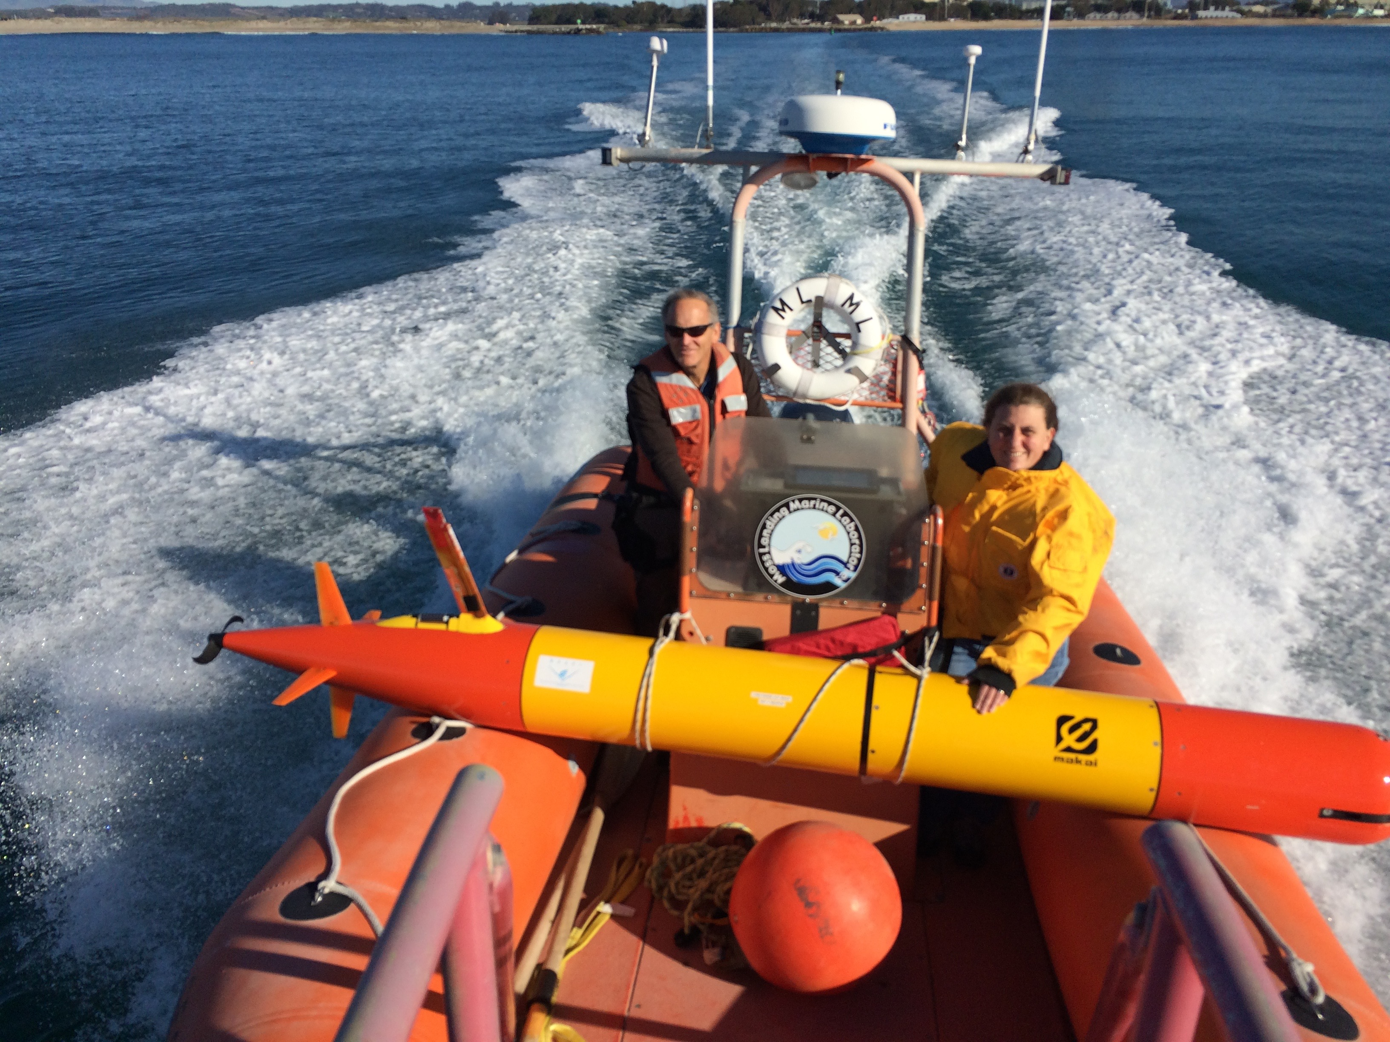
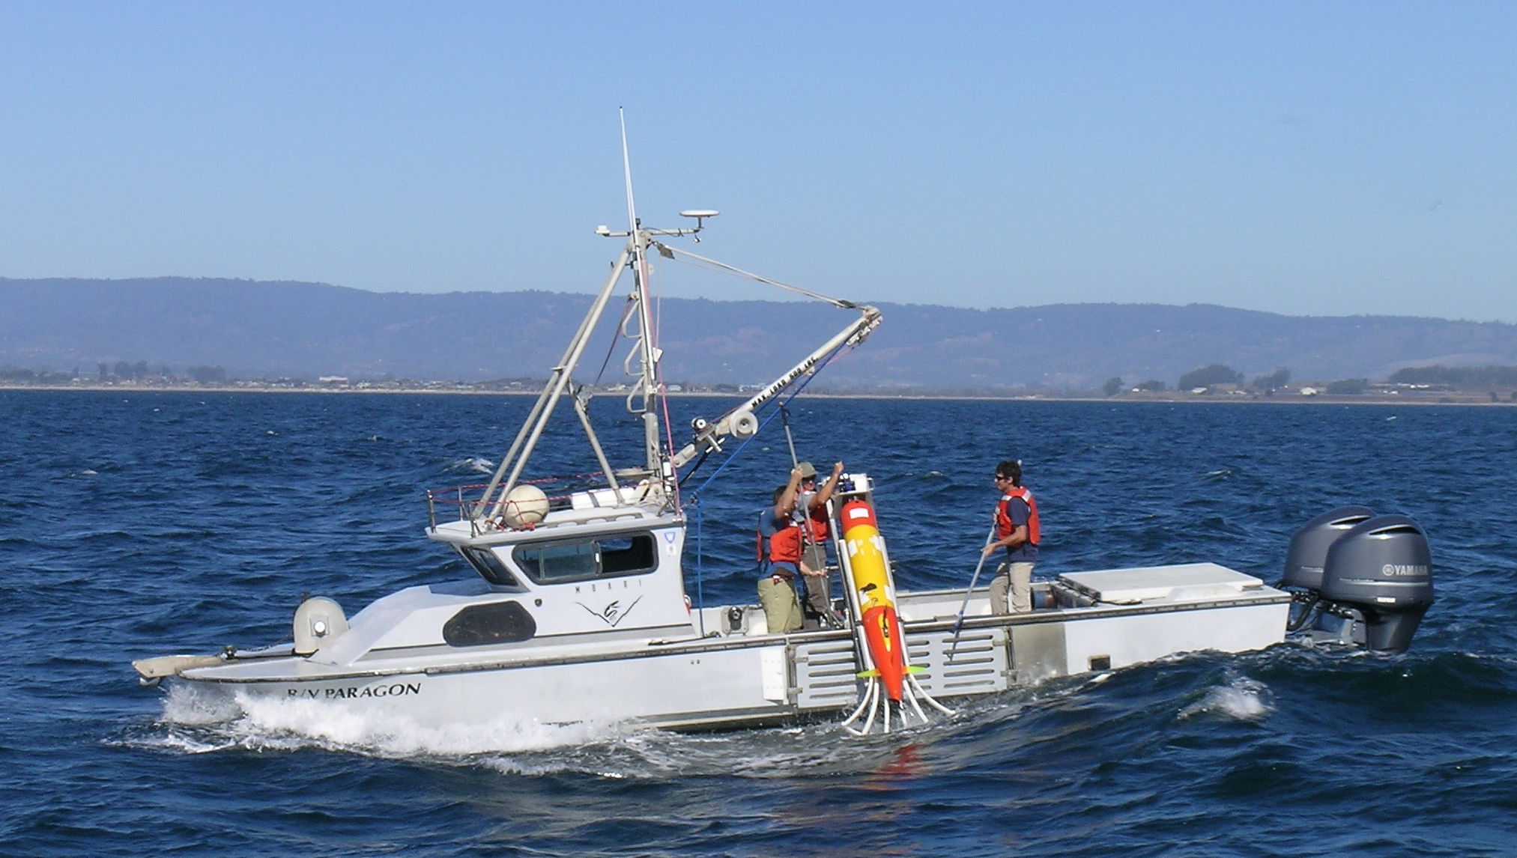

Slide 2
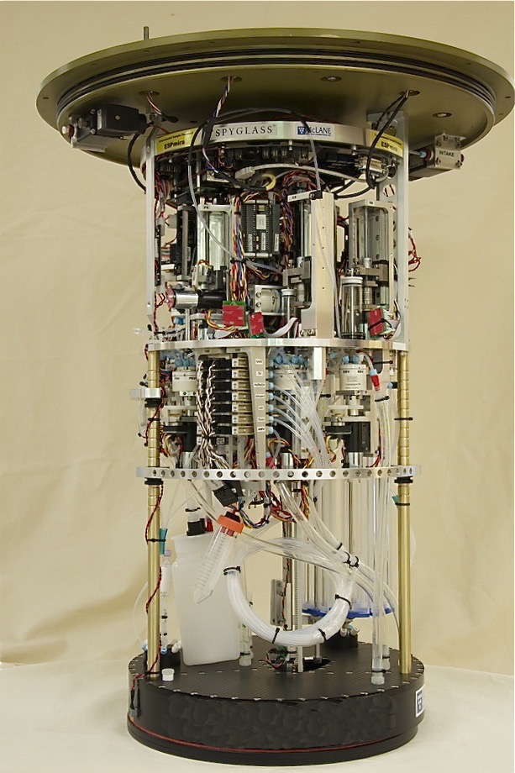
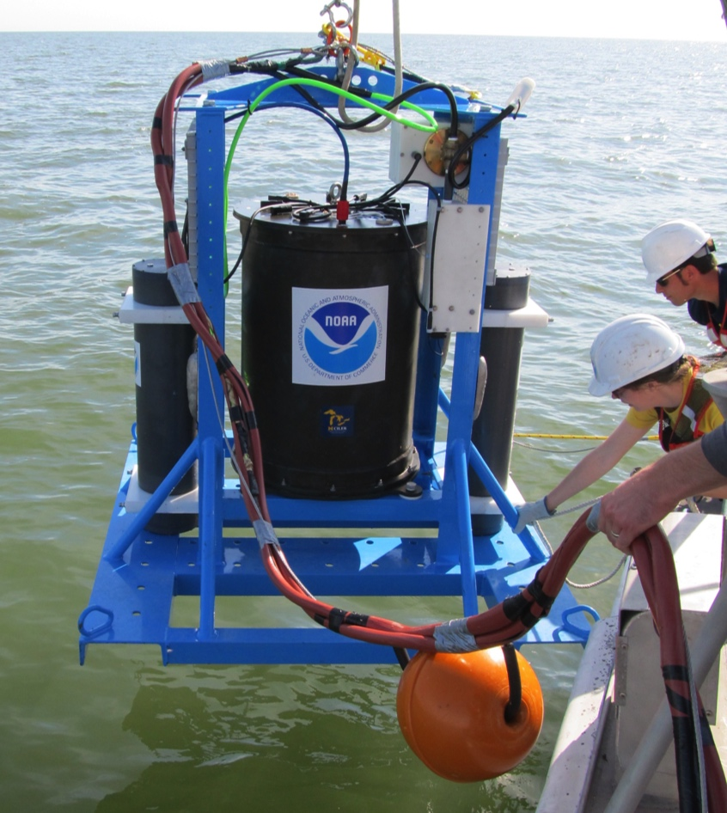
Environmental Sample Processor (ESP)
Collects and processes sample
Real-time probe array analyses
qPCR analysis
Archives samples

Slide 3
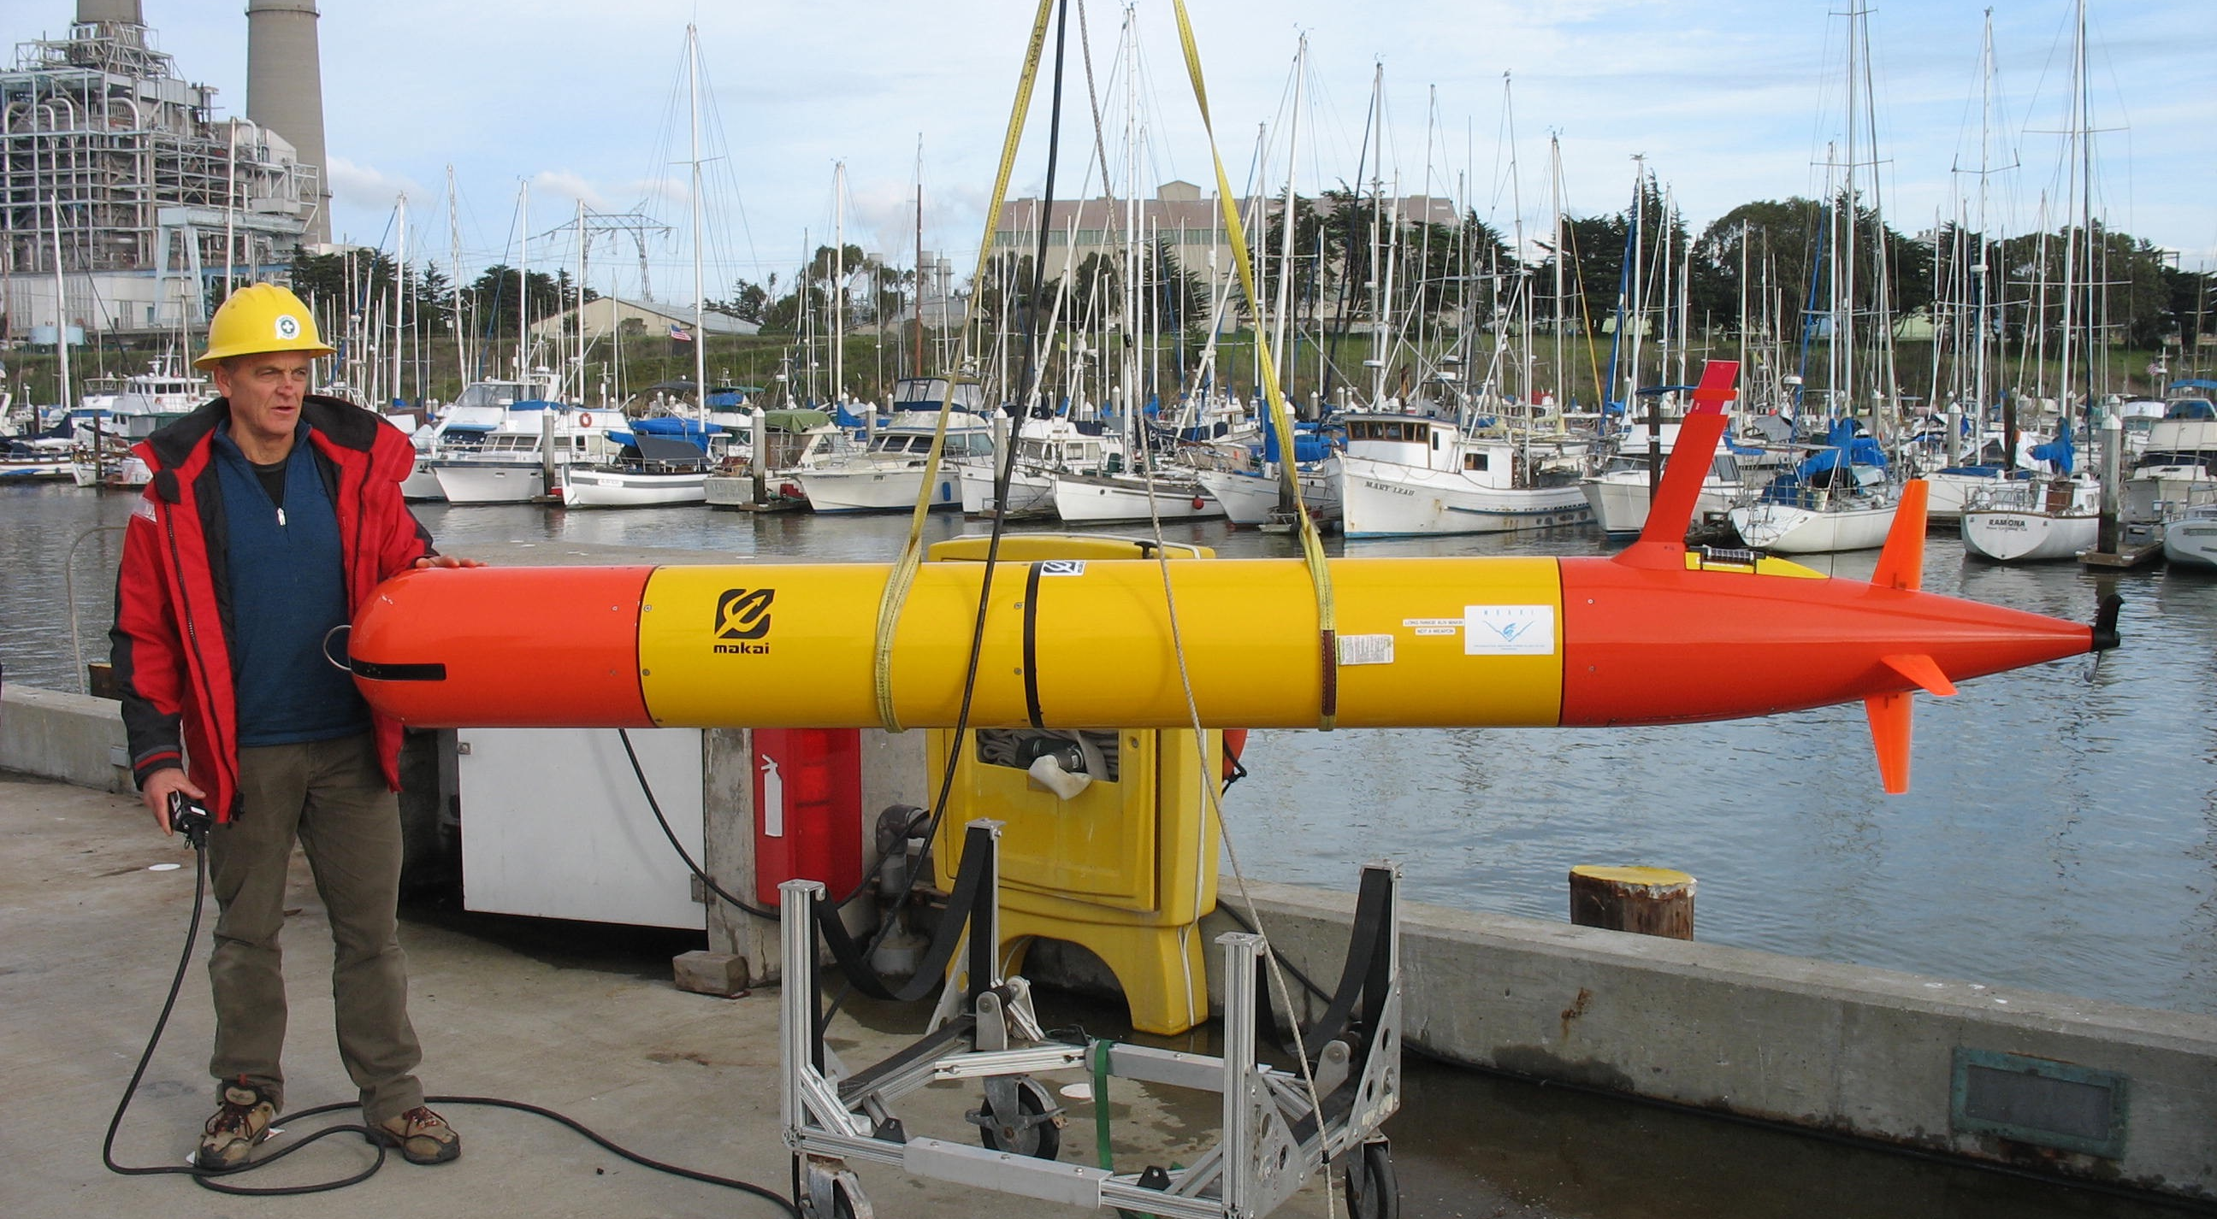

Slide 4
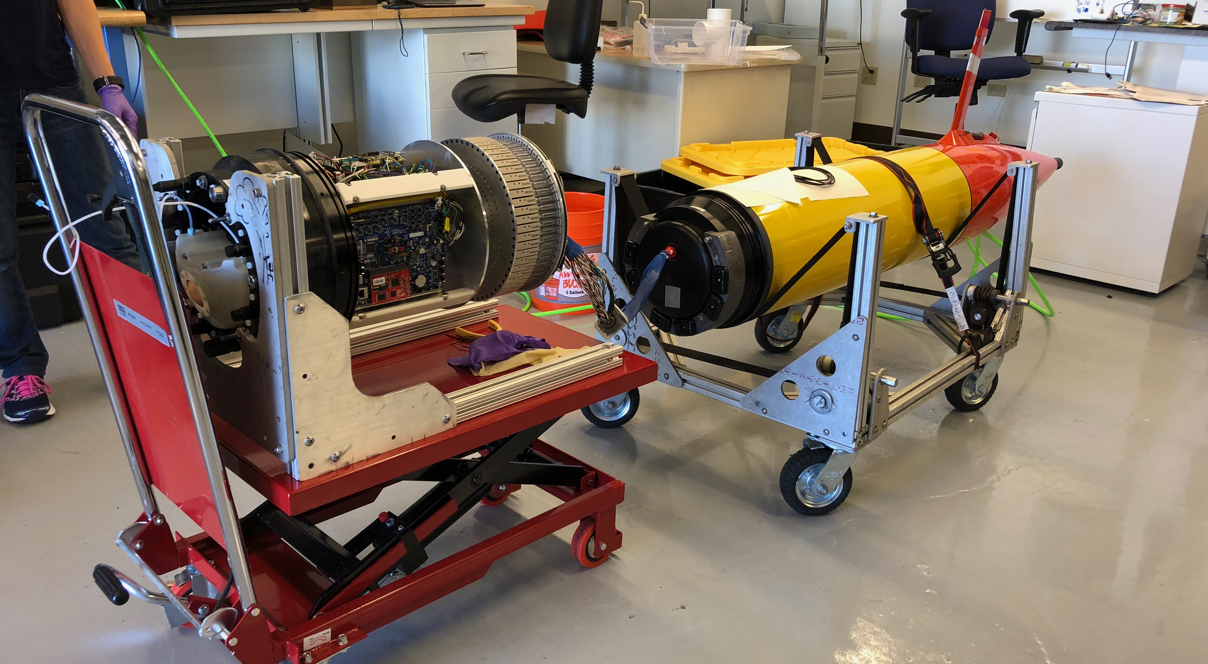

Slide 5
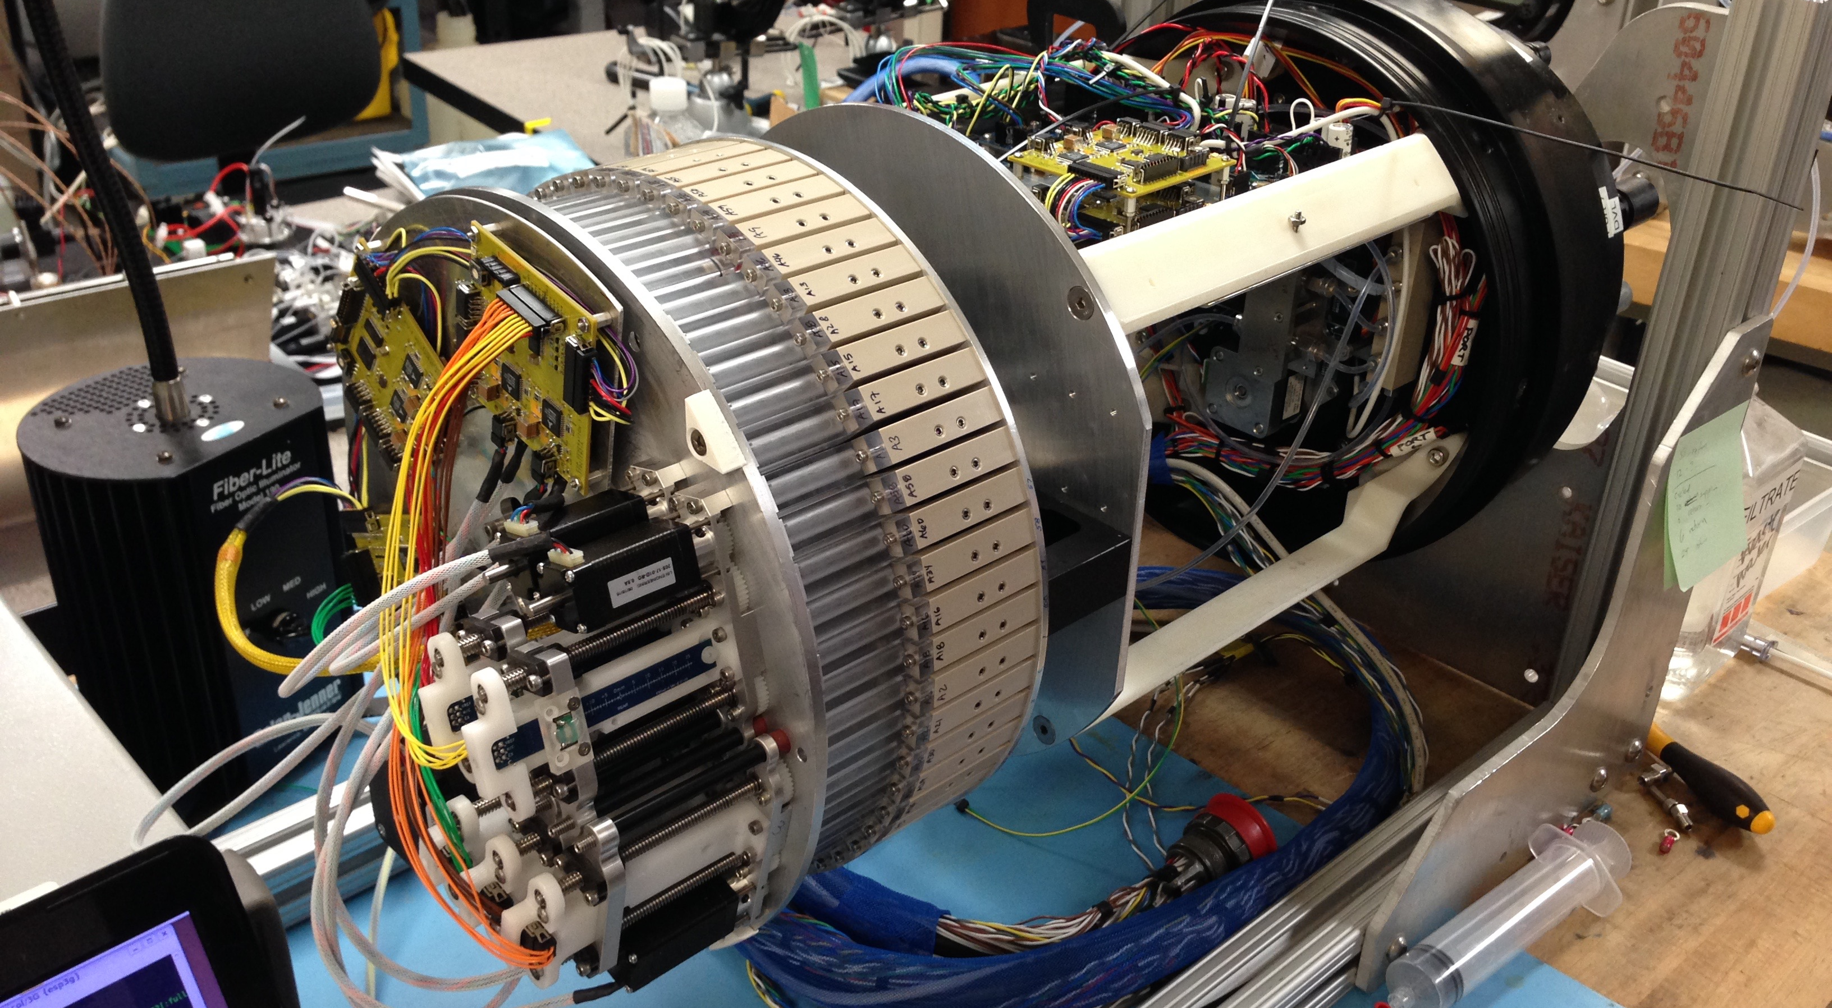

Slide 6
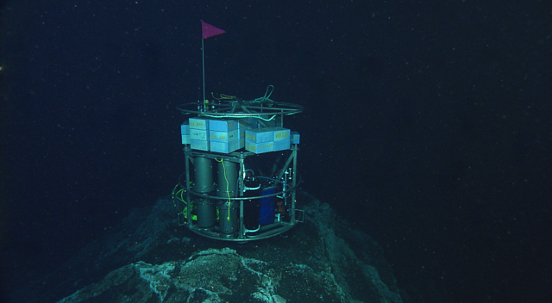
qPCR and rRNA arrays at 800m CH4 seep
Notes:
Good shot of the D-ESP sitting atop the methane mound, placed there by the ROV. 800m deep. July, 2010.

Slide 7
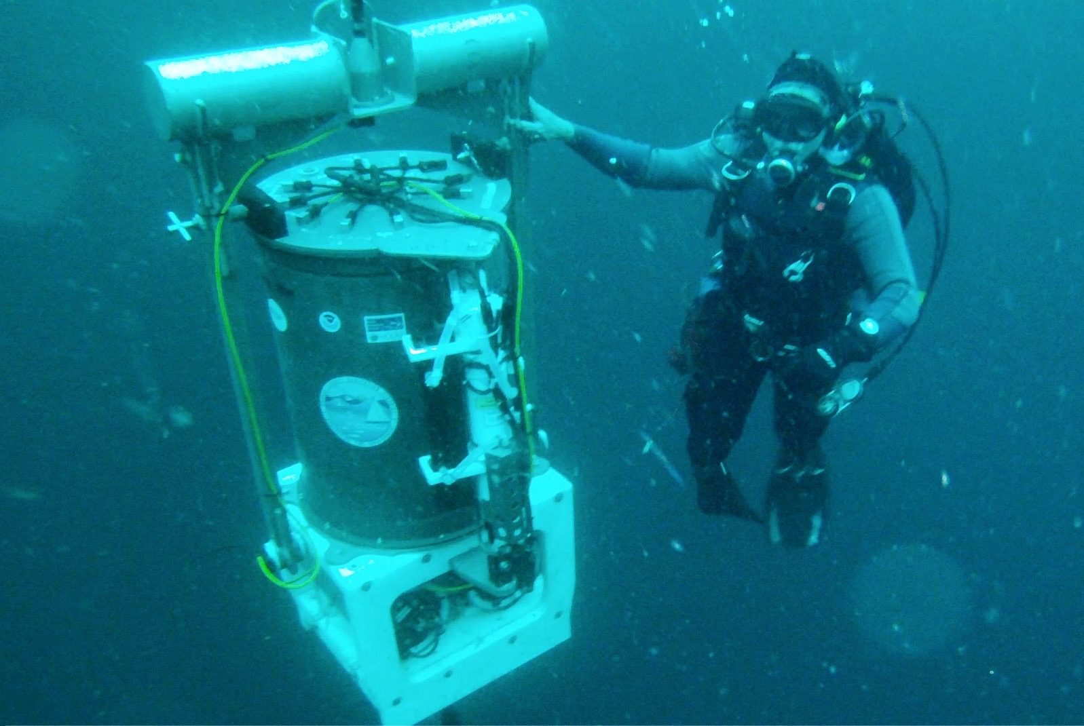
Notes:
Spring 2014. Kim Reisenbichler working on ESP off San Pedro Bay (L.A. area)

