Slide 1
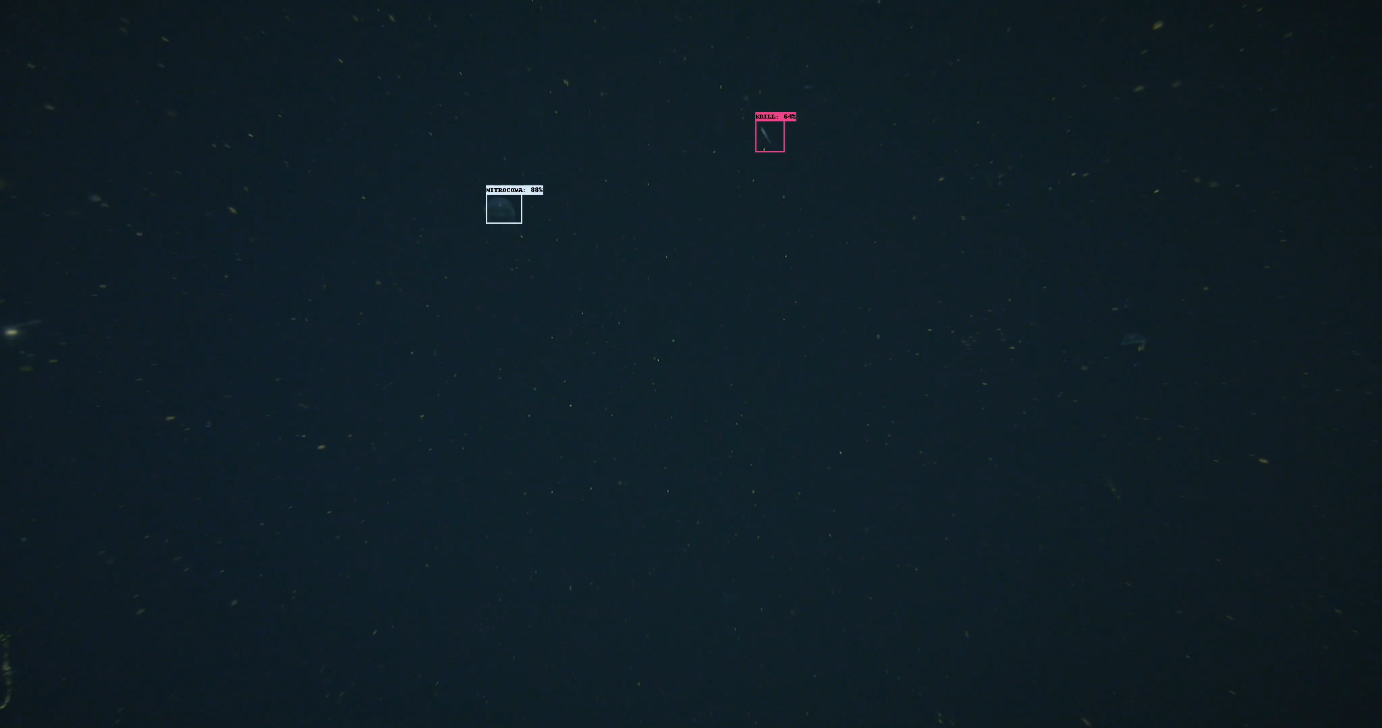
Our goal is to annotate “on the fly”….

